Slide 1
Bone tissue
Bone is a connective tissue that is characterized by a mineralized extracellular matrix. The matrix is secreted by cells called osteocytes.

Slide 2
Bone tissue
UNIQUE QUALITIES OF BONE
HYDROXYAPATITE: Calcium Phosphate crystals.
It prevents diffusion of metabolites.
It prevents interstitial growth -- all bone growth occurs from the periosteum.
A CANALICULAR SYSTEM: Tiny canals connect one haversian system to the other.
VASCULARITY: All bone cells are in close proximity to vessels!
APPOSITIONAL GROWTH: All growth occurs by appositional growth.
BONE RECONSTRUCTION: Bone is dynamic tissue, constantly changing shape.

Slide 3
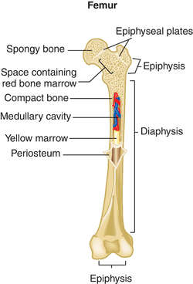
Bone tissue
LONG-BONE GROSS STRUCTURE:
DIAPHYSIS: the shaft with a medullary cavity on inside.
EPIPHYSIS: the ends.
METAPHYSIS: the site of ossification, between the diaphysis and epiphysis.
ARTICULAR CARTILAGE: hyaline cartilage covering compact bone
at the ends of long bones. It lacks perichondrium.
PERIOSTEUM: osteogenic potential around the outside.
ENDOSTEUM: lines the marrow cavity and also has osteogenic potential.

Slide 4
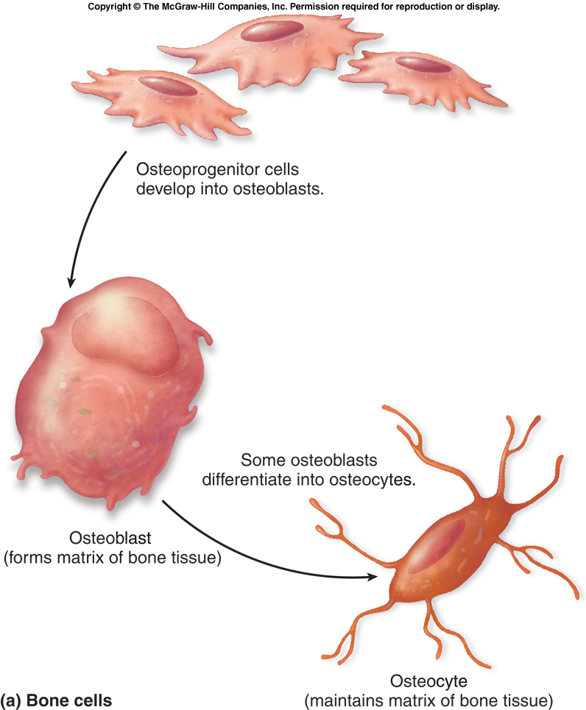
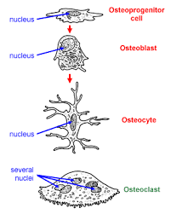
Bone tissue
Consists of cells in lacunae, in an extracellular matrix

Slide 5
Bone tissue
BONE CELL TYPES
A) OSTEOPROGENITOR CELLS:
the stem-Cells of bone, on the inner lining of the periosteum and endosteum
B) OSTEOBLASTS:
secretory cells, secrete the bone matrix
ALKALINE PHOSPHATASE which calcifies the matrix.
have polarity and resemble other secretory cells
C) OSTEOCYTES: they are osteoblasts that have become trapped in their own matrix, found in lacunae, between layers of lamellae, in the matrix of cortical bone
CANALICULI: fine cytoplasmic extensions of the osteocytes running perpendicular to the haversian canals
D) OSTEOCLASTS: large, multinucleate cells derived from monocytes, have acid hydrolases, many lysosomes and are eosinophilic
HOWSHIP'S LACUNAE: the spaces for bone resorption, between the osteoclast and the bone resorption surface
BONE-MATRIX
COLLAGEN: Type I Collagen = 85% - 90% of total bone protein
HYDROXYAPATITE: Bone salts (Calcium Phosphate) composes the non-protein inorganic part.

Slide 6
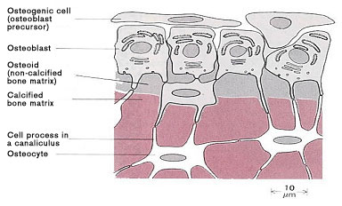
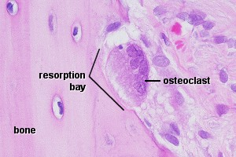
Bone tissue

Slide 7
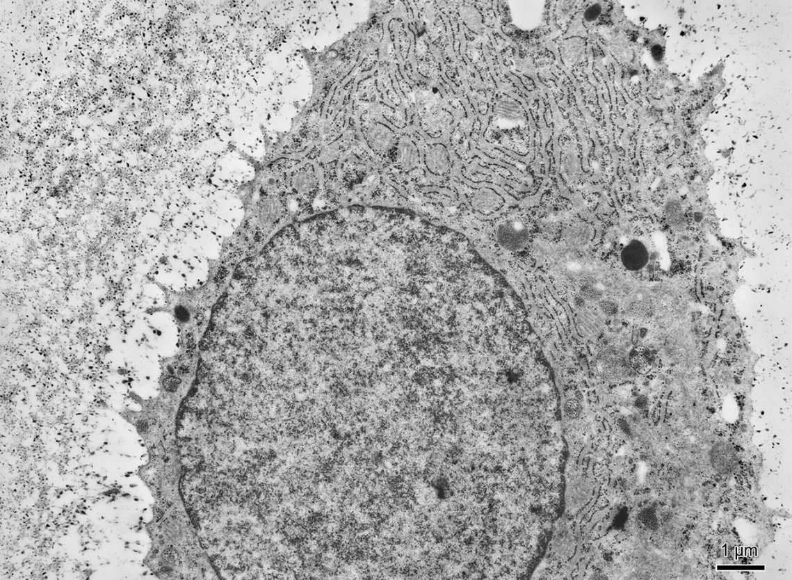
Osteoblast
GER

Slide 8
Osteocyte

Slide 9
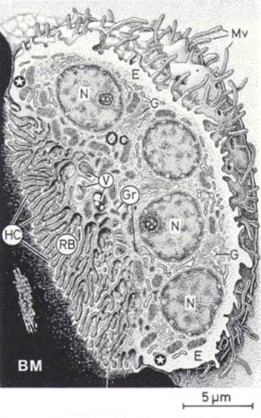
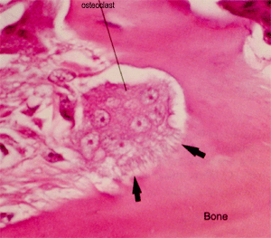
Osteoclast
www.studyblue.com
www.histology.leeds.ac.uk

Slide 10
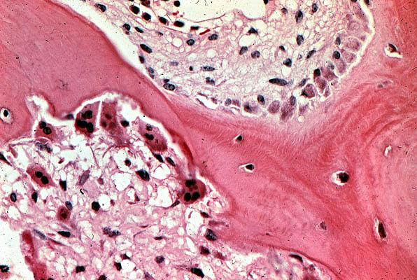
osteoblasts
tchealth.com
osteoclasts
osteocytes

Slide 11
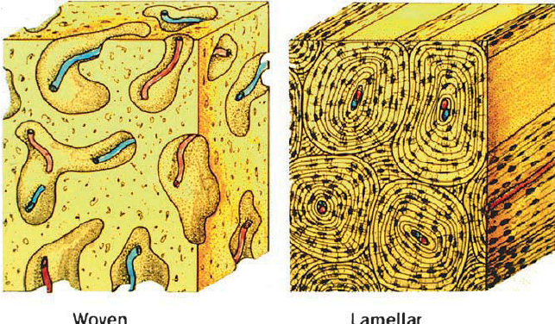
Bone tissue – types
WOVEN BONE - collagen fibers are not arrenged into lamellae and running in different directions, they form a network in gound substance, osteocytes in lacunae are situated in this network
COMPACT BONE - is recognized as:
Lamellar bone: arranged in concentric layers called lamellae, with Haversian Canals containing blood vessels in the center, often found around the outside of large bones
Spongy bone: forms trabeculae inside of bone cavity with the bone-marrow, lamellae are organized in parallel way to their surface

Slide 13
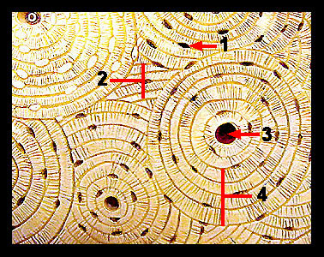
Compact lamellar bone
Haversian Lamellae: lamellae around central Haversian Canals
- contain blood vessels and nerves
Osteocytes are within the lamellae, with canaliculi radiating toward the central haversian canal
Volkmann's Canals: run perpendicular (transverse) to the Haversian Canals, they connect the haversian canals to each other, or to the marrow cavity
1 – osteocyte, 2 – interstitial lamellae, 3 – haversian canal, 4 - lamellae

Slide 14
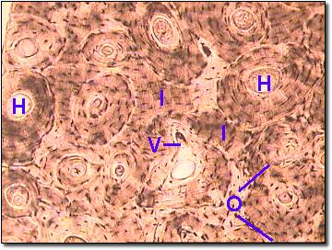
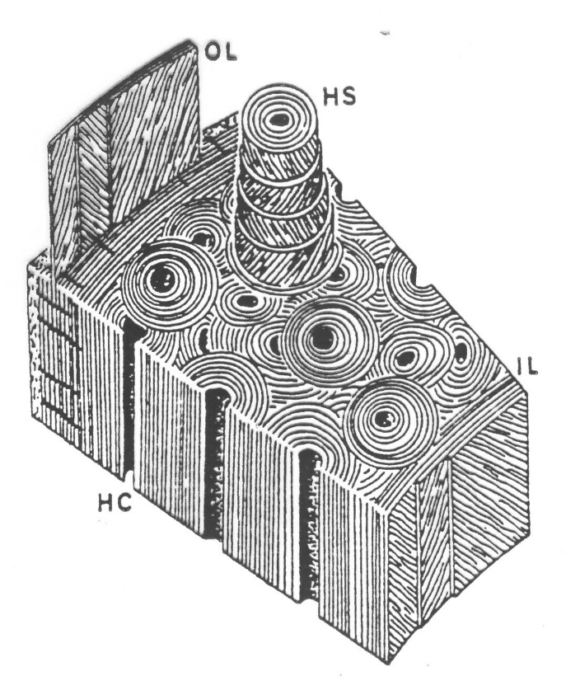
Compact lamellar bone
Interstitial Lamellae: remnants of older haversian lamellae, they are not concentrically arranged, but lie in between the haversian systems
Circumferential Lamellae: the external and internal borders of cortical bone.
Outer Circumferential Lamellae: adjacent to the periosteum
Inner Circumferential Lamellae: adjacent to the endosteum

Slide 15
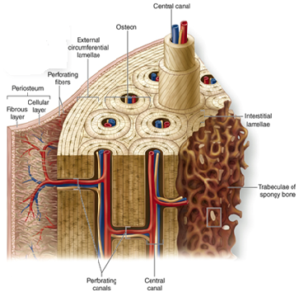
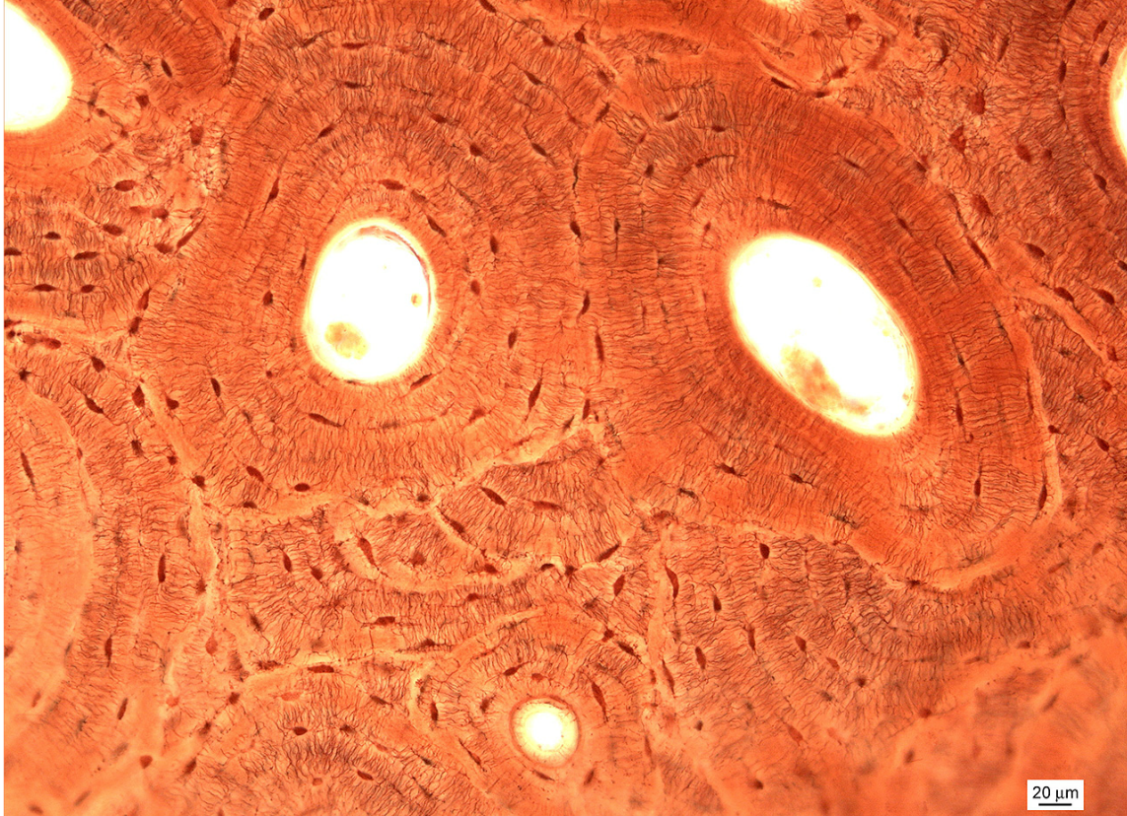
Lamellar compact bone (Schmorl)
http://accessmedicine.mhmedical.com/

Slide 16
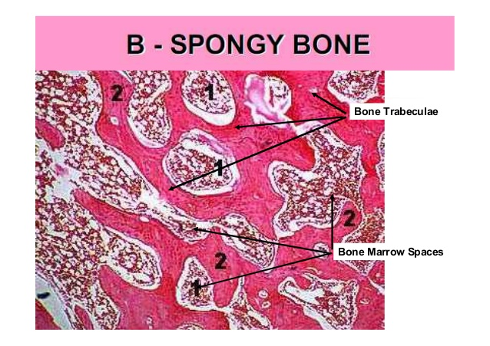
Spongy bone
forms trabeculae inside of bone cavity with the bone-marrow. Lamellae are organized in parallel way to their surface

Slide 17
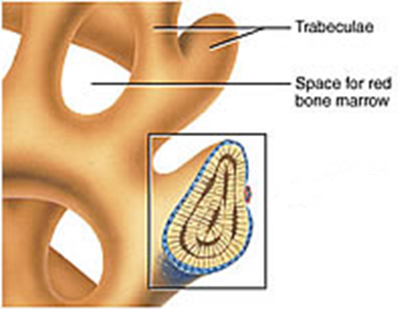
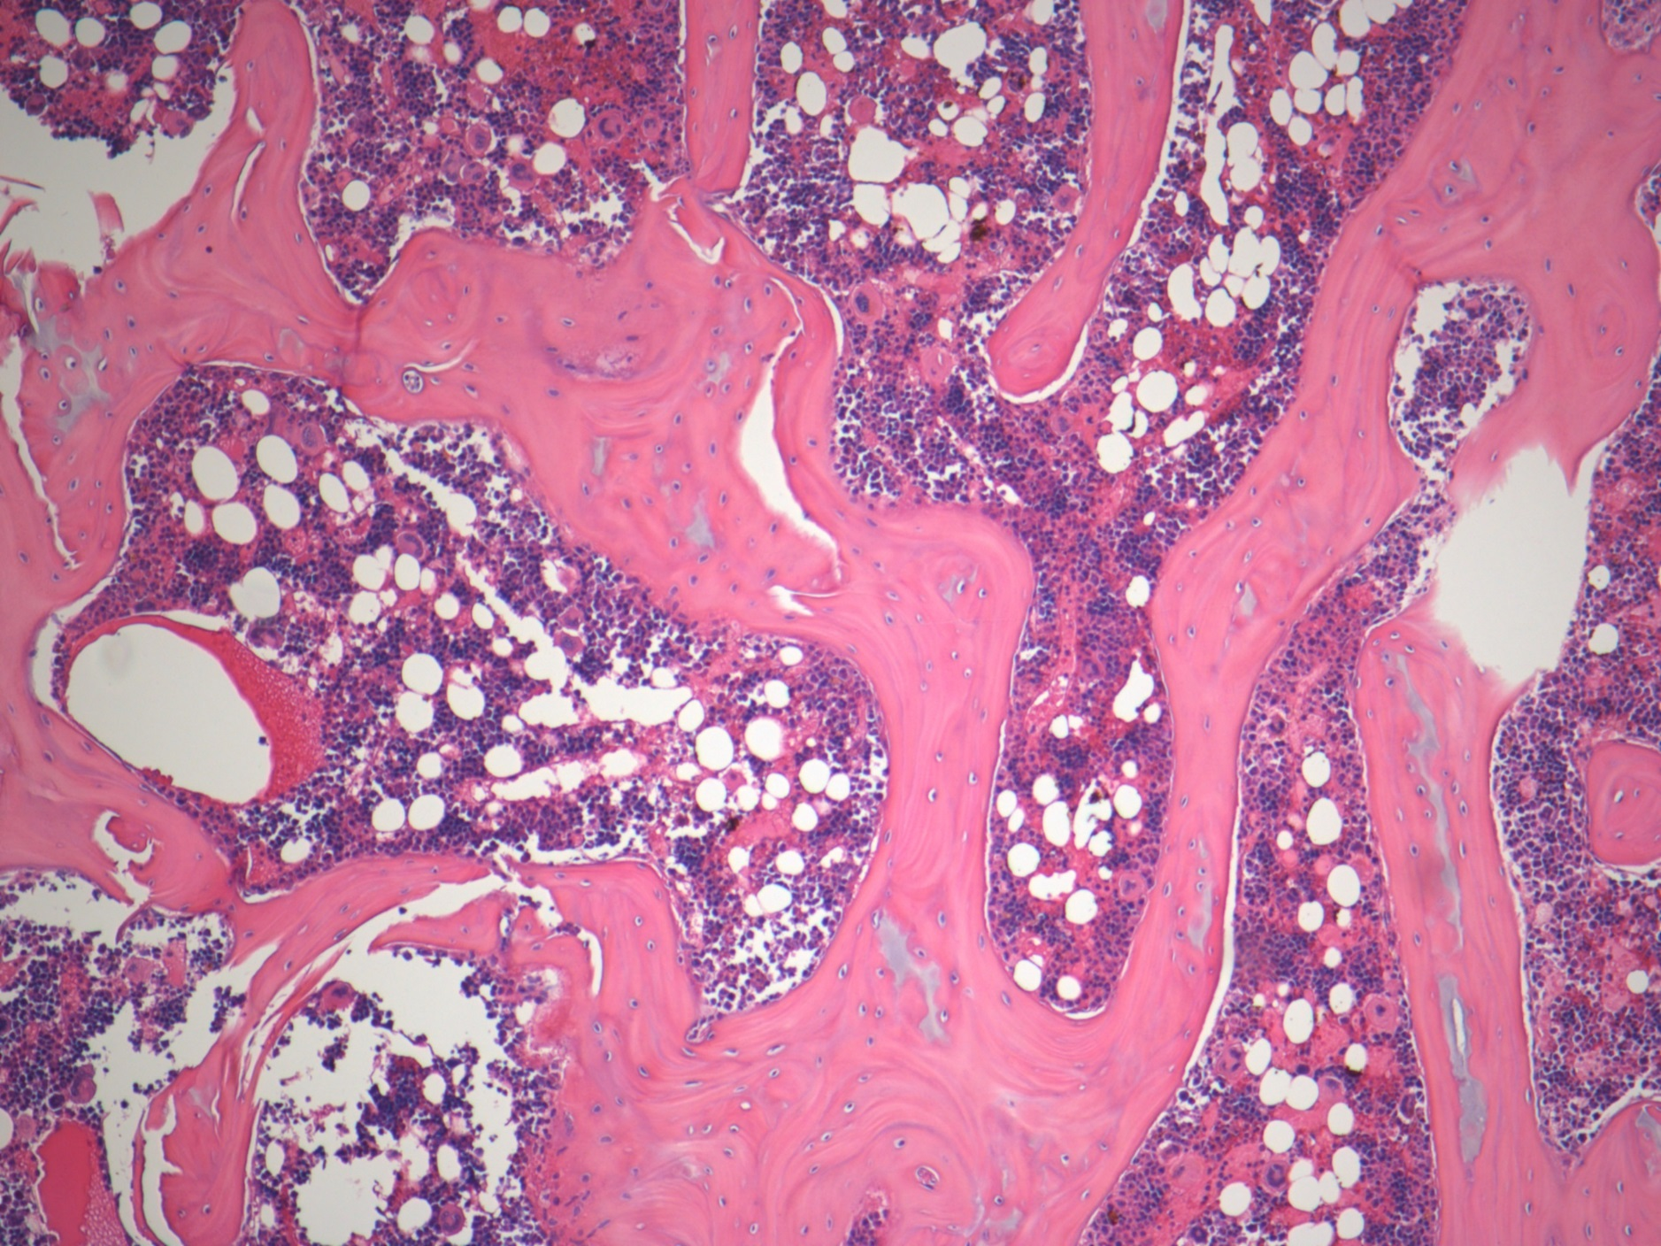
Lamellar spongy bone (HE)
studydroid.com
imgkid.com

Slide 18
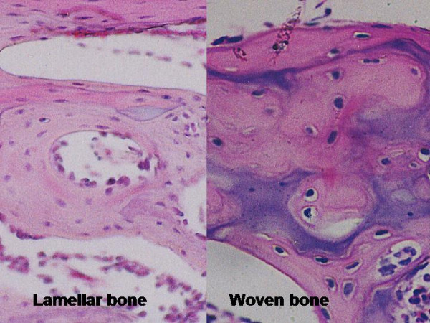
Woven bone
WOVEN BONE: Osteocytes are uniformly distributed and randomly oriented throughout the bone !all bone starts as woven bone!
Bone first appears as little spikes called spicules, which then form trabeculae
The woven bone is reformed to make either cortical bone or spongy bone.

Slide 19
Intramembranous ossification
Formation of bone directly from osteoblasts, with no cartilage intermediate.
Mesenchymal cells --> osteoblasts
Osteoblasts secrete the osteoid matrix
Osteoblasts then secrete alkaline phosphatase to calcify the matrix, trapping themselves in it forming Osteocytes
Some flat bones are formed by intramembranous ossification (bones of the skull, jaws, clavicula)

Slide 20
Enchondral ossification
Long bones are formed on a cartilage model.
GENERAL PROCESS:
Cartilage matrix is laid down
Perichondrium then becomes periosteum, when a vascular bud invades the perichondrial space, the vascular bud contains blood cells, bone marrow cells, macrophages, endothelial cells
GROWTH IN LENGTH: Occurs by proliferation of chondrocytes at the epiphyseal plates and at the primary ossification front.
GROWTH IN DIAMETER: Occurs by deposition of new bone under the periosteal collar along with simultaneous osteoclastic resorption, in order to maintain bone shape. The osteoclastic resorption is necessary to enlarge the medullary cavity.

Slide 21
Enchondral ossification
PRIMARY OSSIFICATION CENTER: Occurs in the center of the diaphysis, and extends toward both epiphyses.
Thus there are two fronts of primary ossification.
Primary ossification centers close around the time of birth. Thereafter, long-bone growth occurs from the secondary ossification centers.
SECONDARY OSSIFICATION CENTER: Forms at the epiphyseal plate.
The orderly columns of chondrocytes are not seen here.
Growth occurs from the epiphysis downward, toward the epiphyseal plate.
EPIPHYSEAL CLOSURE: The end of longitudinal growth in long bone, when the primary ossification center overtakes (i.e. calcifies) the secondary ossification center, and hence long-bone growth ceases.

Slide 22
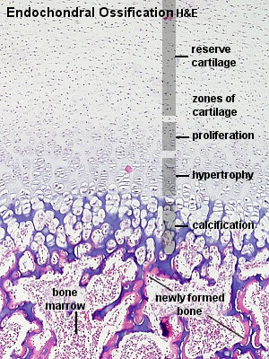
Enchondral ossification

Slide 23
Intracartilaginous ossification (HES)
Erosion line
Hypertrophic zone
Calcification zone
Proliferating zone
Ossification zone
Reserve cartilage

Slide 24
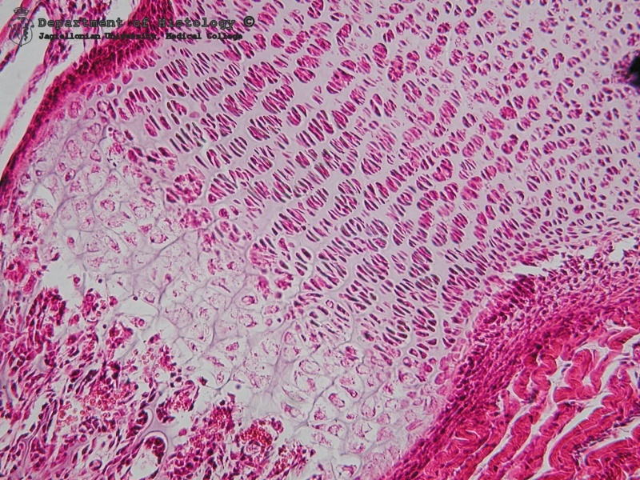
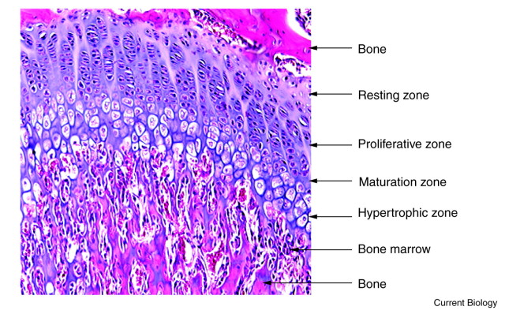
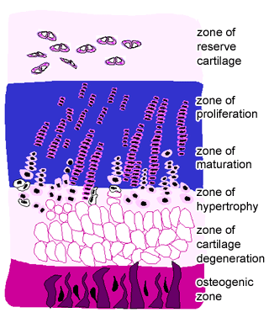

Slide 25
Bone remodeling
The process of BONE-REMODELING, which occurs during growth and in mature bone. It explains relationship between osteoclastic and osteoblastic activity in bone-remodeling, which explains why osteoporosis is difficult to treat.
Activation: Osteoclasts are activated and begin secreting acids to resorb bone.
Resorption: Osteoclastic resorption occurs.
Reversal: Resorption stops and osteoblasts take over.
Formation: Osteoblasts form bone on the opposing surface to complete the bone reforming process.

Slide 26
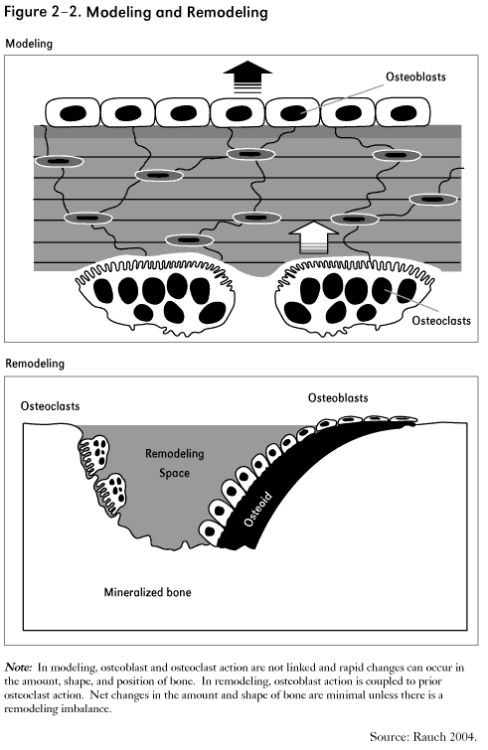
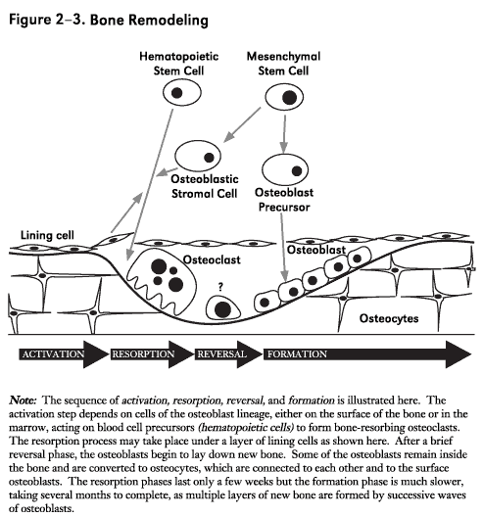

Slide 27
CONNECTIVE TISSUE – II: bone.
Slides:
Lamellar bone (95. Bone – HE or Schmorl staining)
Endochondral ossification (96.)
Atlas EM:
Osteoblast (46)
Osteocyte (47)

