Slide 1
Muscle tissue

Slide 2
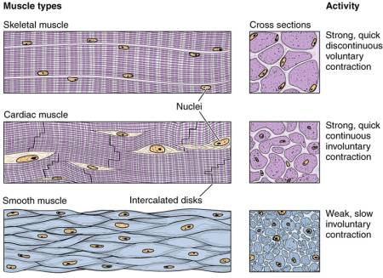
Muscle tissue
1) Striated skeletal muscle tissue.
2) Striated cardiac muscle tissue.
3) Smooth muscle tissue.

Slide 3
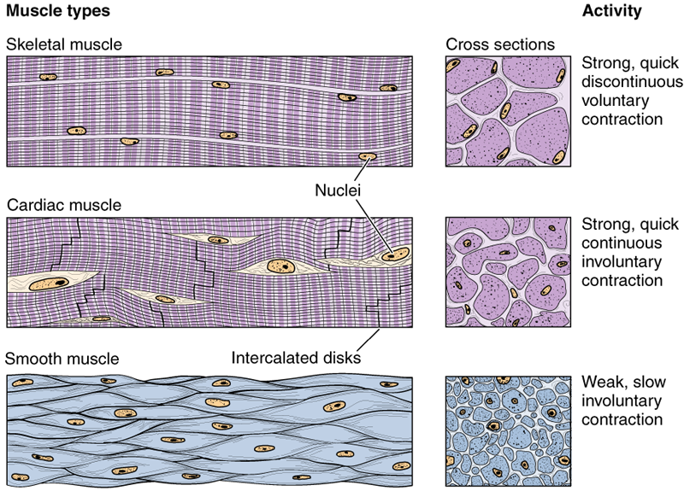
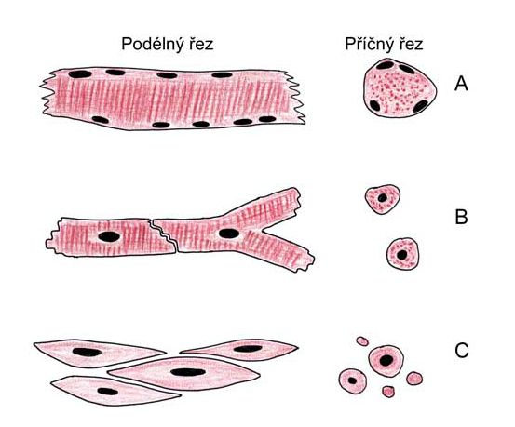
Muscle tissue

Slide 4
Muscle tisssue
Origin: mesoderm and mesenchyme
Excitability
Contraction + relaxation ⇒ movement
Composition: muscle cells + connective tissue, blood vessels
Long axe of cells is oriented paralelly with direction of contraction
mys/myos (muscle) sarx/sarcós (meat):
cell membrane = sarcolemma cytoplasm = sarcoplasm sER = sarcoplasmic reticulum

Slide 5
Muscle tissue – connective tissue
Endomysium – around each muscle cell (fiber)
Perimysium – around and among the primary bundles of muscle cells
Epimysium – connective tissue „capsule“ covering the surface of muscle

Slide 6
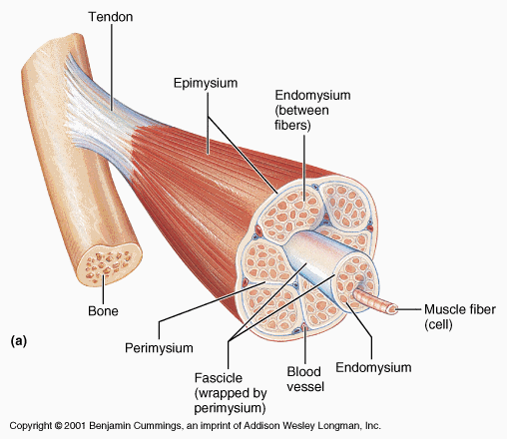
Connective tissue in skeletal muscle
contains vessels and nerves

Slide 7
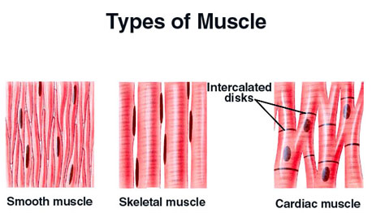
rhabdomyocyte
MUSCLE CELLS
kardiomyocyte
Ø 3-10 µm
Ø 15 µm
leiomyocyte
Ø 25-100 µm

Slide 8
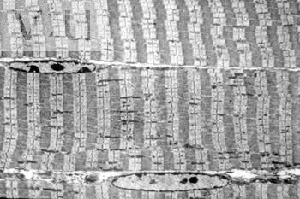
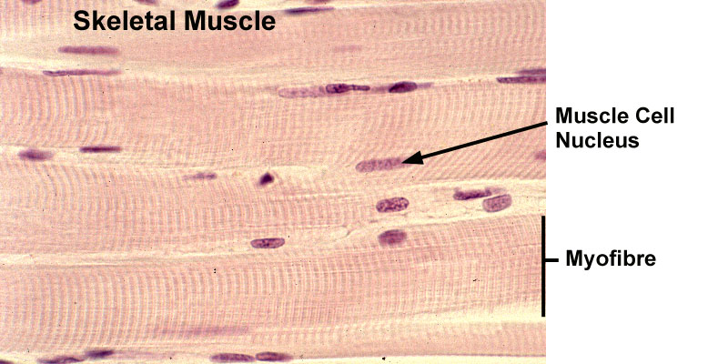
Cross striated skeletal muscle tissue
morphological and functional unit: muscle fiber (rhabdomyocyte) – elongated, cylindrical shape, multinucleated cell (=syncytium) – nuclei are located at the periphery (beneath sarcolemma), myofibrils show cross striation
diameter of muscle fiber: 25-100 μm
length: milimeters - centimeters (up 15)

Slide 9
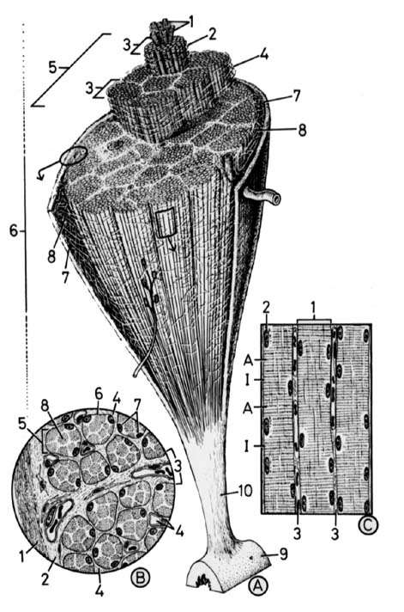
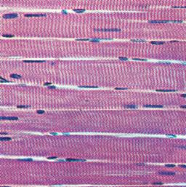
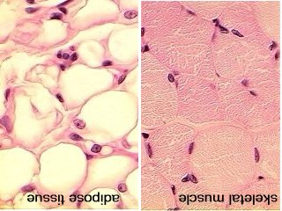
Skeletal muscle:
longitudinal section
of muscle fibers
myofibrils in sarcoplasm
nuclei
see nuclei at the periphery
and cross striation
Skeletal muscle:
cross section trough
muscle fibers

Slide 10
Skeletal muscle
Used terms:
Sceletal muscle cell (fiber) < rhabdomyocyte >
Muscle fiber = myofiber = syncitium = rhabdomyocyte
Muscle fiber – morphologic and functional unit of skeletal muscle
[Ø 25 – 100 μ]
Myofibrils – compartment of fiber sarcoplasm
[Ø 0.5 – 1.5 μ]
Myofilaments – actin and myosin, are organized into sarcomeres (several in the length of myofibril) [Ø 8 and 15 nm]
Sarcomere – the smallest contractile unit
[2.5 μm in length]

Slide 11
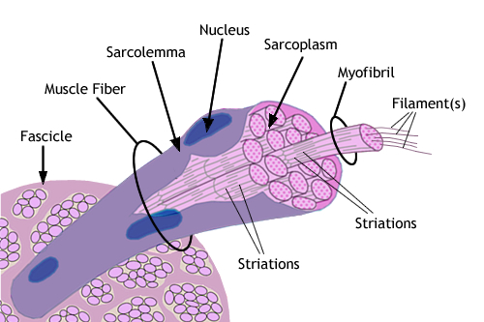
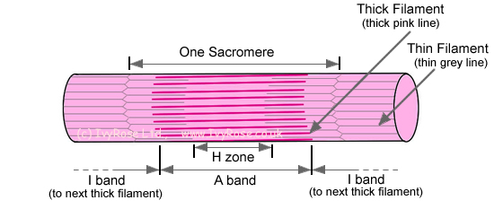
Structure or rhabdomyocyte
Sarcolemme + t-tubules,
In sarcoplasm:
Nuclei,
Mitochondria,
Golgi apparatus,
Glycogen (beta granules)
(sarcoplasm with organelles
forms columns among
myofibrils)
Sarcoplasmic reticulum
(smooth ER) – reservoir
of Ca²⁺
Myofibrils (parallel to the
length of the muscle fiber)

Slide 12
Skeletal muscle
Myofibrils :
- elongated structures [Ø 0.5 – 1.5 μ] in sarcoplasm of muscle fiber,
- are oriented parallely to the length of the fiber,
- contain 2 types of myofilaments: actin and myosin, arranged into the smallest contractile units – sarcomeres
- organization of myofilaments causes cross striation of myofibrils.

Slide 13
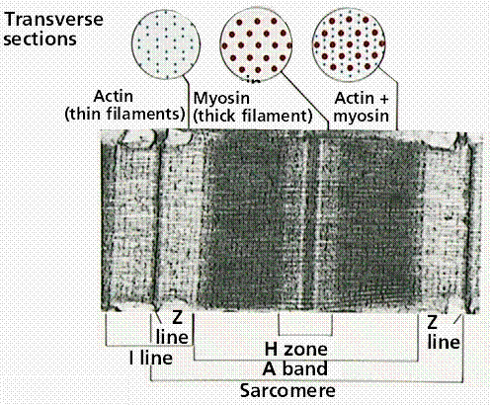
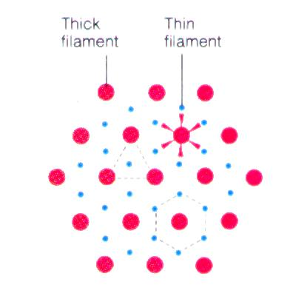
Myofibril
Actin + myosin myofilaments
Sarcomere
Z-line
M-line and H-zone
I-band, A-band

Slide 14
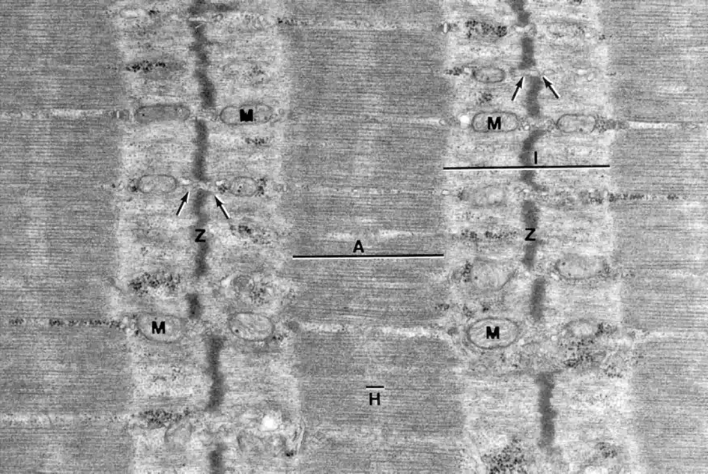
sarcoplasm
myofibrils
columns of sarcoplasm

Slide 15
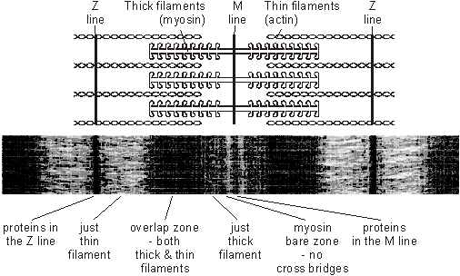
Sarcomere
H-zone
½ I-band
I–band
A–band

Slide 16
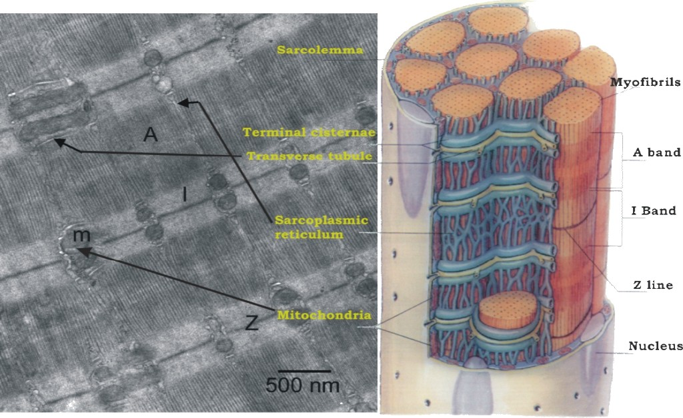

Slide 17
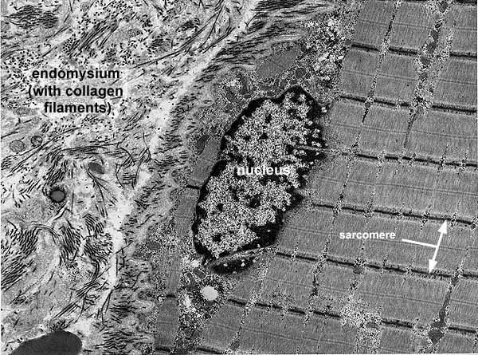
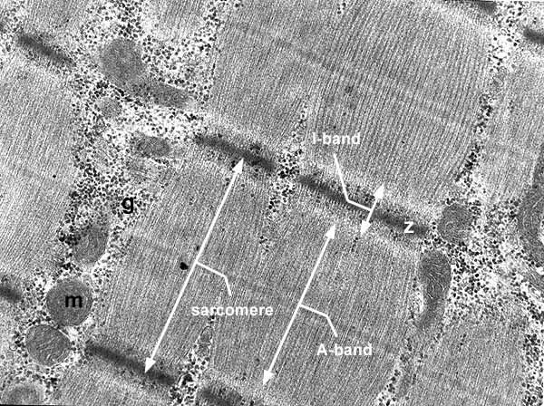
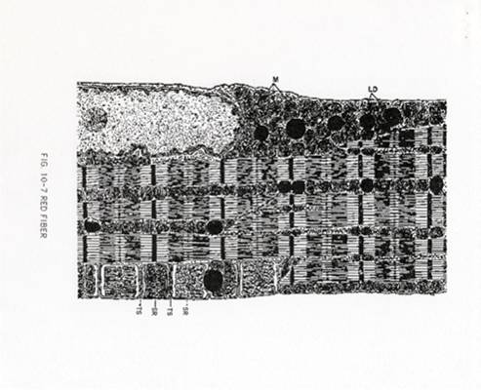
Skeletal muscle in EM

Slide 18
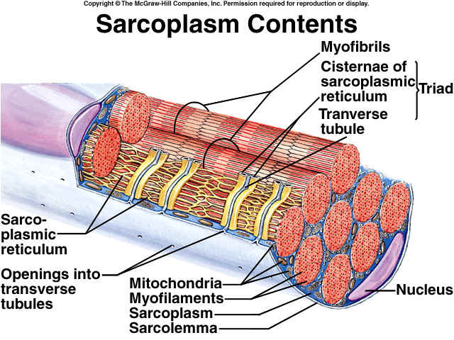
Rhabdomyocyte

Slide 19
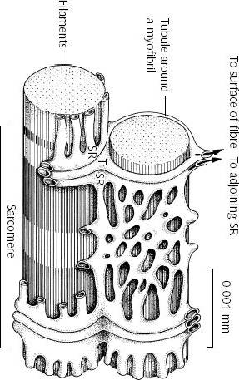
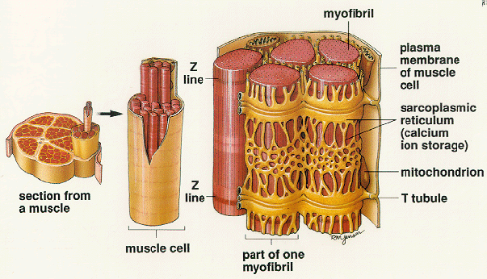
Sarcoplasmic reticulum, t-tubule
Forms transversal terminal cisternae and longitudinal tubules.
Function: reservoir of Ca ions
Terminal cisterna
T-tubule
Terminal cisterna
TRIAD
T-tubule is invagination of sarcoplasm and leads action
potential to terminal cisternae (they change permeability
of membrane for Ca ions)

Slide 20
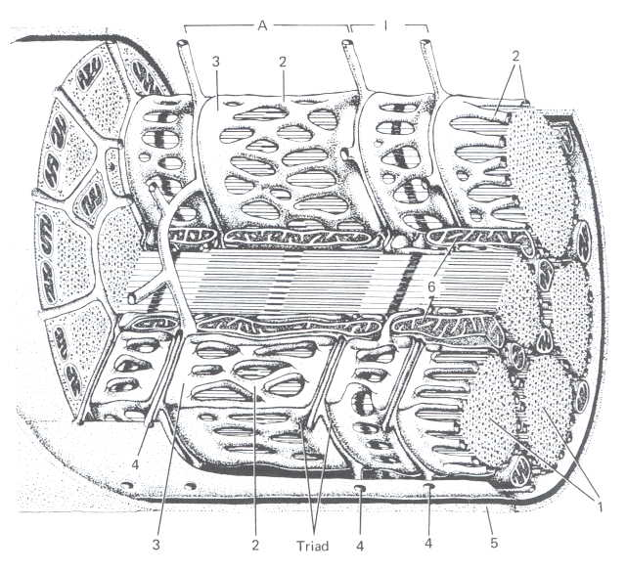
T-tubule
terminal cisterna
mitochondria
sarcolemma
myofibrils
tubules + cisternae of sER

Slide 21
Mechanism of contraction
Propagation of action potential (depolarization) via T-tubule (= invagination of sarcolemma)
Change of terminal cisternae permeability – releasing of Ca⁺ ions increases their concentration in sarcoplasm
Myosin contacts actin and sarcomera shortens by sliding movement – contraction
Relaxation: repolarization, decreasing of Ca²⁺ ions concentration, inactivation of binding sites of actin for myosin

Slide 22
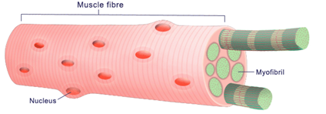
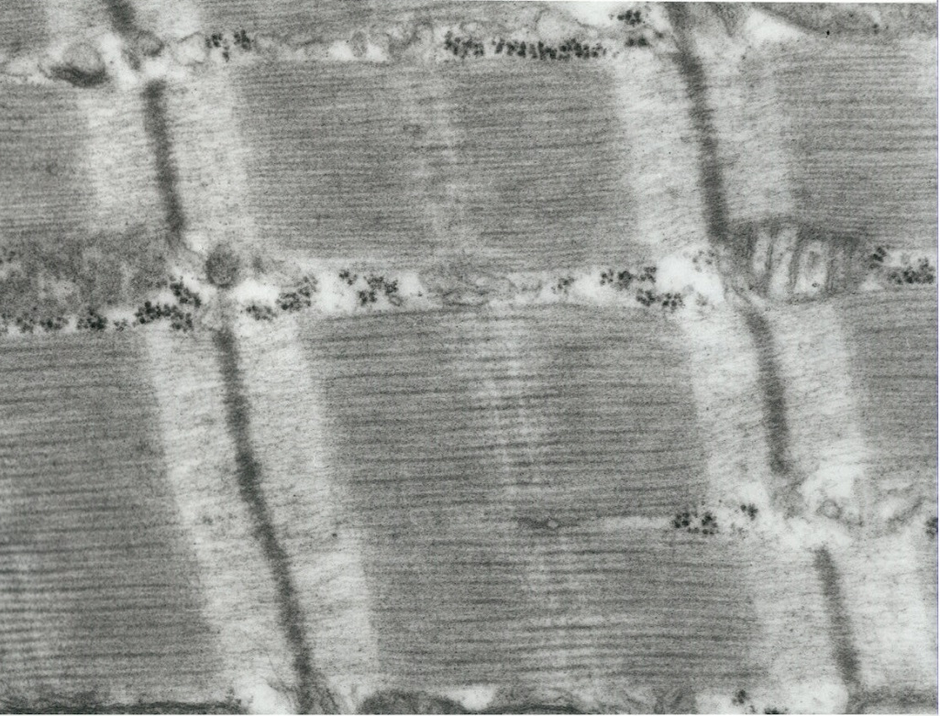
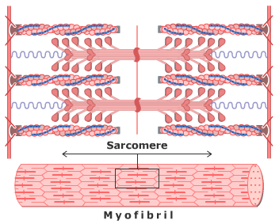
Rhabdomyocyte
myofibrils
myofilaments

Slide 23
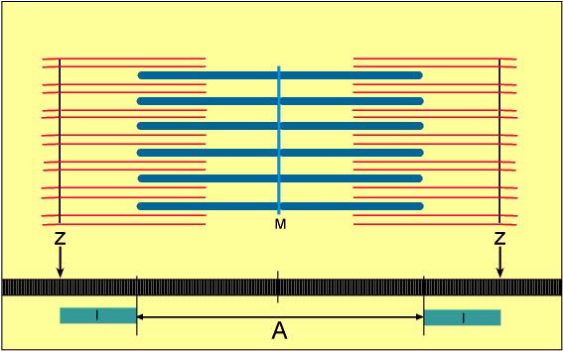
Rhabdomyocyte

Slide 24
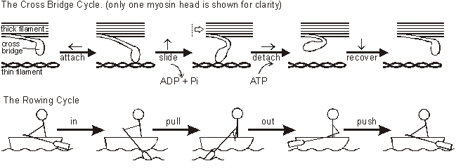
Mechanism of contraction: sliding of myofilaments
myosin
actin

Slide 25
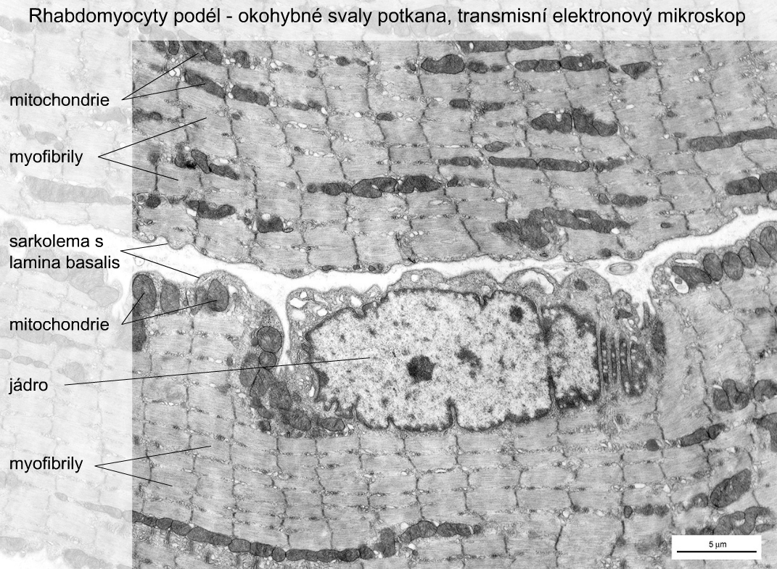
Rhabdomyocytes – oculomotor muscles of rat (TEM)
mitochondria
myofibrils
sarcolemma and lamina basalis
mitochondria
nucleus
myofibrils

Slide 26
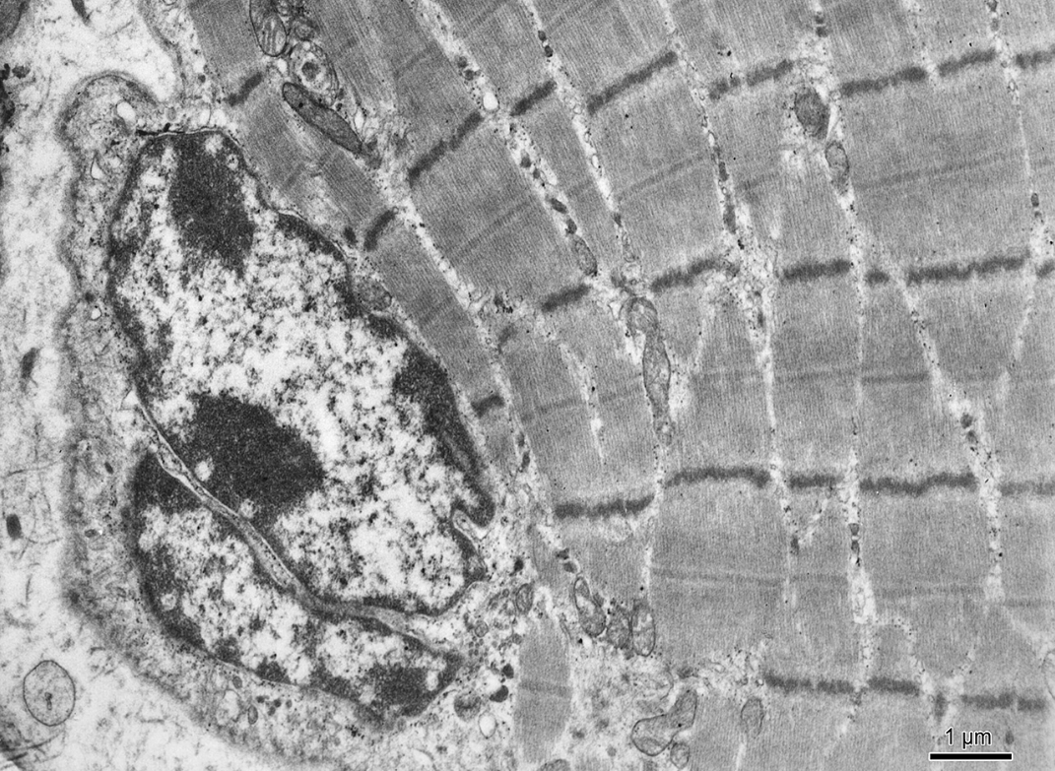
Rhabdomyocyte (TEM)

Slide 27
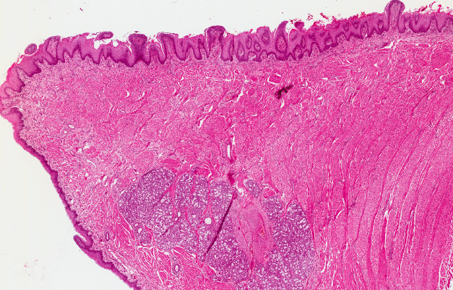
Skeletal muscle tissue – Apex linguae

Slide 28
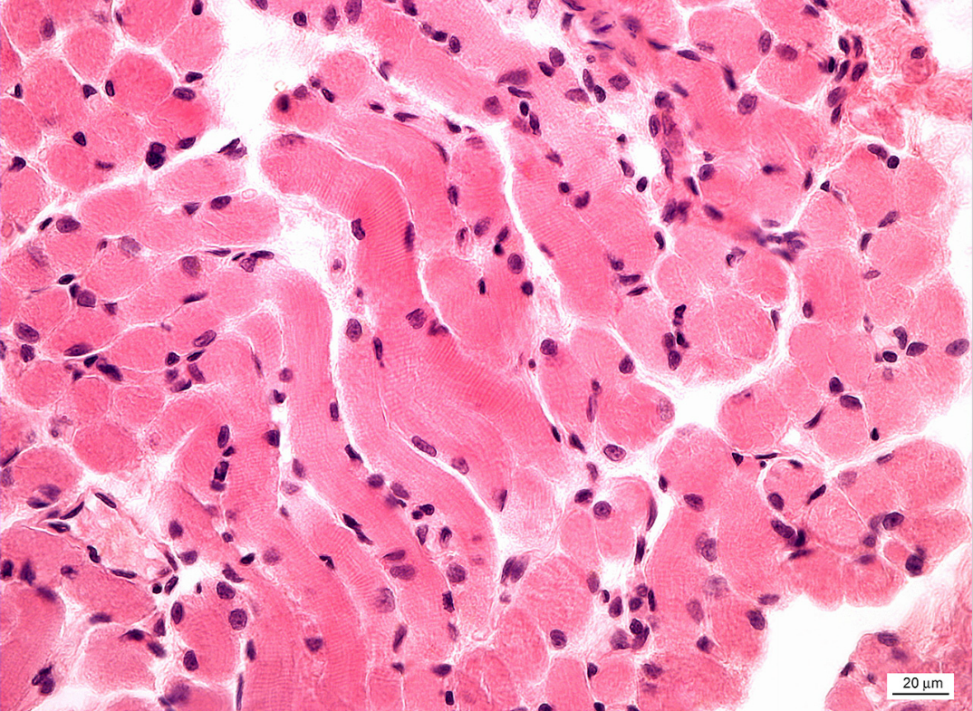
Skeletal muscle tissue (striated)

Slide 29
Cardiac muscle - myocardium
is made up of long branched fibers, composed of cells – cardiomyocytes,
cardiomyocytes are cylindrical cells, which can be branched on one or both ends (Y, X shaped cells),
Sarkoplasm: 1 nucleus in the center of cell, striated myofibrils, numerous mitochondria,
cells are attached to one another by end-to-end junctions – intercalated discs.

Slide 30

chains of cardiomyocytes blood capillary with erythrocytes
Intercalated disc

Slide 31
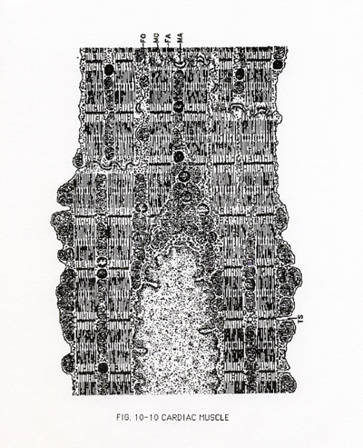
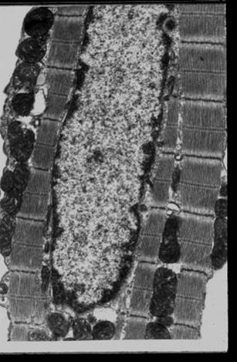
Schema and electron graph
of a part of cardiomyocyte

Slide 32
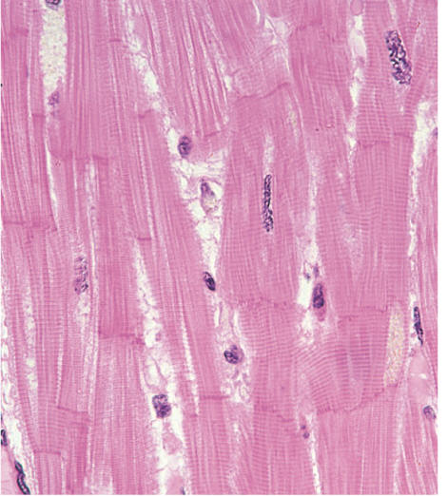
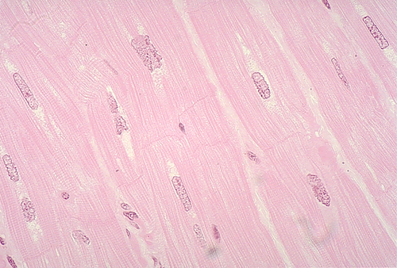
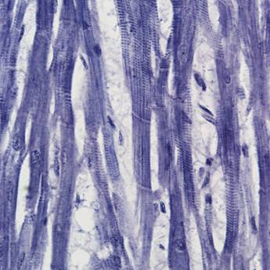

Slide 33
DIFFERENCES BETWEEN CARDIAC AND SKELETAL MUSCLE TISSUES
there are no triads, but diads: 1 t-tubule + 1 cisterna
t-tubules encircle the sarcomeres at the Z lines rather than at the zone of overlap.
sarcoplasmic reticulum via its tubules contact sarcolemma as well as the t-tubules
cardiac muscle cells are totally dependent on aerobic metabolism to obtain the energy needed to continue contracting. The sarcoplasm thus contains large numbers of mitochondria and abundant reserves of myoglobin (to store oxygen). Energy reserves are maintained in the form of glycogen and lipid inclusions.

Slide 34
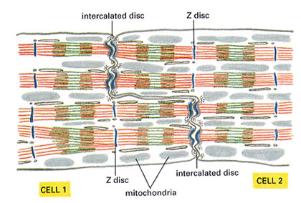
Cardiac muscle
Intercaleted disc :
„scalariform“ shape of cell ends
fasciae adherentes (adhesion of cells)
- Nexus (quick intercellular communication – transport of ions, electric impulses, informations)

Slide 35
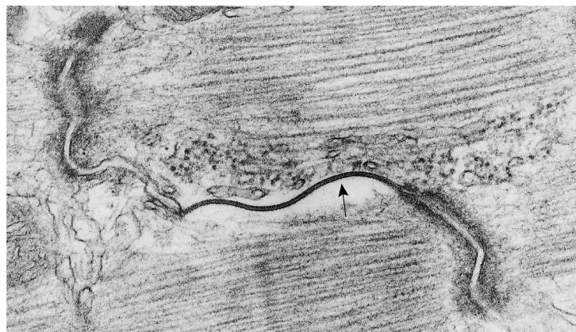

Actin myofilaments
Cell 2
Cell 1
Intercalated disc:
nexus
fascia adherens

Slide 36
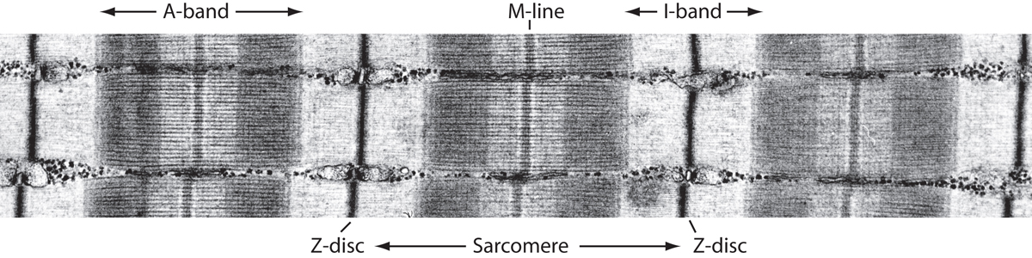
Myofibril of cardiomyocyte
Actin + myosin myofilaments
Sarcomere
Z-line
M-line and H-zone
I-band, A-band
T-tubule + 1 cisterna = diad (around Z-line)

Slide 37
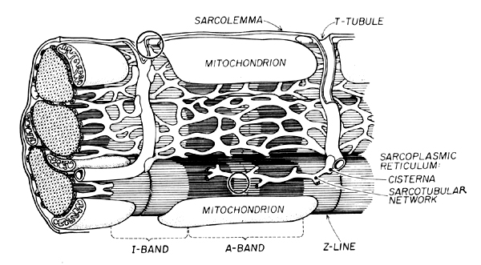

Slide 38
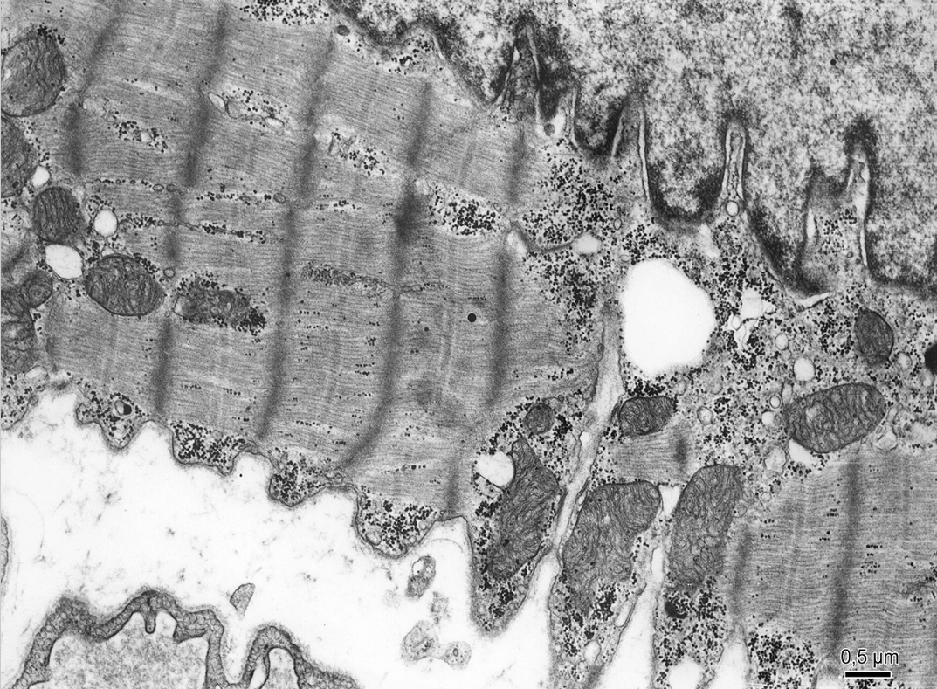
Cardiomyocyte (TEM)

Slide 39
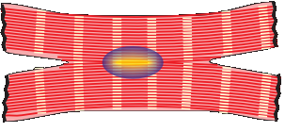
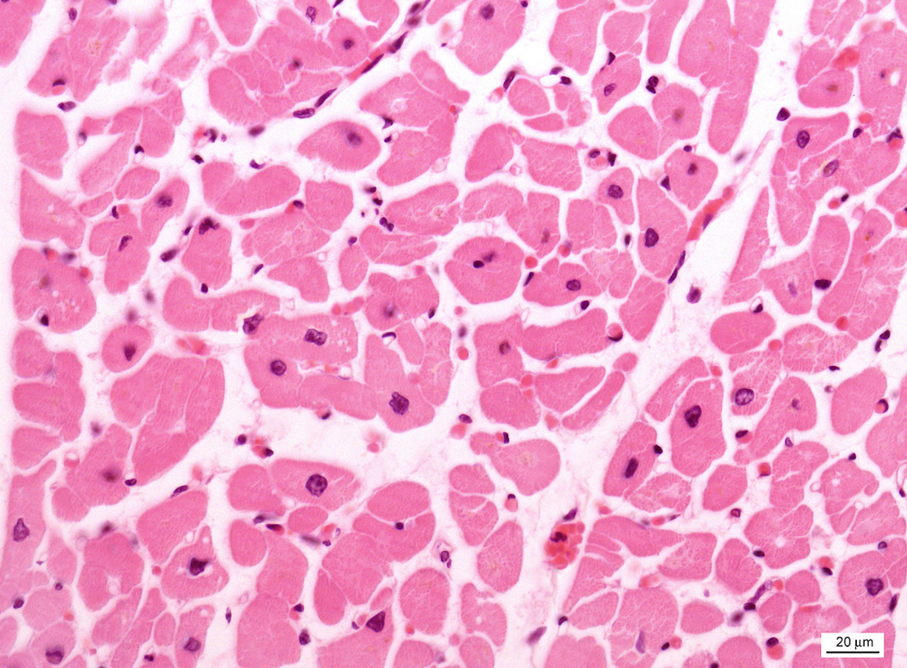
Cardiac muscle tissue (HE) – cross section

Slide 40
Cardiac muscle tissue (HE) – longitudinal section

Slide 41
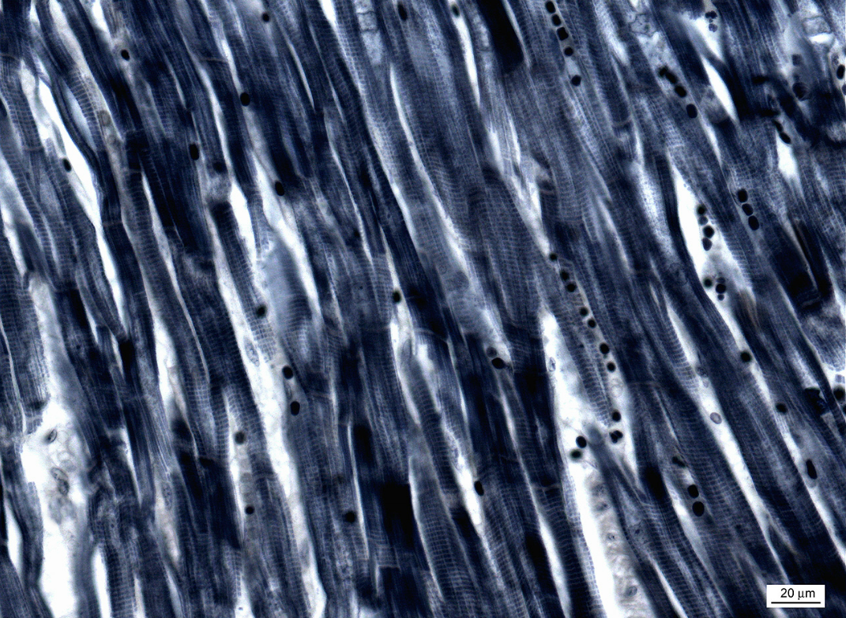
Cardiac muscle tissue (Heidenhein)

Slide 42
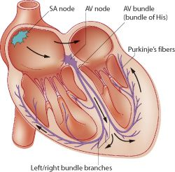
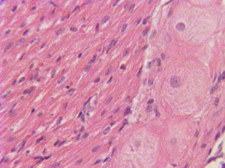
Purkinje fibers
are located in the inner layer of heart ventricle wall
are specialized cells fibers that conduct an electrical stimuli or impulses that enables the heart to contract in a coordinated fashion
numerous sodium ion channels and mitochondria, fewer myofibrils

Slide 43
Smooth muscle cells
spindle shaped cells (leiomyocytes) with myofilaments not arranged into myofibrils (no striation), 1 nucleus in the centre of the cell
myofilaments form bands throughout the cell
actin filaments attach to the sarcolemma by focal adhesions or to the dense bodies substituing Z-lines in sarcoplasm
calmodulin
sarcoplasmic reticulum forms only tubules, Ca ions are transported to the cell via pinocytic vesicles
zonulae occludentes and nexuses connect cells

Slide 44
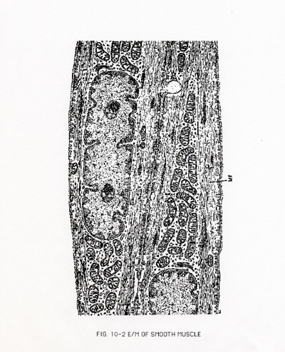
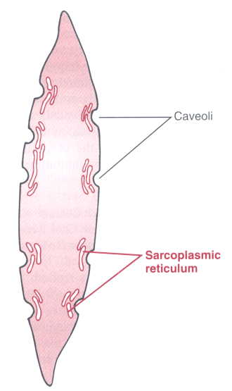
Leiomyocyte
Caveolae are equivalent to t-tubule
and in their membrane ions channel
are present to bring Ca needed fo
Contraction.
Caveolae are in contact with
sarcoplasmic reticulum.

Slide 45

Leiomyocyte (TEM)

Slide 46


Leiomyocyte:
contractile filaments
Myosin flaments
Actin filaments
+
nexuses

Slide 47



Leiomyocytes are arranged into laeyers of wall of hollow (usually tubular) organs
Cross section
Longitudinal section

Slide 48

Smooth muscle tissue – Intestinum tenue (HE)

Slide 49
Smooth muscle tissue – Intestinum tenue (HES)

Slide 50
Muscle tissue
Slides:
Skeletal muscle tissue (2. Apex linguae)
Smooth muscle tissue (16. Intestinum tenue, 17. Intestinum crassum)
Cardiac muscle tissue (64, 65. Myocardium)
Atlas EM:
Rhabdomyocyte (52)
Leiomyocyte (54)
Cardiomyocyte (22, 53)

