Slide 1
The immune system, immunopathology.
Infectious diseases
MUDr. V. Žampachová
PAÚ

Slide 2
Physiologic function
Protection + defence against external and/or internal noxae
Defence against infection incl. toxic products
Autotolerance against body-own antigenes
Immunologic internal control (removal of old, defective, some mutated cells)
Failure possible due to inadequate immune function and/or too violent (event. evasive) noxae

Slide 3
Factors affecting immunity
Alteration of the immune system due to:
Aging
Sex and hormonal influences
Malnutrition
Toxins (environmental, chemicals, …)
Trauma, burns, surgery
Medication incl. immunosuppressive drugy, anaesthesia
Concurrent diseases (diabetes mellitus, chronic renal failure, malignancy, HIV, …)
Stress, sleep disturbance, psychological well-being, …

Slide 4
Exercise immunology
Dose and type of exercise dependent effect on immunity
Moderate exercise enhances immune functions, reduces stress
Rise in number of blood phagocytes and their activity during the exercise and approx. 2-4 hours after it (if ˃ 30 min), up to 24 hours after prolonged exercise
Increased cytotoxicity of NK cells
Increase in lymphocytes in blood
Regular execise may protect against dangerous systemic low-grade inflammation (due to production of antiinflammatory cytokines)

Slide 5
Exercise immunology
Intense and/or long-duration exercise → immune impairment, incl. suppression of lymphocytes, possible increased risk of infection
Suppression of the NK cell activity, even several hours after the exercise (vigorous training – repeated decline – posible cumulative effect?)
High intensity exercise (˃80% of maximal oxygen consumption) → immune function suppression + tissue damage → acute-phase response with complement activation, release of cytokines
Immune system recovery in 6-24 hours

Slide 6
Clinical implications
Regular exercise in aging people may prolongate normal function of the immune system (lower decline, better immunologic balance, delay of age- and/or disease associated apoptosis (brain, heart )
Lower inhibition of immune system after intense exercise in aged patients (x young) – such exercise possible

Slide 7
Clinical implications
During mild viral/bacterial infection exercise in otherwise healty people possible, if symptoms located above the neck („neck check“) – sneezing, throatache, rhinitis – and are not worse after 10 minutes of moderate activity.
If headache, head throbbing start after short term activity → stop and rest
If systemic signs (fever, fatigue) or symptoms below the neck (cough, diarrhea, vomiting, muscle/joint ache → no exercise

Slide 8
Immunity
Innate: not adaptive, non-specific
no immunologic memory (not stronger with more exposures)
Adaptive (specific):
specific recognition and response to the particular antigen
effective reaction to diverse pathogenes/antigenes
memory – rapid response to subsequent exposure to the specific antigen
activation of other defense mechanisms

Slide 9
Phases of immune response
Recognition: receptors (innate non-specific, later adaptive specific) binding to the pathogene
Amplification: start of reaction, production and/or release of humoral factors incl. cytokines (soluble mediators), activation and/or proliferation of immune cells
Effector phase: removal of antigenes (phagocytosis, lysis, neutralization, …)
Termination of the immune response (very important, if not complete – tissue damage and/or chronic inflammation possible)
Memory – specialized long-living T- and B-lymphocytes

Slide 10
Non-specific defenses of innate immunity
Mechanic barrier functions: skin + mucosa (epithelium, cilia in respiratory tract)
Secretory factors: lysozyme in secretions (tears), acid pH in stomach, vagina, acid urine
Microbiome colonisation: commensal microorganisms preventing overgrowth of pathogenes

Slide 11
Innate immunity
Cells: neutrophils, macrophages (phagocytosis, killing of bacteria), eosinophils (antiparasitic, allergic response), basophils, natural killer cells, mast cells
Complement: complex system of interacting plasma proteins, effector mechanism for specific immunity, or direct activation possible
Toll-like receptors on macrophages, neutrophils, dendritic cells; if activated by binding of pathogenes, induce the secretion of pro-inflammatory cytokines
Rapid response - early host response

Slide 12
Mechanisms of nonspecific immunity
Fever
Inflammation
extravasation
phagocytosis
complement
NK cells
Interferons - against viral infection

Slide 13
Natural killer cells
NK cells: subtype of large granular cytotoxic lymphocyte that constitute a major component of the innate immune system. NK cells able of direct killing of cells infected by viruses, intracellular pathogenes, play a major role in the anti-tumor immunity

Slide 14
Adaptive immunity
Pre-activation necessary (days – weeks)
Threat present for longer time at a higher level (activation threshold)
Active immunity: natural contact with the antigen or artificial (vaccination) – usually permanent/long standing activity
Passive immunity: natural transmisssion of antibodies (placenta, breast milk) or artificial (injection of preformed antibody/antitoxin) – temporary activity

Slide 15
Cell-mediated adaptive immunity
Direct cellular reaction to antigenes
Mediated by T-lymphocytes:
  cytotoxic T-cells CD8+, direct killing
  helper T-cells CD4+, cytokine production – activation of other immune mechanisms incl. innate immunity, inflammation
  regulatory/suppressor T-cells – prevention of responses against self-antigenes and commensal microoganisms

Slide 16
Cytokines
Mediators produced by many cells, incl. lymphocytes and macrophages
Regulation of lymphocyte proliferation / maturation
Attraction of immune cells into the focus of inflammation
Activation of variable immune cells functions
Stimulation of hemopoesis

Slide 17
Humoral immunity
Mediated by antibodies (serum globulins), which are produced by plasma cells, i.e. differentiated B-lymphocytes
Plasma cells mature when exposed to antigen
Memory cells can react more quickly to later exposures to the same antigen
Immunoglobulins directly attack antigenes, activate the complement system, stimulate some hypersensitive reactions

Slide 18
Antibody (immunoglobulin) isotypes
IgG- most common in serum, secreted in secondary response
IgM- secreted in primary response; also part of antigen receptor on B-cells
IgA- most common in secretions – mucosal immunity
IgE- immediate hypersensitivity (allergy)
IgD- part of cell surface antigen receptor

Slide 19
Antigen-presenting cells
Antigens are “processed” by antigen-presenting cells (in lymphatic and/or other tissues)
macrophages
dendritic cells
B cells
Major Histocompatibility Complex plays a critical role in antigen presentation

Slide 20
Major Histocompatibility Complex
A highly variable genetic locus on chromosome 6, which codes for cell surface compatibility
Also called HLA (Human Leukocyte Antigens)
Membrane proteins presenting antigenes for recognition by T-cells, which subsequently produce cytokines for regulation of both cellular and humoral immunity.
Recognition and tolerance of all self-cell, all un-recognized cells will NOT be tolerated
Certain MHC subtypes (alleles) associated with increased incidence of some autoimmune diseases

Slide 21
Immunological tolerance
Immune system distinction between self and non-self
“Thymic education”
T cells that might react with self-antigen
are eliminated in the thymus
(clonal deletion; early mechanism)
Clonal anergy – possible autoreactive cells are formed but are not
activated against certain antigens
(later mechanism)

Slide 22
Cancer immunology
Immune surveillance
NK cells - early defense mechanism
MHC Class I activates these cells;
many tumor cells lack MHC Class I
Cytotoxic T cells - antigen specific
(both types of cells have similar killing
mechanisms)

Slide 23
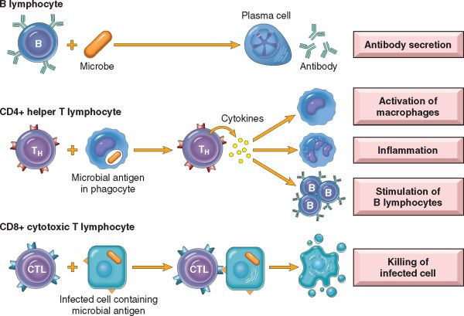
Robbins Pathologic Basis of Diseases

Slide 24
Disorders of the immune system
Exaggerated immune reaction
Hypersensitivity reactions
Autoimmune disorders
Transplantation immunology/immunopathology
Defective immune reaction
Immunodeficiency (primary, secondary)

Slide 25
Hypersensitivity reactions
sensitisation (previous exposition to an antigen) + repeated exposure → possible pathologic (excessive) response: hypersensitivity – imbalance between effector mechanisms of immune responses and control (+limiting) mechanisms
antigens exogenous (chemicals, organic substances incl. microbes, …); endogenous (autoimmune diseases)
association with inheritance of particular susceptibility genes (HLA, non-HLA)

Slide 26
Hypersensitivity
Classification according to the immunologic mechanism (→ mode of tissue injury and disease, manifestations) + time of response
Commonly multiple mechanisms in any one disease
Antibody-mediated allergies are immediate and subacute hypersensitivities
The most important cell-mediated allergic condition is delayed hypersensitivity

Slide 27
Hypersensitivity reactions contribute to:
Type I- rhinitis; asthma; hives; anaphylaxis
Type II- often directed against blood cells; various
types of hemolytic anemia
drug molecules can interact with blood cells
and form immunogenic structures
Type III- immune complex disease
usually complexes are cleared, but if not, are
deposited in tissue and cause inflammation
Type IV- contact dermatitis (basis for TB skin test)

Slide 28
Hypersensitivity reactions
Immediate (type I) hypersensitivity
Rapid immunologic reaction occurring within minutes after the combination of an antigen with antibody bound to mast cells in individuals previously sensitized to the antigen („allergen“).
Systemic disorder or local reaction.
Anaphylaxis; allergies; bronchial asthma (atopic forms)
Vascular dilatation, edema, smooth muscle contraction, mucus production, tissue injury, inflammation

Slide 29
Immediate (type I) hypersensitivity
Anaphylaxis: systemic reaction mostly after injection of an antigen into a sensitized individual. In minutes → shock (may be fatal).
Causes: foreign proteins, polysaccharides, drugs (penicillin), food (nuts, shellfish), insect toxins
Starts with itching, hives, and skin erythema
Contraction of bronchioles → respiratory distress. Laryngeal edema → hoarseness
Vomiting, abdominal cramps, diarrhea
Vascular shock, widespread edema

Slide 30
Immediate (type I) hypersensitivity
Local reactions: diverse, according to the entry of the allergen. Localized cutaneous swellings (skin allergy, hives);
nasal and conjunctival discharge (allergic rhinitis and conjunctivitis);
hay fever; bronchial asthma;
allergic gastroenteritis (food allergy).

Slide 31
Allergic rhinitis

Slide 32
Atopy
Genetically determined susceptibility to immediate hypersensitivity reactions.
Atopy: predisposition to develop localized immediate hypersensitivity reactions to a variety of inhaled and ingested allergens.
↑ serum IgE levels,
Positive family history of allergy in 50% of atopic individuals.
Atopic eczema, allergic rhinitis, asthma (+ secondary hyper-responsiveness of bronchial mucosa to non-specific irritants, e.g. cold, tobacco smoke,… Secondary neural triggering.)

Slide 33
Antibody-mediated (type II) hypersensitivity
Onset usually slow (1–3 hours) after antigen exposure
Production of IgG, IgM → bind to antigen on target cell or tissue → phagocytosis or lysis of target cell,recruitment of leukocytes
Inflammation; in some diseases functional problems without cell or tissue injury (type V hypersensitivity – thyroid hyperfunction - Graves‘ disease)
Malaise, weakness, rash, hoarsness, abdominal cramps, diarrhea, hypotension

Slide 34
Immune complex–mediated (type III) hypersensitivity
  Antigens widely distributed through the body or blood.
  Formation of insoluble antigen-antibody complexes.
Deposition of antigen-antibody complexes (vessel wall)→ complement activation → recruitment of leukocytes → release of enzymes and other toxic molecules
Inflammation, necrotizing vasculitis (necrosis of the vessel wall)
Headache, chest pain, nausea, hematuria

Slide 35
Immune complex–mediated (type III) hypersensitivity
Systemic lupus erythematosus nuclear antigens; nephritis, skin lesions, arthritis, others
Poststreptococcal glomerulonephritis streptococcal cell wall antigen(s); may be “planted” in glomerular basement membrane; nephritis

Slide 36
T cell–mediated (type IV) hypersensitivity
Contact dermatitis; multiple sclerosis; type I diabetes; rheumatoid arthritis; inflammatory bowel disease (i.e. Crohn disease); tuberculosis
Perivascular cellular infiltrates; edema; granuloma formation; cell destruction
Fever, arthralgia, enlarged lymph nodes, hives (urticaria)

Slide 37
T cell–mediated (type IV) hypersensitivity
Rheumatoid arthritis: unknown antigen in joint synovium; role of antibodies? Chronic arthritis with inflammation, destruction of articular cartilage and bone
Crohn disease: unknown antigen; role for commensal bacteria; chronic intestinal inflammation, obstruction, risk of fistulae, peritonitis

Slide 38
T cell–mediated (type IV) hypersensitivity
Peripheral neuropathy; Guillain-Barré syndrome?: protein antigens of peripheral nerve myelin; neuritis, paralysis
Contact sensitivity (dermatitis): various environmental antigens (e.g., poison ivy); skin inflammation with blisters – vesicular dermatitis

Slide 39
Clinical implications
Anaphylaxis or other type I hypersesitivity: emergency, immediate action necessary
Type IV reactions: possible in response to lotions, gels, etc. – observation of skin reaction
In people with known hypersensitivity – skin test
Latex sensitivity/allergy in a therapist possible

Slide 40
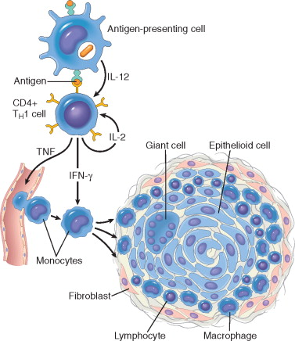
Granulomatous inflammation
Persistent or nondegradable antigens, (tubercle bacilli)
Infiltrate dominated by macrophages in 2-3 weeks.
Activated macrophages transform into epithelium-like cells epithelioid cells.
Granuloma: microscopic aggregation of epithelioid cells usually surrounded by a layer of lymphocytes.
Granulomatous inflammation typically associated with strong T-cell activation with cytokine production
from Robbin‘s Pathologic Basis of Disease

Slide 41
AUTOIMMUNITY
Ability of immune system to differentiate between self and non-self antigens
Immune system response against self antigens

Slide 42
Autoimmune diseases
Autoimmunity arises from a combination of the inheritance of susceptibility genes, which may contribute to the breakdown of self-tolerance, and environmental triggers, such as infections and tissue damage, which promote the activation of self-reactive lymphocytes.
Autoantibodies (AA) in clinically normal people.
Physiologic AA in removal of breakdown products after tissue damage (antigen-antibody complex removed by macrophages)
Imbalance between control mechanisms (normally preventing pathologic self-reactivity) and pathways leading to the generation and activation of pathogenic effector lymphocytes.

Slide 43
Autoimmune diseases
Pathologic autoimmunity: presence of immune reaction specific for self-antigen
+ primary pathogenic, not secondary to tissue damage
+ absence of other cause
Commonly uncertain „pure“ autoimmunity – term immune-mediated inflammatory diseases

Slide 44
Factors influencing autoimmune disease
Internal triggering factors
genotype / HLA
cytokines
apoptosis genes
primary immunodeficiency
hormones
External triggering factors
infections
UV
drugs
chemicals (including food)
stress

Slide 45
Autoimmune diseases
Most autoimmune diseases are complex multigenic disorders
Many autoimmune diseases associated with infections, clinical flare-ups often preceded by infectious prodromes
Disease occurrence in clusters, discordance in identical twins
Many infectious diseases similar to autoimmune disease in pathology (Lyme disease)

Slide 46
Autoimmune diseases
  Changes in self-antigens, that make them look like non-self to the immune system, due to:
  Viral or bacterial infection
Irradiation
Medication
Smoking

Slide 47
Hormones
Females are much more likely to develop autoimmune illness
Rise in hormones associated with pregnancy may even cause abortion of the fetus
Endometriosis and preeclampsia are both thought to be autoimmune in nature
Hypothesis: estrogen response elements (EREs) in several genes

Slide 48
Drugs and foods
gluten – celiac disease
saturated fats – diferent AI diseases (oxygen radicals)
D- penicilamine, hydralazine, oral contraceptives, isoniaside induction of autoantibodies
silicone´s polymers (sclerodermia, systemic lupus, rheumatoid arthritis)

Slide 49
Breakdown of tolerance
Bypass of helper T cell tolerance
Imbalance of suppressor-helper T cell function
Genetic factors
Polyclonal lymphocyte activation

Slide 50
Mechanisms of tissue injury
Auto-antibodies circulating in blood or at site of tissue injury
Autoreactive B and T cells in blood and at site of tissue injury
Hypersensitivity reactions occurring at sites of tissue injury
Histology: chronic inflammation
Pathway for apoptosis

Slide 51
Autoimmune diseases
Different autoimmune diseases show substantial clinical, pathologic, and serologic overlaps.
Precise phenotypic classification often problematic.

Slide 52
Autoimmune diseases
DISEASES MEDIATED BY ANTIBODIES AND IMMUNE COMPLEXES
Organ-specific autoimmune diseases
Autoimmune hemolytic anemia
Autoimmune thrombocytopenia
Myasthenia gravis (muscle weakness)
Graves disease (thyroid hyperfunction)
Systemic autoimmune diseases
Systemic lupus erythematosus (SLE)
Diseases caused by autoimmunity or by reactions to microbial antigens
Polyarteritis nodosa (vessel wall inflammation + necrosis)

Slide 53
Autoimmune diseases
DISEASES MEDIATED BY T-CELLS
Organ-specific autoimmune diseases
Type 1 diabetes mellitus
Multiple sclerosis (brain)
Systemic autoimmune diseases (+ possible role of antibodies)
Rheumatoid arthritis (mainly joints, soft tissues inflammation)
Systemic sclerosis (mainly soft tissues inflammation)
Sjogren syndrome (chronic inflammation of salivary, lacrimal glands)
Diseases caused by autoimmunity or by reactions to microbial antigens
Inflammatory bowel disease (Crohn disease, ulcerative colitis)
Inflammatory myopathies (muscles)

Slide 54
Incidence of autoimmune diseases
Rheumatoid arthritis 1-3%
Sjögren´s sy 1/20 000
Vasculitis 1/100 000
Prevalence of autoimmune diseases
5-7% of population

Slide 55
Diagnosis
clinical picture
laboratory
autoantibodies
autoreactive lymphocytes
autoantigens
related genes

Slide 56
SYSTEMIC LUPUS
ERYTHEMATOSUS (SLE)
Chronic systemic autoimmune disease
Cause unknown
Affects almost any organ(s)
Characterized by chronic inflammation

Slide 57
SLE
The course of the disease is variable and unpredictable.
Rare acute cases result in death within weeks to months.
Appropriate therapy: flare-ups and remissions, years or even decades.
The most common causes of death are renal failure and intercurrent infections.

Slide 58
SLE – typical case
young woman with some of the following features:
a butterfly rash over the face,
fever,
pain but no deformity in one or more peripheral joints (feet, ankles, knees, hips, fingers, wrists, elbows, shoulders),
pleuritic chest pain
photosensitivity

Slide 59
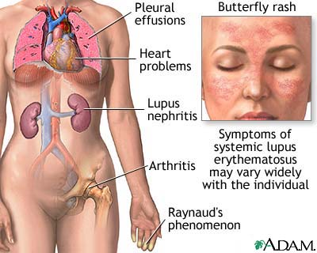
SLE

Slide 60
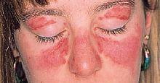

Clinical features of SLE

Slide 61
Special implications of SLE
Physical and occupational therapy important part of treatment
Individual plan, according to the phase (acute flare with mostly rest, gradual start of activities with energy conservation – fatigue common)
Exercise to increase muscle strenght, prevent osteoporosis x avoid increased stress of inflamed joints
Limit exposure to direct sunlight
Immunosuppression due to therapy → risk of infection

Slide 62
Rheumatoid arthritis
Systemic autoimmune disease (joints, skin, blood vessels, heart, lungs, muscles, nerves)
Genetic factors
Etiology unknown, combination of gen. predisposition, environment (trigger), autoimmunity
Rheumatoid factor (RF) in 80%
Start commonly between ages 25-50 years
Women 3:1 men
Prolonged morning joint stiffness (≥ 1 hour)

Slide 63
Rheumatoid arthritis
Chronic nonpurulent proliferative inflammation of synovial joints, symmetrical
Proliferation of synovial lining cells, oedema, fibrin deposition → pannus (synovial cells + granulation tissue + inflammatory cells) →
Erosion of articular cartilage and adjacent bone (osteoclasts) →
Fibrous ankylosis → bony ankylosis

Slide 64
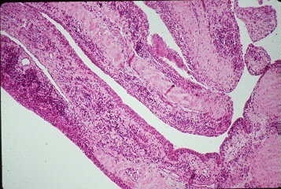
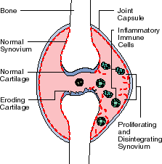
Variable course, usual start in hands or other small joints.
Arthritis + morning stiffness
Worsening limitation of motion
Rheumatoid nodules in organs or tissues – skin, lungs (!x ca), myocardium,…
Systemic signs (fatigue, malaise, weight loss, fever, … )
Notes:
64

Slide 65
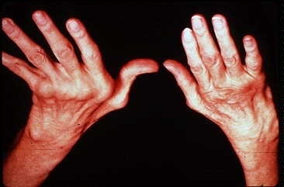
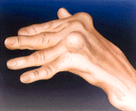

Slide 66
Special implications
Part of diagnostic staff (localisation, type and duration of joint pain)
Signs of possible progression (increased intensity of pain, more joints affected)
True arthritis – pain during active + passive motion x tendinitis – more in active motion
Patient education (type of exercise)
Functional status and rehabilitation

Slide 67
Systemic sclerosis
Chronic inflammation with progressive interstitial and perivascular fibrosis in the skin, subcutaneous tissue, muscles and multiple organs
gastrointestinal tract, kidneys, heart, muscles, and lungs (interstitial fibrosis) frequently involved
death from renal failure, cardiac failure, pulmonary insufficiency, or intestinal malabsorption
limited scleroderma, in which the skin involvement is often confined to fingers, forearms, and face.

Slide 68
Systemic sclerosis
female-to-male ratio of 3 : 1, with a peak incidence in the 50- to 60-year age group
Raynaud's phenomenon: episodic vasoconstriction of the arteries and arterioles of the extremities, in virtually all patients and precedes other symptoms in 70% of cases.
Dysphagia attributable to esophageal fibrosis and its resultant hypomotility in more than 50% of patients

Slide 69
Organ-specific autoimmune diseases
Endocrine system
Autoimmune (Hashimoto’s) thyroiditis - hypofunction
Hyperthyroidism (Graves’ disease; thyrotoxicosis)
Type I diabetes mellitus (insulin-dependent or juvenile diabetes)
Insulin-resistant diabetes
Autoimmune adrenal insufficiency (Addison’s disease)

Slide 70
Organ-specific autoimmune diseases
Neuromuscular system
Myasthenia gravis
Autoimmune polyneuritis
Multiple sclerosis

Slide 71
Organ-specific autoimmune diseases
GIT
Chronic ulcerative colitis
Malignant pernicious anaemia with chronic atrophic gastritis
Autoimmune hepatitis, AI pancreatitis
Primary biliary cirrhosis
Chronic sclerosing cholangitis

Slide 72
Diabetes
Hyperglycaemia
Different mechanisms cause different forms
Genetic and environmental component to all forms
Diabetes gives rise to complications;
microvascular- nephropathy, neuropathy, retinopathy
macrovascular - cardiovascular disease
Two major forms of diabetes:
Type 1 diabetes (autoimmune)
Type 2 diabetes (metabolic)

Slide 73
Multiple sclerosis
–autoimmune brain disorder, genetic + environmental factors (infection as trigger), T lymphocytes reaction against myelin + macrophagic activation by cytokines – demyelinisation
Brain white matter plaque (active, inactive), gliosis – sclerosis
muscular weakness, paraesthesia, sensoric dysfunction (ocular), etc.

Slide 74
Myasthenia gravis
Disease marked by progressive weakness and loss of muscle control
Classified as a B cell disease
Autoantibodies against nicotinic acetylcholine muscle receptors

Slide 75
Celiac disease
Sensitivity to gluten
recurring abdominal bloating and pain
chronic diarrhea/constipation
failure to thrive in infants/loss of weight
fatigue
unexplained anemia
dermatitis herpetiformis Duhring
Autoantibodies

Slide 76
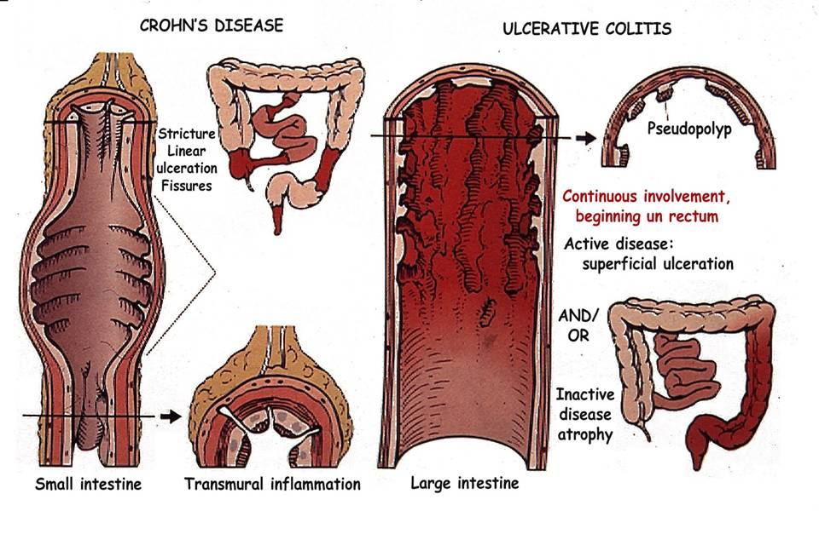
IBD – inflammatory bowel diseases

Slide 77
IMMUNODEFICIENCIES
Primary – genetic, uncommon
Secondary – acquired, very common

Slide 78
Primary immunodeficiencies
Depends on the stage of immune development that is affected
The earlier the defect, the more severe the effect
SCID (severe combined immunodeficiency syndrome)
essentially no protection against infection
difficult treatment (bone marrow transplants, etc.)

Slide 79
PRIMARY IMMUNODEFICIENCY
genetically determined
humoral and/or cellular arms of adaptive immunity (mediated by B and T lymphocytes, respectively)
defense mechanisms of innate immunity (NK cells, phagocytes, or complement)
manifestation mostly in infancy, (6-24 months)
susceptibility to recurrent infections by opportunistic pathogenes, or systemic i. by microorg. normally superficial, or unusually extensive i. by common path.
autoimmune diseases

Slide 80
T-cell defect
Bacterial sepsis
Cytomegalovirus, Epstein-Barr virus, severe varicella, chronic infections with respiratory and intestinal viruses
Fungal infections (Candida, Pneumocystis jirovecii)
Aggressive disease with opportunistic pathogens, failure to clear infections

Slide 81
B-cell defect
Streptococci, staphylococci, Haemophilus
Enteroviral encephalitis
Severe intestinal giardiasis
Recurrent sinopulmonary infections, sepsis, chronic meningitis

Slide 82
Granulocyte defect
Staphylococci, Pseudomonas
Candida, Nocardia, Aspergillus

Slide 83
Complement defect
Neisserial infections, other pyogenic infections

Slide 84
Common variable immunodeficiency CVID
relatively common, heterogeneous group of disorders (dg. by exclusion), both sexes, children - adolescents
hypogammaglobulinemia
sporadic and inherited forms
B cells in normal numbers, not able to differentiate into plasma cells
abnormalities in T helper cell–mediated activation of B cells
hyperplastic B-cell zones in lymphoid tissue

Slide 85
SECONDARY IMMUNODEFICIENCY
Due to impaired synthesis and function:
protein, vitamin and energy deficiency in malnutrition, cachexia in disseminated cancer, anorexia, alcoholism
prevalent monoclonal Ig in some lymphoproliferative diseases
bone marrow infiltration or fibrosis (leukemia, myelofibrosis)
suppression of cell mediated immunity due to acute viral infection (CMV, EBV, measles, etc.), bacterial and protozoal infection – macrophagic dysfunction (leprosy, leishmaniasis)

Slide 86
SECONDARY IMMUNODEFICIENCY
iatrogenic (immunosuppressive and cytostatic drugs, radiotherapy, splenectomy – pneumococcus sepsis)
diabetes mellitus and other metabolic diseases
chronic stress
sarcoidosis (↓ Tcell function)
certain age groups (old, newborn, immature infants)
Increased catabolism or loss: nephrotic syndrome and renal failure, inflammatory intestinal diseases (IBD, lymphangiectasia)

Slide 87
SECONDARY IMMUNODEFICIENCY
Humoral immunodeficiency
intestinal lymphangiectasia, IBD → ↓ all Ig classes, commonly + lymphopenia
nephrotic sy, chronic diarrhea → ↓ IgG
iatrogenic immunosuppression/cytostatic therapy
B-cell malignancies
Splenectomy – spleen B-cell – Ab x polysaccharide antigens – encapsulated microorganisms (pneumococci)

Slide 88
SECONDARY IMMUNODEFICIENCY
Cellular immunodeficiency
temporal after acute viral infection (CMV, EBV, measles, etc.)
AIDS

Slide 89
SECONDARY IMMUNODEFICIENCY
Combined immunodeficiency
Severe general metabolic problems (DM, renal insufficiency), malnutrition, anorexia, chronic alcoholics – inadequate hormones, glucose, vitamins level

Slide 90
SECONDARY IMMUNODEFICIENCY
Defect of phagocytosis
neutropenia in bone marrow insufficiency (irradiation, immunosuppressant/cytostatic th., some chemicals)
autoantibodies
↑ loss in hypersplenism
metabolic diaseases
myeloid leukemia

Slide 91
SECONDARY IMMUNODEFICIENCY
Complement defficiency
immunocomplex diseases
sepsis
severe liver disease

Slide 92
Clinical implications
Increased risk of infections + commonly poor physiologic and psychologic health status + comorbidities + invasive procedures
Infection control strategy necessary
Minimize infection reservoirs (you, the client, reusable equipment, invasive devices)
Stop the transmission (hand washing, clean/sterile techniques and equipment, face mask, maintain skin integrity)

Slide 93
HIV / AIDS
Pandemic infection, affecting cells of the immune system → possible problems in any organ system
Infection by opportunistic microorganisms → inflammation, tumors
Direct influence of HIV on nervous systém
Common co-infection with other infection (hepatitis C, hepatitis B, tuberculosis), esp. in high-risk behaviour

Slide 94
AIDS epidemics
AIDS related illnesses still the leading cause of death among women of reproductive age
(15–49 years) globally
120 000 children dying of AIDS related illnesses (50% decline in 6 years)
Increases in AIDS-related mortality over the past decade in the Middle East and North Africa (48%↑) and eastern Europe and central Asia (38%↑).

Slide 95
AIDS epidemics
HIV infection in Europe: National epidemics concentrated among key populations at higher risk (men who have sex with men – MSM, injecting drug users; prisoners, sex workers, sexual partners of key population).

Slide 96
AIDS epidemics
Europe, Australia and Canada: mortality rates
among people living with HIV in the first five years after infection now ~ in the HIV-uninfected population
Mortality among HIV-infected people increases with the duration of infection
Increasing complications of chronic HAART – highly active antiretroviral therapy

Slide 97
HIV ISSUES
Blood safety
HIV treatment: antiretroviral therapy
Prevention of mother-to-child transmission
Co-management of tuberculosis and
HIV treatment
HIV testing in the general and most-at-risk population

Slide 98
HIV / AIDS - transmission
Exchange of body fluids (blood, semen) – high-risk behaviour
High-risk unprotected sex (vaginal, oral, anal), MSM
Females: 2x↑risk (HIV viral load in semen important), sexually transmitted diseases (STD) further ↑ the risk (defect in mucosa)
Children - during pregnancy, labor, breastfeeding
Infected equipments (needle – intravenous drug use; 0,3% after needlestick injury in heathcare workers; tattoo, …)
NOT transmitted: casual social or household contact, cups, drinking fountains, unbroken skin contact, sweat, tears, nonbloody saliva, urine, faeces…
Postexposure prophylaxis possible

Slide 99
Phases of HIV infection
Acute retroviral syndrome (3-6 wks after infection, in 40-90%, self-limited in 2-4 wks)
Chronic phase (clinical latency, persistent generalized lymphadenopathy – PGL)
Progression to AIDS (AIDS-related complex – ARC, AIDS indicator conditions: constitutional, neurologic, opportunistic infection, neoplasm

Slide 100
Acute HIV infection
Suspect: Signs or symptoms of acute HIV infection with recent (within 2–6 weeks) high risk of exposure
Possible signs: fever, lymphadenopathy, skin rash, myalgia/arthralgia, headache, diarrhea, oral ulcers, leucopenia, thrombocytopenia, transaminase elevation.

Slide 101
Acute HIV infection
High-risk exposures include sexual contact with a person infected with HIV or at risk of HIV, sharing of injection drug use paraphernalia, or contact of potentially infectious blood with mucous membranes or breaks in skin.
Differential diagnosis: Epstein-Barr virus (EBV)- and non-EBV (e.g., cytomegalovirus [CMV])-related infectious mononucleosis syndromes, influenza, viral hepatitis, streptococcal infection, syphilis

Slide 102
HIV neurologic disease
Acute aseptic meningitis
subacute and chronic: HIV-associated neurocognitive disorders (behavioral, cognitive, motor)
HIV meningoencephalitis – AIDS-dementia complex, vacuolar myelopathy, myopathy and peripheral neuropathy
before HAART, clinical signs of neurologic lesion in 40-60% of patients (HIV, opportunistic infection, tumor)
now ↓– chronic encephalitis – microglial nodules + multinucleated giant cell, microfoci of necrosis

Slide 103
Opportunistic infections and neoplasms
Protozoal and helmintic ((cryptosporidiosis, toxoplasmosis, giardiosis, etc.)
Fungal (Pneumocystis, candidiasis, cryptococcosis, coccidiomycosis, histoplasmosis)
Bacterial (mycobacteriosis – atypical, TB; salmonellosis, nocardiosis)
Viral (CMV, Herpes simpex, Varicella-zoster, progressive multifocal leukoencephalopathy – JC polyoma virus)
Neoplasms ( Kaposi sarcoma – HHV 8, B-cell non-Hodgkin lymphomas, primary brain lymphomas – EBV, aggressive cervical and anal carcinomas – HPV)

Slide 104
LUNG INFECTIONS
Pneumocystis
Candidiasis, histoplasmosis, coccidiomycosis
CMV (+ in combination)
TBC
Toxoplasmosis
Nocardiosis

Slide 105
TBC
early in the course of HIV infection
reactivation/reinfection
pulmonary and/or disseminated
multiple and/or highly resistant mycobacteria common – new types of drugs necessary
problems in combination therapy (HIV + TBC)

Slide 106
GIT INFECTIONS
Very common, persistent diarrhea
Cryptosporidiosis, isosporidiosis (protozoa; watery diarrhea, major fluid loss; dg.- oocysts in the stool)
Atypical mycobacteriosis (M. avium-intracellulare complex)
Salmonella, Shigella
CMV

Slide 107
HIV + hepatitis co-infection
Common coinfection of HIV + HBV and/or HCV
↑ acute HCV in HIV infected
accelerated progression of chronic hepatitis to cirrhosis + liver failure
problems in HAART / HCV drug interaction and toxicity
value of the transplantation?

Slide 108
SKIN + ORAL INFECTIONS
Chronic, relapsing, non-healing
Commonly ulcers
EBV + HIV – oral hairy leukoplakia
Candida
HSV, VZV

Slide 109
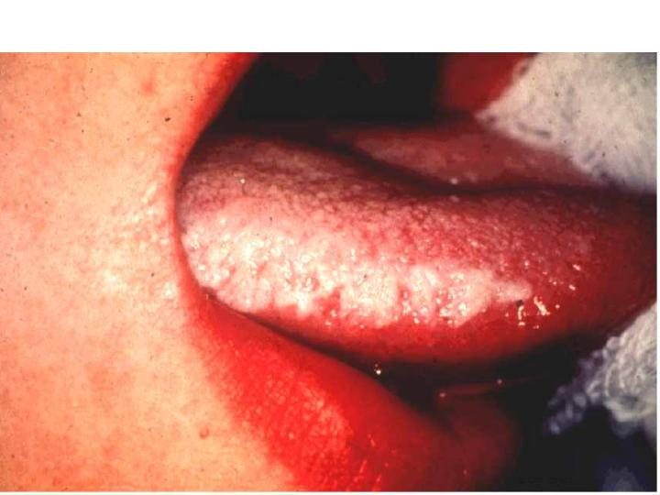
Oral hairy leukoplakia

Slide 110
Musculoskeletal manifestations
Myalgia/arthralgia
Rheumatologic manifestations incl. joint inflammation
Musculoskeletal pain syndrome / HIV wasting syndrome
Delayed healing

Slide 111
HIV-associated neoplasia
HHV-8: Kaposi‘s sarcoma
EBV: non-Hodgkin‘s malignant lymphoma, primary brain ML
HPV: agressive anal, cervical squamous cell carcinoma
general increased risk of malignancy

Slide 112
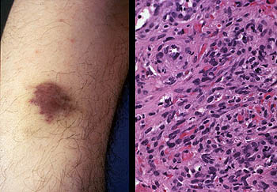
Kaposi sarcoma
copy

Slide 113
HIV lymphoma
Solitary lump or nodule, swelling, nonhealing ulcer
The swelling may be ulcerated or may be covered with intact, normal-appearing mucosa.
Usually painful, rapid growth.
Common association with EBV
Several histopathologic types, atypical localization

Slide 114
Human papilloma viruses
Human papilloma virus lesions appear most commonly in immunocompromised individuals.
Diagnosis based on history, clinical appearance, and biopsy.
Common in early HIV infection.
Spiky warts, raised, cauliflower-like appearance.

Slide 115
Noninfectious HIV-related comorbidities:
The premature aging process in HIV-infected people
2x ↑ risk of myocardial infarction
↑ risk of osteoporosis incl. fractures (even in adolescents!)
↑ risk of chronic renal failure
Non-AIDS tumors

Slide 116
HAART complications
Diarrhea, nausea , and vomiting.
Lipodystrophy: fat in adipous tissue redistributed to other regions, i.e.face and limbs → thin, breasts, stomach and/or neck enlarge.
Glucose intolerance, diabetes. Lactic acidosis.
Liver toxicity – acute hepatitis incl. liver failure. Pancreatitis.
Nephrotoxicity
Neuropathy
Osteonecrosis, osteoporosis, osteopenia

Slide 117
Special implications
Protect yourself (client unaware of HIV+, untrue report of HIV status)
Help the diagnosis (encourage HIV test in unclear clinical signs)
Special support according to the problems (wasting, osteoporosis, …)

Slide 118
Pathology of Infectious Diseases

Slide 119
Categories
Saprophytes: nonpathogenic; in dead organic matter
Parasites: living in or on an host on his the expense
– Commensals: normal inhabitants of skin and mucosa;
– Pathogenic microorganisms: Classic disease-causing pathogens
– Opportunists or facultatively pathogenic microorganisms:
in immunocompromised individuals in an “opportune” situation; frequently from the normal flora, may be from the surrounding environment or other germ carriers
Pathogenicity: capacity of a pathogen species to cause disease
Virulence: sum of the disease-causing properties of a strain
of a pathogenic species

Slide 120
RESIDENT FLORA
NO disease under normal conditions
Includes bacteria, fungi, protozoa, viruses and arthropods (mites)
Most areas of the body in contact with the outside environment harbor resident microbes; large intestine has the highest numbers of bacteria
Internal organs, tissues, fluids microbe-free
Bacterial flora benefit host by preventing overgrowth of harmful microbes

Slide 121
OPPORTUNISTIC FLORA
Potentially pathogenic organisms that do not cause disease in their normal habitat in a healthy person
Organisms that gain access into the tissue through broken skin or mucous membranes
Host already weakened or compromised by infection.

Slide 122
Host involvement
Endogenous infection from the colonizing flora
Exogenous infection from invasion of host by microorganisms from external sources
Nosocomial infection acquired during hospitalization (urinary tract infections, infections of the respiratory organs, wound infection, sepsis)

Slide 123
Host involvement
Superinfection: occurrence of a second infection in the course of a first infection
Relapses: series of infections by the same pathogen
Reinfection: series of infections by different pathogens
Subclinical disease: No noticeable signs or symptoms (inapparent infection)

Slide 124
Host involvement
Local infection restricted to the portal of entry and surrounding area
Generalized (systemic) infection Lymphogenous and/or haematogenous spread of pathogen from the portal of entry; organotropism; three stages: incubation, generalization, organ manifestation

Slide 125
Systemic infection
example: immunocompromised host, mycotic infection, portal of entry – lung, skin
generalisation - haematogenous
organotropism – brain abscesses
lung abscesses
superinfection by bacteria

Slide 126
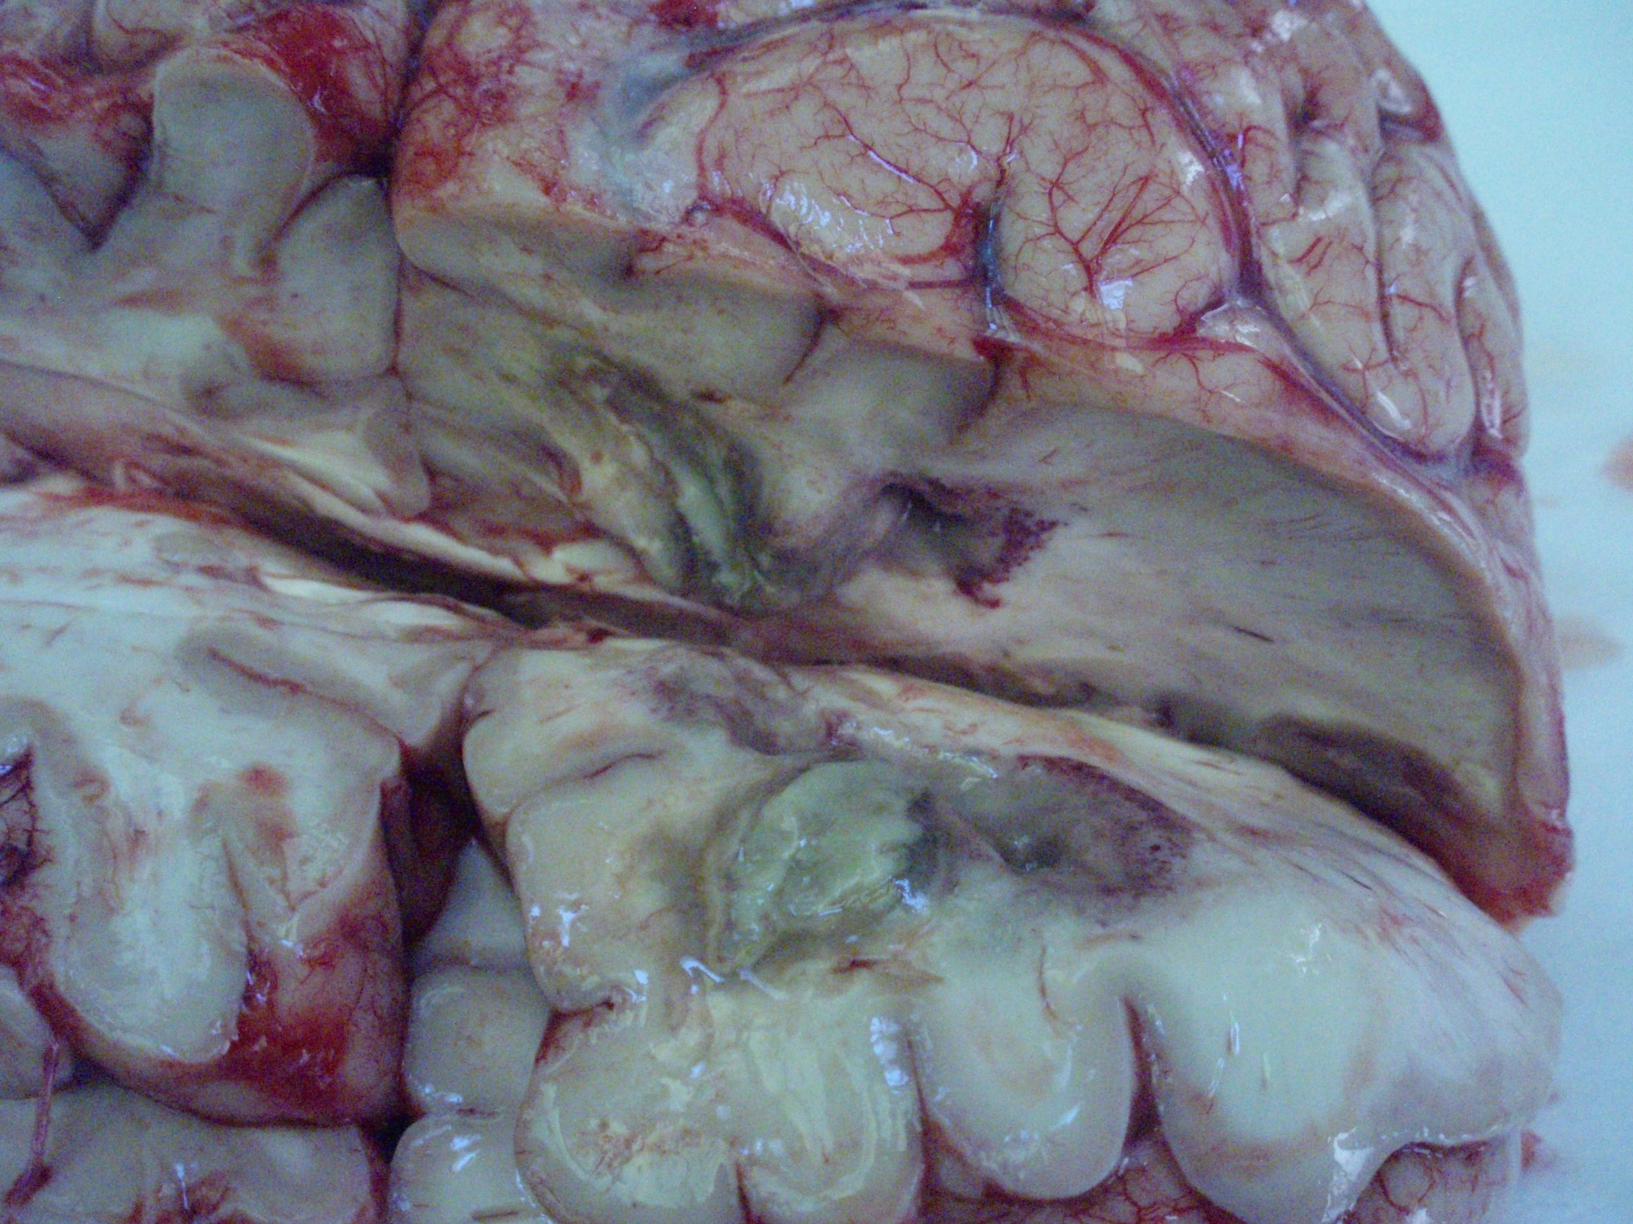

Slide 127
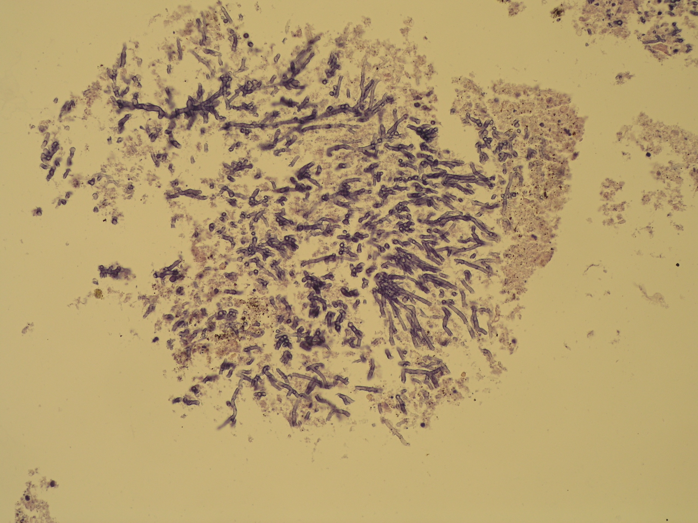
TRUE PATHOGENS
capable of causing disease in healthy persons with normal immune defenses (i.e. influenza virus, plague bacillus, malarial protozoan, …)

Slide 128
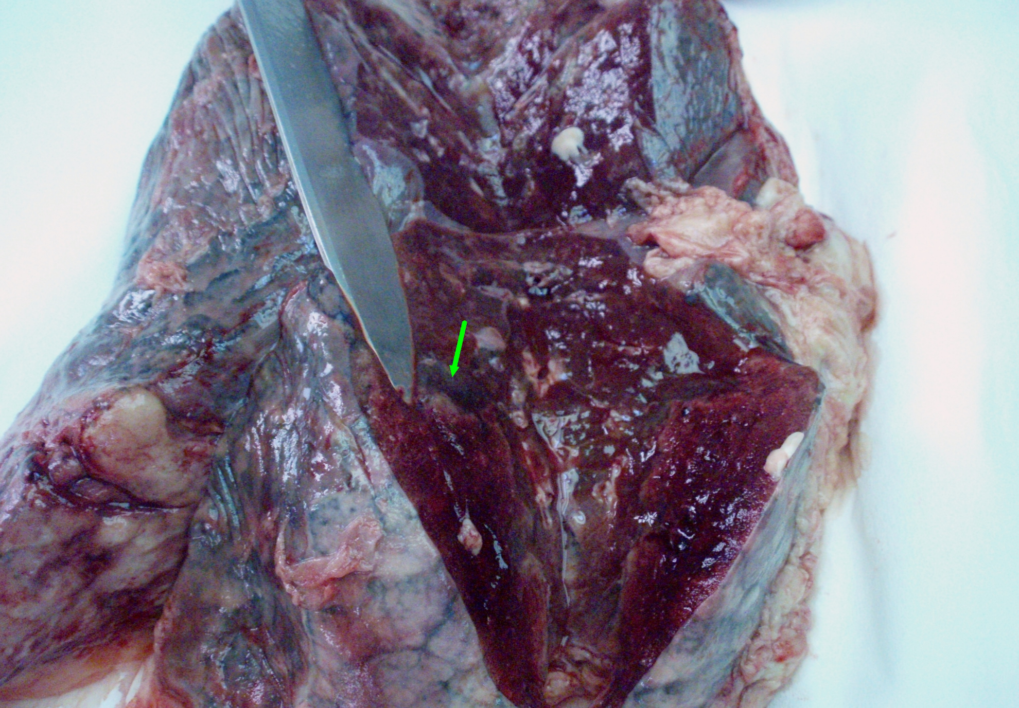

Slide 129
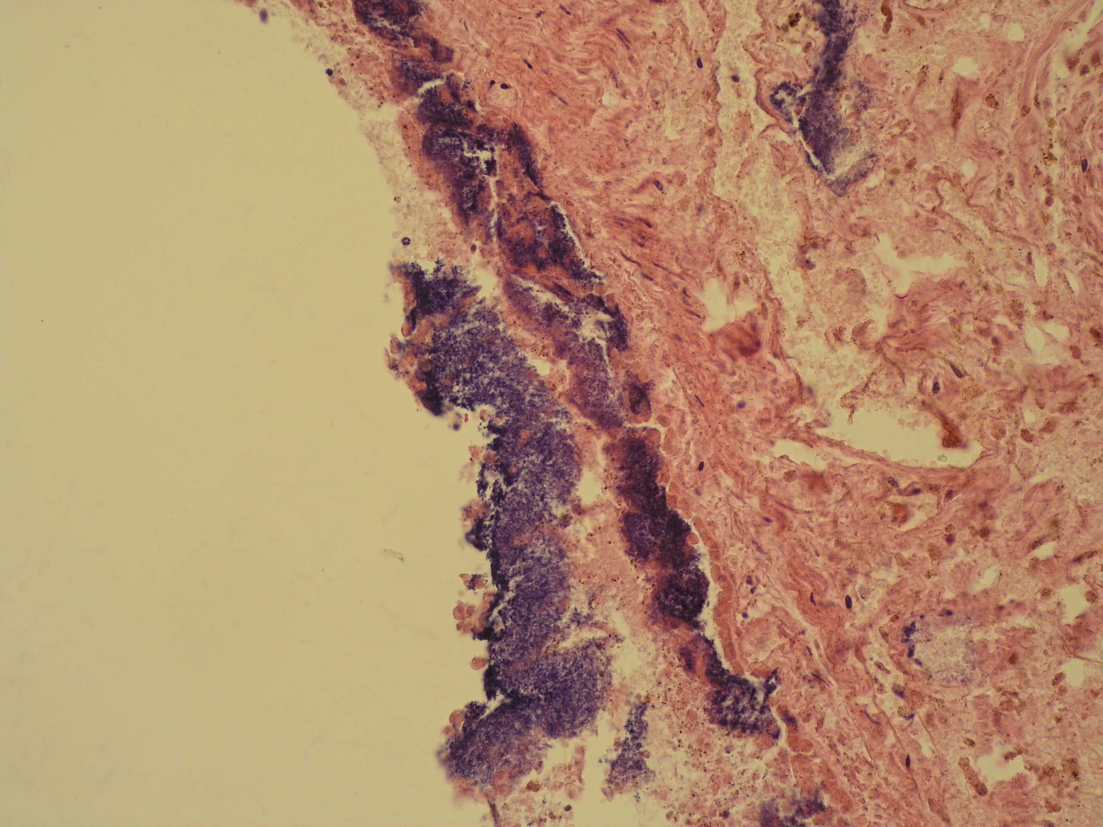

Slide 130
Host involvement
Sepsis Systemic disease by microorganisms and/or their toxic products; often a localized focus of infection from which pathogens or toxic products enter the bloodstream continuously or in intermittent phases, → shock
Septicemia Growth of (pathogenic) bacteria in the blood
Pyemia Bacteria in blood in aggregates (microemboli) + toxemia, → pyemic abscess, septic infarction
Transitory bacteremia/viremia/parasitemia Brief presence of microorganisms in the bloodstream

Slide 131
Epidemic process and epidemic factors of infectious disease
Source of infection (basic conditions)
Patients (acute, chronic), covert infection, carrier, infected animal
Route of transmission
Contact transmission (direct and indirect), blood-borne, soil- borne, food + water-borne, air-borne, insects, …
Susceptibility of population
Factors of influencing epidemic process
nature factors, social factors

Slide 132
Reservoirs of infection
Continual sources of infection
  Human: AIDS, gonorrhea
    Carriers may have inapparent (subclinical) infections
    or latent diseases
  Animal: Rabies, Lyme disease
    Some zoonoses may be transmitted to humans (COVID-19, zika, SARS, …)
  Nonliving: Botulism, tetanus
    Soil

Slide 133
CONTACT TRANSMISSION
DIRECT CONTACT - reservoir to host
INDIRECT CONTACT - reservoir to vehicle to host.
  Vehicle – inanimate material, food, water, drugs, biological products, …
DROPLET - reservoir to air (short distance) to host
Airborne transmission - spread of agents by droplet nuclei or dust at a distance of more than 1 meter from the reservoir to host
VECTOR

Slide 134
Host factors in pathogen transmission
Age (old age, extreme youth – prematurity, infancy)
Immune status (inborn and/or acquired defects, incl. immunosuppressive therapy, stress, etc.)
Concurrent illness or infirmity
Genetic background
Pregnancy
Nutritional status
Demographics of the exposed population (density, etc.)
Social and behavioral traits

Slide 135
Sensitive populations – increased infectious disease risks
Infants and young children
Elderly
Immunocompromized
  Persons with AIDS
  Cancer patients
  Transplant patients
Pregnant
Malnourished

Slide 136
Outcomes of infection process
Exposure
Infection
Asymptomatic infection
Advanced illness, chronic infections and sequelae
Disease
Acute symptomatic illness:
severity and debilitation
Sensitive populations
Mortality
Hospitalization

Slide 137
INFECTIOUS DISEASES
SYMPTOMS - subjective evidence of disease as sensed by the patient.
SIGNS - objective evidence of disease as noted by an observer.
SYNDROMES - a specific group of symptoms or signs which accompany a particular disease.

Slide 138
Common signs and symptoms
Signs Symptoms
Fever Chills
Septicemia Fatigue, soreness
Skin eruptions Itching
Chest sounds Dyspnoea

Slide 139
Portals of entry
Skin
Gastrointestinal tract
Respiratory
Urogenital
Via placenta
Parenteral (injection, bite)

Slide 140
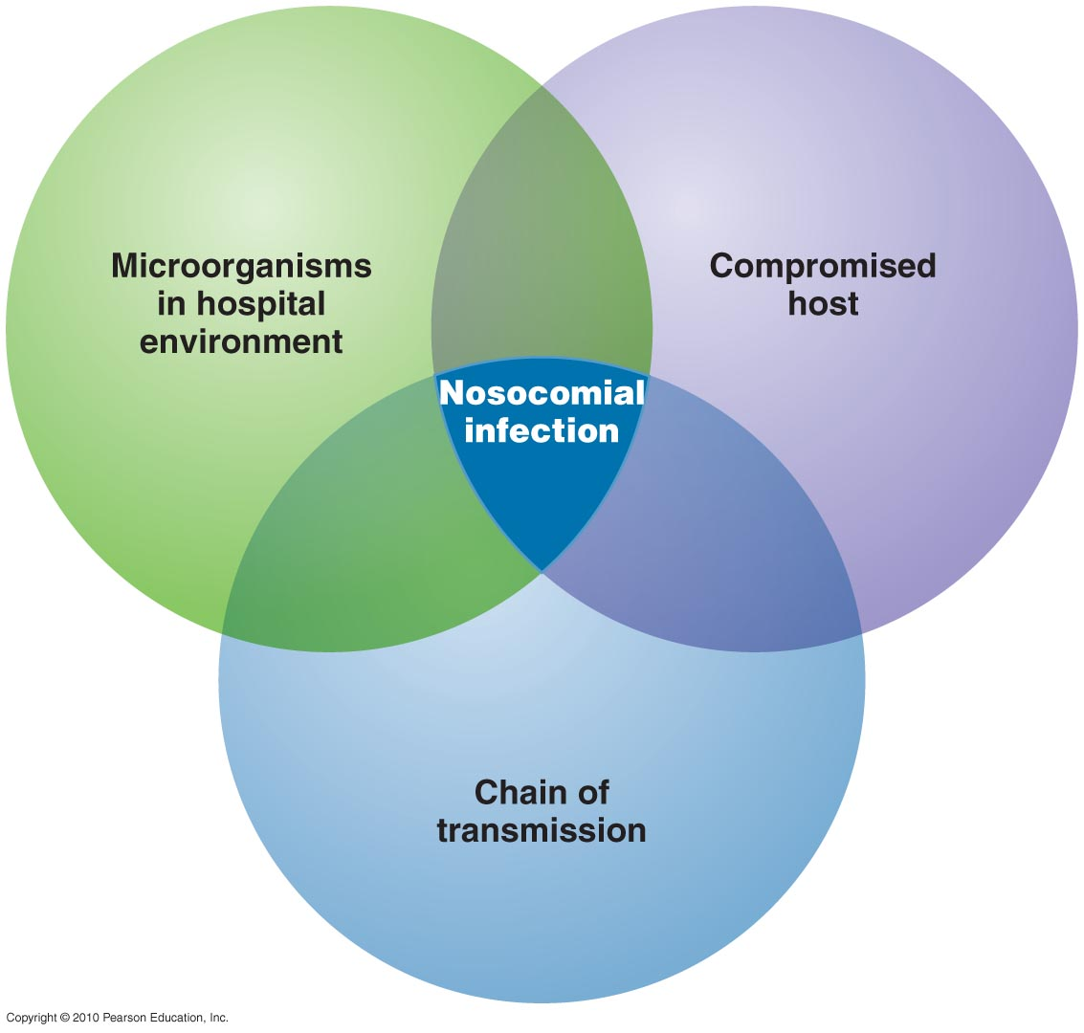
Nosocomial infections – health care-associated infections

Slide 141
Nosocomial infections
~ 10% of patients/clients acquire a clinically significant nosocomial infection
10-30% in developing countries

Slide 142
Nosocomial infections consequences
Additional morbidity/mortality
Prolonged hospitalisation
Permanent damage possible
Increased cost

Slide 143
Nosocomial infections
Colonies of hospital bacterial strains develop on patient‘s skin, in respiratory and genitourinary tract within hours after admission
Risk factors: patient related
iatrogenic
organisational

Slide 144
Iatrogenic risk factors
Medical personnel hands as source
Invasive procedures
Antibiotics use + prophylaxis

Slide 145
Clinical implications
Preventing of infection
Control of transmission (airborne + droplet precaution, contact – hand hygiene, blood)
Work restrictions for personnel with some infectious diseases

Slide 146
Emerging infectious diseases
Diseases that are new, increasing in incidence, or showing a potential to increase in the near future (COVID-19, zika virus, Ebola)
Newly recognised infectious causes of known diseases (Coronaviruses, Borrelia; hepatitis viruses – HEV; etc.)
Opportunistic infections in immunocompromised patients (Mycobacterium-avium complex, Pneumocystis, HHV-8)

Slide 147
Emerging infectious diseases
Geographic spread of known infections (West Nile virus, Plasmodium falciparum - malaria)
Local spread – environmental changes (bats – rabies, COVID-19?; ticks – encephalitis, Lyme borreliosis; mosquitoes – dengue, zika)
Crossing of interspecies barrier (coronaviruses, Ebola, BSE- bovine spongiform encephalopathy)
Re-emerging infections, new strains event. resistant (TBC, Vibrio cholerae, influenza H5N1,H1N1)

Slide 148
Respiratory tract infections
Viral
Rhinoviruses, Influenza,
Bacterial
Str. pneumoniae, Haemophilus infl., Chlamydia, TB,
Fungal
Histoplasmosis, Coccidioimycosis, Pneumocystis

Slide 149
Lower respiratory tract
Pneumonia – lobar (pneumococcus, Klebsiella); bronchopneumonia (variable pyogenic bacteria)
atypical (interstitial): viral – influenza, herpetic viruses,
small bacteria (Mycoplasma, Legionella, Chlamydia)
fungal – Aspergillus, Pneumocystis, Cryptococcus, Candida,
granulomatous: TB, MAC, Histoplasma

Slide 150
Influenza
Acute respiratory illness caused by influenza viruses.
Typical symptoms-fever, chills, myalgia, headache, sore throat, cough.
Serious cases in young children and elderly.

Slide 151
Influenza manifestations
Incubation period: 1-3 days
Typical influenza
abrupt onset of systemic symptoms.
Headache, fever, chills, myalgia, or malaise,
respiratory tract signs, particularly cough and sore throat.
Ocular signs and symptoms include pain on motion of the eyes, photophobia, and burning of the eye.

Slide 152
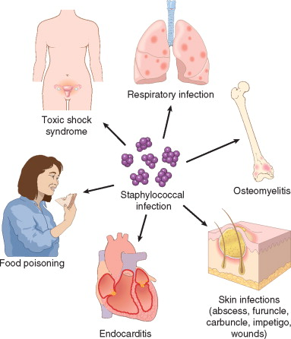
Staphylococci
Copy

Slide 153
Staphylococci
Destructive pyogenic inflammation
Abscess, furuncle, impetigo
Carbuncle: deeper suppurative infection spreading laterally beneath the deep subcutaneous fascia
Hidradenitis: chronic suppurative infection of apocrine glands, most often in the axilla.

Slide 154
Impetigo
Copy

Slide 155
Streptococci
Suppurative infections of the skin, oropharynx, lungs, heart valves.
Post-infectious syndromes, incl. rheumatic fever, immune complex glomerulonephritis, erythema nodosum

Slide 156
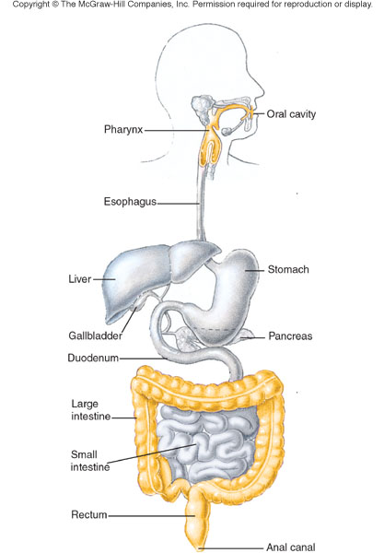
GIT infections
Copy

Slide 157
GIT infections
mostly by contaminated food or water
↓ local host defences (↓ gastric acidity, ↓ enzymatic and mucus secretion, loss of local defensins and IgA, loss of normal flora, obstruction)
general immunodeficiency (→ fungal, CMV, MAC infection)
resistant microorganisms (hepatitis A virus, rotavirus, H. pylori, protozoan cysts,…)

Slide 158
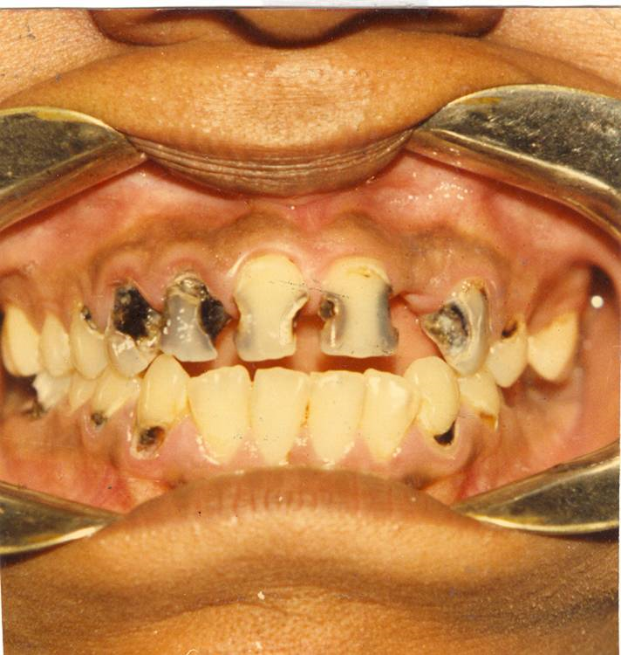
Dental caries
158

Slide 159
Dental caries
Multifactorial dynamic process
Involves the interaction of inborn or acquired host factors (tooth surface, saliva, acquired pellicle), diet (sugars), dental plaque (biofilm) – oral infection.
Caries does not occur in the absence of either plaque or dietary fermentable carbohydrates.

Slide 160
Tonsillitis and pharyngitis
bacterial (Streptococcus – 25%, Staphylococcus, dipthteria…)
viral (EBV, influenza, adenoviruses, …)
Clinical – sore throat, dysphagia, red + swollen tonsils + focal/confluent yellowish exudate, cervical lymhadenopathy, fever, malaise, …
In viral + rhinitis, laryngitis

Slide 161
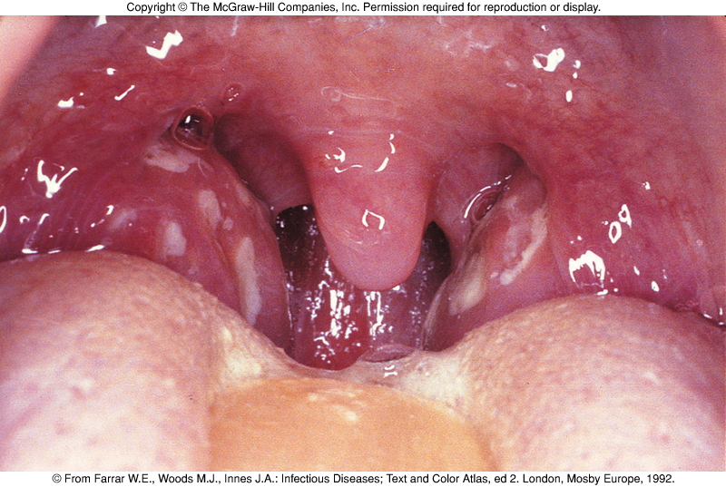
Tonsillitis

Slide 162
Intestinal infections
Enterocolitis – usual manifestation as diarrhea, may be pseudomembranous, ulcerative, non-purulent
worldwide more than 3 millions deaths annually, mainly children ≤ 5 yrs
chronic or recurrent enterocolitis – parasites, protozoa

Slide 163
Infectious hepatitis
Viral hepatitis – part of systemic disease (EBV, CMV, yellow fever, rarely rubella, herpesvirus, etc.
Viral hepatitis – liver specific (hepatitis viruses HAV, HBV, HCV, HDV, HEV, …)
Bacterial – abscess, chronic inflammation
Parasitic – abscesses, cysts - Entamoeba, Echinococcus;
malaria, schistosomiasis, cryptosporidiosis, etc.
Fungal

Slide 164
Urogenital tract infections
Ascending infection via urethra most usual (G- fecal bacteria – E. coli, Proteus,…)
Anatomy – urethra 5 cm lenght in women, 20 cm in men
Predisposing factors – obstruction, reflux, loss of protective vaginal flora, mucosal microtraumata

Slide 165
Sexually Transmitted Infections
Sexually Transmitted Disease - STD
Infection transmitted through vaginal, anal or oral sex
Every sexually active individual is at risk
Women acquire infections from men more than men from women
2/3 of STD occur in people under 25 yrs of age
Infection by multiple agents common (↑ risk)
Fetus or infants – vertical transplacental or perinatal transmission of STD → abortus, inborn defects, neonatal infection. Diagnosis + treatment!!

Slide 166
STI
Viruses: HSV, HPV, HIV, hepatitis B,C
Chlamydiae: Ch. trachomatis
Mycoplasmas: U. urealyticum
Bacteria: Neisseria gonorrhoeae (clap), Treponema pallidum (syphilis), Haemophilus ducreyi (chancroid), Klebsiella granulomatis (granuloma inguinale)
Protozoa: Trichomonas vaginalis (urethritis, balanitis, vaginitis)

Slide 167
Genital Warts
Condyloma acuminatum - HPV
Most HPV infections asymptomatic or unrecognized
Mostly found in young, sexually active; associated with early onset of sexual activity, multiple sexual partners
Transmitted by all types of sexual contact

Slide 168
Chlamydia: Manifestations
In women often asymptomatic until uterus and tubes infected; may present with dysuria, urinary frequency, vaginal discharge
1/3 of men may be asymptomatic; dysuria, urethral discharge, testicular pain
Patient infectious even if asymptomatic

Slide 169
Chlamydia: Complications
May result in PID (pelvic inflammatory disease)
Major cause of infertility, ectopic pregnancy in women; may cause stillbirth or spontaneous abortion (miscarriage)
In men, may result in epididymitis, prostatitis, sterility, Reiter’s syndrome
In neonates, may cause blindness, pneumonia

Slide 170
Gonorrhea
‘clap’; one of the most common STDs (second only to Chlamydia)
Caused by Neisseria gonorrhoeae; incubation period is 2-8 days
Transmitted by sexual contact, during passage through the birth canal
Usually targets the cervix, male urethra

Slide 171
Gonorrhea
Female: mostly asymptomatic until advanced disease; dysuria, urinary frequency or abnormal vaginal discharge
Male: dysuria, serous, milky or purulent urethral discharge; regional lymphadenopathy
Complications: prostatitis, epididymitis, sterility;
PID, endometritis, salpingitis, peritonitis;
in neonates gonorrhea can infect the eyes, nose or anorectal region

Slide 172
Syphilis
Spirochete Treponema pallidum
Transmitted from open lesions during sexual contact
Organism can survive days in fluids
May also be transmitted by infected blood, body fluids, including saliva
Average incubation is 20-30 days
Spreads through blood, lymphatic system
Congenital syphilis - transplacental

Slide 173
Syphilis: Primary stage
Chancre: painless ulcer in the site of innoculation; regional lymphadenopathy
chancre appears 3-4 weeks after infectious contact, disappears within 4-6 weeks
Chancre may go unnoticed in women
Highly infectious during primary stage even if no symptoms are present

Slide 174
Syphilis: Secondary stage
Symptoms of secondary syphilis appear any time from 2 weeks to 6 months after initial chancre disappears, in 75% of untreated people
Primary generalisation, flu-like symptoms, sore throat; generalized lymphadenopathy
Skin rash (especially on palms of hands and soles of feet) maculopapular, pustular;
condylomata lata - mucus patches + erosions in oral cavity; flat, broad-based wart-like papules on labia, anus or corner of mouth, highly infectious; secondary alopecia
Disappear within 2-6 weeks

Slide 175
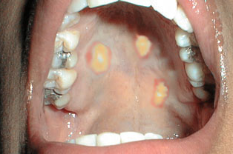
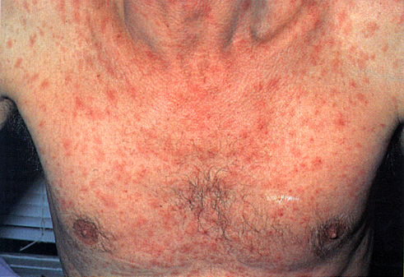
Syphilis - secondary
Syphilitic rash
Condylomata lata

Slide 176
Skin infections
The dense, keratinized outer layer of skin - natural barrier to infection. Low pH of the skin (5.5) and the presence of fatty acids inhibit growth of microorganisms other than residents of the normal flora.
Potential opportunists, such as S. epidermidis and Candida albicans.
Few microorganisms able to traverse the unbroken skin
Most microorganisms penetrate through breaks in the skin

Slide 177
Skin infections
Viral exanthematic inflammations – HSV, varicella-zoster, etc.
Viral pseudotumorous lesions – warts (HPV), molluscum contagiosum (poxvirus)
Bacterial infections – superficial (impetigo – Stph. aureus, blisters + neutrophils), deep (panniculitis, phlegmona)
Fungal inf. – superficial (Tinea – dermatophytes)
Parasitic inf. – scabies etc.

Slide 178
Fungal infections
Superficial infections by dermatophytes : skin, hair, nails.
The term “tinea” + the area of the body affected (e.g., tinea pedis, “athlete's foot”; tinea capitis, “ringworm of the scalp”).
Certain fungal species invade the subcutaneous tissue, causing abscesses or granulomas (e.g., sporotrichosis and tropical mycoses).

Slide 179
Common childhood viral infections
Measles (rubeola, red measles)
Rubella (German measles)
Erythema infectiosum (Fifth disease)
Mumps
Varicella-Zoster (Chickenpox)
Coxsackievirus and Echovirus associated infections (hand-foot-and-mouth disease)

Slide 180
CNS infections
Meningitis
acute pyogenic (bacterial)
aseptic (acute viral)
chronic (+ encephalitis; tbc, borrelia,
T. pallidum, cryptococcus)
Brain abscess (bacterial, Naegleria)
Viral encephalitis (+ meningitis) acute (arboviruses, herpetic, CMV, poliomyelitis, rabies, HIV), persistent (progressive multifocal leukoencephalopathy – JC virus, subacute sclerosing panencephalitis – measles)
Fungal (cryptococcus etc.), parasitic (Toxoplasma)

Slide 181
CJD (Creuzfeldt-Jakob disease)
presents in adults as rapidly progressive dementia often with focal signs – always fatal
sporadic disorder in 1:1 000 000 per year worldwide
transmissible to primates by modified host protein, prion protein
human-human transmission recorded from electrode implantation, grafts and human growth hormone
cortical atrophy, neuron loss and reactive proliferation of astrocytes, but no inflammation
numerous small vacuoles present in neuron and glial processes, so known as spongiform encephalopathy
akin to kuru in New Guinea

