Slide 1

TRAUMATOLOGY
Ladislav Plánka
&
KDCHOT

Slide 2

What is traumatology
„Science of injuries and following states which are conected to the injuries“
But what we need?
Skeletal surgery – traumatology, orthopedics
Abdominal surgery (urology, gynecology)
Thoracic surgery
Neurosurgery
ENT
Ophtalmology
Resuscitation care
Intensive care
Rehabilitation care

Slide 3
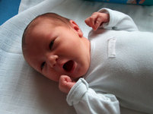
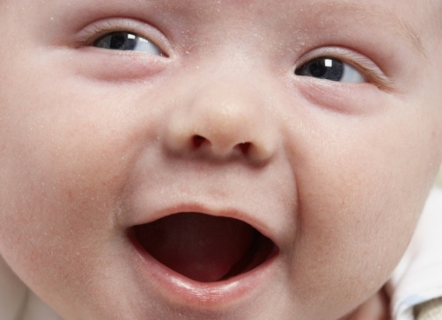
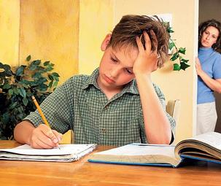

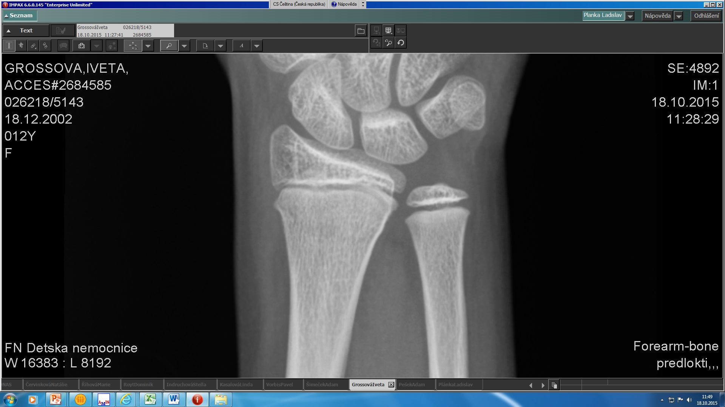
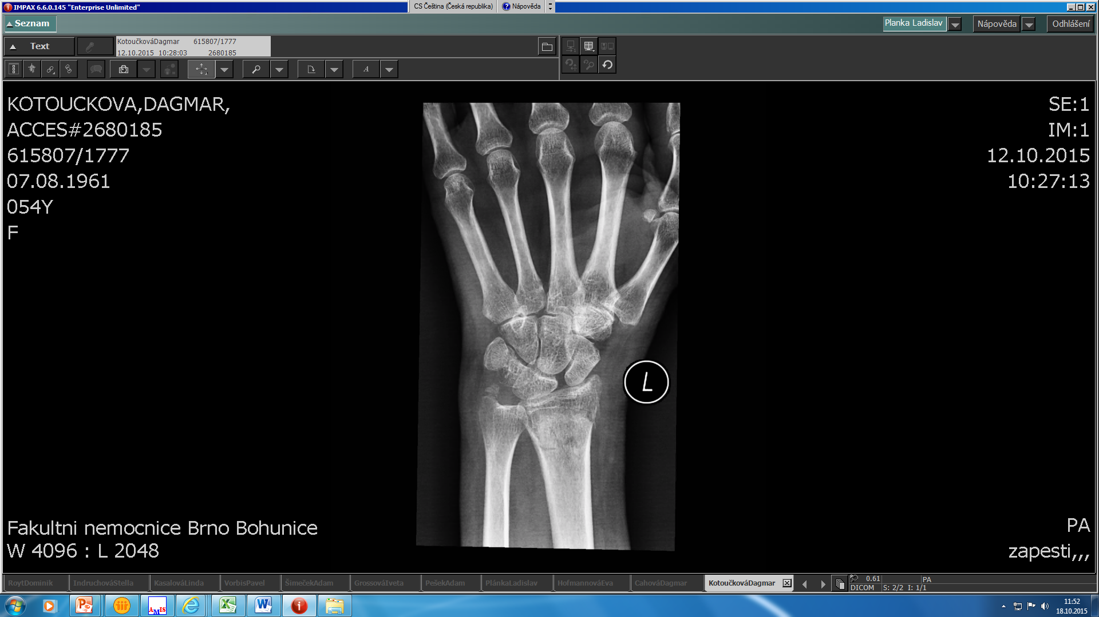
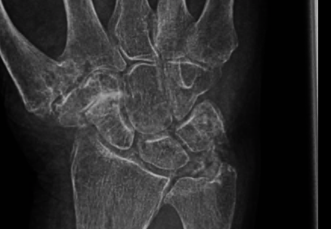
An adult or a child??
Administrative border divides both of the groups in their 19th birthday. Everyone is a child until their 18th + 364 days.
Biological border respects rather stadium of the development and growth.

Slide 4
Epidemiology of injuries
The most frequent reason of the doctor appoitment and hospitalization up to the age of 25
The most frequent cause of death up to the age of 40
  Economical aspects of the injuries!!!!
Every third person in their life is hospitalized because of the injury
Each person experiences the skeleton fracture up to the age of 18

Slide 5
Epidemiology of injuries
 | 2017 | 2018 | 2019
Adults – hospitalized | 156 789 | 157 987 | 159 700
Children – hospitalized | 31 090 | 30 456 | 31 786
Adults – everyone | 2 456 789 | 2 435 678 | 2 501 434
Children - everyone | 492 789 | 501 123 | 500 879
 | 2015 | 2016 | 2017 | 2018 | 2019
Injuries in all | 31 866 | 30 214 | 30 200 | 29 423 | 30 706
Deaths | 168 (0,53 %) | 161 (0,53 %) | 133 (0,44 %) | 122 (0,41 %) | 112 (0,36 %)

Slide 6
Epidemiology of injuries
 | 2017 | 2018 | 2019
Adults – hospitalized | 156 789 | 157 987 | 159 700
Children – hospitalized | 31 090 | 30 456 | 31 786
Adults – everyone | 2 456 789 | 2 435 678 | 2 501 434
Children - everyone | 492 789 | 501 123 | 500 879
 | 2015 | 2016 | 2017 | 2018 | 2019
Injuries in all | 31 866 | 30 214 | 30 200 | 29 423 | 30 706
Deaths | 168 (0,53 %) | 161 (0,53 %) | 133 (0,44 %) | 122 (0,41 %) | 112 (0,36 %)

Slide 7
Injury division
Polytrauma – injury of multiple body systems from which at least one is life threatening
Multiple injury – injury of multiple body systems from which none of them is life threatening
Serious monotrauma – injury of one of the body system which is life threatening
Monotrauma – injury of one of the body system without life threatening

Slide 8
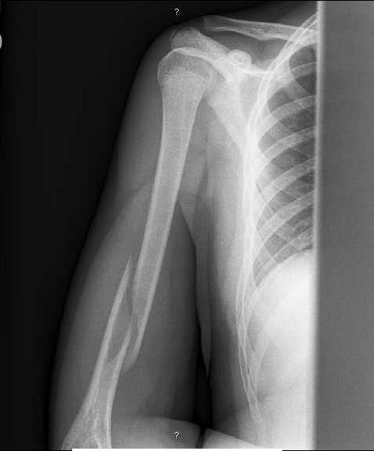
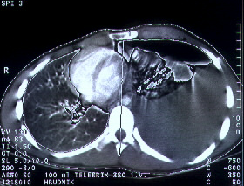
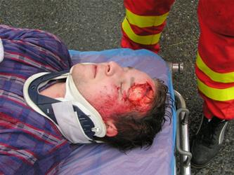
Polytrauma
Lung laceration, hemothorax (ventilation threatening)
Humerus fracture on the right side
Concussion, superficial wound of frontal area

Slide 9
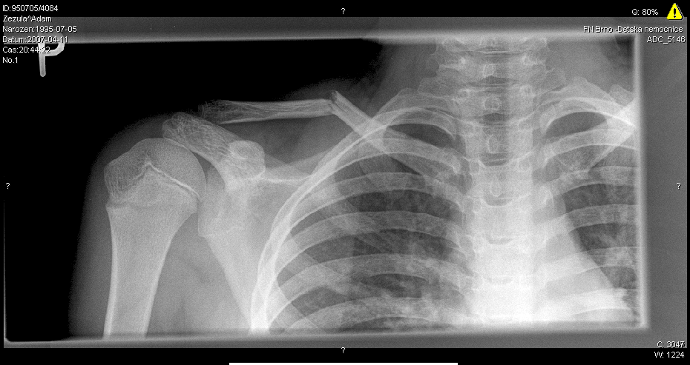
Monotrauma
Clavicle fracture

Slide 10
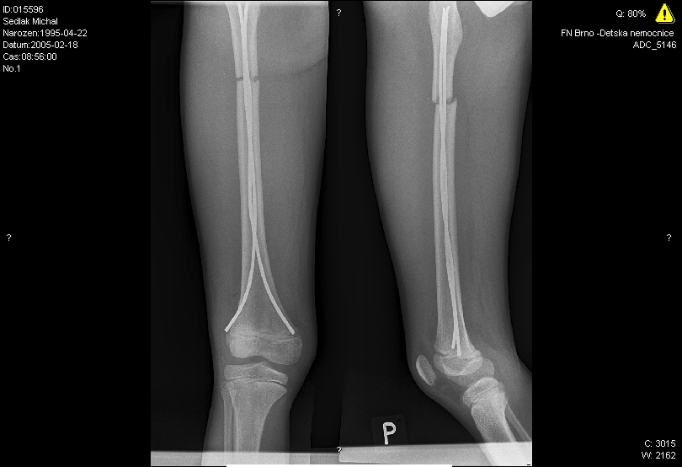
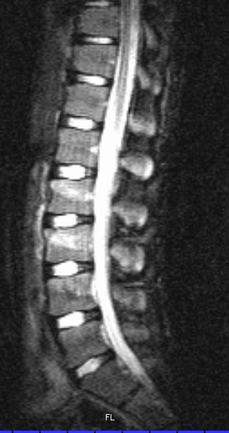
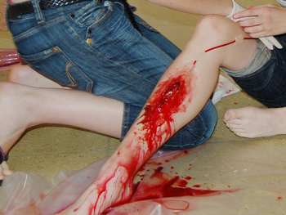
Multiple injury
Open shin wound with muscles injury
Compressionf racture of lumbal vertebrae
Femoral fracture

Slide 11
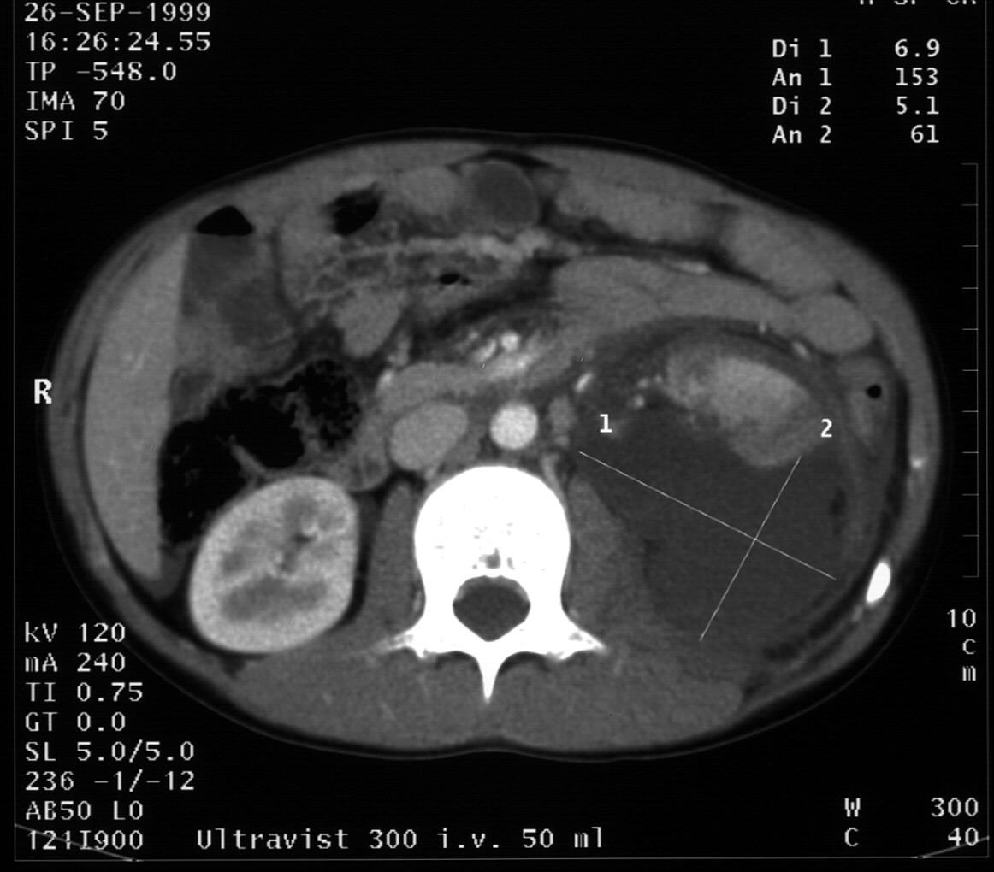
Serious monotrauma
Kidney rupture

Slide 12
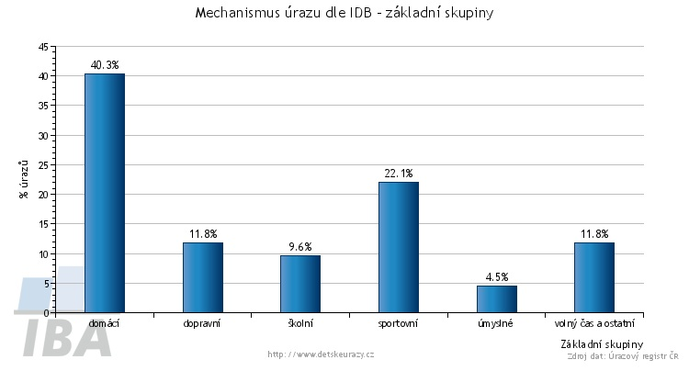
Etiology of injuries
All injuries
Mechanism of injuries according to IDB – basic groups
injuries
domestic transport school sport malicious
free time and the other
Basic groups

Slide 13
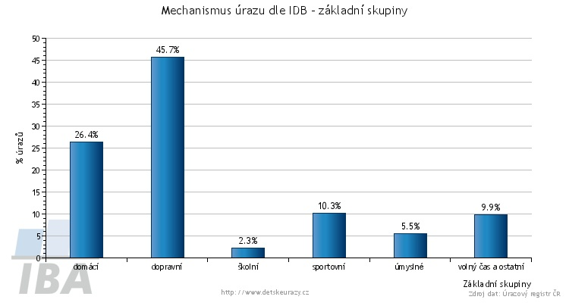
Etiology of injuries
Serious injuries
Mechanism of injuries according to IDB – basic groups
injuries
domestic transport school sport malicious
free time and the other
Basic groups

Slide 14
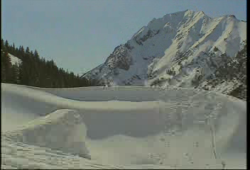

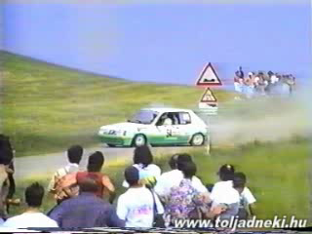
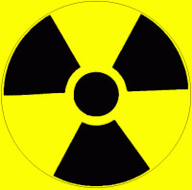

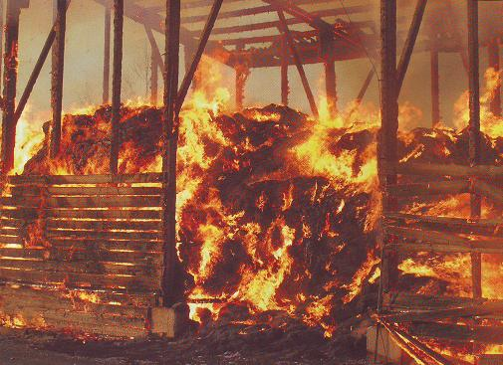


Etiology of injuries
2. Hitting and punching
1. Falls
3. Traffic accidents
4. Burn
5. Poisoning
6. Drowning …..

Slide 15
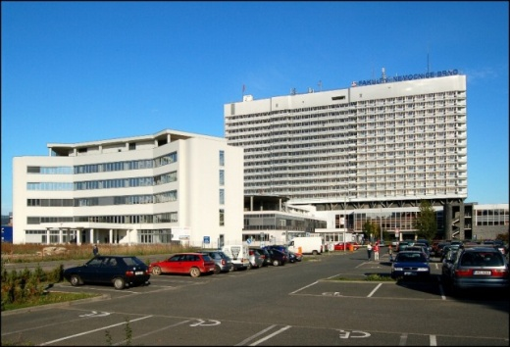
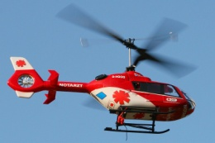
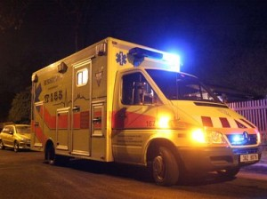
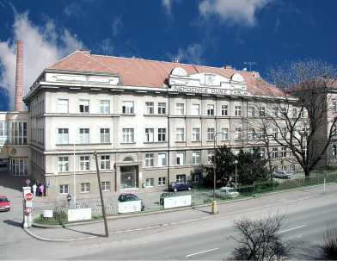
Trauma care system
Prehospital care
Selected score value
ISS
RTS (PTS)
GCS (MGCS)
Risk facts
Triage +
Triage -

Slide 16
Trauma care system
Prehospital care
Selected score value
ISS ≥ 16
RTS (PTS) ≤ 8
GCS (MGCS) ≤ 12
Risk facts
  Fall from height ≥ 6 m
  Hit by car in speed ≥ 35 km/h
  Run by vehicle
  Vehicle catapult
  Vehicle impaction
  Burn ≥ 12 %
  Penetrating neck, chest, abdomen, groin injury
  Waving chest
  Age < 5 let
  Comorbidity

Slide 17
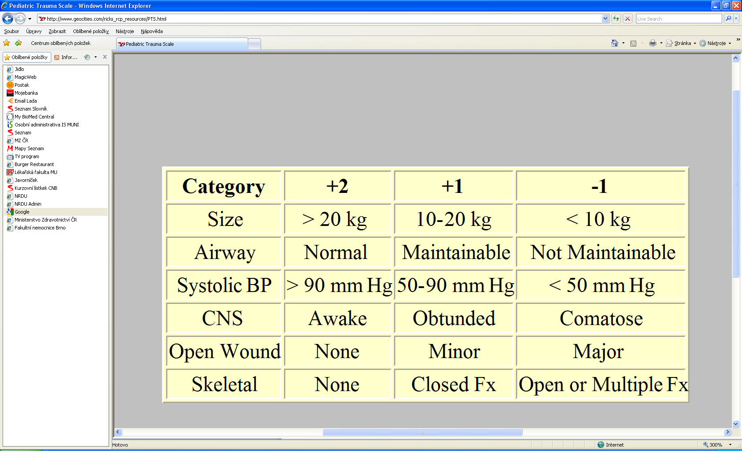
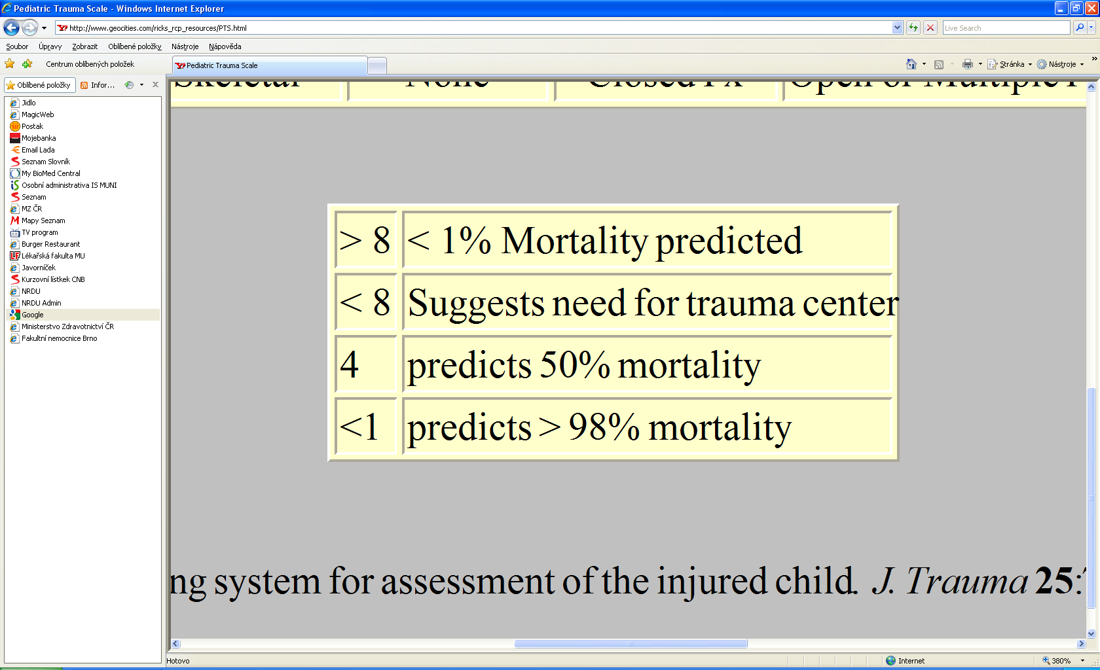
Trauma care system
Paediatric trauma score

Slide 18
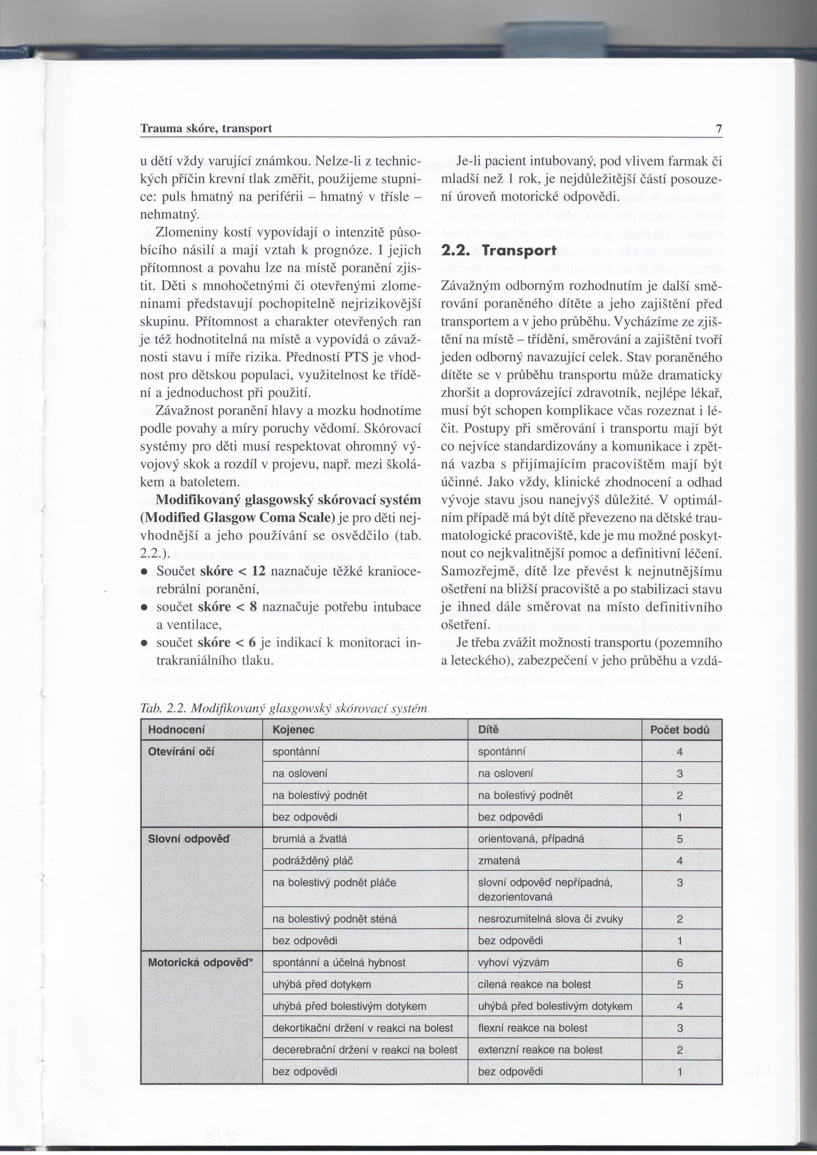
Trauma care system
Glasgow coma scale with infant modification
Assessment
Infant
Child
spontanious
spontanious
Eyes opening
on adressing
on adressing
on painful stimuli
on painful stimuli
without responding
without responding
gurgles and babbles
oriented, possible
Verbal response
cranky crying
confusing
cries on painful stimuli
verbal response impossible, disorientated
moans due to painful stimuli
difficult to understand words or sounds
without responding
without responding
spontanious and effective movement
comply with commands
Motor responce
dodges touch
targeted reaction on pain
dodges painful touch
dodges painful touch
flexion reaction on pain
posture decortication in reaction of pain
decerebrate posture in reaction of pain
extensive reaction on pain
without responding
without responding

Slide 19
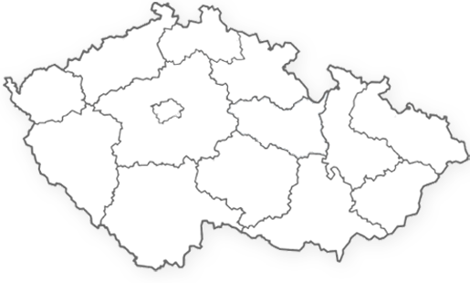
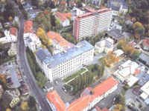
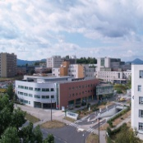

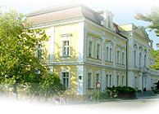
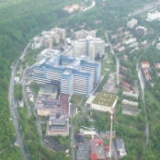
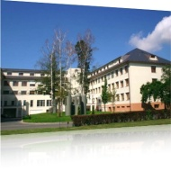
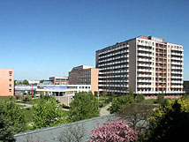

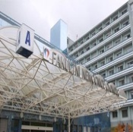
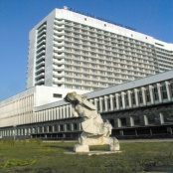
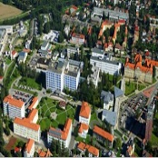
Trauma care system
Trauma centers for adults

Slide 20


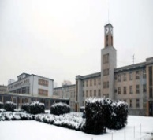



Trauma care system
Trauma centers for children

Slide 21
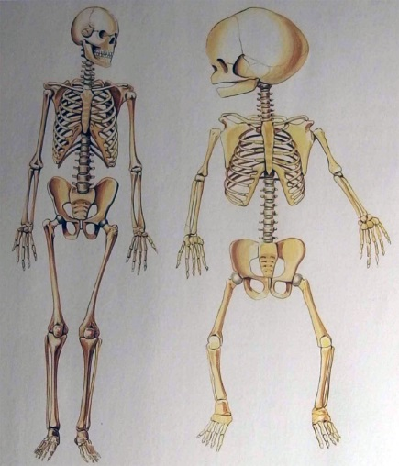


Traumatology
Injury
Soft tissues
Skeletal injury
Organs and organ system
Muscles, ligaments, joints
Skin, subcutaneous tissue
Flat skull bones
Spine injury
Limb skeleton
Normal
Great
Minimal
Low tendency
High
Very active
Short
Coagulation
Circulation reserves
Respiratory reserves
Post-op complication
Speed of healing
Bones remodeling
Rehabilitation
Modified by medicaments
Low due to comorbidity
Mostly great
High tendency
Lowering
Null
Long

Slide 22
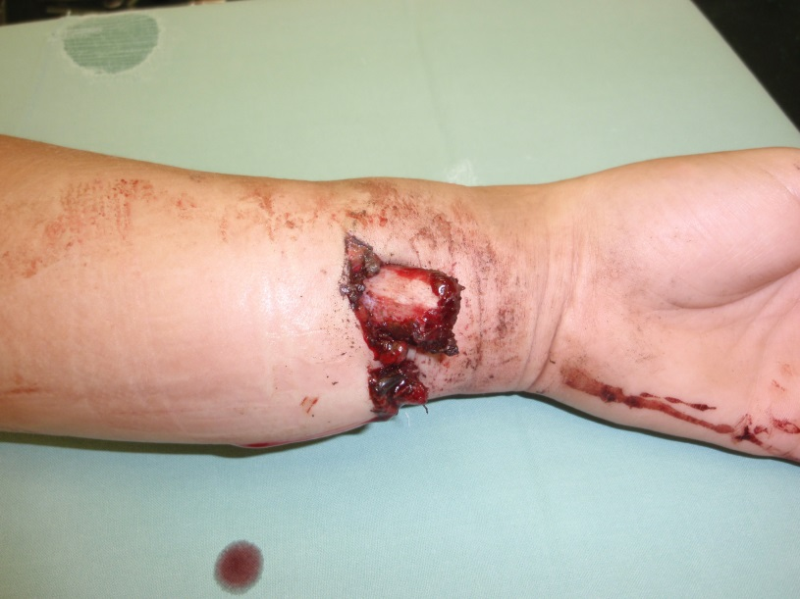
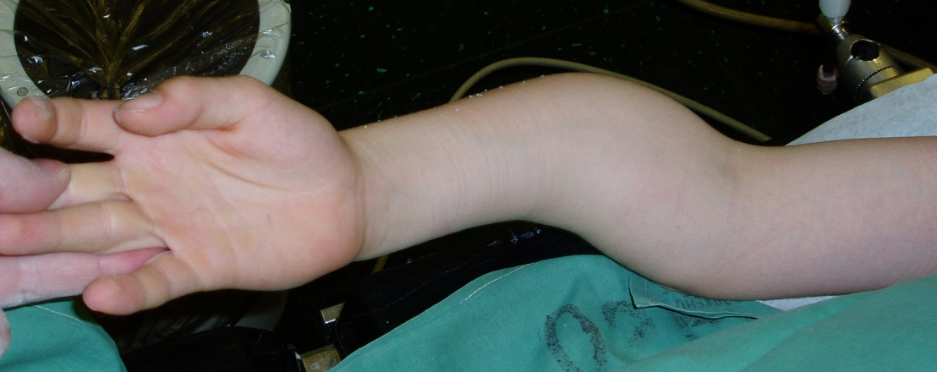
Skeletal injury
Diagnosis
Clear signs of fracture
  Shape change
  Crepitus
  Pathological movement
  Visible bone
Unclear signs of fracture
  Hematoma
  Swelling
  Pain
  Function suppressed

Slide 23
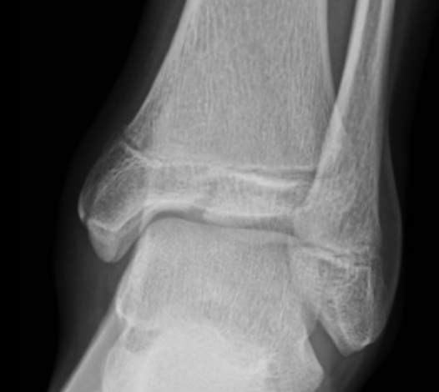
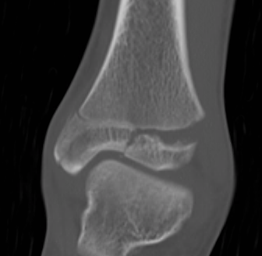
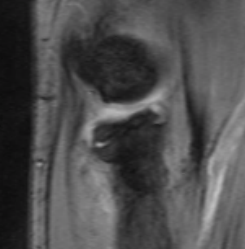
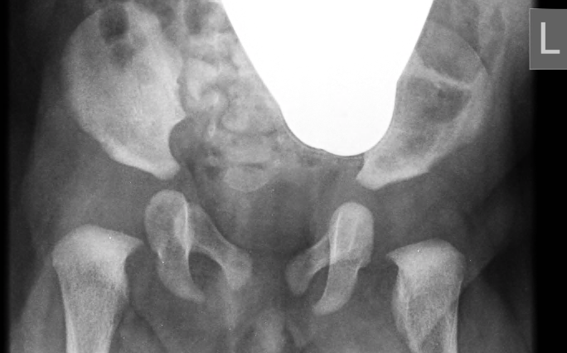
Skeletal injury
Diagnosis
RTG in two projections
US examinatioon
CT examination
Magnetic resonance imaging
RTG in two projections
CT examination

Slide 24
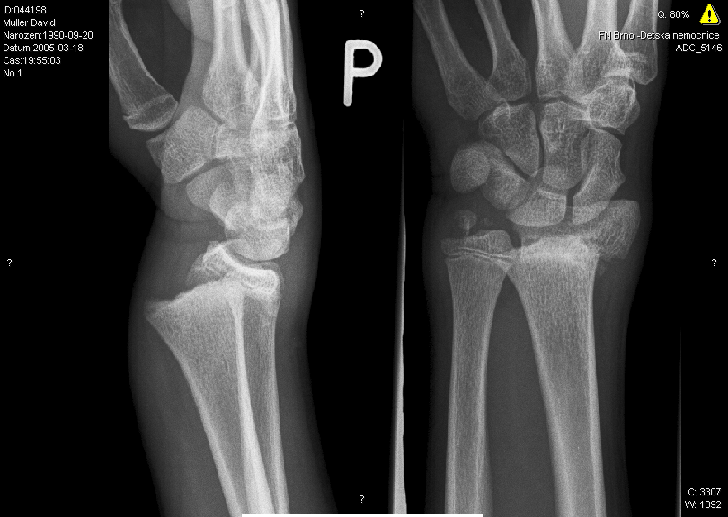
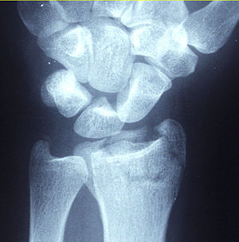
Skeletal injury
Diagnosis
Separation and fracture epiphysis
Epiphyseal injury
Intra-articular fractures

Slide 25
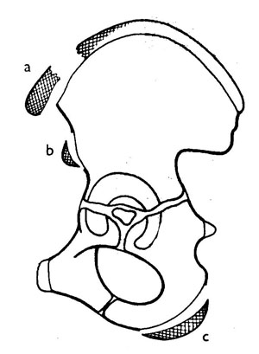
Skeletal injury
Diagnosis
Separation and fracture epiphysis
Avulsive fractures
Epiphyseal injury
Intra-articular fractures

Slide 26
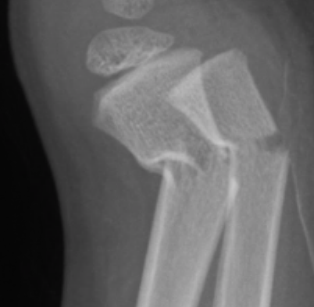
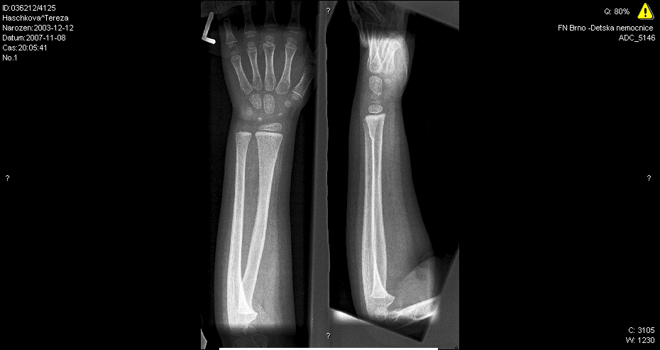


Skeletal injury
Diagnosis
Separation and fracture epiphysis
Avulsive fractures
Torus fractures
Greenstick fracture
Epiphyseal injury
Metaphyseal injury
Intra-articular fractures
Comminuted fractures
Complete fracture

Slide 27


Skeletal injury
Diagnosis
Separation and fracture epiphysis
Avulsive fractures
Torus fractures
Greenstick fracture
Fracture due to flexion
Epiphyseal injury
Metaphyseal injury
Diaphysial fractures
Intra-articular fractures
Comminuted fractures
Complete fracture
Complete fracture

Slide 28


Skeletal injury
Healthy bone
Bowing fracture
Torus fracture
Greenstick fracture
Complete fracture

Slide 29



Skeletal injury
Classification
Salter – Harris classification
Local specific classification
AO classification
Epiphyseal injury
Metaphyseal injury
Diaphysial fractures
AO classification
Local specific classification
AO classification
Local specific classification
AO classification
anatomical
cervix
surgical
neck
great
tuberosity
minor
tuberosity
2 splinters 3 splinters 4 splinters

Slide 30
Skeletal injury
Therapy
Frequently closed
Possible
Cast fixation is often enough
Miniinvasive, adaptive
Shorter
After healing
Kirschner wire
FFS
Kirschner wire
Tractional srew
Elastic nails
External fixator
Reposition
Dislocation left
Retention
Osteosynthesis
Length of healing
Rehabilitation
Epiphysis fractures
Metaphysis fractures
Diaphysis fractures
Open fractures
Frequently open
Necessary anatomical reposition
Osteosynthesis
Stabel
Long-term
Right after OS
Reconstructive splint
Tractional screws
Splint systems
Rigid nails
External fixator

Slide 31

Skeletal injury
Nursing intervention
Fixation
Soft bandage
Semirigid
Rigid
Braces
Reposition
Critical
Manipulation in callus
Plaster cast wedging
Traction
Cutaneous
Skeletal
Traction bandages
Temporary
Definitive

Slide 32


Skeletal injury
Nursing intervention
Operative
treatment
Nursing
intervention
MIO

Slide 33

Skeletal injury
Surgical care
Splint systems

Slide 34

Skeletal injury
Surgical care
Splint systems
Kirschner wire

Slide 35

Skeletal injury
Surgical care
Splint systems
Kirschner wire
FFS

Slide 36

Skeletal injury
Surgical care
Splint systems
Kirschner wire
FFS
Compresed screws

Slide 37


Skeletal injury
Surgical care
Splint systems
Kirschner wire
FFS
Compresed screws
Inter-medullary nail

Slide 38


Skeletal injury
Surgical care
Splint systems
Kirschner wire
FFS
Compresed screws
Inter-medullary nail
External fixation

Slide 39




Skeletal injury
Bone healing
Secondary healing by callus
Ability of remodeling
Quick course
Healing by first intention
Necessary anatomical reposition
Stable compressive osteosynthesis

Slide 40

Growth plates
A place which enable growth of the bone to the length
Peripheral parts of the bones
Histologically hyaline cartilage
The weakest place of the child long bones
Growth dysfunction occures due to its injuries
Question: How many cm shorter will be thigh bone after its complete destruction of its distal growth disc. We know that the heatlhy bone on the other side has grown up 20 cm since the injury and the thigh bone distal growth disc provides 70% of growing of the whole bone.
14 cm

Slide 41


Growth plate

Slide 42
Growth plate
A – Spare layer
    Germinal
    Protein synthesis
    Low division
B – Proliferative layer
    Layer of dividing cells
C – Hypertrophic layer
    Chondrocyte regression
    Sept calcification
    Line refraction spot
    Layer of dividing cells
D – Calcified layer

Slide 43
Fracture complication
Blood loss
Surrounding tissues injury
Compartment syndrome
Suppressed movement
Growth arrest due to GP damage
  Growth dysfunction
  Shape dysfunction
Avascular necrosis
False joint
  Atrophic
  Hypertrophic
Synostosis
Sudeck bone dystrophia
Critical
Late

Slide 44
Compartment syndrome
A state when the perfusion pressure is the same as the tissue one (!↓BP!)
In etiology mainly swelling, bleeding, solid bandage
Clinical and physical diagnostics (IFP measure)
Treatment is surgical
Ischemia
Capillary flow decrease
SWELLING
A-V gradient decrease

Slide 45

Compartment syndrome
Clinical symptoms
  Resting pain (progressive) even after immobilization
  More pain by passive finger strain
  Sensitivity deficiency (even as paresthesia)
  Functional failure (immoility)
  Up to stone hardness area
  Changes of child behaviour, growing disturbance
  Pain does not correspond to the injury
  Tugging is usually maintained!!!
Tissue pressure – over 30 Torr

Slide 46


Compartment syndrome
Fasciotomy of all compartments

Slide 47
Flesh wound
Nerve wound
  Neurapraxia – functional disorder, RHB
  Neurotmesis – severance of some fibres, RHB
  Axonotmesis – severance of nerves, necessary suture or replacement
Tendon wound
  Dislocation – reposition, immobilization
  Tear - immobilization
  Rupture (exceptionally at the healthy one, more likely avulsion), severance – suture, immobilization
Muscle wound
  Contusion – resting regimen
  Rupture – minor range conservatively, great suture
  Herniation – suture fascia
  Crush – syndrome!! – total treatment, dialysis

Slide 48

Fracture complication
Blood loss
Surrounding tissues injury
Compartment syndrome
Suppressed movement
Growth arrest due to GP damage
  Growth dysfunction
  Shape dysfunction (malunion)
Avascular necrosis
Non union
  Atrophic
  Hypertrophic
Synostosis
Sudeck bone dystrophia
Critical
Late

Slide 49

Fracture complication
Blood loss
Surrounding tissues injury
Compartment syndrome
Suppressed movement
Preterm extinction of physis
  Growth dysfunction
  Shape dysfunction
Avascular necrosis
Non union
  Atrophic
  Hypertrophic
Synostosis
Sudeck bone dystrophia
Critical
Late

Slide 50

Fracture complication
Blood loss
Surrounding tissues injury
Compartment syndrome
Suppressed movement
Preterm extinction of physis
  Growth dysfunction
  Shape dysfunction
Avascular necrosis
Nonunion
  Atrophic
  Hypertrophic
Synostosis
Sudeck bone dystrophia
Critical
Late

Slide 51

Fracture complication
Blood loss
Surrounding tissues injury
Compartment syndrome
Suppressed movement
Preterm extinction of physis
  Growth dysfunction
  Shape dysfunction
Avascular necrosis
Non union
  Atrophic
  Hypertrophic
Synostosis
Sudeck bone dystrophia
Critical
Late

Slide 52

Thank you for your attention
Your screenshot showed that you have broken cervical vertebrae
but you can relax as I have already changed it in Photoshop.

