Slide 1
Case report gallbladder
T.Rohan
Klinika radiologie a nukleární medicíny FN Brno a LF MU

Slide 2
Female, 63 years
Coming to surgical ambulance
for pain in righ flank and hypochondrium, irradiating into back a right collarbone, started 12 hours ago, dizziness, did not sleep because of the pain. This problems for the first time. No fever.
Clinical examination: pain during palpation in right mesogastrium and hypochondrium, Murphy’s
Lab.: CRP 1.5 mg/l, leuk 13.7*10⁹/l
Abdominal ultrasound indicated

Slide 3
Abdominal ultrasound - description
Abdominal sonography + contrast examination of the liver (i.v. 2.5 ml Sonovue)
Liver not enlarged, parenchyma of normal echogenicy, in S4 at branching of v.portae 3 cm hyperechogenic lesion – after contrast administration granular saturation from the periphery, within 3 minutes it gradually saturated the whole lesion, no wash-out.
Biliary tract without dilatation.
Gallbladder of normal size, in the area of ​​the neck 20 mm biliary stone with acoustic shadow, gallbladder wall thickened (up to 10 mm) and stratified, in the gallbladder bad no free fluid.
Portal vein of normal width, hepatopetal flow.
Pancreas in the area of ​​the head and body homogeneous, without volume changes, without dilatation of the outlet. Cauda is not visible.
Spleen homogeneous, not enlarged.
Kidneys of normal localisation and size, without dilatation of hollow systems, without lesions, without visible stones over 4 mm.
Bladder with anechogenic content, its wall is not thickened.
No pathological lesion in the accessible parts of the retroperitoneum.
Intestinal loops without gross pathology. No free fluid in the abdominal cavity.
Conclusion:
Signs of inflammatory irritation of the gallbladder, cholecystolithiasis.
Lesions in the liver of the character of hemangioma´.

Slide 4
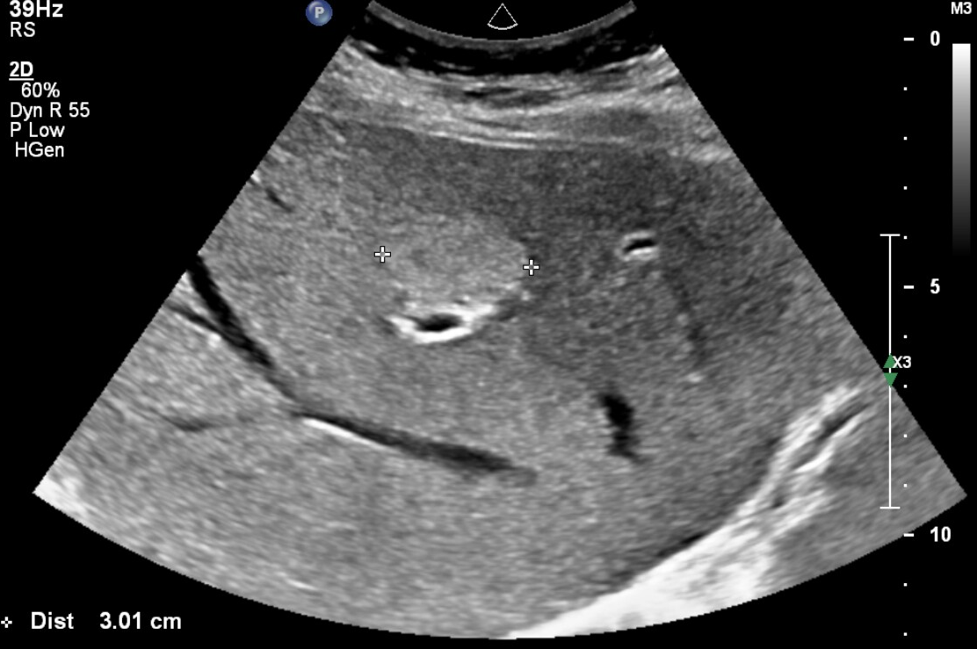
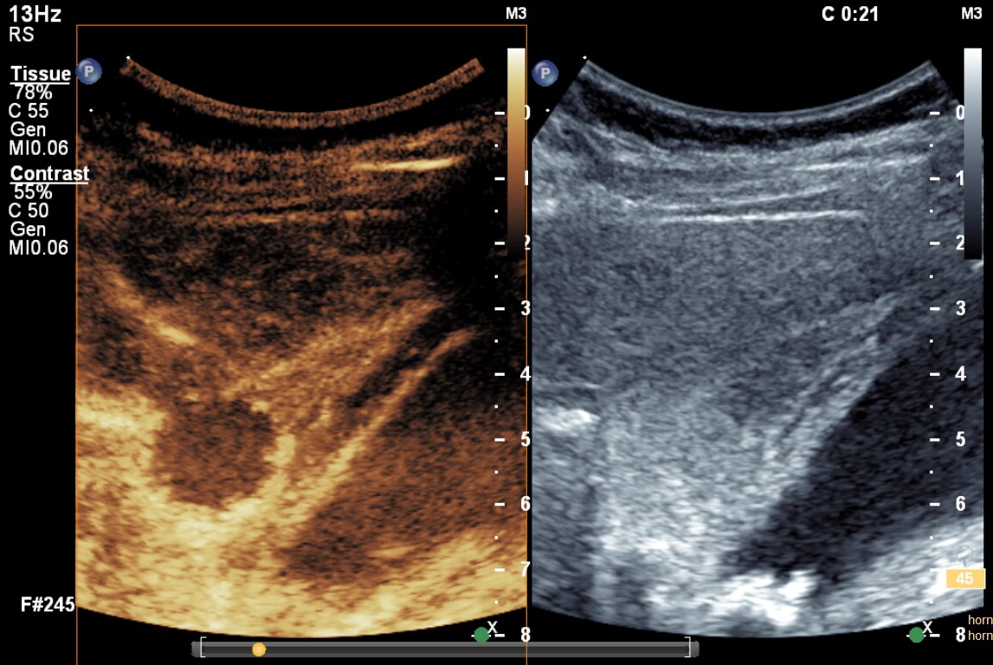
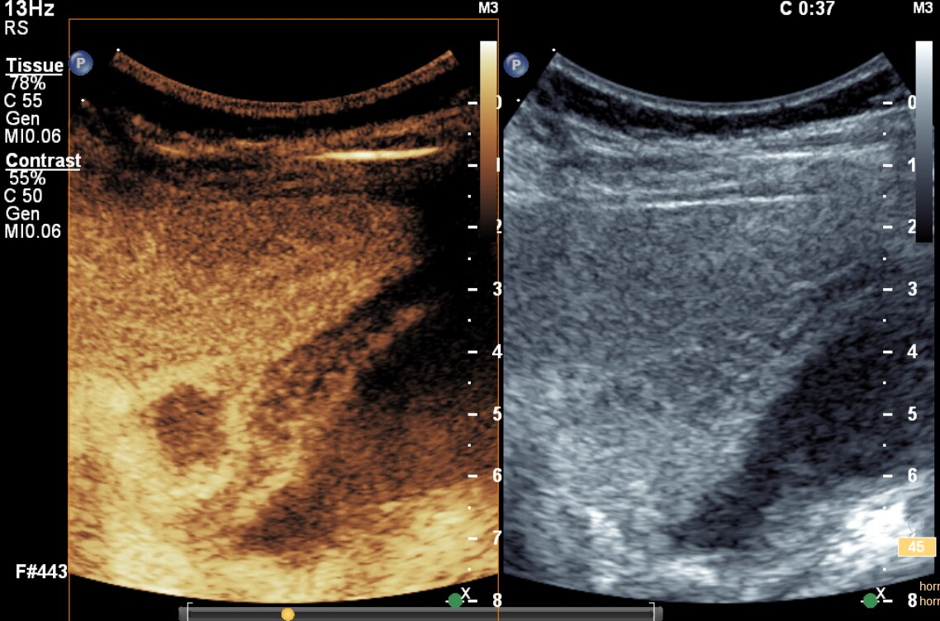
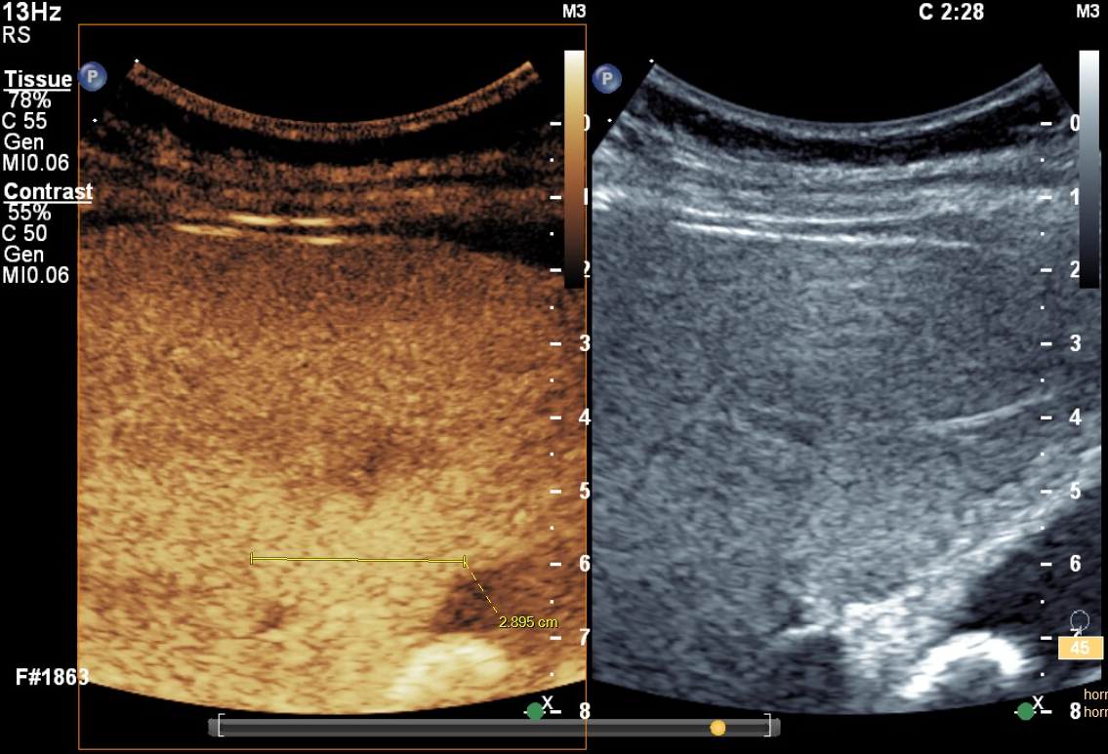
Abdominal ultrasound - findings
Abdominal sonography + contrast examination of the liver (i.v. 2.5 ml Sonovue)
Liver not enlarged, parenchyma of normal echogenicy, in S4 at branching of v.portae 3 cm hyperechogenic lesion – after contrast administration granular saturation from the periphery, within 3 minutes it gradually saturated the whole lesion, no wash-out.
Nativ 21s after contrast administration 37s after contrast administration 2:28 after contrast administration
(hyperechoic lesion) (granular enhancement from the periphery) (lesion is completely enhanced with contrast)
Typical image of hemangioma - no further investigation or monitoring is needed

Slide 5
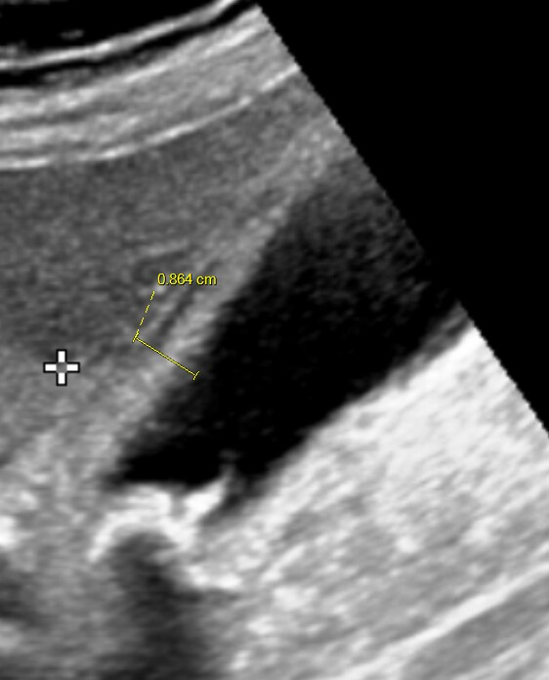
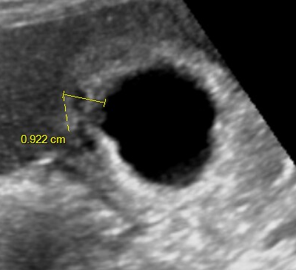
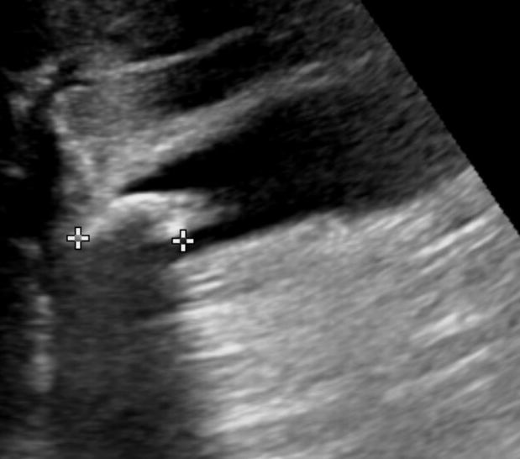
Abdominal ultrasound - findings
Gallbladder of normal size, in the area of ​​the infundibulum 20 mm biliary stone with acoustic shadow, gallbladder wall thickened (up to 10 mm) and stratified, in the gallbladder bad no free fluid.
Thickened and stratified gallbladder wall (normally gallbladder wall is hyperechoic and thick up to 3 mm).
Stratification is caused by wall edema (it can also be present in ascites when there is no gallbladder inflammation).
There was sonopalpable pain during ultrasound in the right hypochondrium – ultrasound Murphy’s sign.
Hyperecho with acoustic shadow – typical image of biliary stone.
Typical image of cholecystitis on ultrasound - if it correlates with the clinical presentation, then there is no need for further investigation.

Slide 6
Follow up
Laparoscopic cholecystectomy was performed during hospitalization.
Perioperative and histological picture of acute cholecystitis.

Slide 7
Conclusion
If a typical picture of hemangioma is present in the native and post-contrast ultrasound, then the finding does not need to be further investigated or monitored.
If the ultrasound has a typical picture of cholecystitis and the finding correlates with the clinic, then it is not necessary to further investigate the finding and it is possible to proceed directly to cholcystectomy (ultrasound has a higher sensitivity to detect cholecystitis and cholecystolithiasis than CT).

