Slide 1


Circulatory Reactions
Assoc. Prof. MUDr. Markéta Bébarová, Ph.D.
Department of Physiology, Faculty of Medicine, Masaryk University

Slide 2

This presentation includes only the most important terms and facts. Its content by itself is not a sufficient source of information required to pass the Physiology exam.

Slide 3
Circulatory Reactions
Regulation of circulation – a complex system of feed backs which are continually in a dynamic balance.
Individual parameters (BP, blood flow through organs, etc.) regulated by neural and humoral mechanisms, both systemic and local – their quantitative ratio changes dynamically.
Physiological stimuli (a change of the body position, exertion, etc.) induce rather standard reaction in a healthy person (integration of many particular reflex changes).
Notes:
In the clinical practise - disturbances of these standard reactions are an indication of impaired function of components in given regulatory circuits.

Slide 4
Circulatory Reactions
Orthostatic / Clinostatic Reaction
a change of the body position from lying to standing / from standing to lying
orthostatic reaction – due to gravity:
→ ↑ BP in all vessels below the heart level
→ ↓ BP in all vessels above the heart level
Notes:
BP – blood pressure

Slide 5
Circulatory Reactions
Orthostatic / Clinostatic Reaction
a change of the body position from lying to standing / from standing to lying
orthostatic reaction – due to gravity:
→ ↑ BP in all vessels below the heart level
veins – a sudden closure of valves due to ↑ BP (prevention of backward flow; persists only shortly, valves open immediately again to keep a continual blood flow) + ↑ venous pressure due to continuous blood inflow from arteries → total filling of veins considerably ↑, blood flow sustained → dilation of veins
Notes:
The dilation of veins can be well observed on the veins of the hand - the difference in the erection of the hand and its subsequent drooping.
The dilation would not only occur if significant extramural pressure was applied.

Slide 6
Circulatory Reactions
Orthostatic / Clinostatic Reaction
a change of the body position from lying to standing / from standing to lying
orthostatic reaction – due to gravity:
→ ↑ BP in all vessels below the heart level
→ ↓ BP in all vessels above the heart level
veins – ↓ volume (in chest veins by ∼20%) → ↓ central venous pressure → ↓ venous return → ↓ stroke volume (from 70 to ∼ 45 ml) → ↓ BP
↓ BP + direct action of gravity – inhibition of baroreceptors → ↓ activity of vagus nerve and ↑ activity of sympathetic system → ↑ HR + ↑ SV + ↑ PR
Notes:
Even a healthy person may experience weakness during transient hypotension due to orthostasis, especially in the heat, when skin vasodilation is present.
Increased PR - vasoconstriction in muscles, splanchnic circulation and kidney - BP adjustment even slightly higher than before reaction.
HR – heart rate
SV – stroke volume
PR – peripheral resistance

Slide 7
Circulatory Reactions
Orthostatic / Clinostatic Reaction
a change of the body position from lying to standing / from standing to lying
orthostatic reaction – due to gravity:
a) acute reaction – passes within 1 min

Slide 8
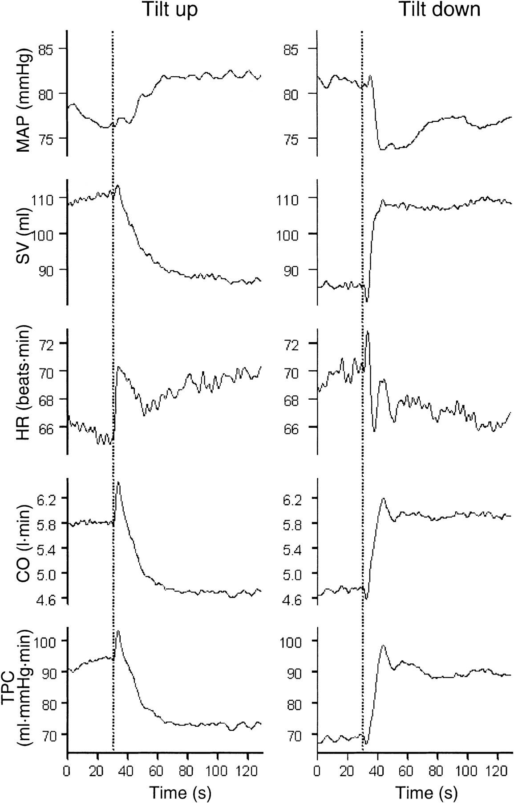
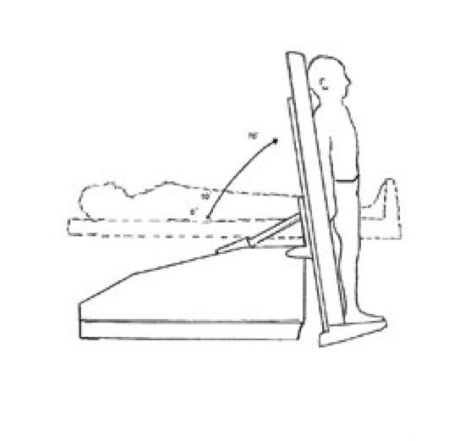
Tilt-up test
Notes:
Tilt-up test in the clinical practise
During head-up tilt, HR showed an immediate increase and initial overshoot, and it stabilized slightly above its pretilt value after ∼30 s. After this, a very slight, linear increase in HR was seen. After tilt back, an increase in HR was seen initially in some subjects; this may have been a nonspecific reaction to the movement. After some initial fluctuations, HR decreased during the next few minutes and returned to its baseline level. The rapid changes in HR are consistent with previous findings that the parasympathetic HR response is almost immediate.
During head-up tilt, TPC decreased to a stable level after ∼30 s. However, TPC showed an initial increase, which may have been caused by an increased perfusion pressure due to the effect of gravity on arterial pressure before the veins were filled with blood, thus distending the arteries. This may, in turn, have provoked a local, myogenic vasocontriction response, but our methods do not allow us to distinguish between different effects such as a myogenic response and a peripheral vasoconstriction caused by baroreflexes.

Slide 9
Circulatory Reactions
Orthostatic / Clinostatic Reaction
a change of the body position from lying to standing / from standing to lying
orthostatic reaction – due to gravity:
a) acute reaction – passes within 1 min
b) subsequently:
↑ capillary filtration → ↓ plasma volume (within ∼40 min; by ∼10 %)
↑ level of ADH + ↑ activity of RAS + reflex vasoconstriction in kidneys → ↓ excretion of salt and water in kidneys
Notes:
Subsequently:
- increase of capillary filtration in capillaries below the heart level, especially in the lower limbs - reduction of plasma volume by about 10 percent (within about 40 min)
- decrease of water and salt excretion in the kidneys (increase in ADH and RAAS activity + reflex vasoconstriction in the kidneys)

Slide 10
Circulatory Reactions
Orthostatic / Clinostatic Reaction
a change of the body position from lying to standing / from standing to lying
orthostatic reaction – due to gravity:
The above described complex reaction provides maintenance of BP and, thus, sufficient perfusion of brain. Despite, the brain blood flow ↓ even by 20%.
The brain blood flow is ↓ due to a reflex vasoconstriction induced by ↓ pCO₂ (↑ ventilation during the orthostatic reaction) and sympathetic vasoconstrictive activity.
orthostatic hypotension
Notes:
If the ability of the autonomous system to increase peripheral resistance is insufficient, orthostatic hypotension or even a critical decrease in brain flow and unconsciousness (fainting, syncope) will occur.

Slide 11
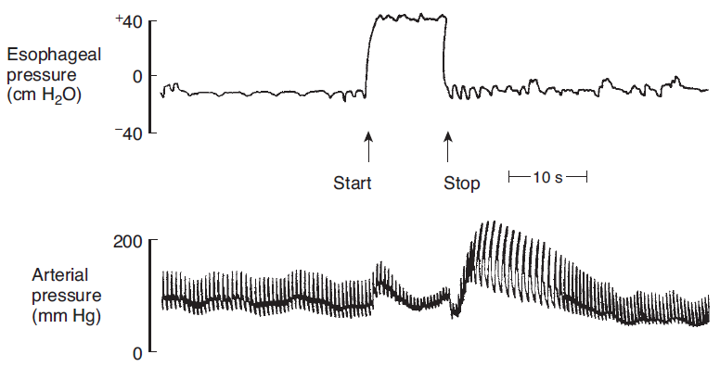
Circulatory Reactions
Valsalva Maneuver
forced expiration over closed or narrowed glottis (cough, defecation, lifting of heavy objects, etc.)

Slide 12
Circulatory Reactions
Valsalva Maneuver
forced expiration over closed or narrowed glottis (cough, defecation, lifting of heavy objects, etc.)
start of maneuver→ ↑ intrathoracic pressure:
→ ↑ BP (the intrathoracic pressure contributes to the aortal pressure)
→ compression of chest vessels → ↓ venous return → ↓ stroke volume (Frank-Starling) → ↓ pulse and mean BP → inhibition of baroreceptors → reflex tachycardia and vasoconstriction → mean BP at the level before maneuver

Slide 13
Circulatory Reactions
Valsalva Maneuver
forced expiration over closed or narrowed glottis (cough, defecation, lifting of heavy objects, etc.)
end of maneuver → ↓ intrathoracic pressure:
→ ↓ BP
→ compression of chest vessels released → ↑ venous return → ↑ stroke volume (Frank-Starling) → ↑ pulse and mean BP → stimulation of baroreceptors → fast reflex bradycardia and gradual vasodilation (∼ ↓ peripheral resistance) → normalizing of BP

Slide 14
Circulatory Reactions
Valsalva Maneuver
forced expiration over closed or narrowed glottis (cough, defecation, lifting of heavy objects, etc.)
Notes:
This examination tests the dynamics of circulatory regulations. In people prone to orthostatic hypotension, in patients with autonomic nervous system insufficiency, etc., baroreflex is weakened - manifested by a gradual slow blood pressure drop during the maneuver and its slow gradual increase after the end of the maneuver without concomitant changes in the heart rate.

Slide 15
Circulatory Reactions
Diving Reflex
well developed in diving animals (duck, whale, …)
diving – excitation of receptors of n. trigeminus (namely around eyes and nose) by cold water:
→ apnoe
→ bradycardia
→ peripheral vasoconstriction
∼ conservation of limited O₂ reserves for function of brain and heart → prolongation of diving period
(whale 2 hours, seal 70 min; they have also higher O₂ reserves in haemoglobin and myoglobin, higher tolerance to hypoxia)
Notes:
Many people also respond to immersion of their face into cold water with a significant reflex bradycardia (from 70 to 40 beats per minute within 1 min - may even stop supraventricular tachycardia) - and vasoconstriction in the skin and muscles.
Immersion of the whole body without immersion of the face does not cause this reflex.

Slide 16
Circulatory Reactions
Reaction on loss of blood
bleeding → hypovolemia → ↓ venous return → ↓ SV → ↓ CO → ↓ BP (even shock)
The resulting state is dependent on the amount of lost blood and on the velocity of loss of blood!

Slide 17
Circulatory Reactions
Reaction on loss of blood – sudden
bleeding → hypovolemia → ↓ venous return → ↓ SV → ↓ CO → ↓ BP (even shock)
loss of 10 % of the blood volume (∼ in a blood donor):
→ slightly and transiently ↓ BP
loss of 20-30 % of the blood volume :
→ ↓ mean BP to about 60-80 mmHg
loss of 30-40 % of the blood volume :
→ ↓ mean BP to about 50-67.5 mmHg → shock with brain and heart ischemia and with anuria, may shift into an irreversible state
Notes:
The mean pressure typically is about 93 mmHg.

Slide 18
Circulatory Reactions
Reaction on loss of blood – sudden
bleeding → hypovolemia → ↓ venous return → ↓ SV → ↓ CO → ↓ BP (even shock)
mean BP
(mmHg)
97.5
48.5
according to prof. N. Honzíková (Comments to the physiological lectures, 1992; in Czech)
0
2
4
6
time (hod)
Notes:
The state caused by the bleeding either results in the patient's recovery after some time (i.e., normalization of blood pressure; whether spontaneously or after a possible medical intervention, if necessary), or may result in death (for ca).uses - see end of lecture

Slide 19
Circulatory Reactions
Reaction on loss of blood – sudden
bleeding → hypovolemia → ↓ venous return → ↓ SV → ↓ CO → ↓ BP (even shock)
Instantaneous reaction (seconds till minutes)
Reaction within 5 - 60 min
Reaction within hours till days

Slide 20
Circulatory Reactions
Reaction on loss of blood – sudden
Instantaneous reaction on ↓ BP (seconds till minutes)
↓ stimulation of baroreceptors → ↓ activity of parasympathicus and ↑ activity of sympathicus → ↑ HR + ↑ CO + ↑ PR → ↑ BP
limited tissue perfusion due to ↑ PR → metabolic acidosis
limited renal perfusion due to ↑ PR (v. eff. > v. aff.) → ↑ FF but, anyway, ↓ urine formation → retention of Na⁺ in body (prospectively also of waste nitrogen products – uremia – a risk of renal tubule damage)
RAS activation (angiotensine II, aldosteron) + ↑ secretion of ADH, thirst → vasoconstriction + retention of salt and water in body → ↑ PR + ↑ volume of body fluids → ↑ BP
Notes:
Generalized sympathetic vasoconstriction (splanchnic, kidneys, skin, muscles); minimal vasoconstriction in the brain; adrenergic vasodilatation predominates in the heart. Also venoconstriction - emptying of blood reservoirs in tissues.
Activation of sympathetic system - sweating, contraction mm. arrectores pilorum, pale and cold acra (vasoconstriction), accelerated breathing.
Metabolic acidosis and muscle weakness.
RAAS activation – caused by an increased sympathetic activity + decreased BP (including a. renalis) + less Na+ in macula densa.

Slide 21
Circulatory Reactions
Reaction on loss of blood – sudden
Reaction on ↓ BP within 5 - 60 min
↓ capillary hydrostatic pressure → oncotic pressure > hydrostatic pressure → reabsorption of fluids from the interstitial tissue into cappilaries → ↑ volume of intravasal fluid even by 500 ml in adults („internal transfusion“) → ↑ BP + ↓ haematocrit + ↓ concentration of plasmatic proteins
The so far described reactions provide the sufficient blood flow through brain and myocardium.

Slide 22
Circulatory Reactions
Reaction on loss of blood – sudden
Reaction on ↓ BP within hours till days (even weeks)
restoration of content of salt and water in the organism (↓ GFR due to sympathetic constriction of v. aff., RAS, ADH, thirst)
restoration of plasmatic proteins including albumin (liver)
stimulation of erythropoiesis in the bone marrow (erythropoietin)

Slide 23
Circulatory Reactions
Reaction on loss of blood – sudden
bleeding → hypovolemia → ↓ venous return → ↓ SV → ↓ CO → ↓ BP (even shock)
mean BP
(mmHg)
97.5
48.5
according to prof. N. Honzíková (Comments to the physiological lectures, 1992; in Czech)
0
2
4
6
time (hod)
Notes:
The death may be caused by….

Slide 24
Circulatory Reactions
Reaction on loss of blood – sudden
irreversible state (shock) may be caused by:
primary heart failure: ↓ BP → insufficient perfusion of myocardium → ↓ contractility → ↓ CO → ↓ BP (positive feed back, circulus vitiosus)
serious tissue hypoxia: accumulation of metabolites → metabolic acidosis + ↑ permeability of capillaries → vasodilation → loss of fluid into the interstitial tissue → ↓ BP (positive feed back)
Notes:
The death may be caused by primary heart failure and serious tissue hypoxia which both activate positive feedback reaction (circulus vitiosus).

