Slide 1


Coronary Circulation
Assoc. Prof. MUDr. Markéta Bébarová, Ph.D.
Department of Physiology, Faculty of Medicine, Masaryk University

Slide 2

This presentation includes only the most important terms and facts. Its content by itself is not a sufficient source of information required to pass the Physiology exam.

Slide 3
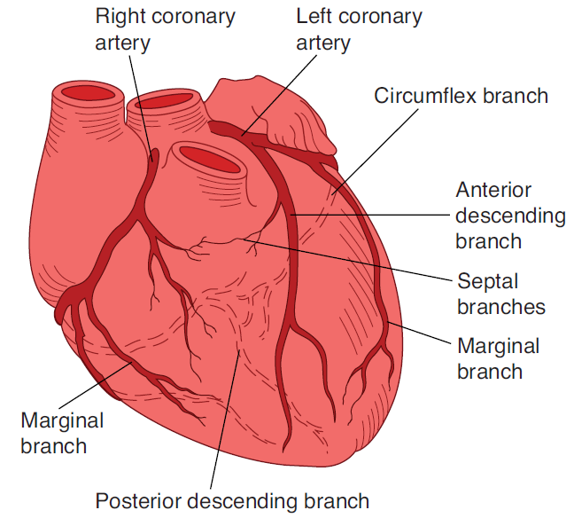
Coronary Circulation
a. cor. sinistra 85% of the blood flow (the frontal part of septum, the conductive system, majority of the left ventricle)
a. cor. dextra (the right ventricle, the posterior part of septum and usually also the posterior part of the left ventricle)
O₂ diffusion directly from the blood situated in the cardiac cavities
Ganong´s Review od Medical Physiology, 23rd edition
placing of coronary arteries and capillaries in the cardiac walls
Notes:
Large branches of the coronary arteries are placed subepicardially, submerged in the myocardium, reaching the subendocardial layers, where they end up in a very dense capillary network with a minimum number of collaterals. Capillaries are practically all open even at rest. A millimeter layer just below the endocardium is oxygenated by blood directly from the heart cavities.

Slide 4
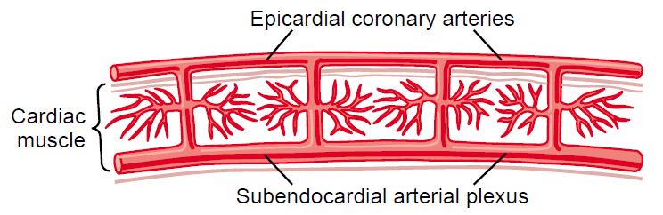
Coronary Circulation
epicardial coronary arteries supply most of the muscle
intramuscular arteries (smaller) penetrate the muscle
plexus of subendocardial arteries
Guyton and Hall.
Textbook of Medical Physiology, 11th edition
During systole, blood flow through the plexus of subendocardial arteries is reduced (compression of intramuscular arteries) – compensated through extra vessels in the plexus (sensitivity to coronary ischemia).

Slide 5
Coronary Circulation
a. cor. sinistra 85% of the blood flow (the frontal part of septum, the conductive system, majority of the left ventricle)
a. cor. dextra (the right ventricle, the posterior part of septum and usually also the posterior part of the left ventricle)
O₂ diffusion directly from the blood situated in the cardiac cavities
Ganong´s Review od Medical Physiology, 23rd edition
placing of coronary arteries and capillaries in the cardiac walls
coronary angiography
Notes:
The coronary circulation can be mapped by the coronary angiography …

Slide 6
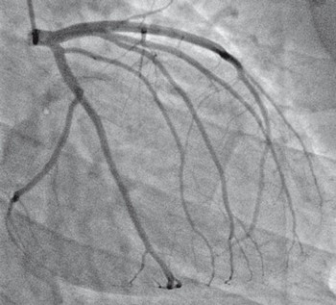
Coronary Circulation
http://pochp.mp.pl/aktualnosci/show.html?id=55102
Notes:
The coronary circulation can be mapped by the coronary angiography - a special catheter is introduced into the opening of the coronary artery by means of an arterial approach and the circulation is visualized by injection of a contrast agent; stenosis, extent and localization, can be detected. It is performed before surgery (bypass) or immediately before the coronaroplasty with a balloon catheter with possible stent insertion) or to exclude ischemic etiology of dilated cardiomyopathy.

Slide 7
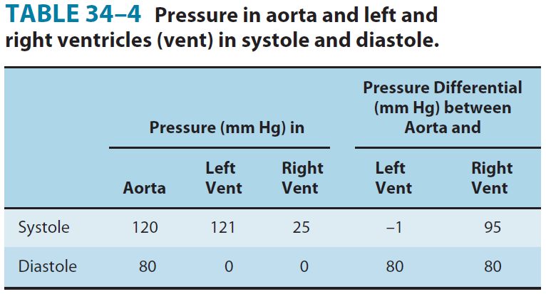
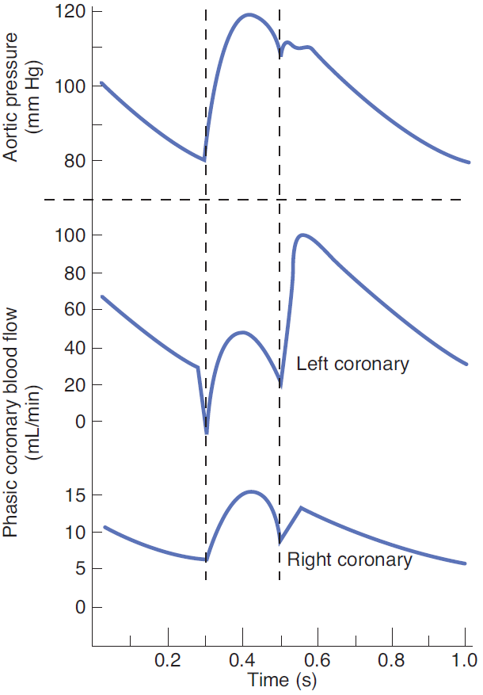
Coronary Circulation
during the systole, vessels situated intramurally are pressed by the contracting myocardium
left vs. right ventricle
high heart rate
Ganong´s Review od Medical Physiology, 23rd edition
Notes:
The intramural pressure in the left ventricular wall is so pronounced that the flow almost ceases during the systole, and even reverses at the beginning of the systole.
Therefore, the ratio of systole to diastole length is very significant. Thus, at high pulse rates, not only the ventricular filling is critically reduced, but also the left coronary artery flow time reduces.
In the right ventricle, the flow changes during the heart cycle are also apparent, but they are much smaller due to the significantly lower contraction (lower afterload).

Slide 8
Coronary Circulation
orificia of the coronary arteries
isovolumic relaxation
ejection
Notes:
Considering the location of openings of the coronary arteries, the blood flow passes by the openings during the ejection phase. After the blood pressure in the aorta exceeds the pressure in the left ventricle, the blood flow changes its direction for a while, the valve closes and blood flows directly to the openings. This flow steeply increases during the diastole, namely during its first phase.

Slide 9
Coronary Circulation
O₂ extraction is almost maximal already at rest, capillaries are open
The only possibility how to increase O₂ supply (for example during exercise) is the coronary vasodilation!
Notes:
During physical activity, the cardiac output increases up to 5 times, which significantly increases myocardial oxygen consumption. However, O2 extraction is almost maximal at rest and the capillaries are open, so increased flow must be done by coronary vasodilation!

Slide 10
Coronary Circulation
Control of coronary blood flow
reduction/interruption of the blood flow or increased demands (exercise, increased blood pressure)
hyperaemia (reactive or active) based on the metabolic vasodilation mediators: ↓pO₂, ↑pCO₂, ↓pH, ↑[K⁺]_{e}, adenosine, bradykinin, prostaglandins, NO

Slide 11
Coronary Circulation
Control of coronary blood flow
the neural regulation of the vessel diameter – secondary impact
indirect effects
X
(mostly opposite)
direct effects
Notes:
Indirect influence plays a much more important role and causes mostly opposite changes than direct effects.

Slide 12
Coronary Circulation
Control of coronary blood flow
the neural regulation of the vessel diameter – secondary impact
indirect effects
sympathetic system (NE, E)
↑ HR + contractility → rate of cardiac metabolism → increased O₂ consumption → activation of local vasodilating mechanisms
parasympathetic system (ACH)
opposite changes → vasoconstriction

Slide 13
Coronary Circulation
Control of coronary blood flow
the neural regulation of the vessel diameter – secondary impact
indirect effects
direct effects
vasospastic myocardial ischemia
sympathetic system (NE, E)
epicardial vessels – mostly α-rec. → vasoconstriction
intramural vessels – mostly β-rec. → vasodilation
parasympathetic system (ACH)
vasodilation, but not significant (only few fibers)
Notes:
Sympathetic vasoconstriction is small.
Sympathetic-induced vasodilatation works in harmony with the metabolic autoregulation.

Slide 14
Coronary Circulation
Control of coronary blood flow
the neural regulation of the vessel diameter – secondary impact
indirect effects
direct effects
Whenever the direct effects alter the coronary blood flow in the wrong direction, the metabolic control overrides them within seconds!
Notes:
To sum up, the regulation of the coronary artery flow is mainly metabolic, less nervous through the beta receptors.

Slide 15
Coronary Circulation
the resting blood flow: 225 ml/min (4-5% of CO)
at physical exertion:
cardiac work may increase 6-9fold
cardiac output increased 4-7fold
higher afterload
coronary blood flow increases only 3-4fold!
efficiency of the cardiac utilization of energy has to increase to make up for the relative deficiency of coronary blood supply

Slide 16
Cardiac Muscle Metabolism
at rest: 70% of energy – fatty acids
anaerobic/ischemic conditions: anaerobic glycolysis
high glucose consumption + high quantities of formed lactic acid (one of causes of the ischemic pain + ↓pH)
severe ischemia: degradation of ATP to ADP, AMP and, finally, to adenosine → loss of adenosine into circulation through sarcolemma → vasodilation
lost adenosine replaced by new synthesis of adenine, but very slowly (2% per hour)
Major cause of death of cardiomyocytes during ischemia is the adenosine deprival! (30 min of severe ischemia may cause irreversible changes and cell death)
Notes:
Carbohydrates play a smaller role in the resting heart metabolism than in other tissues.

Slide 17
Coronary Reserve
ability of coronary vessels to adapt blood flow to the actual cardiac work (ergometry)
the maximal blood flow / the resting blood flow
reduction of the coronary reserve:
relative coronary insufficiency (too high resting demands, high resting blood flow cannot be sufficiently increased)
absolute coronary insufficiency (∼ coronary heart disease) (the stenotic arteriosclerotic process)
Reduced coronary reserve is a limiting factor of the cardiac output, thus, also of the effort of organism!
Notes:
Examination of the coronary reserve – measurement of the coronary blood flow before and after the exercise ergometry.
As in other reserves (respiratory, cardiac), no unit, it expresses how many times the parameter can be increased at maximum load!
Behind the stenosis, vasodilation is present already at rest (to ensure sufficient blood flow). During exercise, the coronary reserve is inadequate (a part is already depleted at rest) and myocardial ischemia is manifested.

