Slide 1
Regional Circulation II
(renal, fetal)
Assoc. Prof. MUDr. Markéta Bébarová, Ph.D.
Department of Physiology, Faculty of Medicine, Masaryk University

Slide 2
This presentation includes only the most important terms and facts. Its content by itself is not a sufficient source of information required to pass the Physiology exam.

Slide 3
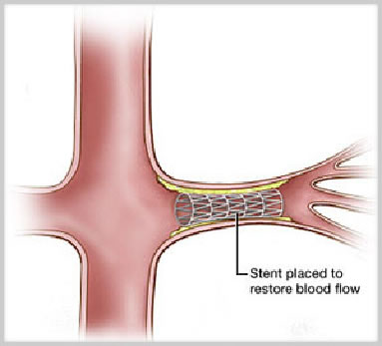
Renal Circulation

Slide 4
Renal Circulation
main functions of kidneys – control of composition and volume of extracellular fluid, detoxification
High filtration rate requires an adequate blood supply!
kidneys form only ∼0.4 % of the body weight
blood flow 1.2 l/min, ∼25% of cardiac output
distribution of blood flow is irregular, the most flows through cortex (glomeruli – filtration)
cortex: 5.3 ml/g/min
medulla - outer zone: 1.4 ml/g/min
medulla - inner zone: 0.4 ml/g/min
Notes:
High blood flow in the renal cortex due to presence of glomeruli where plasma is filtered.
Low blood flow in the inner medulla helps to prevent dilution of the hypertonic interstitium in this region.

Slide 5
Renal Circulation
http://classes.midlandstech.edu/carterp/Courses/bio211/chap25/chap25.htm
Notes:
Two capillary nets in series:
The glomerular capillaries – high pressure (60 mmHg – approx. doubled compared to the arterial end of a common tissue capillary) capillary net ensuring high filtration rate in the kidney; pressure not decreasing along the glomerular capillary (in contrast to a common tissue capillary) because the efferent arteriole follows (not a vein)
The peritubular capillaries – low pressure (12-15 mmHg) capillary net enabling high reabsorption rate of the tubular fluid

Slide 6
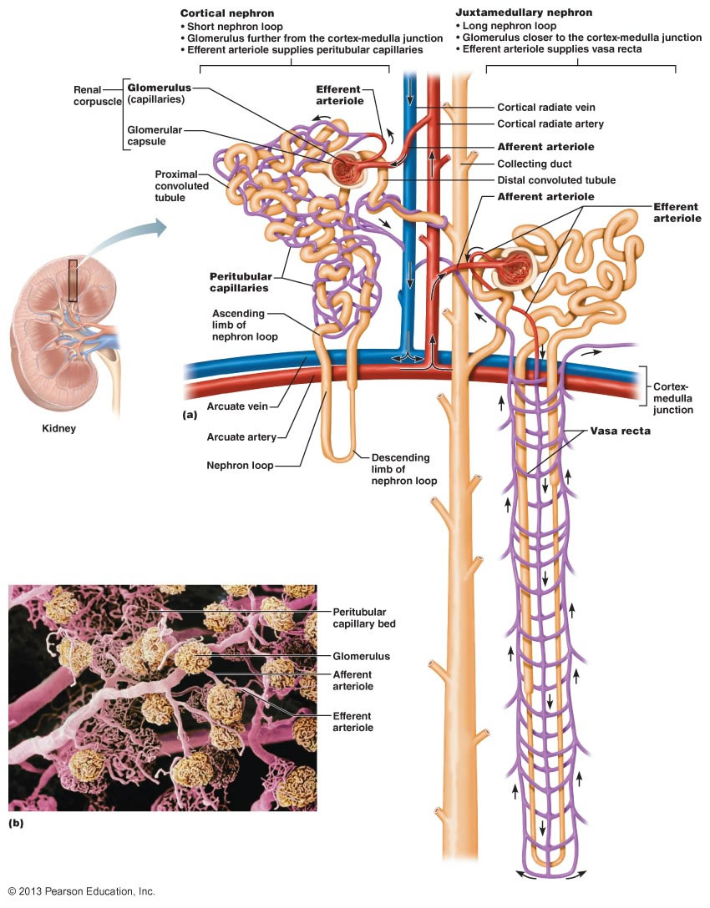
http://classes.midlandstech.edu/carterp/Courses/bio211/chap25/chap25.htm
Notes:
Vasa recta only along the long loops of Henle of the juxtamedullary nephrons.

Slide 7
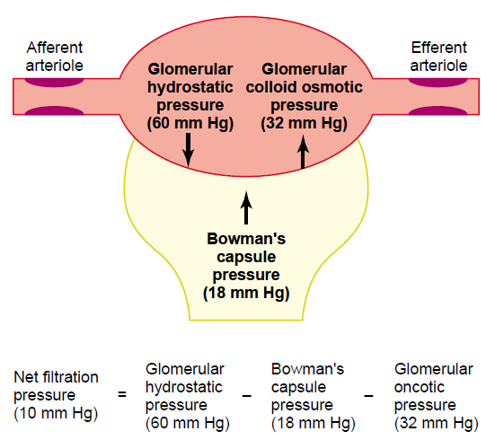
Renal Circulation
v. aff., v. eff.
Guyton & Hall. Textbook of Medical Physiology
entry/exit of high pressure glomerular capillary system
P_{v.a.} – P_{v.e.}
glomerular blood flow =
R_{v.a.} + R_{v.e.} + R_{g.k.}
↑ resistance in vas aff. or vas eff. → ↓ the renal blood flow (if the arterial pressure is stable)
regulate the glomerular filtration pressure:
constriction of vas aff. → ↓ glomerular pressure → ↓ filtration
constriction of vas eff. → ↑ glomerular pressure → ↑ filtration
Notes:
The resistance of the glomerular capillaries is negligible. The blood flow through the glomerulus is regulated in particular by changes in vas afferent and vas efferent resistance (diameter), which, like other arterioles, are characterized by a thick layer of the smooth muscle. The effect of changes of the diameter of vas afferens and vas efferens on the renal blood flow is the same, but on the filtration opposite! If both arterioles constrict at the same time, the flow will be reduced, but (unless it is extreme) without changing the filtration pressure - it is possible to regulate the flow in conjunction with the systemic blood circulation without changing the filtration! Behind the constriction in vas efferens, there is a pressure drop in the peritubular capillaries - the resorption of substances in the peritubular capillary network increases.

Slide 8
Renal Circulation
Regulation of renal blood flow:
Myogenic autoregulation
Neural regulation
Humoral regulation

Slide 9
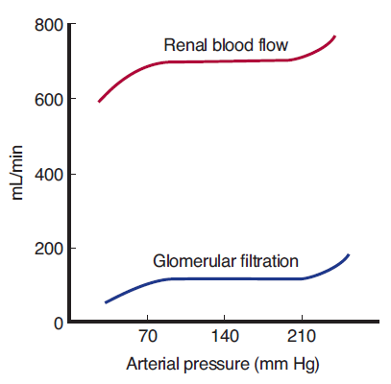
Renal Circulation
Regulation of renal blood flow:
Myogenic autoregulation
dominates
provides stable renal activity by maintaining stable blood flow at varying systemic pressure (stable glomerular pressure and, thus, also stable glomerular filtration rate)
Ganong´s Review of Medical Physiology, 23rd edition
Notes:
Myogenic autoregulation (based on the Bayliss effect): When the blood pressure rises, tension in the vascular wall rises (the law of Laplace). It causes mechanical stimulation, depolarization and contraction of the vascular smooth muscles (due to activation of stretch-sensitive calcium channels). The resulting vasoconstriction shifts the blood flow back to the original level.
The myogenic autoregulation asserts especially in tissues requiring stable blood flow, as in the brain and kidneys.

Slide 10
Renal Circulation
Regulation of renal blood flow:
Neural regulation
conformed to demands of systemic circulation
renal blood flow forms 25% of the cardiac output, thus, it considerably influence BP
sympathetic system - norepinephrine
light exertion (both emotional and physical) + upright body posture → ↑ sympathetic tone → ↑ tone of v. aff. and eff. → ↓ renal blood flow but without ↓ GFR (↑ FF)
higher ↑ of sympathetic tone - during anesthesia and pain - GFR may already ↓
Notes:
The kidneys help to regulate the systemic blood pressure without impairing kidney function (filtration) under physiological consitions.
Clinical comment: Decreased GFR (due to substantially increased sympathetic tonus, for example at extreme hypotension caused by bleeding, or during surgical stress) may result in uremia.

Slide 11
Renal Circulation
Regulation of renal blood flow:
Humoral Regulation
contribute to regulation of systemic BP and regulation of body fluids
norepinephrine, epinephrine (from adrenal medulla)
→ constriction of aff. and eff. arterioles → ↓ renal blood flow and GFR
in agreement with ↑ activity of sympathetic system (small impact with the exception of serious conditions, for example serious bleeding)

Slide 12
Renal Circulation
Regulation of renal blood flow:
Humoral Regulation
contribute to regulation of systemic BP and regulation of body fluids
endothelin
constriction of aff. and eff. arterioles → ↓ renal blood flow and GFR
released locally from the impaired endothel (physiological impact - hemostasis; pathologically increased levels at the toxemia of pregnancy, acute renal failure, chronic uremia)
Notes:
In the physiological state, endothelin (produced locally by the blood vessel endothelium) does not significantly contribute to regulation of the renal blood flow.

Slide 13
Renal Circulation
Regulation of renal blood flow:
Humoral Regulation
contribute to regulation of systemic BP and regulation of body fluids
NO (from the endothel)
continual basal production → vasodilation in the kidney → stable renal blood flow and GFR
prostanglandins (PGE₂, PGI₂), bradykinin
→ vasodilation – minor impact under physiol. cond.
decrease the effect of vasoconstrictive substances which reduce marked ↓ of renal blood flow and GFR
non-steroidal anti-inflammatory agents during stress
(surgery, ↓ fluid volume) may → notably ↓ GFR
Notes:
Locally acting vasodilators counterbalance the continuous acting vasoconstrictive stimuli to stabilize the renal blood flow.
Clinical comment: patients treated with inhibitors of NO synthesis or patients with impaired endothelial function (hypertension, atherosclerosis) – vasoconstriction in the kidneys, decrease of GFR and, thus, decrease of natriuresis – body fluid expansion – blood pressure increase

Slide 14
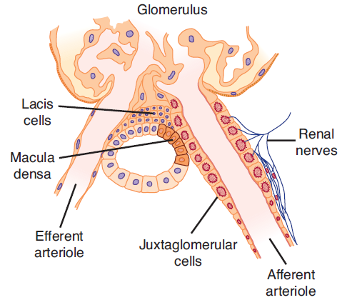
Renal Circulation
Regulation of renal blood flow:
Humoral Regulation
contribute to regulation of systemic BP and regulation of body fluids
Renin-angiotensine system
Ganong´s Review of Medical Physiology, 23rd edition
Notes:
Juxtaglomerular apparatus - renin-angiotensin-aldosterone system (RAAS) - see also other lectures (kidneys, hormones)

Slide 15
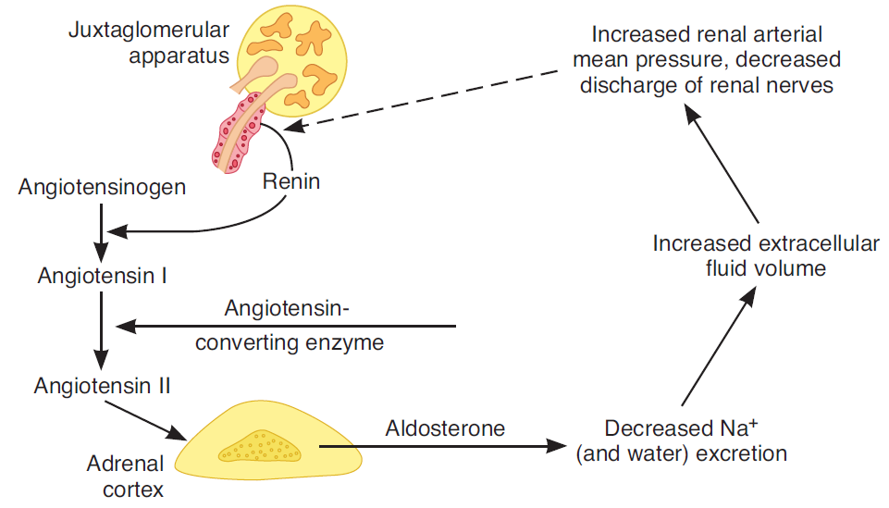
Renal Circulation
Renin-angiotensine system
Na⁺ in plasma
BP
↑ sympathetic activity (β rec.)
vasoconstriction
thirst, ADH
Ganong´s Review of Medical Physiology, 23rd edition
Notes:
RAAS activation via angiotensin II, which acts in the kidney by vasoconstriction primarily in vas efferens, leads to normalization of GFR (which decreased due to hypotension that activated RAAS) and a decrease of the blood flow in the peritubular capillaries, thereby reducing hydrostatic pressure which increases reabsorption of tubular fluid. Reabsorption in tubules is further supported by the direct hormonal effect of angiotensin II and aldosterone on renal tubules (stimulating effect on Na+ and, thus, water reabsorption).

Slide 16
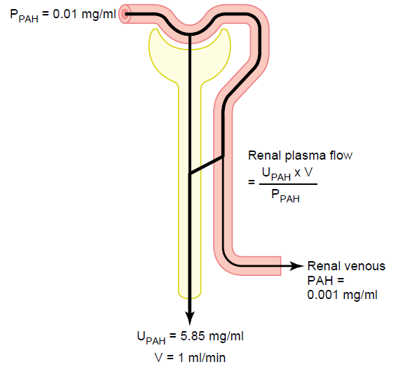
Renal Circulation
Determination of renal plasma flow velocity (RPF)
Clearance of a substance which is fully cleared from plasma in glomerulotubular apparatus.
PAH (paraaminohippuric acid) cleared by 90%
5.85 x 1 mg/min
RPF =
= 585 ml/min
0.01 mg/ml
Guyton & Hall. Textbook of Medical Physiology
(in juxtamedullar nephrons, vasa recta additionally originate from v. efferens – not in contact with proximal and distal tubuli → no excretion of substances)
Notes:
Clearance was given in detail in lectures focused on kidney function.

Slide 17
Renal Circulation
Determination of renal plasma flow velocity (RPF)
Clearance of a substance which is fully cleared from plasma in glomerulotubular apparatus.
PAH (paraaminohippuric acid) cleared by 90%
5.85 x 1 mg/min
RPF =
= 585 ml/min
0.01 mg/ml
Guyton & Hall. Textbook of Medical Physiology
Correction to the extraction ratio of PAH (E_{PAH}):
P_{PAH} - V_{PAH}
585 ml/min
E_{PAH} =
= 0.9
RPF =
= 650 ml/min
P_{PAH}
0.9
Notes:
The Renal blood flow: RPF / (1-hematocrit) = approx. 1200 ml/min

Slide 18
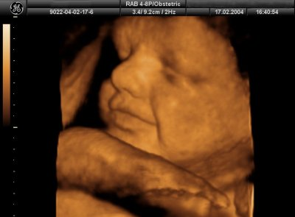
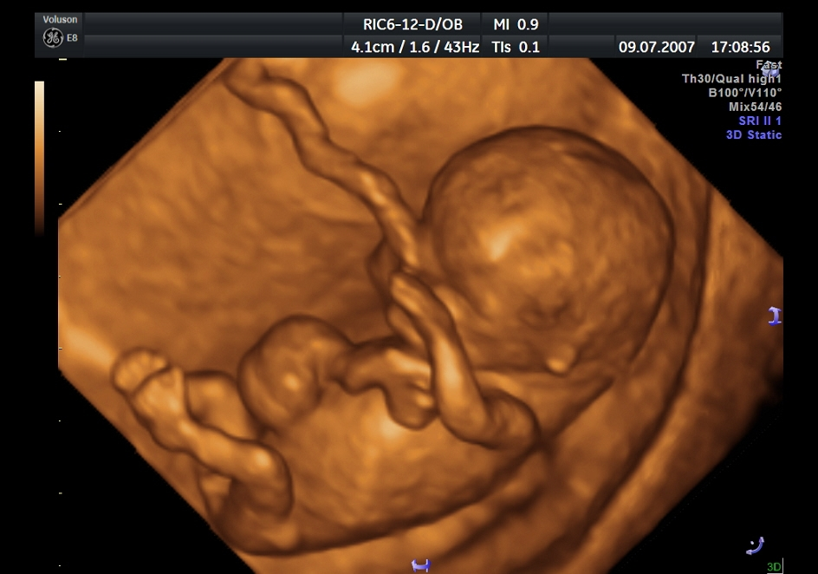
Fetal Circulation

Slide 19
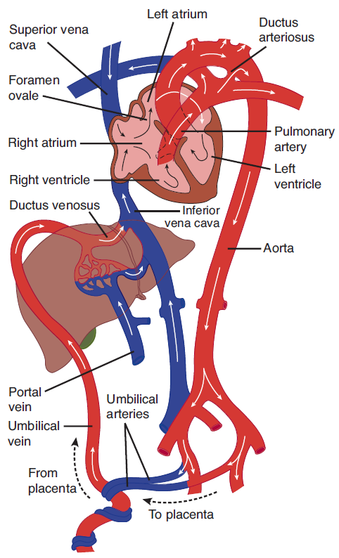
Fetal Circulation
placenta, umbilical vein
62%
liver, ductus venosus
67%
crista dividens, foramen ovale
62%
blood supply of the head and upper limbs
52%
v. cava superior and inferior
58%
the right ventricle
ductus arteriosus
aorta – the blood supply of the lower part of body + 60% of the cardiac output is directed to placenta
80%
Ganong´s Review of Medical Physiology, 23rd edition
Notes:
The blood from the umbilical vein (saturation 80%) goes mainly to the liver, but part of the blood bypasses the liver through the ductus venosus. The blood from the liver and the ductus venosus flows through the vena cava inferior to the right atrium (separated by the crista dividens). The blood from the umbilical vein is directed to the foramen ovale in the atrial septum (right-to-left shunt) thanks to crista dividens and is driven by the left ventricle (along with the blood from the lungs) into the aorta and arteries of the head and upper limbs (still rather high O2). Only about 1/3 of the blood expelled from the right ventricle is delivered to the lungs (the lungs do not breathe, high resistance in the pulmonary circulation, pulmonary pressure slightly exceeds the aortic pressure), the rest flows via the second right-to-left shunt through the ductus arteriosus to the aorta. Blood continues to flow to the lower half of the body and to the placenta (60% of the fetal cardiac output goes to the placenta). The left ventricle pumps about 1/5 more blood than the right ventricle. The liver, heart, head and upper limbs are best supplied with oxygen.

Slide 20
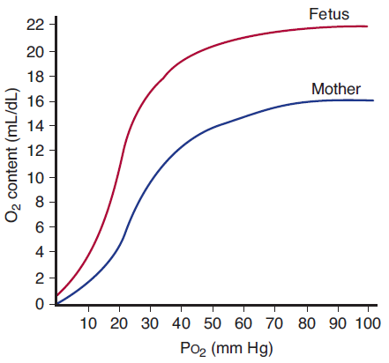
Fetal Circulation
fetal haemoglobin (higher affinity to oxygen)
short-period hypoxia
longer hypoxia
thick muscle wall of umbilical vessels (sensitive contractile reaction to many stimuli – injury, hypoxia, sympathomimetics, etc.)
Ganong´s Review of Medical Physiology, 23rd edition
Notes:
Oxygen saturation of the fetal blood is possible due to the fetal hemoglobin, which has a higher affinity for oxygen than the adult hemoglobin (related to less effective 2,3-DPG binding) and can therefore bind oxygen from the maternal hemoglobin when flowing through the placenta. In addition, the fetus has a significantly higher number of red blood cells. After delivery, large quantities of red blood cells with the fetal hemoglobin disintegrate and gradually change into red blood cells with the adult hemoglobin. This condition, combined with immature liver enzymes, leads to the state called neonatal jaundice. Short-term hypoxia - tachycardia and increased umbilical vessel flow; longer hypoxia - bradycardia. The muscles of the umbilical veins respond sensitively to a number of stimuli by contractions (for example injury, tension, oxygen drop, sympathomimetics,…). In animals, it helps to stop bleeding from the umbilical stump after the birth.

Slide 21
Fetal Circulation
Changes after birth
Closure of umbilical vein
sudden ↑ of peripheral resistance and blood pressure
contraction of musculature of ductus venosus and its closure
The first inspiration (due to asphyxia and cooling of the body)
↓ resistance of the lung bloodstream
much more blood into lungs
Ganong´s Review of Medical Physiology, 23rd edition
Notes:
The first change after delivery - closure of the umbilical cord - leads to fetal asphyxia + to an increase in the total peripheral resistance of the systemic circulation and thus to an increase in the systemic blood pressure. This is followed by a reflex contraction of the ductus arteriosus and its closure. Asphyxia, along with cooling of the newborn's body due to changes in the temperature around - the first breath - decreases the resistance of the pulmonary circulation (up to 1/10 of the fetal) as well as its pressure (about 1/2 of the fetal). Placental transfusion - about 100 ml of placental blood is aspirated due to a sharp drop in the intrathoracic pressure during the first inspiration.

Slide 22
Fetal Circulation
Changes after birth
Decrease of pressure in right atrium and its increase in left atrium due to:
↑ filling of left atrium by the blood from lungs
↓ venous return to right atrium due to closure of umbilical vein
left ventricle works against ↑ pressure in aorta
Closure of formanen ovale
Closure of ductus arteriosus
Ganong´s Review of Medical Physiology, 23rd edition
Notes:
Increase of the pressure in the left atrium (more blood coming from the lungs, higher pressure in the left ventricle due to increased afterload) and its decrease in the right atrium (lower venous return due to closure of the umbilicus) results in closure of the foramen ovale.
Reversed pressure gradient between aorta and a. pulmonalis reverses flow in ductus arteriosus which results in constriction of its smooth muscle and closure (likely started by increased pO2 in the blood flowing through the ductus but other factors definitely contribute, for example decreased formation of vasoconstrictive prostaglandins after the birth – closure may be promoted by drugs inhibiting cyclooxygenase).

Slide 23
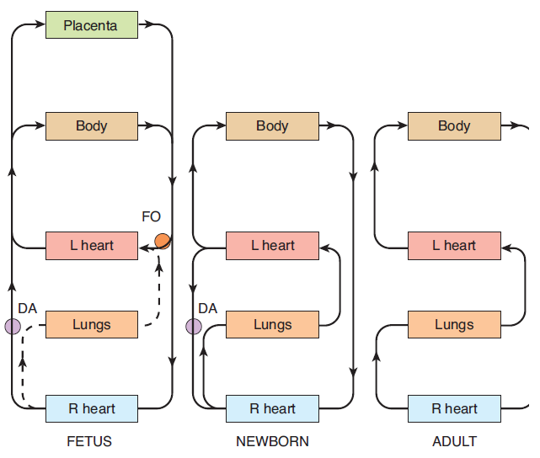
Fetal Circulation
left and right heart work in parallel
all connected in series
Ganong´s Review of Medical Physiology, 23rd edition
Notes:
The left and the right heart work in parallel in fetus due to presence of two shunts – ductus arteriosus and foramen ovale.

