Slide 1
Respiratory physiology
Dr. Amir Samadian m.d.
Department of physiology
Spring 2020

Slide 2
Learning objectives
Pulmonary ventilation
Mechanism of breathing – breathing muscles, intrathoracic and intrapulmonary pressure. Surface tension in alveoli, surfactant. Application of the law of Laplace in lungs. Respiratory work. Pneumothorax.
Transport of gases through alveolar-capillary membrane
Composition of atmospheric and alveolar air. Diffusion through the alveolar-capillary membrane. Oxygen –haemoglobin dissociation curve, the Bohr effect. CO₂ dissociation curve.
Regulation of breathing
Neuronal regulation – respiratory centre. Chemoreceptors – effect of hypoxia and hypercapnia. Mechanoreceptors in lungs – Hering–Breuer reflexes. Protective reflexes of respiratory system. Response of the ventilation to physical activity.
Diagnostic and therapeutic methods in clinical practice
Spirometry – flow-volume loop. Pneumotachography. Pneumography. Measurement of the death space. Measurement of residual volume of the lungs. Artificial ventilation.

Slide 3
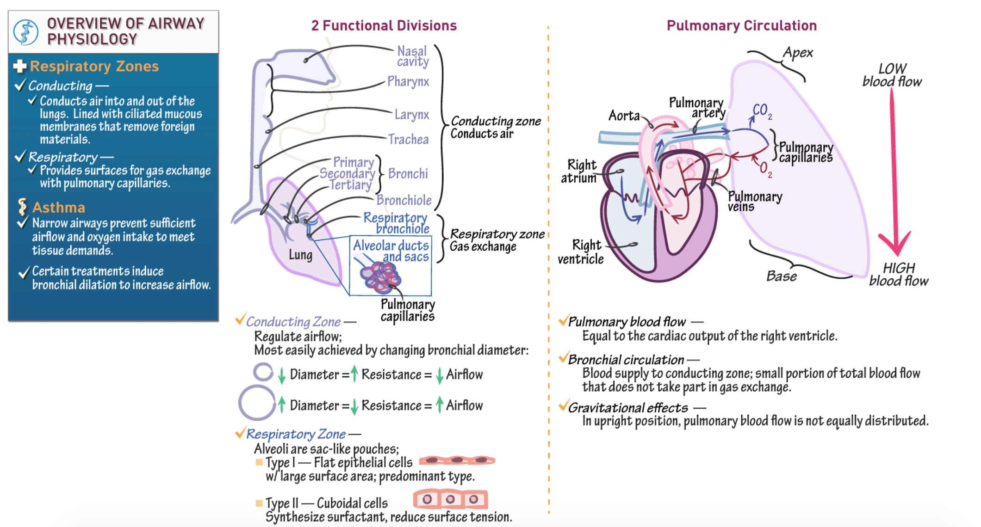
Overview of respiratory system

Slide 4
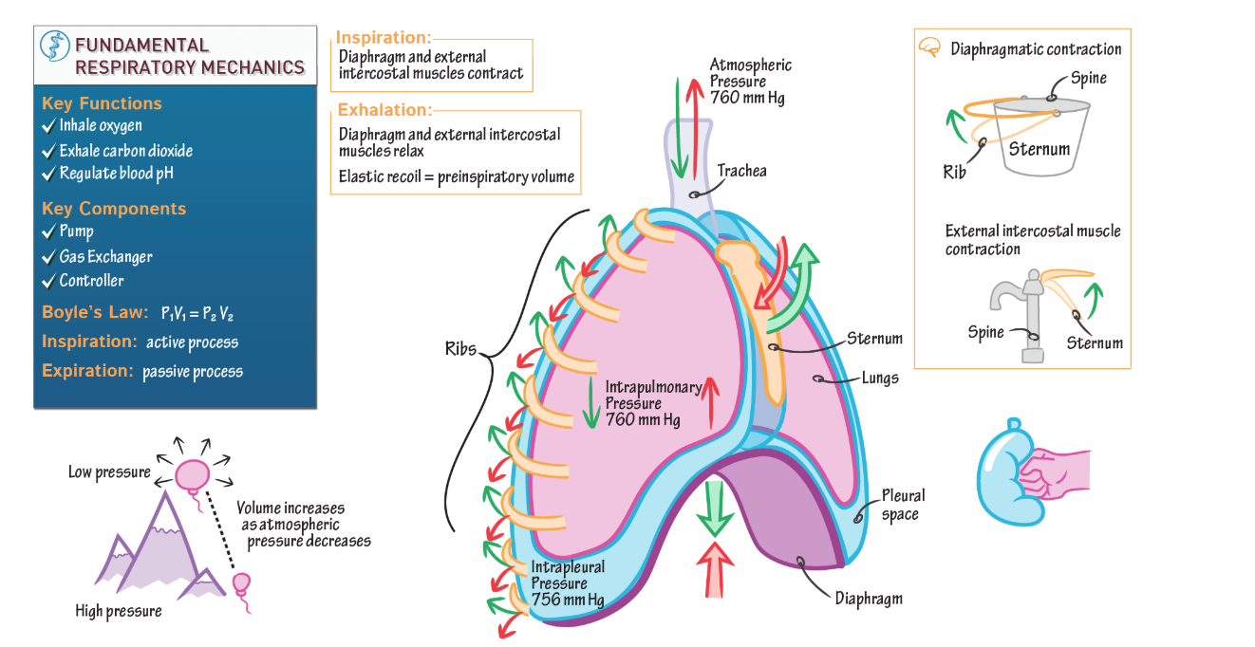
Respiratory mechanics

Slide 5
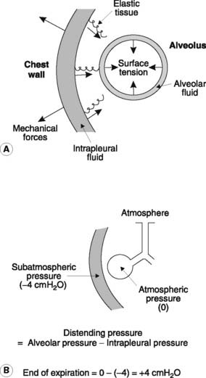
Forces acting on the lung
elasticity of lung (elastic recoil) (collapsing force)
Lung surface tension (collapsing force)
Chest wall recoil (opening force)
Intrapleural pressure-IPP (opening force)

Slide 6
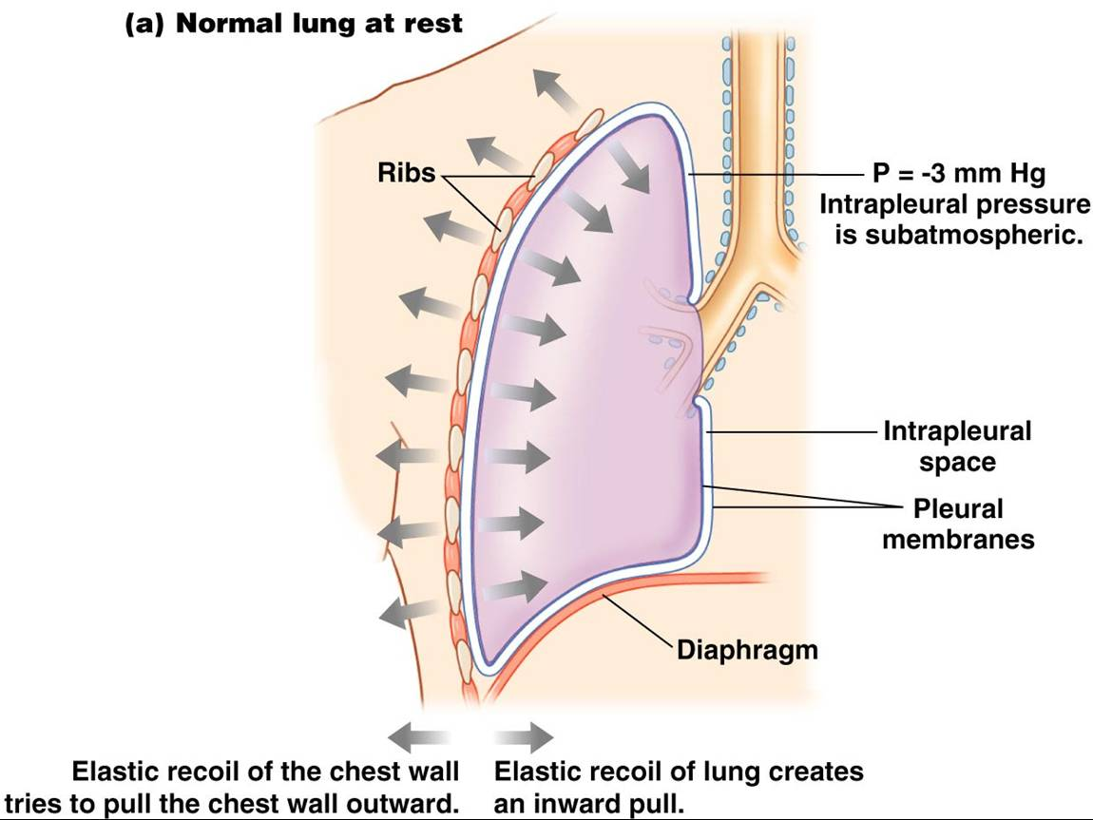
Lung recoil and chest wall recoil

Slide 7
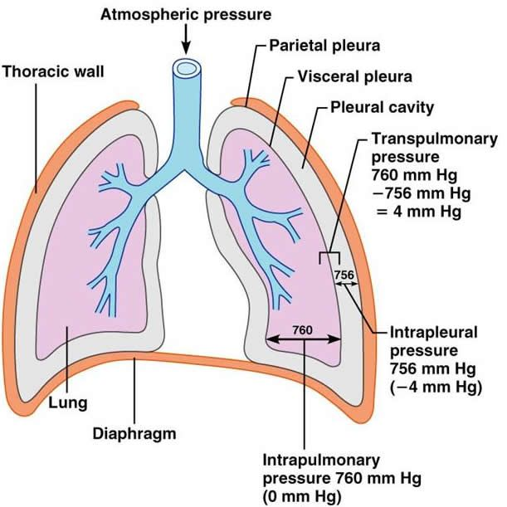
Intrapleural pressure

Slide 8
Major forces acting on the lung
Important points
Intrapleural pressure > Lung recoil → Lung Expands
Intapleural pressure < lung recoil → lung collapse
Intrapleural pressure = Lung recoil → lung size constant

Slide 9
Transmural pressure

Slide 11
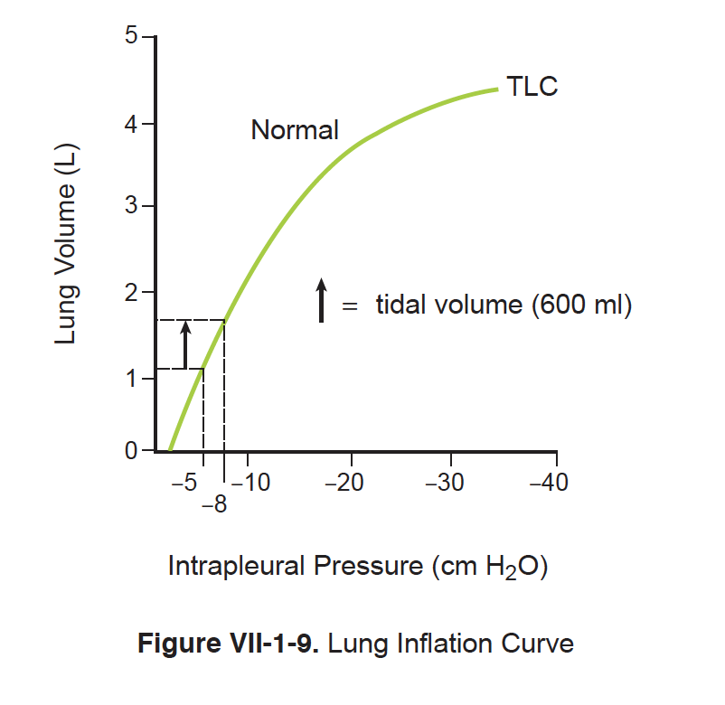
Respiratory compliance

Slide 12
Compliance vs elastance

Slide 13
Lung compliance changes

Slide 14
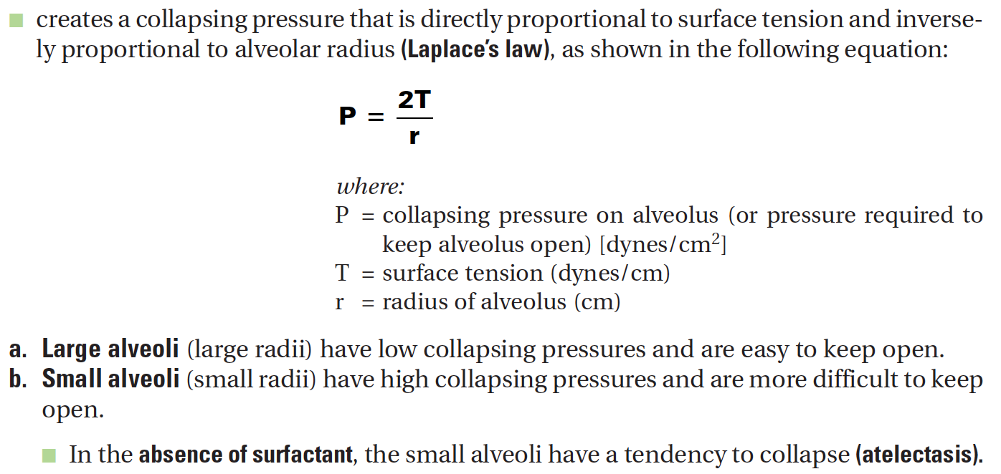
Surface tension

Slide 15
Surface tension

Slide 16
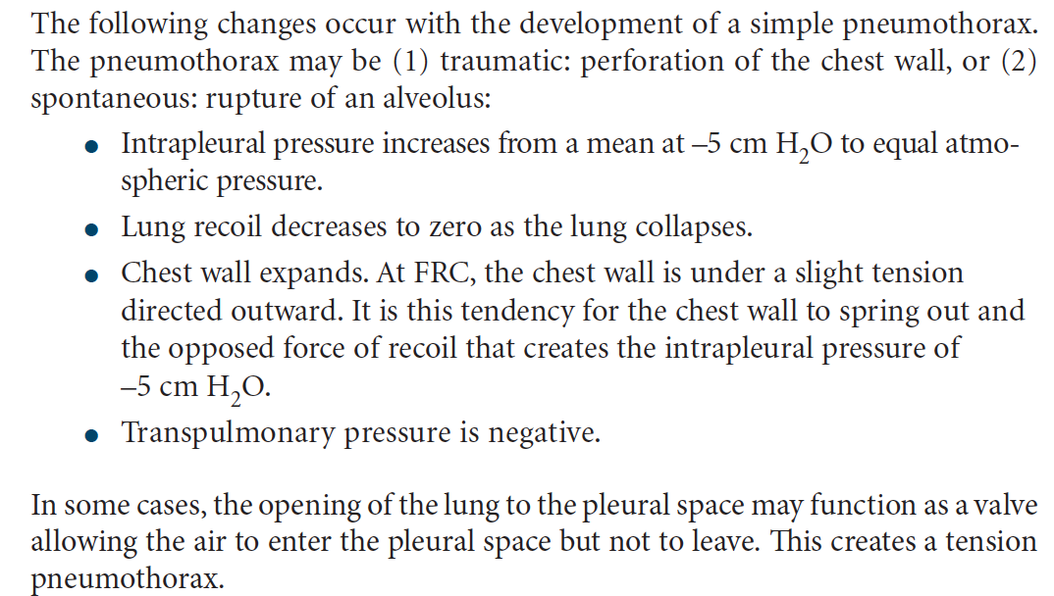
Pneumothorax

Slide 17
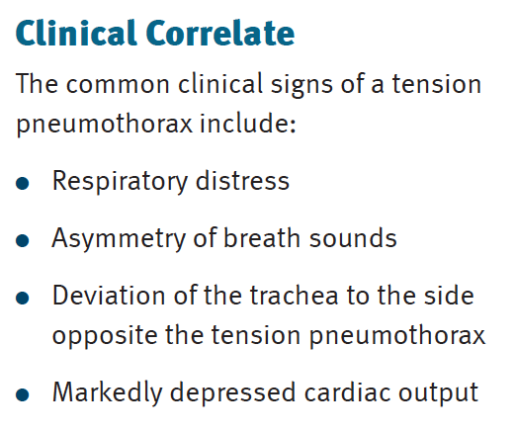
Pneumothorax

Slide 18
Total work of respiratory muscles at quiet breathing
Elastic (static) work (65%)
To overcome the elastic forces of the chest and lungs
Dynamic work (35%)
To overcome the resistence of air passage during the air movement - aerodynamic resistence (28%)
To overcome the friction during mutual movement of inelastic tissue – Viscous resistence (7%)

Slide 19
Respiratory work

Slide 20
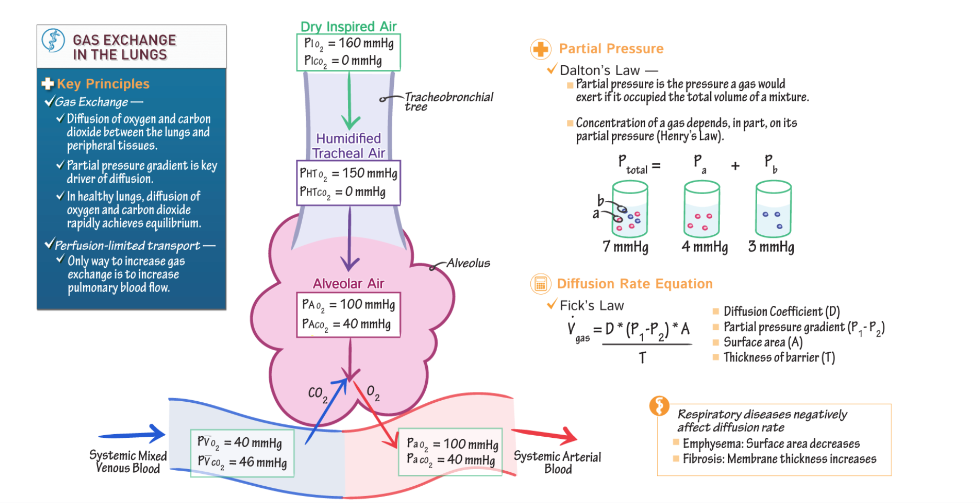

Slide 21
The lung and the transport of O2

Slide 22
Factors affecting PACO2

Slide 23
Factors affecting PAO2

Slide 24
Solubility vs Hem affinity of Gasses

Slide 25
Oxygen-hemoglobin sat curve

Slide 26
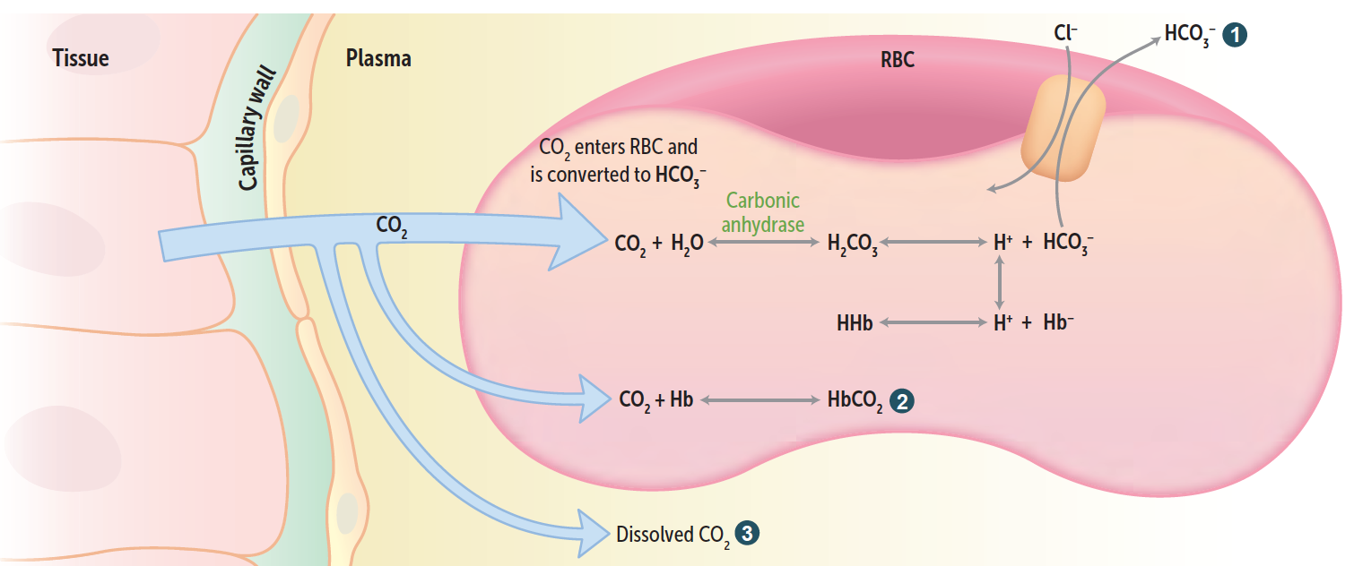
Carbon dioxide transport

Slide 27
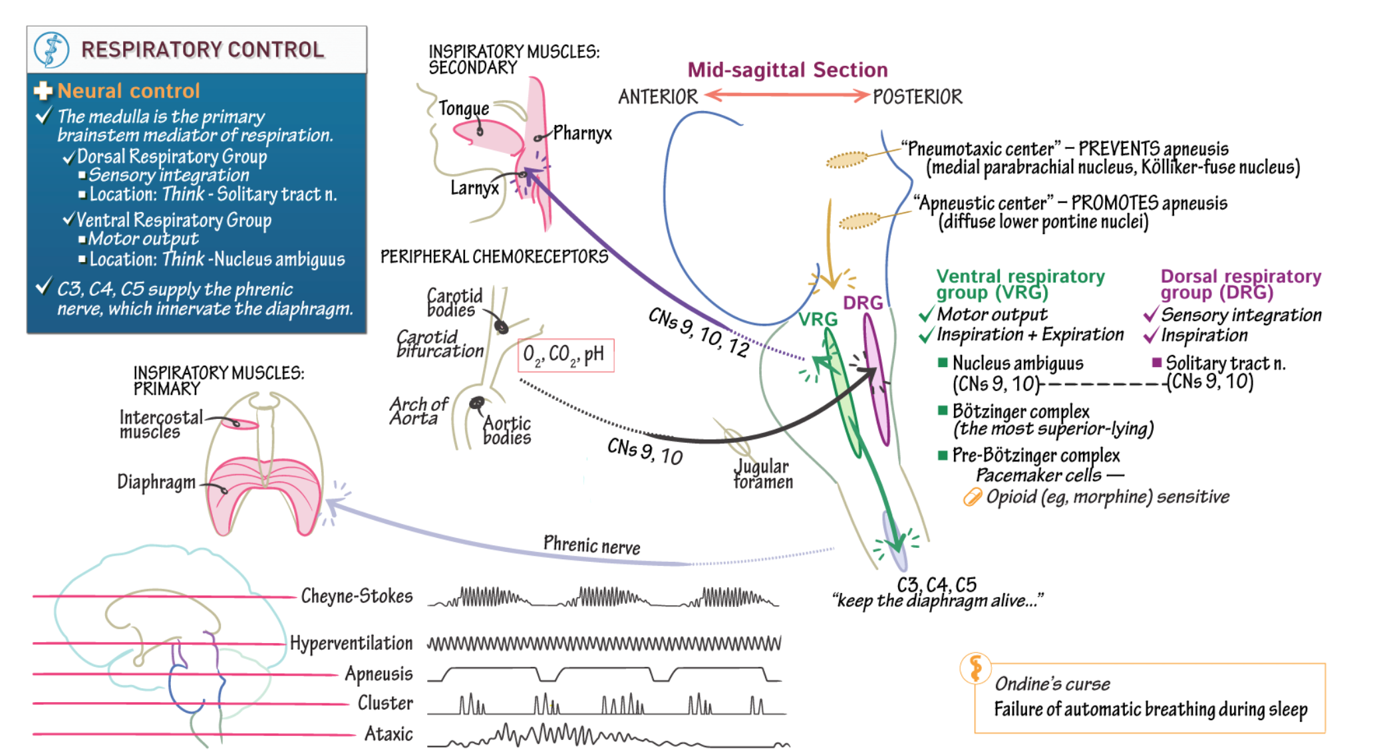

Slide 28
Respiratory center

Slide 29
Regulation of Respiration

Slide 30
Other receptors
Irritants receptors on mucose of respiratory system – quickly adaptated,
Stimulus: chemical substances (histamin, serotonin, cigarette smoke).
Respons: increase mucus secretion, constriction of larynx and brochus
C-receptors (=J receptors)– free nerve ending of n.vagus (type C) in intersticium of bronchus and alveolus;
Mechanical irritans (pulmonary hypertension, pulmonary oedema)
Response: hypopnoe, bronchoconstriction, cough
Stretch receptors slowly adaptation, in smooth muscle trachea and bronchus; its irritants triggered decrese activity of respiratory centre – Hering-Breuer´s reflexes.

Slide 31
Respiratory response to high altitude

Slide 32
Respiratory response to Exercise

Slide 33
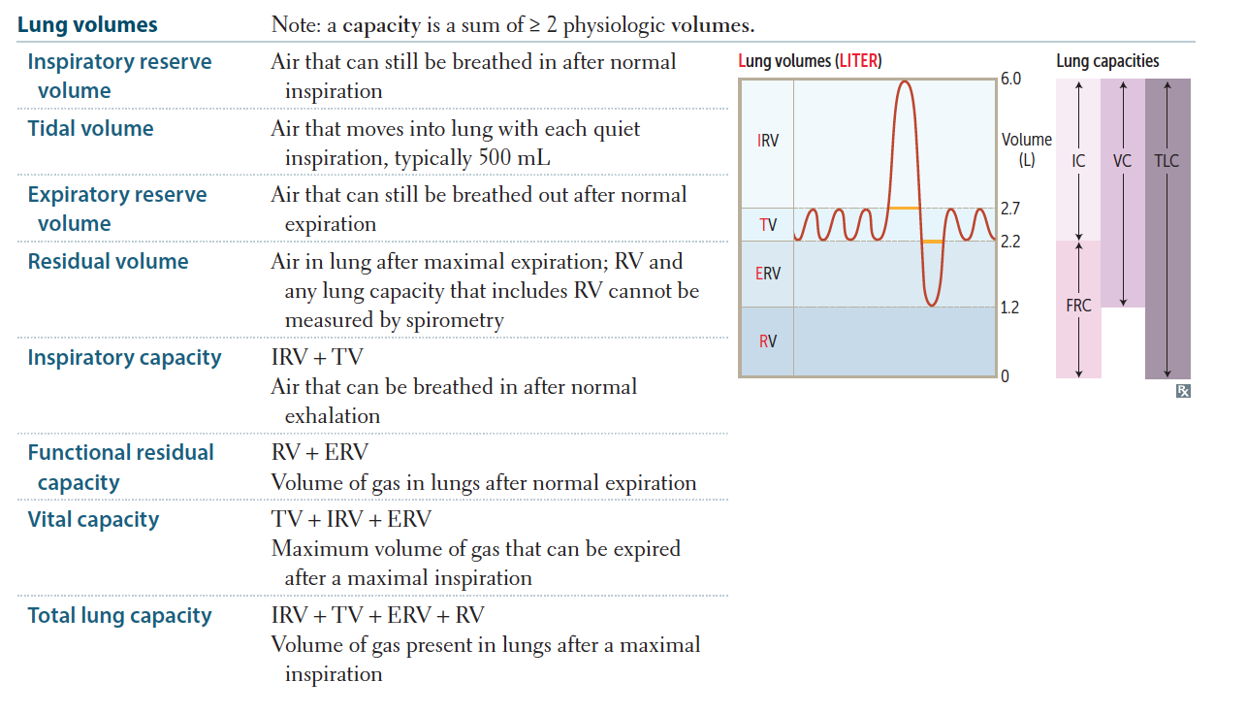

Slide 34
(FEV1/FCV < 80%) = Obstructive pattern

Slide 35
FEV1/FVC = or > 80% (restrictive pattern)

Slide 36
Obstructive vs restrictive diseases studies

Slide 37
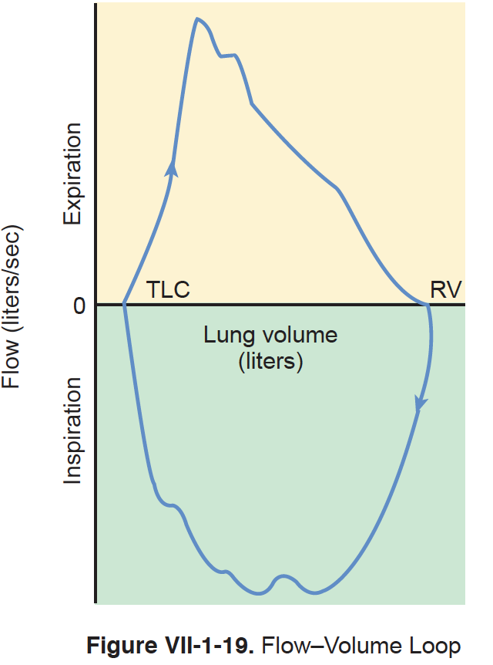
Flow-volume loop

Slide 38
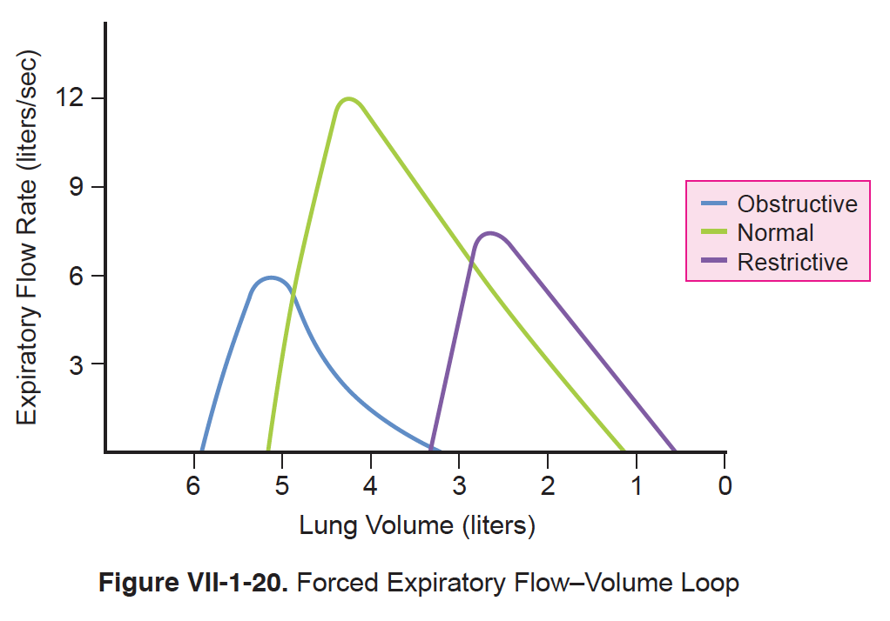
Obstructive vs restrictive lung diseases

Slide 39
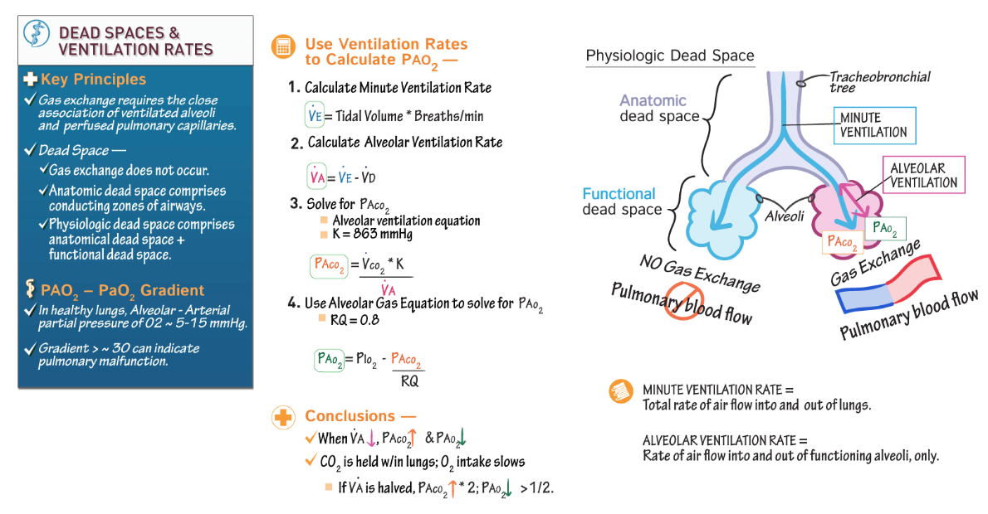

Slide 40
Anatomic dead space

Slide 41
Measurement of Dead space (nitrogen wash out) -video

Slide 42
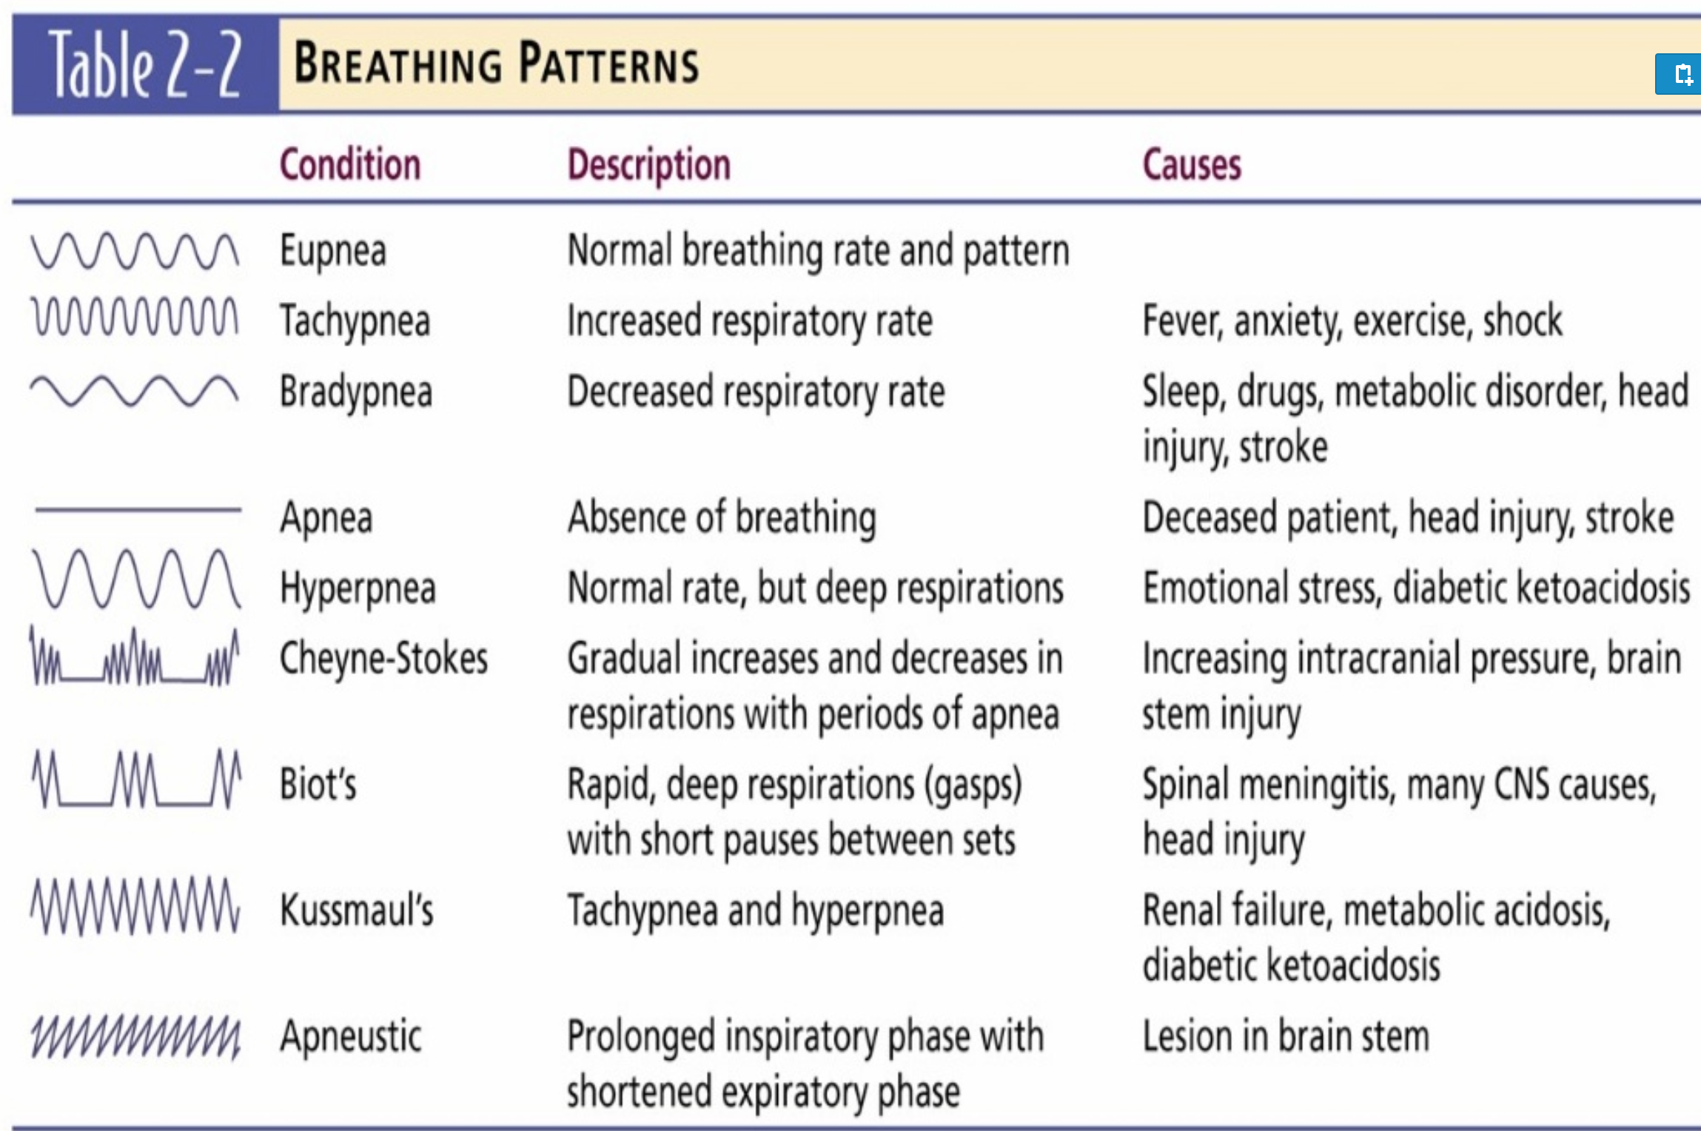
Pneumograph

Slide 43
Hyperventilation
Definition: Both, accelerated and deep breathing
In humans, hyperventilation coming as combination of anxiety and pain
During hyperventilation is expired CO₂ (hypocapnia) and the increase of pO₂ (hyperoxia) → vasoconstriction of cerebral vessels
Symptoms: tingling in the ears, feeling light in the head, headache etc.
Tx : by increasing pCO₂ in the body – e.g.: by breathing into and out of the bag (re-breathing)

Slide 44
Hypoxia
Hypoxia is a general name for a lack of oxygen in the body or individual tissues.
Hypoxemia is lack of oxygen in arterial blood.
Complete lack of oxygen is known as anoxia.

Slide 45
Classification of hypoxia

Slide 46
THANK YOU
Resources
First Aid for USMLE Step 1 2020
Costanzo Physiology
Kaplan Physiology
Illustrations → Drawittoknowit

