Slide 1
Cystic Fibrosis (Mucoviscidosis)
Mayuko Yashiro

Slide 2
Cystic Fibrosis
An AR disorder that affects epithelial cell ion transport and causes abnormal fluid secretion in exocrine glands, as well as in respiratory, gastrointestinal, and reproductive mucosa.
1 of 2500 live births in US
The most common lethal genetic disease affecting Caucasian population
Heterozygote carriers also have a higher incidence of respiratory and pancreatic pathology relative to general population

Slide 3
Cystic fibrosis transmembrane conductance regulator (CFTR) protein
The gene mutated in CF encodes CFTR protein – a chloride channel; activated via agonist-induced increases in intracellular cAMP, followed by PKA activation and CFTR phosphorylation
CFTR regulates other ion channels and cellular processes; CFTR association with the epithelium sodium channel (ENaC) has the most pathophysiologic relevance to CF (see next page)
CFTR mediates bicarbonate transport. Alkaline fluid (containing bicarbonate) are secreted in normal tissues; in some CFTR mutations acidic fluids are secreted → acid environment → mucin precipitation & duct obstruction

Slide 4
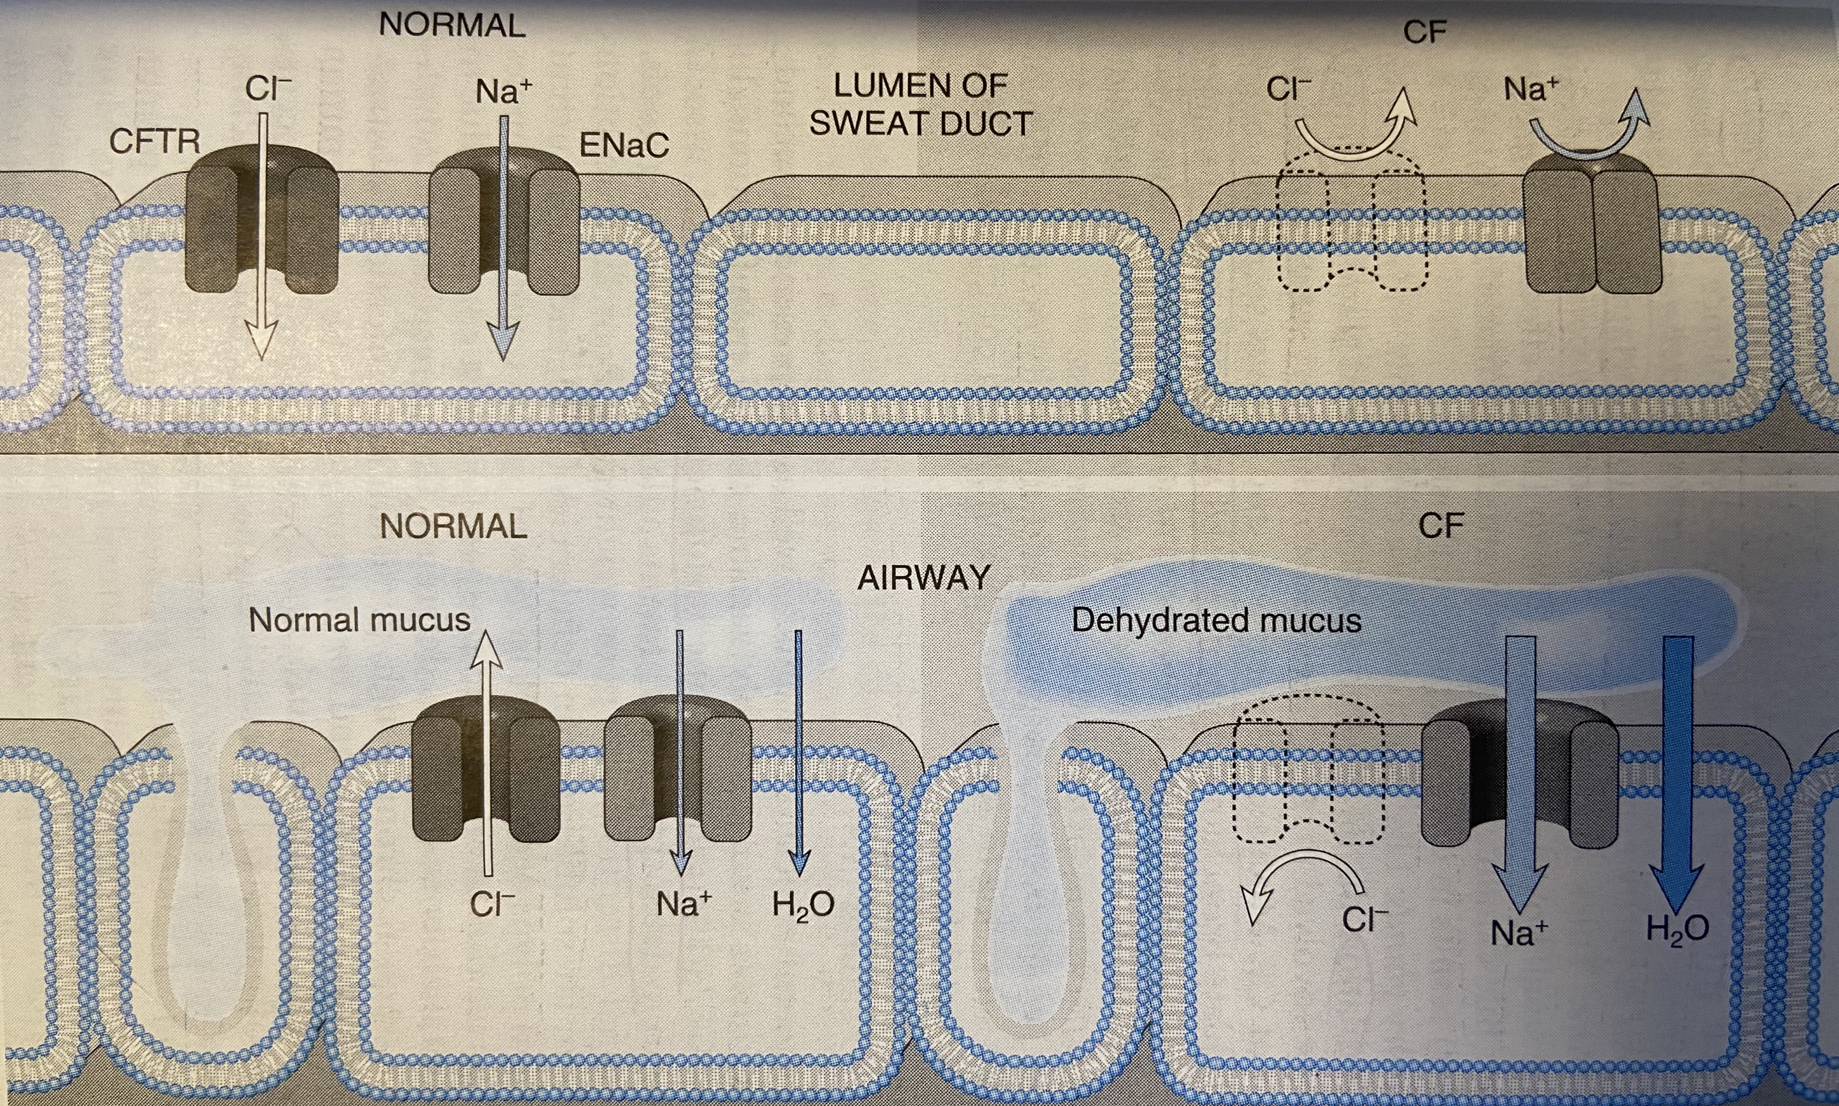
CFTR protein
Tissue-specific CFTR functions
In eccrine sweat duct epithelium, normal CFTR augments ENaC activity. In CF, ENaC activity lost → hypertonic sweat (sweat chloride test used for clinical dg.)
In respiratory and intestinal epithelium, normal CFTR inhibits ENaC activity. In CF, ENaC activity augmented → increased sodium movement into the cell → increased osmotic water resorption from the lumen → dehydration of mucus secretions → defective mocociliary action & accumulation of hyperconcentrated, viscous secretions → obstruct ductal outflow from the organs

Slide 5
CFTR protein
At least 1800 disease-causing mutations of CFTR have been identified
The most common (70% worldwide) is a three-nucleotide deletion coding for phenylalanine at position 508 (delta F508) → defective intracellular CFTR processing with degradation before reaching the cell surface
Classic CF: homozygous for delta F508 mutation (or a combination of any two severe mutations) → virtual absence of CFTR function → severe clinical disease incl. early pancreatic insufficiency and various degrees of pulmonary damage
Atypical or variant CF: other combinations

Slide 6
Modifiers
Genetic and environmental modifiers impact CF severity
Mannose-binding lectin2 (involved in microbial opsonization): reduced expression → increased risk of end-stage lung disease
TGF-β (a direct inhibitor of CFTR function): polymorphisms exacerbate the pulmonary phenotype
The nature of secondary pulmonary infection will impact subsequent inflammation and lung destruction

Slide 7
Morphology
Pacreas: 85-90% of patients, ranging from mucus accumulation in small ducts with mild dilation to total atrophy of the exocrine pancreas. Absence of exocrine secretions → impairs fat absorption → avitaminosis A → ductal squamous metaplasia
Intestine: thick viscous plugs of mucus (meconium ileus) → small bowel obstruction (5-10% of affected infants)
Liver: bile canalicular plugging by mucinous material → diffuse pancreatic cirrhosis

Slide 8
Morphology
Salivary glands: like pancreas, duct dilation, ductal squamous metaplasia, and glandular atrophy
Lungs: involved in most cases and the most serious complication of CF. Mucus cell hyperplasia and viscous secretions block and dilate bronchioles. Superimposed infections and pulmonary abscesses are common. Eg. S. aureus, H. influenzae and P. aeruginosa; Burkholderia cepacia is associated with fulminant illness
Male genital tract: Azoospermia and infertility occur in 95% of male surviving to adulthood, frequently with congenital absence of the vas deferens

Slide 9
Clinical features
In classic CF, pancreatic exocrine insufficiency → malabsorption
→ large, foul-smelling stools, abdominal distention and poor weight gain
→ fat-soluble vitamin deficiencies (A,D and K)
Recurrent sinonasal polyps (10-25%)
Male infertility due to obstructive azoospermia (most commonly due to congenital absence of the vas deferens)
Cardiorespiratory complications such as cor pulmonale are the most common causes of death (approx. 80%)
Chronic liver disease in 15%
The mean life expectancy is approaching 40 years

Slide 10
Treatment
Traditionally focused on antimicrobials, pancreatic enzyme replacement, and bilateral lung transplantation
More recently, “potentiator” therapy has been introduced for defective forms of CFTR that are present at normal levels in the cell membrane; partially restore normal ion transport function
Thank you!

