Slide 1

Duchenne muscular dystrophy (DMD)
Clinical Genetics – Faculty of Medicine, Masaryk University
Nao Fujitani, Pranav Naresh Gajria, Sumeet Gulati

Slide 2
Pathology
(Definition)
Duchenne muscular dystrophy (DMD) is a genetic disorder affecting the largest gene in the human body
progressive skeletal muscle degeneration (wasting) and weakness
gene mutations result in alterations of dystrophin protein involved in keeping muscle cells intact
Dystrophin connects cytoskeleton of individual muscle fibers to underlying basement lamina
> Absent dystrophin allows entry of excess Ca++
>> Ca++ triggers multiple signal pathways & allows
movement of water into the cell
>>> Mitochondria burst

Slide 3
Pathogenesis/ Pathophysiology
Etiology: mutation of dystrophin gene at locus Xp21 (short arm of the X chromosome)
Mitochondrial dysfunction increases stress-responses
Increased production of ROS
Damage to sarcolemma leading to cell death (muscle fibres undergo necrosis.
Necrosis is replaced with adipose + connective tissue

Slide 4
Epidemiology
X-LINKED RECESSIVE
typically males < 5years old ~ 1/3,500 worldwide
female carriers (unaware until birth of affected son)
extremely rare disease in females ~ 1/50,000,000
Can occur in females with:
1) affected father and carrier mother;
2) in those who are missing an X chromosome;
3) those who have inactivated X chromosome.
2010 US study – Hispanics most affected

Slide 5
Genetics
Inherited – X-LINKED RECESSIVE DISEASE
son of carrier mother has a 50% chance of inheriting defective gene
daughter of carrier mother has 50% chance of being carrier AND 50% chance of having 2 normal copies of gene
In all cases, unaffected father passes normal Y to son OR a normal X to his daughter
Female carriers of X-linked recessive condition (e.g. DMD) can show symptoms depending on their pattern of X-inactivation (lyonization)
* (Mutations within the dystrophin gene can either be inherited or occur spontaneously during germline transmission???????????????????????????????????????????????????????)

Slide 6
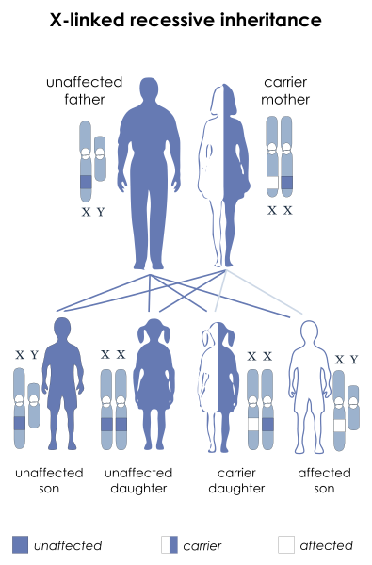
X-Linked Inheretence
https://en.wikipedia.org/wiki/File:X-linked_recessive.svg

Slide 7
Signs & Symptoms
Male infant, <5 years old – visible from first steps!
Muscle wasting voluntary muscles affected first (hips/pelvic area & thighs/calves)
progresses to the shoulders/neck, followed by arms/respiratory muscles…other…
Fatigue
Short Achilles’ tendon
Problems with motor skills (posture/gait – walk on toes)
Trouble getting up from lying/sitting = Gower’s Sign
Spinal issues (lordosis/scoliosis)
Cardiomyopathy (often dilated)
Neurobehavioral/learning difficulties

Slide 8

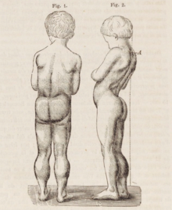
Clinical Picture
POSITIVE GOWER’S SIGN https://upload.wikimedia.org/wikipedia/commons/thumb/7/7c/Gower%27s_Sign.png/330px-Gower%27s_Sign.png
Drawing of 7-year-old boy with Duchenne muscular dystrophy. There is excessive development of the lower limbs (pseudohypertrophy), and thinness of the arms. In the figure on the right, lumbar hyperlordosis is visible.
https://upload.wikimedia.org/wikipedia/commons/thumb/4/49/Drawing_of_boy_with_Duchenne_muscular_dystrophy.png/330px-Drawing_of_boy_with_Duchenne_muscular_dystrophy.png

Slide 9
Diagnosis
Genetic counselling for those with Familial Anamnesis OR carrier detection
95% accuracy of genetic studies during pregnancy
(markers/genetic sequences)
CVS @ 11 wks; Amniocentesis @ 15 weeks
DNA test in affected patient – dystrophin gene mutation
Muscle biopsy – immunohistochemistry, etc…

Slide 10
Treatment, Management & Prognosis
No cure
Av. life expectancy = 26 yrs (many living into 30s)
Trx – aims to control onset of symptoms + optimal quality of life (use of questionaires)
Corticosteroids (short-term improvements ~ 2 yrs)
Physical Therapy
Orthopaedics (braces/wheelchairs)
Respiratory support
Pacemaker for cardiac problems
Eteplirsen: antisense oligo - controversially approved in US for trx of mutations due to dystrophin exon 51 skipping
Ataluren: approved for certain cases in EU.
Golodirsen: antisense oligo - approved in US in 2019 for the treatment of cases that benefit from skipping exon 53 of the dystrophin transcript

