Slide 1
DiGeorge syndrome
Emil Sagberg, Barak Moskovitz & Omar Magdi

Slide 2
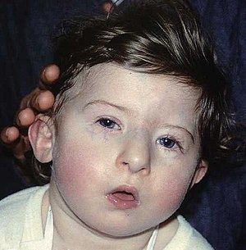
History
Also known as:
  22q11.2 deletion syndrome
  Velocardiofacial syndrome
First described in 1968 by Angelo DiGeorge.
The underlying genetics were found in 1981.

Slide 3
Epidemiology
DiGeorge syndrome affects one in 2000-4000 live births.
Probably underdiagnosed due to some individuals having very few and mild symptoms – and therefore not diagnosed
It is one of the most common causes of intellectual disability due to a genetic deletion syndrome.

Slide 4
Etiology
Caused by the deletion of a small segment of chromosome 22
  Typically deletion of 30-50 genes
  22q11.2 (long arm of chromosome 22, region 1, band 1, sub-band 2)
  Very rarely due to deletions on short arm of chromosome 10
Autosomal dominant
90% due to new mutation
10% inherited from parents
=> hypoplasia of 2nd & 3rd pharyngeal pouch derivates
Very wide register of symptoms – due to incomplete penetrance

Slide 5
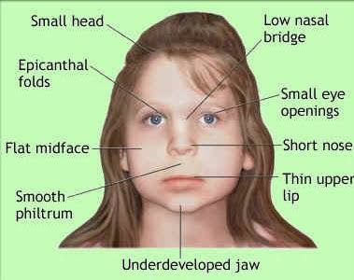
Symptoms
Birth defects
  Congenital heart disease (40%) w. cyanosis
  Cleft palate (due to neuromuscular problems) (50%)
Thymic hypoplasia - recurrent infections & autoimmune disorders due to altered T-cell response
Parathyroid gland dysfunction – low PTH & hypocalcemia
Kidney- & GIT problems
Hearing loss (both sensorineural & conductive)

Slide 6
Cognitive- & psychiatric impairments
Usually below borderline normal IQ
  Learning difficulties in 90%
Speech & language
  Hypernasality, articulation errors & delayed vocabulary aquisition
Autism-like behavior (severe hypocalcemia in early childhood)
ADHD
Seizures
High risk of schizophrenia (25%) & psychosis
High risk of early onset Parkinson's Disease

Slide 7
Diagnosis
Diagnosis can be difficult due to great variability of symptoms and phenotypes between individuals.
Fluorescence in situ hybridization (FISH) is able to detect microdeletions that standard karyotyping miss.
Newer methods of analysis which can detect atypical deletions (not detected by FISH):
  Multiplex ligation-dependent probe amplification assay (MLPA)
  Quantitative polymerase chain reaction (qPCR)

Slide 8
Treatment
No cure is known for DiGeorge syndrome.
Although there is no cure, treatment can improve symptoms. The key is to identify each of the associated features and manage each using the best available treatments.
  E.g., cardiac surgery is often required for congenital heart abnormalities. Hypoparathyroidism causing hypocalcemia often requires lifelong vitamin D and calcium supplements, etc..

Slide 9
Sources
https://www.mayoclinic.org/-/media/kcms/gbs/patient-consumer/images/2013/08/26/10/45/ds00738_ds00998_im02607_fl7_cleft_palatethu_jpg.png
https://scontent-prg1-1.xx.fbcdn.net/v/t1.0-9/35993643_630093554033065_3043657204562395136_n.jpg?_nc_cat=103&_nc_sid=9267fe&_nc_ohc=PfhlYAE1zkUAX_PEeKw&_nc_ht=scontent-prg1-1.xx&oh=f26a8809bc64da7e99ae0d037237acd6&oe=5EF93F63
https://upload.wikimedia.org/wikipedia/commons/thumb/c/cb/DiGeorge_syndrome1.jpg/300px-DiGeorge_syndrome1.jpg
https://en.wikipedia.org/wiki/DiGeorge_syndrome

