Slide 1
Fragile X Syndrome
By: Neha SINGH, Maddalena Dal Pozzo AND HANA TAKAHASHI.

Slide 2
Pathology
Autosomal recessive, X-linked disease.
Inherited defect in 5’ untranslated region of familial mental retardation-1 (FMR1) gene→ trinucleotide expansion→ abnormal length→⬆️ methylation→ promoter region methylation→ ↓ familial mental retardation protein (FMRP) synthesis→ clinical phenotype.

Slide 3
Causes
Trinucleotide (CGG) repeat expansion-:
45-54: intermediate expansion repeat number.
55-200: carrier/premutation individual repeat number.
200-4000: affected individual repeat number.
Inheritance-:
Autosomal recessive
Mutations occur/worsen during oogenesis.
Anticipation-: genetic mutation continue through pedigree→ ↑ length of expansion→ ↑ severity of disease.

Slide 4
Signs and Symptoms
Females are likely to show mild symptoms as compared to males.
Common features are as follows-:
Physical phenotype-: long face, prominent forehead, large ears, flat feet, low muscle tone, macro-orchidism after puberty, hyperextensible thumbs and finger joints and soft skin.
Speech-: begin to talk later than other children.
Vision-: strabismus, if left untreated can lead to amblyopia.
Neurological-: intellectual disabilities, social anxiety, hypersensitivity and repetitive behavior, ADHD, fluctuating mood, self-harm, aggression and irritability.

Slide 5
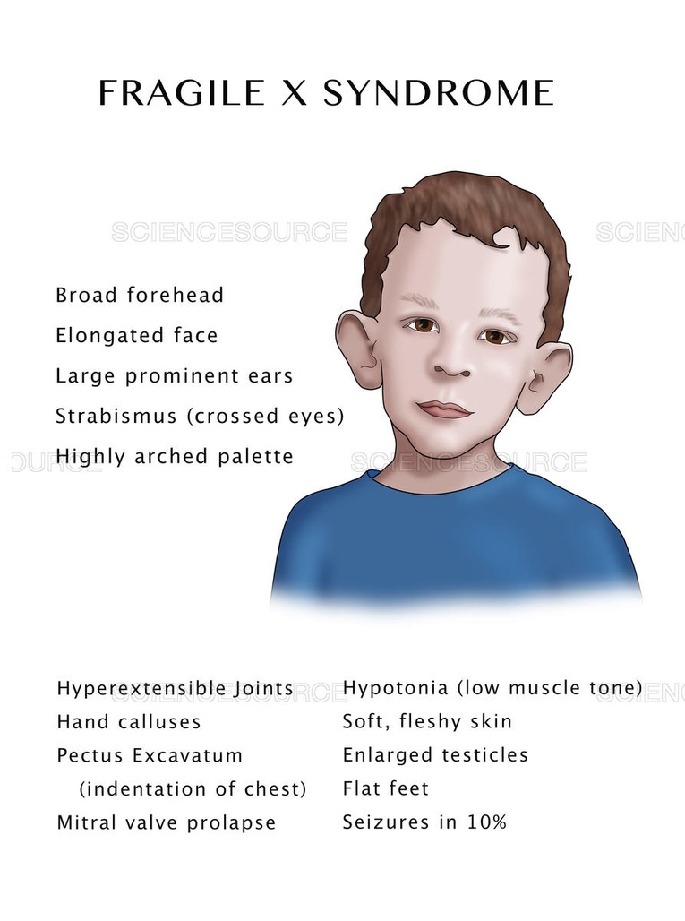

Slide 6
Complications
Behavioural features-: Autism, ADHD, anxiety disorders.
Seizures
Fragile X tremor/ataxia-: observed in carrier/premutation individuals.
Tremor/ataxia- parkinsonism.
Short term memory loss, executive dysfunction (common).
In females ovarian insufficiency; early menopause.

Slide 7
Diagnosis
Count CGG repeats on X-chromosome with the help of
Polymerase chain reaction (PCR).
Methylation status with the help of southern blot analysis.
2. Prenatal testing:
Chorionic villus sampling.
Amniocentesis.

Slide 8
Treatment
Medication-: symptoms directed management.
Behavioural features- ADHD Presentation-: > 5yr old- stimulant preparation e.g. methyphenidate.
Anxiety/mood disorders- SSRI- SELECTIVE SEROTONIN REUPTAKE INHIBITORS.
Seizures- anticonvulsants.
Psychotherapy
Others-:
Special education.
Vocational training.
Antidepressants and antipsychotics.
Early intervention.

Slide 9
References-:
Garber, KB; Visootsak J, Warren ST. (2008). “Fragile X syndrome”.
European Journal of Human Genetics. 16 (6): 666–72. doi:10.1038/ejhg.2008.61. PMID 18398441.
Hagerman RJ; Berry-Kravis E; Kaufmann WE; Ono, M. Y.; Tartaglia, N.; Lachiewicz, A.; Kronk, R.; Delahunty,
C.; Hessl, D.; Visootsak, J.; Picker, J.; et al. (2009). “Advances in the treatment of fragile X syndrome.”
Pediatrics. 123 (1): 378–90. doi:10.1542/peds.2008-0317. PMC 2888470 Freely accessible. PMID 19117905.
U.S National Library of Medicine (2017).
Retrieved from: https://ghr.nlm.nih.gov/condition/fragile-x-syndrome
US Department of Health and Human Services | National Institutes of Health (2017).
Retrieved from:
https://www.nichd.nih.gov/health/topics/fragilex/conditioninfo/Pages/commonsymptoms.aspx

