Slide 1
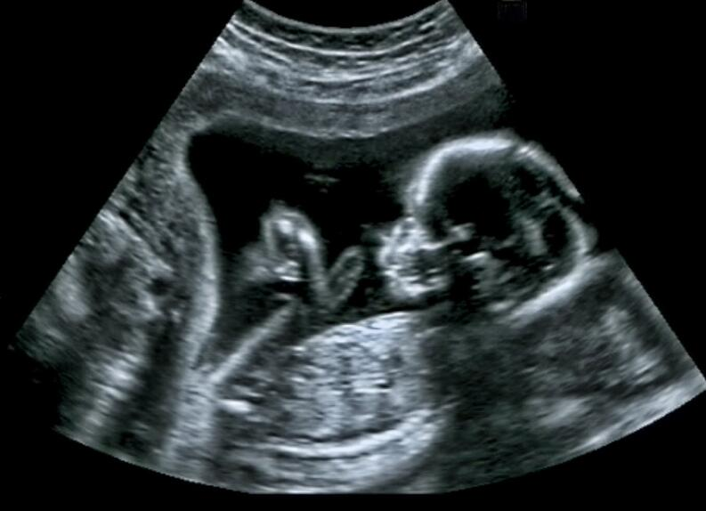
Genetic testing in pregancy

Slide 2
Amniocentesis
Diagnostic test for withdrawing amniotic fluid from uterine cavity
Using a needle via transabdominal approach
Under continous ultrasound guidance
To obtain a sample of fetal exfoliated cells, transudates, urine or secretion
Used since 1960s
Performed at 15-20 weeks

Slide 3
What it does
Various chromosomal, biochemical, molecular and microbial studies are performed on amniotic fluid sample
Most common reasons:
chromosomal disorders (Down‘s syndrome)
Sex chromosome abnormalities (Turner syndrome, Klinefelter syndrome)
Genetic disorders (cystic fibrosis, sickle cell disease)
Neural tube defects (spina bifida)
fetal infection and intra-amniotic inflammation
assess fetal lung maturity
blood or platelet type

Slide 4
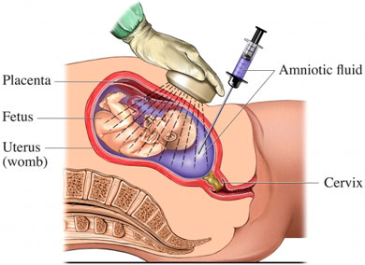
How it works
Under guidance of ultrasound, a sterile needle is inserted through abdominal wall into amniotic sac
A small amouhnt of amniotic fluid is withdrawn through needle
The amniotic fluid contains fetal cells, which are seperated from amniotic fluid and cultured
Test are performed on cultured cells

Slide 5
Candidate for amniocentesis
Pregnant woman > 40 years
Woman with high risk blood tests and fetal ultrasound
Woman whose ultrasound shows potential fetal chromosomal anomaly
Woman with family history or whose partner has family history of one or more incidents of chromosomal anomalies or genetic disorders
Possible for woman < 40 years with nor history of genetic disorders to have amniocentesis; it is a matter of personal choice!

Slide 6
Risks and Complications
Risk of fetal loss of approximaltely 0,5%
Amniotic fluid leakage
Placental hemorrhage
Intra-amniotic infection
Abdominal wall hematoma
Fetal lesion

Slide 7
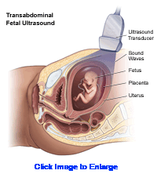
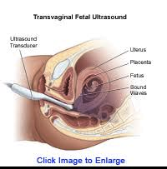
Prenatal Ultrasound

Slide 8
Prenatal Ultrasound
Technique for identifying physical signs of gene abnormalities
Non-invasive use of US equipment
Safe and painless for mother and fetus
Practical use in decision making regarding keeping/not keeping fetus
Used as “double testing” together with serological test of the mother
Used since 1960s
Performed at 11-14th week, also repeated in second and third trimesters

Slide 9
What it does
Image of the fetus within the womb
Allows the doctor to access physical abnormalities of the fetus
Especially the fetus' neck is accessed for extra fluid or thickening – indication for trisomy 13, 18, 21
Use for determining length of pregnancy, number of fetuses, condition of uterus and cervix

Slide 10
How it works
Gell will be applied on the belly, the transducer is applied and emits high-frequency sound waves
These waves are interpreted into images by a computer
The woman is often asked to maintain a full bladder, to increase the image resolution
Transvaginal US is possible, f.ex early in pregnancy when better seen from this angle
Duration proximate 30 min

Slide 11
Candidate for fetal ultrasound diagnosis
Mothers of higher age, 38+
Family history of genetic disorders – hereditary diseases
Genetic parents previously having had a child with genetic abnormality
Mother in risk group, e.g., she is a drug user, use certain medications etc.
A previous US examination showed indications for abnormality → new “double examination” with US and serology
Ultrasound examination as part of prenatal care (Norway)

Slide 12
Risks and Complications
No risk related to the ultrasound
If probable finding of genetic defect the doctor will recommend amniotic fluid sampling to confirm the diagnosis

Slide 13
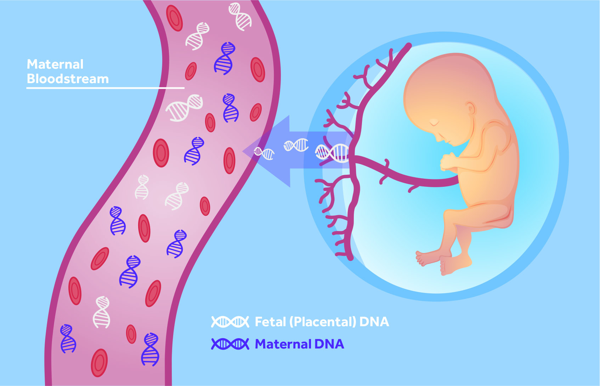
Maternal blood test
Noninvasive screening test that helps to assess the risk of chromosomal abnormalities and neural tube defects
It is usually used in a combined form with other tests

Slide 14
How it works
Blood from the mother is taken in the first and second trimester of the pregnancy.
First trimester blood (week 9-13) is tested for the levels of hCG and pregnancy associated plasma protein
Second trimester blood (week 15-17)is tested for multiple markers like AFP, hCG, Estriol and Inhibin.
The fetus or placenta produces those markers. Over the placenta those markers enter the maternal blood.
The amount of those markers changes during pregnancy and also in case of chromosomal abnormalities and neural tube defects.

Slide 15
Maternal blood testing
First trimester screening for:
pregnancy-associated plasma protein (PAPP-A)– placental protein
Human chorionic gonadotropin– placental hormone of early pregnancy
Abnormal levels of PAPP-A or hCG indicate a higher risk for chromosomal defects such as Trisomy 18 or trisomy 21.
Second trimester screening:
Alpha-fetoprotein screening– made by the fetal liver and is found in amniotic fluid. Abnormal levels indicate:
open neural tube defects e.g. spina bifida
Chromosomal problems e.g. down syndrome
Twins
Incorrect due date– levels vary throughout pregnancy
hCG
Estriol
Inhibin

Slide 16
What it does:
it is a screening test to identify pregnancies with a higher risk for chromosomal abnormalities like down syndrome (trisomy 21) or Edwards syndrome (trisomy 18).
It can also be used to search for neural tube defects.
Twins or multiples produce more of some markers and can therefore be detected.
It is not very accurate and therefore a positive result is not a diagnosis, it is only an indication for further testing. The test will detect between 69-81% of babies with down syndrome and about 80% of neural tube defects. Exact detection rates depends on the number of proteins tested and the laboratories. To increase the accuracy of the tests it is often used in combined forms with other tests.

Slide 17
Risks, complications and indication
The risks are the same as for any other blood draw during pregnancy. If correctly performed it is a very safe test.
It is indicated in all pregnancies.

Slide 18
Chorionic villus sampling
Technique to obtain placental tissue.
Can be performed as a needle biopsy through the belly or by inserting a catheter through the cervix.
The test increases the risk of miscarriage and is therefore only used if indicated by other tests
Was performed for the first time in 1983 in Milan.
Can be used as early as in week 8 of pregnancy.
Can detect more than 200 different disease.

Slide 19
What it does
Identifies:
chromosomal disorders (Down‘s syndrome)
Sex chromosome abnormalities (Turner syndrome, Klinefelter syndrome)
Genetic disorders (cystic fibrosis, sickle cell disease)
Can be used to obtain fetal stem cells.

Slide 20
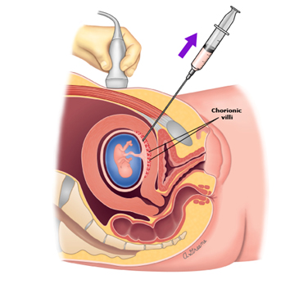
How it works
First the position of the placenta is identified by ultrasound.
Transabdominal chorionic villus sampling– a long thin needle is inserted through the abdominal wall into the uterus to obtain the tissue sample
Transcervical chorionic villus sampling– a hollow tube is inserted through the cervix and when the catheter reaches the placenta a small tissue sample is obtained by suction.
The procedure is not performed in case of an active cervical or vaginal infection, bleeding or an inaccessible placenta due to a tilted uterus.
The procedure is quided by ultrasound
The genetic material of the obtained sample will be evaluated

Slide 21
Candidates for chorionic villi sampling
Women with abnormal first trimester screen results
Family history of chromosomal abnormalities or other genetic disorders
Age of the mother over 35 years
Abnormal findings on ultrasound

Slide 22
Risks and complications
The risk of miscarriage after CVS is 1-2%.
Some research suggest that the increased risk may not be only due to the sampling but also due to the higher risk of miscarriage in
Infection from the puncture site
Amniotic fluid leakage that may result in oligohydramnios (low amniotic fluid levels)
Untreated oligohydramnios may result in hypoplastic lungs
Risk of Limb Reduction Defects
Rh sensitization

