Slide 1
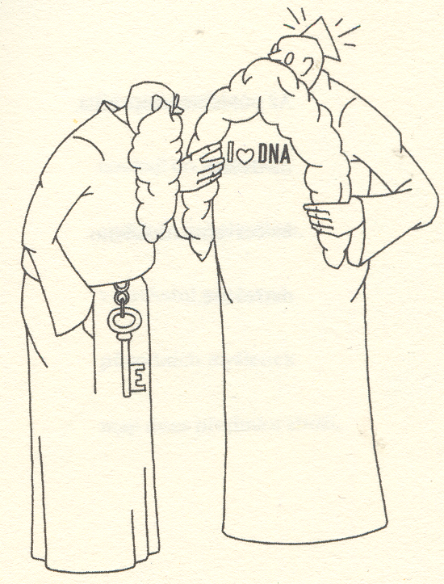
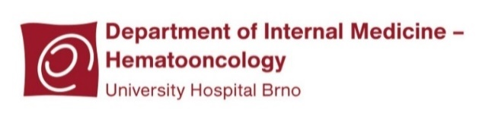



Medical Genetics
Miroslav Barták
Kateřina Staňo Kozubík, Michael Doubek

Slide 2
Why medical genetics
Genome role in diagnostics, therapy and prevention
= application in medical practice
It is possible to implement into practice only what I know and what I have in mind

Slide 3
What you should already know
What is a gene
genes: structural
for functional RNAs
- housekeeping genes
- gene expression
- exones, intrones, non-transcribed regions, promotors
Informational macromolecules
Transcription, alternative splicing, translation
Chromosomes

Slide 4
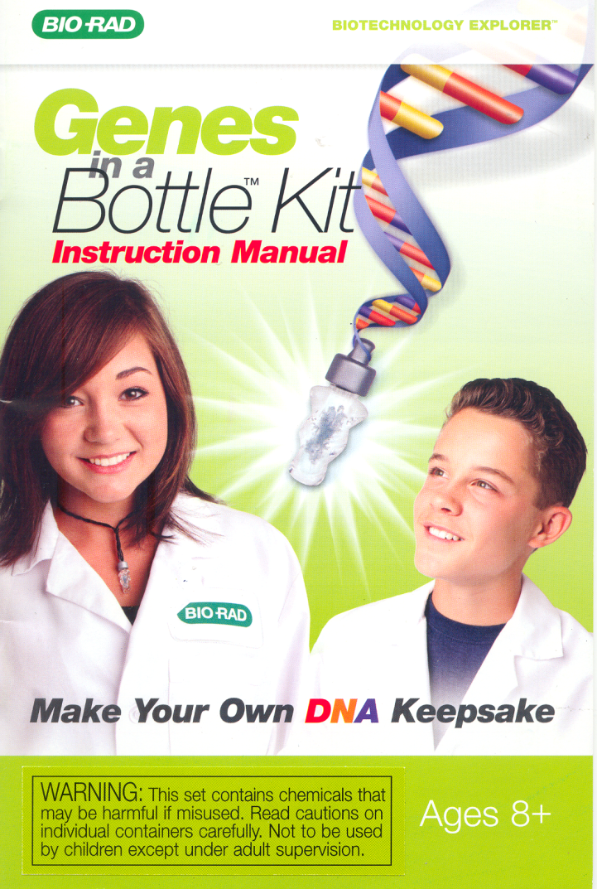
What is a DNA?
cold ethanol + salt + detergent
> 1 m DNA
Věda je zábava, Svojtka & Co, 2015

Slide 5
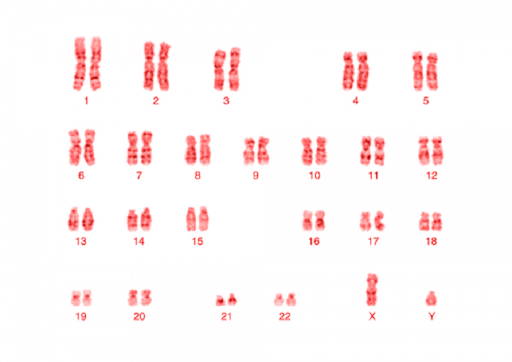

Slide 7
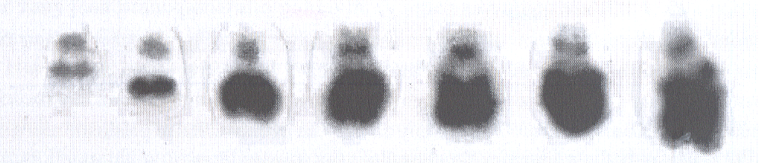
Kočárek, 2013

Slide 8
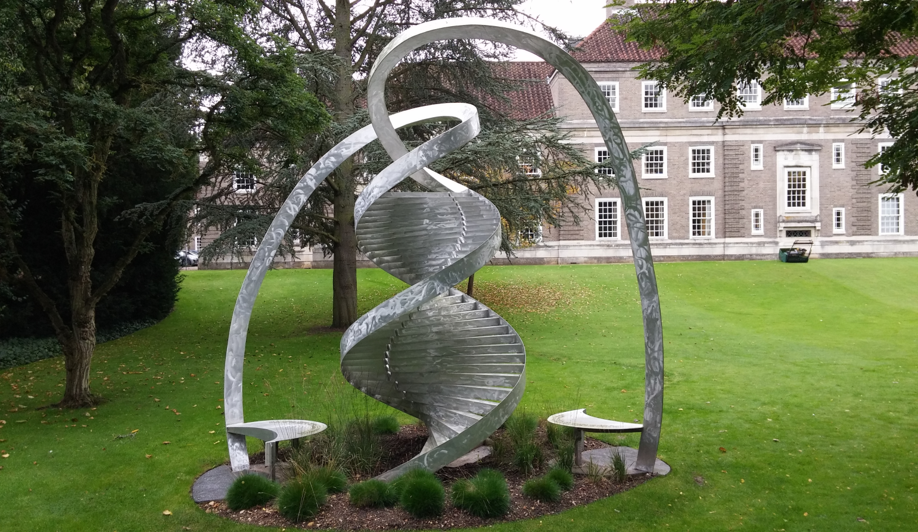
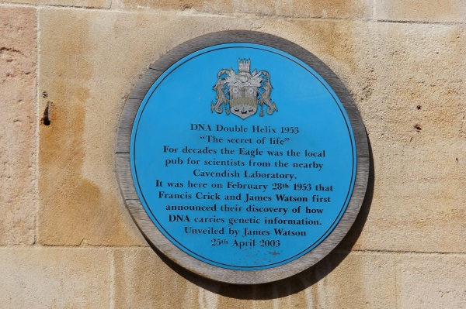
Cavendish Laboratory and The Eagle Pub
Watson + Crick + Wilkins + Franklin

Slide 9

?
Using results without permit
Eugnenics
Black men’s IQ
Cavendish Laboratory and The Eagle Pub
Watson + Crick + Wilkins + Franklin

Slide 10
Terminology
Genetics: study of genes, genetic variation, and heredity in living organism
Genome: complete set of DNA within a single cell of an organism
Genomics: focuses on the structure, function, evolution, and mapping of genomes

Slide 11
Terminology
Genome is more than just a sum of genes
Genetics
Genome
Genomics

Slide 12
Terminology
- Structural
(DNA, chromosomes)
- Functional
(RNA, gene expression)
- Comparative
Genetics
Genome
Genomics

Slide 13
Terminology
Genetics
Genome
Genomics
Microbiome
Transcriptome
Epigenetics

Slide 14
Terminology
Community of microorganisms inhabiting
a particular environment
Genetics
Genome
Genomics
Microbiome
Transcriptome
Epigenetics

Slide 15
Terminology
Genetics
Genome
Genomics
Microbiome
Transcriptome
Epigenetics
Set of all RNA molecules in one cell or a population of cells in certain time

Slide 16
Terminology
Genetics
Genome
Genomics
Microbiome
Transcriptome
Epigenetics
Study of heritable changes in gene function that do not involve changes in the DNA sequence

Slide 17
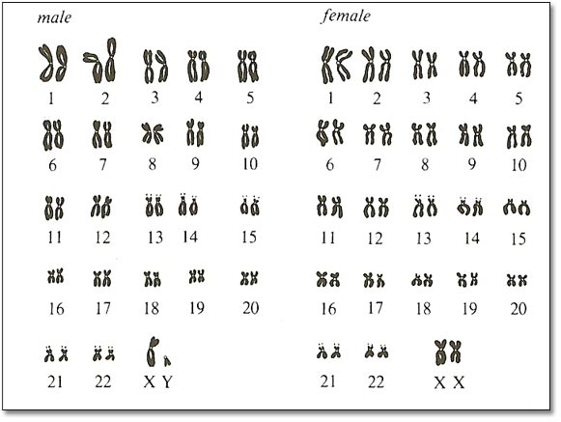
What is a genome?
Human genome:
3.2 x 10⁹ bp,
~ 20,000 genes

Slide 18
What is a genome?
Genome Variability
Nucleotide polymorphism
- Single Nucleotide Polymorphisms - SNP
Structural variations
- Copy Number Variations – CNV
- Short Tandem Repeats – STR (2-5)
Human genome:
3.2 x 10⁹ bp,
~ 20,000 genes

Slide 19
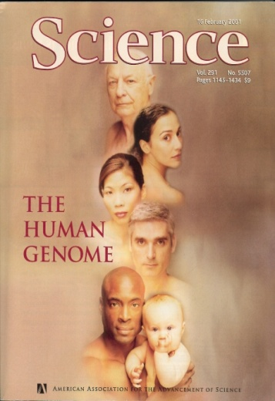
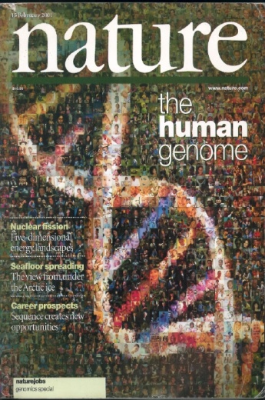
Human genome was published in 2001

Slide 20
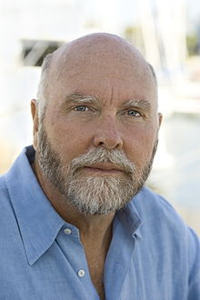
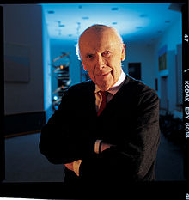
C. Venter
J. D. Watson
Individual sequences of human genomes were published in 2007 and 2008

Slide 21
C. Venter
J. D. Watson
Individual sequences of human genomes were published in 2007 and 2008
Difference in 7648 amino acid substitutions

Slide 22
C. Venter
J. D. Watson
Individual sequences of human genomes were published in 2007 and 2008
The 1000 genome project published in 2010

Slide 23
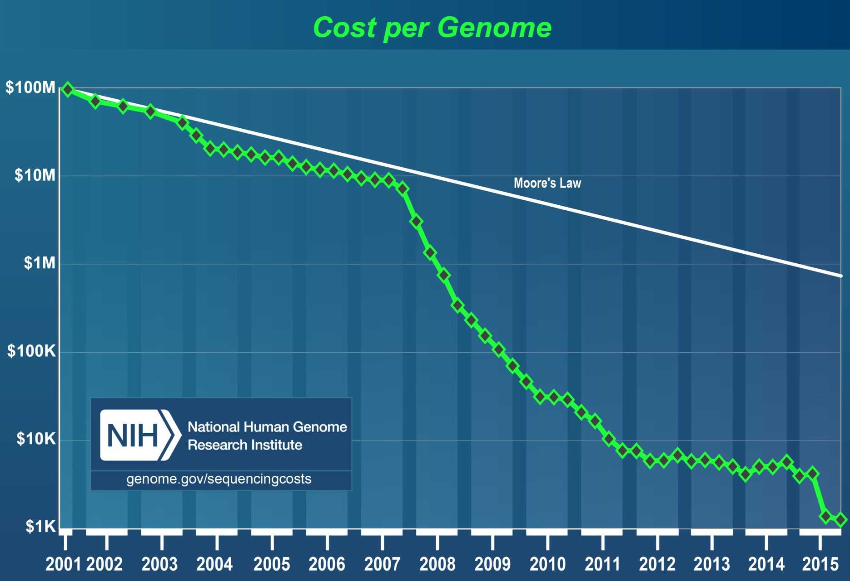
Moore’s law (1965): „The number of transistors (hence the processing power) that can be squeezed onto a silicon chip of a given size will double every 18 months”.

Slide 24
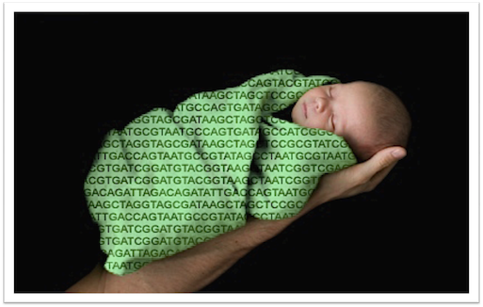
Postgenomic era
Genomes were described
Ongoing genomes annotations

Slide 25
Genetics today
from phenotype to genotype
DNA RNA protein fenotype
from genotype to phenotype

Slide 26
Modern techniques of genome analysis

Slide 27
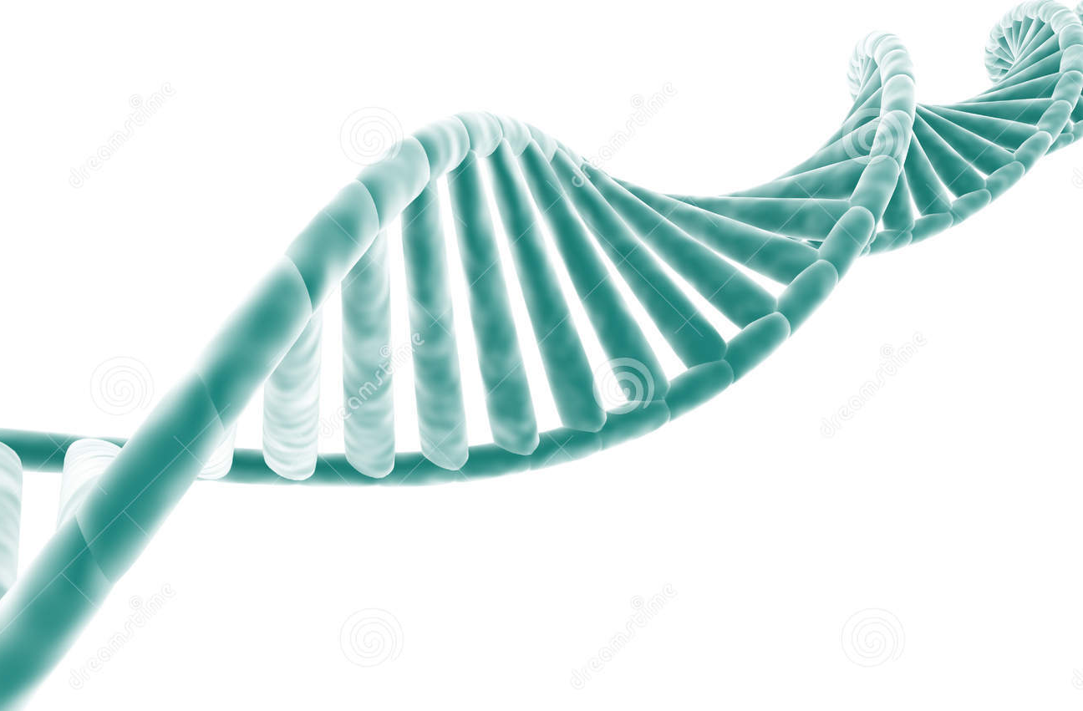
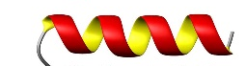
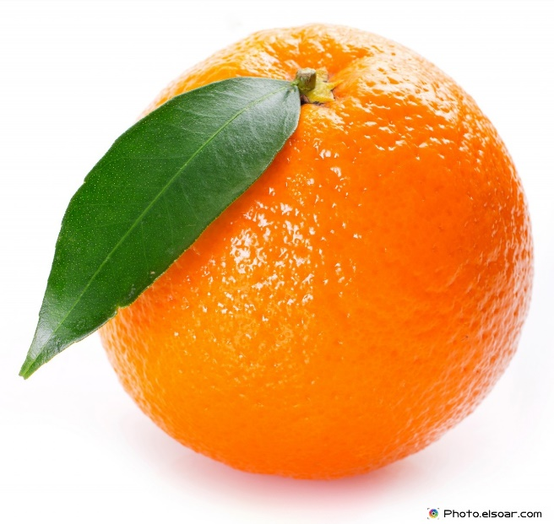
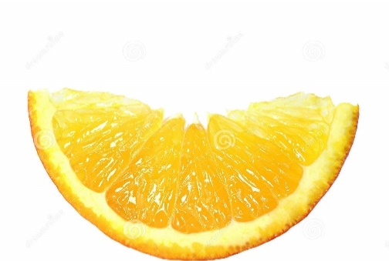
Whole-Genome Sequencing
vs.
Whole-Exome Sequencing
DNA strand
gene
human Genome
= 3.2 * 10⁹ bp
~ 20 000 genes
Exome = < 1.5% of human genome
contains ~ 85% of known disease causing mutations
intron
exon
whole genome
protein
all exons = exome
< 1.5% of whole genome

Slide 28

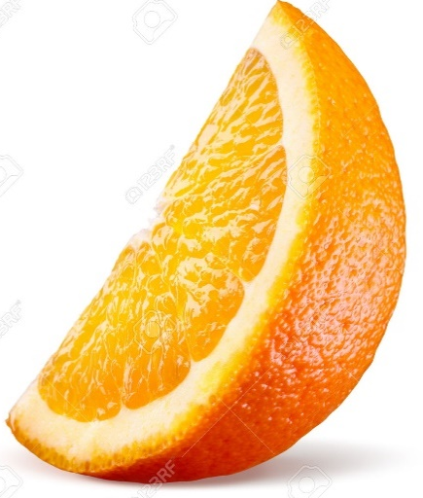
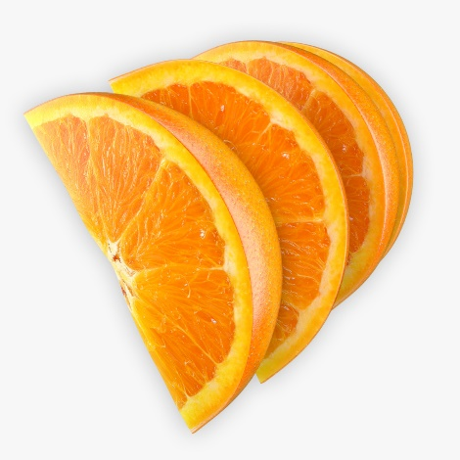
NGS – flexibility
whole genome
exome
targeted genes or hotspots
3 200 000 000 bp
30 x coverage
20 000 genes
100 x coverage
< 100 genes
≥ 1000 x coverage

Slide 29
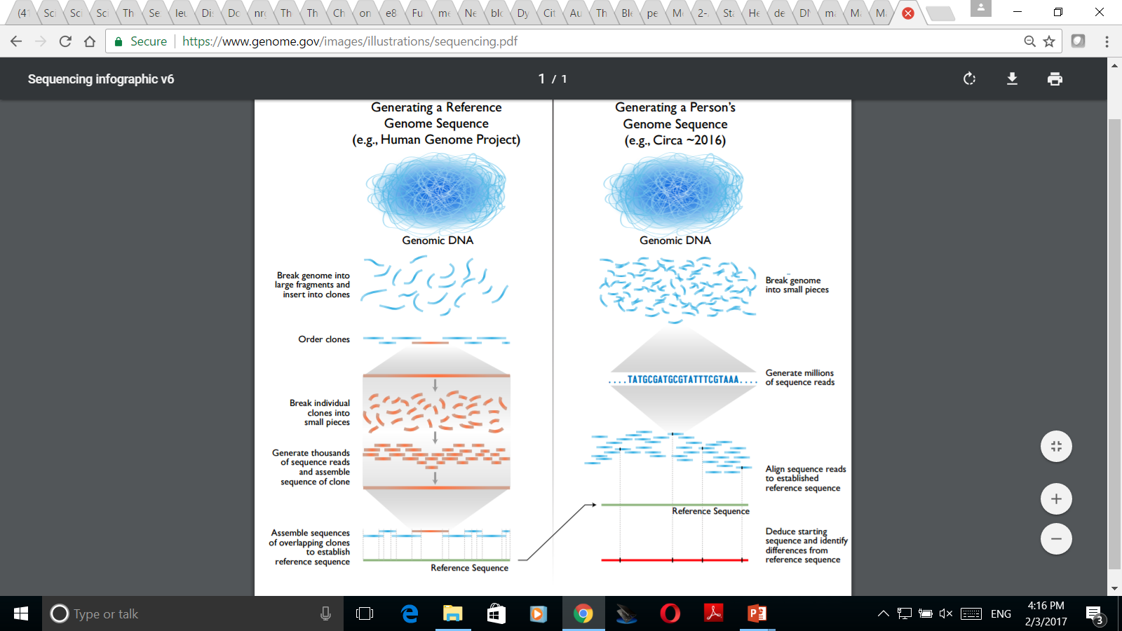
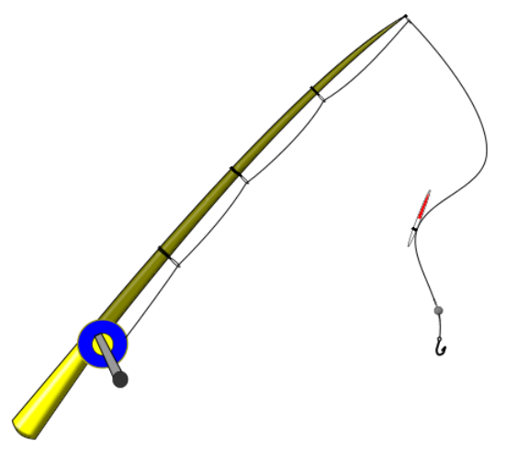
Whole-Genome Sequencing
Generating a Person’s Genome Sequence
Whole-Exome Sequencing
Break genome into small pieces
Genomic DNA
Genomic DNA
Capture library
Generate millions of sequence reads
Align sequence reads to establish reference sequence
Deduce starting sequence and identity differences from reference sequence
Reference Sequence
Reference Sequence

Slide 30
Mutation
vs. human genome variability

Slide 31
Mutation
vs. human genome variability
Every 1000th base could be mutated ⇒ 3.2 x 10⁶ variants
One men has approx. 0.5 x 10⁶ variants
Exome analysis (1.5% of genome) ⇒ tens thousands of variants
Which of the found variants is the disease causing one?

Slide 32
Mutation
vs. human genome variability
Every 1000th base could be mutated ⇒ 3.2 x 10⁶ variants
One men has approx. 0.5 x 10⁶ variants
Exome analysis (1.5% of genome) ⇒ tens thousands of variants
Which of the found variants is the disease causing one?
mutation frequency
1.1 – 1.3 x 10⁻⁸

Slide 33
Mutation
vs. human genome variability
Every 1000th base could be mutated ⇒ 3.2 x 10⁶ variants
One men has approx. 0.5 x 10⁶ variants
Exome analysis (1.5% of genome) ⇒ tens thousands of variants
Which of the found variants is the disease causing one?
mutation
x polymorfisms

Slide 34
Mutation
vs. human genome variability
Mutations: spontaneous vs. induced
gene vs. chromosomal
Mutations: missense
nonsense (terminating triplet)
same sense
frameshift

Slide 35
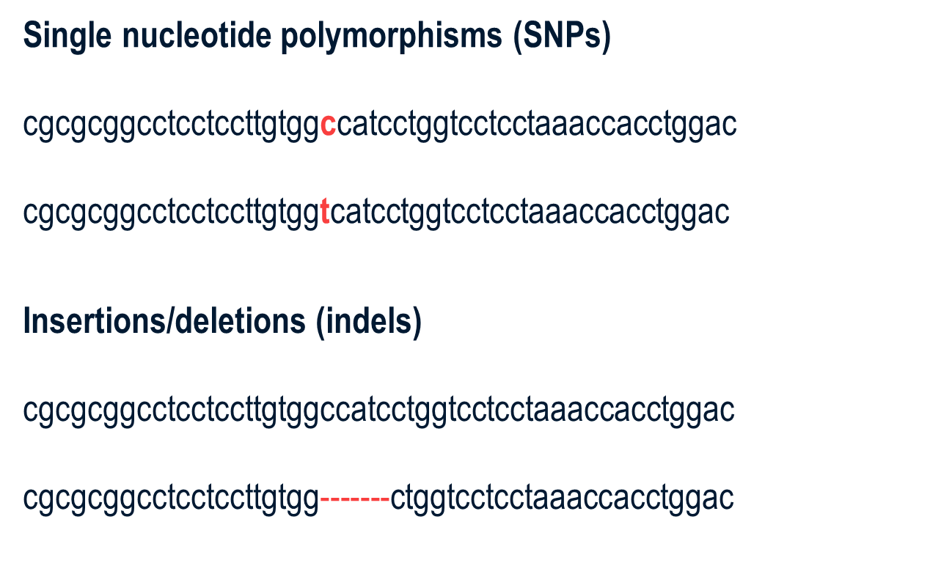
Mutation
vs. human genome variability

Slide 36
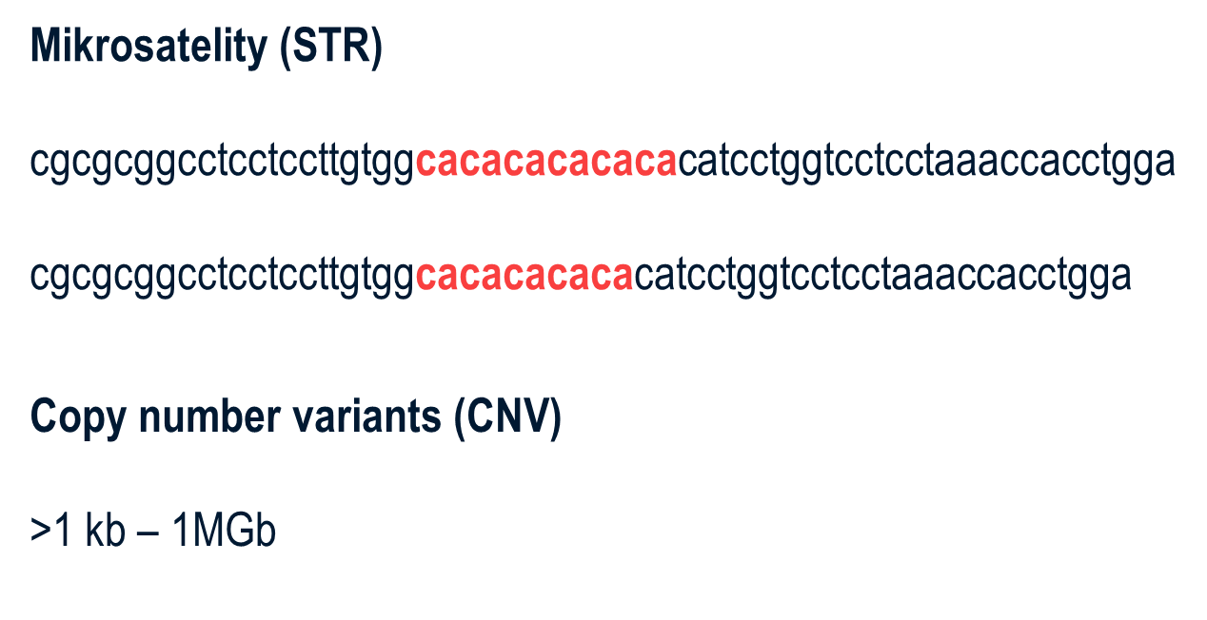
Mutation
vs. human genome variability
Microsatelites (STR)

Slide 37
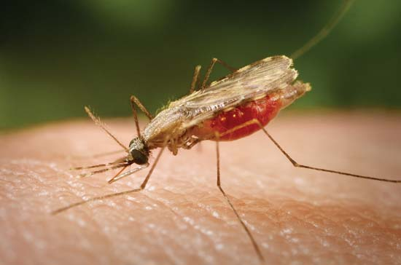
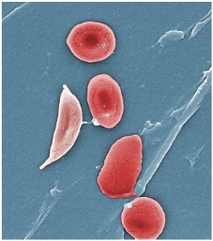
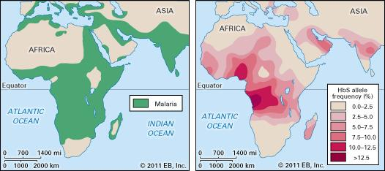
Mutation
vs. human genome variability
Sickle-cell anemia

Slide 38
Mutation
vs. human genome variability
Sickle-cell anemia
Thalassemia
Leiden mutation of f. V
Hemochromatosis
Cystic fibrosis

Slide 39
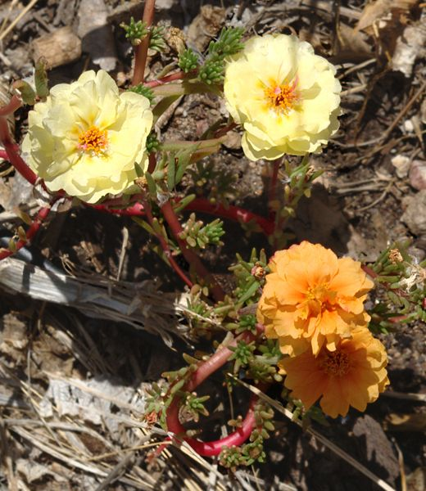
Positive mutations
mutation

Slide 40
Germinal vs. somatic mutations

Slide 41
Germinal vs. somatic mutation
Germinal mutation
Somatic mutation

Slide 42
Are we Homo sapiens?

Slide 43
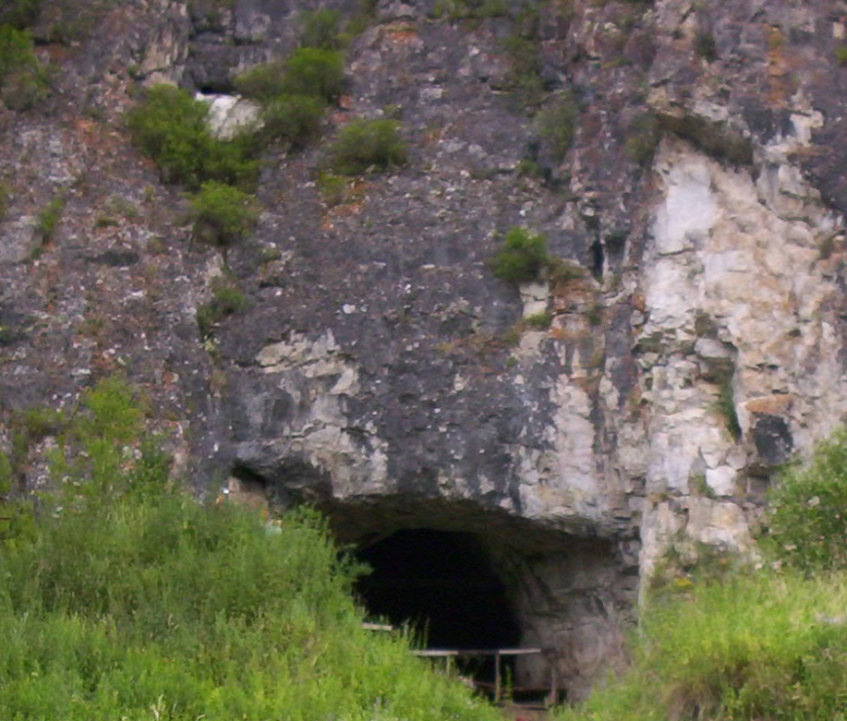
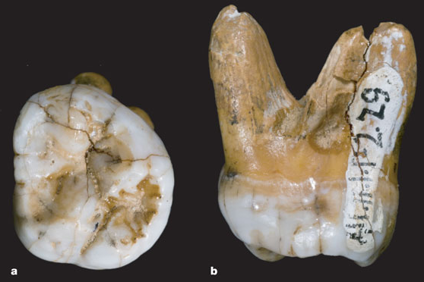
Are we Homo sapiens?
Denisova hominins, 41 000 years ago
mtDNA
Reich a kol.
Nature 2010

Slide 44
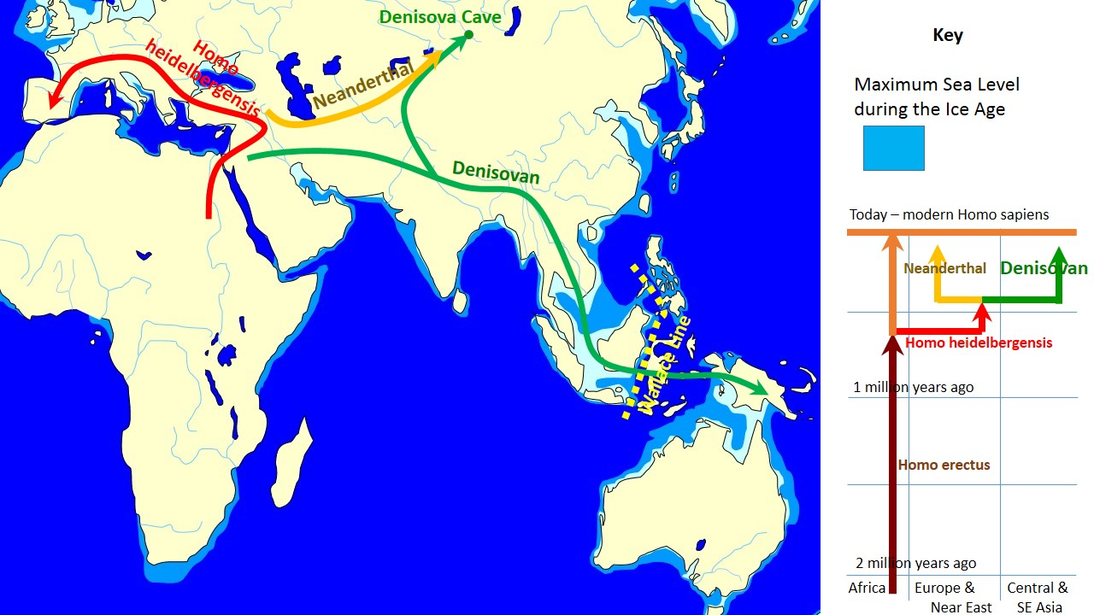

Slide 45
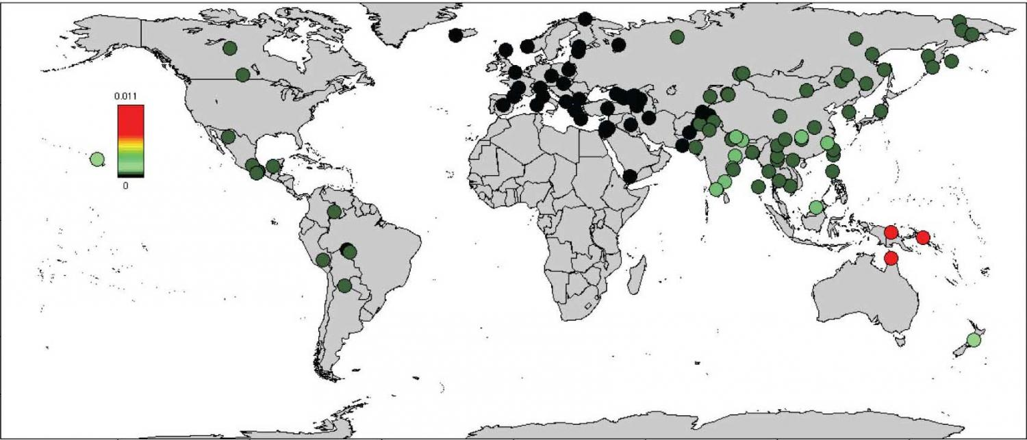
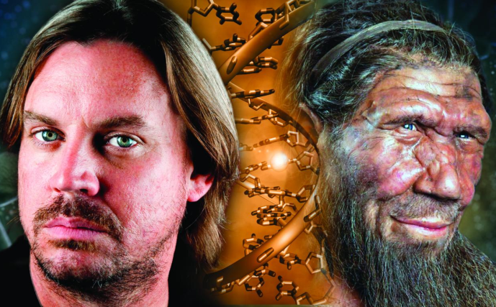
Are we Homo sapiens?
Europe 1 – 3% of the genome
Some diseases of Neanderthal origin – depression,
skin disorders?

Slide 46
Ancient genomes analysis

Slide 47
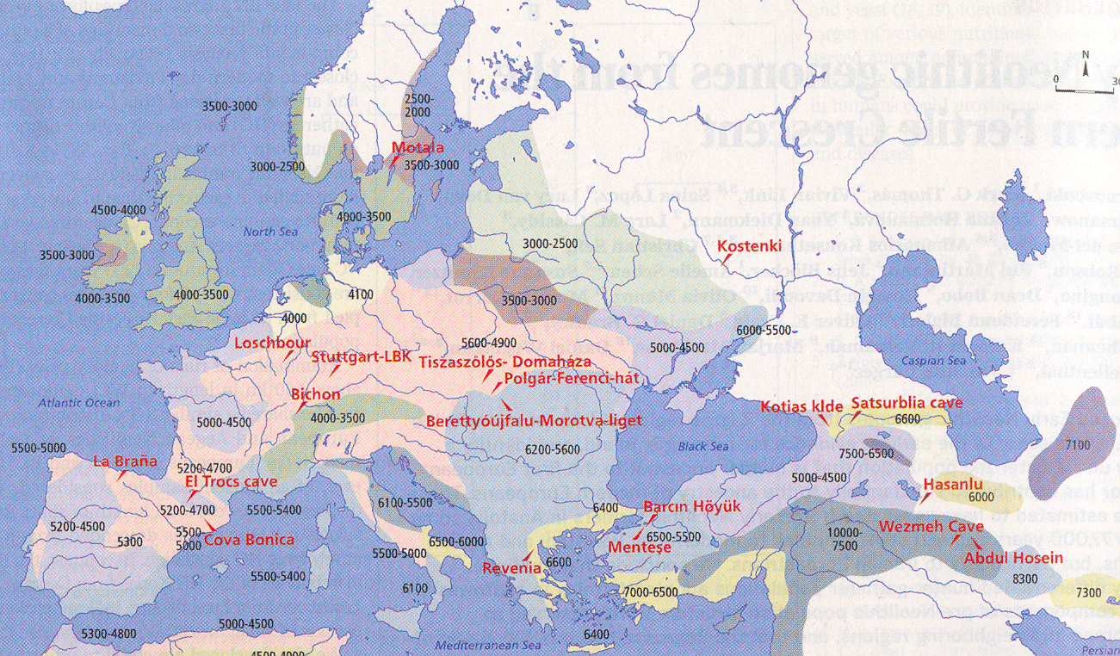
Genome from the Younger Stone Age and Iron Age - Zagros, Iran
Broushaki a kol., Science 2017

Slide 48
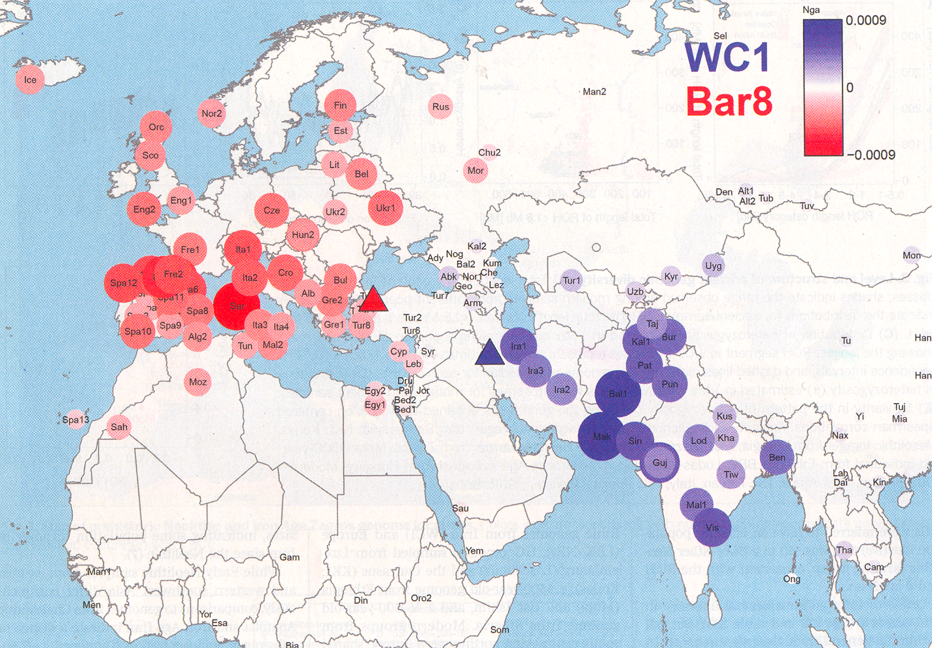
Two ancient genomes in modern humans
Broushaki a kol., Science 2017

Slide 49
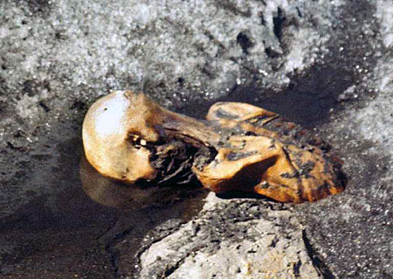
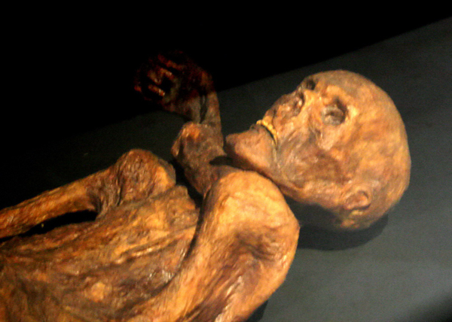
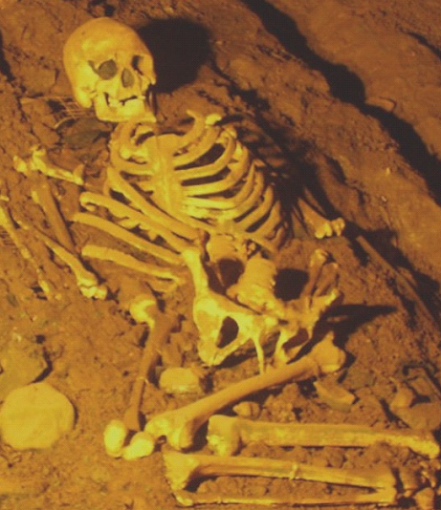
Famous ancient genomes
Őtzi
Cheddar man

Slide 50
Origin based on mitochondrial DNA

Slide 51
Mitochondrial and Y-inheritance
father
mother

Slide 52
The seven daughters of Eve
Xenia
25 000 years
Helena
20 000 years
Katrine
16 000 years
Velda
17 000 years
Tara
17 000 years
Ursula
30 – 50 000 years
Jasmine
43 000 years

Slide 53
The seven daughters of Eve
mitochondrial Eve (140 000 years ago in Ethiopia)
7 main mitochondrial haplotypes in Europe
29 haplotypes worldwide
Results are not as accurate as from other methods – mtDNA is very similar
offspring of the mitochondrial Eve may still live
Bryan Sykes, 2004

Slide 54
The seven daughters of Eve
in the Czech population
Helena 43.51% (dominant lineage from Polland and european part of Russia)
Ursula 17.6% (mainly UK and Scandinavia)
Tara 11.17%
Jasmine 8.78%
Katrine 5.89% (Ashkenazi Jews)
Velda 4%
Xenia 3%

Slide 55
The seven daughters of Eve after the Ice Age
Xenia
25 000 years
Helena
20 000 years
Katrina
16 000 years
Velda
17 000 years
Tara
17 000 years
Ursula
30 – 50 000 years
Jasmine
43 000 years

Slide 56
The seven daughters of Eve after the Ice Age
Xenia
25 000 years
Helena
20 000 years
Katrina
16 000 years
Velda
17 000 years
Tara
17 000 years
Ursula
30 – 50 000 years
Jasmine
43 000 years

Slide 57
The role of genome in the disease onset
Mendelian hereditary diseases 8%
Multifactorial 90%
Others 2%

Slide 58
The role of genome in the disease onset
Mendelian hereditary diseases 8%
Multifactorial 90%
Others 2%
⇒ genetic background plays almost always a role in the disease onset

Slide 59
Inheritance types

Slide 60
Inheritance types
Mendelian
monogenic: one gene ⇒ one feature
X-linked and Y-linked (sex-linked disorders)
Polygenic
several genes ⇒ one feature
Mitochondrial
Environmental factors

Slide 61
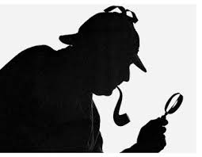
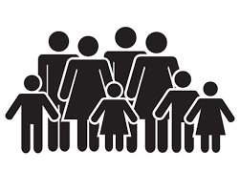
What is the procedure of hereditary diseases tracing?
family studies:
pedigree
monozygous twins
odds ratio
relative risk
disease frequency in population
molecular biology methods
genetic linkeage and functional tests

Slide 62
Common ancestor
two common ancestors in previous generation: parents
4 grandparents, 8 great-grandparents
the number of ancestors in generation n is 2^{n}
40th generation (1000 years back): 2⁴⁰ = 1.09 x 10¹²
so many people didn’t live on this planet (7.0 x 10⁹)

Slide 63
Pedigree

Slide 64
Mitochondrial inheritance

Slide 65
Y-chromosome inheritance

Slide 66
Y-chromosome inheritance
What Y-chromosome carries on?

Slide 67
Autosomal dominant inheritance

Slide 68
Autosomal dominant inheritance

Slide 69
Autosomal recessive inheritance

Slide 70
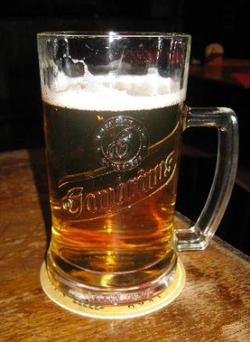
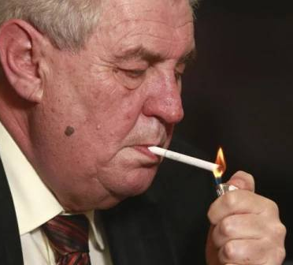
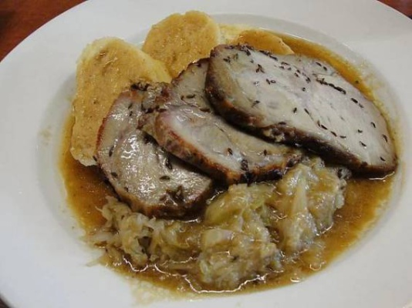
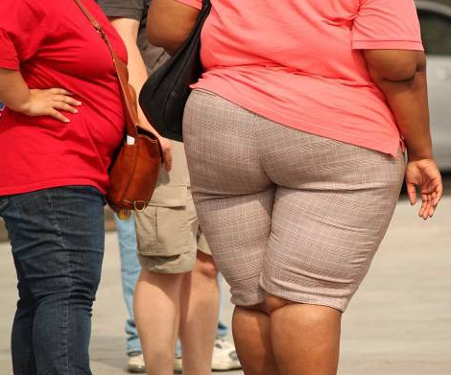

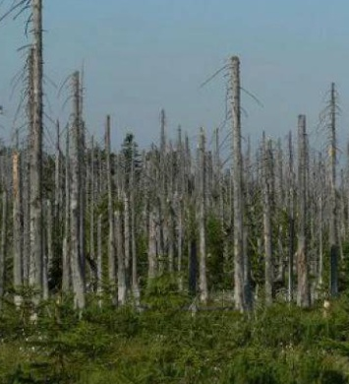
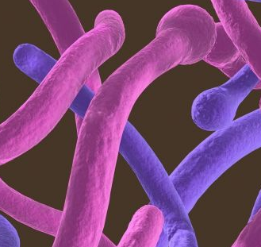
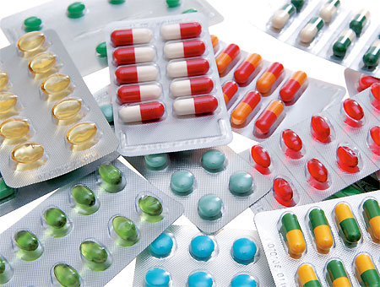
Environmental factors

Slide 71
Monogenic disorders

Slide 72
How many monogenic disorders exist?
≈ 1 000
≈ 10 000
≈ 100 000

Slide 73
How many monogenic disorders exist?
≈ 1 000
≈ 10 000
≈ 100 000

Slide 74
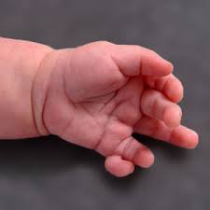
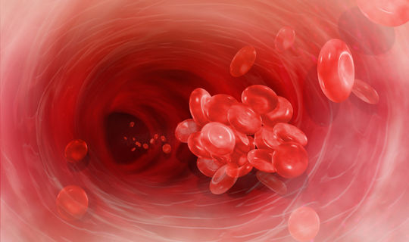
Recessive disorders
Dominant disorders
hemochromatosis (1:10)
mutation of factor V Leiden (1:20)
cystic fibrosis (1:25)
spinal muscular atrophy (1:40)
deafness
polydactyly
Huntington's Chorea
Li-Fraumeni syndrome
breast and ovarian cancer

Slide 75
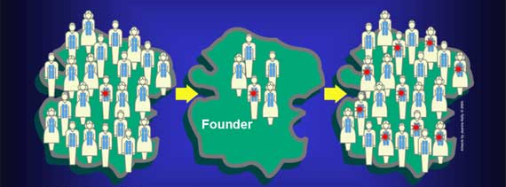
Origin by mutation type
Founder effect
Small closed populations:
Ashkenazi Jews
franco-Canadiens
Iceland
surroundings od Maracaibo lake…
Marriages of relatives

Slide 76

Consanguinity map

Slide 77
Consanguinity map
Mandatory genetic testing of partners:
Bahrajn
Saudi Arabia
(Iceland)

Slide 78


Consanguinity example

Slide 79
Consanguinity example
Homozygous mutation
BLM gene
c.1642C>T, p.(Gln548*)

Slide 80
Genetic diseases in Czech population

Slide 81

Nijmegen breakage syndrome = Seeman syndrome (NBS)
NBN gene for nibrin in 8q21
Heterozygotes 1:130-150
Common ancestor
Seemanová,
1985

Slide 82


Czech dysplasia
COL2A1 gene
absence of ocular and orofacial anomalies
shortening of third and/or fourth toes
Neumann,
2003

Slide 83
How do we search for new genetic disorders?

Slide 84
Molecular biology methods
Analysis of known disease-associated genes
Comparing genetic information of healthy and
affected family members
Looking for new variants and “new” genes
Verification by functional tests

Slide 85
DNA variants and disorders
Li-Fraumeni
Syndrome
Transcriptional
factors
impairment
IKZF, PAX5, ETV6,
CEBPA, RUNX1, GATA2
RASopathies
Noonan syndrome
DNA repair
impairment
Immunodeficiency
NBS, BS, AT,
SDS, CMMRD
Epigenetic
dysregulation
Sotos, RSTS,
Weaver
Chromosomal
aberrations
+21, +8 (mosaic),
rob. t(15;21)
genes together with non-coding regions

Slide 86


Twins
Genetic vs. nongenetic influences
- monozygotic: 100% of identical alelleles
- dizygotic: twins/siblings 50% of identical alelleles
Genetic influence: (concordance in MZ and DZ twins):
Diabetes mellitus
Schizophrenia
Lupus
Cleft
Sclerosis multiplex

Slide 87
Are monozygotic twins genetically identical?

Slide 88
Clinical cases

Slide 89
Clinical case: thrombocytopenia
?
?
cancer
?
Breast cancer
MPN – JAK2 p.V617F
hyperdiploid c-ALL, allo PBSC
analyzed samples

Slide 90

ETV6
Exome sequencing – exome comparison of healthy and affected family members
variant in gene ETV6: p.W380R
Adjusted from Moriyama et al., 2015

Slide 91
Bioinformatics and biostatistics
- Mapping on a reference sequence (BWA-mem)
- build-up of two variant files (Samtools mpileup):
1. file – affected family members
2. file – healthy family members
Exclusion of population and familial variants (VarScan):
Selection of variants present only in affected family members
Identification of potentionally causal variants:
variant anotation (Annovar)
filters: coverage > 20
left only exonic, ncRNA exonic, downstream and upstream variants
left out synonymous variants
excluded variants annotated in dbSNP dtb. with rsXXXXX ID

Slide 92











Bioinformatics and biostatistics
Annotated mutations
Variant frequency in population
Variant effect on the protein structure

Slide 93

Functional analysis of ETV6 :
fluorescence microscopy

Slide 94
Functional analysis of ETV6 :
fluorescence microscopy

Slide 95
CYCS: exon 2, p.T20I
? 50 years
?
92 years
plt:74.7*10⁹/l
unavailable sample
plt: 54.6*10⁹/l
plt: 47.7*10⁹/l
?
plt: 23.3*10⁹/l
analyzed samples

Slide 96

Asn32
CYCS: p.T20I
Lys26
Thr20
His19
Fe

Slide 97


Slide 98

What are the skills of clinical geneticist?
complex examination
gene/s analysis indication
- exome sequencing
- genome sequencing
- functional tests
results interpretation
(from practitioners to clinical geneticists)
therapeutic and preventive intervenation proposal
- respecting wishes of affected individuals together with ethical aspects

Slide 99
What are the skills of clinical geneticist?
complex examination
gene/s analysis indication
- exome sequencing
- genome sequencing
- functional tests
results interpretation
(from practitioners to clinical geneticists)
therapeutic and preventive intervenation proposal
- respecting the desire of affected individuals together with ethical aspects
Complex information analysis – complex is more than the sum of individual parts

Slide 100



Why genetics?
Disease diagnostics:
prenatal
preimplantational
genetic counselling
Therapy:
pharmacogenetics
pharmacogenomics
immunogenetics
Prevention
Gene therapy, genome editing

Slide 101


Slide 102



CRISPR-Cas9

Slide 103

Made-to-order children?

Slide 104


