Slide 1
Immobilisation techniques
1st Dpt. Of Surgery
University Hospital of St. Anne
Faculty of Medicine, Masaryk University, Brno

Slide 2
GOAL OF FRACTURE MANAGEMENT
to ensure that the involved limb segment, when healed, has returned to its maximal possible function
This is accomplished by obtaining and subsequently maintaining a reduction of the fracture with an immobilization technique that allows the fracture to heal and provides the patient with functional aftercare
Either nonoperative or surgical means may be employed

Slide 3
Fracture management
3 R PRINCIPLE!!!!
Reposition /reduction/
Retention of bone alligment
Rehabilitation /as soon as possible
FRACTURE – BONE, SOFT TISSUES
Appendix:
Pediatric fractures are generally much more tolerant of nonoperative management, owing to their significant remodeling potential

Slide 4
Reduction/reposition
reduction is needed if the fracture is significantly displaced or angulated
Closed vs. Open
Indirect vs. Direct
Local anesthesia vs. General anesthesia
Myorelaxans
Usually principle of traction and countertraction
If closed reduction is inadequate, surgical intervention may be required

Slide 5
Nonoperative (closed) therapy
-casting-
Splints and casts- made from fiberglass or gypsum
Closed reduction should be performed initially for any fracture that is displaced, shortened, or angulated
achieved by applying traction to the long axis of the injured limb, reversing the mechanism of injury/fracture
finally immobilizing the limb through casting or splinting

Slide 6
Indications for casts
Fractures
Sprains
Joint infections
Tendosynovitis
Acute arthritis/gout
Laceration over joints
Puncture wounds, animal bites

Slide 7
Aims of casting
To reduce/prevent contracture
To increase grip strenght
To stabilize and rest joint in ligamentous injury
To correct deformity
To support and immobilize joints and limbs postoperatively until healing has occured

Slide 8
Indications for surgical intervention
Failed nonoperative (closed) management
Unstable fractures that cannot be adequately maintained in a reduced position
Displaced intra-articular fractures (>2 mm)
Patients with fractures that are known to heal poorly following nonoperative management (eg, femoral neck fractures)
Large avulsion fractures that disrupt the muscle-tendon or ligamentous function of an affected joint (eg, patella fracture)
Impending pathologic fractures
Multiple traumatic injuries with fractures involving the pelvis, femur, or vertebrae
Unstable open fractures, any type II or type III open fracture
Fractures in individuals who would poorly tolerate prolonged immobilization required for nonoperative management (eg, elderly patients with proximal femur fractures [)
Fractures in growth areas in skeletally immature individuals that have increased risk for growth arrest (eg, Salter-Harris types III-V)
Nonunions or malunions that have failed to respond to nonoperative treatment

Slide 9
Contraindications to surgical reconstruction
Active infection (local or systemic) or osteomyelitis
Soft tissues that compromise the overlying fracture or the surgical approach because of poor soft-tissue quality due to soft-tissue injury or burns, excessive swelling, previous surgical scars, or active infection
Medical conditions that contraindicate surgery or anesthesia (eg, recent myocardial infarction)
Cases in which amputation, rather than attempted fracture fixation, would better serve the limb and the patient

Slide 10
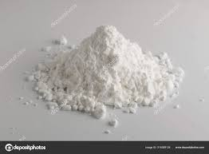
Splinting material
Plaster of Paris- made from gypsum (calcium sulfate dehydrate)
Exothermic reaction when wet- recrystallizes (may burn patient!)
Setting time 3-9 min.
Drying time 24-72 hours
Advantages: easier to mold, cheap
Disadvantages: more difficult to apply, gets soggy when wet

Slide 11
Ready made splinting material
Plaster- 10-20 sheets of plaster with padding and cloth cover
Fiberglass (orthoglass)- cure rapidly, less messy, stronger, lighter, less moldable/ more expensive
Prefabricated splints
Air splints
Vacuum splints

Slide 12
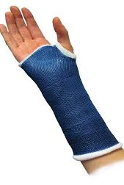
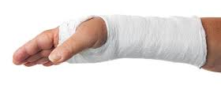
Fiberglass/plaster of Paris

Slide 13
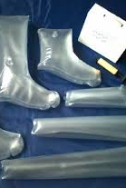
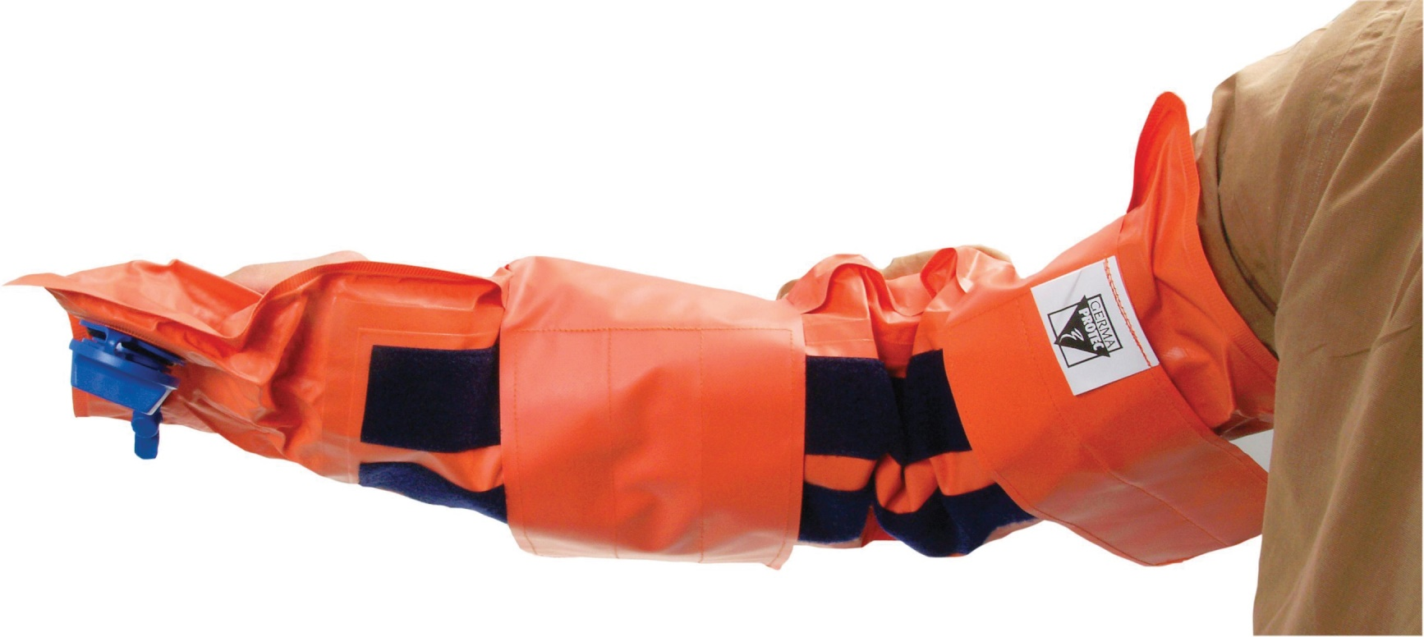
Air/vacuum splint

Slide 14
Pre/post splints check
F- function
A- arterial pulse
C- capillary refill
T- temperature (skin)
S- sensation

Slide 15
Splitting the cast
Most casts should be split after they have dried to accommodate post-reduction swelling
Three grades of split:
1. A single split is carried out at the end of the operative or reduction procedure. This is routine for most cast applications
2. The split is opened with spreaders and all the encircling bandages are divided if there is significant swelling or any signs of neurovascular compromise
3. Two complete splits in the cast convert it to a "bivalve" for crush injuries, open fractures and fractures with overlying burns

Slide 16
Complications- Compartment syndrome
the most serious condition
increased pressure within a closed space that compromises blood flow and tissue perfusion, causes ischemia and potentially irreversible damage to the soft tissues within that space
If an immobilized patient experiences worsening pain, tingling, numbness, or any sign of vascular compromise (severe swelling, delayed capillary refill, or dusky appearance of exposed extremities) an immediate visit to the nearest emergency department or urgent care office is indicated for prompt removal of the cast

Slide 17
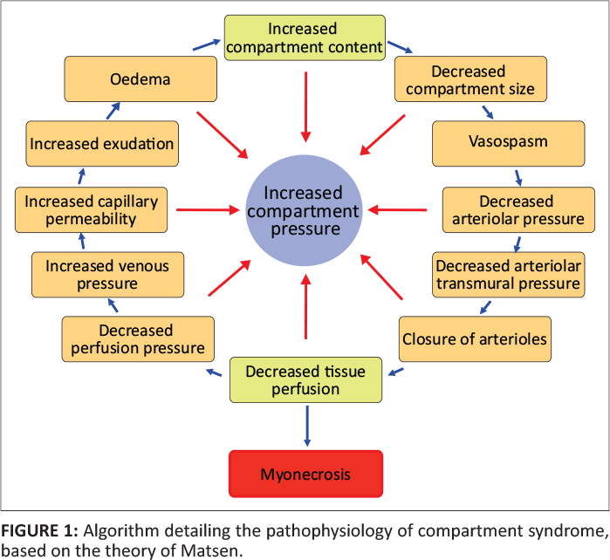

Slide 18
Complications-Skin injuries
Thermal injury can occur as a result of the casting or splinting process
Skin breakdown- often caused by focal pressure from a wrinkled, unpadded, or underpadded area over a bony prominence or underlying soft tissue
can be minimized by ensuring that the padding is adequate and smooth, without indentations during application
Infection, pruritic dermatitis

Slide 19
Complications- Function
Stiffness
Partial or complete loss of function
Prevention: adequate reduction, imobilisation, early rehabilitation

Slide 20
Traction
Pulling effect exerted on a part of skeletal system
For hundreds of years, traction has been used for the management of fractures and dislocations that cannot be treated by means of casting
With the advancement of orthopedic implant technology and operative techniques, traction is rarely used for definitive fracture/dislocation management

Slide 21
Traction
Reduce muscle spasms
Realign bones
Relieve pain
Prevent deformities

Slide 22
Types of traction
Manual
Skin
Skeletal

Slide 23
Manual traction
Pulling on body using s person´s hands and muscular strenght
Used to realign dislocated fracture, replace dislocated bone within a joint

Slide 24
Skin traction
traction tapes are attached to the skin of the limb segment that is below the fracture or a foam boot is securely fitted to the patient's foot
usually 10% of the patient's body weight (up to a maximum of 10 lb) is recommended
At weights greater than 10 lb, superficial skin layers are disrupted and irritated
Because most of the forces created by skin traction are lost and dissipated in the soft-tissue structures, skin traction is rarely used as definitive therapy in adults
temporary measure until definitive therapy is achieved

Slide 25
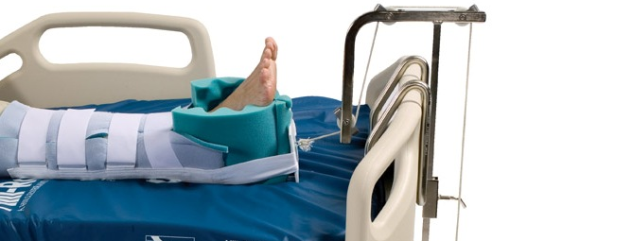
Buck´s traction
Femoral fractures
Acetabular fractures
Lower back pain

Slide 26
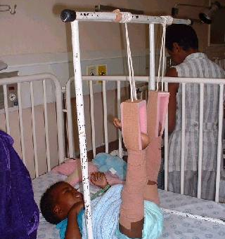
Gallows traction
Femoral shaft fracture in children under 2 years

Slide 27
Skeletal traction
a pin (eg, a Steinmann pin) is placed through a bone distal to the fracture
Weights are applied to this pin
patient is placed in an apparatus to facilitate traction and nursing care
most commonly used in femur fractures: A pin is placed in the distal femur or proximal tibia 1-2 cm posterior to the tibial tuberosity
Once the pin is placed, a Thomas or Bohler-Braun splint is used to achieve balanced suspension

Slide 28
Skeletal traction
More powerful than skin traction
Up to 20% of patient body weight can be pulled up
Requires local anaesthesia
Long bone, pelvic/acetabular fracture

Slide 29
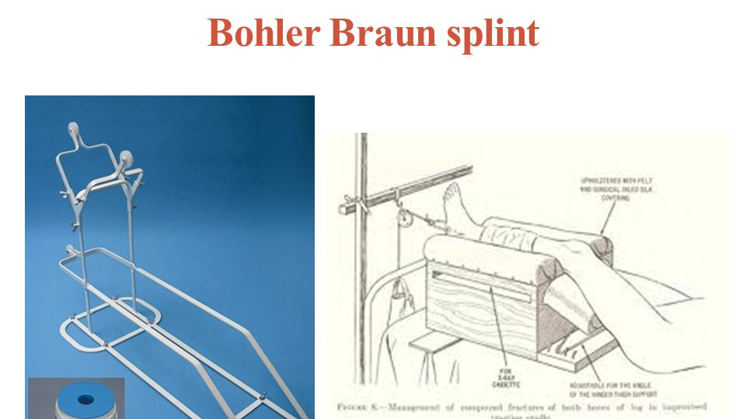

Slide 30
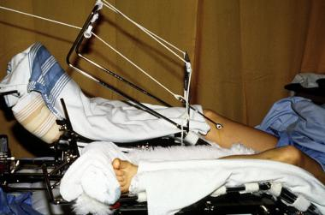
Skeletal traction

Slide 31
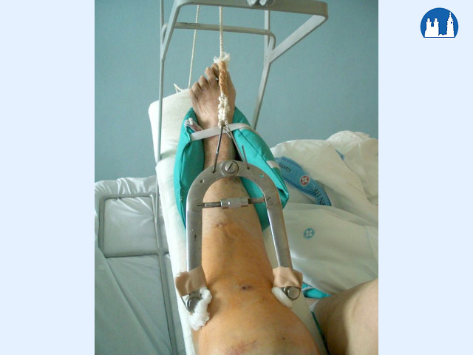
Kirschner´s bow

Slide 32
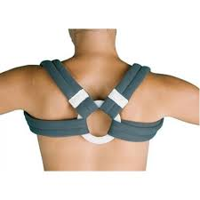
Upper limb- shoulder and arm
Figure of eight - clavicle fracture
Patient standing with hands on iliac crest, abducted shoulders

Slide 33
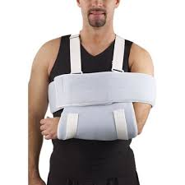
Upper limb- shoulder and arm
Sling and swathe
Shoulder and humeral injuries
Sling supports weight of shoulder
Swathe holds arm against chest to prevent shoulder rotation
Placing with elbow flexed in 90°

Slide 34
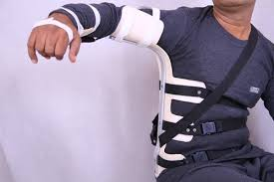
Upper limb- shoulder and arm
Aeorplane splint
Injury of brachial plexus

Slide 35
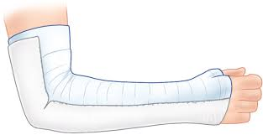
Elbow-forearm
Long arm posterior
Forearm and elbow injuries
Olecranon and radial head fr.
Distal humeral fr.
Not recommended for unstable fr.
Doesn´t completely eliminate pronation/supination

Slide 36
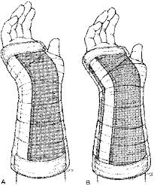
Volar forearm
Distal forearm/ wrist
Not used for distal radius or ulna
Soft tissue injuries, sprains
From volar palmer crease to 2/3 forearm
Allows elbow and finger ROM

Slide 37
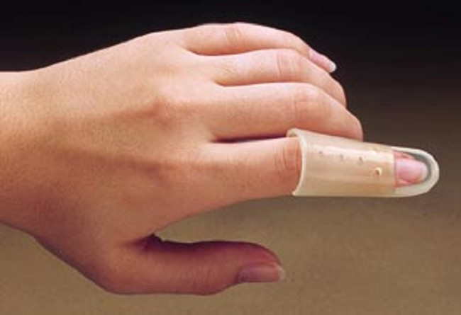
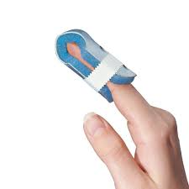
Finger splints

Slide 38
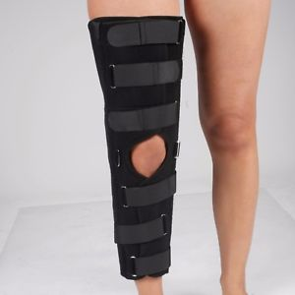
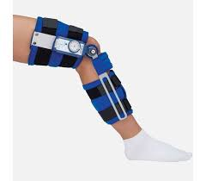
Lower limb-knee splint
Knee/ proximal tibia injuries
Full extension of knee/ROM

Slide 39
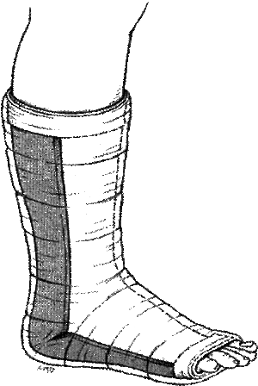
Ankle- posterior ankle split
Distal tibia/fibula fractures
Reduced dislocations
Severe sprains,tarsal/MTT fr.
12-15 layers
Placed from metatarsal heads on plantar side, extends up back of leg to level of fibular neck
Coaptation splint (stirrup) eliminates inversion/eversion

Slide 40
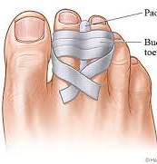
Buddy strapping
Phalang fr. of toes
Small piece of padding between fingers to prevent maceration
Fractured to secured to adjacent with tape

Slide 41
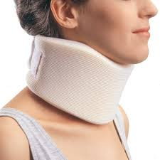
Spine- Cervical collar
Flexible foam/adjustable/rigid
Encircled the neck
Motion control, keeping warm
Soft tissue injury, minor sprains, postoperative immobilisation

Slide 42
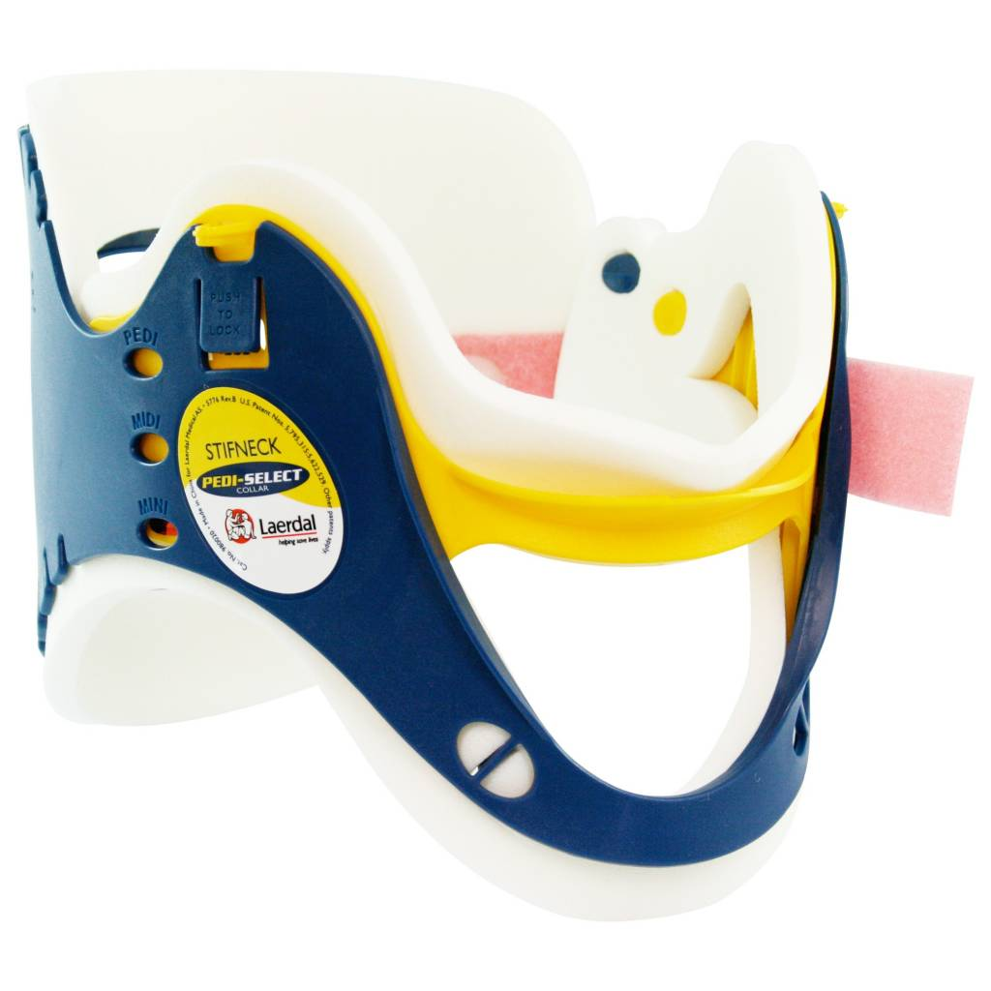
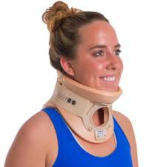
Spine- Cervical collar
Philladelphia- semi-rigid
Access to trachea
Stiffneck- emergency, transport

Slide 43
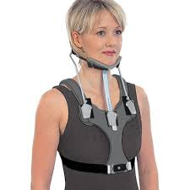
SOMI- Sternal Occiptal Mandibular Immobilizer
Cervical spine injury
Rigid frame
Limits flexion/ extension
Extends inferior into thoracic level for greater control of all cervical levels

Slide 44
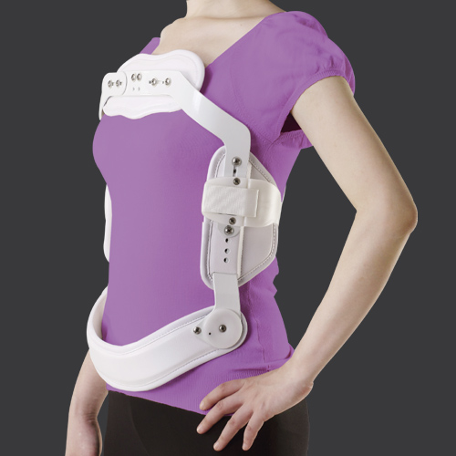
Spine- Jewett brace
Stable spinal compression fracture
Th7-L2
hyperextension

Slide 45
