Slide 1
Malignant Lymphomas
Janikova A et al

Slide 2
What´s essential to remember – „Take home message“
For students and non-hematologists:
Clinical manifestation – when the disorder is to be suspected
Diagnostic algoritm – how the correct diagnosis to be made
Basic overview of disorders – nosological units, treatment , prognosis
For hematology specialists:
Recent optimal treatment algoritms

Slide 3
CANCER INCIDENCE CZECH REPUBLIC 2016 (men; ÚZIS)
3.8%

Slide 4
CANCER INCIDENCE IN CZECH REPUBLIC 2016 (women; ÚZIS)
3,5%

Slide 5
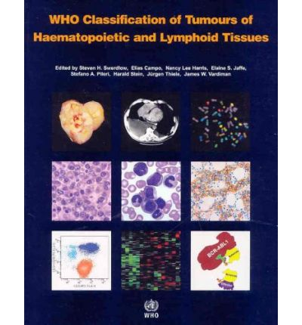
Overview of hematological malignancies
WHO classification of Haematopoietic and Lymphoid system (last update 2018)
-separated system from ICD (MKN)
Hematological malignancies are derived:
from lymphoid cell-line
from myeloid cell-line
from histiocytic cell-line
from monocytoid- macrofagocytic
system

Slide 6
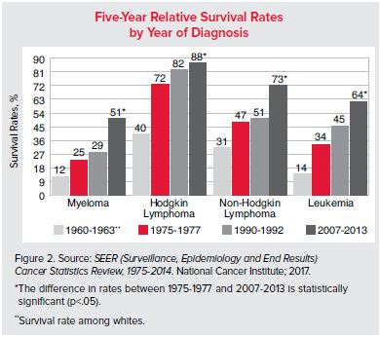
SURVIVAL OF PATIENTS WITH HEMATOLOGICAL MALIGNANCIES
-world data

Slide 7
LYMPHOPROLIFERATIONS = malignancies from lymphoid tissue
WHO 2018 > 60 nosological units
LYMPHOMAS
  Hodgkin lymphoma (Hodgkin´s lymphogranuloma) ~30%
    Classical (~95%)
    Nodular lymphocyte predominant (~ 5%)
  NonHodgkin´s lymphomas (NHL) ~70%
    B-NHL (~90%)
    T-NHL (~10%)
LYMPHOCYTIC LEUKEMIAS
  B-line: B-CLL, Hairy cell, prolymphocytic leukemia
  T-line: T-prolymphocytic leukemia, T-LGL, adult T-cell leukemia
MULTIPLE MYELOMA

Slide 8
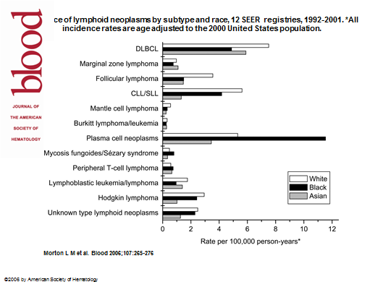
ETHNICAL DIFFERENCES IN LYMPHOID NEOPLASM
DISTRIBUTION

Slide 9
CLINICAL SYMPTOMS OF MALIGNANT HEMATOLOGICAL DISEASES
We can recognise:
Systemic (General) symptoms
Symptoms of local expansion
  Nodal
  Extranodal

Slide 10
GENERAL SYMPTOMS
(the most frequent)
WEIGHT LOSS
(≥10% during 3 months; GIT disorders, chronic inflamatory diseases…)
SUBFEVER/FEVER
(lasting > 3 weeks, dif dg infections, other tumors or autoimunity disorders)
ITCHING (with or without skin lesions)
NIGHT SWEAT (need to change clothes/pyjama during sleeping)
FATIGUE (pathological tiredness interfering with usual daily activity)

Slide 11
SYMPTOMS OF LOCAL EXPANSION
NODAL:
Peripheral (palpable) lymphadenopathy:
  „lumps“
Mediastinal lymphadenopathy:
  irritative dry cough, feeling of pressure, vena cava superior syndrom
Abdominal lymphadenopathy:
  stomach and intestinal dyspepsia, hydronephrosis due to uretheral compression.
Splenomegaly:
  enlarged spleen compressing stomach, feeling of fullness after small meal
EXTRANODAL:
Bone marrow infiltration: (pan)cytopenia
Osteolytic destruction of bones: pain (backbone), pathol. fractures
Organ specific symptoms: ~30% primary extranodal lymphomas
  mimicking relevant carcinoma (different therapy approach!)

Slide 12
Diagnostic algoritm
Periferal
lymphadenopathy
Non-specific (general) symptoms
Clinical examination (lumps)
Infection must
be excluded
EBV, HIV, toxoplasma
Lymph node biopsy and histological examination
Native sample is prefered
Imaging examination:
Ultrasonogrphy- peripheral lymph node, abdomen
CT mediastinum + retroperitoneum
PET
MR

Slide 13
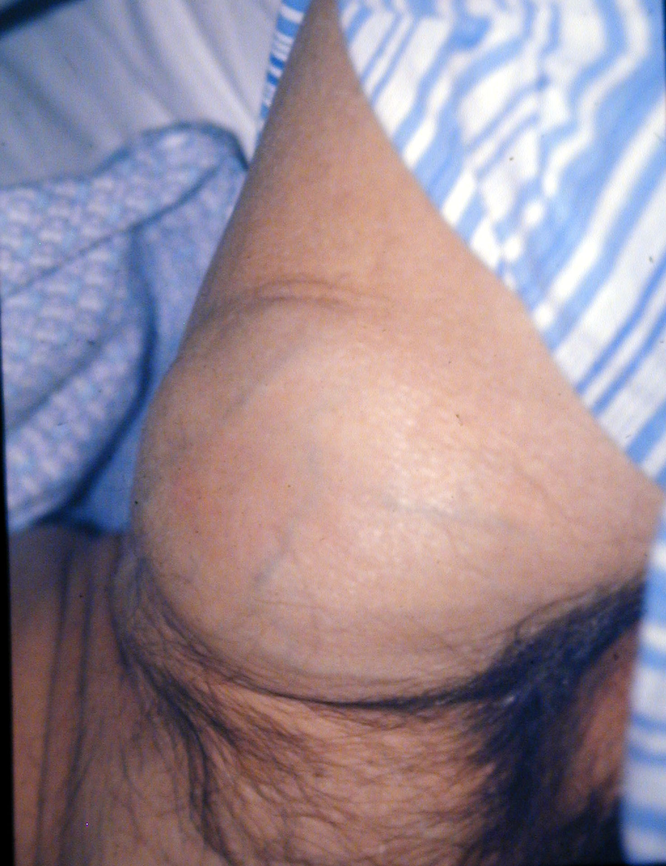

Slide 14
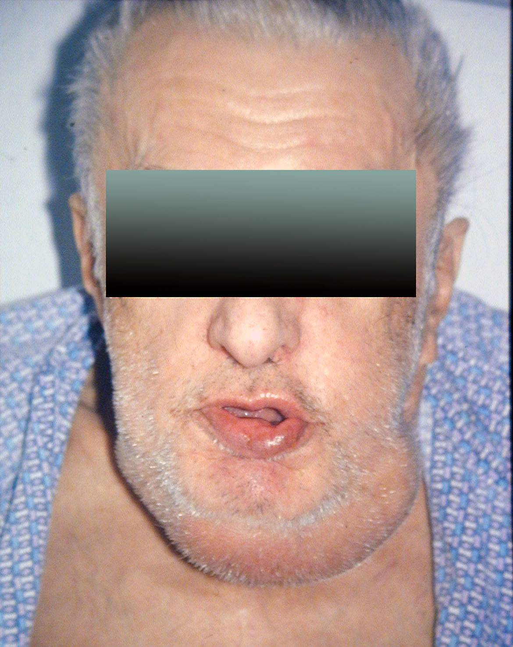

Slide 15
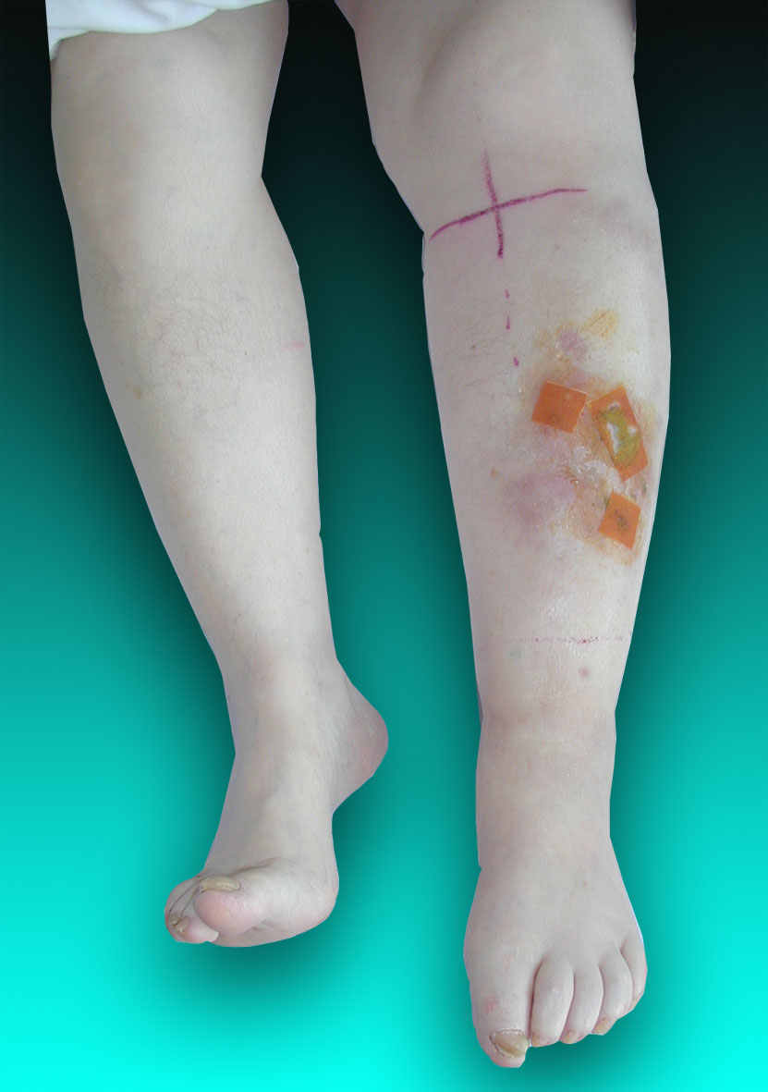

Slide 16
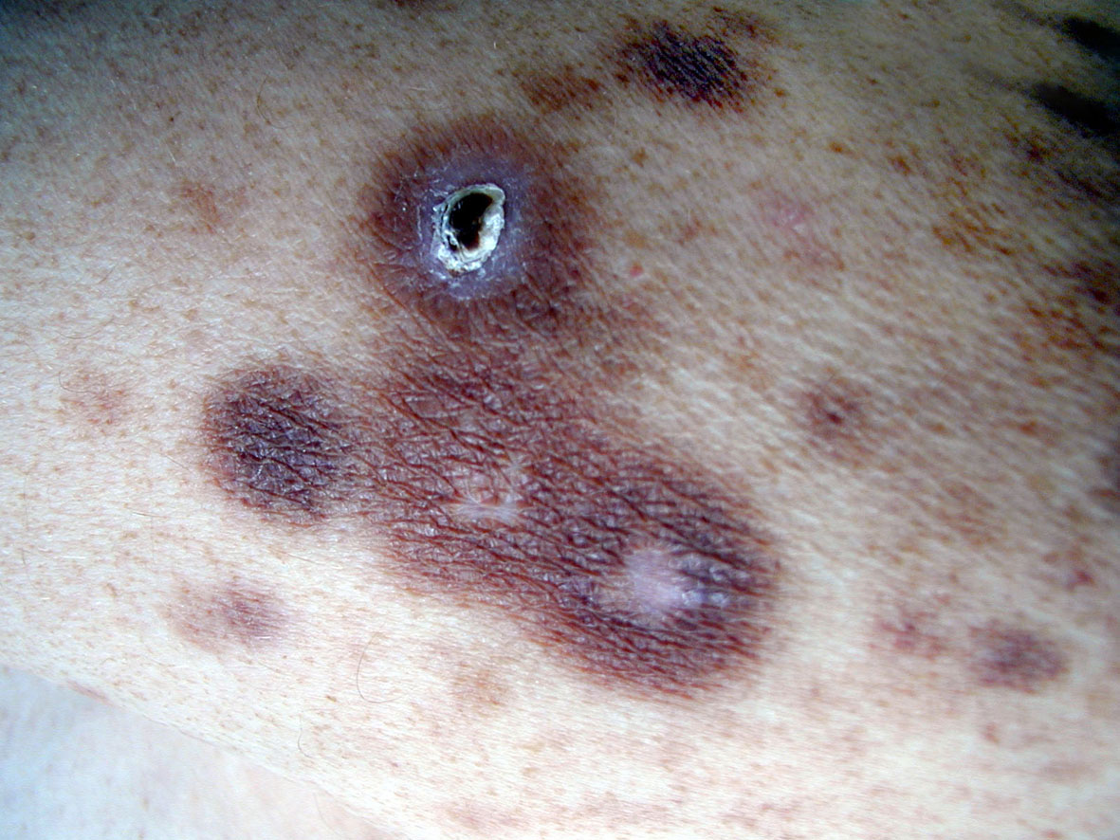

Slide 17
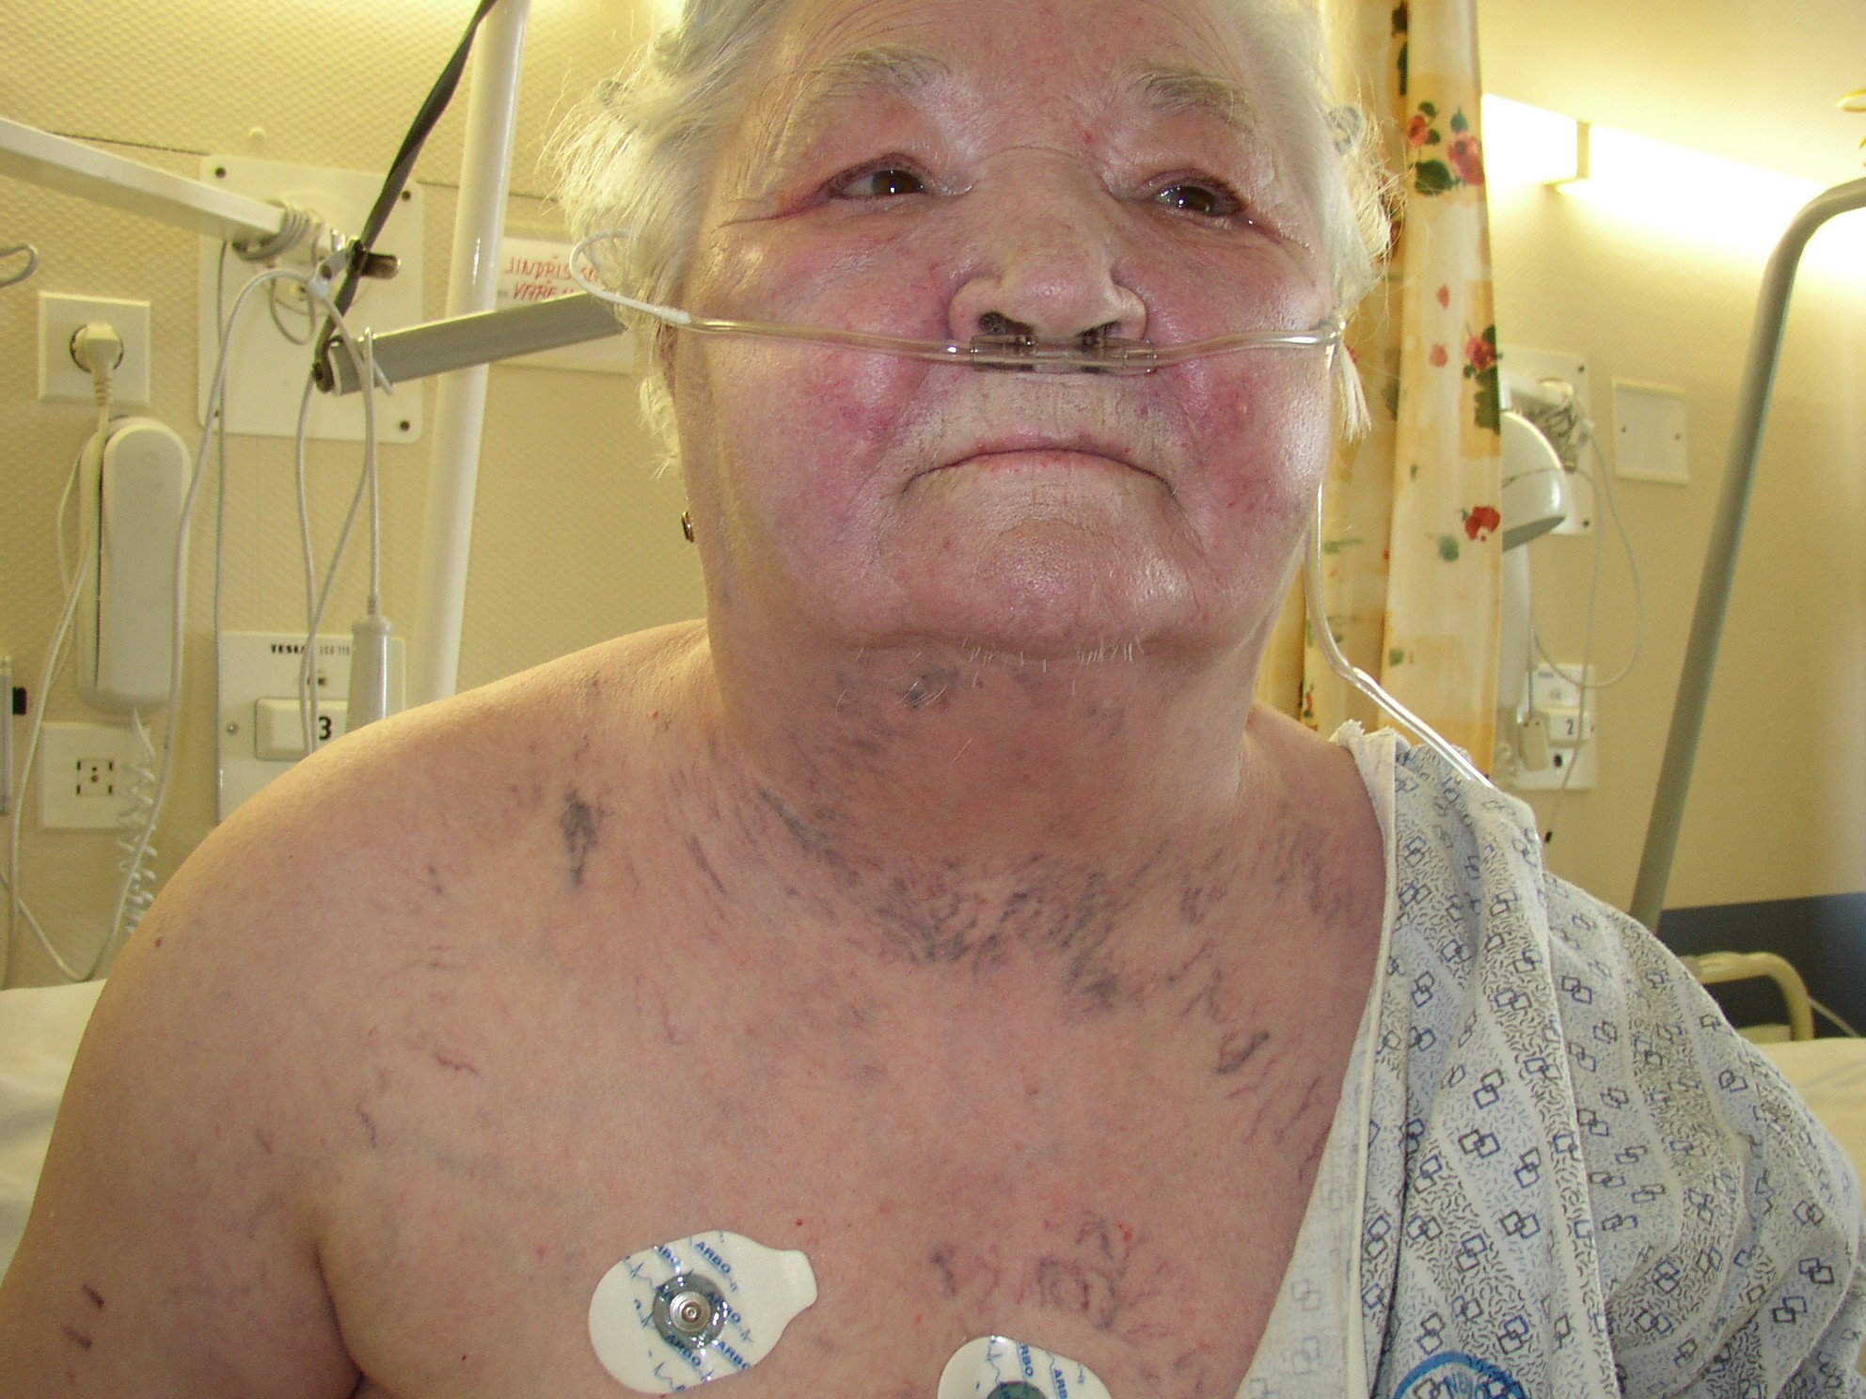
Vena cava superior syndrom
Swelling of face, enlarged volume of neck
Visible collateral veins between vena cava superior and inferior

Slide 18
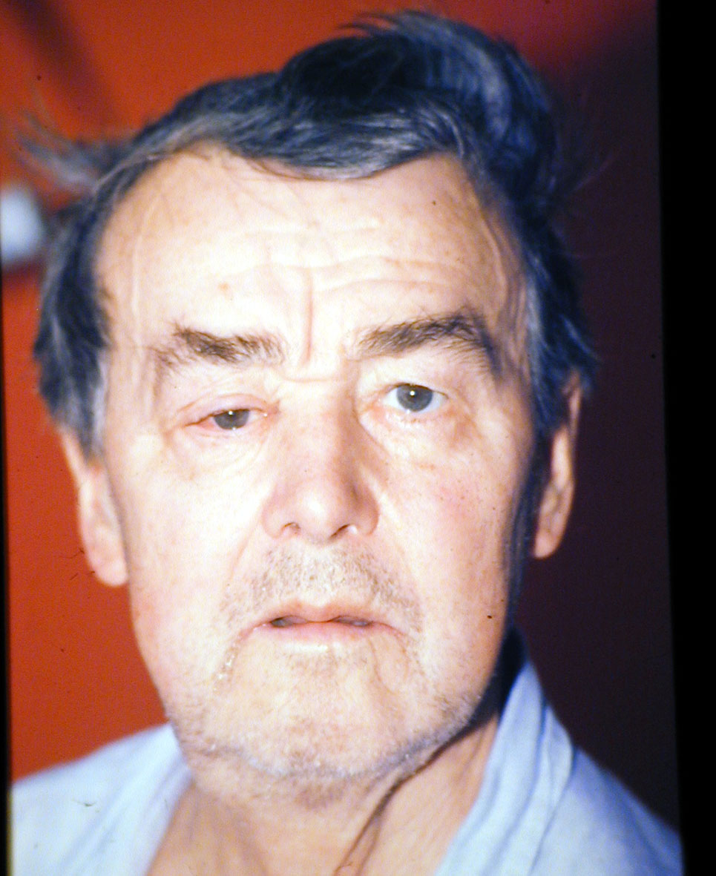

Slide 19
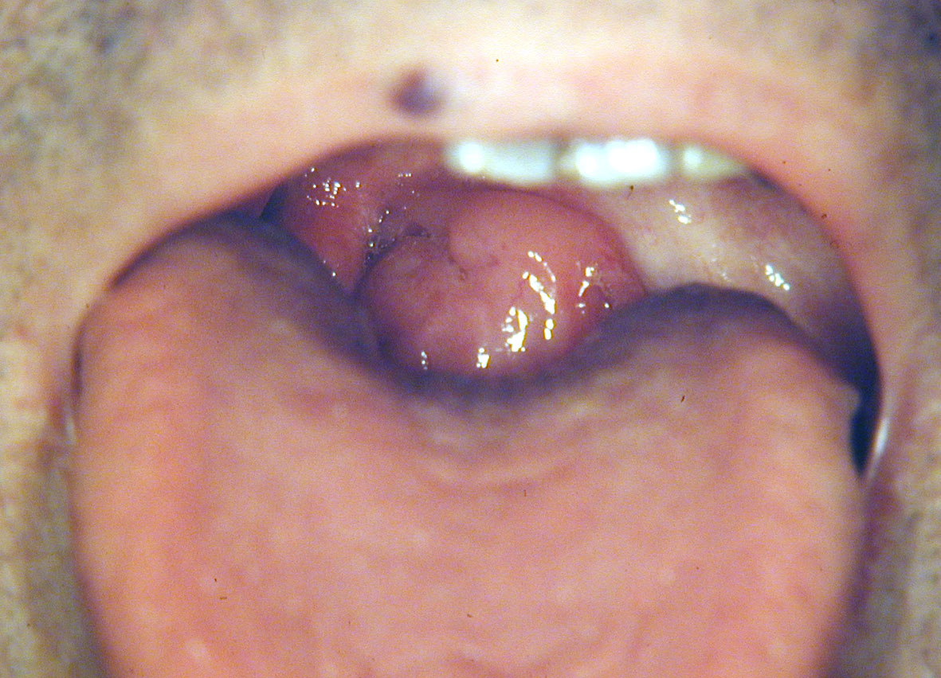

Slide 20
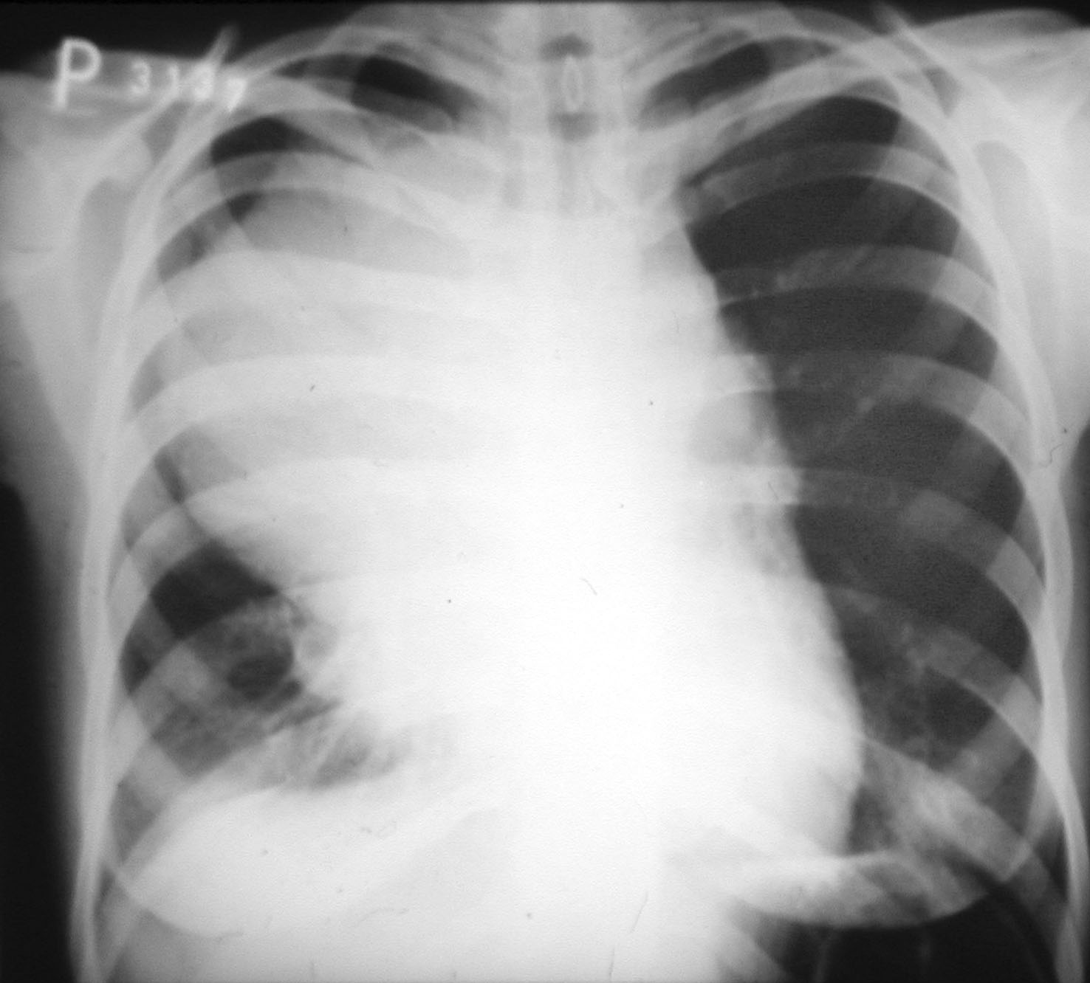

Slide 21
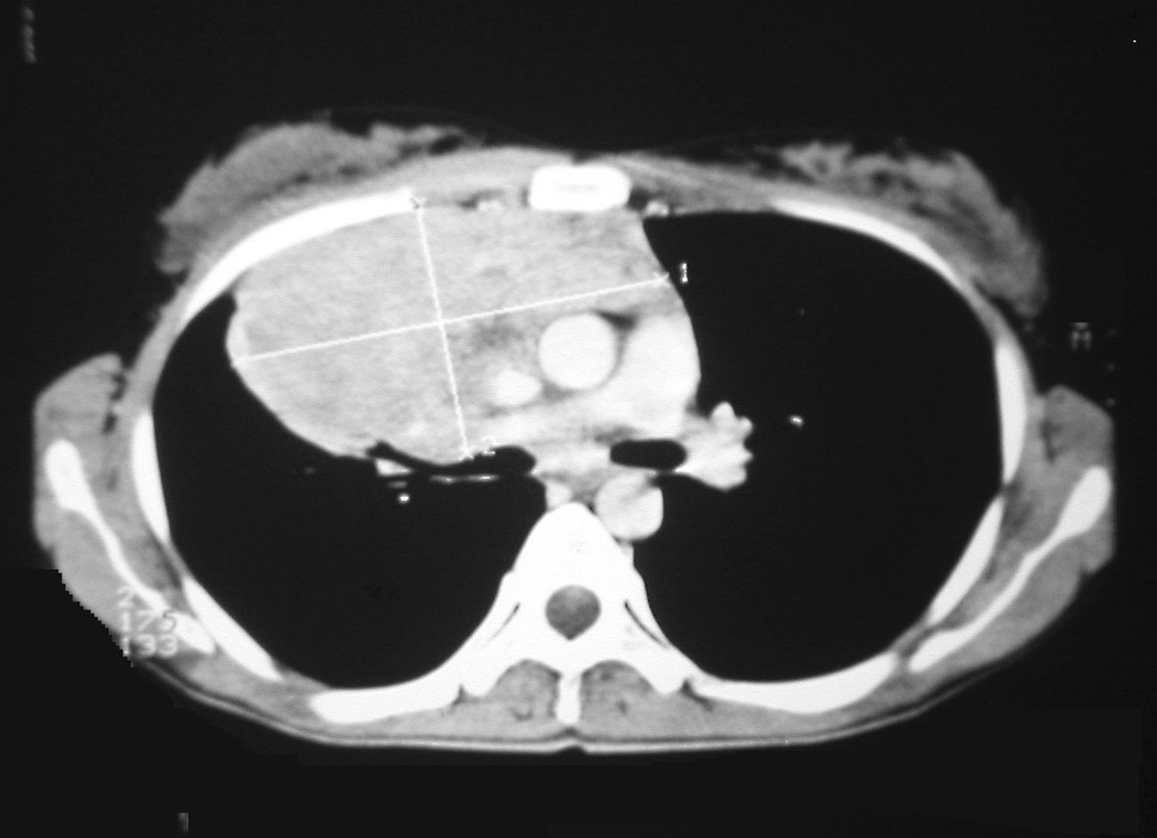

Slide 22
PROGNOSIS OF PATIENT WITH MALIGNANT LYMPHOMA IS BASED ON:
Histology subtype
Performance status (according to ECOG/WHO)
Laboratory examination
Extent of disease = clinical stage
Imaging (CT±PET ev. MRI±PET)
  CT usually „gold standard“
Bone marrow examination (trephine biopsy)
  Not necessary in some lymphomas

Slide 23
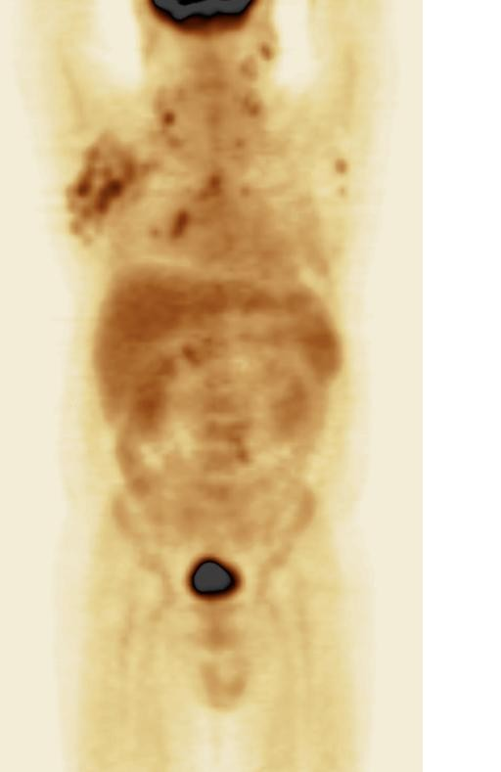
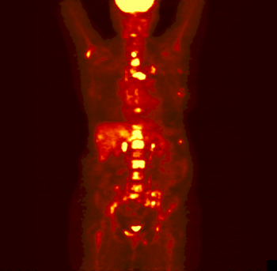
STAGING: FDG-PET (¹⁸Fluordeoxyglucose -positrone emission tomography)

Slide 24

FDG-PET – BUT, what can we really see???
Be cautious with the interpretation of PET scan!
PET image/scan
REALITY

Slide 25
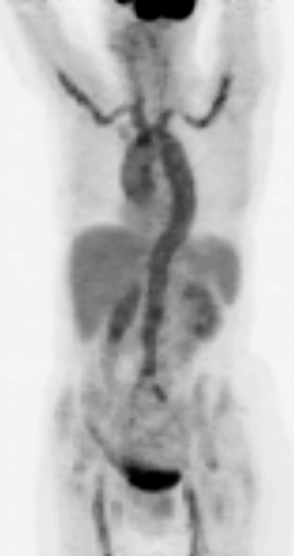
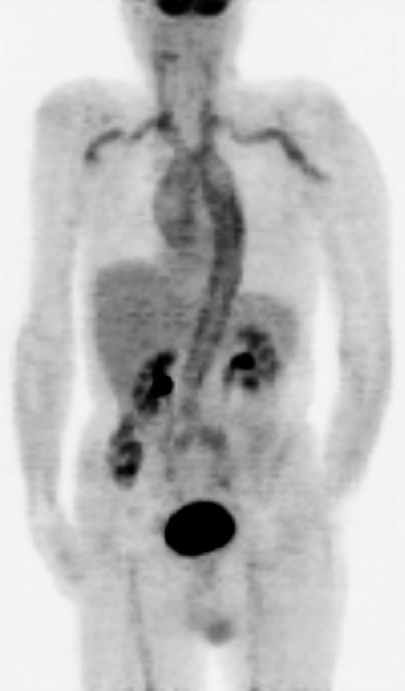
PET is sensitive but not specific for tumor!
Fever of unknown origin – vasculitis descovered by FDG-PET

Slide 26
STAGING -
ANN ARBOR CLASSIFICATON (modified)
Stage I | Involvement of 1 lymph nodes (LU) group or 1 extralymfatic organ (EN) (IE)
Stage II | Involvement 2 or more LN regions on the same side of diaphragma or LOCALISED involvement of 1 EN organ (IIE) including lymph node involvement of 1 or more groups LN on the same side of diaphragma
Stage III | Involvement of LN or lymphatic organs (spleen, Waldayer circle) on both side of diaphragma, which can be accompanied with LOCALISED involvement of 1 EN organ (IIIE)
Stage IV | Difuse or diseminated involvement of 1 or more EN organs or tissues with or without LN involvement
¹Carbone PP, Kaplan HS, Musshoff K, et al. Report of the Committee on Hodgkin’s Disease Staging Classification. Cancer
Res 1971; 31(11):1860-61.
²Rosenberg SA. Report of the committee on the staging of Hodgkin’s disease. Cancer Res 1966; 26: 1310.
³Lister TA, Crowther D, Sutcliffe SB, et al. Report of a commitee convened to discuss the evaluation and staging of
patients with Hodgkin’s disease: Cotswolds Meeting. J Clin Oncol 1989; 7(11):1630-36.

Slide 27
WHY IS IMPORTANT TO KNOW STAGE (~EXTENT) OF THE LYMPHOMA?
Limited stages: I and II
Advanced stages: III a IV
vs.
IF-RT- based / IF-RT containing
therapy
Systemic therapy (immuno-, chemo-,
or immunochemotherapy)
TREATMENT STRATEGY DEPENDS ON THE STAGE IN THE MOST LYMPHOMA SUBTYPES!
EXTENT OF DISEASE DYNAMICS IS USED FOR RESPONSE EVALUATION

Slide 28
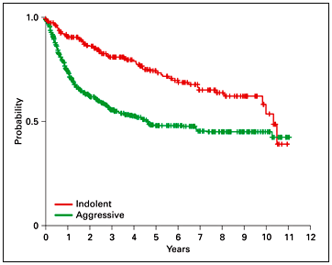
MALIGNANT LYMPHOMAS - GENERAL SURVIVAL
Clinical behavior (aggressive vs. indolent) is an important factor for therapy decision
Irrespective of the lymphoma subtype
Low agressive (indolent)
slow growth
usually incurable (relapses)
start of treatment in symptoms
Aggressive/ high aggressive
rapid progression
BUT several categories potentially curable
start of treatment the earliest possible

Slide 29
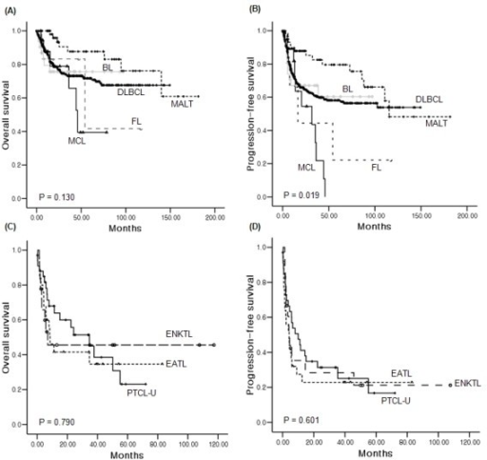
OVERALL SURVIVAL OF SELECTED NONHODGKIN LYMPHOMA SUBTYPES
B-NHL (~90% of NHLs):
MCL – mantle cell lymphoma
BL – Burkitt lymphoma
DLBCL- diffuse large B-cell lymphoma
FL –follicular lymphoma
MALT- mucosa associated lymphoma tissue lymphoma
T-NHL (~10% of NHLs):
ENKTL –extranodal NK/T lymphoma
EATL- enteropathy associated lymphoma
PTCL U –peripheral T-cell lymphoma (unspecified)

Slide 30
MALIGNANT LYMPHOMAS
(overview of clinically important subtypes)
HODGKIN LYMPHOMAS (~30% of lymphomas)
CLASSICAL (~95% of Hodgkin lymphoma)
NODULAR LYMPHOCYTE PREDOMINANT
NON-HODGKIN LYMPHOMAS (~70% of lymphomas)
B-CELL LYMPHOMAS (~90% of NHLs)
DLBCL (DIFFUSE LARGE B-CELL LYMPHOMA; 40% NHLs)
BURKITT LYMPHOMA (1% of NHLs)
FOLLICULAR LYMPHOMA (20% of NHLs)
MZL (MARGINAL ZONE LYMPHOMA; 10%of NHLs)
MCL (MANTLE CELL LYMPHOMA; ~7% of NHLs)
PCNSL (PRIMARY CNS LYMPHOMA; ~1%)
T-CELL LYMPHOMAS (~10% of NHLs)
ALCL (ANAPLASTIC LARGE CELL LYMPHOMA)
PTCL-NOS (PERIPHERAL T-CELL LYMPHOMA, NOS)
AITL (ANGIOIMMUNOBLASTIC LYMPHOMA)

Slide 31
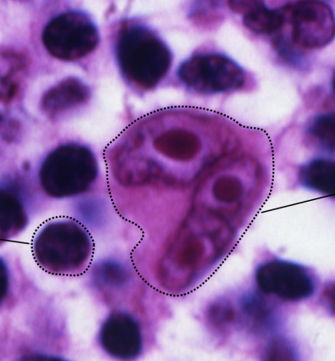
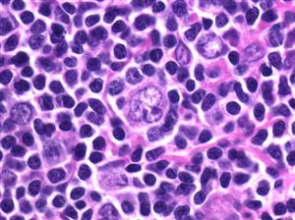
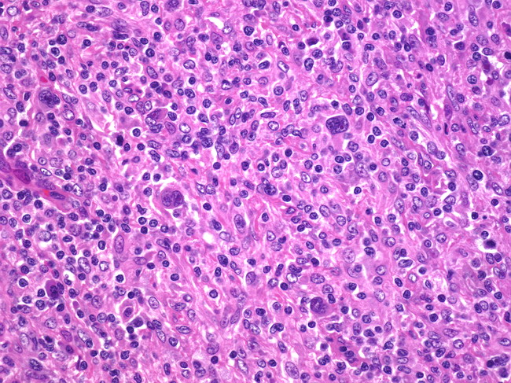
HODGKIN LYMPHOMAS
CLASSICAL HODGKIN
CD30+, CD15+
Reed-Sternberg cc.
Nodular sclerosis
Mixed cellularity
Lymphocyte-rich
Lymphocyte-depleted
NODULAR LYMPHOCYTE PREDOMINANT
  CD20+
  „popcorn“ cells
RS cells ~ derived from thymic B-lymphocytes
Peaks of incidence: 20-30yrs (75%), 60-80yrs (25%)
Symptoms similar like in NHLs with one exception:
Alcohol-related pain (10-15% pts)

Slide 32
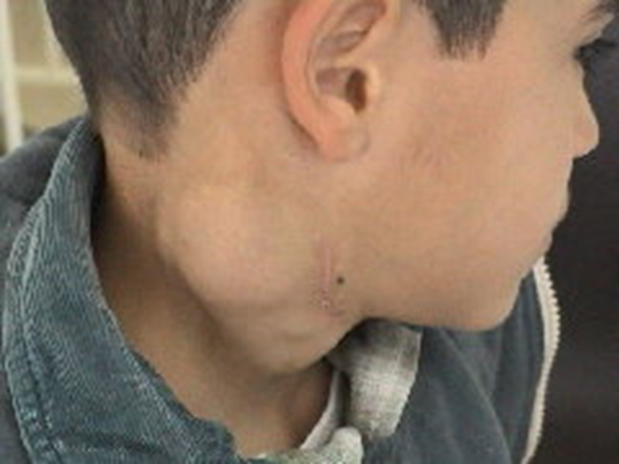
HODGKIN LYMPHOMAS – TREATMENT
Localised disease: 2x cycle ABVD+ IF RT 20Gy
Intermediate disease: 2x ABVD+ 2x BEACOPP escalated+ IF RT 30Gy
Advanced disease: 6x BEACOPP escalated
HODGKIN LYMPHOMA: highly curable disease (80-85%)
IF RT: involved field radiotherapy
BEACOPP ESCALATED
  bleomycin, etoposid, adriamycin,
  cyklofosfamid, vinkristin, prokarbazin,
  prednison
ABVD
  adriamycin, bleomycin, vinblastin,
  dacarbazin

Slide 33
B-NONHODGKIN LYMPHOMA
90% of NHLs
Expression of CD19+, CD20+
Anti-CD20 based therapy
B-cell receptor (BCR) signaling pathway
  ibrutinib
  idelalisib
Microenvironment
  lenalidomid
Aggressive B-NHL
  DLBCL
  Burkitt
Indolent B-NHL
  Follicular lympoma
  Marginal zone lymphoma
  Mantle cell lymphoma

Slide 34
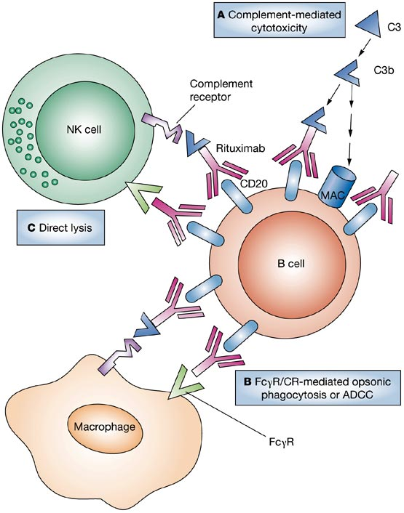
Anti CD20 monoclonal antibody
Rituximab – Mabthera®, Rituxan®
Chimeric humanized IgG1
CD20 receptor on surface
of nearly all B-lymphoid cells
including malignant lymphocytes
R is standard component of
treatment of B-lymphomas
Favourable efficacy/toxicity ratio
Mechanism of action
  CDC (complement dependent cytolysis)
  ADCC (antibody dependent cytotoxicity)
  Apoptosis induction
  Direct antiproliferative effect

Slide 35
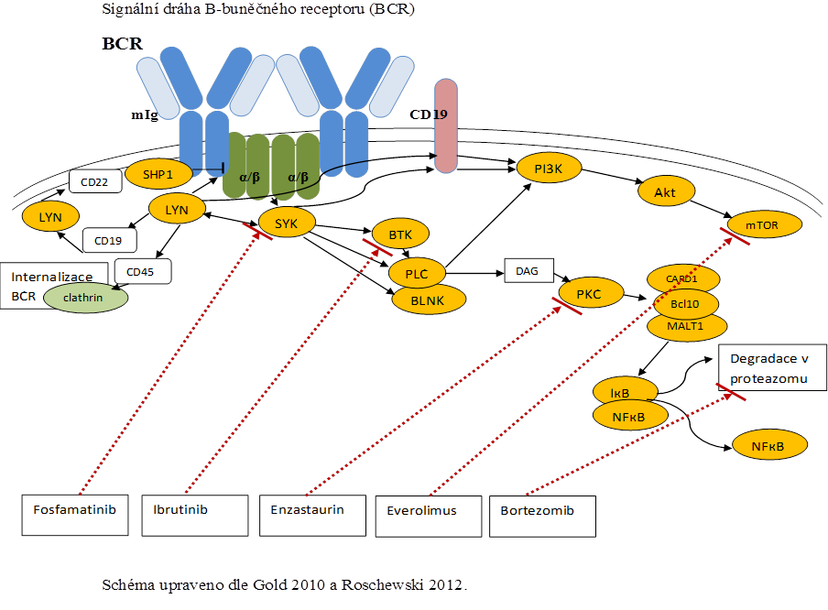
BCR (B-CELL RECEPTOR) SIGNALING
Active BCR signaling
Antigen driven
BCR immobile clusters
activation of NF-кB, PI3, MAPk
NF-кB activated by BTK
ABC-DLBCL
Tonic BCR signaling
Antigen independent
essential for B-cell survival
BCR freely mobile
namely PI3 pathway
Burkitt lymphoma

Slide 36
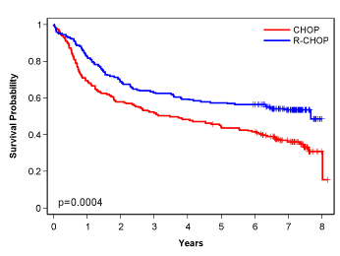
DIFFUSE LARGE B-CELL LYMPHOMA (DLBCL)
An aggressive subtype of NHL (~ 35-40% of NHLs)
Median age at diagnosis around 60yrs
Clinically and biologically heterogeneous disease
Recently identified at least 2 distinct subtypes („GCB“ vs. „ABC“)
Clinical course usually with aggressive, rapid progression
50% long term cure with current standard therapy (R-CHOP)
CHOP (Cyclophosphamide, Doxorubicin, Vincristine, Prednisolone) developed empirically ~ 40 years ago, R-CHOP is current global standard
Doxorubicin & Cyclophosphamide essential drugs in high grade lymphomas
100
80
60
40
20
0
CHOP
MACOP-B
ProMACE-CytaBOM
m-BACOD
Overall survival (%)
0 5 10 15
Patients over 60 (LNH98-5) 2002
36

Slide 37
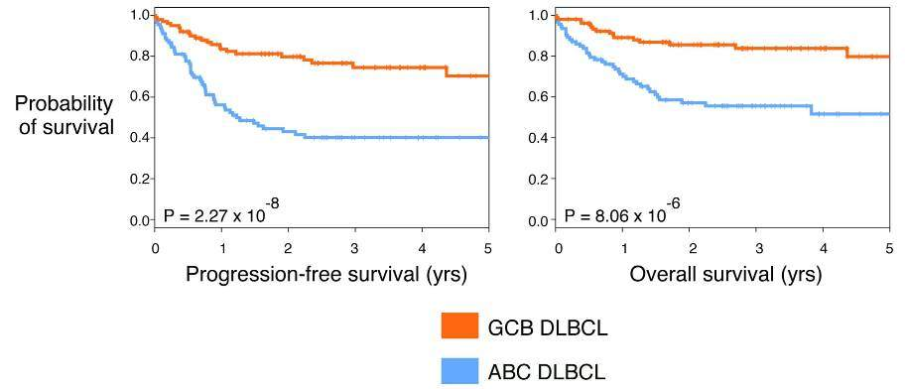
DLBCL – MOLECULAR CLASSIFICATION
DLBCL
~50%
~10%
~40%
GCB
Type 3
non-GCB(ABC)
GCB (germinal center) phenotype:
Bcl2, c-myc
Rare mutation in BCR subunits
ABC( = activated B-cell) phenotype
CARD11, BCL10, MALT1, NF-кB
mutation in BCR subunits
1. Alizadeh et al, Nature 2000
2. Davis et al, Exp Med 2001
3. Rosenwald et al, NEJM 2002
4. Hans et al, Blood 2004
5. Ngo et al, Nature 2006
6. Lenz et al, J Clin Oncol 2007
Lenz et al, 2008
37
Notes:
37
37

Slide 38
DIFFUSE LARGE B-CELL LYMPHOMA
Morphological variants:
  centroblastic, immunoblastic, anaplastic
DLBCL subtypes according to WHO 2008
  DLBCL, NOS
  Primary mediastinal DLBCL
  Plasmablastic lymphoma
  EBV associated DLBCL in elderly
  Primary DLBCL of CNS
  T-cell histiocyte rich
  Primary cutaneous leg-type
  ALK+ anaplastic DLBCL
  DLBCL associated with chronic inflamation
  Intravascular DLBCL
  Primary effusion lymphoma
  HHV8 associated DLBCL
  DLBCL myc+bcl2+
Borderline DLBCL: DLBCL/BL
Gray zone lymphoma: DLBCL/Hodgkin
38

Slide 39
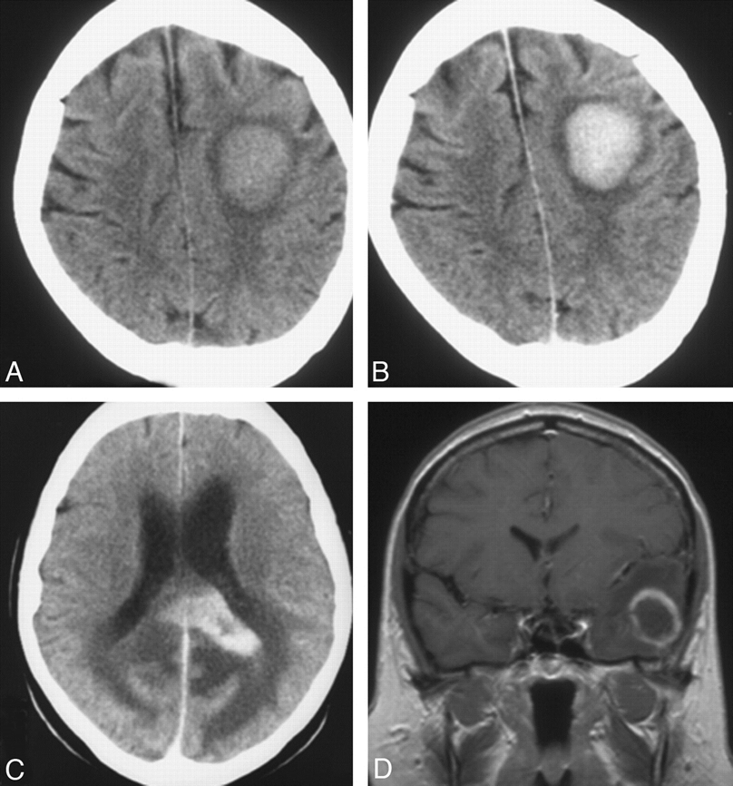
PRIMARY CNS LYMPHOMA
Rare type of aggressive lymphoma
  about 4% of CNS tumours
  about 1% of all lymphoma
Localization:
  common in hemispheras (38%)
  Thalamus/basal gangliae (16%)
  c.calosum (14%)
Median age 60-65 ys
PCNSL (5-year OS 30-50%)
Histologically: DLBCL in 95% cases

Slide 40
PRIMARY CNS LYMPHOMA
Symptoms: neurological deficits, epi-paroxysms,
amention, lethargy
Diagnosis: MRI (typical pattern) + stereotactic biopsy
!Corticosteroids! give in antiedematic setting
NOT BEFORE BIOPSY, corticoids can completely destroy
lymphoma tissue for histological evaluation!!!!
Treatment: cytostatics with ability to cross blood-brain
barrier and have sufficient level in CSF
- high-dose MTX (~3g/m2) and high-dose AraC (~2g/m2) +
whole brain radiotherapy (36-46 Gy)

Slide 41
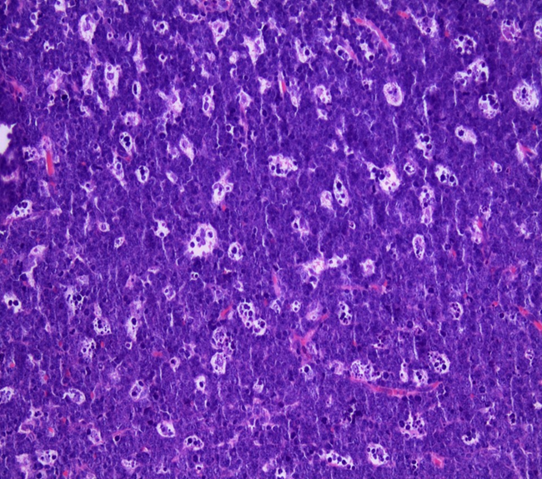
BURKITT LYMPHOMA
Very rapidly growing/ aggressive; high-grade B-cell lymphoma
Rare disease in central Europe
  Endemic (Africa, young boys, jaw or facial mass, EBV related)
  Sporadic (any age, usually abdominal mass)
  Epidemic (immunodeficiency associated)
Different behavior (and therapy) compared to DLBCL
„Starry sky“ morphology (medium-sized lymphocytes)
  Phenotype: CD10+, bcl6+, bcl2-, CD20+, sIgM+, Ki67≥95%,
  t(8;14) in 80% cases, c-myc translocation
Abdominal symptomatology (intususception, appendicitis-like)
BM and CNS involvement in 30% of cases
Tumor lysis syndrome (spotaneous!)
  hyperuricaemia, extremelly elevated LDH
Therapy: highly intensive chemo: CR 80%, long-term survival 50%

Slide 42
BASIC CHARACTERISTICS OF LOW AGGRESSIVE B-NHLs (FL, MZL, SLL,..)
Overall survival even without treatment in years to 10 ys
Radiotherapy (IF RT) can have a curative effect in stage I or II
Advanced stages (III/IV) are chemosensitive but generally
incurable because of reccurent disease
Chemotherapy-based (CHT) therapy is indicated in symptomatic cases or in large mass
Transformation into more aggressive and resistant lymphoma
in 10-60% patients during course of disease

Slide 43
FOLLICULAR LYMPHOMA clinical behavior
Slow growing (sometimes vanishing) painless lymphadenopathy with relapsing course after treatment, spontaneous remissions are not exception, with or without general symptoms
Global median overall survival >18 years,
BUT up to 20% dies during 2 years since diagnosis
FL is considered incurable with exception of localised (limited stages I/II ~ 10-20% FL patients)
Cause of death – treatment toxicity and transformation (~25-60%) to more aggressive NHL

Slide 44
Follicular Lymphoma (and other indolent B-NHLs): principles of therapy
PRIMARY THERAPY (first line)
Localised FL (stage I+II): IF RT 24Gy
Advanced FL (stage III+IV):
  /large tumor/: antiCD20+ chemotherapy + antiCD20 maintenance (2ys)
  /low tumor/: watch and wait
THERAPY OF RELAPSE
Chemotherapy ± antiCD20 maintenance
High-dose chemotherapy + autologous stem cell support
Allogeneic bone marrow transplantation
Radioimmunotherapy
Radiotherapy even very low dose (~4Gy!!!)

Slide 45
Anti-CD20 antibody therapies have changed the course of FL
100
CHOP + antibody*
80
ProMACE
60
Overall survival (%)
40
CHOP
20
p < 0.001
0
0
2
4
6
8
10
Time (years)
ProMACE: prednisone, methotrexate, doxorubicin, cyclophosphamide, etoposide
* SWOG 9911: CHOP + ¹³¹I-tositumomab;
SWOG 9800: CHOP + MabThera
OS = overall survival
1. Fisher RI, et al. J Clin Oncol 2005; 23:8447–8452.

Slide 46
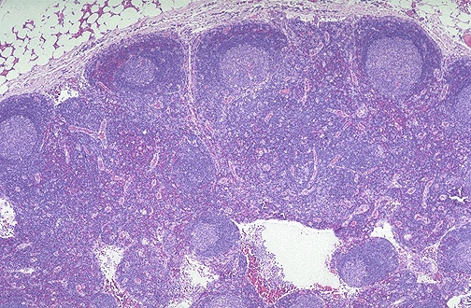
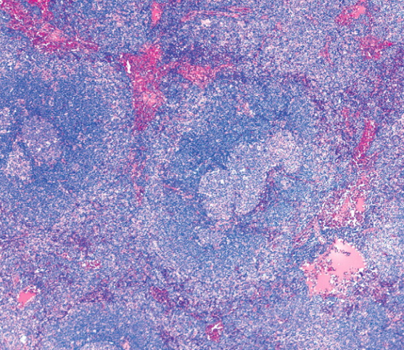
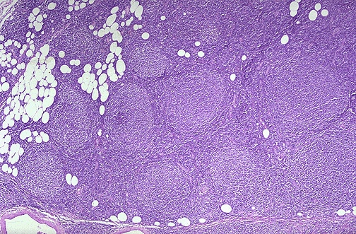
MARGINAL ZONE LYMPHOMAS (MZLs)
Indolent B-NHLs
Nodal – very similar to FL
Splenic with/without vilous lymphocytes
  Splenomegaly leading symptom
  Treatment options: splenectomy
        rituximab monotherapy
Extranodal (MALT)
LYMPHADENITIS MZL FOLLICULAR LYMPHOMA

Slide 47
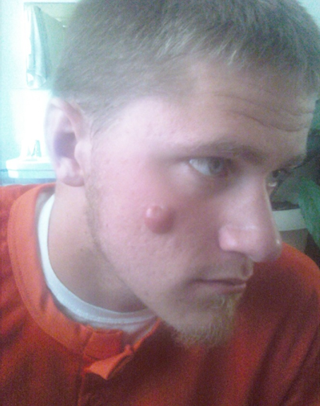
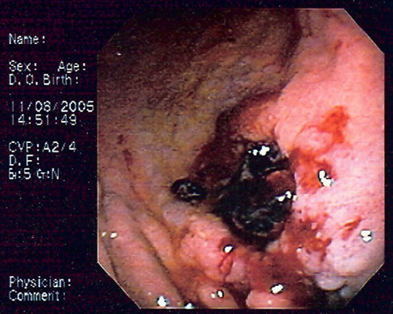
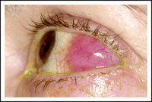
MALT: MUCOSA ASSOCIATED LYMPHATIC TISSUE LYMPHOMA
Subtype of MZL
Etiology: antigen stimulation (H.pylori, Borellia, Chlamydia, HCV…)
MALT-lymphoma of stomach
  symptoms: „gastric ulceration“ (reccurent or non-healing)
  Helicibacter pylori
MALT lymphoma of conjunctiva
  chlamydia
MALT lymphoma of skin
  Borelia infection

Slide 48
MALT lymphomas: treatment principles
Limited stage (I and II)
  Antibiotics, curative radiotherapy (30Gy)
Generalized stage (III and IV)
  treatment like in FL (RCOP/RCHOP)
REMARKS:
Multiple biopsy of mucosa (even normally looking)
Helicobacter pylori must be ALWAYS examined

Slide 49
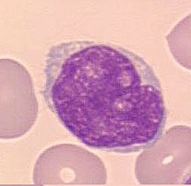
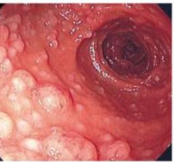
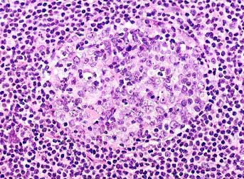
MANTLE CELL LYMPHOMA
Mantle cell lymphoma = lymphoma from „mantle cells“ of lymphatic follicle
6-8 % of all Nonhodgkins´s lymphomas
B-NHL (CD20+)
Typically in older men
Frequent extranodal involvement (>80%cases)
  Blood, bone marrow
  Gut (multiple lymphomatpus polyposis)
CD5+10-19+20+23-79b+sIgDM+sλ+
Diagnosis of MCL can be made by flow from blood and/or bone marrow!

Slide 50
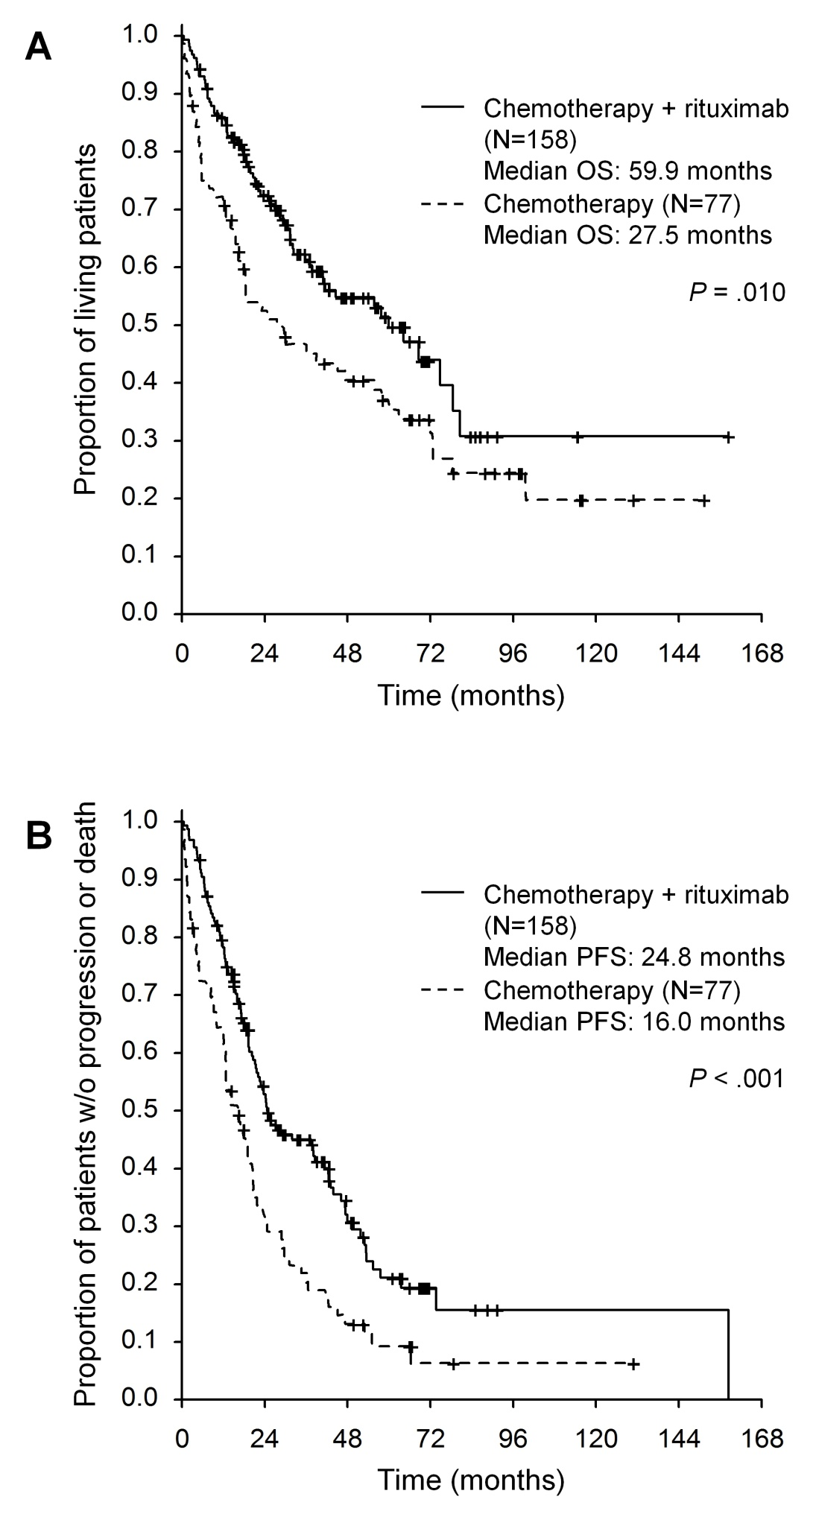

Prognosis of MCL
(Czech Lymphoma Database)
Prognosis is generally poor
New drugs are needed
Chemotherapy has
limited efficacy
Targeted therapy antiCD20
New drugs (ibrutinib)
t(11;14) is hallmark
cyclinD1 overexpression

Slide 51
Gene instability/
Chromatin interaction/
enzymes modified histones
Degradation
P
p27
Cyklin D1
Cyklin D1
Cyklin E
DNA damage
CDK4/6
CDK2
ATM
E2F
P
ATM mutation
P
RB1
P
RB1
p53
E2F
transition from G1 to S phase of cell cycle

Slide 52
MCL- treatment
intensive chemotherapy is recommended if possible
R-MaxiCHOP/high dose Arac/ high dose BEAM
transplantation therapy is indicated in younger patients
majority of MCL patients not able to receive intensive
treament
rituximab in induction and in maintenance improved MCL prognosis
new „smart“ drugs (biological agens) focused on
BCR signaling are promissing
  Ibrutinib, bortezomib, temsirolimus +/- rituximab

Slide 53
T-CELL LYMPHOMAS
  Nodal
    PTCL, NOS: peripheral T-cell lymphoma not otherwise specified (25-36%)
    ALCL: anaplastic large cell lymphoma (12-29%)
    AITL: angioimunoblastic lymphoma (7-19%)
  Extranodal (tissue tropism)
    Hepatosplenic γδ lymphoma (1.4%)
    Enteropathy associated T-lymphoma (EATL) (5%)
    Panniculitis-like T-cell lymphoma (0.9%)
  Leukemic
    Adult T-cell leukemia, LGL-leukemia, NK-cell leukemia, T-prolymphocytic leukemia

Slide 54
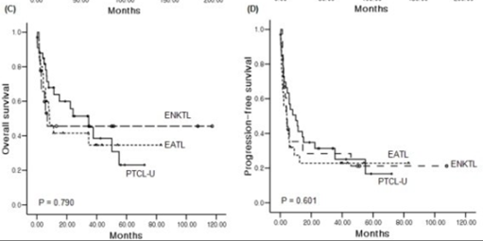
T-CELL LYMPHOMA -prognosis
Non-cutaneous T-lymphoma have very poor prognosis
  Heterogeneity of units/ smal populations for clinical trials
  Treatment used in B-cell lymphoma (CHOP) is insufficient
  CHOEP (CHOP+ etoposide) better than CHOP
  CD30+ T-cell lymphoma can be treated with brentuximab vedotin

Slide 55
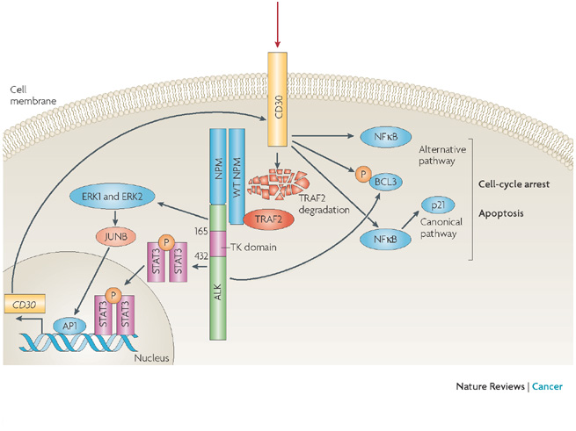
CD30 signal pathway
CD30 is expressed:
  on RS-cells of M.Hodgkin
  on ALCLs
  on primary cutaneous T-lymphomas
  on some PTCL NOS and AITL
  Anti CD30 alone is not suficiently efficace!

Slide 56
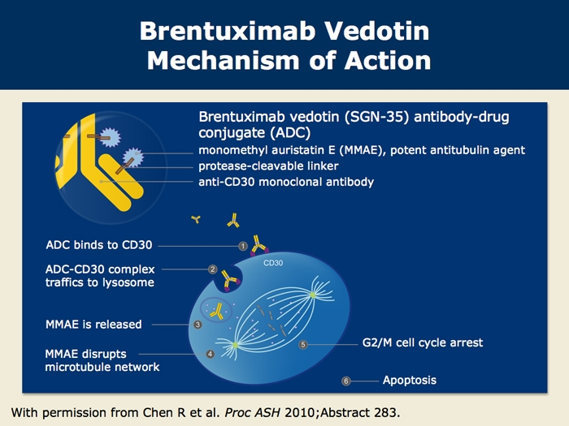

Slide 57
Long-term problems related to treatment of Hodgkin´s disease
Typically ~10yrs or more since end of therapy
Chemotherapy/radiotherapy
Increased general incidence of secondary malignancies
  More then 10-times
Damage of gonadal functions (sterility)
Long-term adverse events (toxicity)
  cardiomyopathy
  lung fibrosis
  myelodysplastic syndrome

