Slide 1
Arthroscopy
„key-hole“ surgery“
Vyskočil R., Rouchal M., Ryba L., Vališ P., Nýdrle M., Filipovič M.,
Ortopedická klinika FN Brno
Přednosta: Prof. MUDr. Martin Repko Ph.D.

Slide 2
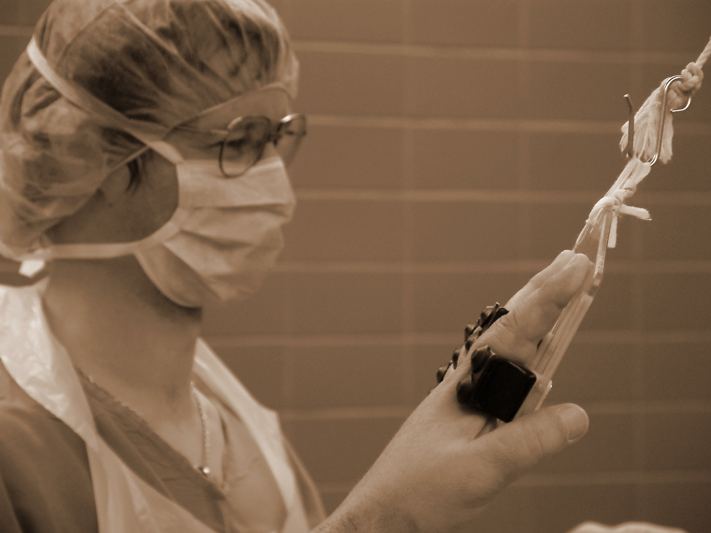
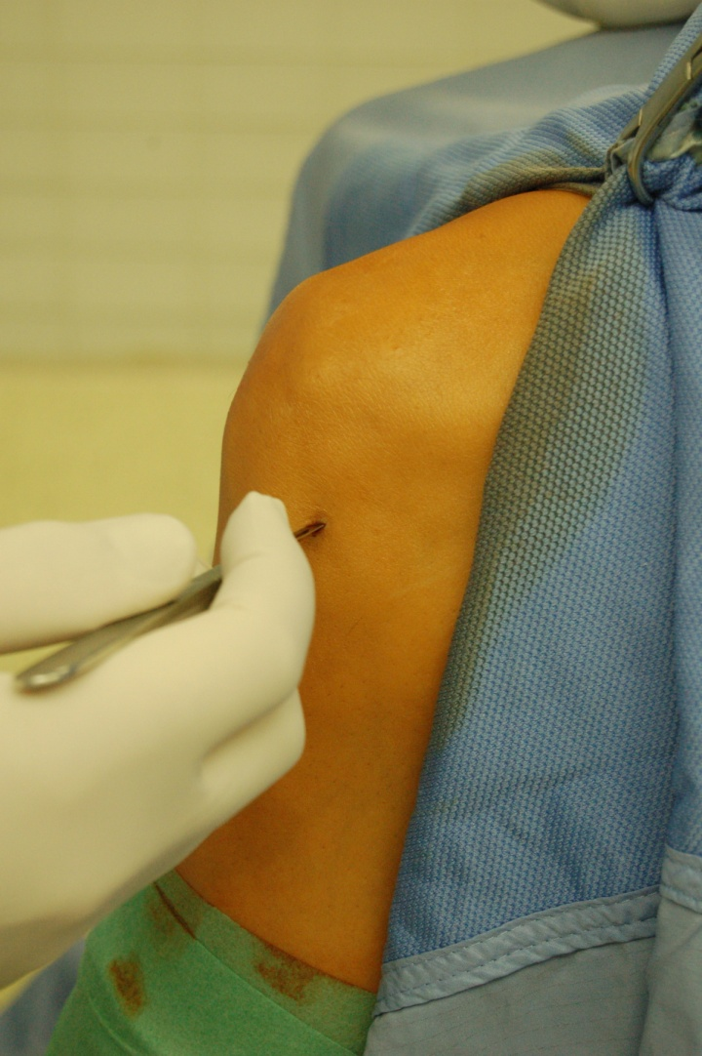
Endoscopic surgical procedure
2 /or 3/ small incisions:
optics
/ camera + source of light /
instruments
/ probe, punch, shaver, wiper.. /

Slide 3
History
- 1918 Kenji Takagaki
  Cystoscope used into knee joint
  1920 Eugen Bircher
  Diagnostic Arthroscopy
- 1931 M.S. Burman
  AS of shoulder on the cadaver
    - 1950 - Masaki Watanabe
    Modernisation of Arthroscopes and usage in clinical work
- 1970 - first usage of arthroscopic camera

Slide 4
Knee
Shoulder
Wrist
Elbow
Hip
Para-articular spaces
/ Achilles tendon, carpal tunnel – CTD /

Slide 5
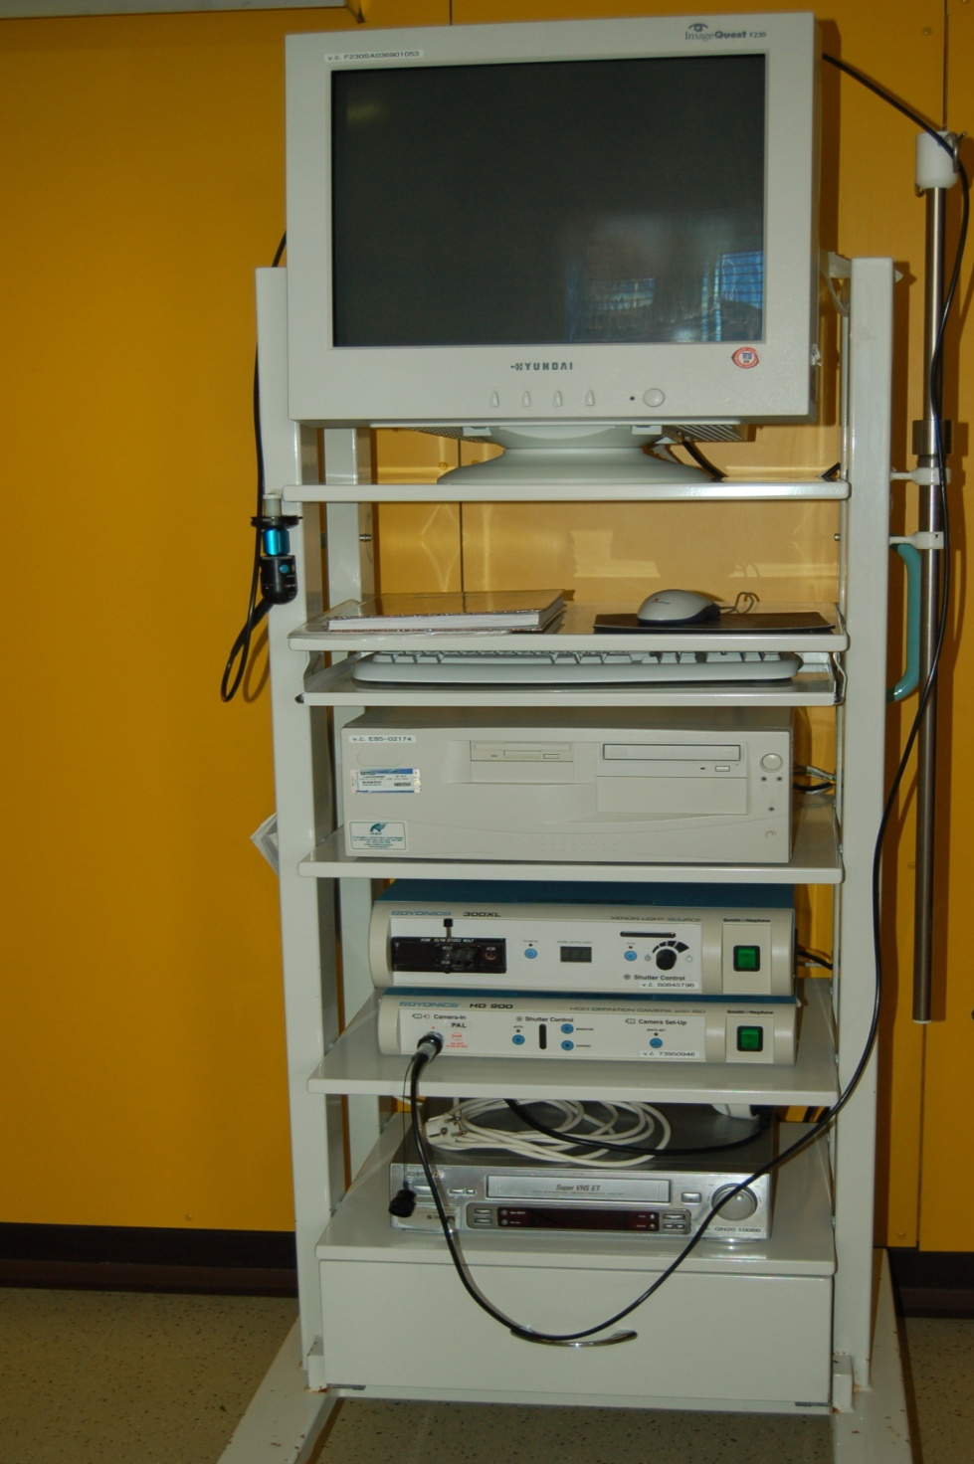
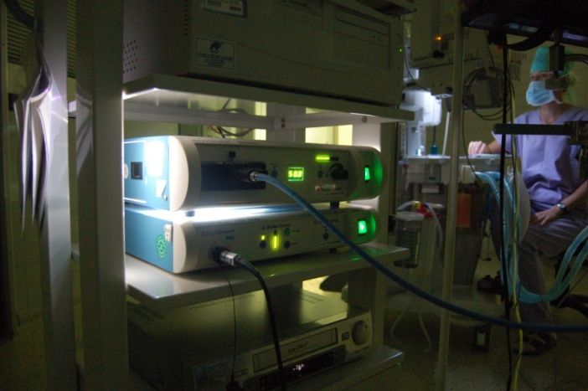
monitor
PC
light source
processor of the camera

Slide 6
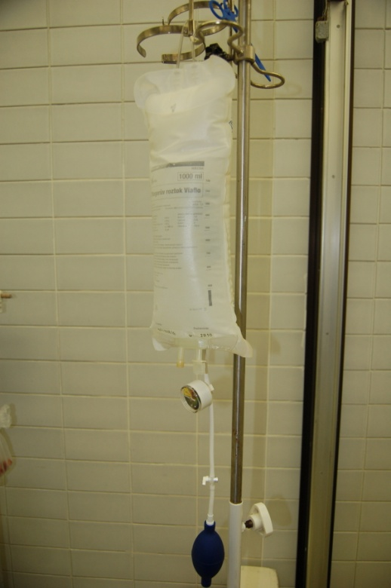
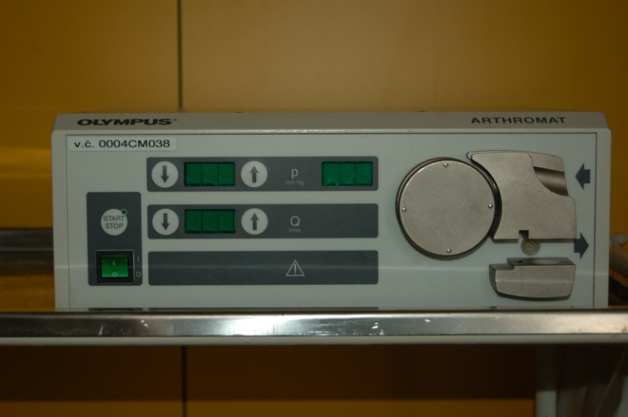
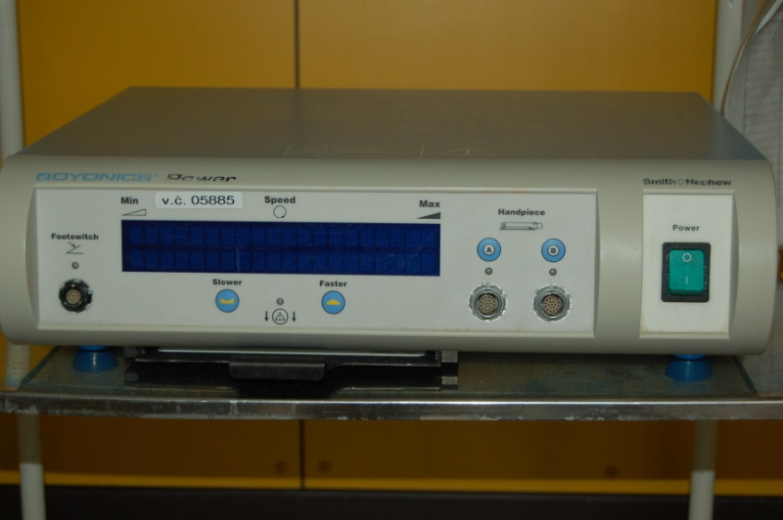
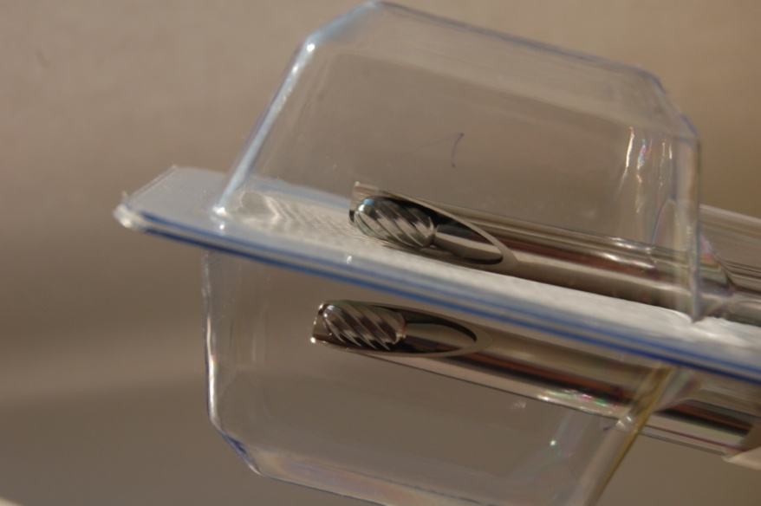
Pump
Shaver

Slide 7
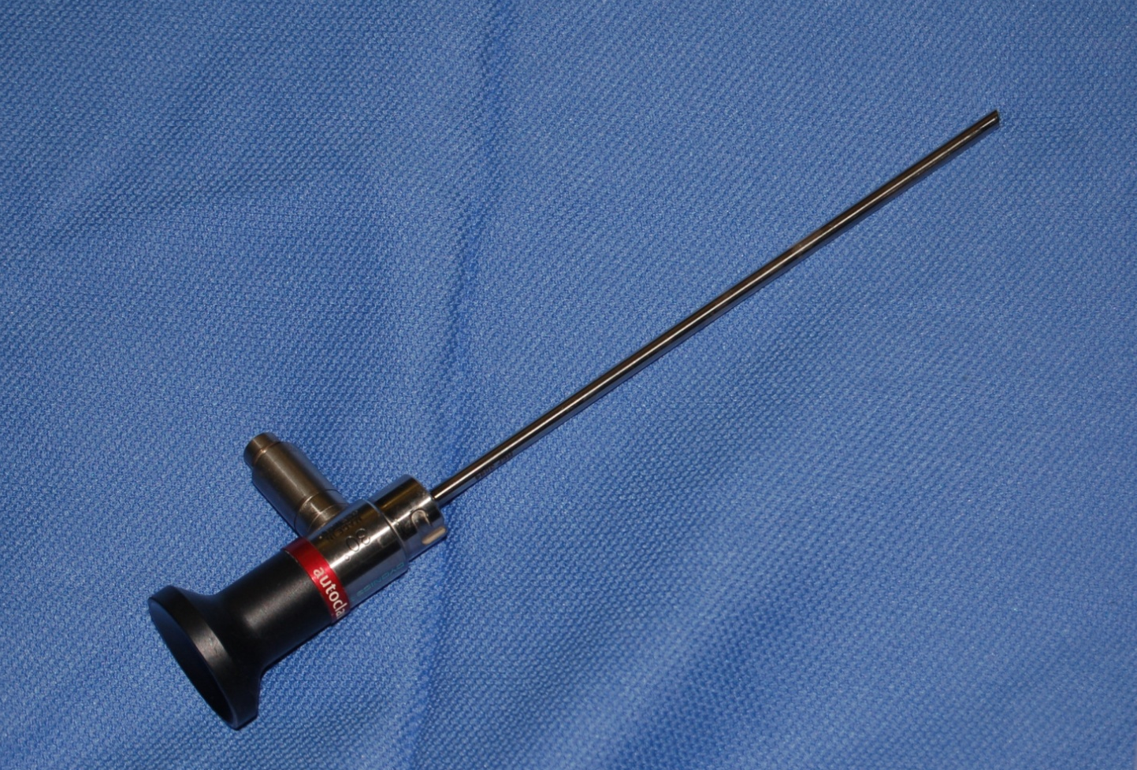
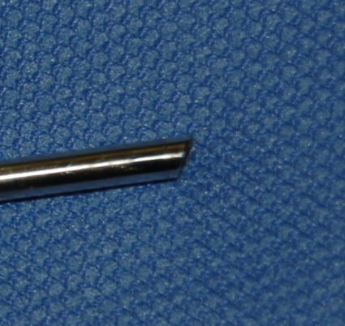
optics 30°

Slide 8
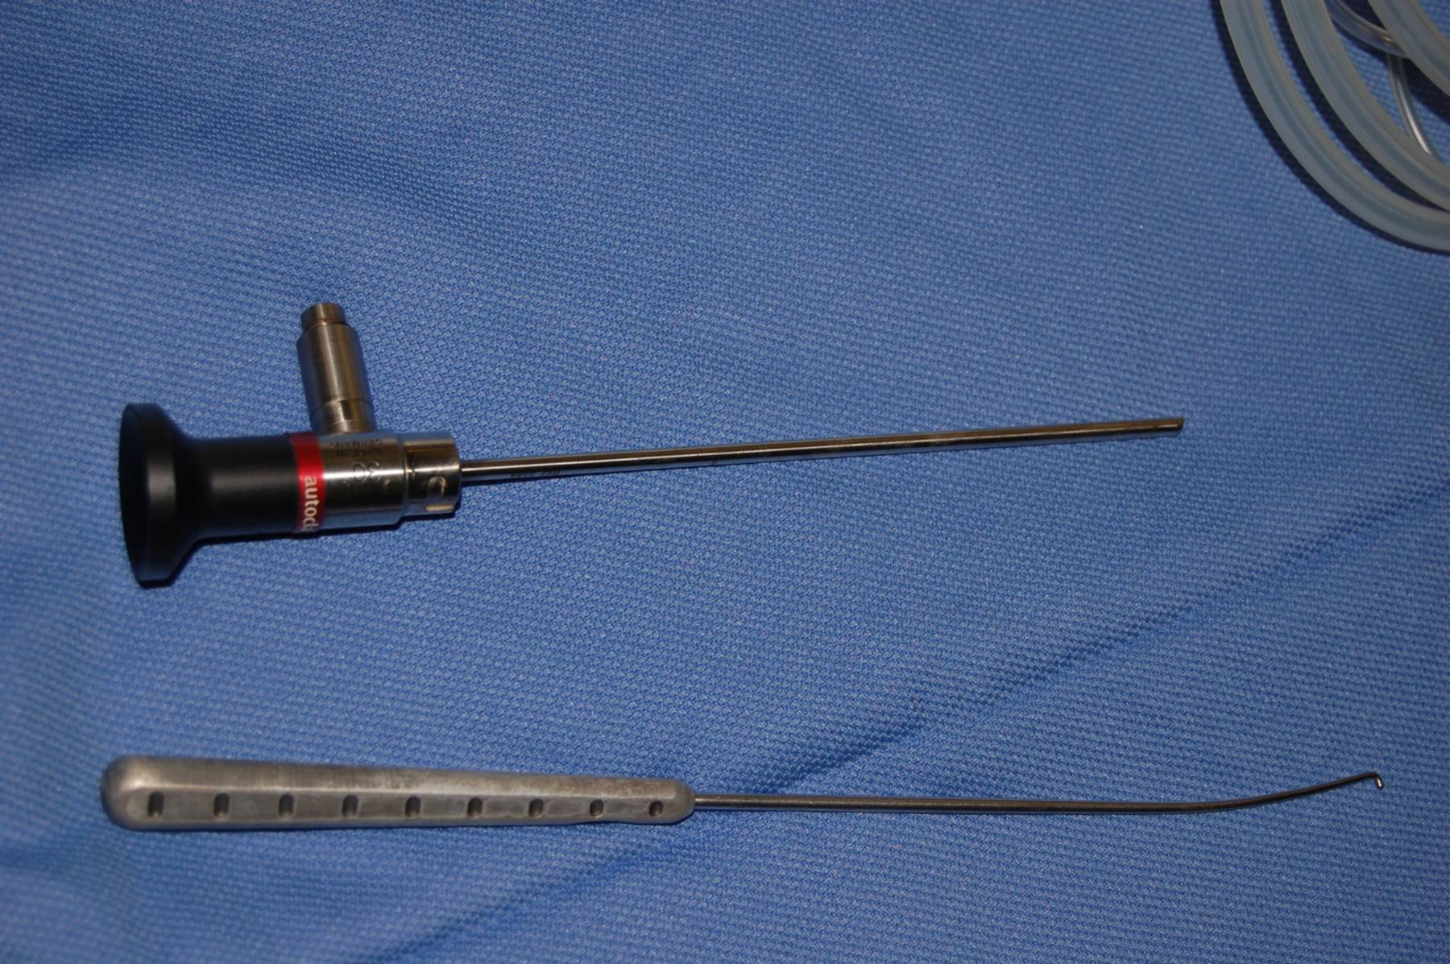

Slide 9
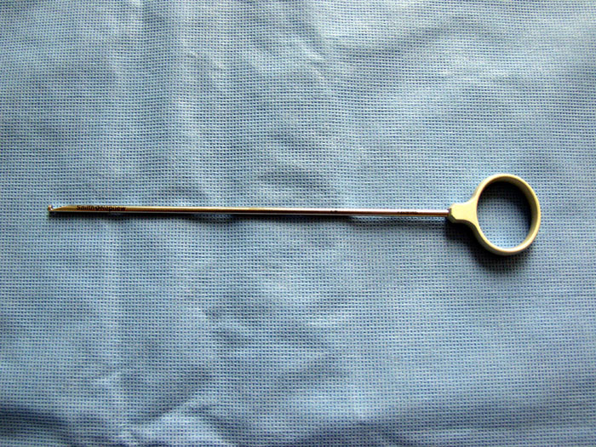
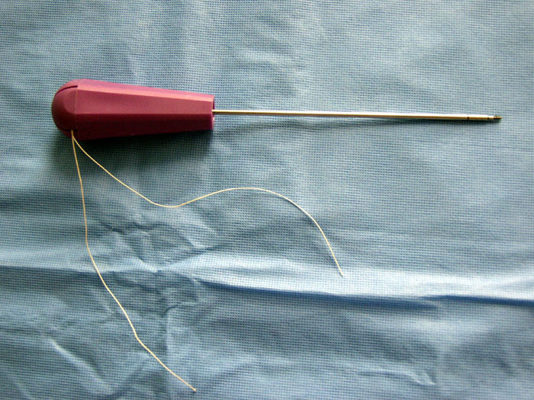
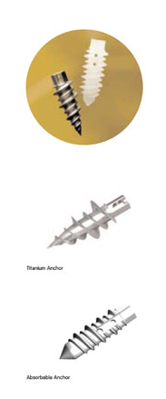
Instruments

Slide 10
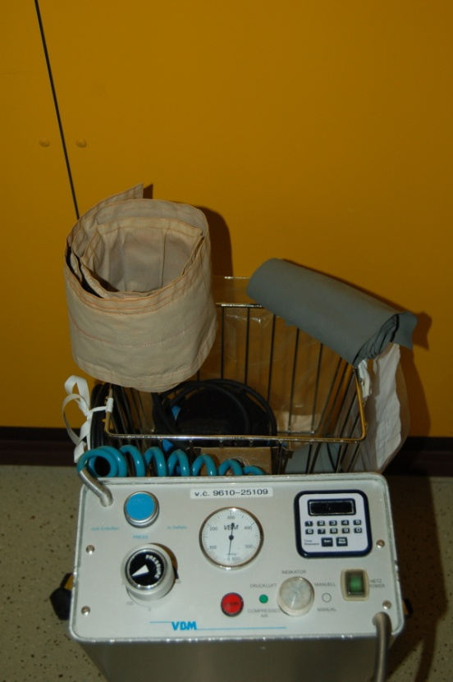
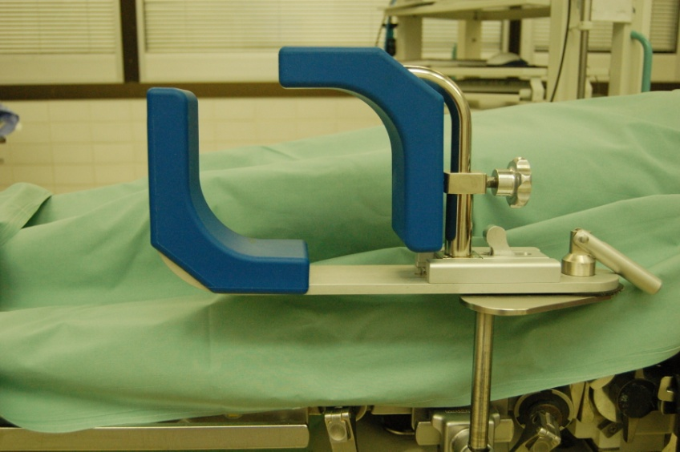
Turniquet
Ischemisation of the leg
„bloodless“ procedure
250 Torr / Systolic BP + 100 /
Maximum 90 min
Knee, ankle, foot ASC

Slide 11
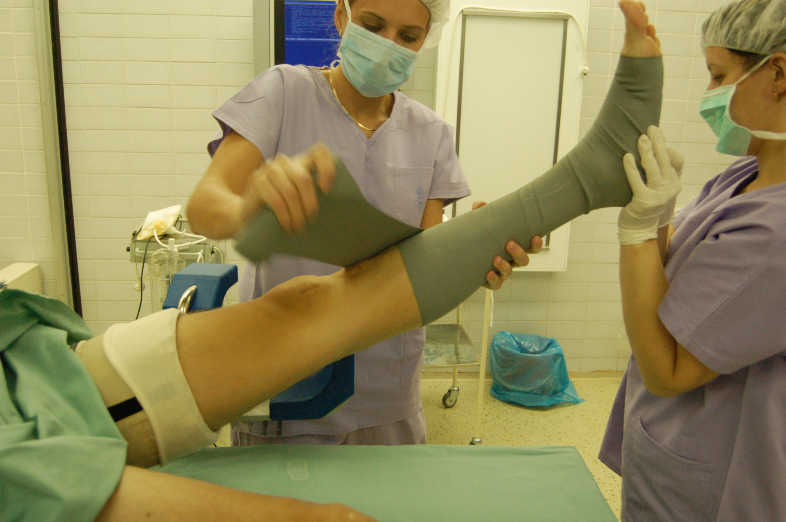
Preparation
Knee scope
Supine position
Thigh holder
Turniquet

Slide 12
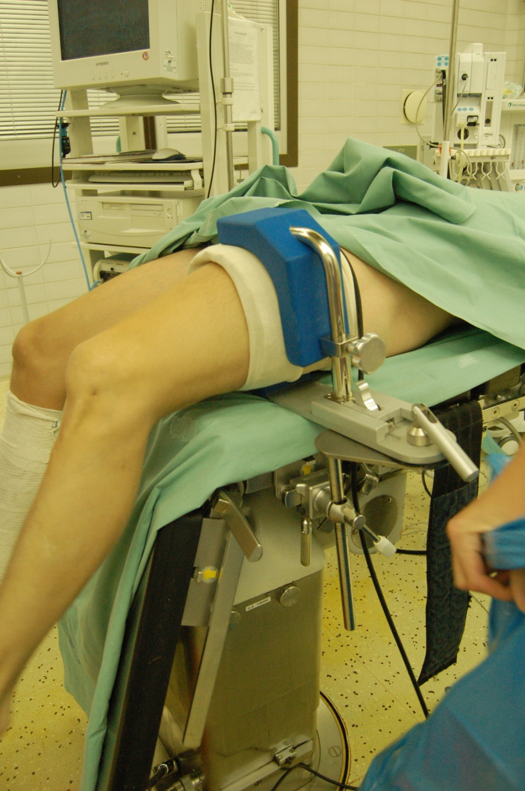
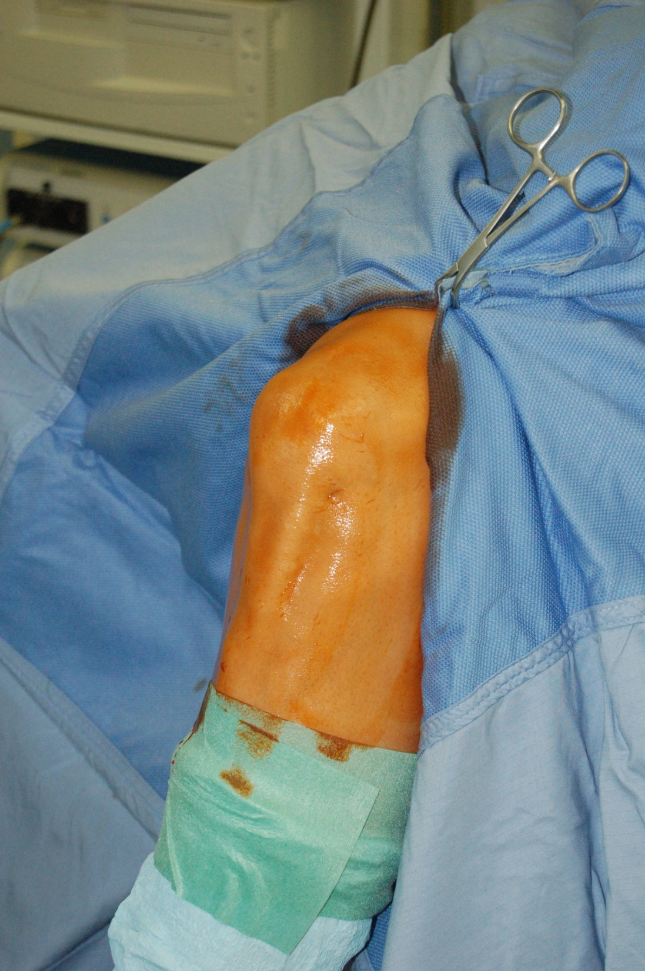

Slide 13
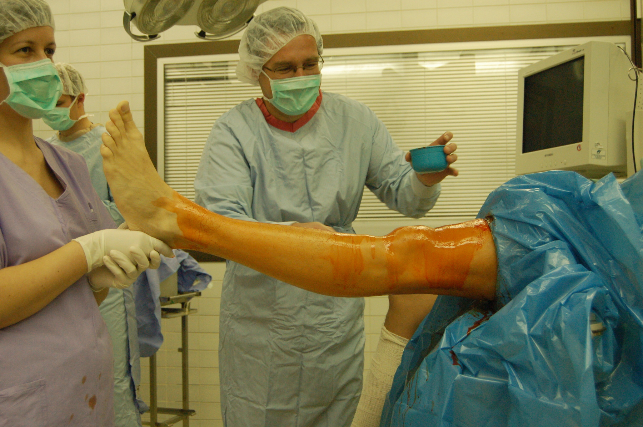

Slide 14
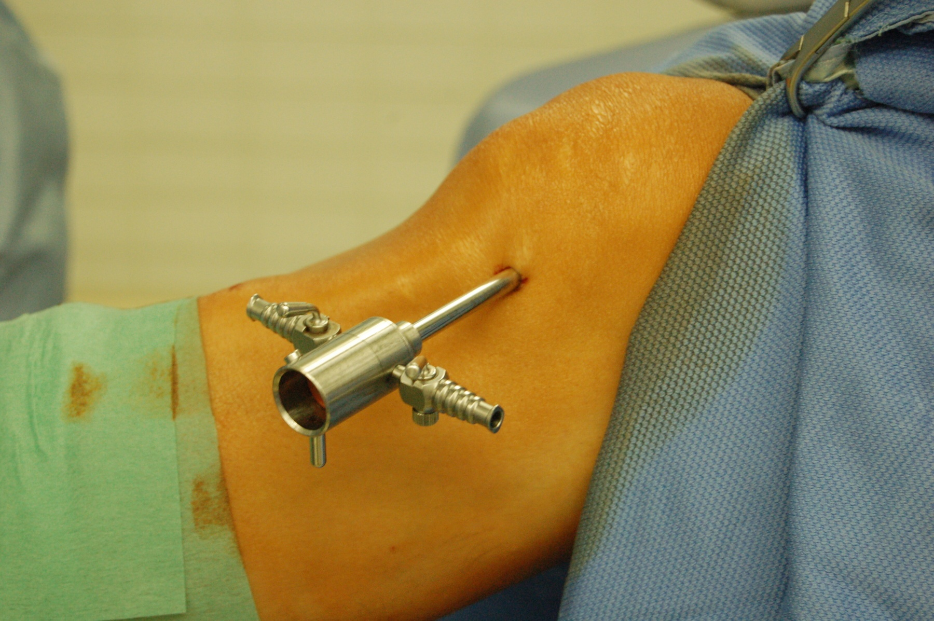
Basic 2 portals
For Optics – AL
Instruments – AM

Slide 15
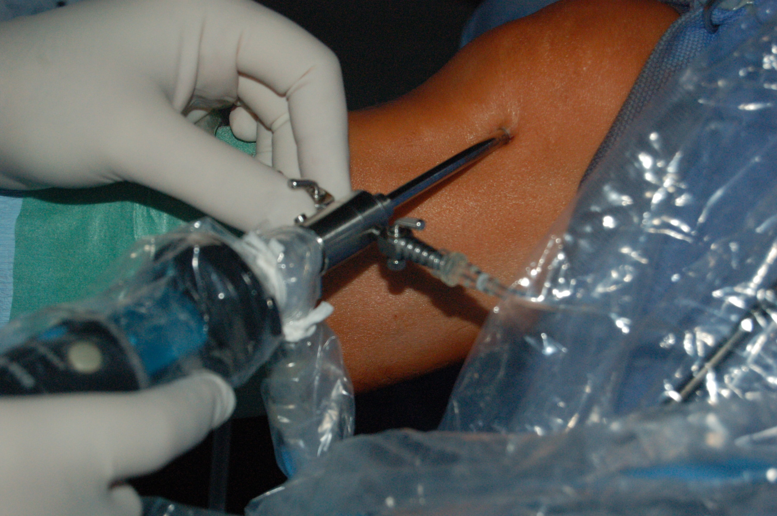

Slide 16
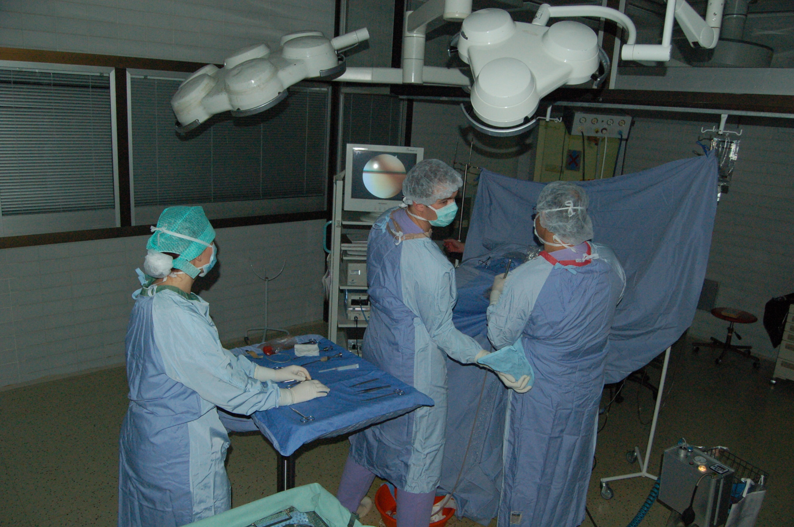
patient
asistent
anesthetist
surgeon
Scrub nurse

Slide 17
Upper limb
Shoulder
Indication:
Degeneration
Trauma, post – traumatic pathology
Infection - lavage
Tumour - biopsy

Slide 18
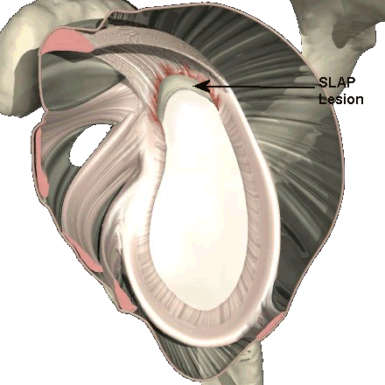
Most common diagnosis of shoulder Arthroscopy:
Repeated shoulder dislocations – „Bankart“ lesion
venral labrum tear
Slap lesion Superior – „ superior labrum antero-posterior“
upper labrum tear
Rotator cuff pathology – tear, rupture
Pathology of SA space – „Shoulder Impingement“
Osteoarthritis, degeneration

Slide 20
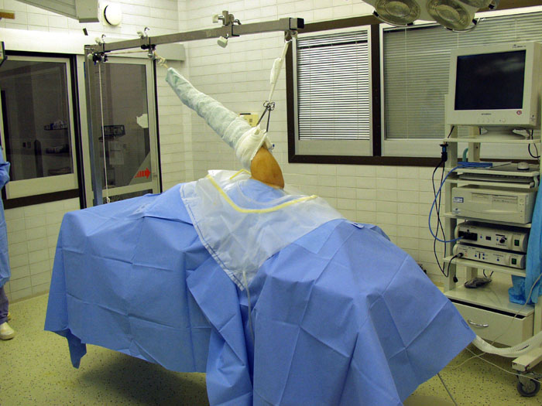
position on the table
lateral decubitus
traction of operated limb
2. „beach chair“ position

Slide 21
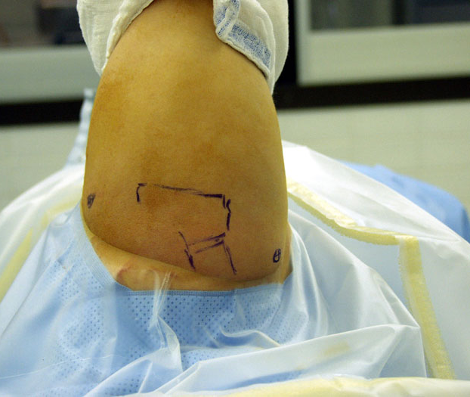
ASC portals:
Dorsal/posterior
Ventral/anterior
Lateral /SA space/

Slide 22
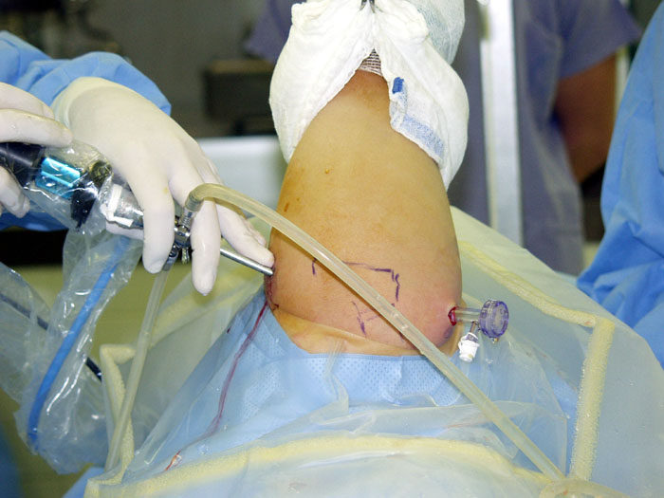

Slide 23
Ventral defect of the labrum – Bankart lesion
ventral shoulder dislocation
Labrum destroyed / Hill Sachs lesion of the head

Slide 24
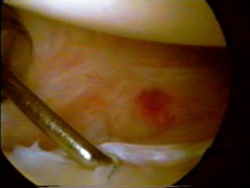
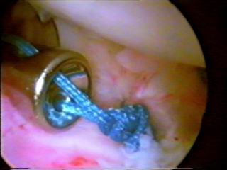
Restored labrum + capsule and fixed with anchors

Slide 25
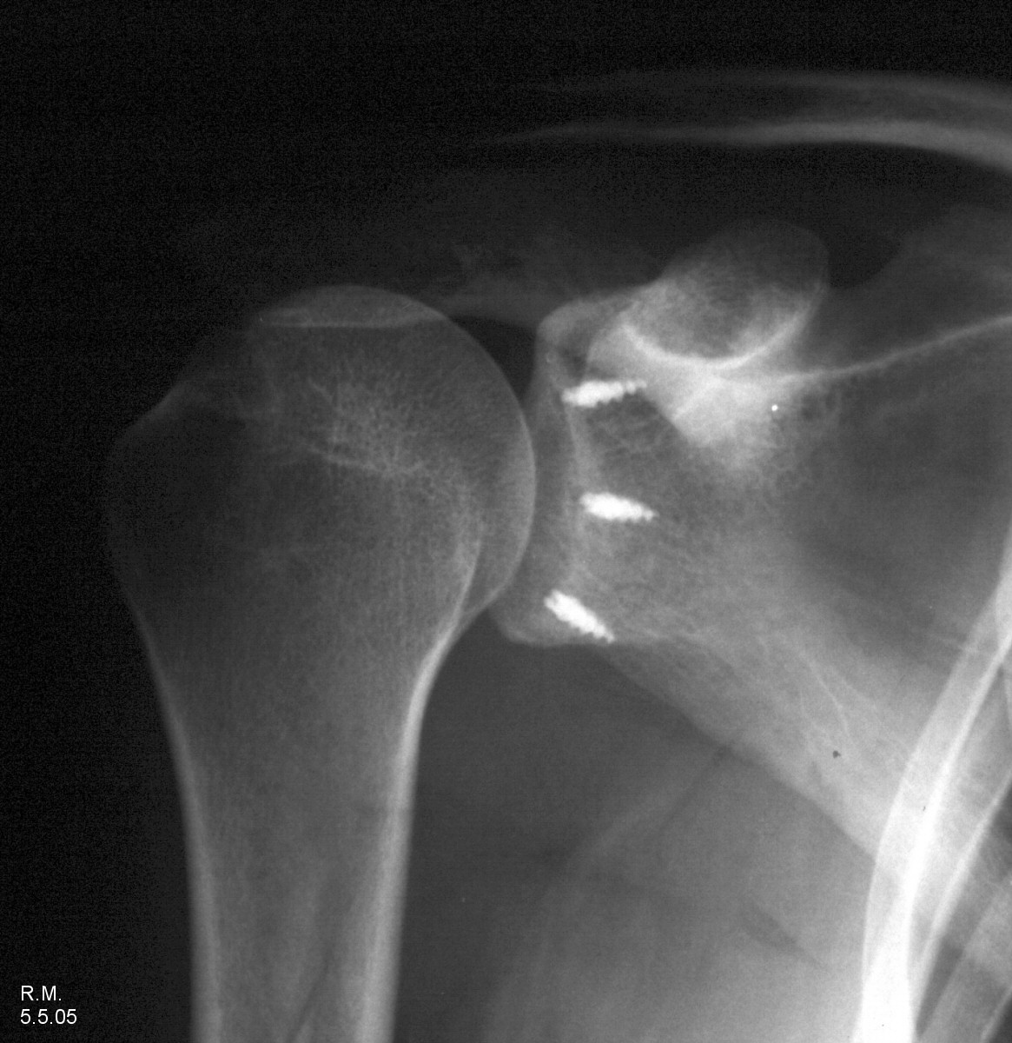
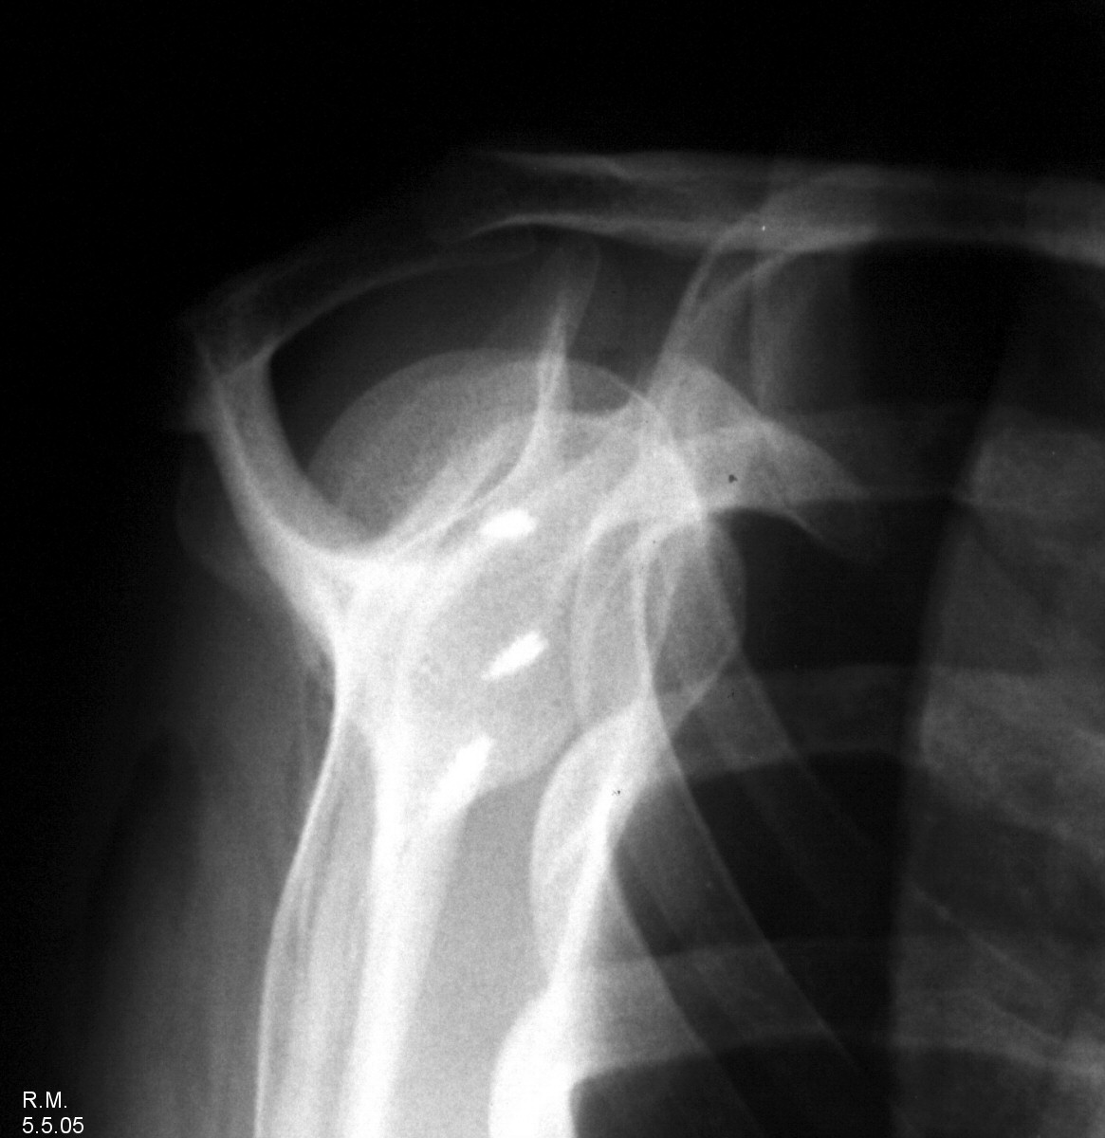
Post op X ray

Slide 26
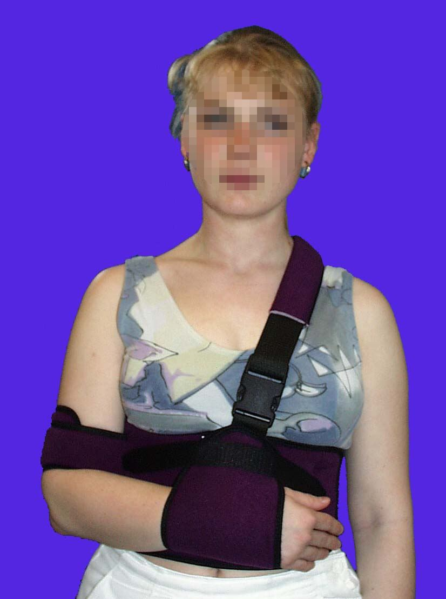
Post op fixation
Labrum reconstruction - Dessault orthosis for 6/52
SAD /decompression/ - scarf bandage, intensive RHB
Rotator cuff suture - Abduction splint for 6/52 – 3/12

Slide 27
Open surgery
Mini-invasive approach
Rotator cuff repair/suture
/ m. supraspinatus, infaspinatus,
teres minor, subscapularis /
Open Resection of distal /lateral/ end of the clavicle
/ Stewart operation /

Slide 28
Wrist
Smaller optics and instruments
No pump and turniquet
Pathology of TFCC
/ triangular fibrocartilage complex /
Scapho-lunate dissociation

Slide 29
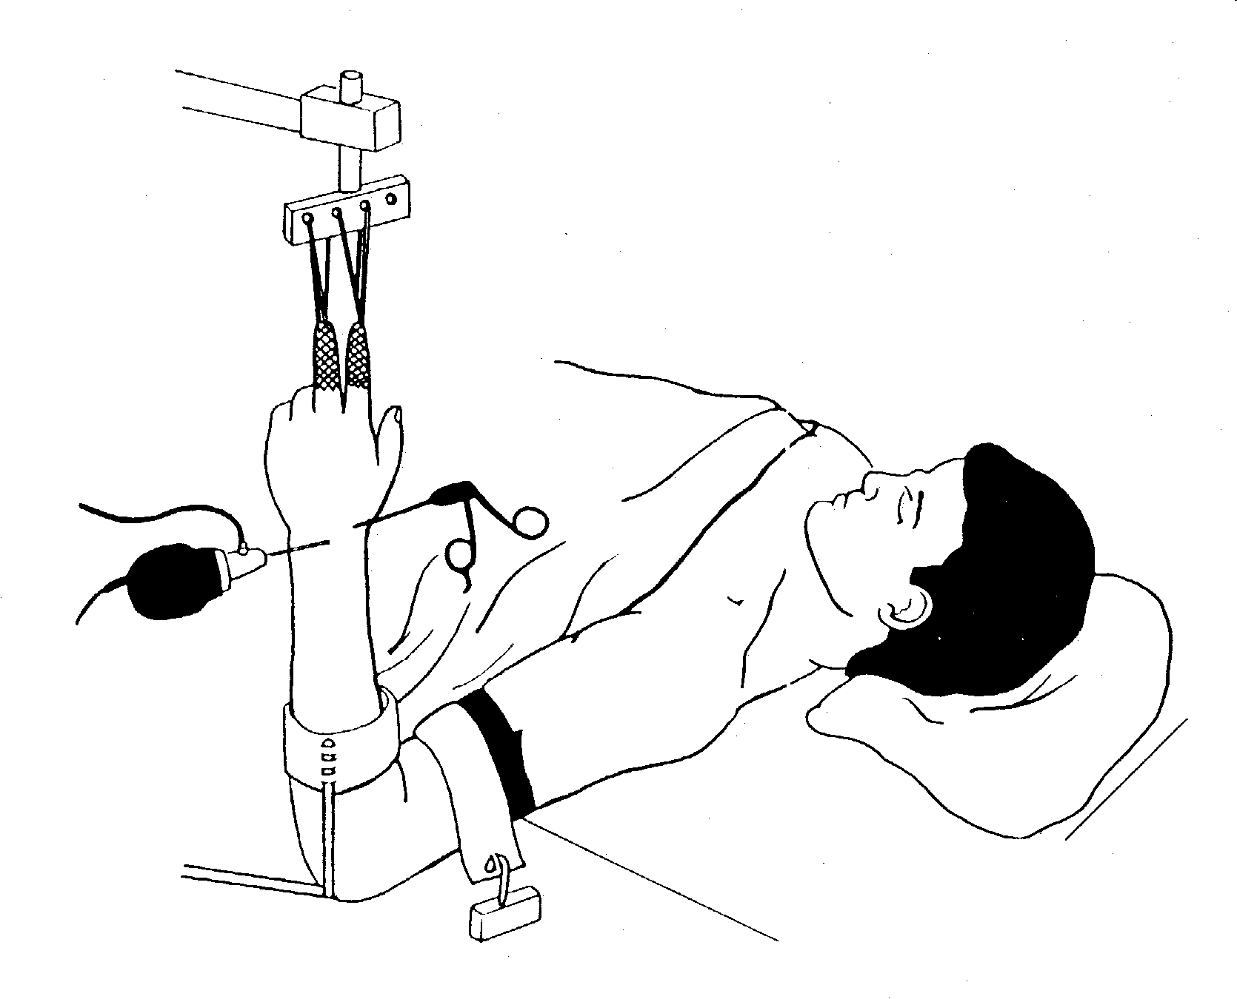
Wrist instability
Partial excisions of the wrist
Distal ulna/radius ostetomy
Pseudoarthrosis ossis scaphoidei
CTD carpal tunnel decompresion
Artrodesis of the wrist and fingertips
Synovectomy
open surgery...

Slide 30
Lower Extremity
Hip
Post-traumatic /degenerative arthrosis
Coxitis – debridement + lavage
Foreign bodies removal
Labral reconstruction
FAI – Femoro-acetabular impingement
repair

Slide 31
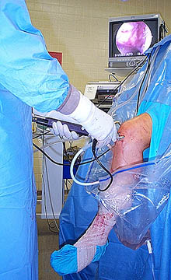
Knee
Acute trauma: haemarthros
Instability – rpt ACL/PCL
Infection / gonitis - lavage
Osteoarthritis - debridement
Meniscus repair/resection, LCA/PCL reconstruction, plica resection,
chondral defects, foreign bodies removal, patellar release,….

Slide 34
ACL /Ligamentum cruciatum anterius/ reconstruction – sec. Brückner
BTB – Bone - Tendon – Bone
Bony parts for patella and tibial tubercle
Tendon graft from lig.patellae
Stronger graft compared to hamstrings
/ m. gracilis, m semitendinosus /

Slide 36
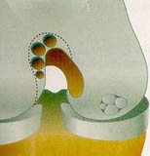
Chondral defects
Mosaicplasty
osteochondral blocs taken from non-bearing zone
Autologous chondrocytes transplantation
taken healthy parts of cartilage – multiplication
after 6 weeks open implantation on the carriers –
scaffolds to the defect
Allogeneic chondrocytes transplantation
( USA )

Slide 38
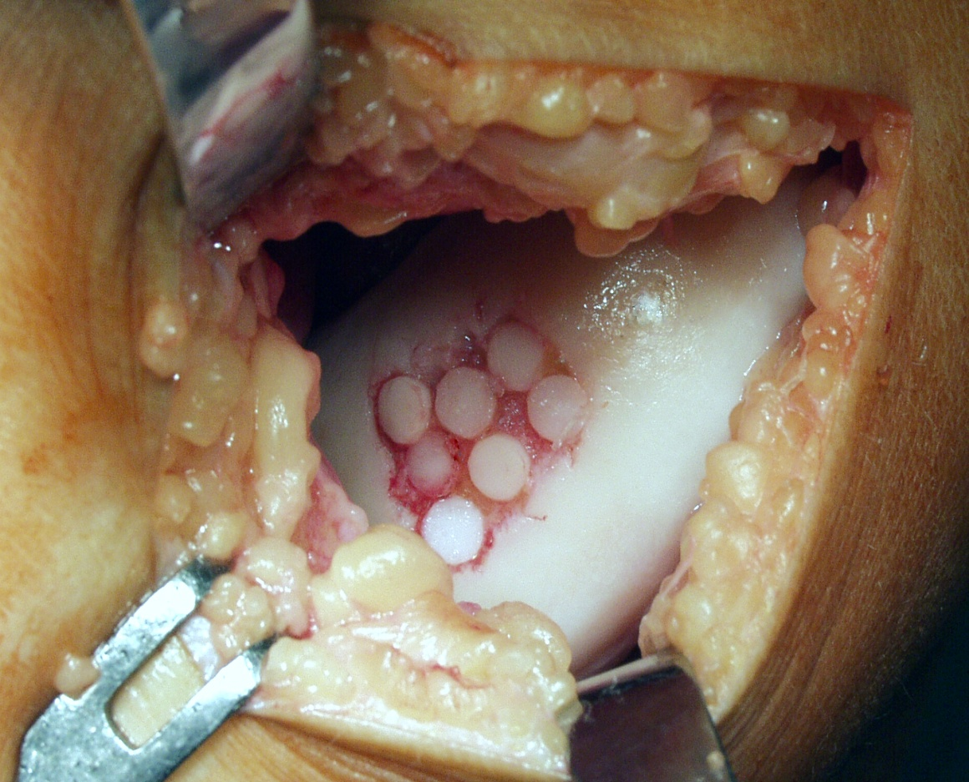
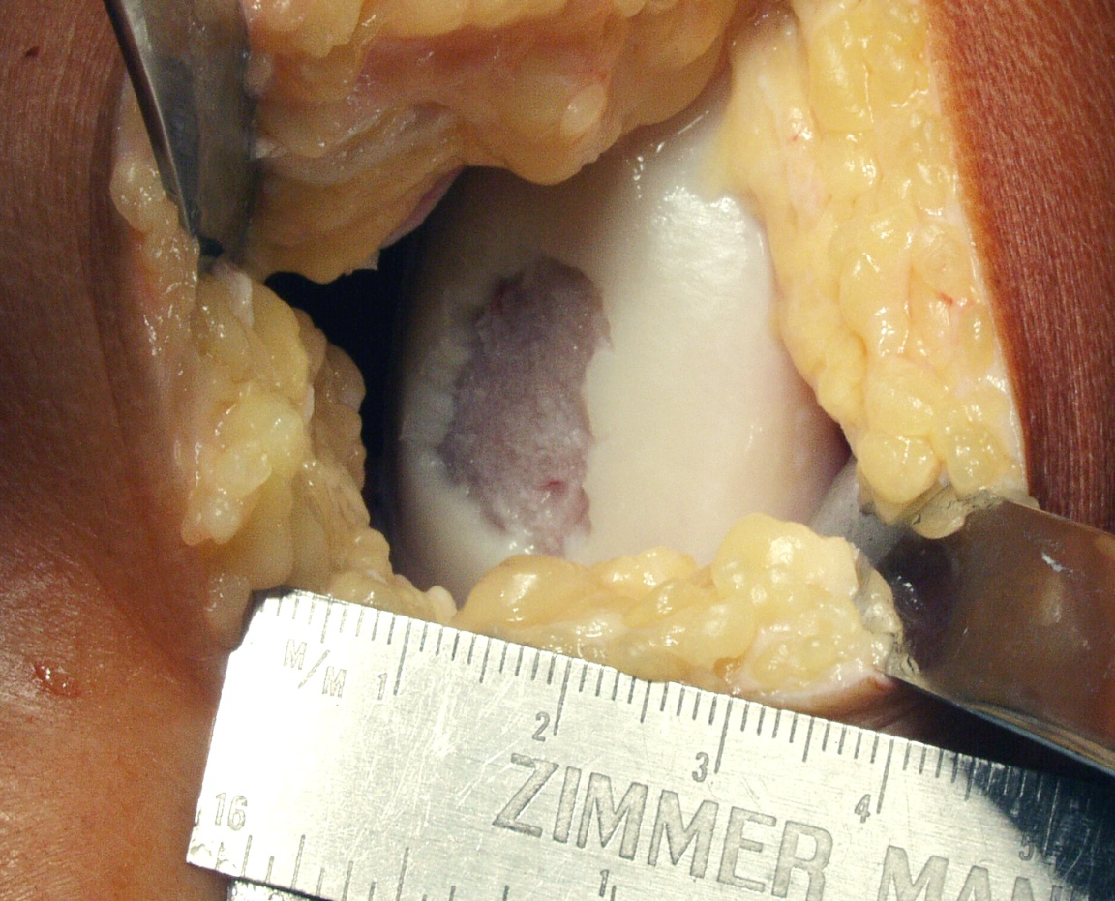
Mosaicplasty

Slide 39
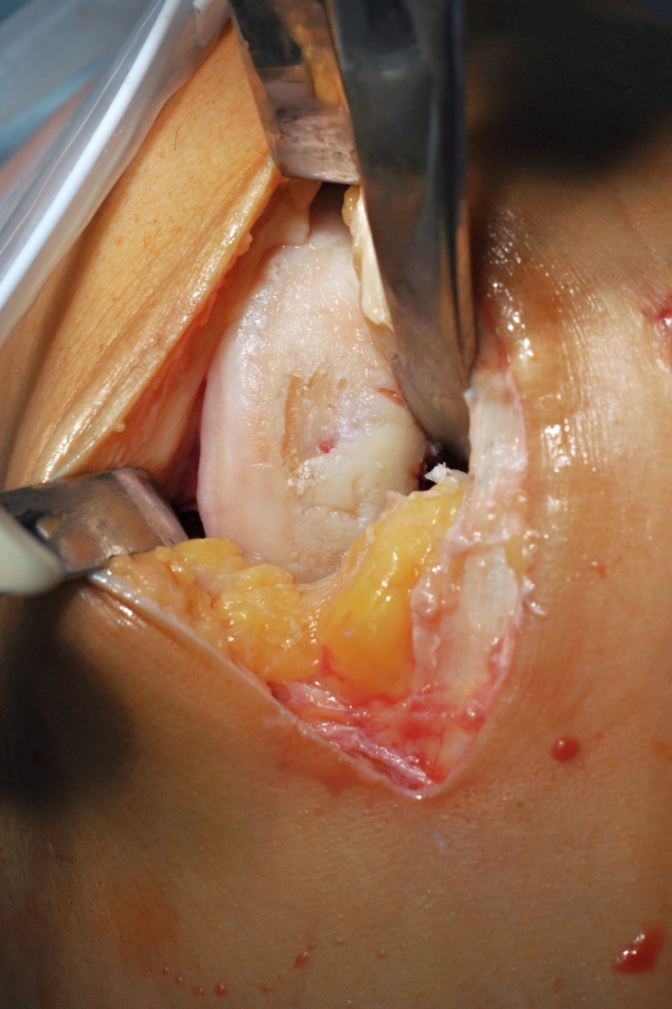
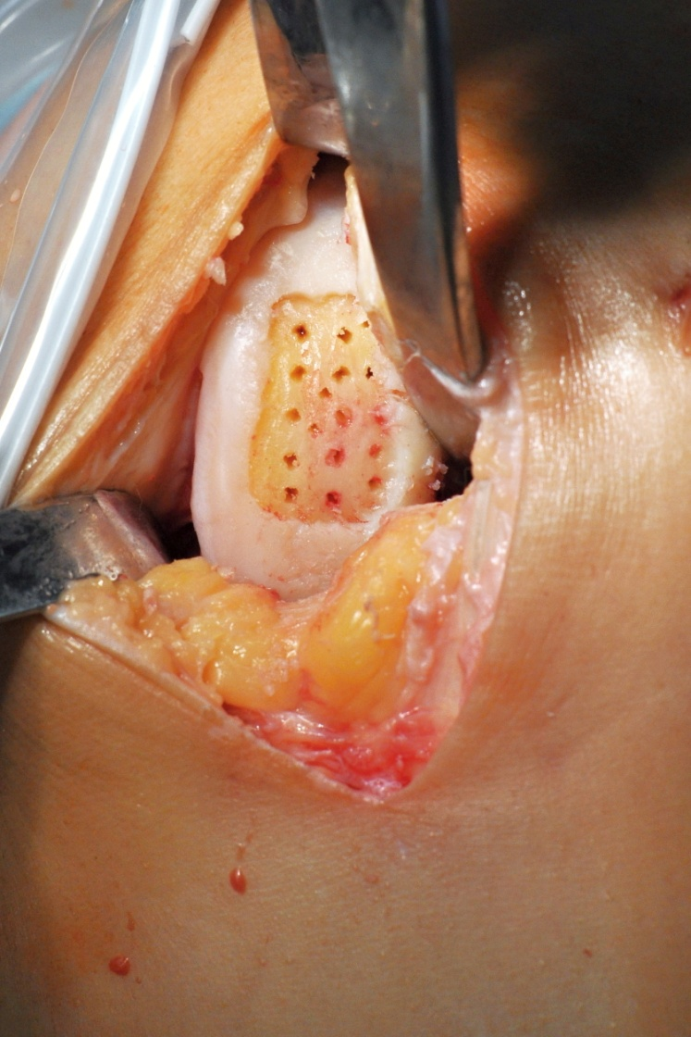
Autologous chondrocytes transplantation - chondrograft

Slide 41
ATC – Ankle Arthroscopy
Acute injury
Degeneration
necrosis
ostechondritis dissecans
chondral defects

Slide 42
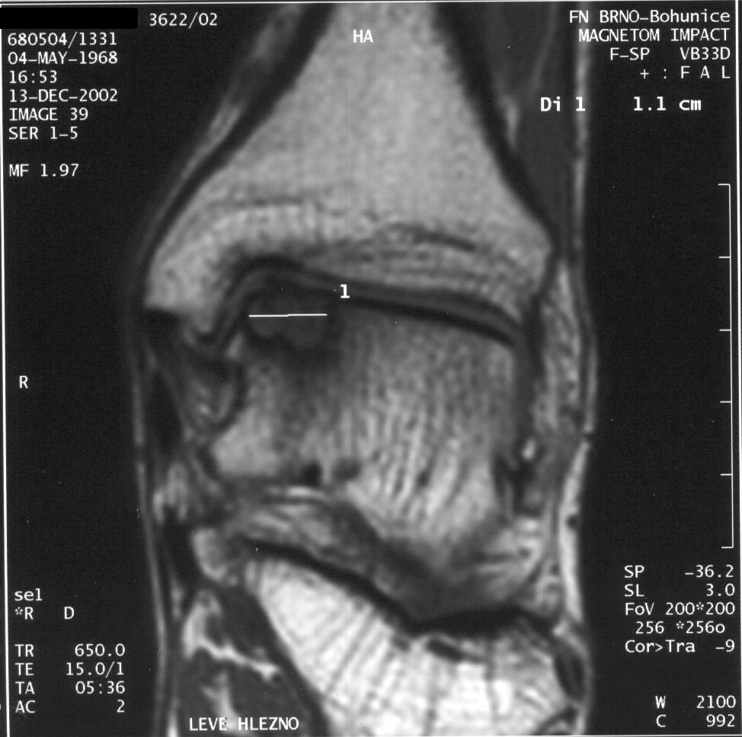
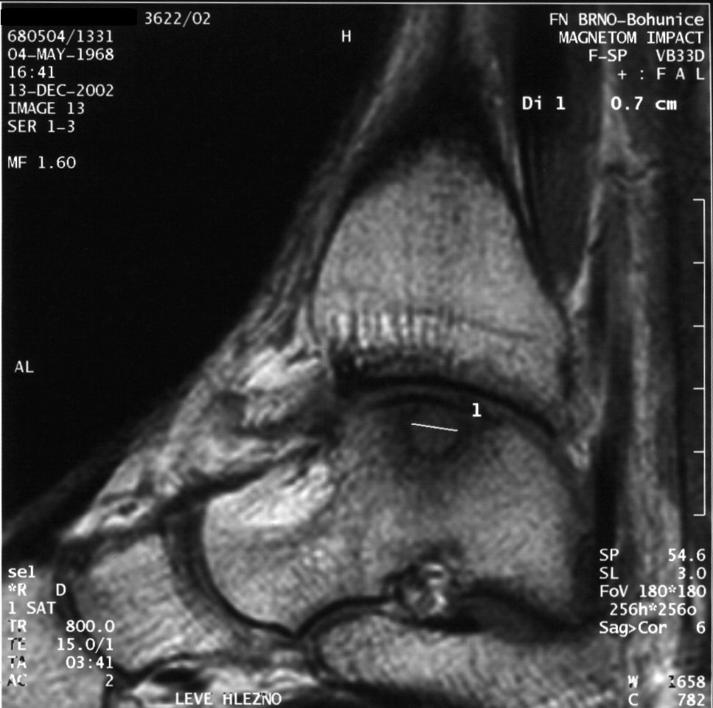
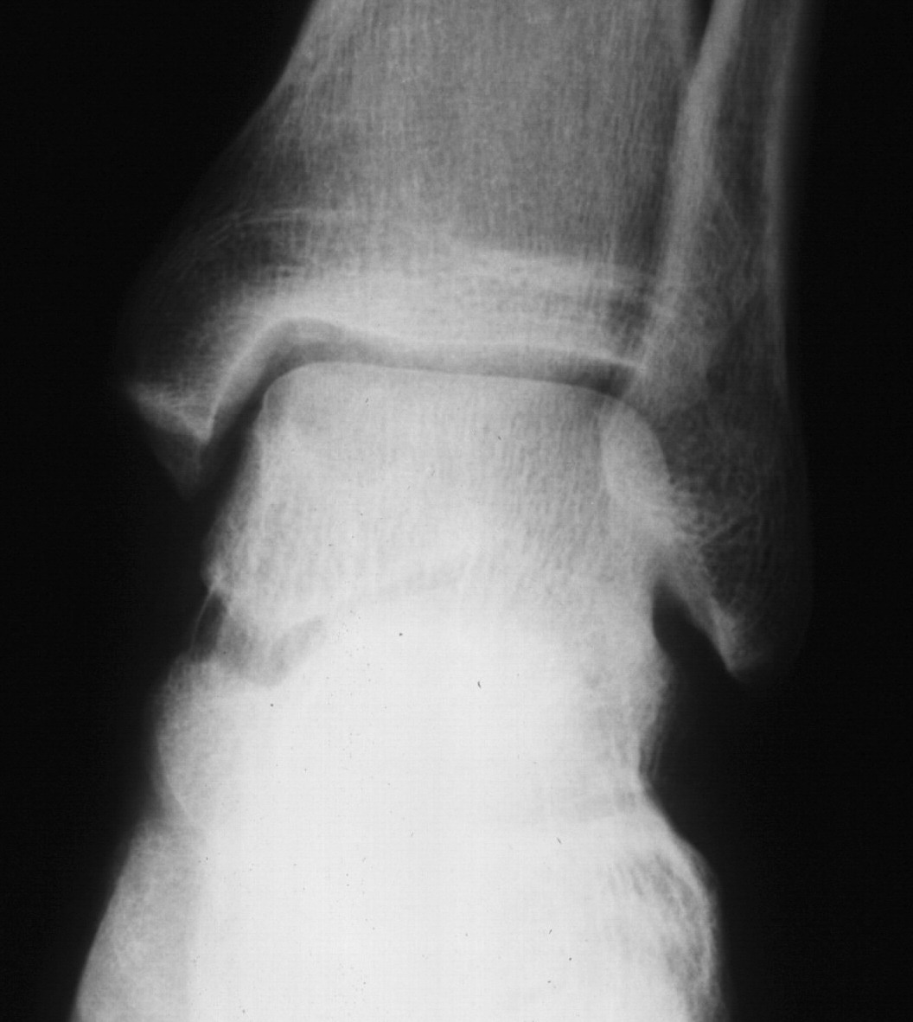
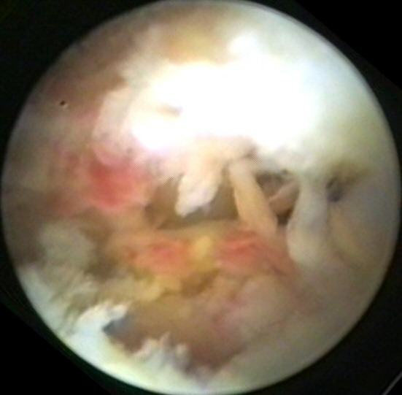
Osteochondrosis dissecans / OCHD /

Slide 43
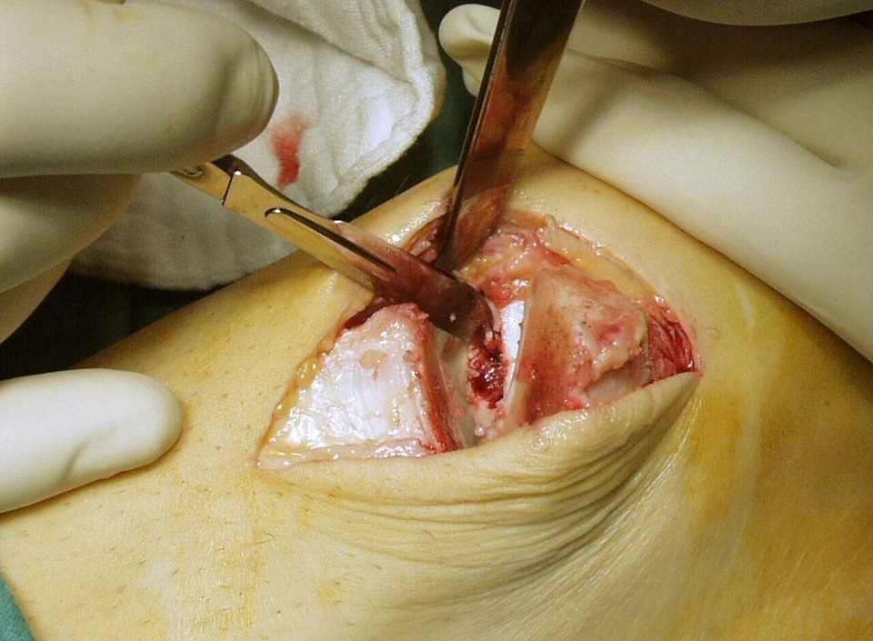
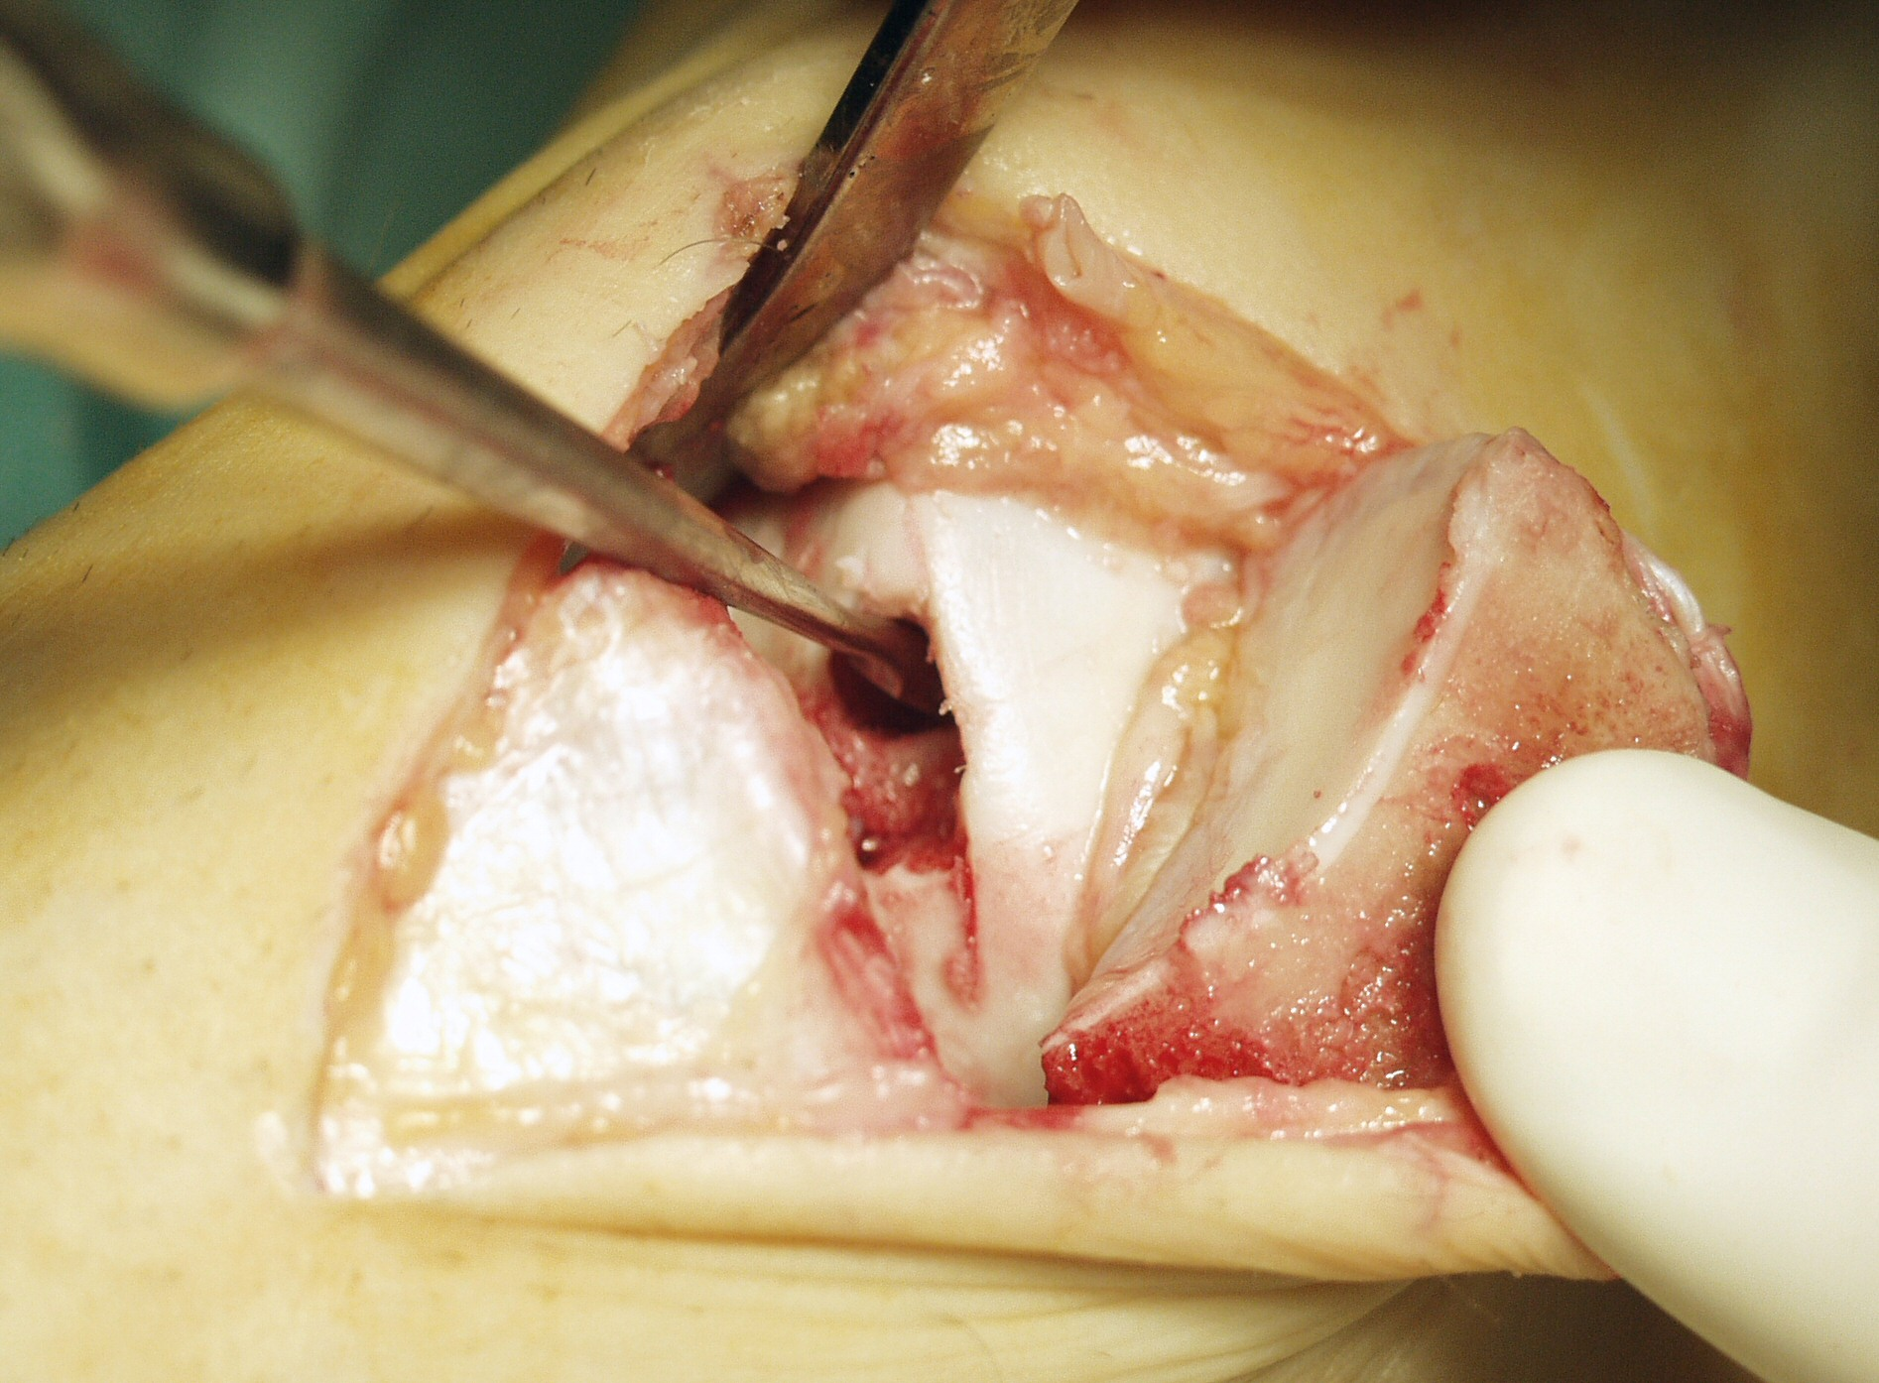
OCHD
necrotic bone – debridement, use chondrograft
healthy bone – fixation back with the screw
Medial Malleolus ostetomy

Slide 44
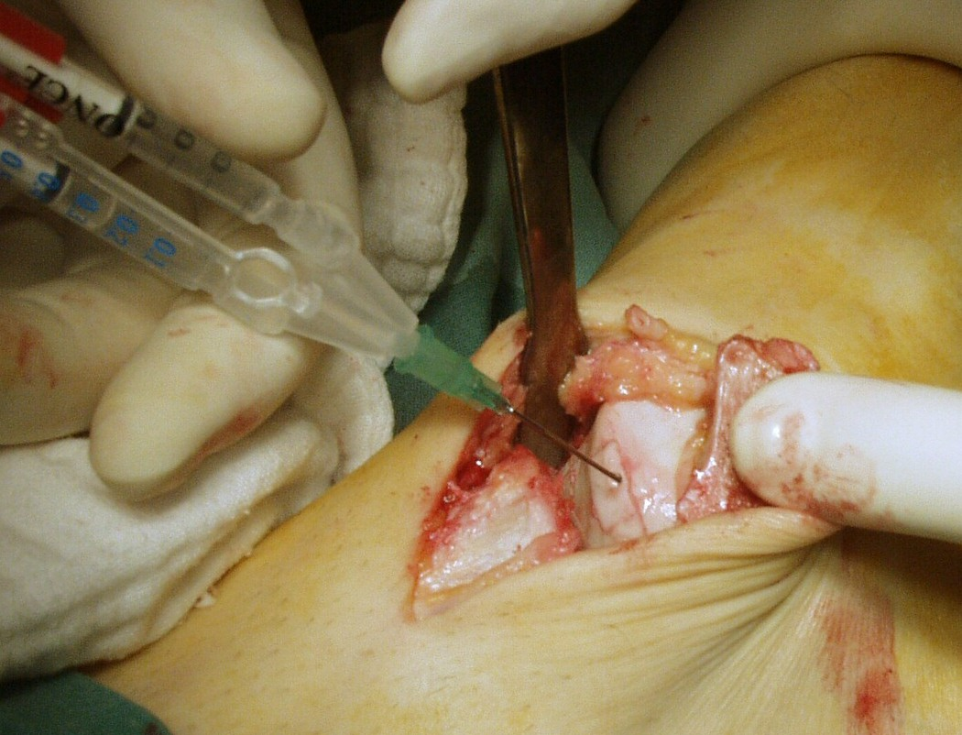
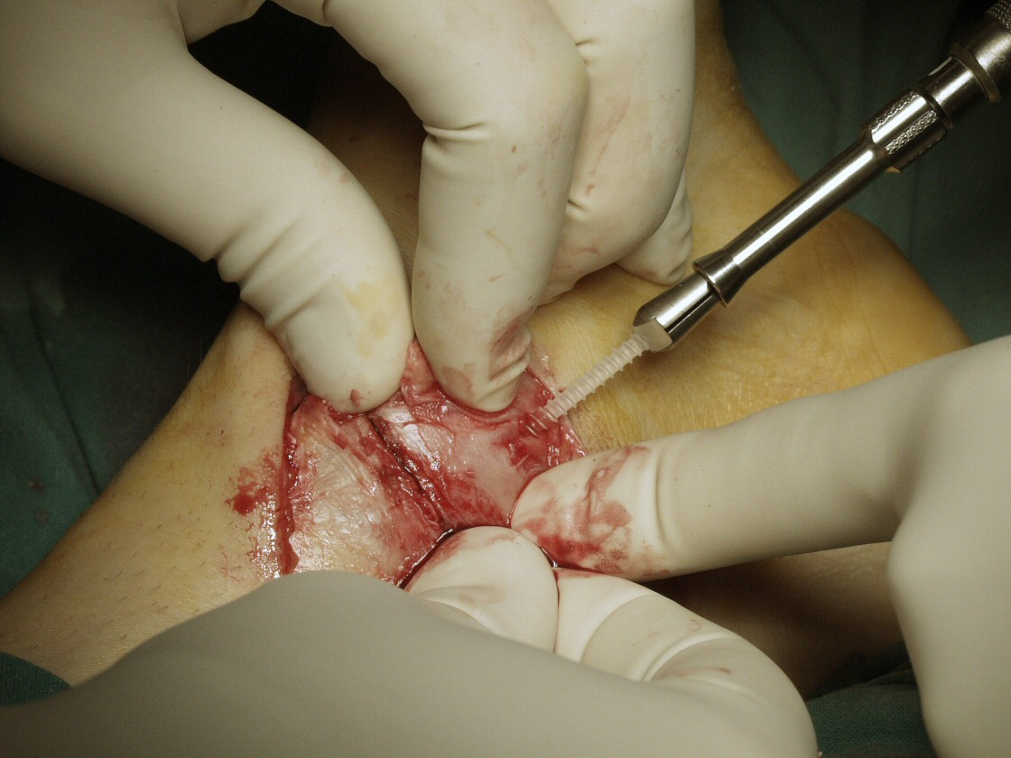
Chondrograft fixation
Screw fixation of medial malleolus

Slide 45
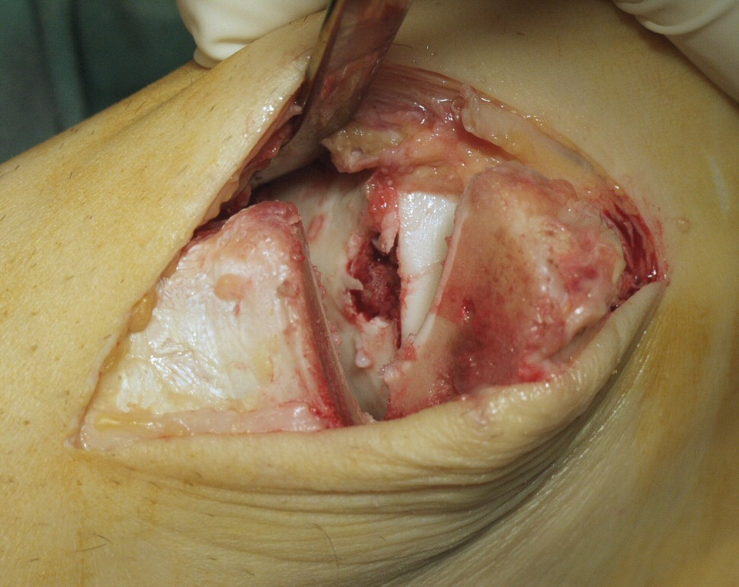
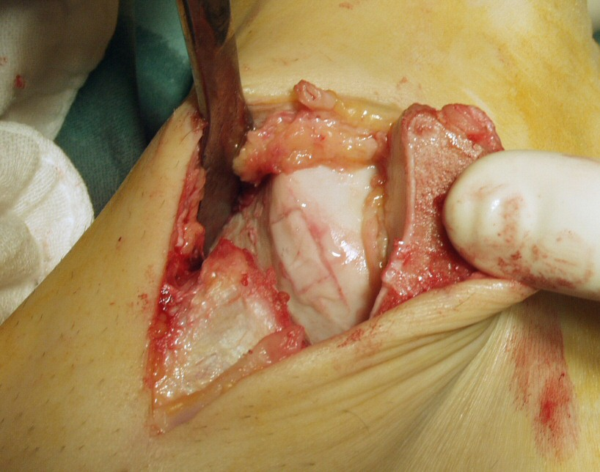
before
after

Slide 46
Thank you for your attention

