Slide 1
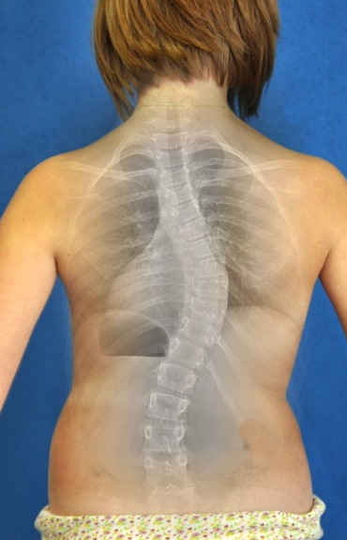
Scoliosis
Prýmek M., Repko M., Filipovič M., Leznar M.
Ortopedická klinika LF MU a FN Brno

Slide 2
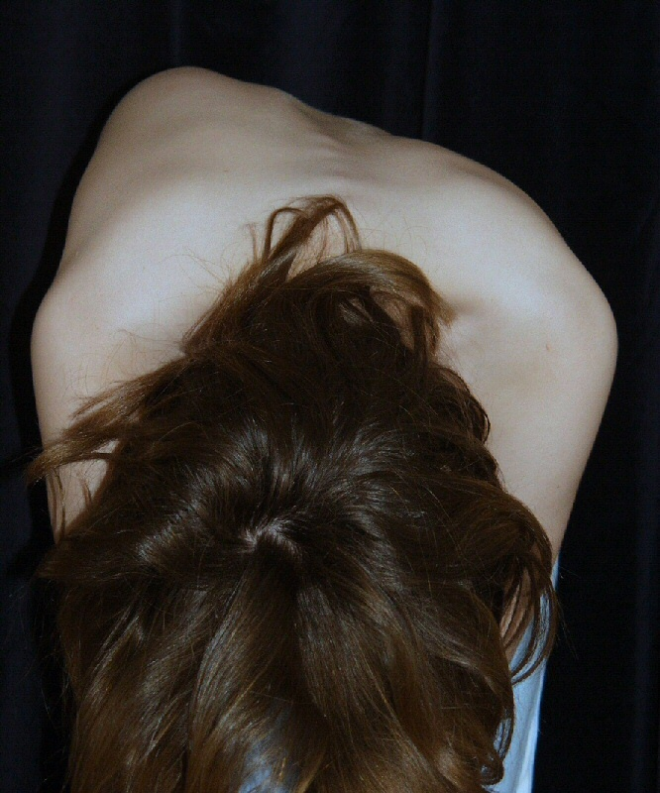
Scoliosis = 3 D deformity
Frontální rovina
Sagitální rovina
Axiální rovina

Slide 3
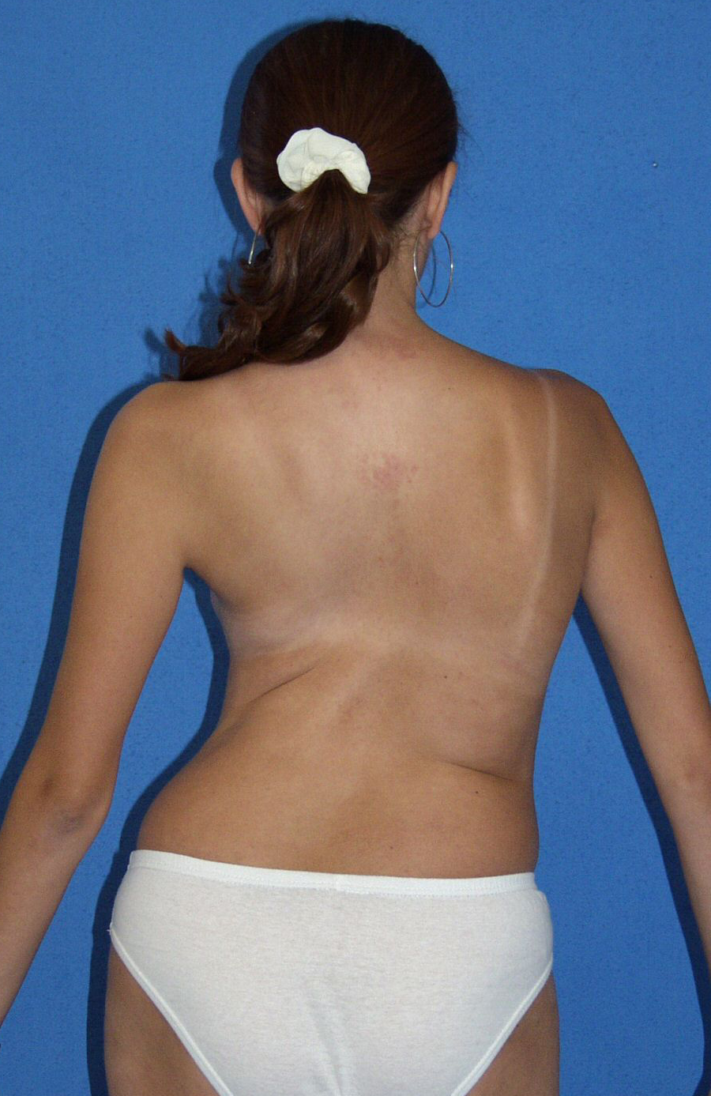
Shoulder height disbalance
Gibbus – paravertebral prominence
Waist asymetry
Trunk decompensation - frontal plane , C7 plumb line

Slide 4
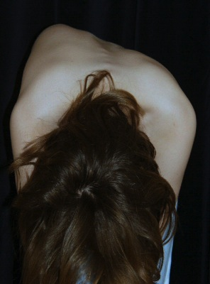
Bending forward!
= Adams test

Slide 5
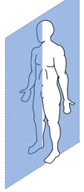
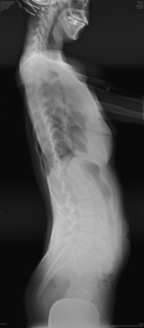
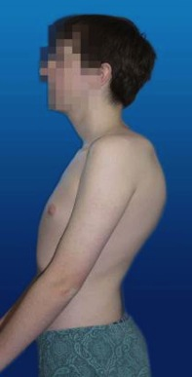
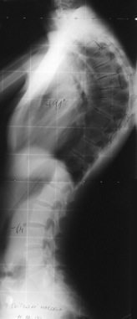
SAGITTAL aspect
HYPOkyphosis
HYPERkyphosis

Slide 6
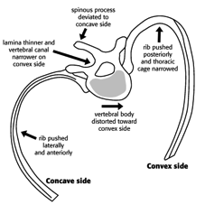
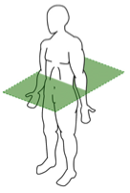
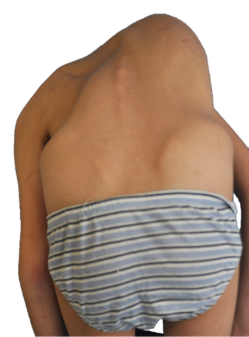
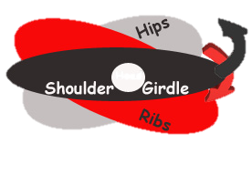
TRANSVERSE aspect

Slide 7
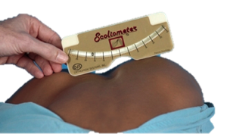
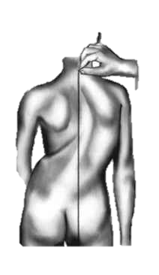
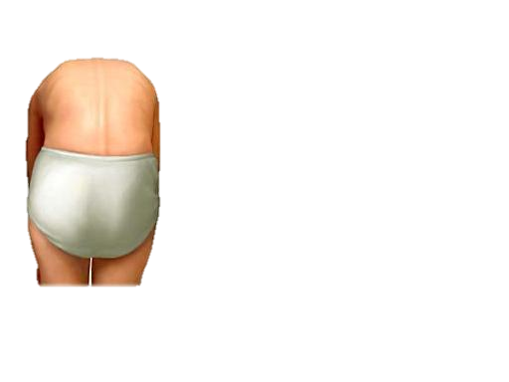
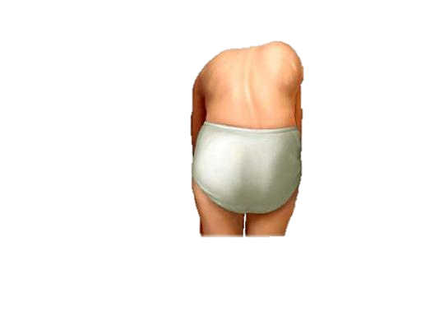
Scoliometer
Scoliotic patient
EVALUATION
Plumb line
Adam‘s test
normal
scoliosis

Slide 8
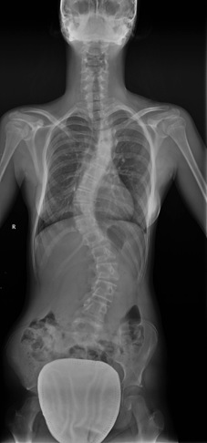
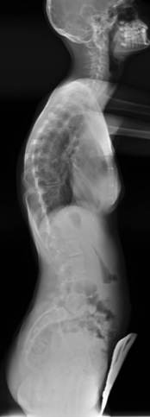
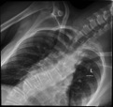
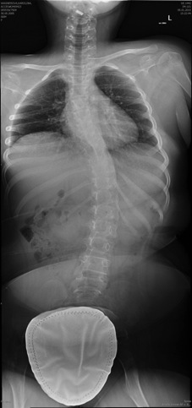
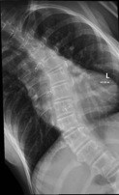
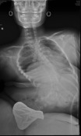
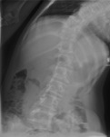
X-RAY
AP
lateral
bending
traction

Slide 9
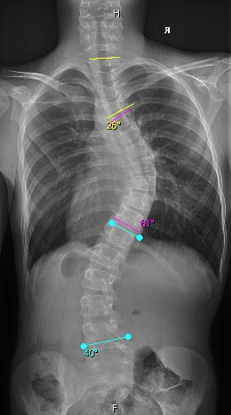
COBB‘s angle

Slide 10
Descriptive terminology
Apical vertebra
End vertebraKoncový ratel
Neutral vertebra
CSVL
Stabile vertebra

Slide 11
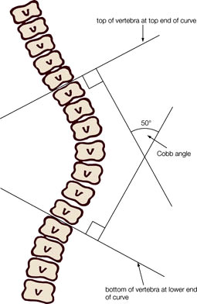
Therapeutic scheme
COBB
observe
Brace
surgery
0-20°
20-40°
>40°
Physiotherapy

Slide 12
Natural evolition of untreated juvenile idiopathic scoliosis
10+5
12+7
14+3
16+5
29+4
45°
50°
61°
68°
73°

Slide 13
Deformity worsening
68% pts had progresion even in adult age !
(Weinstein et al)
Thoracic curves - 1 dg./year
Thoracolumbar curves - 0,5 dg./year
Lumbar curves - 0,24 dg./year

Slide 14
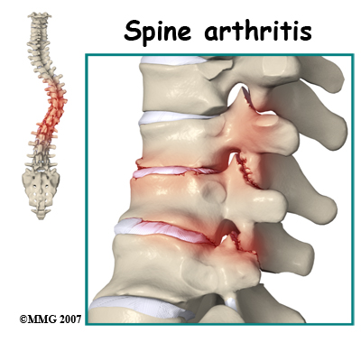
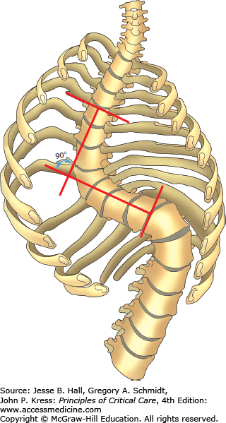
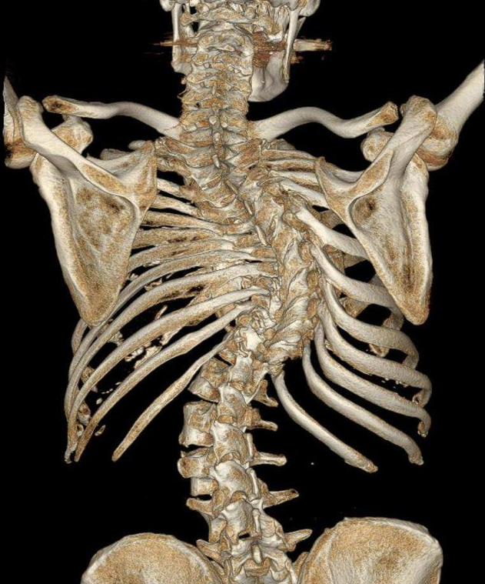
Sever complication of untreated scoliosis in childhood
=
Degenerative changes and cardiopulmonal insuficiency

Slide 15
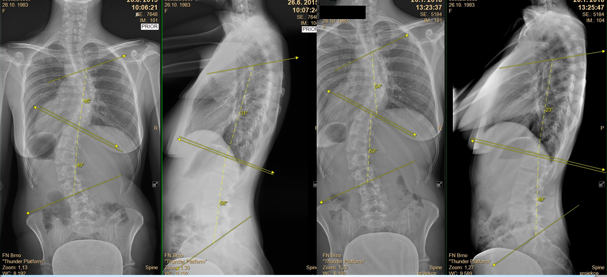
2015
2018
32 let
35 let

Slide 16
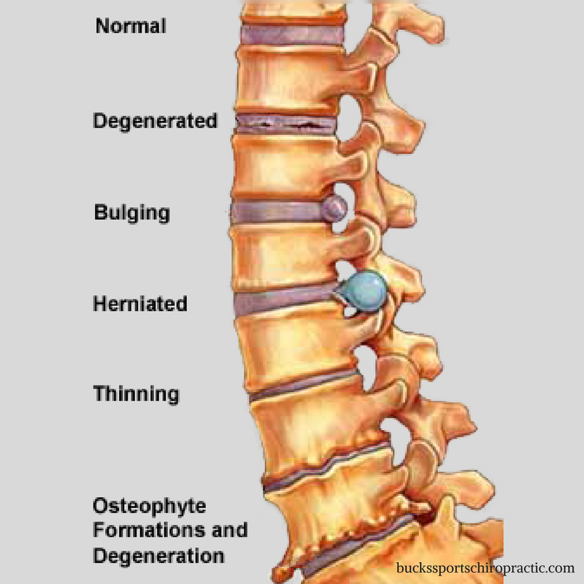
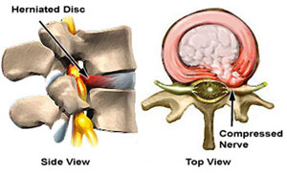
Risks of curve progression
Progressive oppression of intra-abdominal organs
Heart + Lungs
Indigestion
Degeneration of spine structures
Intervertebral joints
Intervertebral disc->
production of osteophytes with possible nerve compression !

Slide 17
Goals of scoliosis surgery in childhood
Stop deformity progression
Correction of deformity
Improvement of cardiopulmonary functions
Prevention of degenerative spine changes

Slide 18
Scoliosis surgery in adult age
Higher surgery risks with lower success rate of deformity correction
Often associated with nerve impairment
Difficult tolerance of corrected torso and spine position
Slow postoperative convalescence (pain) - long-term rehabilitation care is required
Notes:
18

Slide 19
Surgical risks in general
From GA
Chirurgické
Venous thrombosis
Pulmonary embolism
Nausea, vomiting, rhythm disorders, etc.
Surgical wound infection
ATB therapy
Bleedig
blood transfusion

Slide 20
Surgical risks specific for scoliosis surgery
Increased postoperative pain due to stretching of shortened muscles - in each patient
Paralysis due to surgery
For thoracic and lumbar curves it refers to the lower limbs Very rare complication, but very serious as a result.

Slide 21
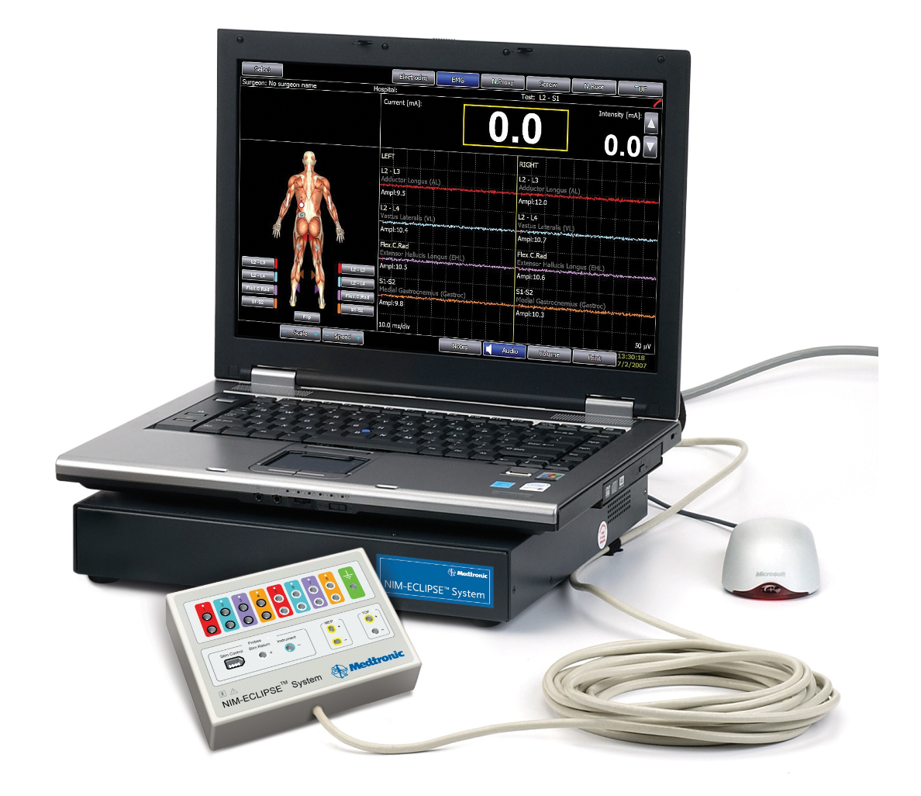
MEP – motor evoked potentials (SSEP)
Monitoring of nervous system functionality during surgery
It enables immediate reaction to the problem and thus minimizes the risk of permanent nervous disability

Slide 22
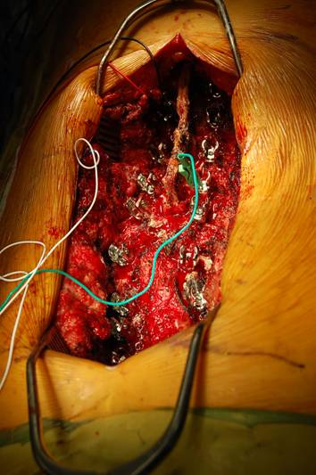
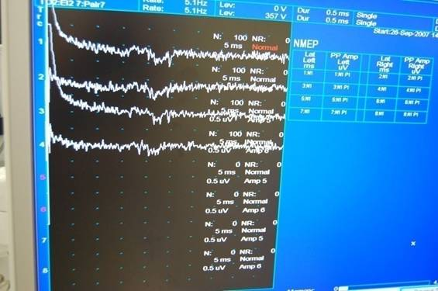
MEP – motor evoked potentials (SSEP)
SEP a MEP

Slide 23
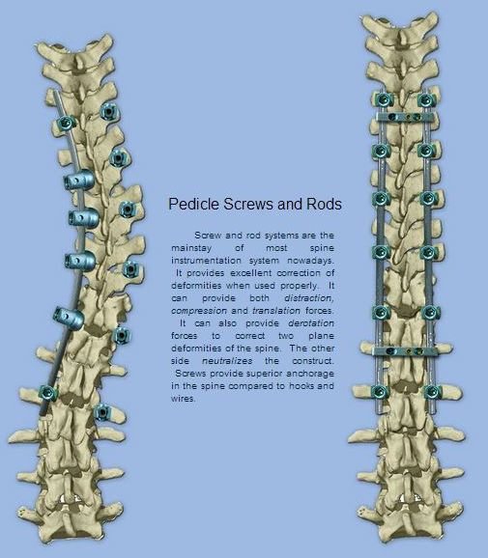
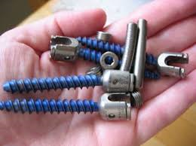
Method of surgical scoliosis treatment.
Transpedicular screws
Bended rods
Bone grafts (autografts, alografts)
= INTERVERTEBRAL FUSION

Slide 25
Notes:
25

Slide 27
Základní pojmy popisné
Apical vertebra
End vertebraKoncový ratel
Neutral vertebra
CSVL
Stabile vertebra

Slide 28
Scoliosis types due to ethiology
Idiopathic……..............4/5 80%
infantile
juvenile
adolescent
Neuromuscular
neuropathic
myopathic
Syndromic - Neurofibromatosis
Secondary
postural
tumors
Other syndromes(Marfan, Ehlers-Danlos……..)
Histerical
Degenerative

Slide 29
Scoliosis types due to ethiology
TYPU deformity
VĚKU pacienta
Idiopathic
Congenital
Neuromuscular
Infantile
< 3 y
Juvenile
4-10 y
Adolescent
11-17 y
Adult
> 17 y
Notes:
29

Slide 30
SCOLIOSIS
= 3 dimensional deformity
Coronal plane
Sagittal plane
Transverse plane

Slide 31
COBB‘s angle

Slide 32
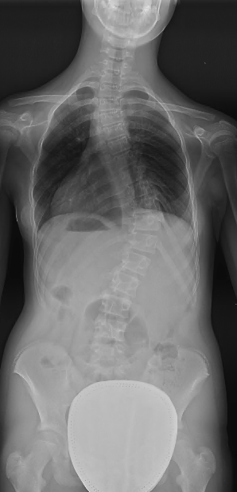
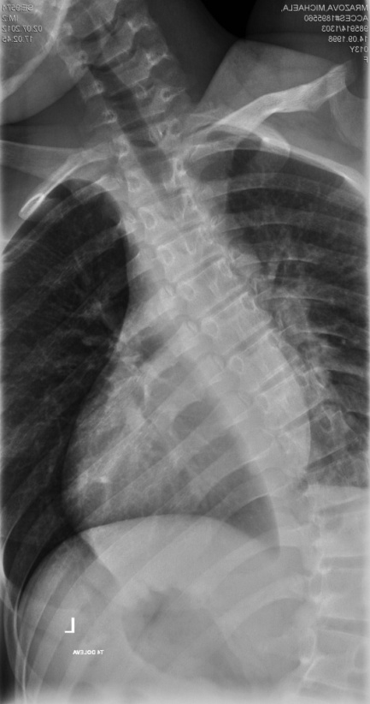
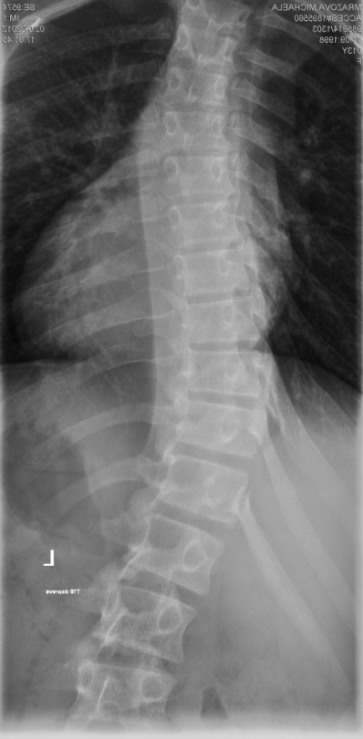
Essentially distinguish between:
Structural
curve
Non-structural
curve
bending >25°
bending <25°
34°
17°
49°
27°

Slide 33
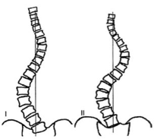
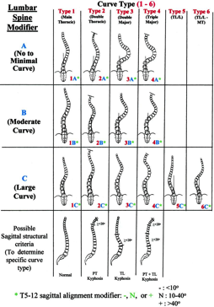
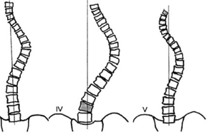
EVOLUTION in scoliotic classifications
KING-MOE
LENKE
3D
1D
frontal
2D
frontal+sagittal
???

Slide 34
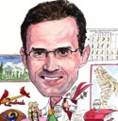
LENKE‘s classification
Curve type
Lumbar spine modifier
Thoracic sagittal profile

Slide 35
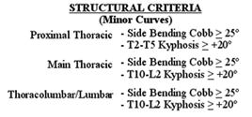
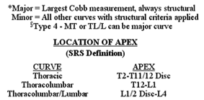
LENKE‘s classification
Curve type

Slide 36
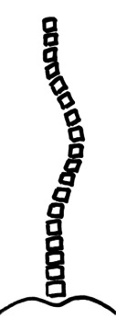
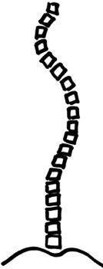
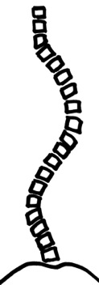
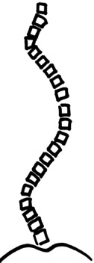
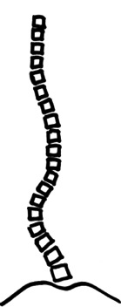
Lenke‘s classification curve types
1
2
3
4
5
6

Slide 37
LENKE‘s classification
Lumbar spine modifier

Slide 38
Lenke‘s classification lumbar parameter
A
B
C

Slide 39
LENKE‘s classification
Thoracic sagittal profile

Slide 40
Lenke‘s classification sagittal parameter
< 10°
10° - 40°
> 40°
-
N
+

Slide 41
Lenke‘s classification EXAMPLES
> 40°

Slide 42
Lenke 1
Girl 13+9
Lenke 1A-
type | Proximal thoracic | Main thoracic | Thoracolumbar/lumbar | Description
1 | Non-Structural | Structural (Major) | Non-Structural | MT (Main Thoracic)
+6°
45°

Slide 43
Lenke 2
Girl 14+1
type | Proximal thoracic | Main thoracic | Thoracolumbar/lumbar | Description
2 | Structural | Structural (Major) | Non-Structural | DT (Double Thoracic)
46°
50°

Slide 44
Lenke 3
Girl 14+2
type | Proximal thoracic | Main thoracic | Thoracolumbar/lumbar | Description
3 | Non-Structural | Structural (Major) | Structural | DM (Double Major)
72°
64°

Slide 45
Lenke 4
Girl 12+9
type | Proximal thoracic | Main thoracic | Thoracolumbar/lumbar | Description
4 | Structural | Structural (Major) | Structural (Major) | TM (Triple Major)
43°
51°
47°

Slide 46
Lenke 5
Girl 12+5
type | Proximal thoracic | Main thoracic | Thoracolumbar/lumbar | Description
4 | Non-Structural | Non-Structural | Structural (Major) | TL/T (Thoracolumbar/Lumbar)
56°

Slide 47
Lenke 6
Girl 16+9
type | Proximal thoracic | Main thoracic | Thoracolumbar/lumbar | Description
4 | Non-Structural | Structural | Structural (Major) | TL/T-MT (Thoracolumbar/Lumbar-Main Thoracic)
96°
114°

Slide 48
Therapeutic chart
COBB
observation
bracing
surgery
0-20°
20-40°
>40°
PHYSIOTHERAPY

Slide 49
Non-operative treatment
physiotherapy
casting
bracing

Slide 50
CASTING
Indication: INFANTILE scoliosis
Applying under the general anesthesia
Changing each and every 2 month

Slide 51
BRACING

Slide 52
BRACING
Indication for bracing:
progressive scoliosis
poor or no casting toleration
unable to undergo surgery

Slide 53
3D scoliotic correction

Slide 54
Corrective methods
1-distraction
2-compression
3,4-translation
5-derotation

Slide 56
EVOLUTION in corrective maneuvers
DISTRACTION
TRANSLATION
VCM
Rod Roduction
1D
frontal
1D
frontal
2D
frontal, axial
3D
frontal, axial, sagittal

Slide 57
EVOLUTION in corrective maneuvers
BRACING
Source: Rigo et al, Scoliosis 2010

Slide 58
EVOLUTION in corrective maneuvers
BRACING
Advantages:
Surgery elimination
Disadvantages:
Poor toleration
Lung function decreasing
Muscle weaking
Problems:
HYPOKYPHOSIS
POOR DEROTATION

Slide 59
EVOLUTION in corrective maneuvers
DISTRACTION
hypokyphosis

Slide 60
EVOLUTION in corrective maneuvers
DISTRACTION
Advantages:
Simple implantation
Possibility of spine growth
Miniinvasive approach
Disadvantages:
Uniplanar correction (frontal)
High rate of complications
Problems:
HYPOKYPHOSIS
NO DEROTATION

Slide 61
EVOLUTION in corrective maneuvers
TRANSLATION
hypokyphosis
rod
derotation

Slide 62
EVOLUTION in corrective maneuvers
TRANSLATION
Advantages:
Good frontal correction
Disadvantages:
Uniplanar correction (frontal)
Problems:
HYPOKYPHOSIS
NO DEROTATION

Slide 63
EVOLUTION in corrective maneuvers
VCM
VERTEBRAL COLUMN MANIPULATION
hypokyphosis

Slide 64
Derotation
WHY derotation?
3D scoliotic correction
Correction of Rib Hump prominence
Secondary curve correction in selective fusion
Balanced spine

Slide 65
Transpedicular screw constructs
Allows effective derotation of single vertebra
Derotation instruments
Allows safe and effective derotation of single vertebra as well as the whole apical area.

Slide 66
EVOLUTION in corrective maneuvers
VCM
Vertebral column manipulation
Advantages:
Good frontal and axial correction
Disadvantage:
little too forced isolated technique
Problem:
HYPOKYPHOSIS

Slide 67
EVOLUTION in corrective maneuvers
RESULT
of most correction maneuvers
HYPOKYPHOSIS
ABSENCE or RESTRICTIVE
DEROTATION

Slide 68
DEROTATION
Transversal plane

Slide 69
Scoliosis
Spiral concept

Slide 70
3D geometrical changes
Notes:
70

Slide 71
Surgical posterior approach

Slide 72
level checking

Slide 74
Probe - pedikle finding

Slide 75
Sound - pedikle hole checking - screw length measuring

Slide 76
Screwdriver - screw insertion

Slide 77
Screwdriver - screw insertion

Slide 78
Chisel – facet resection

Slide 79
Chisel – facet resection

Slide 80
Luer – cortex resection

Slide 106
Nonfusion surgery methods

Slide 108
VEPTR = vertical expandable prosthetic titanium rib
Indikace: kong. def. + thoracic insufficiency syndrom + kostní nezralost
Cíl: zvětšení objemu hrudníku + korekce deformity
Nutné opakované redistrakce

Slide 110
Magnetické tyče (Magnetic rods)

Slide 112
Growth Guided System
Deformity correction + growth enabled
Fusion of the apex of the curve
The rest of spine grows guided along the rods

Slide 114
3+9 3+10 5+10 7+5

Slide 115
10 +9 poop 13+8 15+1

Slide 116
GGS requires definitive fusion !
Pts need 2 surgeries at least !
Convertion to definitive fusion after skeletal maturity.

Slide 117
Scoliosis types due to ethiology
TYPU deformity
VĚKU pacienta
Idiopathic
Congenital
Neuromuscular
Infantile
< 3 y
Juvenile
4-10 y
Adolescent
11-17 y
Adult
> 17 y
Notes:
117

Slide 118
Congenital scoliosis
Congenital Scoliosis- inborn spine deformity due to imperfect formation of vertebrae and their association.
Hard to predict development and deformity progression …

Slide 119
Congenital scoliosis
deformity occurs during the first 6 weeks of embryonic development without hereditary burden, it is not hereditary
wide diversity of severity of disability
dg. newborns / toddlers, can occur at any time during growth

Slide 120
CONGENITAL scoliosis
Failure of
FORMATION
Failure of
SEGMENTATION
COMBINED
failure
Hemivertebra
Unsegmented bar
Notes:
120

Slide 121
Congenital scoliosis
Failure of SEGMENTATION- failure of the connection of one or more vertebrae on one side
Failure of FORMATION- most often, disorder of vertebra formation, shape anomalies
COMBINED failure

Slide 122
Failure of segmentation
Anterior :
Vertebrae are held together due to unsegmented bar a , but they grow normaly all the posterior structures
-> kyphosis !
„anterior unsegmented bar“

Slide 123
Failure of segmentation
Posterior unsegmented bar – fusion of intervertebral joints and laminas
-> lordotization

Slide 124
Failure of segmentation
Unilateral unsegmented bar leads to sever scoliosis deofrmity

Slide 125
Failure of segmentation
Usualy asymptomatic
Can lead to relative shortening of spine
„block vertebra“ – iv disc is missing

Slide 126
Failure of formation
anterior
Could affect just part of vertebra / all structures
Solitary or multiple changes
„posterior hemivertebra“
-> kyphosis
posterior – much less common
- > lordosis

Slide 127
Failure of formation
Lateral
Hemivertebra
-> scoliosis deformity
Important one !

Slide 128
Failure of formation
Postižení solitární až mnohočetné
Postižení sousedních obratlů nebo
v různých úsecích páteře

Slide 129
Hemivertebra types
closed type / neuzavřený poloobratel
bez progrese / progrese deformity

Slide 130
Failure of formation
Aterior central defect
The two parts of vert. are not connected together
„butterfly vertebra“
- According to severity of the anterior defect can lead to kyphosis or is completely asymptomatic

Slide 131
Combined failure
- Very common
Multiple changes
Very individual
- Hard to predict progression in multiple changes, observation is the key.

Slide 132
Combined failure
The highest risk of progression =
Fully segmented hemivertebra + contralateral unsegmented bar !!

Slide 134
Congenital scoliosis - therapy
Main rule – STOP the progression !
Observation – X-ray á 6months
if there is progression of deformity -> surgery
fastest growth– frist 5y of age
+ adolescent growth spurt
-> highest risk of progression !!!

Slide 135
Hemivertebra
non-segmented
semisegmented
fully segmented
Risk of
sever scoliosis

Slide 136
2 main used surgical techniques
Hemivertebrectomy with instrumentation
Simple bony fusion
Correction of scoliotic curve
-in greater curves -in supposed curve progression
Arrest of curve progression (without direct correction) -in small curves -in early detection

Slide 137
Surgery of hemivertebra
Simple fusion
Hemivertebrektomy
Small deformities
Blockage of worsening
Without correction possibility
Larger deformities
Curve correction
Prevention of secondary curves
Notes:
137

Slide 138
Hemivertebrectomy combined approach

Slide 140
Hemivertebrektomy
posterior approach only

Slide 142
The main factors of succesful treatment of congenital scoliosis
Conclusion
early detection
good timing
adequate surgical approach

Slide 143
Diastematomyelie
Skl, Mot

Slide 145
Tethered cord syndrome

Slide 146
CT

Slide 147
MRI

Slide 148
Neuromuscular scoliosis

Slide 149
Scoliosis types due to ethiology
TYPU deformity
VĚKU pacienta
Idiopathic
Congenital
Neuromuscular
Infantile
< 3 y
Juvenile
4-10 y
Adolescent
11-17 y
Adult
> 17 y
Notes:
149

Slide 150
Neuromuscular scoliosis
- Significant progression (even after growth)
severe deformities
combined with pelvic and hip deformities
high degree of associated dysfunction
cardiopulmonary
urinary
pressure sores
osteoporosis

Slide 151
Conservative treatement
1.physiotherapy
2.Protsthetic care
braces
Sitting support brace in wheelchair
3.Nursing care

Slide 152
Léčebné postupy
1. Conservative treatement
disadvantages : -small effect - Poor orthosis tolerance -negative influence of K-P function with orthosis -decubits
2. surgery
indication: -collapse and instability of the spine -deterioration of cardiopulmonary functions by orthosis -back pain - the tendency to pressure sores

Slide 153
Neuromuscular spine deformity = complex deformity
Long thoracolumbar dx convex curve
kyphoscoliosis
hyperlordosis
Hip anomaly
Pelvic obliquity

Slide 154
Windswept hip

Slide 155
Basic NM scoliosis types
SPASTIC
FLACCID
brain
cerebellum
Upper motoneuron
Lower motoneuron
Primary myopathy
Stiff , rigid deformities
Paralytic deformities

Slide 156
NM spine deformities
Spastic forms
Rigid kyfoscoliosis
2.Hypotonic forms
paralytic deformities

Slide 157
NM spine deformities
Sitting instability
Standing instability

Slide 158
Clinical examination of NM deformities
Gibbus prominence meas.
Plumb line
Correction in traction

Slide 159
FLACCID
deformity
gravity
Trunk collapse

Slide 160
TYPES A. Neuropathic I.upper motoneuron failure
cerebral palsy
spinocerebellar degeneration (Friedrich's Ataxia, CHMT, Roussy-Levy syndrome)
syringomyelie
spinal tumors
spinal cord injury

Slide 161
A. Neuropathic II. lower motoneuron failure
Poliomyelitis
other viral myelitis
Injuries
SMA spinal muscular atrophy Werdnig-Hoffman, Kugelberger-Welander

Slide 162
B . Myopathic curves
Arthrogryposis (not progressive)
Muscular dystrophy (Duchene, limb-girdle syndrome,
fascioscapulohumeral syndrome)
fiber type disproportion syndrome
congenital hypotonia
dystrophic myotonia

Slide 163
SMA Infantile WERDING-HOFFMAN
Most common
Fleet contractures, disability
Often without affecting the inteletctus
Disability of the hips
Scoliosis: paralytic curves, progression

Slide 165
Duchene muscular dystrophy
- absence of dystrophin protein
Muscle biopsy
DNA tests - absence of dystrophin + significant creatine phosphokinase elevae
Poor muscle regeneration
Gradual replacement of muscles by fibrous tissue.

Slide 166
Duchene muscular dystrophy
2– 6y - the first symptoms come, dystrophin deficiency and, as a consequence, dying muscle fibers are beginning to be replaced by ligaments.
problems with walking, during, getting up from a lying or sitting position
pseudohypertrophy of calves
wheelchair
developent of kyphoscoliosis

Slide 168
Terapeutický postup
A. Muscular disbalance of the lower limbs -extension of adductors in DMO B. solution of hip dislocations C. deformity of pelvis and spine

Slide 169
Operační léčba
INDICATION
CONTRAINDICATION
Paralytic curves collapse and instability of the spine
Progressive deformity
Sitting instability
Impairment of cardiopulmonary functions by orthosis
Back pain
Tendency to pressure ulcers
Poor overall internal condition Very low breathing capacity General or local infection Significant non-cooperation of the patient

Slide 170
Operační léčba
Cíle
Komplikace
avoiding curve progression improved sitting stability
reduction of back pain
preventing further loss of motor and sensitive functions
Improvement of cardiopulmonary and GIT functions.
nerve structures injury bleeding and extensive loss organ injury Heart Failure cerebral dysfunction sudden death neurolgical complications infection chronic infection instrumentation failure pseudoarthrosis

Slide 172
Pelvic fixation
Galveston
Iliac screw
S2AI screw

Slide 173
Luque Galveston technique

Slide 180
Universal Clamp

Slide 181
o

Slide 182
NM scoliosis – take home
Progression after even after skeletal maturity
Numerous comorbidities
Higher peri and postoperative complications
Necessity to include pelvic fixation in pelvic obstruction deformities
The need for post-operative care.

Slide 183
Scoliosis in general-take home message
3D deformity !
AIS 80% of all deformities
Physiotherapy does not stop progression in AIS !
Brace from 20°Cobb to stop progression in growing patient
Surgery above 40°Cobb angle

