Slide 1

Nutritional Status Assessment
Assoc. Prof. Jindřich Fiala
Department of Public Health
Faculty of Medicine, Masaryk University

Slide 2
Outline, main points
Background, basics, definitions, objectives, indications
Malnutrition
Techniques (in assessing nutritional status):
History
Anthropometry
Physical (clinical) examination - general appearance
Biochemical and immunological examinations
Dynamometry tests (muscle strength)
Validated screening tools
Children (specifics)
2
Notes:
2

Slide 3
Definitions, scope
Nutritional status:
- The resulting status of health and nutrition given and influenced by diet, dietary intake and uptake, factors influencing uptake (including malfunctions and diseases), energy output, heredity, environmental factors, lifestyle (physical activity, smoking, alcohol etc…)
Nutritional assessment – differentiate between:
- Dietary assessment, (Food consumption, Dietary habits …)
v.s.
- Nutritional status assessment
Malnutrition
- Nutritional status, which is characterized by a deficit or excess of energy or individual nutrients (undernutrittion vs. overnutrition).
- This imbalance results in measurable changes in the tissues, the body's form, the functions of the organism, and the clinical condition of the individual
3
Notes:
3

Slide 4
Malnutritions
Malnutrition by deficiency - undernutrition
Energy, energy-protein deficiency malnutritions:
Underweight
Cachexia
Marasmus
Kwashiorkor
Marasmic kwashiorkor
Specific deficiencies
Iodine deficiency - endemic goitre (Struma)
Vit. A deficiency - xeroftalmia
Nutritional anaemia
Nutritional osteopenia
B1 (Thiamine) deficiency - Beri beri
B2 (Riboflavin) deficiency
B3 (Niacin, vit. PP) - Pellagra
Vit C deficiency) - Scurvy
Sarcopenia
Malnutritions by excess, overnutrition
Overweight
Obesity
Micronutrient excess
4
Notes:
4
Cachexia = kačeksia, kwashiorkor = kvošiorkór, deficiency = defišnsy

Slide 5
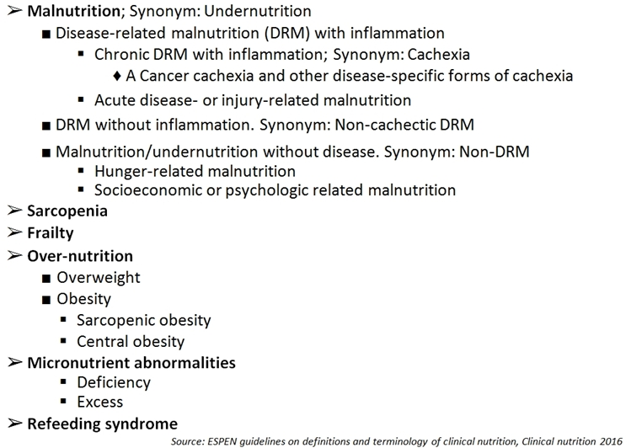
Clinical malnutritions according to ESPEN
5
Notes:
5
ESPEN = European Society of Parenteral and Enteral Nutrition
Frailty syndrome: Frailty is a common clinical syndrome in older adults that carries an increased risk for poor health outcomes including falls, incident disability, hospitalization, and mortality. Asociated with aging = weakness, slowing, decreased energy, lower activity, and, when severe, unintended weight loss.

Slide 6
Types of Protein-Energy Malnutrition (PEM)
Underweight - adults low BMI, children low weight for age
Starvation – pure caloric deficiency, conserves lean mass, increases fat metabolism
Wasting – gradual loss of body mass (getting thinner). In children: Low weight for height.
Stunting – low height for age
Kwashiorkor – edematous PEM by protein deficiency
Marasmus – severe wasting due to energy deficiency
Marasmic kwashiorkor
Cachexia –associated with inflammatory or neoplastic condition
Sarcopenia - skeletal muscle wasting by ageing
6
Notes:
6
edem·​a·​tous | \ i-ˈde-mə-təs \

Slide 7
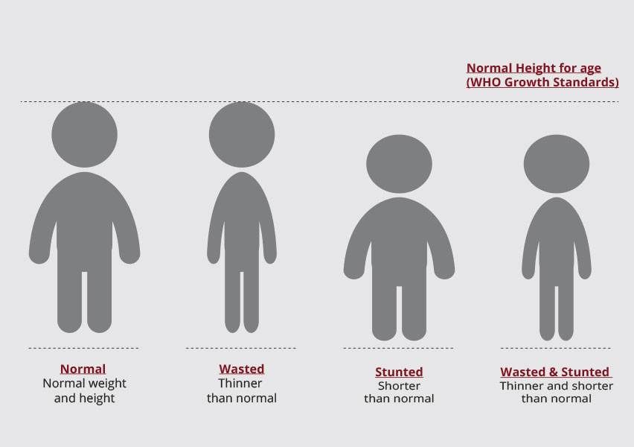
7
Notes:
7

Slide 8
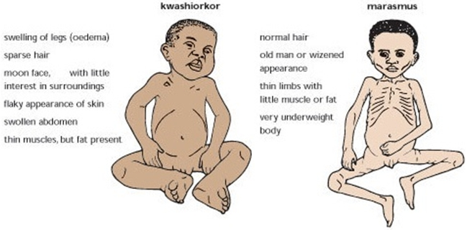
Marasmus vs Kwashiorkor
Marasmus
Marasmus is caused by a severe deficiency of nearly all nutrients, especially protein, carbohydrates, and lipids.
Kwashiorkor
Sufficient calorie intake, but with insufficient protein consumption.
8
Notes:
8

Slide 9
Malnutrition - causes
Low intake of food
This may be caused by symptoms of an illness, for example, dysphagia, when it is difficult to swallow. Badly fitting dentures may contribute.
Mental health problems
Conditions such as depression, dementia, schizophrenia, anorexia nervosa, and bulimia can lead to malnutrition
Social and mobility problems
Some people cannot leave the house to buy food or find it physically difficult to prepare meals. Those who live alone and are isolated are more at risk. Some people do not have enough money to spend on food, and others have limited cooking skills.
Digestive disorders and stomach conditions
If the body does not absorb nutrients efficiently, even a healthful diet may not prevent malnutrition. People with Crohn's disease or ulcerative colitis may need to have part of the small intestine removed to enable them to absorb nutrients. Celiac disease may result in damage to the lining of the intestines and poor food absorption. Persistent diarrhea, vomiting, or both can lead to a loss of vital nutrients
Alcoholism
Alcohol can lead to gastritis or damage to the pancreas. These can make it hard to digest food, absorb certain vitamins, and produce hormones that regulate metabolism. Alcohol contains calories, so the person may not feel hungry. They may not eat enough proper food to supply the body with essential nutrients.
Lack of breastfeeding
9
Not breastfeeding, especially in the developing world, can lead to malnutrition in infants and children.
Notes:
9

Slide 10
Worldwide most frequent micronutrient deficiencies
Iron deficiency
The world's most widespread micronutrient deficit (2 billion people)
Anaemia, reduced mental and physical performance, susceptibility to infections
Vitamin A deficiency
In adult individual pool for 2 years
In developing countries, babies are born with small supplies and do not receive vitamin A by breastfeeding either
First, reversible night blindness
Later, irreversible blindness (annually 1.5 million children)
Decrease in immune functions, pneumonias, infectious diarrhea, death
Iodine
The second most common deficit, very serious manifestations for the population
The world’s most prevalent, yet easily preventable, cause of brain damage
"Iodine Deficiency Disorders" (IDD) - goiter, hypothyroidism, retardation of psychomotor development, cretinism
The best prevention: iodised salt
Natural content in food outside marine products depends on the geological basement - mountain deficiency
The urinary excretion shows the saturation (<100 ug / l = deficiency)
10
Notes:
10

Slide 11
The spectrum of iodine deficiency disorders, IDD
Fetus | Miscarriage Stillbirths Congenital anomalies Increased perinatal morbidity and mortality Endemic cretinism
Neonate | Neonatal goiter Neonatal hypothyroidism Endemic neurocognitive impairment Increased susceptibility of the thyroid gland to nuclear radiation
Child and adolescent | Goiter (Subclinical) hypothyroidism Impaired mental function Retarded physical development Increased susceptibility of the thyroid gland to nuclear radiation
Adult | Goiter with its complications Hypothyroidism Impaired mental function Spontaneous hyperthyroidism in the elderly Iodine-induced hyperthyroidism Increased susceptibility of the thyroid gland to nuclear radiation
11
Notes:
11

Slide 12
METHODS
12
Notes:
12

Slide 13
Methods, techniques
History
Physical, (clinical) examination – general appearance
Anthropometry
Laboratory – biochemical and immunological examinations
Dynamometry tests (muscle strength)
Validated screening tests
Children
13
Notes:
13

Slide 14
History
To a large extent, it overlaps with the „Dietary assessment" , or "Nutritional history". Directly within the Nutritional Status assessment,we focus especially on the factors that can influence the nutritional status:
Dietary habits, possible alternative diets, social status..
Lifestyle – physical activity, alcohol…
Chronic and current diseases of the examined person
Focus on gastrointestinal problems
Using drugs that can interact with the digestion and uptake of nutrients
14
Notes:
14

Slide 15
Methods, techniques
Physical, (clinical) examination – general appearance
15
Notes:
15

Slide 16
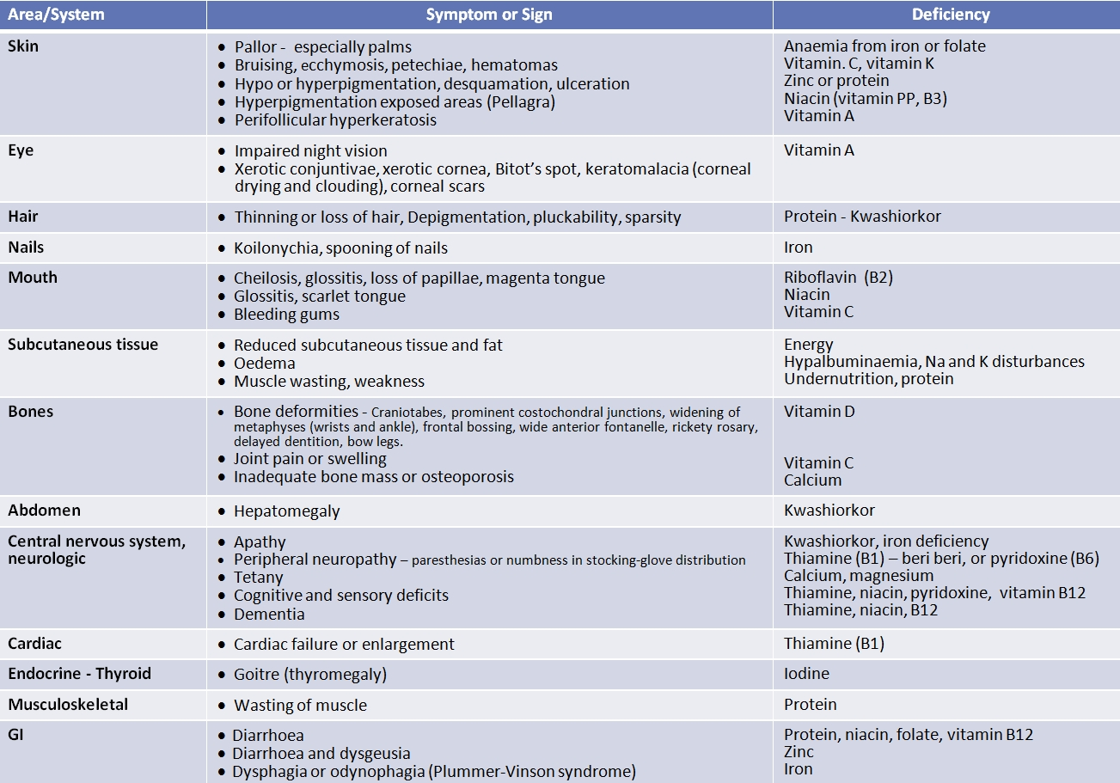
Symptoms and signs of undernutrition and micronutrient deficiency
16
Notes:
16

Slide 17
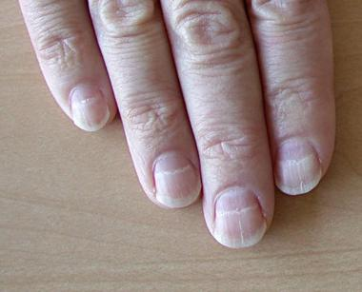
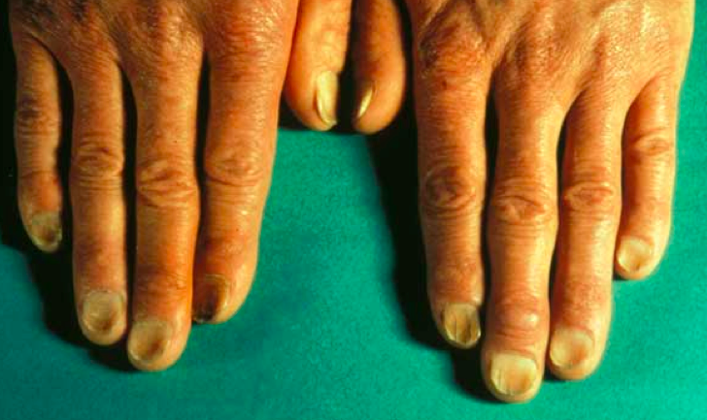
Nails
Fe deficiency - koilonychia, spooning of nails
Protein deficiency – white tranverse strips
https://classconnection.s3.amazonaws.com/639/flashcards/1040639/png/screen_shot_2012-09-29_at_73928_pm1348962057890.png
https://img.medscapestatic.com/pi/meds/ckb/41/28841tn.jpg

Slide 18
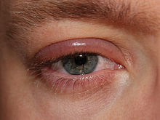
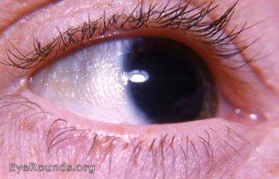
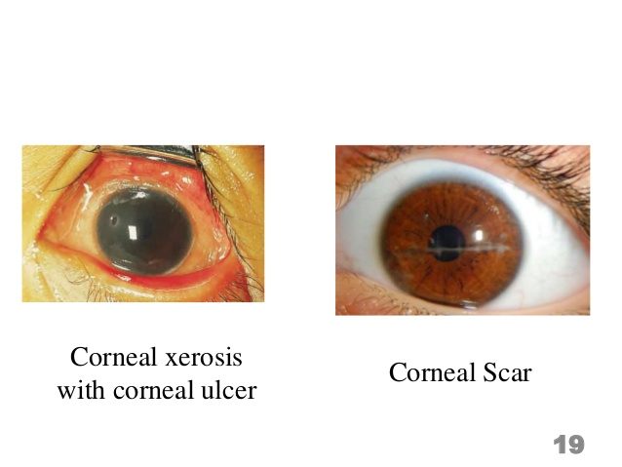
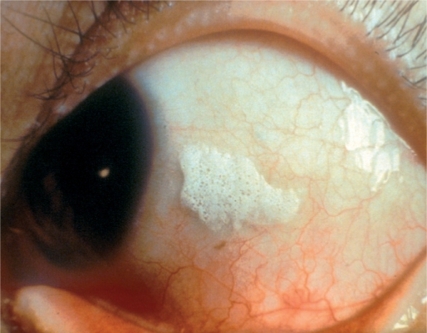
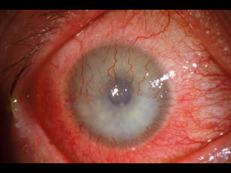
Eyes
Vit. A deficiency
Xerotic cornea
Bitot’s spot
Keratomolacia
Corneal scars
Impaired night vision
https://upload.wikimedia.org/wikipedia/commons/thumb/3/34/Blepharitis.JPG/220px-Blepharitis.JPG
https://webeye.ophth.uiowa.edu/eyeforum/atlas/photos-earlier/xerosis-conjunctivae.jpg
https://image.slidesharecdn.com/problemsolvingexercise-vita-copy-160505054605/95/vitamin-a-and-its-deficiency-19-638.jpg?cb=1462427304
https://openi.nlm.nih.gov/imgs/512/100/2873666/PMC2873666_jceh_23_72_004_f18.png?keywords=vitamin+a+deficiencies,bitot%27s+spots
http://3.bp.blogspot.com/-xl6WLqTk1uI/TriLOUllM6I/AAAAAAAAAJw/rU2PltJiqsc/s1600/corneal_neovascularization.jpg

Slide 19
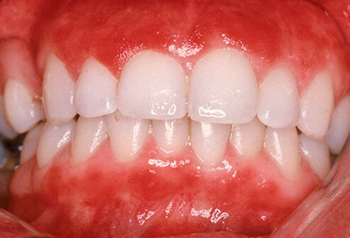
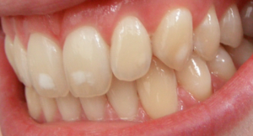
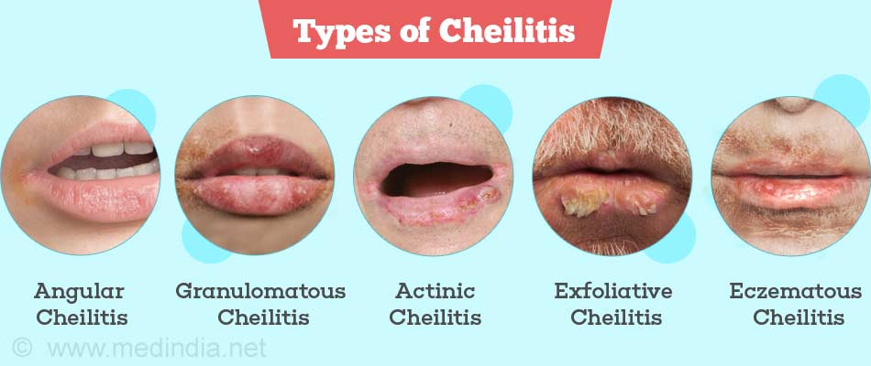
Mouth, tongue, teeth, gums
Gums
  Bleeding gums – vit C
Tongue
  Glosssitis, loss od papillae
Teeth
  Caries
    Ca, F
  Spotty enamel
    Fluorine excess
https://images.onhealth.com/images/slideshow/dental-problems-s6-gingivitis.jpg
Rty
  Angulární stomatitis – nedostatek riboflavinu, pyridoxinu, železa
  Angulární jizvy – nedostatek riboflavinu, pyridoxinu
  Cheilitis – nedostatek riboflavinu
https://upload.wikimedia.org/wikipedia/commons/thumb/4/4e/Dental_fluorosis_%28mild%29.png/300px-Dental_fluorosis_%28mild%29.png

Slide 20
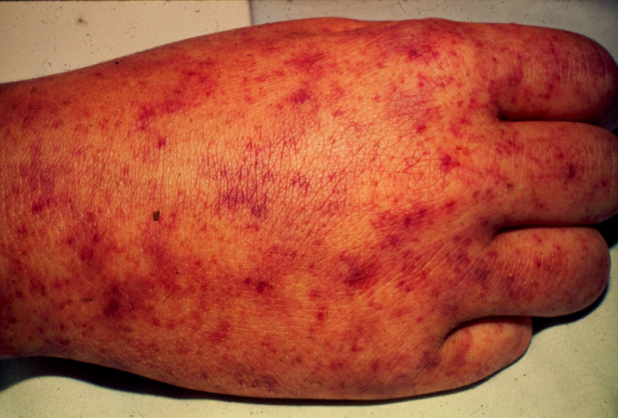
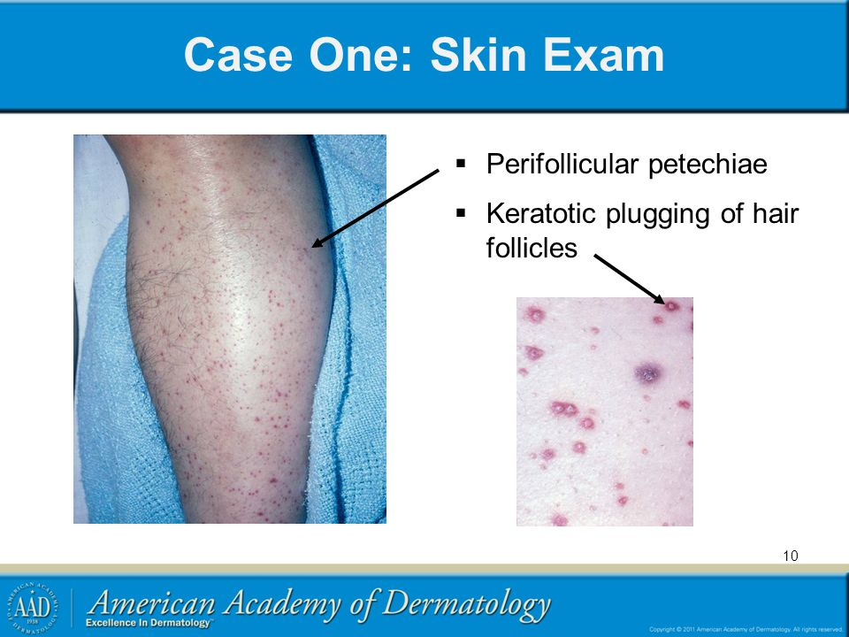
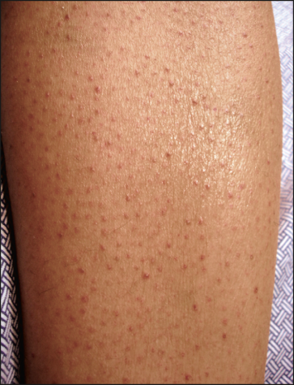
Skin
  Pallor (anemia from iron, folate)
  Bruising, petechiae, hematomas (vit C, vit K)
  Hypo or hyperpigmentation (Zinc, niacin)
  Perifollicular hyperkeratosis (vit A
http://www.uaz.edu.mx/histo/pathology/ed/ch_7/c7_rmsf_hand.jpg
https://jamanetwork.com/data/Journals/DERM/4687/dsk50017f2.png
https://noskinproblems.com/wp-content/uploads/2015/06/seborrheic-dermatitis-face.jpg
http://slideplayer.com/1718407/7/images/10/Case+One%3A+Skin+Exam+Perifollicular+petechiae.jpg

Slide 21
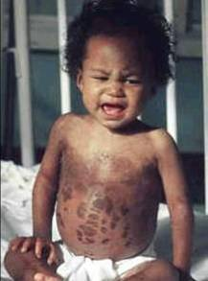
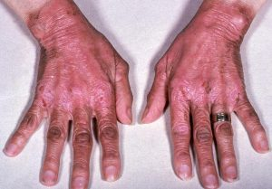
Skin
Kůže
  Změny pigmentace
    Špinavě hnědé skvrny – chronická podvýživa
    Depigmentace – kwashiorkor
    Erytém, svědění, pálení – puchýřky – hrubnutí kůže – pelagra
    Bledá kůže - chudokrevnost
https://www.med.uottawa.ca/sim/data/Images/Kwashiorkor.jpg
https://niacinreviews.com/wp-content/uploads/2016/10/Pellagra-300x209.jpg

Slide 22
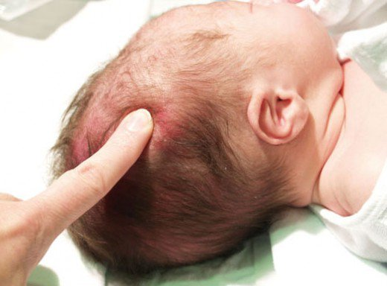
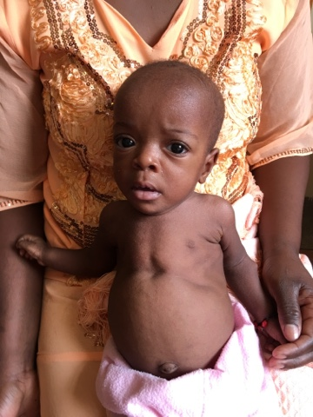
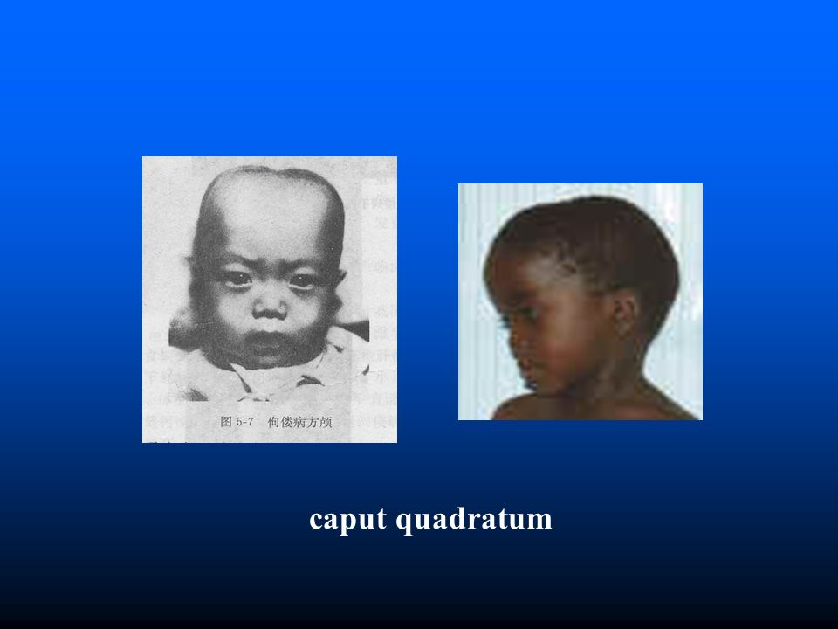
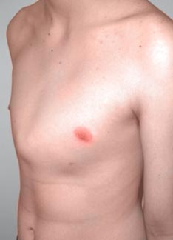
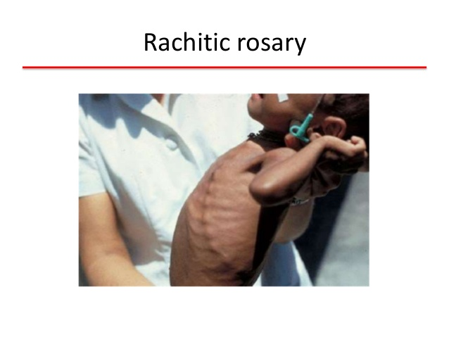
Bones, skeleton
Vit. D deficiency
  Bone derformities:
  Craniotabes
  Prominet costovertebral junctions
  Widering of metaphyses (wrist and ankle)
  Frontal bossing
  Wide anteri
https://usercontent2.hubstatic.com/8761643_f520.jpg
https://lh3.googleusercontent.com/-j4DAMWNSi1E/VyuFmVjt3BI/AAAAAAAABis/ww3CnqYmfno/s640/blogger-image-2107067516.jpg
http://www.orthokids.com.au/static/uploads/images/pectus-carinatum-patient-wfwwhgzwmqop.jpg
http://slideplayer.com/10592260/36/images/20/caput+quadratum.jpg
https://image.slidesharecdn.com/bonedemineralizationpblariff-150108110339-conversion-gate02/95/bone-demineralization-10-638.jpg?cb=1420720388

Slide 23
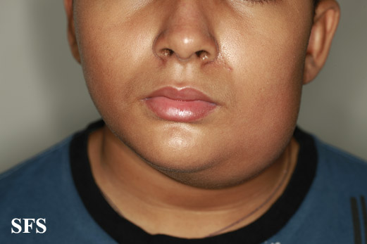
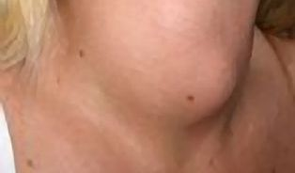
Thyroid
Iodine defeficiency
  Goitrea (thyromegaly)
https://www.wikidoc.org/images/a/aa/Parotitis01.jpg
https://i.iinfo.cz/images/414/struma-vole-zvetsena-stitna-zlaza-2-thumb.jpg

Slide 24
ANTHROPOMETRY
24
Notes:
24

Slide 25
Anthropometric (somatometric) measurements used in nutritional status assessment
Directly measured simple parameters:
Height
Weight
Waist
Hip
Arm (MUAC)
Skinfolds
Anthropometric indexes:
BMI
WHR
Body composition analysis:
BIA
Hydrodensitometry (hydrostatic weighing)
DEXA
MRI
Plethysmography (BodPod) (whole body air displacement plethysmography)
3D-scanning
25
Notes:
25

Slide 26
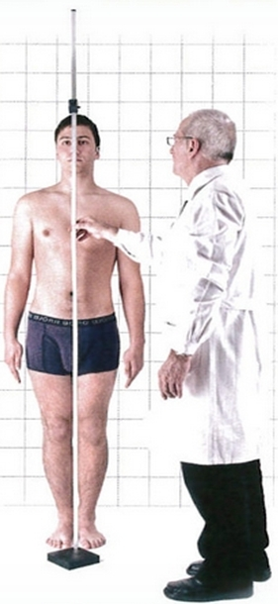
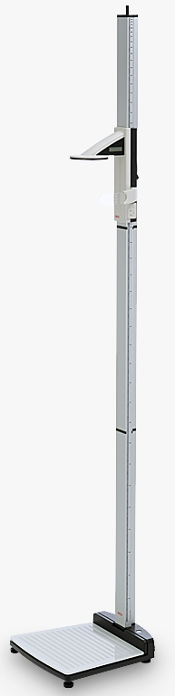
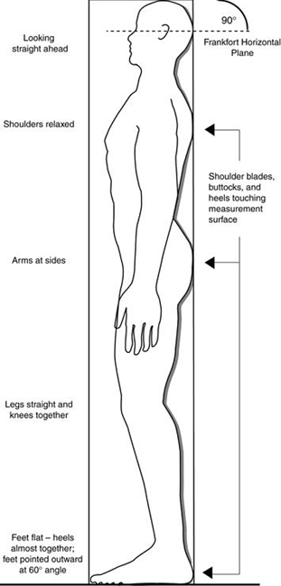
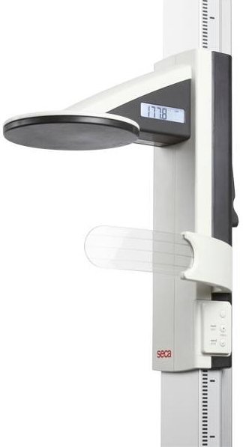
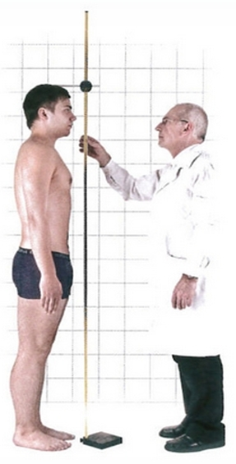
Height
26
Notes:
26

Slide 27
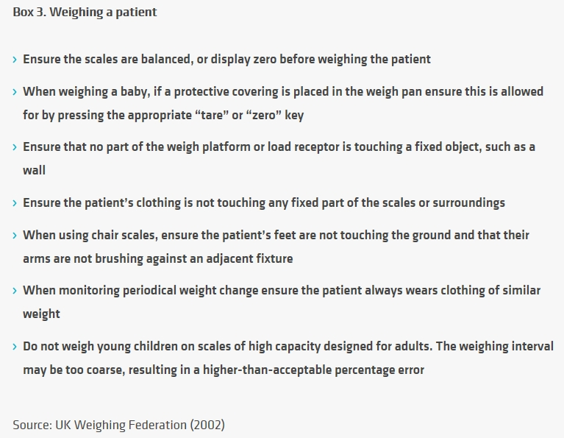
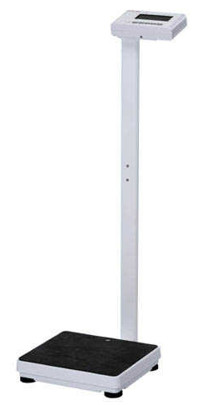
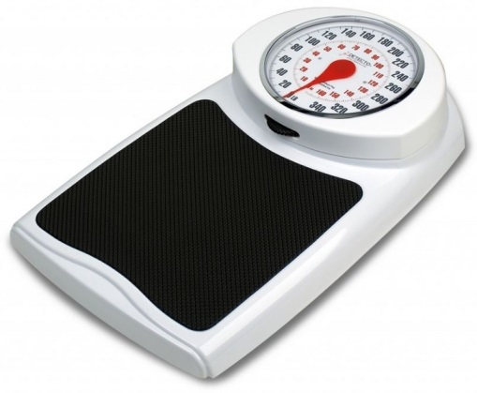
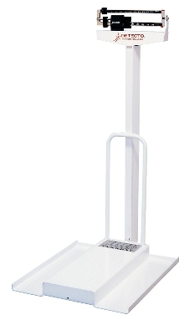
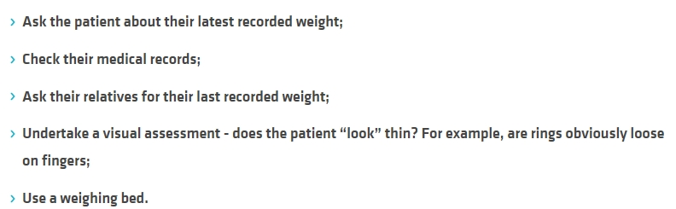
Weight
Alternatives to weighing patients:
27
Notes:
27

Slide 28
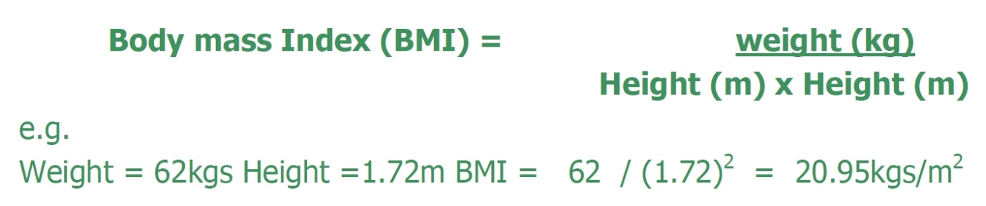
BMI
BMI = weight (kg) / height² (m²)
Classification: | Underweight | Normal range | Overweight | Obesity
BMI | < 18.5 | 18.5 – 24.9 | 25.0 -29.9 | ≥ 30.0
28
Notes:
28

Slide 29
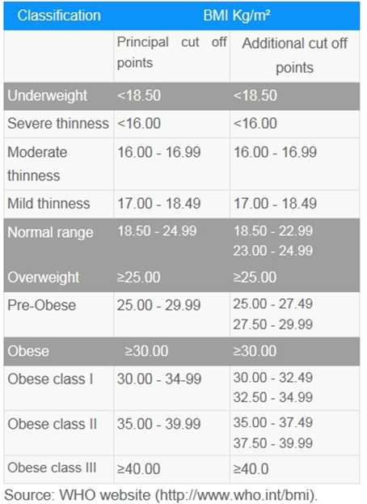
BMI – Diagnostic criteria (cut-offs)
29
Notes:
29

Slide 30
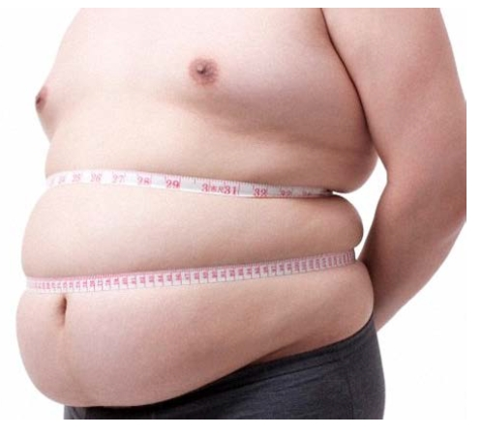
Circumferences
Possible circumferences in nutritional status assessment:
Waist
Hip
Arm
Calf
30
Notes:
30

Slide 31
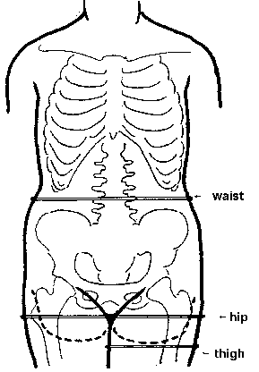
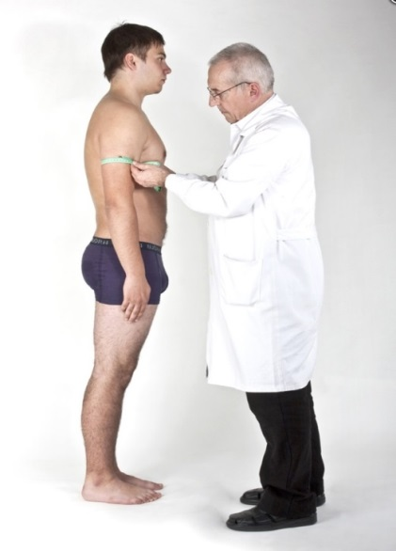
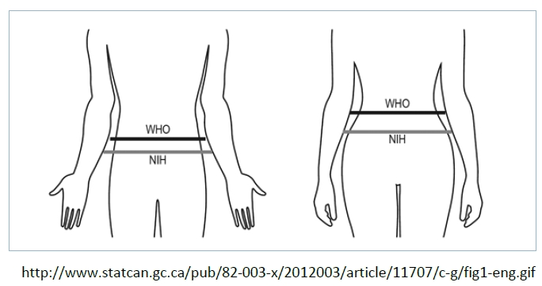
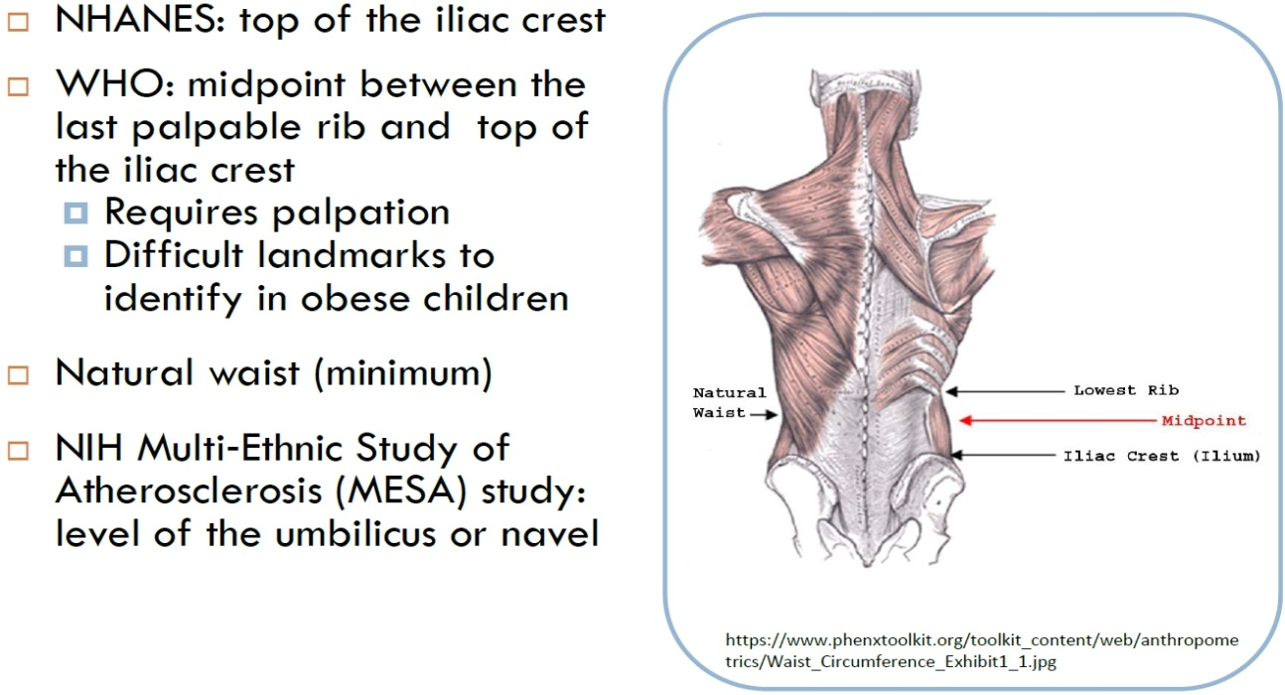
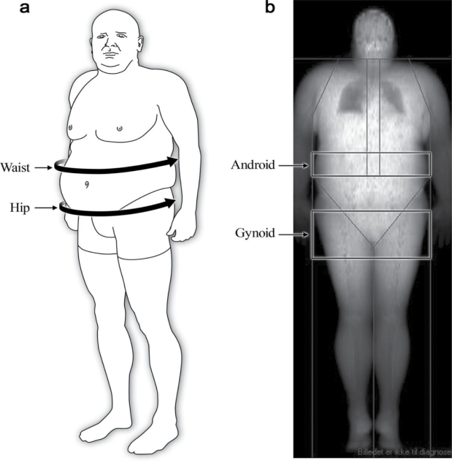
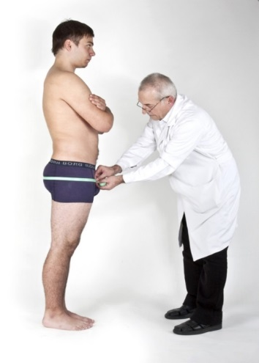
Circumferences – measuring sites:
Waist – taken in level of the umbilicus (navel)
Hip - measurement is taken at the widest lateral extension of the hips
Arm – mid upper arm, relaxed
31
Notes:
31

Slide 32
Waist circumference – diagnostic criteria
WHO – risk of metabolic complications:
 | OK | Risk increased | Substantially increased
Men | < 94 | 94.1 - 102 | > 102
Women | < 80 | 80.1 - 88 | > 88
32
Notes:
32

Slide 33
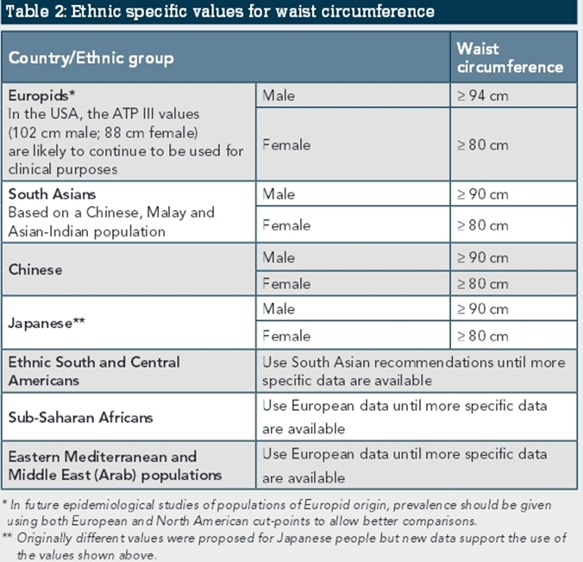
33
Notes:
33

Slide 34
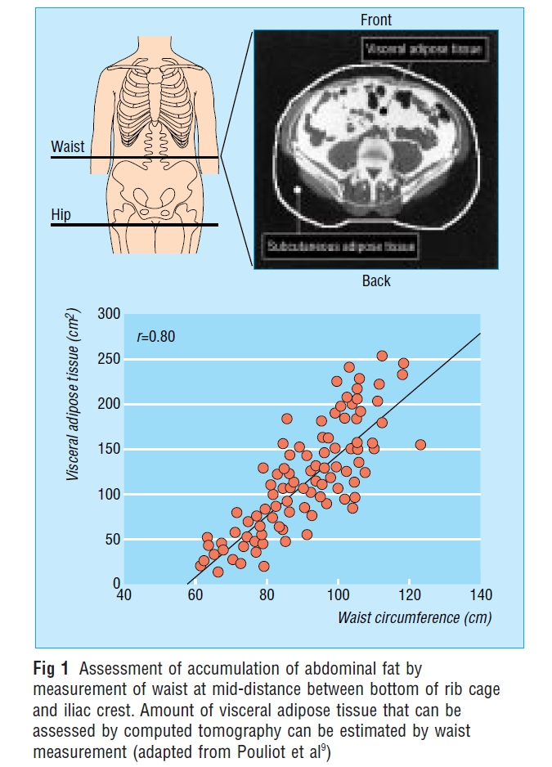
Waist circumference – correlation with abdominal fat
34
Després J P, Lemieux I, Prud'homme D: Treatment of obesity: need to focus on high risk abdominally obese patients. BMJ. 2001 Mar 24;322(7288):716-20.
Notes:
34

Slide 35
Metabolic syndrome
Metabolic syndrome, sometimes known by other names, is a clustering of at least three of the five following medical conditions: abdominal obesity, high blood pressure, high blood sugar, high serum triglycerides and low high-density lipoprotein (HDL) levels.
Metabolic syndrome is associated with the risk of developing cardiovascular disease and type 2 diabetes.
Insulin resistance, metabolic syndrome, and prediabetes are closely related to one another and have overlapping aspects.
The syndrome is thought to be caused by an underlying disorder of energy utilization and storage.
35
Notes:
35

Slide 36
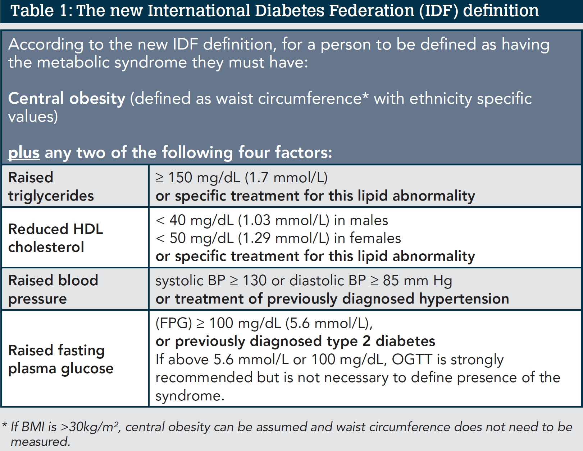
Metabolic syndrome
36
Notes:
36

Slide 37
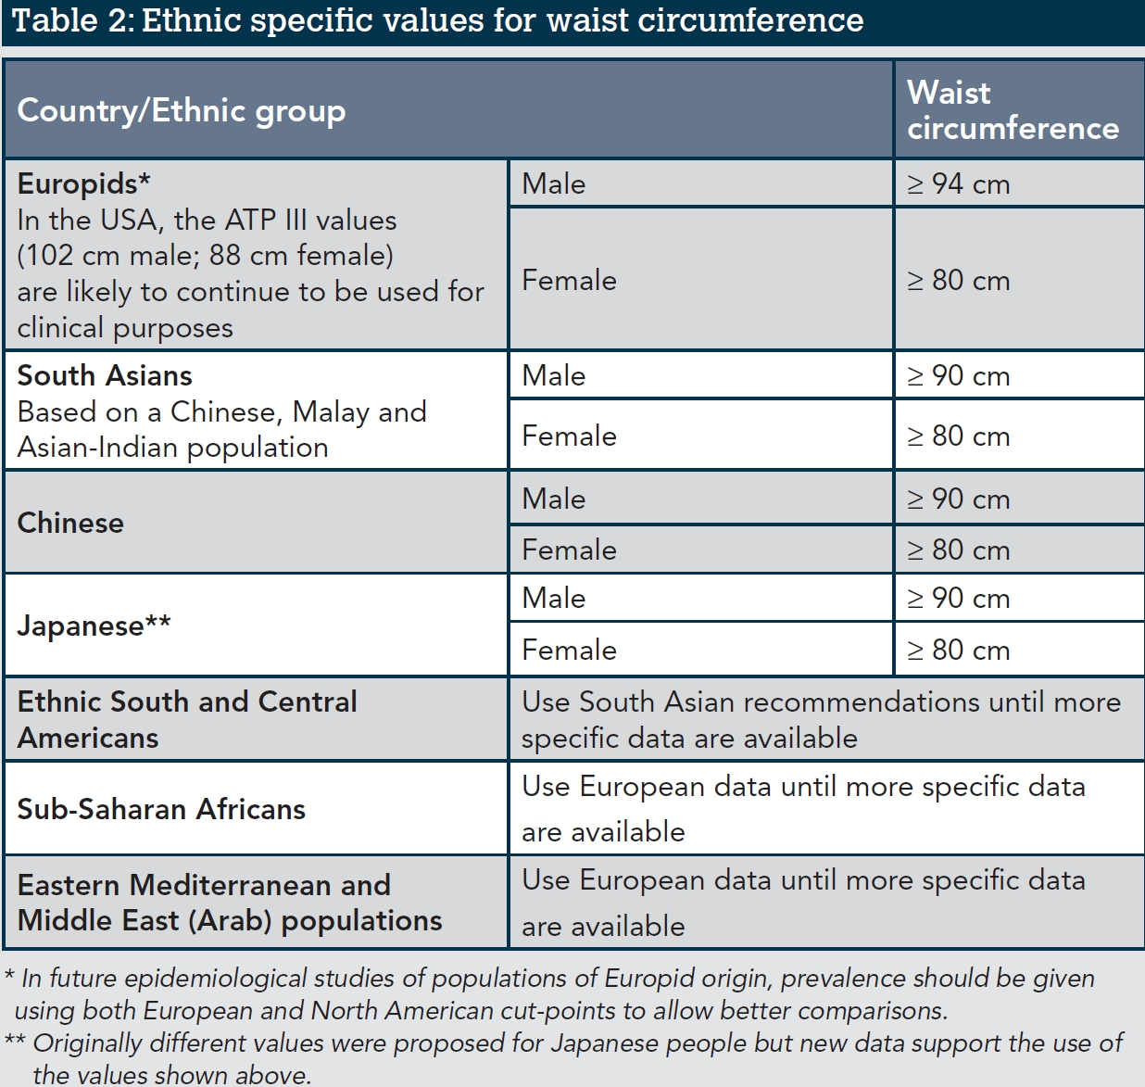
37
Notes:
37

Slide 38
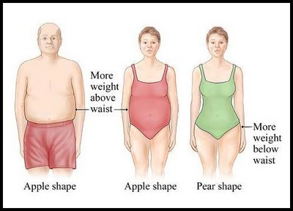



WHR – Waist to Hip Ratio
38
Notes:
38

Slide 39

WHR – diagnostic criteria
 | Low risk | Moderate risk | High risk
Men | < 0.95 | 0.95 - 1.00 | > 1.00
Women | < 0.80 | 0.81 - 0.85 | > 0.85
Ideal value (health and fertility): Men 0.9, Women 0.7
39
Notes:
39

Slide 40

WHR interpretation pitfalls
Després J P, Lemieux I, Prud'homme D: Treatment of obesity: need to focus on high risk abdominally obese patients.
BMJ. 2001 Mar 24;322(7288):716-20.
40
Notes:
40

Slide 41




WHR
The most desirable between 0.6 – 0.75
41
Notes:
41

Slide 42

Diagnostická kritéria - WHR
42
Notes:
42

Slide 43



MUAC (Mid Upper Arm Circumference), MAC, AC
♂ >26 cm
♀ >25 cm
Adults:
UNICEF – Adults:
Low MAC adult =< 24
21 – 23 = yelow zone
< 21 cm – red
Children tape:
43
Notes:
43

Slide 44
Calf circumference cut-offs
Calf (CC):
< 31 cm – manutrition
> 31 - OK
Mid-arm and calf circumferences (MAC and CC) are better than body mass index (BMI) in predicting health status and mortality risk in institutionalized elderly Taiwanese.
Arch Gerontol Geriatr. 2012 May-Jun;54(3):443-7.
Mid-arm and calf circumferences are stronger mortality predictors than body mass index for patients with chronic obstructive pulmonary diseaseInt J Chron Obstruct Pulmon Dis. 2016; 11: 2075–2080.
44
Notes:
44

Slide 45
BODY FAT AND BODY COMPOSITION MAEASUREMENT
45
Notes:
45

Slide 46




Skinfolds measurement
Several types od calipers
Best:
Harpenden:
46
Notes:
46

Slide 47




Skinfolds measurement
Measuring with Best caliper:
Triceps
Supraspinal
Subscapular
47
Notes:
47

Slide 48







BIA – Bioelectrical impedance analysis
BIA actually determines the electrical impedance, or opposition to the flow of an electric current through body tissues which can then be used to estimate total body water (TBW), which can be used to estimate fat-free body mass and, by difference with body weight, body fat.
48
Notes:
48

Slide 49

Inbody S10
49
Notes:
49

Slide 50



Inbody S10
50
Notes:
50

Slide 51
OTHER TECHNIQUES
51
Notes:
51

Slide 52

Underwater weighing - hydrodensitometry
52
Notes:
52

Slide 53




DEXA – Dual Energy X-ray Absorptiometry
53
Notes:
53

Slide 54


BodPod –Air displacement plethysmography
54
Notes:
54

Slide 55

Body fat - diagnostic criteria
Cut-offs for „too high BFP“ according to different sources:
 | Men ♂ | Women ♀
PBF Corressponding to BMI | < 20 | < 32
Oliveros | < 20 | < 30
Tanita | < 20–25 | < 33–36
Biospace | < 20 | < 28
Bodystat | < 18 | < 26
Measured PBF corresponding to BMI cut-offs: (Galagher et al.)
Category | OK | Overweight | Obesity
BMI | < 25 | 25 – 30 | > 30
PBF males | < 20 % | 20 – 25 % | > 25 %
PBF females | < 32 % | 32 – 38 % | > 38 %
55
Notes:
55

Slide 56


Body fat - diagnostic criteria
 | Men | Women
Normal | < 20 | < 30
Overfat | 20 - 25 | 30 - 35
Obesity | > 25 | > 35
Oliveros E, Somers V, Sochor O, Goel K, Lopez-Jimenez F: The concept of normal weight obesity. Progress in cardiovascular diseases, 2014, 56, 426-433
Biospace: Standard body fat percent is 15 % (range 10 - 20) for men and 23 % (range 18 - 28) for women
Measured PBF corresponding to BMI cut-offs: (Galagher et al.)
Category | OK | Overweight | Obesity
BMI | < 25 | 25 – 30 | > 30
PBF males | < 20 % | 20 – 25 % | > 25 %
PBF females | < 32 % | 32 – 38 % | > 38 %
56
Notes:
56

Slide 57
The health impact of obesity, NWO
Condition „fit fat“ is better (healthier) than „unfit unfat“
The most important is the ratio between fat and muscle tissue
NWO (Normal Weight Obesity) – increased fat in normal BMI, it poses metabolic and health risk. Diagnosis is often missed!
57
Notes:
57

Slide 58
LABORATORY
58
Notes:
58

Slide 59

Biochemical parameters in nutritional status
 | Normal [g/l] | Heavy deficiency [g/l] | Halftime
Albumin | > 32 | < 21 | 20 days
Transferin | > 2 | < 1 | 8-10 days
Prealbumin | > 0.2 | < 0.1 | 2 days
59
Notes:
59

Slide 60

60
Notes:
60

Slide 61





Dynamometry - hand grip (muscle strength)
♂ >30 kp
♀ >20 kp
The values above refers to age category 65-70, where they correspond to 85% of the table norm according to age.
61
Notes:
61

Slide 62
CHILDREN
62
Notes:
62

Slide 63


Nutritional status assessment in children – BMI percentiles
63
Notes:
63

Slide 64

Hodnocení výživového stav dětí
64
Notes:
64

Slide 65

Definitions of nutrition indicators in children
65
Notes:
65

Slide 66
Z - score
The difference between the measured value and the 50. percentile, expressed in units of SD.
66
Notes:
66

Slide 67


MUAC (Mid Upper Arm Circumference), MAC, AC
Children tape:
67
Notes:
67

Slide 68
Screening tests
68
Notes:
68

Slide 69

Validated screening test
MNA – Mini Nutritional Assessment (+ MNA-SF – short form)
SGA – Subjective Global Assessment
NRS (or NRS 2002) – Nutritional Risk Screening
MUST – Malnutrition Universal Screening Tool
69
Notes:
69

Slide 70

MNA (SF)
70
Notes:
70

Slide 71



MNA - continuing
71
Notes:
71

Slide 72

72
Notes:
72

Slide 73
SGA – Subjective Global Assessment
It covers 3 areas:
Medical History
Weight change
Dietary intake change
Gastrointestinal symptoms
Functional capacity
Physical examination
Loss of subcutaneous fat
Loss of muscle mass
Presence of oedema, ascites
Subjective global assessment
A – Well nourished
B - Mildly/Moderately Malnourished
C - Severely Malnourished
The individual items are not point scored as the assessment is subjective. The results of the medical history and physical examination are summarized in the „Subjective Global Assessment“
73
Notes:
73

Slide 74

74
Notes:
74

Slide 75


SGA – Subjective Global Assessment Guidance for Body Composition
Subcutaneous fat
Muscle wasting
75
Notes:
75

Slide 76

SGA – Subjective Global Assessment
Fluid retention
Subjective Global Assessment
A - Well-nourished | B - Mildly/moderately malnourished | C- Severely malnourished
No decrease in food/nutrient intake; < 5% weight loss; No/minimal symptoms affecting food intake; No deficit in function; No deficit in fat or muscle mass | Definite decrease in food/nutrient intake; 5% - 10% weight loss without stabilization or gain; Mild/some symptoms affecting food intake; Moderate functional deficit or recent deterioration; Mild/moderate loss of fat and/or muscle mass | Severe deficit in food/nutrient intake; > 10% weight loss which is ongoing; Significant symptoms affecting food/ nutrient intake; Severe functional deficit OR *recent significant deterioration obvious signs of fat and/or muscle loss
76
Notes:
76

Slide 77



NRS 2002 - Nutritional Risk Screening
77
Notes:
77

Slide 78

78
Notes:
78

