Slide 1
Environment in the Czech Republic
For General Medicine
Doc. MUDr. Jan Šimůnek, CSc., Doc. Ing. Martin Krsek, CSc.
Department of Public Health

Slide 2
Dear colleagues!
I checked carefully the whole presentation. Where it was necessary, I added few comments or explanatory notes. I hope, that the presentation is quite self-explanatory now. If you have any questions, please, do not hesitate to ask me any question. I will do my best to answer them as well as I can.
My email is : krsek@med.muni.cz
Good luck!
Martin Krsek

Slide 3
Definition of the issue
I would like to remind you a lecture in the first year of your study
Ecological issue of the nuclear energy
Nuclear incidents and its implication on population of Central Europe
Jaslovské Bohunice
Černobyl – was already discussed
Fukushima
another
Temelin and its implication on public health
Issue of radiation in general (plus noise)

Slide 4
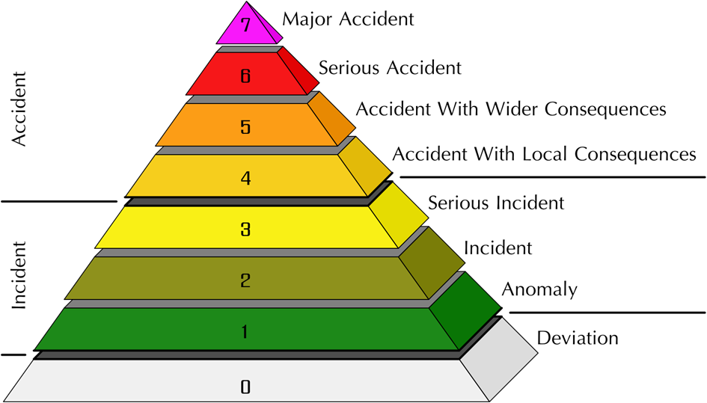
Levels of incidents/accidents in nuclear power stations

Slide 5
Designed accident at nuclear power station
Designed accident is accident for which the facility is designed to cope with.

Slide 6
Nuclear power station at Jaslovské Bohunice 1 (Block A1)

Slide 7
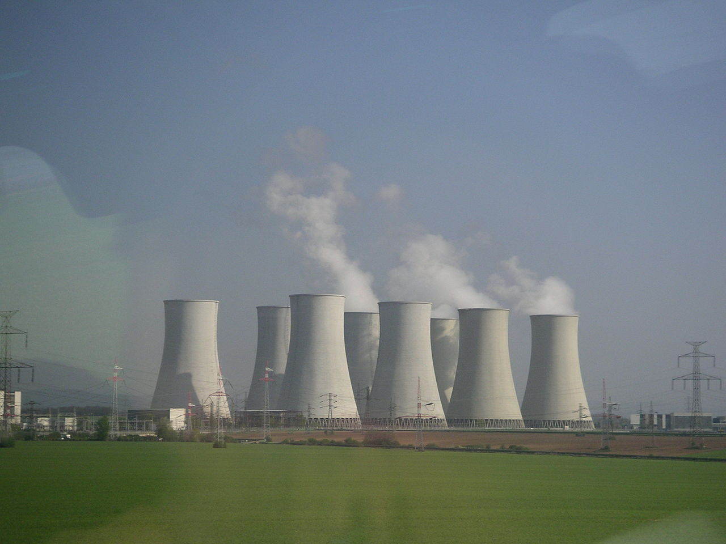
Jaslovské Bohunice 2
Two power plants, two designs
- A1 original Czechoslovak design, heavy water, cooled by CO₂
- highly technically elaborated
- for example enabled to change fuel during operation of
reactor
- demanding for operation (1972)
- V1 classic according to Soviet model (VVR) control rod elements, light water in primary circuit (two reactors – 1980)
- V2 – another two reactors – still working (1985)

Slide 8
Jaslovské Bohunice 3
Accidents
There were two accidents there:
1. 5. 1. 1976 Due to fault of gasket there was a leak of CO₂ from reactor. Accident was reduced by operators of refilling instrument, who used the refilling instrument to seal the leakage. Two workers were killed but not by the radioactivity, but by suffocating by CO₂ (they were working below the reactor).
Incident was level 3.
2. 22. 2. 1977 There was a rupture of silica gel sachet used to keep fuel core elements (rods) dry. Not all particles of silica gel were removed before insertion into the reactor, where they swelled up by the heat and deformed the fuel core element. There was a de-hermetisation of fuel and reactor had to be closed down because of high contamination of primary circuit.
  Now the reactor is under liquidation.
Accident was level 4.
Both accidents did not do any harm outside the power station.

Slide 9
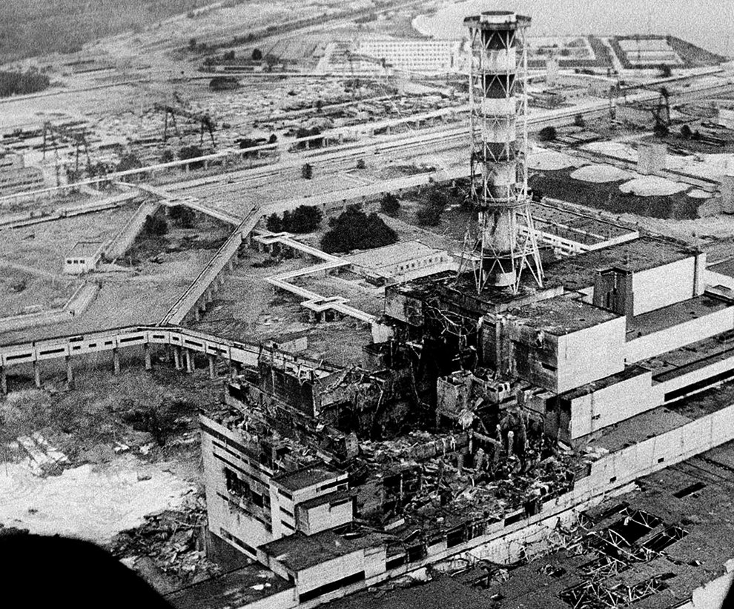
Chernobyl – 26.4.1986
Was discussed in the first year.
Despite the fact that it was major
accident of level 7, implication
on health of population of central
Europe was relatively small.
Consequences of the Catastrophe for
People and the Environment is a 2007
Russian publication that concludes that
there were 985,000 premature deaths
as a result of the radioactivity released.
2000 – closed down.
Notes:
V některých monitorovaných potravinách je stále nezanedbatelné množství cesia Cs-137 z takzvaného počernobylského spadu, který byl v 80. letech 20. století způsoben havárií Jaderné elektrárny Černobyl. Na webu to uvedl Státní úřad pro jadernou bezpečnost (SÚJB) s tím, že jde především o zvěřinu, houby a lesní plody. Předsedkyně úřadu Dana Drábová řekla, že v množství v potravinách není v žádném případě zdravotně závadné. Cesium se podle ní bude rozkládat ještě několik desítek let.
Úřad připomněl, že například kančí maso s hodnotami nad 1250 Bq/kg (Becquerelů na kilogram) by se nemělo dostat do obchodní sítě.
Loni bylo v ČR ze 157 změřených vzorků podle něj takových vzorků 35, maximální hodnota byla 11.987 Bq/kg ve vzorku z okolí Horní Stropnice na Českobudějovicku. Průměr byl 890 Bq/kg, uvedl SÚJB.
Divočáci jsou podle ní radioaktivní kvůli tomu, že žerou podzemní houbu jelenku obecnou, která má schopnost fixovat radioaktivitu z půdy.

Slide 10
Consequences of Chernobyl at Czech Republic
In some monitored foods, there is still a significant amount of cesium Cs-137 from the so-called
Chernobyl fallout. This was stated on the website by the State Office for Nuclear Safety (SÚJB),
Saying that it is primarily game, mushrooms and forest berries.
The chairwoman of the office, Dana Drábová, said that the amount in food is by no means
harmful to health. According to her, Cesium will decompose for several decades.
The Office recalled that, for example, boar meat with values ​​above 1250 Bq / kg should not
enter the marketing network.
In the Czech Republic last year, of the 157 measured samples, 35 were samples, the maximum
value was 11,987 Bq / kg in a sample from the area around Horní Stropnice in the České
Budějovice region. The average was 890 Bq / kg, according to SÚJB.
According to her, wild boars are radioactive because they eat an underground mushroom,
which has the ability to fix radioactivity from the soil.

Slide 11
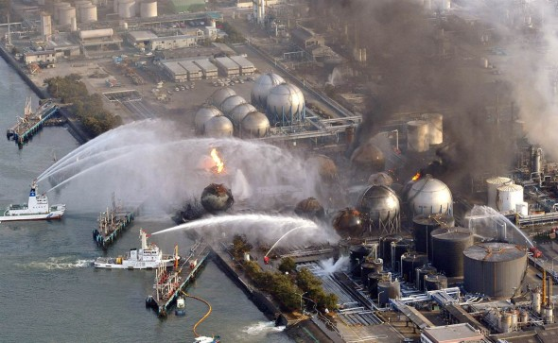
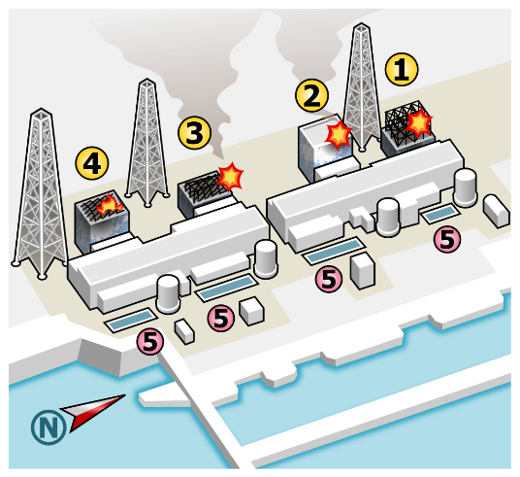
Fukushima
Nuclear power plant at Japan coastline.
Due to earthquake and following tsunami there was
an over designed accident on 11.3.2011.
Three reactors were on planned shut down and the other three were working. Earthquake did not damaged working reactors, they shut down as well. The situation was stable until the earthquake-induced tsunami waves destroyed back-up diesel generators, seawater pumps, power lines inside the power plant, and DC power sources. The blocks were not cooled, and explosions gradually broke out.
Mistakes were also out of power plant, were priorities were set wrong (power plant did not received fuel for generators, etc.)
Disaster affected surrounding of the power plant, adjacent areas were evacuated.
In August 2012, researchers found that 10,000 nearby residents had been exposed to less than 1 millisievert of radiation, significantly less than Chernobyl residents.
https://en.wikipedia.org/wiki/Fukushima_Daiichi_nuclear_disaster
Accident was of level 7.
Latest informations at: https://www.tepco.co.jp/en/decommision/index-e.html

Slide 12
Fukushima - consequences
A 2012 analysis of the intermediate and long-lived radioactivity released found about 10–20% of that released
from the Chernobyl disaster.
In 2013, the World Health Organization reported that area residents who were evacuated were exposed to so
little radiation that radiation-induced health effects were likely to be below detectable levels
Although there were no deaths from radiation exposure in the immediate aftermath of the incident, there were
a number of (non-radiation related) deaths during the evacuation of the nearby population.[
The report indicated that for those infants in the most affected areas, lifetime cancer risk would increase
by about 1%
The maximum predicted eventual cancer mortality and morbidity estimate according to the linear no-threshold
theory is 1,500 and 1,800, respectively, but with the strongest weight of evidence producing an estimate much
lower, in the range of a few hundred.^{[214]} In addition, the rates of psychological distress among evacuated people
rose fivefold compared to the Japanese average due to the experience of the disaster and evacuation.^{[215]}

Slide 13
Fukushima - Effects on evacuees
(https://en.wikipedia.org/wiki/Fukushima_Daiichi_nuclear_disaster)
In the former Soviet Union, many patients with negligible radioactive exposure after the Chernobyl disaster displayed extreme
anxiety about radiation exposure. They developed many psychosomatic problems, including radiophobia along with an increase
in fatalistic alcoholism. As Japanese health and radiation specialist Shunichi Yamashita noted:^{[274]}
We know from Chernobyl that the psychological consequences are enormous. Life expectancy of the evacuees dropped
from 65 to 58 years – not because of cancer, but because of depression, alcoholism, and suicide. Relocation is not easy,
the stress is very big. We must not only track those problems, but also treat them. Otherwise people will feel they are just
guinea pigs in our research.^{[274]}
A survey by the Iitate local government obtained responses from approximately 1,743 evacuees within the evacuation zone.
The survey showed that many residents are experiencing growing frustration, instability, and an inability to return to their
earlier lives. Sixty percent of respondents stated that their health and the health of their families had deteriorated after
evacuating, while 39.9% reported feeling more irritated compared to before the disaster.^{[275]}
Summarizing all responses to questions related to evacuees' current family status, one-third of all surveyed families live
apart from their children, while 50.1% live away from other family members (including elderly parents) with whom they lived
before the disaster. The survey also showed that 34.7% of the evacuees have suffered salary cuts of 50% or more since
the outbreak of the nuclear disaster. A total of 36.8% reported a lack of sleep, while 17.9% reported smoking or drinking
more than before they evacuated.^{[275]}

Slide 14
Monitoring of influence of Temelin on (population) health
Areas for comparison
Rural areas
Surrounding of Temelin is compared with similar rural areas around Pisek and Ceske Budejovice.
It is additionally divided into nearer and more distant area (according to visibility of power station from that area).
Urban territories
The nearest bigger town, Ceské Budejovice, is compared with Hradec Králové and Olomouc (mainly potential psychogenic influence)
Further division
Control and more distant exposed areas are further divided in districts.

Slide 15
Data and their processing
Origin of data
Czech Statistical Office
What is monitored – health
Total mortality
Mortality for cardiovascular diseases
Mortality for malign tumor
Total mortality in productive age
Mortality for cardiovascular diseases in productive age
Mortality for malign tumor in productive age
So called „lost years“
Occurence of spontaneous abortion
Number of children with birth weigh under 2500 g
Indicators are standardized and processed separately for male and female. Beside that three year moving average to smooth random variations is calculated.

Slide 16
Age standardization
It represents the conversion of measured mortality into what it would be at a defined standard age composition (most often ratio of age groups the same as in the whole state).
The purpose of age standardization is
to eliminate fact, that older people are more likely to be ill, and more often they die
and by this way to prevent a different proportion of young and old between the populations under investigation.
With a little simplification:
If we build a big home for the seniors in a city, clients will be coming from the wider neighborhood and it will affect the rough mortality, but age-standardized mortality should be change little, ideally not at all.

Slide 17
Lost years
Numeric indicator averaging the years (of deceased people) that remained to the age to be experienced by each (most often the age of retirement)
e.g.
If age of retirement is 65, so:
Person dying in 65th and more years of age is count as 0
Person dying in 64th year of age is count as 1
Person dying in 55th year of age is count as 10 etc.
The sum is divided by the number of deceased persons in the given year.

Slide 18
Data and their processing
What is monitored – sociodemographic characteristics of populatins in monitored localities
Existing differences in age structure and gender representations, income, type of housing, and many similar indicators can identify differences which were not caused by the power station but just differences in these characteristics themselves.

Slide 19
Why data from Czech Statistical Office were chosen
There is quarantee of the same method of data collection, which can elliminate artificial differences given by various probability of disease record in various locations.
It happened for example at Hiroshima and Nagasaki, where impact of nuclear bombarding on population health was overestimated.
The reason was that residents from these two towns were examined much more carefully than the rest of Japan population and part of detected differences aroused from this fact.

Slide 20
General knowledge
Leukemia
Bigger incidence od leukemia, mainly for children, was described close to nuclear power plants.
The reason could be not radiation, but accumulation of many people from distant
localities and mutual attacks of viruses, which can cause not only banal diseases, but can be also oncogenic.
This is not the case only for nuclear power stations, but any large scale building sites, where very different professions of workers are taking turns in big numbers (starting with laborers of rough construction up to operators of working power station).

Slide 21
What was found?
Better health around Temelín
It is not caused by positive influence of nuclear power plant on human health, but it is likely to be socio-economic, such as employment, salary, economic power of numerous JETE staff to purchase goods and services in the neighborhood.

Slide 22
What was found?
Some negative trends in health indicators
These trends are based on comparison of years 2000 up 2016.
They are comparable for exposed and control areas.
Problems with statistics used (small samples)

Slide 23
Risks of radiation
The main argument of ecologists
In fact, there are also issues related to nuclear fuel mining and processing and storage.

Slide 24
Benefits
Permanent source
The nuclear power station is independent of weather and daytime.
All ecological and alternative resources lack this characteristics.
Even hydroelectric power plants can be knocked out by long-term drought or put us in front of the dilemma of whether to produce electricity or save water for irrigation and water transport purposes.
Side effects
Spent fuel contains a number of critical elements for modern technologies, such as lanthanides (metallic chemical elements with atomic numbers 57 through 71), which are indispensable for LEDs that are essential for optoelectronics.
At present, lanthanides are mined only in China. Existence of lanthanide in spent fuel is an important factor limiting China’s demands for their price, human rights, etc.

Slide 25
Radiation – sorting and basic concepts
Depending on the type of particles
corpuscular - a stream of atomic and subatomic particles of defined masses
and speed (alpha particles, beta particles, and neutrons).
electromagnetic - a stream of photons, described as electromagnetic radiation of a certain wavelength and intensity
Depending on the influence on matter
ionizing - produces electrically charged particles in the irradiated mass – ions
non-ionizing - electrically charged particles are not produced

Slide 26
Types of radiation
Types of ionizing radiation
Ionizing radiation types include particle radiation (common types, such as helium nucleus streams (α radiation), electrons (β radiation), positrons (β + radiation), neutrons, protons, etc.) and electromagnetic radiation with a wavelength shorter than ultraviolet light.
Types of non-ionizing radiation
Non-ionizing radiation includes electromagnetic radiation of higher wavelength, and some types of less common particles (eg neutrino).

Slide 27
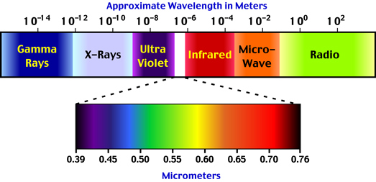
Types of electromagnetic radiation as defined by wavelength
Visible light

Slide 28
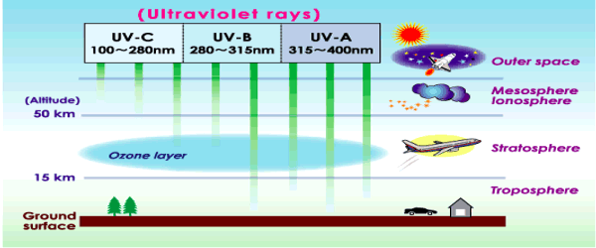
Non-ionizing radiation - Ultraviolet (UV) radiation
UV radiation can be considered bottom border (due to wavelength) of non-ionizing radiation, because at higher intensity it produces O₃ in the air and free radicals in some materials.
UV-C can be regarded as very weak ionizing radiation.
Sources of UV radiation
objects heated to high temperature, eg. electric arc, Sun
- different types of lamps (vacuum tubes etc), LED (for near UVA)

Slide 29
Effects of UV radiation
bactericidal effects
- produces vitamin D from cholesterol contained in blood
a positive effect on some skin infections as well as some noninfectious skin diseases (eg psoriasis)
irritation of the skin to inflammation and necrosis (consequence – pigmentation
according to the phototype)
- skin cancer - melanoma + carcinomas
damage to the conjunctiva and the retina
For the vitamin D production exposition for about 1 hour daily in lightweight clothing is sufficient especially in southern countries early in the morning or late afternoon, higher exposure does not bring any other positive effect.
Notes:
The vast majority of skin cancers are basal cell carcinomas and squamous cells carcinomas. While malignant, these are unlikely to spread to other parts of the body. They may be locally disfiguring if not treated early.
A small but significant number of skin cancers are malignant melanomas. Malignant melanoma is a highly aggressive cancer that tends to spread to other parts of the body. These cancers may be fatal if not treated early.

Slide 30
Comment
Epidemiologists do not recommend relying on bactericidal and virucidal effects of germicidal fluorescent lamps and take them as a complementary measure.
Any grain of dust creates a shadow in which survival of bacteria and other microorganisms is many times longer than in the neighborhood (and survival time may be longer than the duration of work of the germicidal lamp, it means the time, when there are no people in the room). Therefore, this radiation should be used after perfect cleaning only.

Slide 31
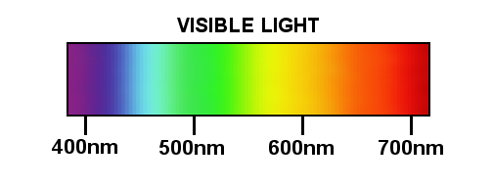
Visible light
Wavelength approx. 400–760 nm.
Sensitivity of visual receptors to light drops very steeply on shortwave end of the spectrum, decreases slowly on the long-wave end .
The people adjusted to the dark were able to detect radiation with a wavelength exceeding 1000 nm.
The source may be heated objects (continuous spectrum, characterized by Kelvins) as well as lamps and LED (line spectrum, deforms color perception).

Slide 32
Visible light
Significance 1
Visible light participates in vision.
Illumination is measured in luxes (the intensity of light falling on the illuminated area)
The hygienic standards take into account:
- visual complexity of the activity being performed
- glare, or alternation of light and darkness (especially if workers have to move
from one place to another)
- some work has to be done for several tens of minutes ongoing adaptation
to the dark
- special standards for working with lasers

Slide 33
Visible light
Significance 2
For fluorescent lamps, lamps and LEDs, there is a stroboscopic effect
The color of light is important for mental well-being, a colorful interior design for the use of light, the shape of the window also contributes to the intensity of natural lighting
Intense visible light causes photodermatitis on the skin and can also contribute to conjunctivitis (so-called „snow blindness“ after long term exposition without protection in the snow-covered landscape; but UV radiation is part of it).
Together with IR, it is involved in the generation of sunburn (see below).

Slide 34
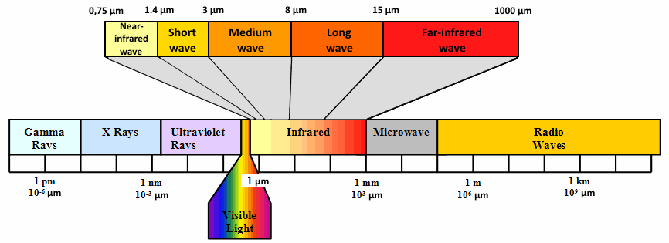
Infrared radiation
IR-A (760 – 1400 nm), IR-B (1400 – 3000 nm) and IR-C (above 3000 nm)
Caution: Location is symmetrical around visible light. It is sorted by wavelength as follows: UVC – UVB – UVA – visible light – IRA – IRB – IRC.
Its source are heated objects, IR-A and IR-B are a component of the sun’s radiation, which falls on the Earth’s surface, IR LEDs are often in home electronics controls
A B C
C B A

Slide 35
Infrared radiation
Effect on health
- at high intensities, the thermal effect can cause acute burns
- blurred eye lens - mainly for workers exposed to radiation from furnaces or hot
material - glass cataract.
sunburn occurs due to total overheating of the organism by visible and IR radiation. Also contribute air temperature, relative humidity and flow air, that is the so-called thermal complex. There is a total overheating of organism, accompanied by nausea and vomiting.
sunstroke is caused mainly by the overheating of the head, the longwave component IR-B
can penetrate through the surface structures and irritate the brain packaging. Symptoms
are similar to sunburn, but nausea and strong headaches on the first place.

Slide 36
Infrared radiation
Effect on health
both (sunburn and sunstroke) can cause epileptic or epileptiform convulsions
in the individual with disposition.
Preventing both:
- avoiding an open space in the sun
- sufficient drinking regime
- wearing headgear is a prevention of sunstroke
- especially children with epilepsy, kidney disease, diabetes, illneses of
cardiovascular system, diabetics, etc. should be monitored carefuly!
- chronic effects of IR radiation: the possible influences of extremely long exposures
of the same places on the skin were discussed, however the risk of tumors etc. is
very low.

Slide 37
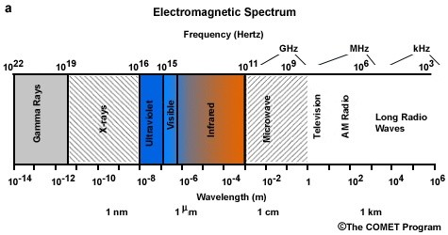
Radiation with higher wavelengths
Microwaves and waves used in
telecommunication have heat effects primary
(heating in microwave).
- Possible negative health effects
- the risk of some malignant brain tumors
- heating and bleeding of brain tissue during intensive exposure
- Possible beneficial effects:
- the most gentle heating possible
- availability of rapid help for accidents and illness
Higher incidence of tumors around the HV and VHV lines was explained by electrostatic
ion concentration, unrelated to microwaves

Slide 38

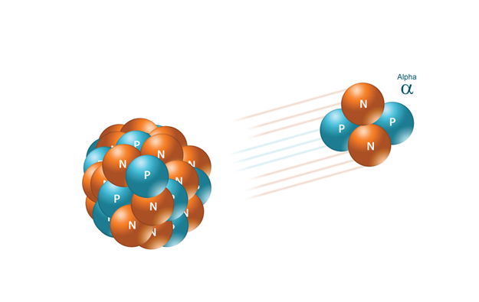
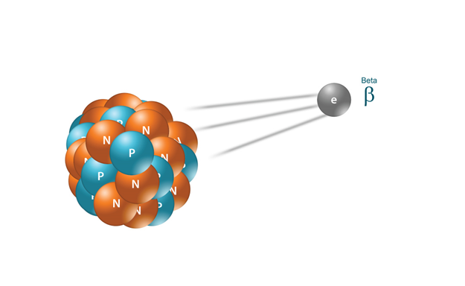
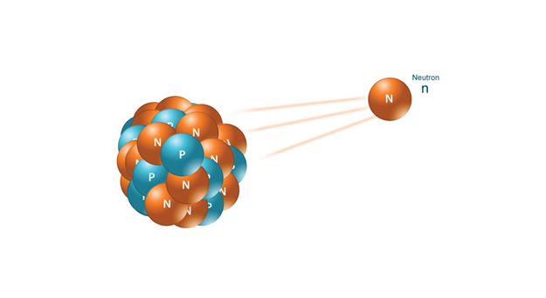
Ionizing radiation
These include:
- electromagnetic radiation with a wavelength shorter than UV-C,
- RTG radiation
- γ radiation
- cosmic rays
- α radiation (nuclei of helium atoms)
- β radiation (stream of electrons, or like +, a stream of positrons)
- neutron radiation
Some particulate radiation does not ionize, eg neutrino, which pass freely without interaction with the mass of the whole planet, others are highly exotic.

Slide 39
Penetration of radiation
To cause harm the radiation must:
- penetrate into living tissue
- at least partially interact with matter and pass on it its energy (or part of it)

Slide 40
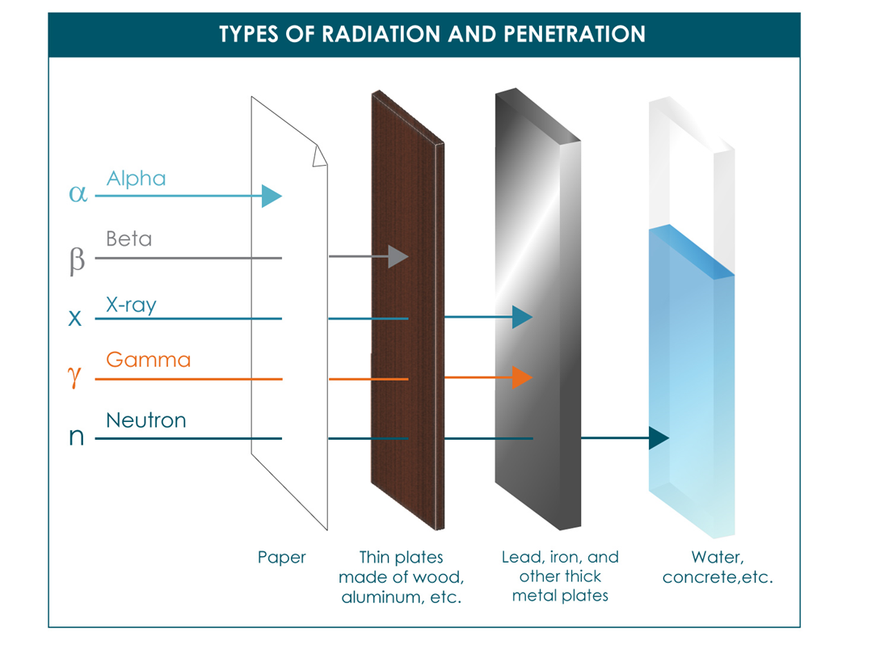

Slide 41
Penetration of Radiation – Types
Little penetrating radiation
The most famous radiation of this type is α.
Any solid matter, even a sheet of paper, and dead cells on the surface of skin, will stop it.
It has effect only under specific circumstances.
Highly penetrating radiation
Extrem is neutrino.
It passes through matter without interacting with it - it does not hurt.
Penetration „between“
It is these radiation that give their energy to the living mass and are the source of risk. They are also a source of secondary photons (Compton’s phenomenon) – they are even better trapped in the tissue.

Slide 42
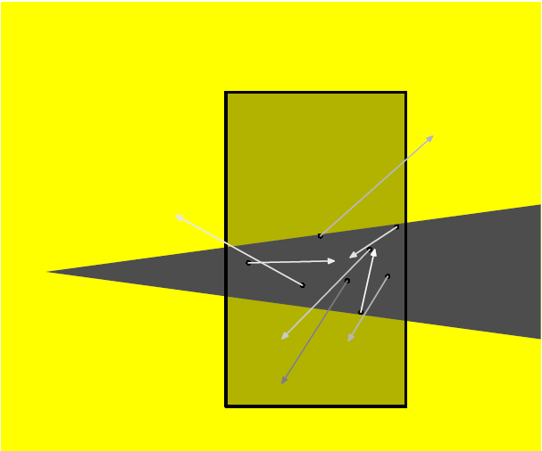
Compton effect
In the irradiated
material secondary
photons are formed at
random locations
with random (but
always lower than
photons irradiating
material) energy

Slide 43
Comment
Compton's phenomenon can thus endanger workers who are outside the mainstream
beam of ionizing radiation, e.g., escort of an treated patient at the RTG devices.
In order to disperse this irradiation to more people, children and mentally impaired patients when making X-rays images are accompanied by either family members or department staff on which they lie (except for pregnant women).
Ionizing air can also lead to inhalation of the ion. For this reason, X-rays and similar devices are equipped with a strong ventilation.

Slide 44
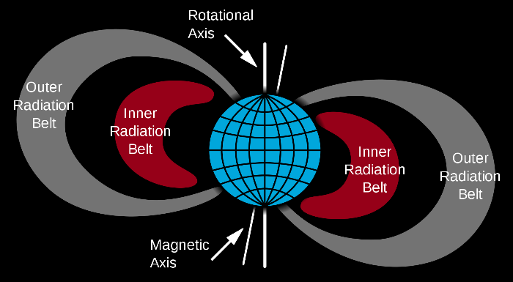
Sources of ionizing radiation
Natural sources of ionizing radiation Van Allen belts
- Sun and other similar astronomical objects
- Secondary radiation from Van Allen belts
- Exotic space objects (γ flashes, etc.)
- Radioisotopes
Isotopes of heavy elements at the end of the periodic table (and other radioisotopes with extra long half-life) – remains after explosion of the supernova before creation of the solar system
Isotopes continuously occurring in high atmospheric layers by influence of radiation from space, eg ¹⁴C, ⁴⁰K.
Notes:
A Van Allen radiation belt is a zone of energetic charged particles, most of which originate from the solar wind, that are captured by and held around a planet by that planet's magnetic field. Earth has two such belts and sometimes others may be temporarily created.

Slide 45
Sources of ionizing radiation
Artificial sources of ionizing radiation
- Artificially Concentrated Natural Radioisotopes
- Artificially created radioisotopes
- RTG device
- Other technical devices, particle accelerators
- γ lasers

Slide 46
Characteristics of radioisotopes
Half-life
is the time at which half of the atoms of the respective radioisotope decay.
Activity
depends on the half-life of atoms of the relevant isotope and their amount contained in the observed material.
It is expresses in the Becquerel unit [Bq], which is one decay per second.
However, the most commonly we work with specific activity that refers to weight, or of the volume (ie Bq.kg⁻¹, Bq.l⁻¹ (in case of some liquids) or Bq.m⁻³ (for some gases, including air).

Slide 47
Comment
When working (including health workplaces) with radioisotopes with short half-life (hours), objects contaminated by them are stored in the workplace for a predetermined time (days, storing places are called "extinction chambers") and then disposed of as normal
or bio-waste.
The urine and faeces of the patients who received the injections of such radioisotopes are discharged from special WCs through a loop in which the waste flow is so slow that the isotopes just decay, and then they go into normal sewerage.
For long-lived radioisotope, waste must be stored separately and transported into special storage. This would also apply to urine and stool of patients who were (eg in an accident) contaminated by such isotopes.

Slide 48
Measurement of ionizing radiation
Transient
Impacts of particles (but also photons of sufficient energy) can be measured
by different types of sensors.
Geiger-Müller's counter is well-known, its sensor is formed by a tube with a very dilute gas, whose conductivity will change for a moment with the passing of the ionizing radiation particle – this is changed by electronic circuits to a characteristic click in the headphones or the speaker.
The modern ones then calculate the particle flow and apply it on the time axis.
In principle, it is not possible to detect particles with very low penetration using this apparatus because they can not pass through the tube.

Slide 49
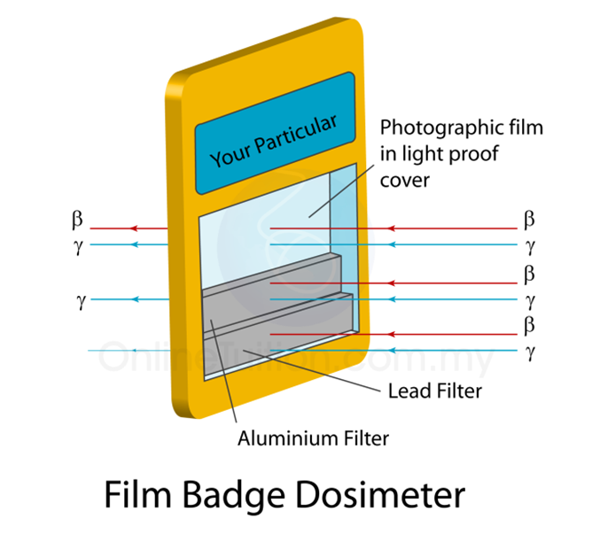
Measurement of ionizing radiation
Dosimetry 1
Film dosimeters
Equipment of radiological and RTG workers
worn on chest.
This is a piece of special photographic film in the box
impervious for visible light. Parts of the film are still
covered by metal plates. After exposure (weeks to
months, if not for example accident), the film is processed.
From darkening of areas covered by different shading
materials can be estimated the penetrating radiation,
to which the worker was exposed, and from this data
the dose equivalent for the deep tissues.

Slide 50
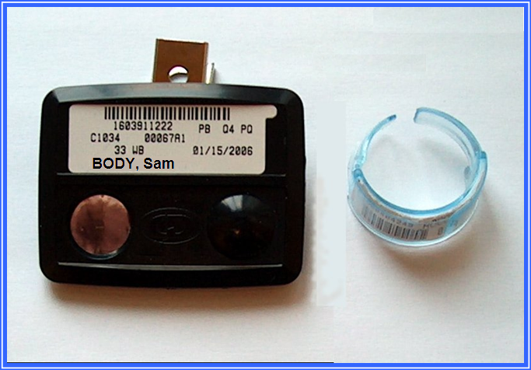
Measurement of ionizing radiation
Dosimetry 2
Thermoluminescent Dosimeters
For example, it can be placed in the ring and monitore hand exposure.
Dosimetry for α particles
The plastic disc, after the etching, shows the impact of the α particles.
Important:
Dosimeters do not warn their personel about a continuously received dose!
A TLD measures ionizing radiation exposure by measuring the intensity
of visible light emitted from a crystal in the detector when the crystal
is heated.
The intensity of light emitted is dependent upon the radiation exposure.

Slide 51
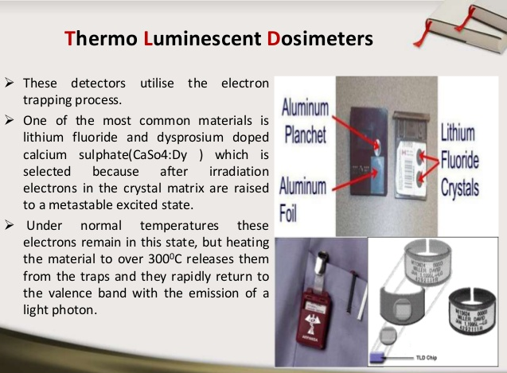

Slide 52
Radiation measurement units
Radiation delivers energy to the irradiated matter. We call this energy dose and we express it with the unit Gray [Gy]
One gray is the absorption of one joule of energy, in the form of ionizing radiation, per kilogram of matter.
Dose Calculation
The dosage can be relatively easily calculated for homogeneous bodies of regular geometric shapes. This is not the case of the human body.
Puppets made of plastic, imitating the properties of human tissues, enabling to put into the individual parts of the body are used to calculate the doses you get from different types of radiation in different irradiation modes - a measuring technique called a phantom.

Slide 53
Older unit – roentgen (R)
Definition
A dose that creates a 1 Coulomb charge in m³ of air.
Advantages and Disadvantages
The disadvantage is that it is defined for air, for other materials there are conversions that are not very precise.
The advantage is that it is an easy measurement based on the discharging of an
electroscope from which the charge is charged/transfered by the ions contained in the ambient air.

Slide 54
Biological effect of radiation
Individual types of radiation have different biological effects.
Therefore, for evaluation of live objects irradiation the batch equivalent is used, whose unit is Sievert [Sv], which is Gy multiplied by the qualitative factor of the relevant type of radiation.
Equivalent dose (H_{T}) is a measure of the radiation dose to tissue where an attempt has been made to allow for the different relative biological effects of different types of ionising radiation.
Because in healthcare we most often encounter x-rays radiation and gama radiation, which have a qualitative factor of 1, therefore dose and dose equivalent are numerically identical, sometimes they are confused.
To predict the effect, it is still necessary to take into account the different sensitivity of the irradiated tissue.
There are two types of effects: stochastic and nonstochastic.

Slide 55
Stochastic effects
They occur at random, their intensity is not dose-dependent; on the dose depends the probability that effects will occur.
Tumors in irradiated persons and their offspring (practically take into
account next two generations)
Inborn developmental defects in offspring of irradiated (again in more generations).
Practical manifestation may be a fertility disorder
The upper limit of the stochastic effects is given by the onset of non-stochastic effects. Below this limit linear dose dependence (dose equivalent) and its consequences was experimentally proved. Lower limit is due to the natural radioactivity of the environment.

Slide 56
Non-stochastic effects
They have a threshold and the magnitude of these effects increases with dose (or dose batch respectively).
Irradiation sickness (1st to 3rd grade)
Local tissue necrosis („X-ray ulcers“)
Cataract
Gonad damage

Slide 57
Radiation sickness
First stage : bone marrow and organs producing immunocompetent cells are affected. Deaths occur for secondary infections, anemia, etc. It is possible to survive light forms under antibiotic protection, with blood transfusions, a special diet etc. This form of radiation sickness is artificially created in patients with leukemia.
The second and third degree of irradiation illness have a fatal prognosis.
Second stage is characterized by the disintegration of digestive tract mucosa with subsequent conditions similar to severe cholera, dysentery, and the like.
In general, patients die in a days after irradiation.
Third stage is characterized by a disruption of the nervous activity, states of confusion up to loss of consciousness.
Death occurs within hours, at high radiation levels in minutes.

Slide 58
Hormesis
It means increasing vitality after small doses of radiation (the same for some harmful chemicals).
It has been demonstrated in bacteria, unicellular eukaryotes, plants and some lower animals. In the higher animals it was not proven, although it was searched for. These attempts are today unacceptable for ethical reasons (the 40s and 50s of the 20th century).
Linear Model
So far, it is generally accepted. It allows estimate of health damage even in the case of uneven exposure of the population.

Slide 59
Radiation load of population
The sources of radiation load vary according to the living conditions of the population.
For our population (that part that does not have a professional exposure to ionizing radiation) approximately one third of the yearly dose equivalent is from radon, another third is divided by radiation from the environment (radioisotopes in building materials, air, soil, etc.) and radioisotopes from our organism itself (including the mentioned C¹⁴), the remaining is from cosmic radiation and artificial resurces.

Slide 60
Comment
We are trying to reduce population burdens (from investigation methods) by replacing ionizing radiation methods by other imaging methods - by replacing x-rays with an ionizing radiation (represents a significantly lower load).
We protect the workplace surroundings (barite plasters and concrete - with content
barium sulphate, leaded sheets, leaded aprons, and windows of leaded glass).
It is necessary to guard the walls during construction works - all breaks/opening should be broken (not straight) so that there is no room for the direct flashing out).

Slide 61
Comment
The vast majority of professionals will "fit" within the limit for unprofessional population, the vast majority of the rest will not reach the limit for professionals.
This is usually exceeded only because of an accidents.
When the dosimetry approaches the limit, the worker is - for the rest of year - transferred to work without radiation load.
The same is done with workers who get pregnant.

Slide 62
Radon
Resources
Isotopes of radon in uranium ore. For release, they must be scattered in porous or crystalline rock.
Characteristic
Radon isotopes have a half-life from several hours to several days.
They decay with α disintegration - the isotopes with a very short half-life are created, and subsequently again with alpha decay more stable isotopes are created.
From the radon atom, then, when it begins to disintegrate, two α particles come out.
Danger
Incidence in the inhaled air - radon is an inert gas, it is not caught up by filters.
It causes lung cancer.

Slide 63
Radon – Risks for the population
Outlet of radon from the subsoil
Very important if they go inside the buildings. The result is the highest known concentrations of radon.
Outlet from building material
Only some types of uranium ore-contaminated slag.
Water, gas
Only in case of contamination of underground sources.
Measurement
The air activity in Bq.m⁻³ is measured because Rn has several isotopes of different activity and its chemical content does not characterise the hazard.

Slide 64
Radon – risk reduction
Building isolation (from the ground)
Radon wells
Monitoring Rn in building materials
Monitoring Rn in groundwater
Natural gas batches with greater content of Rn go to industrial boilers and heating plant, not in households
A condition of risk reduction is its proper detection.

Slide 65
Comment
The radon well is a pit with permeable walls. Radon gets into it, because it is heavier than air and is drained and dispersed into the outside air.
The level of radon in the soil decreases and it then stops penetrating the buildings around.

Slide 66
Other preventable sources
Radiation from Van Allen’s Belts
The dose equivalent increases with altitude and distance from the equator.
Chernobyl stains
Until now, a map of Chernobyl stains, with higher contamination with isotopes Sr and Cs having a high affinity for organisms, has not been published.

Slide 67
Artificial sources
The main source is X-ray examination, prevention is a substitute for other types of examination and technical measures to ensure that the patient is irradiated as little as possible during the examination.

Slide 68
Radiophobia issue
To a large extent, it is due to sensory undetectability of radiation.
It is sometimes caused deliberately for political reasons (Temelín).
Sometimes there are rumors induced by effects other than radiation (for example, toxicity manifestations of uranium).
It often arises as a response to concealment and disinformation from official sources (Chernobyl).
Sometimes legitimate concerns (such as risk of terrorist attack on a nuclear waste repository) are identified as „radiofobia“, again for political reasons.
Notes:
Although the data on which to establish oral and inhalation acute LD50 for uranium in humans are sparse, they are adequate to conclude that the LD50 for oral intake of soluble uranium compounds exceeds several grams of uranium and is at least 1.0 g for inhalation intakes.

Slide 69
Smog
Definition:
„smoke“ + „fog“ = „smog“
Smog Types
London = SO₂, soot, other reducing substances, water, salt,
- H₂SO₄ is produced by oxidation
human-influenced resources: coal burning
natural resources: sea fog
Losangelean = O₃ + nitrogen oxides
human-affected resources: internal combustion engines
natural resources: high intensity and long sun exposure to UV radiation

Slide 70
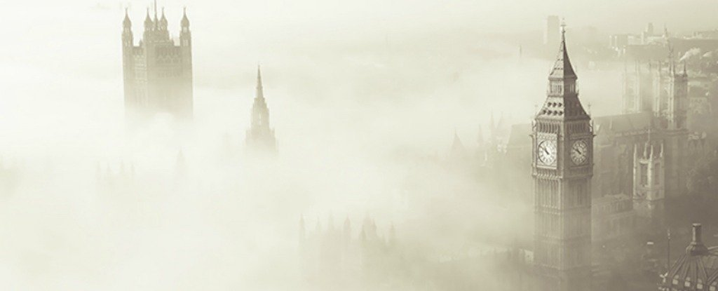
London smog

Slide 71
Los Angeles type of smog

Slide 72
Smog in the Czech Republic
Summer Smog
Summer smog in areas with high traffic load is close to the losangelean-type smog, which is predominated by oxidising chemicals.
Winter Smog
Winter smog, especially in areas with a high coal production, and in the inversion period, is close to the London type, with the predominance of reducing chemicals.
Note
Both our smogs do not reach extreme values because we have no sea or desert.

Slide 73
Impact on health
During the smog peak, increased mortality was observed.
Further studies have shown that
dying people have died of health problems; after the end of the smog situation, mortality significantly decreased
the statistical significance of the increase is questionable (based on highly specialized mathematics, specialized in time series statistics)
However, this problem can be concluded by the fact that the initial study, taking into account only gross mortality during smog, the risk of smog overstated.

Slide 74
Factors damaging health
Overview
Physical
Noise and vibrations
Radiation
Others
Chemical
From the point of view of one person
From the point of view of environment and its influence on health
Biological
Psychosocial

Slide 75
What is it noice?
Physical definition
Vibration of air or other medium, which can be transmitted on hearing apparatus of human = sound
Origin
By vibration of solid bodies plus transmission on other media
Correction for subjectivity
Noise is sound, which is perceived negatively, it damages health (the latter is not necessary 100% true)

Slide 76
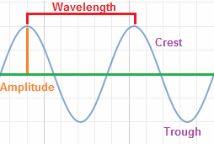
Physical characteristic
Waves
Noise as waves is characterized by wave length or frequency (if we know speed, they are convertible) and intensity, which is height of waves in graphical representation
Measured in Hertz – Hz – 1 cycle per second
Relation to human organism
Man sense 16Hz – 20kHz (limited by age etc.)
Human voice is in range 2 – 5kHz (the average male voice is about 120 Hz and the average female voice is 200 Hz.)
But also sound out of mentioned range can damage human health.
1Hz

Slide 77
Measuring intensity of noise
Primarily it is issue of pressure of sound waves on objects.
It is measured in decibels, but there are also (not so common) units, which take into account various ear sensitivity for different wave lengths.
We can measure actual level of noise (using sound level meter) or weighted
average (using the sound level meter plus noise dosimeter) for which norms are
designed.

Slide 78
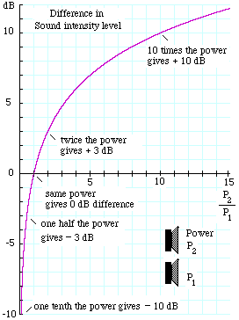
Examples of intensity
dropping water 10 dB
human voice 40 – 50 dB
limit of working environment 85 dB
school gym 90 – 100 dB
techno music 110 dB
aircraft motors 130 dB
pain threshold 150 dB

Slide 79
Types according to duration
- stable
- variable
- pulse
Why we distinguish
Protection of inner ear by reflective tension MUSCULUS STAPEDIUS, MUSCULUS TENSOR TYMPANI
it works if noise is stable not with fast changes
it fails with pulse noise changeable with rapid leaps
Consequence of failure: high energy reaches the inner ear and damages sense cells

Slide 80
Impact
Physiological
- background (it was proved, that 0 leads to stress)
- informational, communication
Harmful
- Annoying, disturbing (moderate intensity, more depends on character of activity)
disrupting communication
- Harm mediated by ear apparatus - various psychosomatic and neurotic damage
- Damage of ear apparatus
- acute - acute trauma, damage of middle ear plus eardrum;
- chronical - damage of sense cells
- Damage of other tissues (using very high intensity)

Slide 81
Damage of hearing
- On the edge of damage, in some cases it can still cause a problem:
higher intensity wave prevent interception of following waves of lower intensity
(it is matter of fractions of seconds)
- it can cover warning acoustic signals
- exploitation – lossy data compression sound formats, e.g. MP3
- Deafening – shift of sound threshold for tens of minutes or hours
- Acoustic trauma – physical resilience of ear was exceeded (mainly middle ear)
- Chronical irreversible damage of hearing – after long-lasting impact of high
intensities (months or years, very high inter-individual differences): target tissue is
sense epithelium in the inner ear

Slide 82
Overall impact on nerve system
It can cause
mental stress (generally)
neurotic manifestations - mainly sleep disorder, feeling of tension, and failure of concentration
neurosis varied neurotic and somatic symptomatology
It can make worse or provoke crises
psychosis - make their course generally worse
epilepsy - it can cause acute seizure

Slide 83
Relations to injuries
Injuries:
- of ear apparatus – cause directly
- others – it increases risk of injury by various mechanisms, starting with lowering of ability to concentrate up to masking of alarm signals and blocking ability to notice them (loss of hearing)

Slide 84
Relationship to psychosomatic illnesses
Cardiovascular illnesses
It mainly make worse hypertension and ischemic heart disease and mediating further problems
Gastrointestinal diseases
Mainly contributes to development of stomach and duodenum ulcer, but also other chronical diseases of GIT
Diabetes mellitus
It makes worse development of both types of diabetes, it changes insulin demand in both directions
Psoriasis
It makes worse psoriasis and other systemic diseases
It makes worse development of all serious chronical diseases

Slide 85
Influence on fetus development
Damage of fetus
It is born with lower birth weight (risk)
It can cause premature delivery (risk)
Hearing can be damaged already from the prenatal period (mainly inner ear).

Slide 86
Hygienic limits (in Czech Rep.)
Working environment
Basic level
75 dB
Correction according to length of exposure
Up to +20 dB
Correction according to psychological demands of work
-40 up to + 10 dB
Correction according to protective equipment
Safety limit can be increased according to ability of protective equipment to lower the noise.
Effects of protective equipment can be partly added up.
It is necessary to protect not only ear canal, but also temporal bone or even whole skull with high intensities of noise.

Slide 87
Hygienic limits
Environment
According to characteristic of environment
Basic limits are determined according to characteristic of housing development – environment (for example residential zone, industrial or shopping area, holiday resort etc.)
Adjustment according to day time
Adjustment towards lower levels is done during night.
Source of problems and controversy
Music, mainly during night

Slide 88
Anti-noise (acoustic) arrangements 1
Technical
To reduce production of noise by source, remove the source or transfer it
To reduce conduction of noise from source into environment
Organizational
(minly industrial sphere)
Make exposition to noise shorter
Prevent unnecessary exposition

Slide 89
Anti-noise (acoustic) arrangements 2
Individual
Protection of ear canal: cotton wool, special cotton, special ear plugs
Protection of ear: various type of shell protectors, similar protection can partly provide also headphone
Protection of head: anti-noise helmets

Slide 90
Vibration
Similar to noise problems
Main health problem is vasoneurosis, including the fact, that it has tendency to re-occur
Protection is in principle similar to noise protection (against vibration)
Protection mainly hands (anti-vibration gloves), regime of work

Slide 91
Thank you for your
attention!

