Slide 1
Labour Law

Slide 2
Employee
Employer
Government
Union

Slide 3
PRIVATE LAW
Individual
Equality
Authonomy
Freedom
PUBLIC LAW
  Constitution
  Hierarchy
  Enforcement
  Formal process

Slide 4
Equal conditions of workers in the EU
Prohibition of discrimination on grounds of nationality between EU Member States
Any discrimination in working conditions between domestic workers and persons coming to work in the territory of a given State from other Member States is considered inadmissible
Gender equality – equal wage for equal work
The right to vocational training under the same conditions as domestic workers
The right to join unions in the country of employment

Slide 5
Labour Contract

Slide 6
Before signature
Employer
Employee

Slide 7
After signature
Employer
Employee

Slide 8
Minimum requirements
Example of Czech Republic
Type of work
Place of work
Day of commencement of work

Slide 9
Duration of the contract
Indefinitely
For a definite period
may be limited – e.g. in the Czech Republic, at most three times in a row with the same employer, then it must be concluded for an indefinite period

Slide 10
Termination of employment
By Employee
  Usually, the reason does not need to be stated
  Notice period
By Employer
  Usually, the reason must be stated – not for employmet „at-will“ (typically some states of U.S.A.)
  For breach of obligations by the employee
  Change of organizational structure/cancellation of job position
  Termination of employer

Slide 11
Rights and obligations under the Labour Code
The employee is required:
Follow the instructions of the employer
Only the work that corresponds the position
In apportioned working time and
To comply with obligations that arise from the employment relationship.
Perform work personally

Slide 12
Obligations of healthcare professional according to HCA
(a) provide healthcare services to which they have a professional or specialist qualification,,
to the extent corresponding to their competence, patient's medical condition
on appropriate professional level
and to act in accordance with ethical principles,
b) immediately provide first aid to everyone
c) fulfill other obligations imposed by HCA or other legislation.

Slide 13
Unions

Slide 14
Union
Legal entity consisting of employees or workers having a common interest
  E.g. all the assembly workers for one employer, or all the workers in a particular industry
Formed for the purpose of collectively negotiating with an employer (or employers) over wages, working hours and other terms and conditions of employment
Often use their organisational strength to advocate for social policies and legislation favorable to their members or to workers in general

Slide 15
The Community Charter of the Fundamental Social Rights of Workers - 1989
Employers and workers of the European Community shall have the right of association in order to constitute professional organisations or trade unions of their choice for the defence of their economic and social interests.
Every employer and every worker shall have the freedom to join or not to join such organisations without any personal or occupational damage being thereby suffered by him.

Slide 16
Salary

Slide 17
Salary
Remuneration for work performed on behalf of an employer
Including such elements as a basic rate, a piecework bonus and other forms of bonus, overtime, etc.

Slide 18
Determining the amount of salary
Contractually agreed
Specified by regulation
internal regulations of the employer
collective agreements
government decree

Slide 19
Minimum wage
Should be in the amount that allows a decent living for workers and their families.
Most EU Member States have a statutory national minimum wage in place, although its level, adjustment mechanisms and coverage vary. Austria, Denmark, Finland, Italy and Sweden have minimum wages set within collective agreements, while Cyprus has statutory rates for different occupations.

Slide 20
Working hours
(DIRECTIVE 2003/88/EC concerning certain aspects of the organisation of working time)

Slide 21
Breaks
Breaks during work hours
No leter than after 6 work hours
Rest hours
11 consecutive hours per 24-hour period
Weekly rest period
minimum uninterrupted rest period of 24 hours plus the 11 hours' daily rest
If objective, technical or work organisation conditions so justify, a minimum rest period of 24 hours may be applied

Slide 22
Maximum weekly working time
The average working time for each seven-day period,
Should not exceed 48 hours including overtime

Slide 23
Annual leave
At least four weeks
Minimum period of paid annual leave may not be replaced by an allowance in lieu, except where the employment relationship is terminated

Slide 24
Nigth work
Night workers whose work involves special hazards or heavy physical or mental strain do not work more than eight hours in any period of 24 hours during which they perform night work.
Health assessment
Obligation of an employer to notify authorities of regular use of night workers

Slide 25
Derogations from Daily rest, Breaks, Weekly rest period and Length of night work
In the case of activities involving the need for continuity of service or production, particularly … treatment and/or care provided by hospitals or similar establishments, including the activities of doctors in training …

Slide 26
Change in working ability

Slide 27
Change in health condition
Temporary incapacity
a short-term change in health that does not allow work
Partial incapacity
health status has been changed in the long term so that it allows to perform work only with certain limitations
Total incapacity
health status has been changed in the long term so that it does not allow to work anymore

Slide 28
Pregnancy
Pregnant worker
  worker who informs her employer of her condition, in accordance with national legislation
DIRECTIVE 92/85/EEC - https://eur-lex.europa.eu/legal-content/EN/TXT/?uri=CELEX:01992L0085-20140325

Slide 29
Pregnancy
Employer shall assess the nature, degree and duration of exposure, in the undertaking and/or establishment concerned
  If the adjustment of her working conditions and/or working hours is not feasible, or cannot reasonably be required on duly substantiated grounds, the employer shall take the necessary measures to move the worker concerned to another job.
  If moving her to another job is not feasible or cannot reasonably be required on duly substantiated grounds, the worker concerned shall be granted leave in accordance with national legislation and/or national practice for the whole of the period necessary to protect her safety or health.

Slide 30
Pregnancy
Workers shall not oblige to perform night work during their pregnancy and for a period following childbirth which shall be determined by the national authority competent for safety and health

Slide 31
Pregnancy
Prohibition of dismissal
  from the beginning of pregnancy to the end of the maternity leave, save in exceptional cases not connected with their condition which are permitted under national legislation, provided that the competent authority has given its consent;

Slide 32
Employee Liability

Slide 33
Assumptions of Liability
Breach of legal obligations
Causality
Damage/violation of a legally protected interest

Slide 34
The obligation of prevention
The employee is obliged to act in such a way as to prevent material damage, non-material damage or unjust enrichment.
If intervention is urgently needed to prevent damage to the employer, the employee is obliged to intervene; employee does not have to do so if it is prevented by an important circumstance or if employee would put himself or other employees at serious risk.

Slide 35
Damages
The employee is usually liable to his employer for the damage he causes
usually associated with a breach of some obligation (remember lege artis, confidentiality etc.)
May be limited
e.g the upper limit of liability in Czech Republic is four and a half times the average monthly wage

Slide 36
Loss
Loss of vested things
an employee is liable for the loss of vested thing, which he has taken over, in its entirety
Loss of entrusted value
an employee is liable for the loss of entrusted values (eg money), which he has taken over, in its entirety

Slide 37
Health insurance and out-of pocket payments of patients

Slide 38
Four revenue sources overall
Government spending (tax)
Compulsory „social“ insurance
Commercial insurance
Out of pocket payments

Slide 39
REVENUES SHARE
Revenues of financing schemes |  | Government | Social insurance contributions | Compulsory prepayment | Voluntary prepayment | Other private (insurance)
Country
Norway |  | 85,4 | .. | .. | .. | 14,6
Sweden |  | 83,4 | .. | .. | 0,6 | 16,0
United Kingdom |  | 80,1 | .. | .. | 2,9 | 17,0
Canada |  | 71,7 | 1,4 | .. | 9,9 | 16,9
Spain |  | 67,8 | 3,3 | .. | 4,6 | 24,3
Hungary |  | 51,1 | 16,6 | .. | 2,2 | 30,1
Japan |  | 41,0 | 43,0 | .. | 2,2 | 13,7
United States |  | 40,0 | 10,1 | 34,4 | 4,4 | 11,1
Israel |  | 38,9 | 24,6 | .. | 11,2 | 23,5
Turkey |  | 37,7 | 40,7 | .. | .. | 21,6
Switzerland |  | 28,4 | 1,3 | 33,1 | 6,7 | 30,6
Mexico |  | 23,9 | 28,5 | .. | 5,6 | 42,1
Korea |  | 17,5 | 40,1 | 1,5 | 6,8 | 34,1
Germany |  | 14,7 | 62,5 | 7,1 | 1,4 | 14,2
Poland |  | 11,3 | 58,0 | 0,5 | 5,4 | 24,7
Average |  | 46,2 | ^{27,5} | ^{15,3} | ^{4,9} | ^{22,3}

Slide 40
Conclusion
Each system relies on combination of state subsidies and individual insurance
Out of pocket payments /prepayments/ are usually strictly regulated if not directly forbidden
  Physician has to be aware of rules not to be accued of bribery or taking advantage of patient

Slide 41
Physician needs to know the rules regarding:
Gratitude and gifts
Direct payments
Conflict of interest
Prefferential treatment (skiping the queue)

Slide 42
Conflict of interest

Slide 43
Significant policy problem
Antyhing that can create risk, that your actions regarding primary interest (patients well-being) will be influenced by your secondary interest.

Slide 44
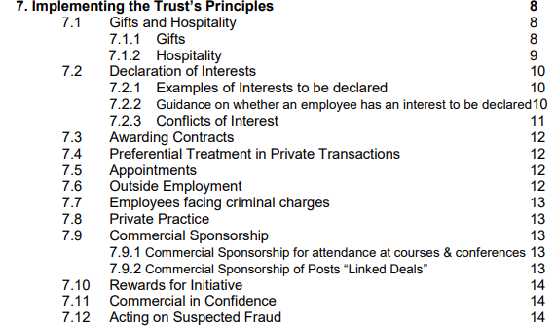
EXAMPLE from the UK: NHS Code of conduct

Slide 45
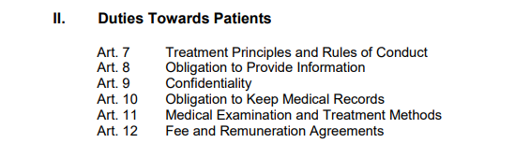
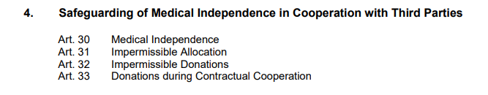
Example Professional Code for Physicians in Germany – Adopted by german medical assembly

Slide 46
Gifts and tokens of gratitude

Slide 47
Gifts and gratitude
Small gifts in the value 5-10 EUROS are usually tolerated
Gifts from patients after the treatment is provided
Commercial merchandise from companies (pens, stickers)
Larger gifts can be considered as compromising „Medical Independence“
Sometimes outright forbidden
Sometimes need to be declared

Slide 48
Examples

Slide 49
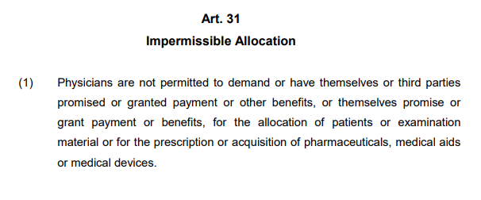
Example – German code of conduct

Slide 50
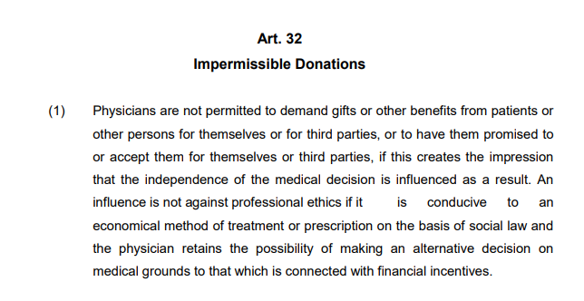
Example – German code of conduct

Slide 51
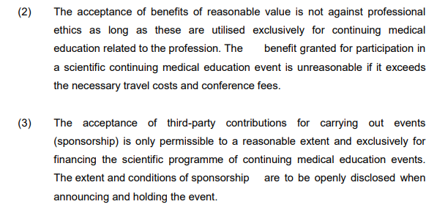
Example – conference events (GER)

Slide 52
Example NHS code of conduct - UK
Gifts should normally be firmly but politely declined. However, articles of low intrinsic value, need not necessarily be refused.
Items of intrinsically small value [less than £5] need not be declared. Diaries; Pens; Calendars; Mugs; Office Stationery; Boxes of chocolates or biscuits.
Gifts with the value of between £5- £25 may be accepted but must be declared.
Bottles of wine or spirits; Books , CDs / DVDs; Decorative objects such as glass tankards, glass crystal, ornaments.
Any other gifts over this value should be politely declined. Under no circumstances should employees accept personal gifts of cash even if this is below the limit of £25.

Slide 53
Invitations to lunches, conferences and events

Slide 54
Invitations to free attendance of conferences and events
Accepted only if it serves education and scientific purpose
Must not compromise your independence
Regulation of pharmaceutical companies
Not so important to physicians
Regulation on the ethical side of physician
See examples
How to organize „promotional“ events

Slide 55
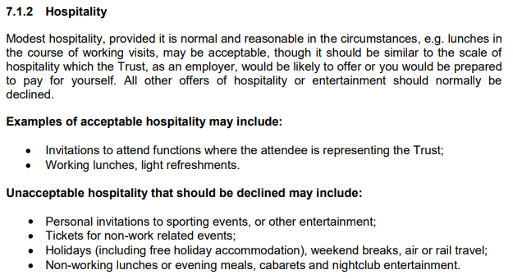
NHS Code

Slide 56
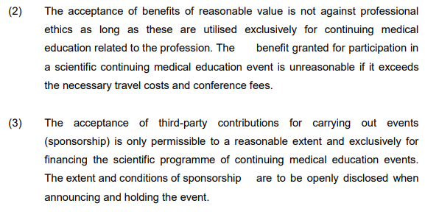
German code of conduct

Slide 57
Direct payments for treatment

Slide 58
If the treatment is fully paid by the patient
Non-necessary treatment (i.e. cosmetic surgery)
Usually without regulation
Price can be negotiated
Necessary treatment (i.e. patient is not covered by insurance)
Price usually is regulated
Cannot be excessive to what is charged to insurance entity

Slide 59
Treatment is partially paid by the patient
Compulsory payments
Sometimes the physician is obliged to charge small compulsory payments as a „de facto tax“ to protect systems from overspending
Extra payments
Payments for extra benefits otuside what is covered by insurance as „standard treatment“
Cannot be conditional, patient cannot be treated negatively if they refuse these payments

Slide 60
Treatment is partially paid by the patient
Compulsory payments
Sometimes the physician is obliged to charge small compulsory payments as a „de facto tax“ to protect systems from overspending
Extra payments
Payments for extra benefits otuside what is covered by insurance as „standard treatment“
Cannot be conditional, patient cannot be treated negatively if they refuse these payments

