Slide 1

The Central Nervous System: Tumors
The peripheral nervous system
Markéta Hermanová

Slide 2
Tumor of the CNS
Gliomas
Chorioid plexus tumors (papillomas and carcinomas)
Neuronal and mixed (glio)neuronal tumors
Embryonal tumors (poorly differentiated)
Pineal tumors
Meningeal tumors
Other primary tumors of CNS
Secondary (metastatic tumors – lung, breast,…)

Slide 3
CNS tumors
Clinicopathological features:
CNS tumors do not metastasise to other organs
(only infiltration of adjacent tissues and spreading through
CSF pathways)
Local effects
Signs related to the site of the tumor
e.g. epilepsy with a temporal lobe tumor, paraplegias in spinal cord tumor
Mass effects
Signs and symptoms of space occupying lesions
Vasogenic oedema around CNS tumor
Herniation
Hydrocephalus in posterior fossa tumor

Slide 4
Gliomas
Astrocytomas (AC)
Diffuse astrocytomas (grade II) – LG AC (static, with slow progression)
Variants: gemistocytic
Anaplastic astrocytomas (III)
Glioblastoma multiforme (grade (IV)
Pilocytic astrocytoma (I)
Pleomorphic xanthoastrocytoma (II)
Anaplastic pleomorphic xanthoastrocytoma (III)
Oligodendrogliomas
Oligondendroglioma (II)
Anaplastic oligodendroglioma (III)
Mixed gliomas (provisional entities according WHO 2016)
Mixed oligoastrocytoma (II)
Anaplastic mixed oligoastrocytoma (III)
Ependymal tumors
Ependymoma (II)
Anaplastic ependymoma (III)
Myxopapillary ependymoma (I)
Subependymoma (I)

Slide 5
High grade (HG) astrocytomas (AC)
Anaplastic astrocytoma (III)
Increased cellularity
Increased degree of anaplasia, nuclear pleomorphism, increased proliferative aktivity
Glioblastoma (IV)
Necrosis and pseudopalisading
Vascular endothelial proliferation
Primary (in older) and secondary (in younger with history of LG AC)
Very poor prognosis

Slide 6
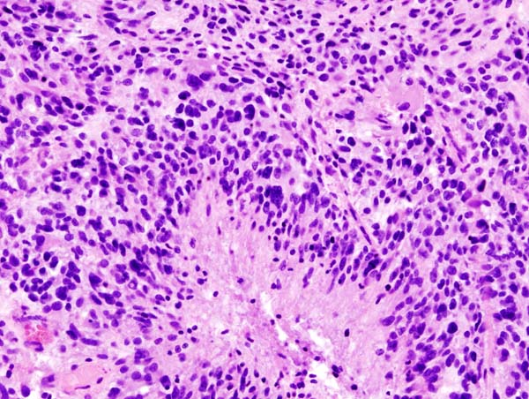
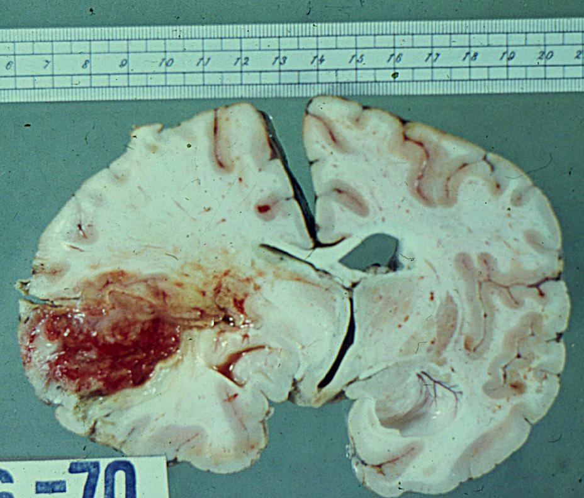
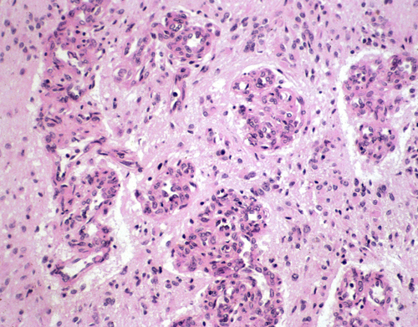
Glioblastoma
Necrosis and pseudopalisading
Vascular endothelial proliferation

Slide 7
WHO 2016: integrated diagnosis
Histopathological diagnosis/typing
Histopathological grading/WHO grade
Molecular information

Slide 8
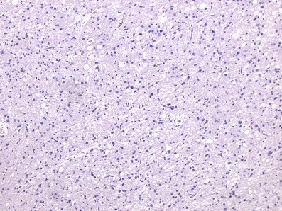
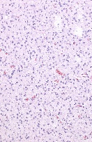
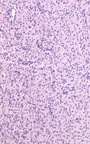
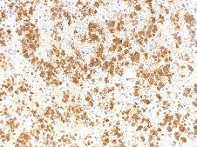
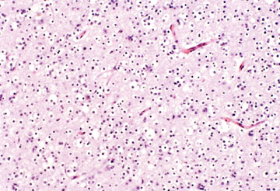
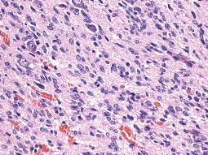
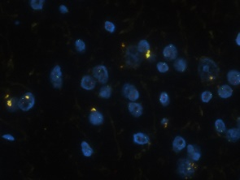
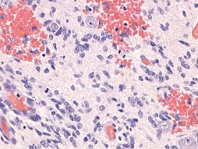
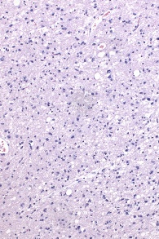
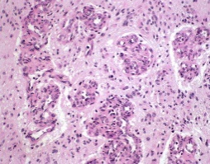
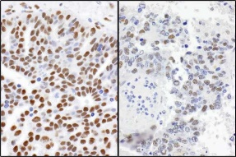
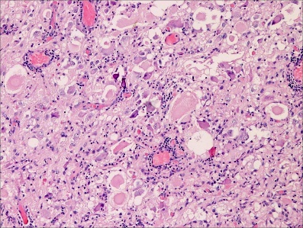

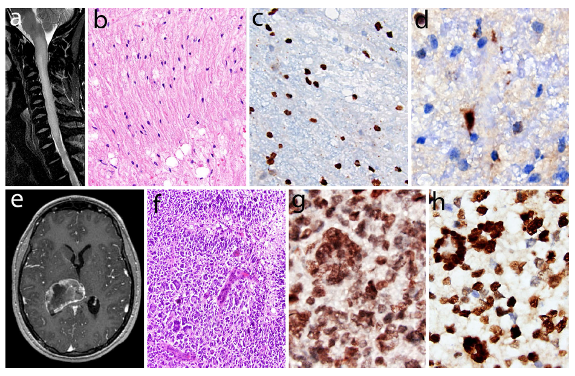
Phenotype of gliomas
Grading of gliomas
Genotype of gliomas
Mutations IDH1, IDH2
Astrocytic
Cellularity
Cytonuclear atypia
Oligodendrocytic
Mitoses
Codeletion 1p/19q
Oligoastrocytic
Microvascular
proliferates
Mutation ATRX
Glioneuronal
Necroses
Mutation H3K27M

Slide 9
Oligodendroglioma (II)
White matter of cerebral hemispheres (most frequently frontal lobes)
Well circumscribed, gelatinous, gray masses, with cysts, hemorrhage, calcification
Sheets of regular cells, clear halo of cytoplasm
Delicate network of anastomosing capillaries
Perineuronal satellitosis
LOH for 1p and 19q/IDH mutated
Better prognosis than AC
+ anaplastic oligodendroglioma (III): hypercellularity, nuclear anaplasia,
mitotic activity, necrosis

Slide 10
Oligodendroglioma

Slide 11
Pilocytic astrocytoma (I)
Often cystic, also solid
Usually circumscribed, arising from optic nerve to conus medullaris
Bipolar cells („hair cells“) + Rosenthal fibers and eosinophilic granular bodies
Often biphasic (fibrillary areas + loose microcystic pattern)
Usually first two decades
Pleomorphic xantoastrocytoma (II); anaplastic (III)
Temporal lobe of children and young adults
Neoplastic occasionally bizarre astrocytes, also lipidized
Necrosis and mitotic activity indicate higher grade

Slide 12
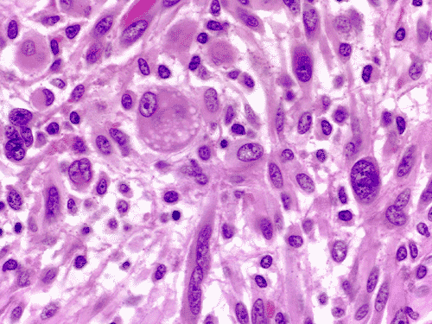
Pleomorphic xantoastrocytoma

Slide 13
Ependymoma (II)
Next to ependyma-lined ventricular system, 4th ventricle
First 2 decades affected
Solid or papillary masses; complete extirpation due to localization impossible
Small „blue“ cells, granular chromatin, dense fibrillary background, perivascular pseudorosettes and rosettes
Anaplastic ependymoma (III)
Subependymoma (I)
benign, slowly growing, intraventricular
Myxopapillary ependymoma (I)
Filum terminale of spinal cord

Slide 14
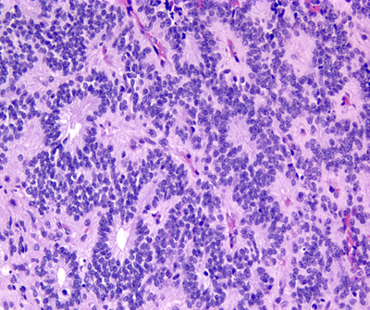
Ependymoma

Slide 15
Neuronal and mixed (glio)neuronal tumors
Gangliogliomas (I-II)
Dysembryoblastic neuroepithelial tumor (DNET)
In temporal lobe
Associated with epilepsy
Usually grade I; gangliogliomas may be gr. II/III
Dysplastic gangliocytoma of the cerebellum (I)
Central neurocytoma (II)
LG neuronal neoplasms
Within vetricular system

Slide 16
Spectrum of long-term epilepsy associated tumors
WHO 2007
Usually low grade, well differentiated, with low proliferating activity and low malignant potential, superficially localized (cortical or subcortical; frontal and temporal localization), mixed neuronal-glial tumors, expression of stem cell marker CD34
Mixed neuronal-glial tumors :
Ganglioglioma (GI, rare GII-GIII)
Dysembryoplastic neuroepithelial tumor (DNET, GI)
Others:
Pilocytic astrocytoma (GI)
Diffuse astrocytoma (GII)
Oligodendroglioma (GII)
Pleomorphic xanthoastrocytoma (GII)
Subependymal giant cell astrocytoma (GI ; associated with tuberous sclerosis)
Angiocentric glioma (GI)

Slide 17
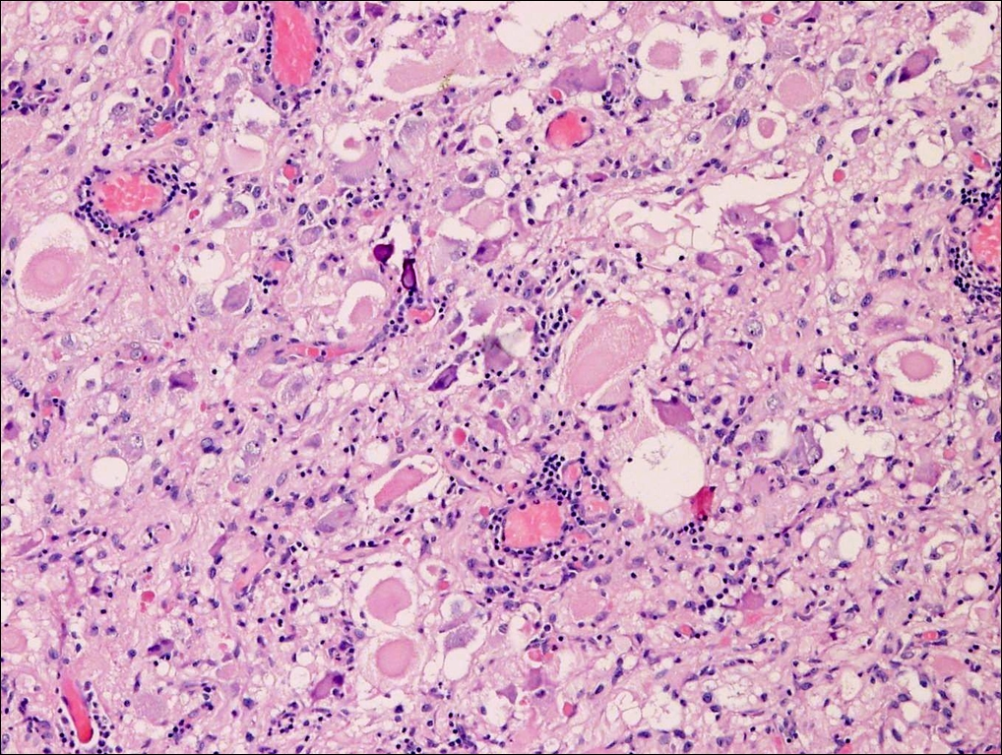
Ganglioglioma
well differentiated, slowly growing neuroepithelial tumor
neoplastic ganglion cells + neoplastic glial cells
WHO GI; higher grades very rare; >70 % in temporal lobe

Slide 18
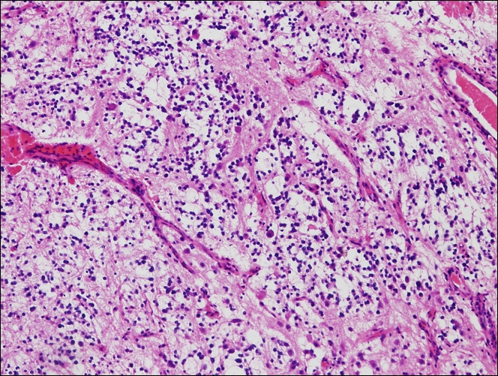
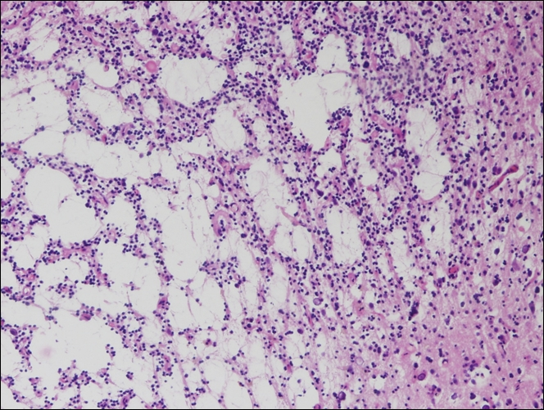
DNET
- WHO GI, benign, usually supratentorial glial-neuronal neoplasms
in children and young adults
cortical location
complex columnar and multinodular architecture, „specific glioneuronal elements“
(bundles of axons lined by oligodendroglia-like cells+floating neurons)

Slide 19
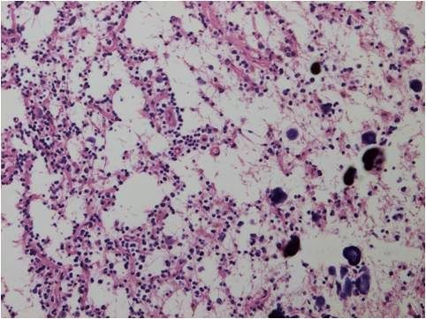
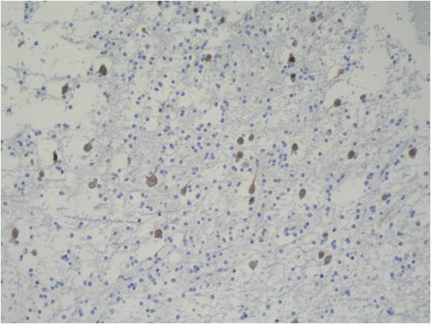
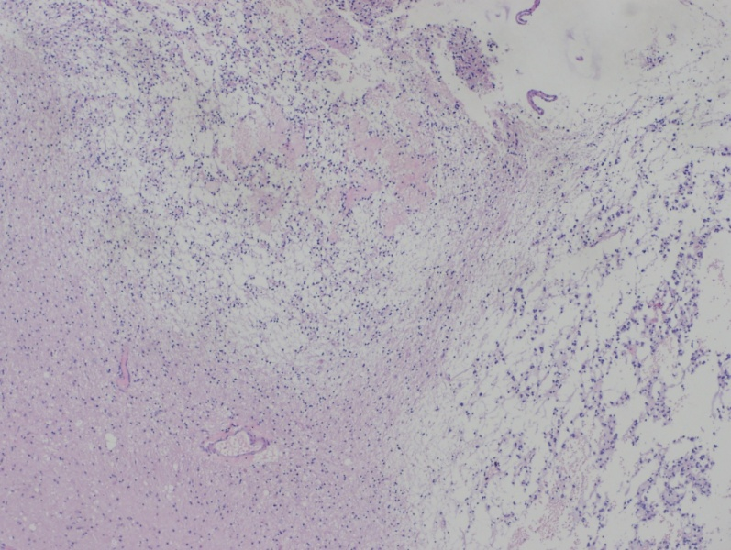
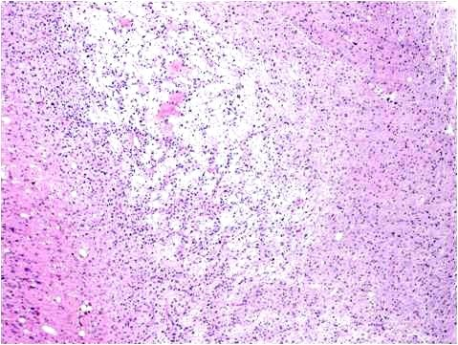
DNET
Calcification in DNET
NeuN immunohistochemistry
Nodular architecture

Slide 20
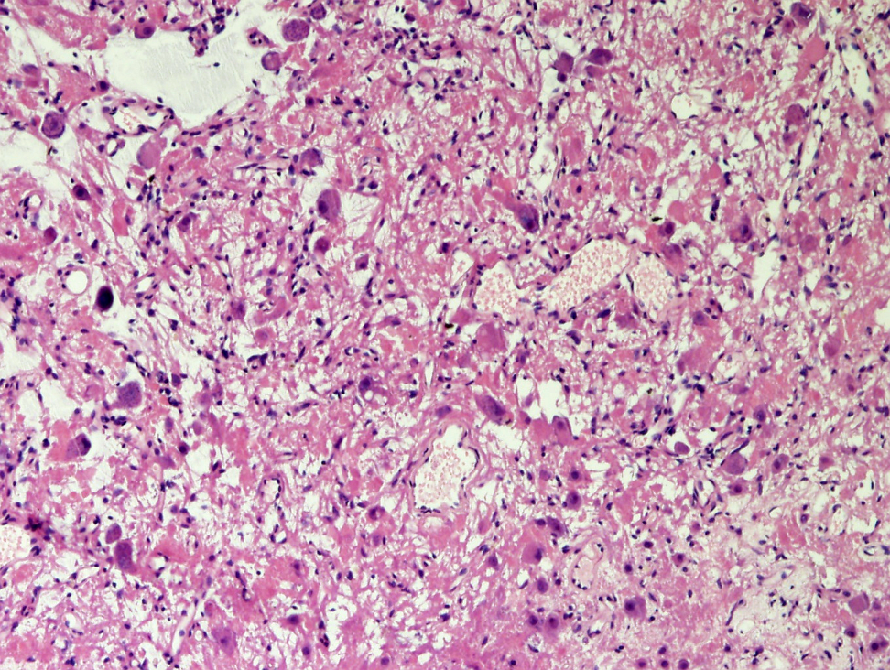
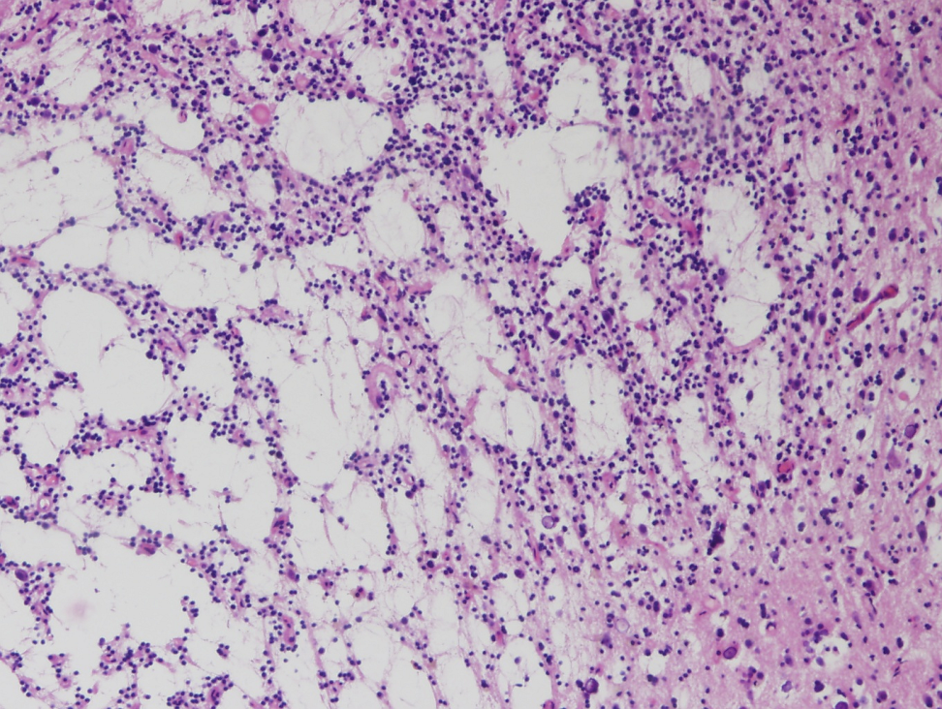
Composite glioneuronal tumour:
DNET and ganglioglioma component
Ganglioglioma component
DNET component

Slide 21
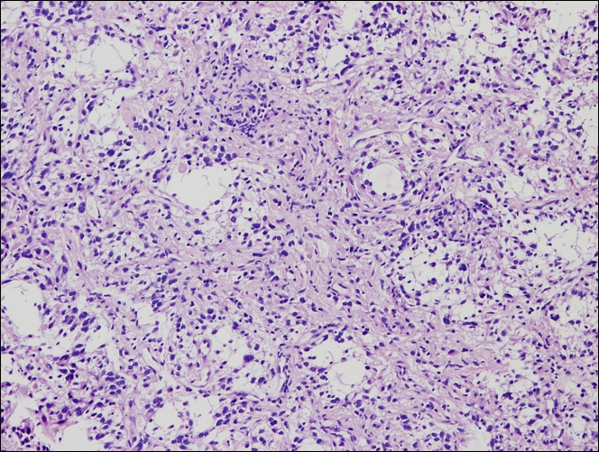
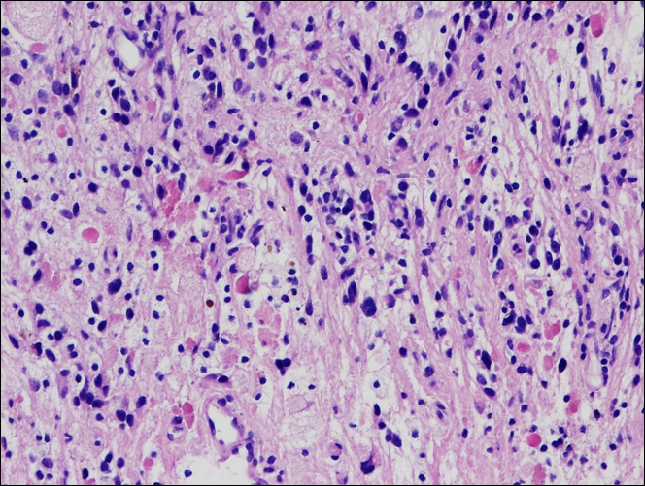
Pilocytic astrocytoma
WHO GI, relatively circumscribed, slowly growing, often cystic
histologically biphasic pattern (compacted bipolar cells and loose-textured
multipolar cells + Rosenthal fibers and eosinophilic granular bodies)

Slide 22
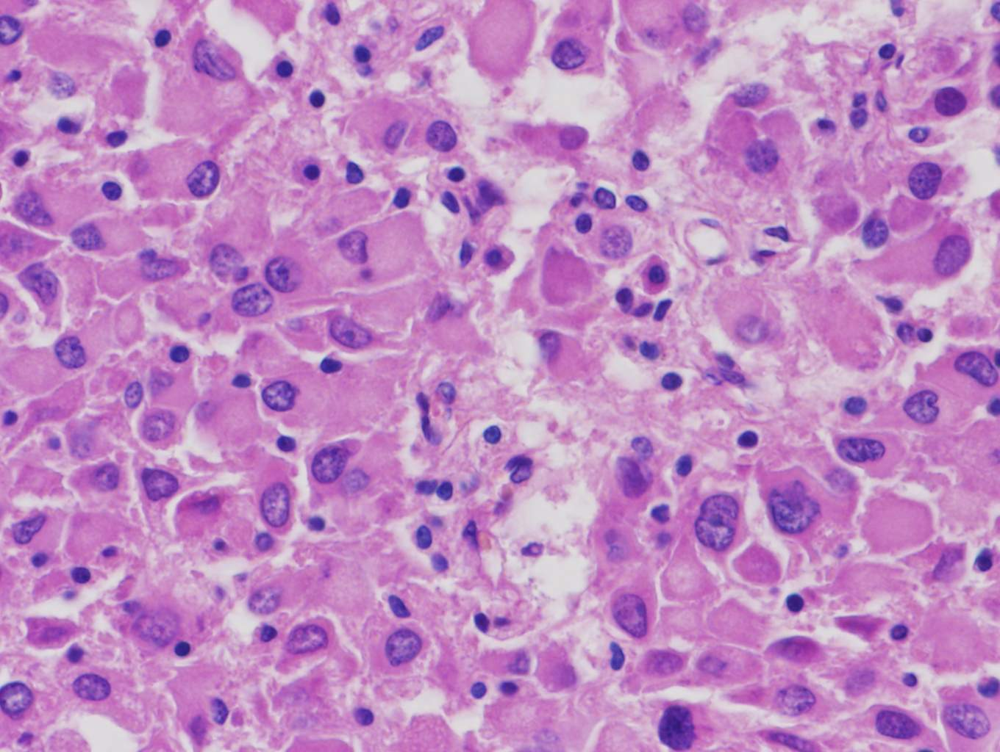
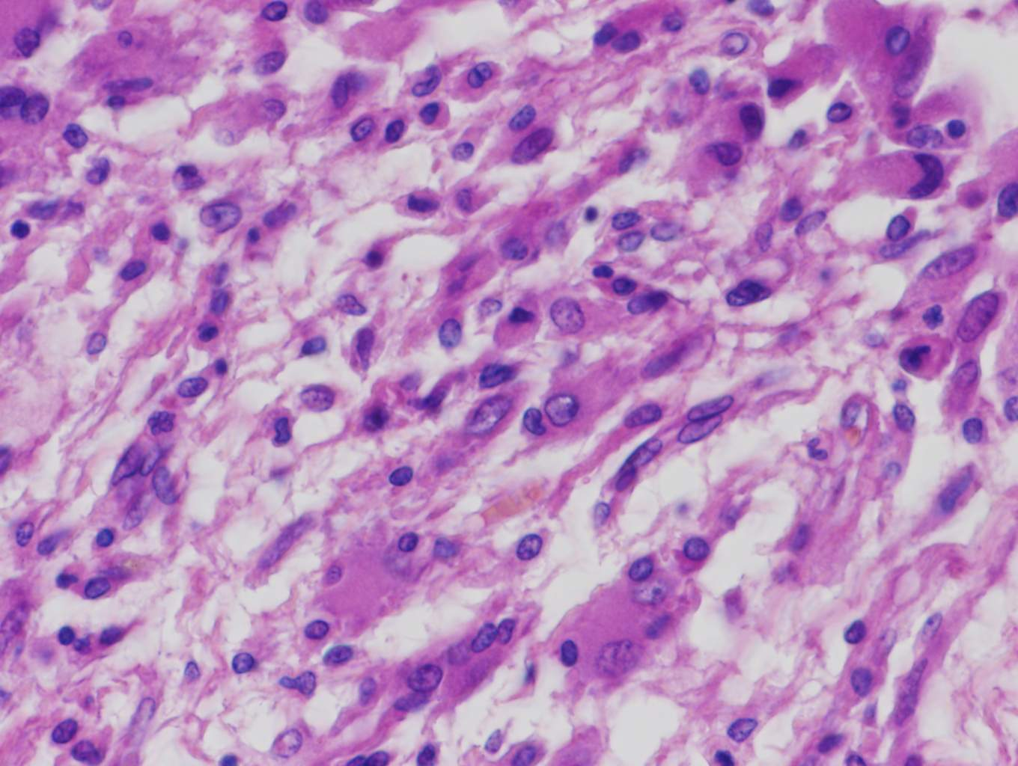
Subependymal giant cell astrocytoma
Pleomorphic eosinophilic tumour cells
Elongated tumour cells forming streams
WHO GI; tuberous sclerosis complex
benign, slowly growing, arising in the wall of the lateral ventricles, composed
of the large ganglioid astrocytes

Slide 23
Oligodendroglioma
Pleomorphic xantoastrocytoma
WHO GII, a diffusely infiltrating
WD glioma
cerebral hemispheres
deletions 1p and 19q
WHO GII
superficial localisations in cerebral
hemispheres + involvement of meninges
- pleomorphic lipidized cells

Slide 24
Medulloblastoma (gr. IV)
20 % of brain tumors in children
In the midline of cerebellum; 4th ventricle, hydrocephalus
Well circumscribed, grey
hypercellular, „small blue cells“, neuroblastic rosettes (Homer Wright rosettes)
High proliferation, mitoses
Expression of neuronal markers (synaptophysin, NF; GFAP+ cells, vimentin)
Dissemination through the CSF
4 histological subtypes; 4 molecular subtypes
Prognosis in untreated dismal; with total excision and irradiation: 5-year survival rate as high as 75 %

Slide 25
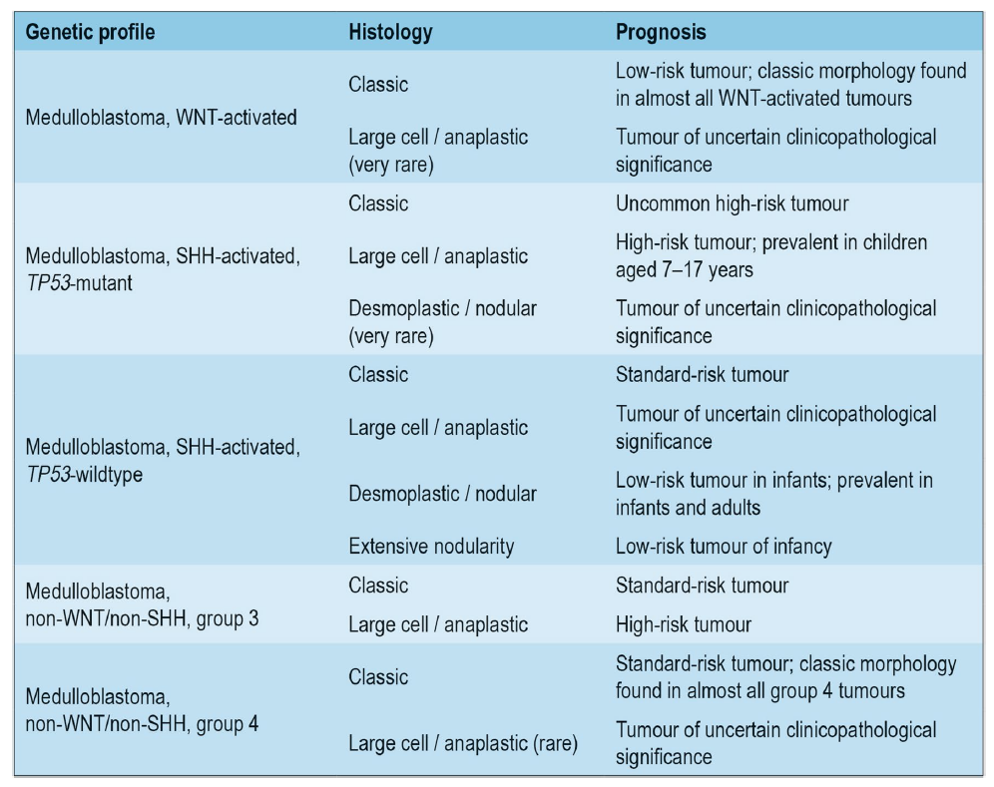
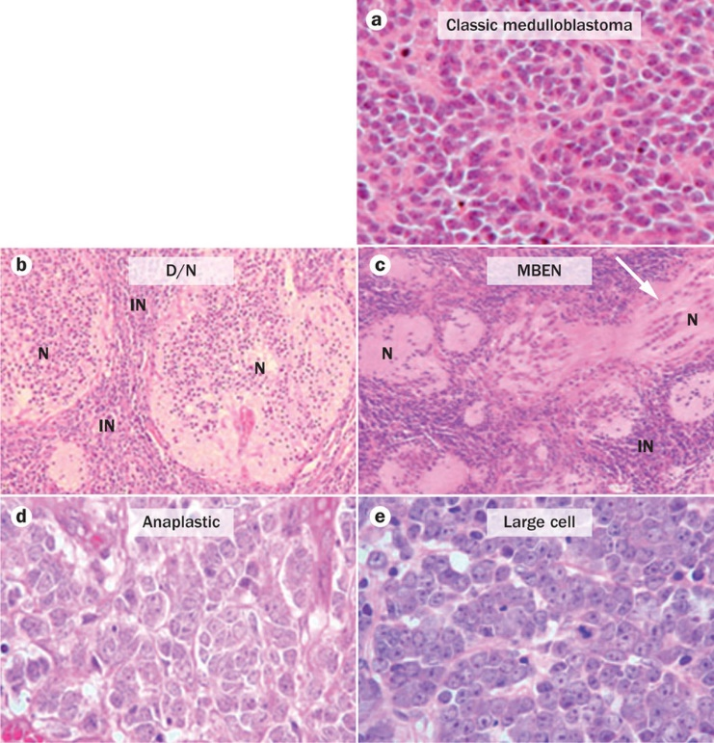
Integrated diagnosis of medulloblastomas:
histopathological diagnosis/typing
genetic profiling – 4 molecular subtypes
Histological subtypes
of medulloblastomas

Slide 26
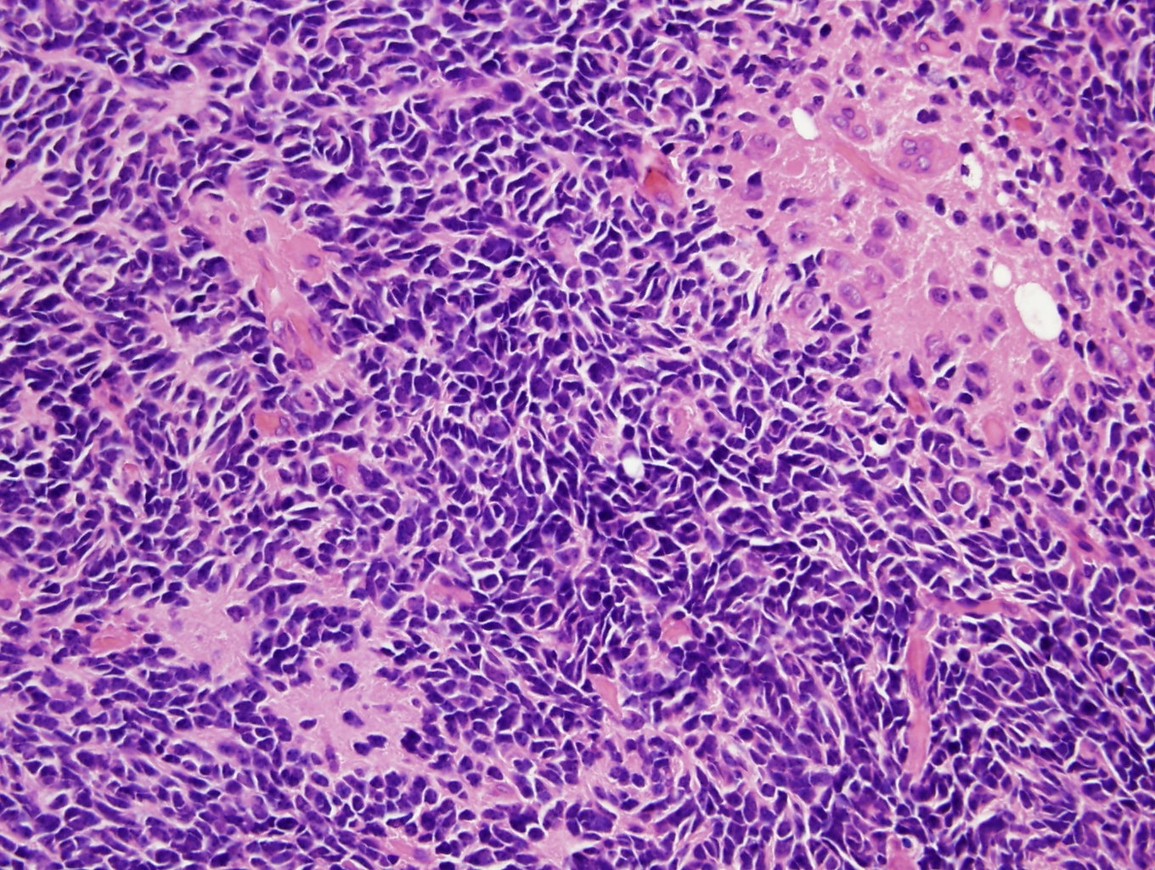
Medulloblastoma

Slide 27
Other embryonal tumors/ WHO gr. IV
Atypical teratoid/rhabdoid tumors
(posterior fossa, supratentorially; under 5, dismal prognosis)
Embryonal tumor with multilayered rosettes, C19MC altered
Medulloepithelioma
CNS neuroblastoma/ganglioneuroblastoma
CNS embryonal tumor

Slide 28
Other tumors of CNS
Primary CNS lymphomas (DLBCL)
Germ cell tumors
Midline structures, pineal region, suprasellar region
Teratomas; germinomas (similar to seminomas),…
Pineal parenchymal tumors
Pinealoblastomas (high grade tumors)
Pineocytomas (well differentiated)
Gliomas in pineal region

Slide 29
Tumors of the meninges
Meningioma (meningothelial)
- nonmeningothelial
Meningeal hemangiopericytoma (so-called)
Solitary fibrous tumors

Slide 30
Meningioma (gr. I-III)
Usually well defined rounded masses, adjacent to dura; encapsulated, extension into bone (reactive hyperostotic changes); less common „en plaque“ growth
Grade I meningiomas:
- meningothelial
fibroblastic
transitional
psammomatous
microcystic, secretory, angiomatous,….
Grade II meningiomas:
atypical, clear cell, chordoid
Grade III meningiomas:
- anaplastic (malignant), rhabdoid, papillary

Slide 31
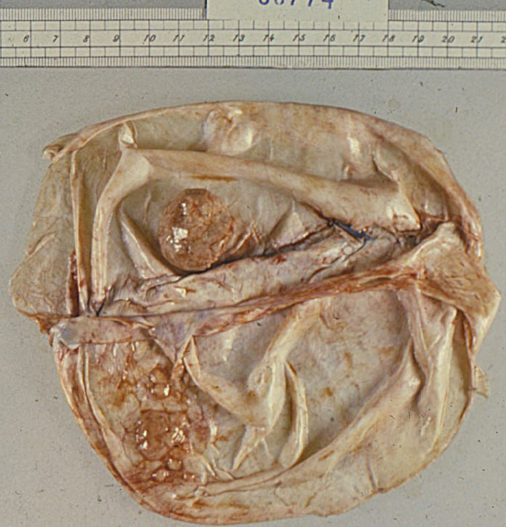
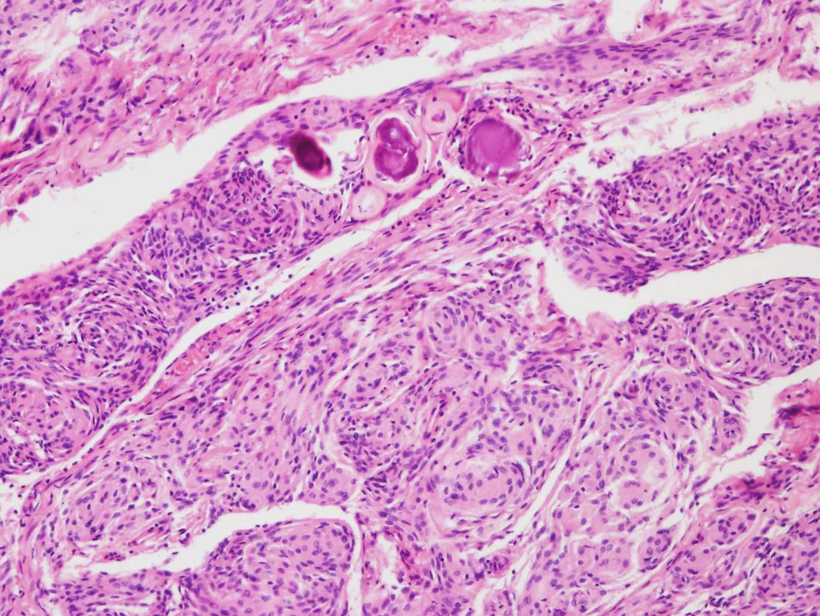
Meningioma
2
1
1 menigocytes
2 psamommata

Slide 32
Craniopharyngeoma:
Arise from squamous cell rests (derived from Rathke pouch) in sellar region
Benign (gr. I), partly cystic epithelial tumor
Hemangioblastoma:
Sporadic or ass. with VHL sy (in younger)
Cerebellum (medulla, spinal cord,…., supratentorial, retinal in VHL)
Well circumscribed, cystic, with mural nodule(s)
Capillary-size and larger thin-walled vessels with intervening neoplastic „stromal cells“ (large polygonal, vaculated, lipid-rich, PAS+)

Slide 33
Familial tumor syndromes with involvement of tumor suppressor gene (AD)
Cowden syndrome
PTEN mutation
Dysplastic gangliocytoma of the cerebellum
Li Fraumeni syndrome
Inactivation of p53
Medulloblastoma
Turcot syndrome
Mutations in APC or mismatch repair gene
Medulloblastoma or glioblastoma
Gorlin syndrome
PTCH mutations, upregulation of SHH
medulloblastoma

Slide 34
Neurofibromatosis type I
AD; neurofibromas (plexiform and solitary)+gliomas of optic nerve+pigmented nodules of iris-cutaneous hyperpigmented macules (café au lait spots)
Malignant transformation of neurofibromas
NF1 gene (17q11.2); neurofibromin
Neurofibromatosis type II
AD; 8th nerve schwannomas and multiple meningiomas + gliomas, ependymomas of spinal cord + non-neoplastic lesions of Schwann cells, meningeal cells, hamartia
NF2 gene (22q12); merlin
Tuberous sclerosis complex
AD; hamartomas and benign tumors of the brain and other tissues: cortical tubers (epileptogenic), subependymal nodules, subependymal giant cell astrocytomas,…, + renal angiomyolipomas, retinal glial hamartomas, pulmonary lympangioleiomyomatosis, cardiac rhabdomyoma + cysts – cutaneous lesions (angiofibromas, subungual fibromas, hypopigmented lesions)
tuberin or hamartin genes mutated
Von Hippel Lindau Disease
AD; hemangioblastomas + cysts (pancreas, liver, kidney) + renal carcinomas, pheochromocytomas
tumor suppressor gene – pVHL – 3p25-p26

Slide 35
Peripheral nerve sheath tumors
Schwannoma
benign, from neural crest-derived Schwann cell, component of NF2
well circumscribed, encapsulated, attached to nerve; 2 patterns: Antoni A and Antoni B
often vestibular branch of 8th nerve; sensory nerves preferentially involved (trigeminus, dorsal roots,..); extradurally – large nerve trunks
Malignant peripheral nerve sheath tumor
highly malignant, medium and large nerves affected; in NF1
Neurofibroma:
Cutaneous: localized, in dermis or subcucateously
Plexiform: infiltrating lesion growing within and expanding a peripheral nerve; NF1; potential for malignant transofrmation; significant neurologic deficits

Slide 36
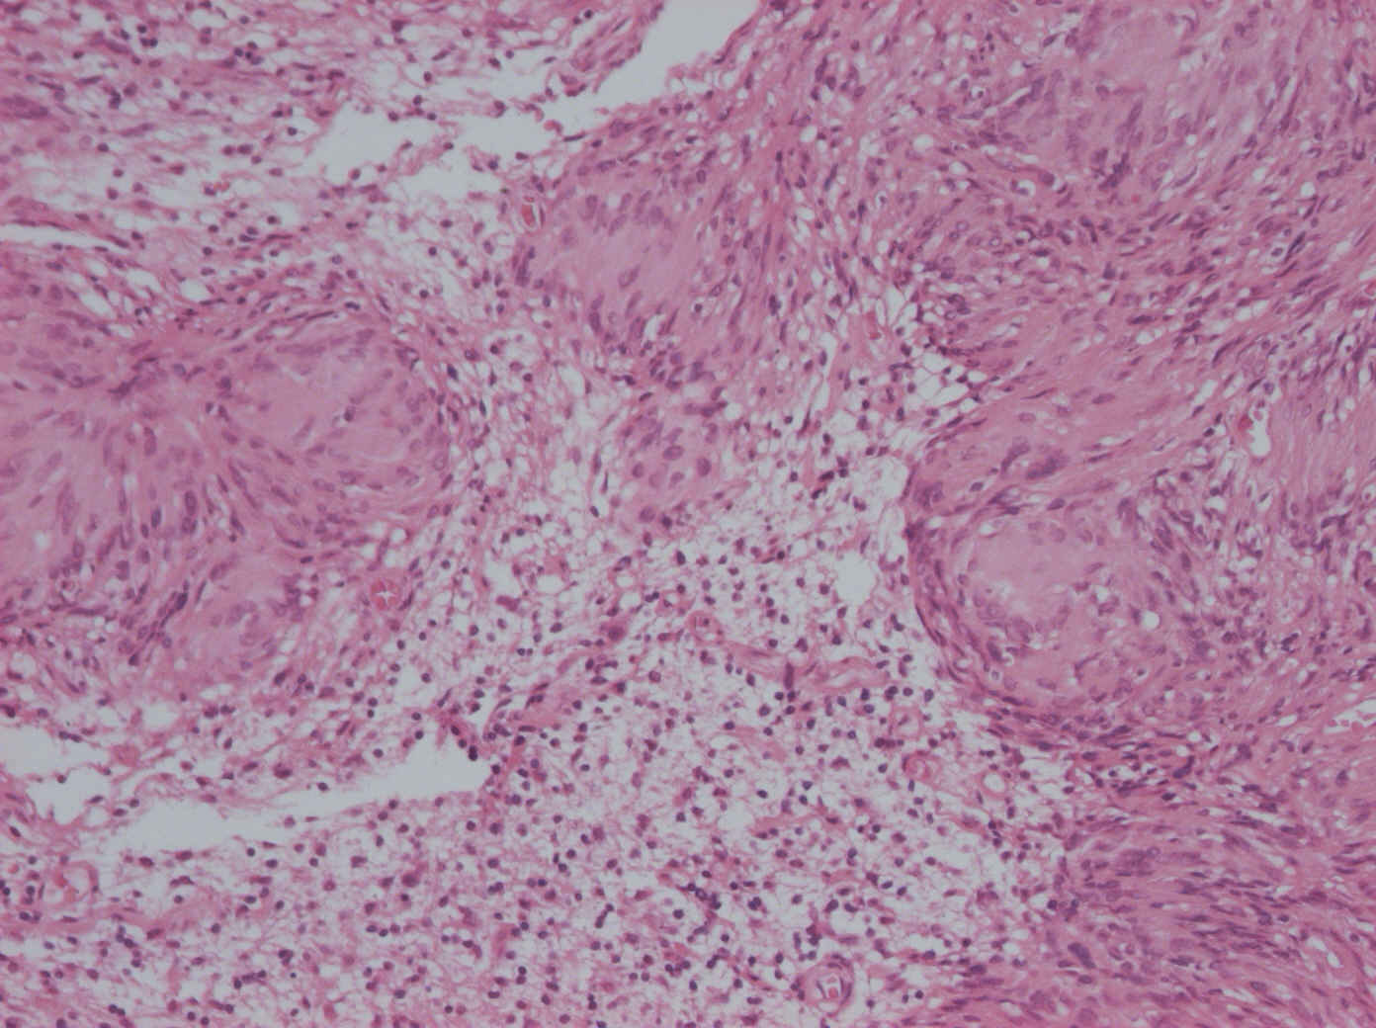
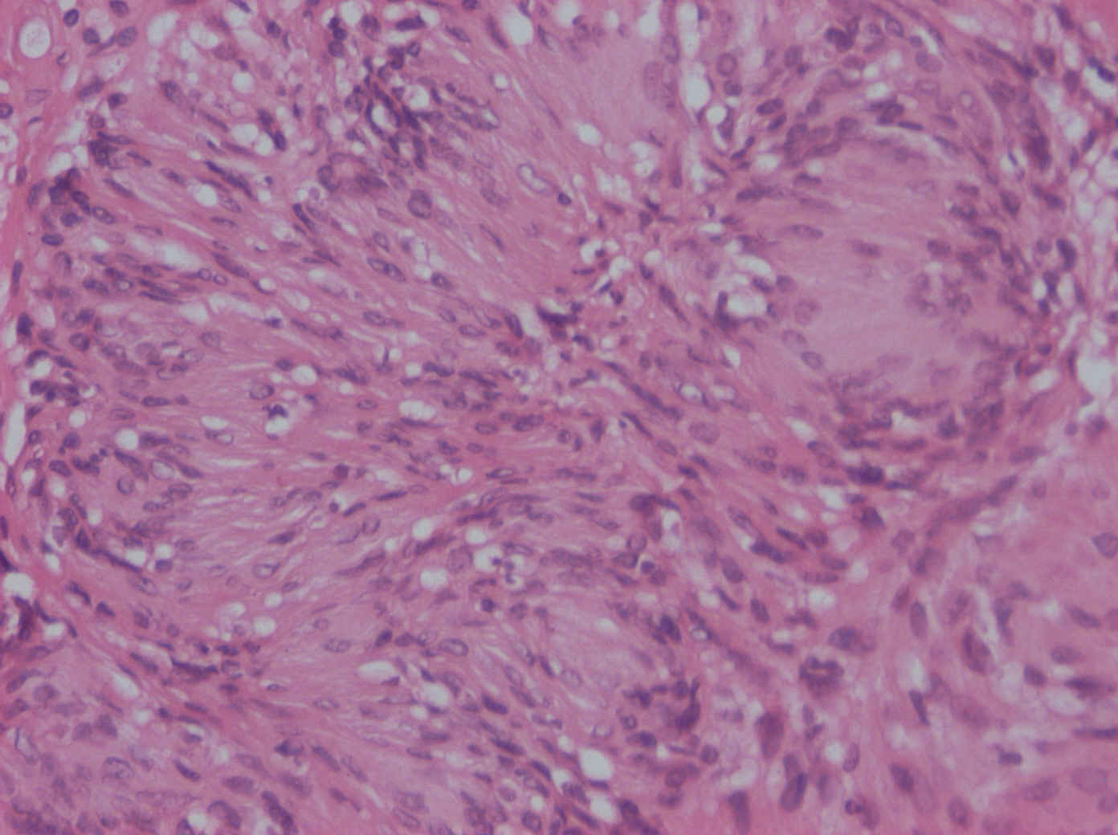
Schwannoma

Slide 37
Diseases of peripheral nerves
Inflammatory neuropathies
Infectious polyneuropathies
Hereditary neuropathies
Acquired metabolic and toxic neuropathies
Traumatic neuropathies

Slide 38
Inflammatory neuropathies
Immune mediated neuropathies: Guillain-Barré syndrome – GBS (acute inflammatory demyelinating polyradiculoneuropathy)
Weakness in distal limbs, ascending paralysis, hospital intensive care before recovering normal function (up to 20 % long term disability); in some patients followed by a subacute or chronic course
Inflammation and demyelination of spinal nerve roots and peripheral nerves (radiculoneuropathy)
Infections or prior vaccination ass. with GBS
T-cell mediated immune response

Slide 39
Infectious polyneuropathies
Leprosy (Hansen disease)
Lepromatous leprosy: Mycobacterium leprae invading Schwann cells
Segmental demyelination, remyelination, loss of axons; endoneurial fibrosis and multilayered thickening of perineurial sheats
Symmetric polyneuropthy; pain fibers (loss of sensation)
Tuberculoid leprosy: cell-mediated immune response to M. leprae – granulomatous inflammation in dermis, cutaneous nerves affected
Diphteria (diphteria exotoxin; selective demyelination of axons)
Varicella zoster virus (varicella zoster virus; following chickenpox virus persists in neurons and sensory ganglia with potential ractivation)

Slide 40
Hereditary neuropathies
Hereditary motor and sensory neuropathies (HSMN I-III,….)
Hereditary sensory and autonomic neuropathies (HSANs)
Familial amyloid polyneuropathies
Peripheral neuropathy accompanying inherited metabolic disorders

Slide 41
HSMN
HSMN - Charcot-Marie-Tooth (peripheral myelin protein 22, myelin, connexin,…
Demyelinating neuropathy; usually AD
Repetitive de- and remyelinations (onion bulbs – Schwann cell hyperplasia)
Slowly progressive, progressive muscular atrophy (legs) , uscle weakness, pes cavus
HSMN II (kinesin family member KIF1B)
Axonal form – loss of myelinated axons
HSMN III – Dejerine-Sottas neuropathy
AR, genetically heterogeneous (the same genes as in HSMN I)
Enlarged peripheral nerves, trunk and limb muscles affected

Slide 42
Acquired metabolic and toxic neuropathies
Peripheral neuropathy in adult onset diabetes mellitus (polyol pathway and nonenzymatic glycation of proteins involved)
Distal symmetric sensory or sensorimotor neuropathy
Autonomic neuropathy
Focal or multifocal asymmetric neuropathy
Loss of small myelinated fibers, also unmyelinated fibers
Thickening of endoneurial arterioles
Metabolic and nutritional neuropathies
Uremic neuropathy
Chronic liver disease, respiratory insuf., thyroid dysfunction
Thiamine deficiency (neuropathic beriberi)
Avitaminosis B₁₂, B₆, and E
Neuropathies associated with malignancy
Brachial plexopathy (apex of a lung), obturator palsy (pelvic tumors), cranial verve palsies (intracranial tumors,….)
Paraneoplastic effect (small cell ca of lungs, plasmocytoma)
Toxic neuropathies
Heavy metals, lead, arsenic

Slide 43
Tumors of autonomic nervous system
Extraadrenal paragangliomas (carotid body paragangliomas, vagal and other paragangliomas)
non-chromaffin paragangliomas, usually related to parasympathetic nervous system
Alveolar pattern, cell nests; chief cells and sustentakular cells
Also malignant forms
Extraadrenal paragangliomas of sympathoadreal neuroendocrine system (anywhere from the pelvic floor to the neck)
Pheochromocytomas (adrenal paraganglioma) (production of katecholamins, hypertension, usually benign)
Gangliocytic paraganglioma (benign, in duodenum)

Slide 44
Tumors of autonomic nervous system
Neuroblastoma and ganglioneuroblastoma
In children under 4 ys (85 %)
In adrenal gland or intra-abdominal sympathetic chain (70 %) and in thorax (at least 20 %)
„Small blue cell“ tumor, bulky, multinodular, hemorrhages and necrosis often, calcification, also pseudocystic, lobular or nesting pattern, fibrillary material between cells (neuritic cell processes) – neurofibrillary matrix, rosettes, chromatin: „salt-and- pepper“ appearance
Ganglioneuroblastoma – some cytodifferentiation or maturation with recognizable ganglion cells
Ganglioneuroma
In posterior mediastinum or retroperitoneum; some arising in adrenal gland
Patient over 10 ys
Well, circumscribed, with no necrosis or hemorrhages, on cut surface whorled or trabecular pattern
Spindle cell matrix and mature ganglion cells

Slide 45
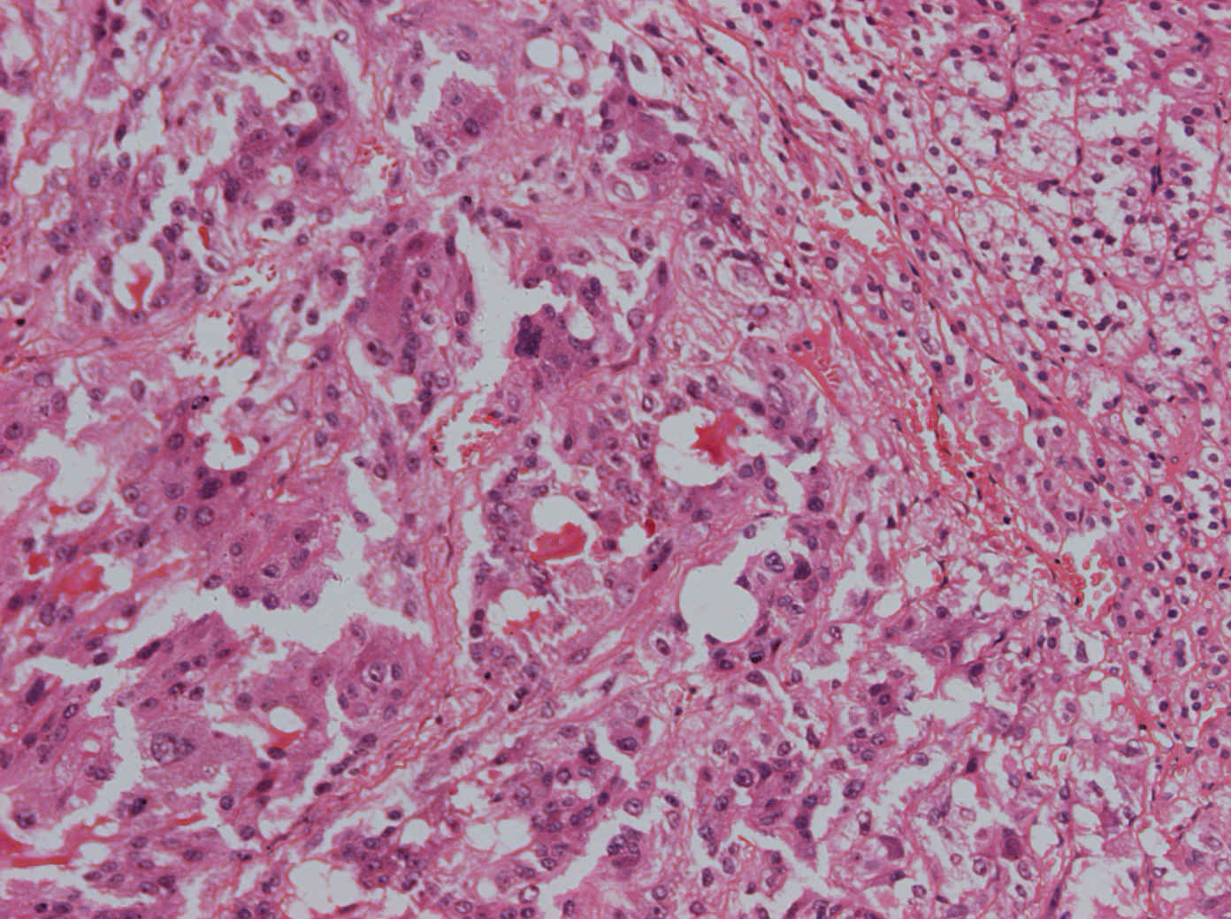
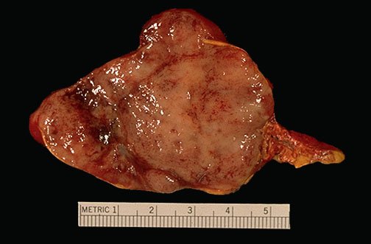
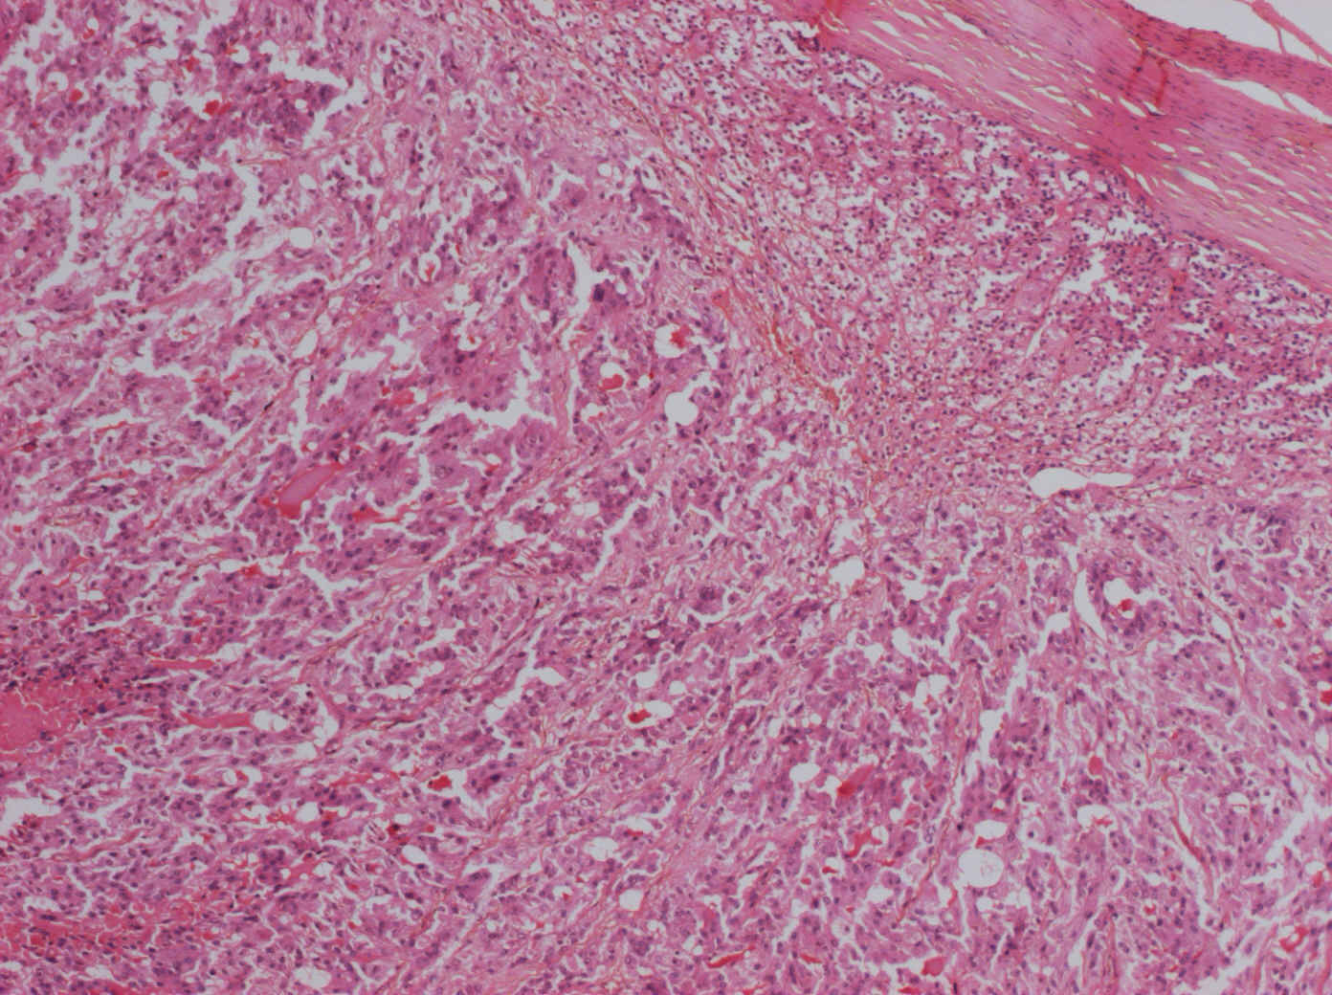
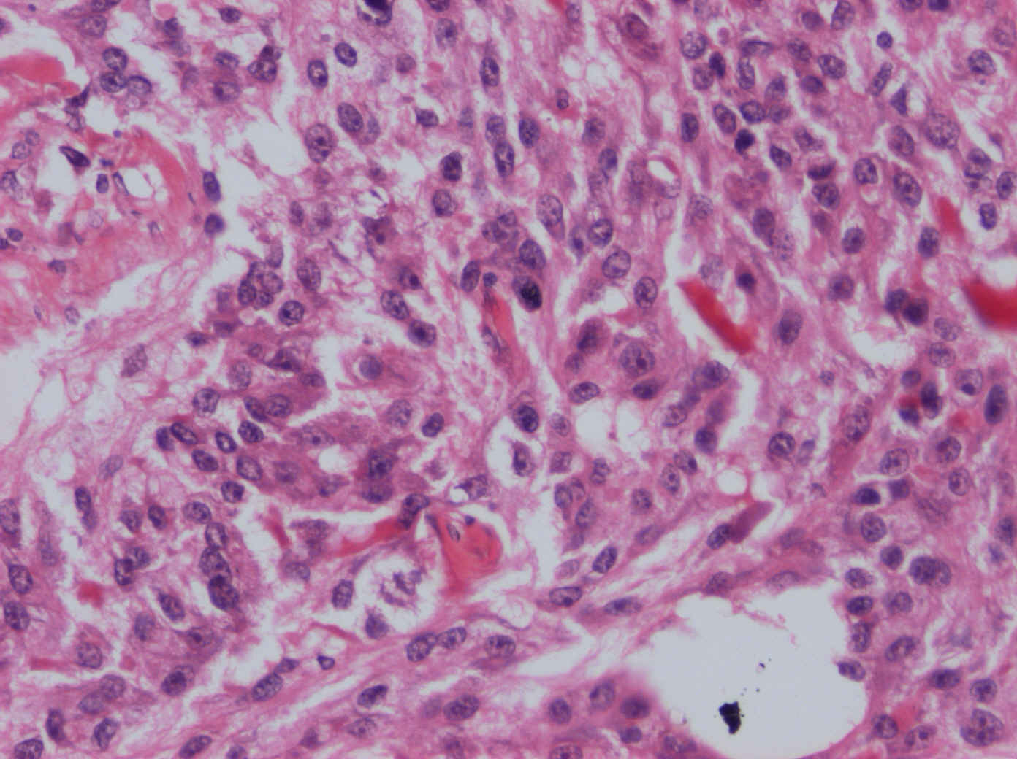
Pheochromocytoma

Slide 46
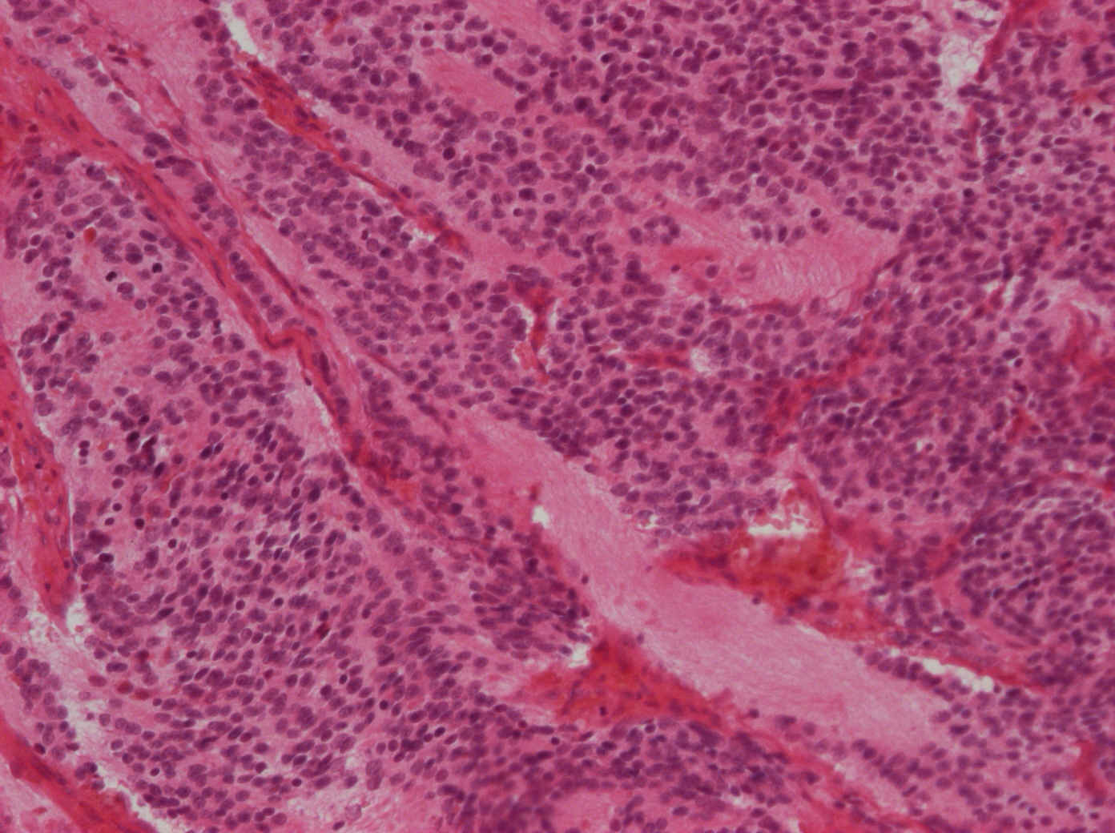
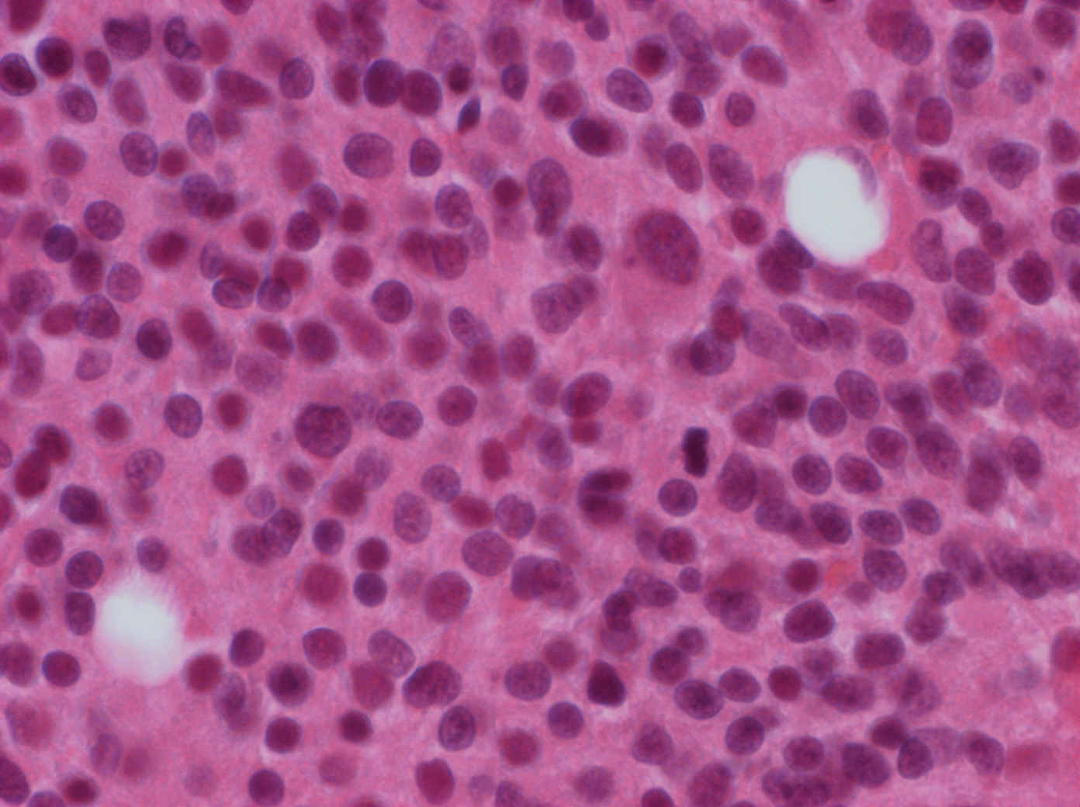
Neuroblastoma

Slide 47
Thank you for your attention …

