Slide 1

Ultrasound in obstetrics and gynecology
Romana Gerychová
2019/2020

Slide 2

History
1920s – sonar for marine purposes
1944 – first therapeutic use of ultrasound (brain tissue disruption)
UK, Australia, Germany, USA, Japan – leading countries
2D, 3D imaging, CFM – color mapping
21st century – quality, miniaturisation, intracavital application

Slide 3
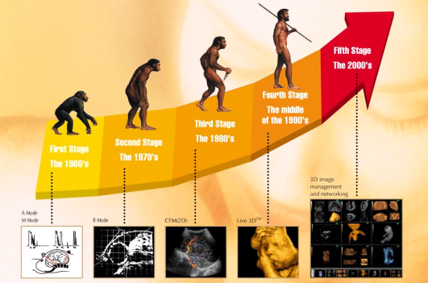
US technology development

Slide 4
Ultrasound diagnostics advantages
non-invasive method
method based on mechanical energy (relatively safe)
examination is carried by obgyn specialists themselves
(direct link between clinical status and objective method results)

Slide 5
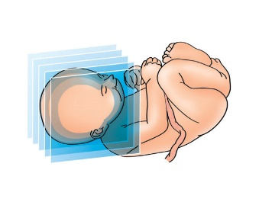
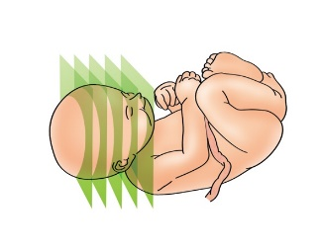
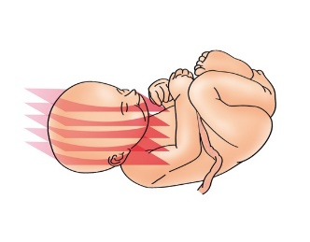
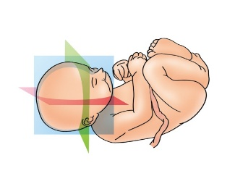
Ultrasound diagnostics
2D imaginig
base examination, gold standard
3D/4D imaging
additional examination
multiplanar image
volume CT mode
3D power Doppler

Slide 6
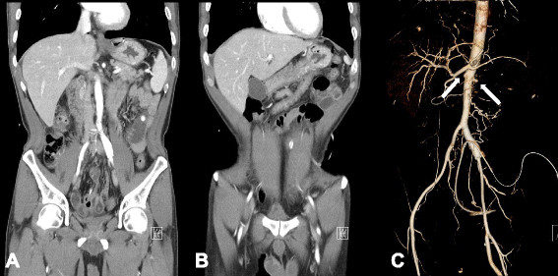
Contemporary imaging techniques
CT
gynecology (diff.dg. abdominal cavity pathologies)
exclusion peri/postoperative complications (TEN)
oncogynecology (staging)

Slide 7
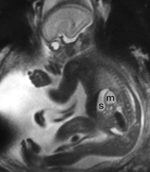
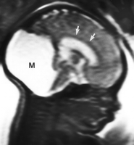
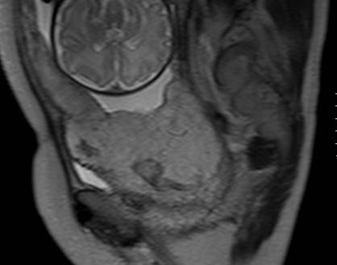
Contemporary imaging techniques
MRI
- gynecology
- obstetrics - fetal anomalies
- abnormal placentation
- placental functional examination
- fetal weight estimation
- virtual fetal autopsy

Slide 8
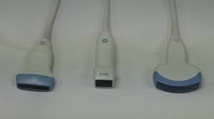
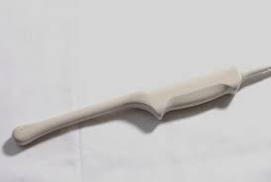
Imaging techniques
transabdominal (3,5-5 MHz)
visualisation abdominal cavity
(gynecology – formation bigger than small pelvis,
obstetrics, pediatric gynecology)
full bladder
transvaginal (5-7,5 MHz)
better visualisation (examination distance 8-10cm)
empty bladder
hymen, vaginal stricture - impossible

Slide 9
US in obstetrics and gynecology
options, limits
equipment (probe type, frequency,…)
limitations
- not influenced (e.g.obesity,…)
- probably influenced (e.g.oligohydramnion, multiple pregnancy,..)
- influenced (fetal movement, fetal position, empty bladder,…)

Slide 10
US - gynecology
congenital anomalies
dif.-dg amenorhoe
diff.-dg pelvic pain, inflammation, tumor
IUD visualisation
sterility treatment
uro/oncogynecology
peri/postoperative diagnostics

Slide 11
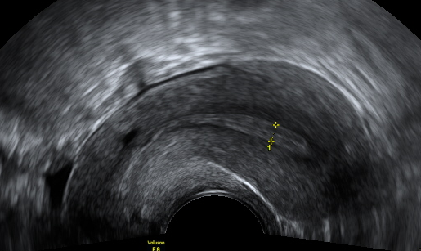
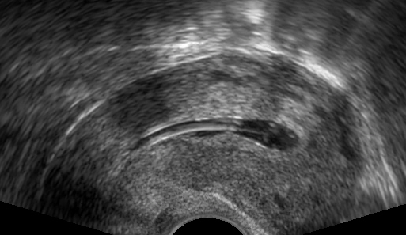
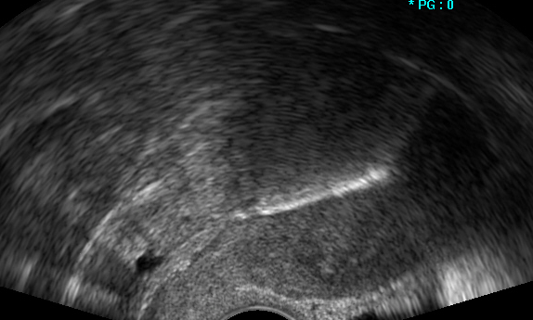
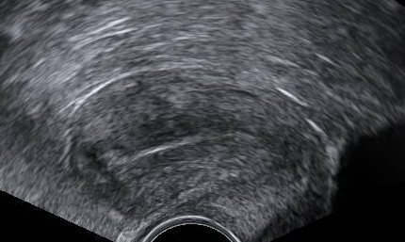
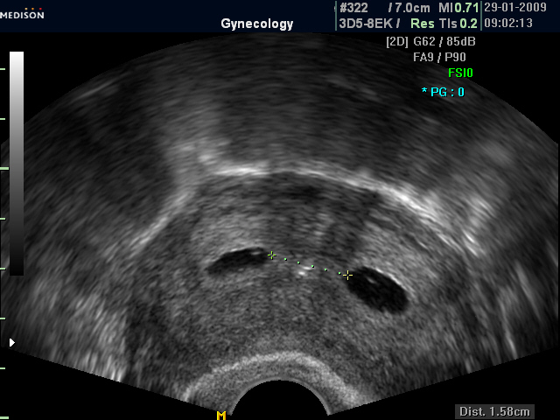
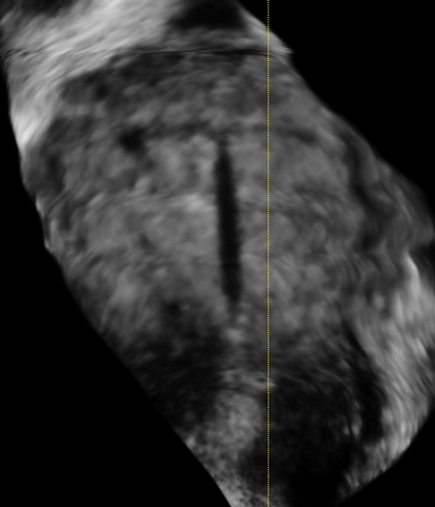
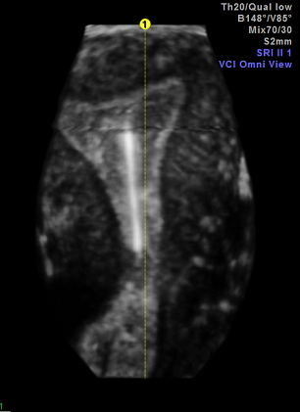
US - gynecology - uterus

Slide 12
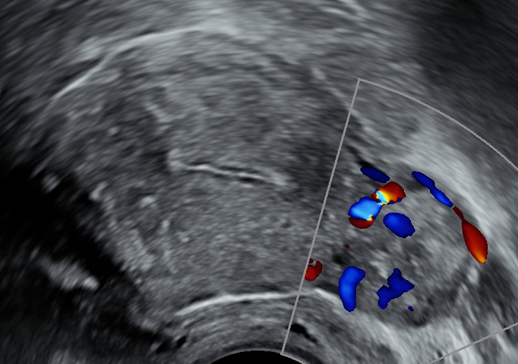
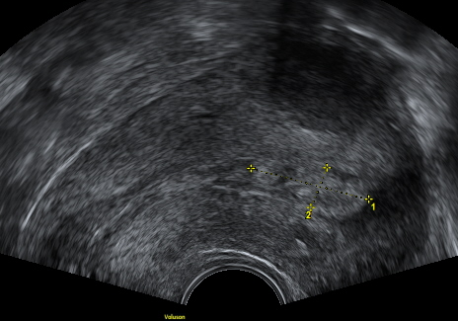
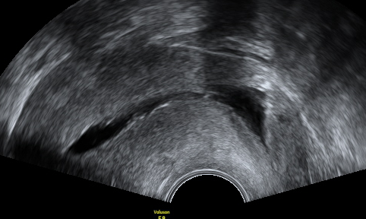
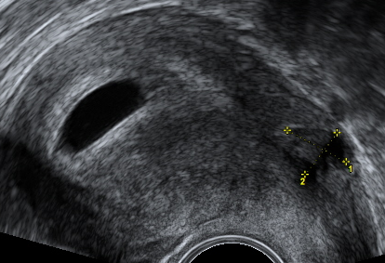
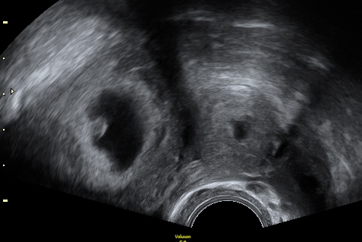
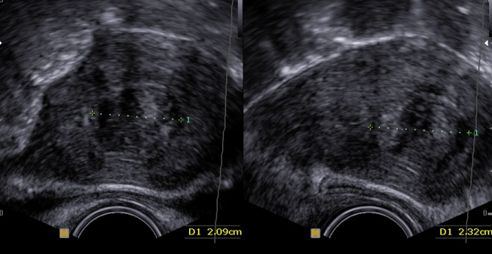
US - gynecology - uterus

Slide 13
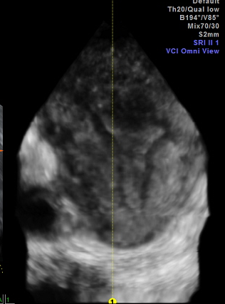
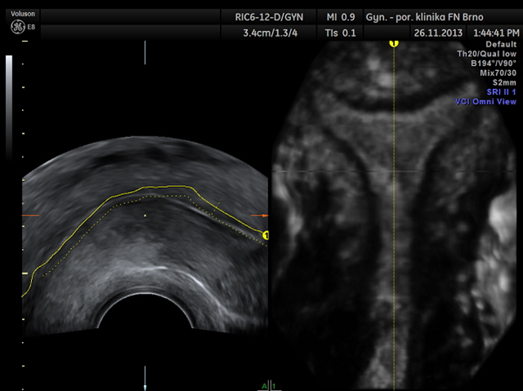
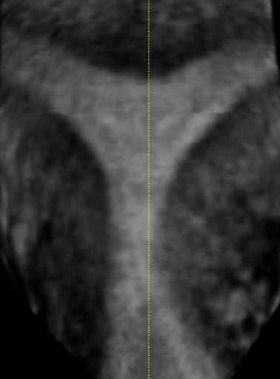
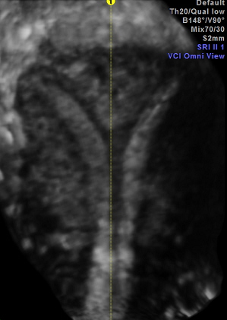
Uterine anomalies - 3D/4D image
uterus arcuatus uterus bicornis uterus duplex

Slide 14
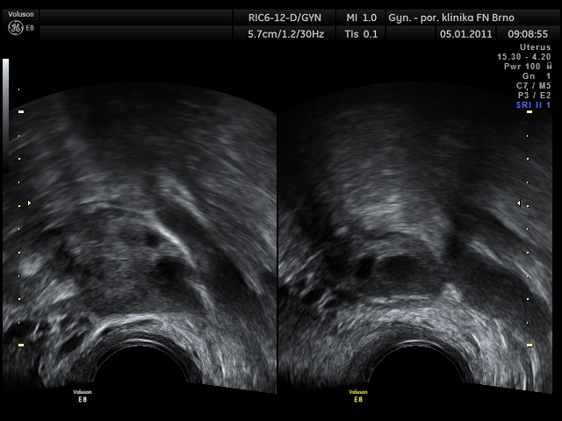
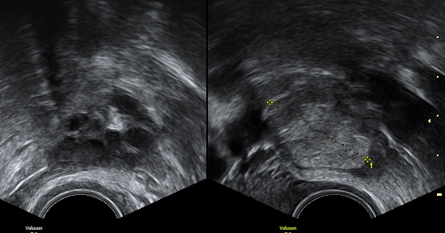
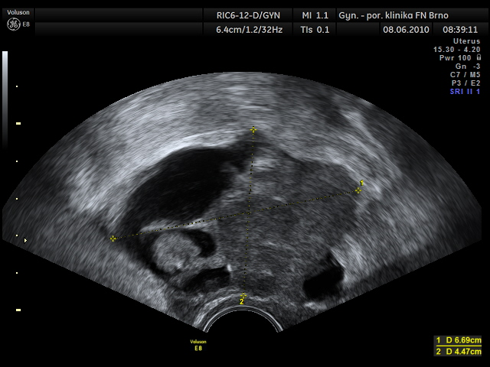
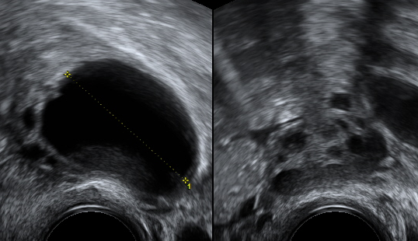
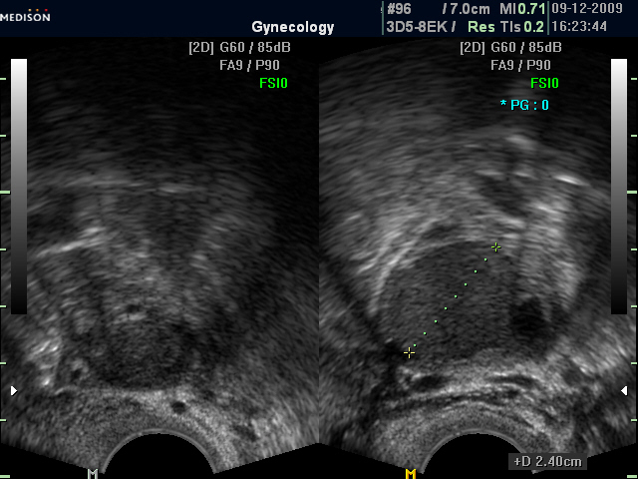
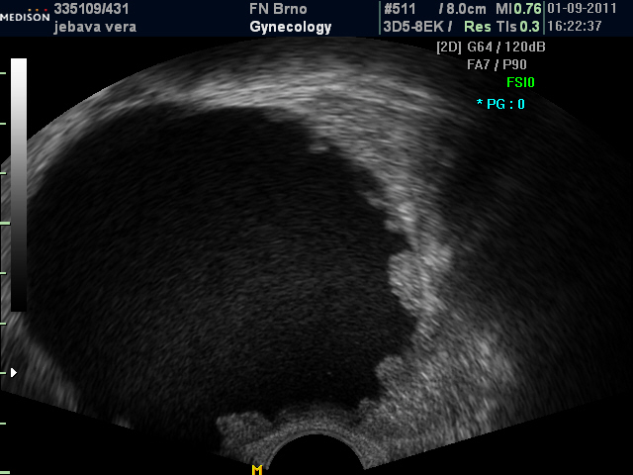
US - gynecology - ovaries

Slide 15
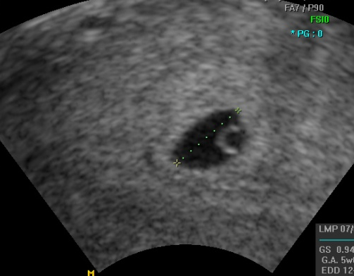
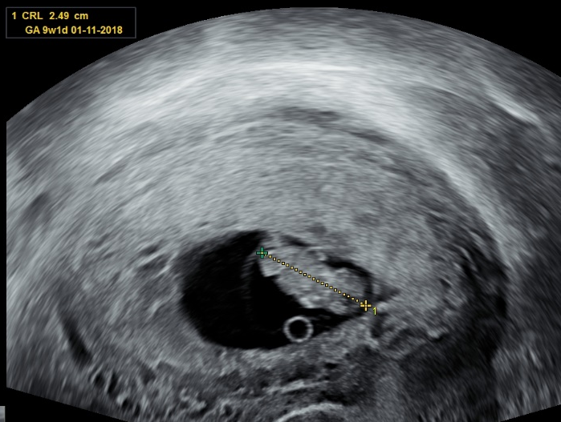
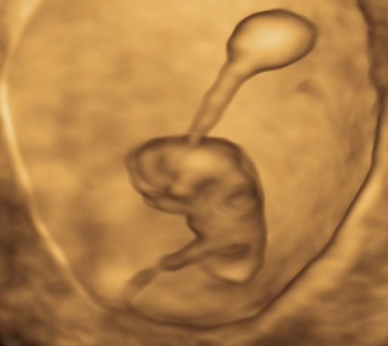
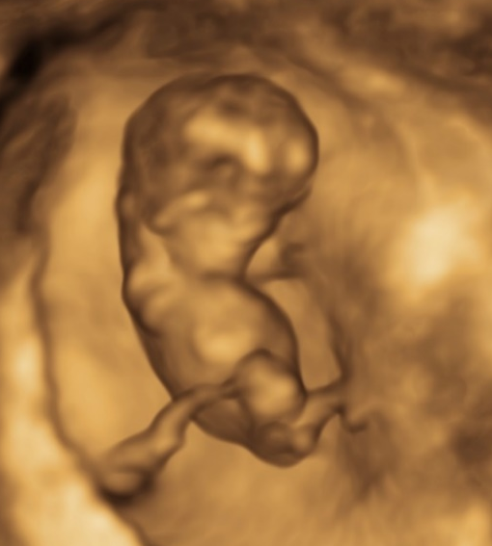
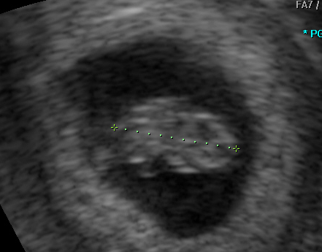
US - obstetrics - sonoembryology
fetal development observation

Slide 16
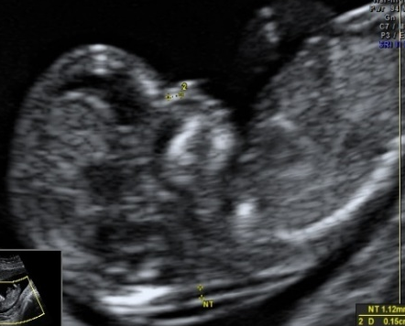
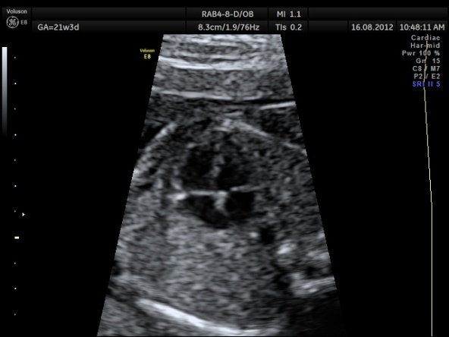
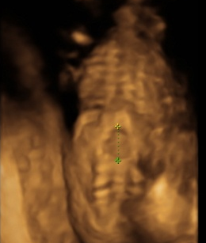
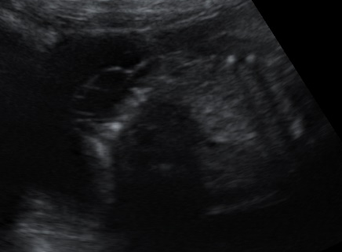
US - obstetrics
anomaly scan
3 – steps screening
I. trimestr (11-14 wks)
II. trimestr (20-22 wks)
III. trimestr (30-32 wks)

Slide 17
I trimestr screening
targets, specifics
screening for fetal anomalies
screening for fetal chromosomal anomalies
better visualisation
time for genetic counselling
safer termination of pregnancy
screening for pregnancy risk (e.g. preeclampsia, placental pathology)

Slide 18
I trimestr screening
11-14 wks (11+0 - 13+6)
pregnancy date
number of fetuses (amnionicity, chorionicity)
anomaly scan
- direct (structural anomalies)
- indirect (chromosomal anomalies)

Slide 19
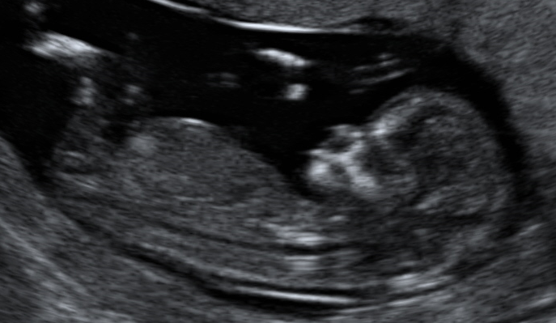
I trimestr screening
pregnancy date
birth date estimation
CRL measurement (crown-rump lenght)
estimating
- birth term
- timing next exams

Slide 20
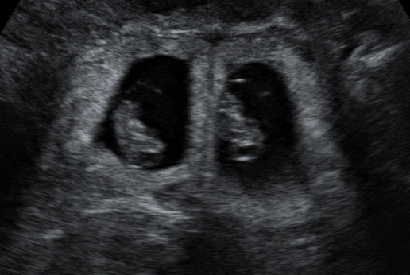
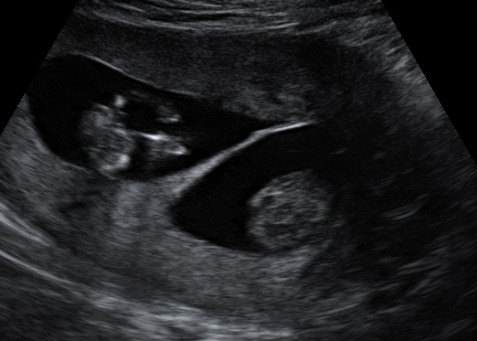
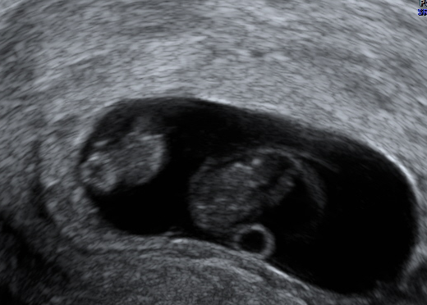
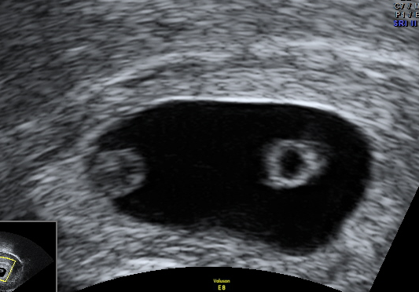
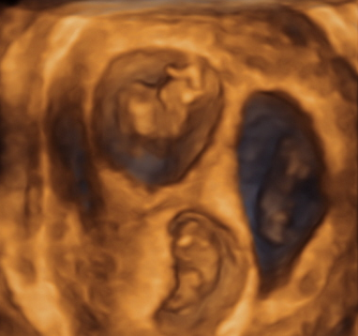
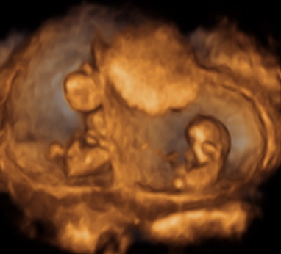


Amnionicity/chorionicity

Slide 21







I trimestr screening
anomaly scan
morfologic anomalies
chromosomal anomalies

Slide 22

Fetal chromosomal anomalies screening I
markers
nasal bone
intracranial translucency
nuchal translucency

Slide 23
Fetal chromosomal anomalies screening II
nuchal translucency ˃ 3mm
75% fetal aneuploidy
30% fetal structural anomaly,
genetic syndrome
1% normal fetus
Evans 1999, Nicolaides 2009, Pereira 2011, Kagan 2015, Grande 2015
main marker of fetal abnormality

Slide 24




Fetal chromosomal anomalies screening III
ductus venosus
abnormal flow
tricuspide valve
regurgitation
- facial angle

Slide 25



II trimestr screening
20-22 wks
fetal structural anomalies detection
fetal cardiac defect detection
placental dysfunction detection

Slide 26

III trimestr screening
30-32wks
anomaly scan
fetal growth
fetal position
placental position
birth plan

Slide 27




Obstetrics vaginal US
placental position
cervical lenght
lower uterine segment (CS scar, fibroma)
vasa praevia
fetal examination (I trimestr, head,..)

Slide 28



Doppler measurement
a./v.umbilicalis a.cerebri media ductus venosus
placental pathology - increasing placental resistence – decreasing diastolic flow (umbilical cord) – increasing diastolic flow in the fetal brain vessels – centralisation of bloodstream

Slide 29







Ultrasound – invasive prenatal dignostics
amniocentesis
chorionic villi sampling
umbilical cord puncture
abortion risk 0.8 - 1%
fetal genetic status examination

Slide 30




Fetal therapy - intrauterine transfusion
maternal red blood cells antibodies
fetal hemolytic anemia
follow up - laboratory - antibody level
- fetal RhD (cfDNA)
- ultrasound - MCA Doppler flowmetry
therapy- intrauterine transfusion

Slide 31






Fetal therapy – vesico-amniotic shunting
fetal obstructive uropathy

Slide 32





Fetal therapy - thoraco-amniotic shunting
pleural effusion - indications for therapy
- fetal hydrops
- massive effusion (> ½ thoracic cavity volume)
- rapid progression, polyhydramnion
22.t 23.t. 24.t 36.t

Slide 33



Fetal therapy - next indications
- laser fetoscopy
- twin-to-twin transfusion sy
- sIUGR monochorionic twins
- TRAP sequence
- sacrococcygeal teratoma
- diafragmatic hernia (endoscopic tracheal oclusion)
- fetal aortal valvuloplasty

Slide 34



Conclusion
ultrasound - inherent helper of ob-gyn specialist
theoretical knowledge, practical training
regular quality audit
ultrasound of specialist
subspecialisation for postgradual trainee

