Slide 1
Nursing and communication
PhDr. Simona Saibertová
Notes:
Welcome to our Nursing department. Let me introduce myself. My name is SS and I´m going to teach Nursing teoretical lesson and practical lesson in the hospital.

Slide 2
This subject has three main parts
Theoretical lessons – Nursing – 4 hours
PhDr. Simona Saibertová
Theoretical lessons – Communication – 3 hours
Prof. Andrea Pokorná – Thursday
Practical lessons – practice in the hospital – 2x 4 hours – The University Hospital Brno

Slide 3

Practical lessons
Gastroenterology unit (IGEK - A,B)
Practice takes from 6:30 – 10:00
Time of arrival: 6:10 in the morning
Meeting point: 4th floor, A1

Slide 4
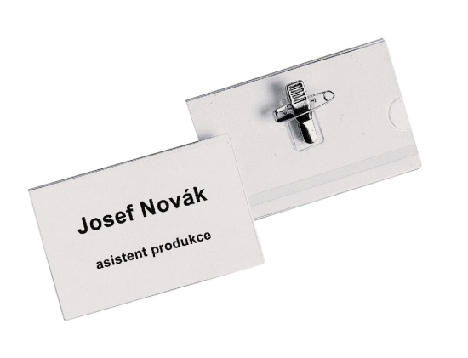

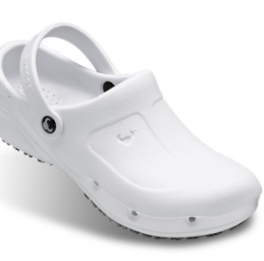


Practice in the hospital
white T-shirt (no pictures, writing on)
white trousers
shoes
tag /nameplate (ask for it the Office for students)
long hair – ponytail
remove all jewels from your fingers and wrist
one padlock for 2-3 people
blue and red pen
Notes:
Regarding you dress code during the practice, you are going to have wearing a T-shirt… You must have nameplate, Who has long hair, please make ponytail and remove all jewels from your fingers add wrist. Next, you are going to have blue and red pen, one padlock for 2-3 people on the wardrobe. Take some money for coffee or drinks.

Slide 5
Definition of Nursing
Nursing is a system of typical nursing activities concerning the individual, families or group which assist these people to able to take of their health and well-being.
Notes:
What is the Nursing?

Slide 6
Nursing
is the protection, promotion, and optimization of health and abilities;
prevention of illness and injury;
alleviation of suffering through the diagnosis and treatment of human responses;
advocacy in health care for individuals, families, communities, and populations.

Slide 7
A Nurse
carries out a lot of procedures
Assists the doctors and the professionals
Assists the patients with daily living activities (bath, dressing..)
Prepares and serves meals according to the instruction
Turns and positions patients in the bed
Gives bedpan and urinal or provides incontinent care
Takes the patient´s temperature, pulse, respiration and blood pressure
Takes samples some other biological materials
Gives injections and medicaments
Notes:
These activities you are going to make in the hospital

Slide 8
Why to use the Nursing Process?
It is important because it provides a framework for clinical decision-making, which helps to guide care and promote critical thinking.
It is a systematic and goal oriented framework for problem solving.
Critical thinking is thought how the nursing process can improve client care
Notes:
During their daily activities nurse use the Nursing process

Slide 9
Benefits of Nursing Process
Continuity of care
Prevention of duplication
Individualized care
Standards of care
Increased client participation
Collaboration of care
Notes:
Nurses have a unified working practices

Slide 10

Nursing process
The nursing process consists of five dynamic and interrelated phases
Notes:
This process consists of five phases namely: assessment, diagnosis, planning, implementation and evaluation.

Slide 11
Assessment
Purpose: to establish a data base
Assessment = Observation+ Interview+ Physical Examination
Data are collected, organized, validated, and recorded

Slide 12
Subjective data
Are reported but not objectively measurable
You cannot see them
Are often referred to as symptoms and represent thinks a client tells you about than you cannot observe or measure
(nausea, pain..)
Most subjective data will be collected during a health history

Slide 13
Objective data
Are measurable
Are often referred to as signs
These signs can be measured , seen, heard, felt or smelled and are often collected during a physical exam.

Slide 14
Subjective/objective data
Headache subjective data
Cough
Nausea objective data
Vomit
Itchy skin
Sore throat
Rash on the skin
Notes:
determine what the symptoms are

Slide 15
Diagnosis – second step
Nursing diagnoses determine the client´s response or problem related to an illness or situation
Formulating a clear diagnosis helps communication among team members.
Nurses cannot make a medical diagnosis like Asthma or Myocardial infarction.

Slide 16
Nursing diagnosis
Actual diagnosis – is a statement about a health problem that the client has, and could benefit from nursing care (pain, hypothermia)
A risk diagnosis – is a statement about a health problem that the client hasn´t had yet, but comprise potential or likely risk factors in which a patient is vulnerable to (at risk for infection)
Notes:
Divided into risk for bloodstream infections

Slide 17
Comparison of selected nursing and medical diagnoses
Nursing
Ineffective Breathing Pattern
Activity intolerance
Acute pain
Body image disturbance
Risk of Altered Body Temperature
Medical
Chronic Obstructive Pulmonary Disease
Cerebrovascular Accident
Appendectomy
Amputation
Strep Throat
Notes:
patient has paraplegia, angina – tonsilitis/ he has high temperature, sore throat, he can not swallow// risk of dehydration, pain,
hyperthermia

Slide 18
Nursing planning – third step
1) Establishing priorities – the nurse examines the client´s nursing diagnoses and ranks them in order of physiological or psychological importance.
2) Setting goals – short term (can be met fairly and quickly), long term (cover a long time period)
3) Developing expected outcomes – expected outcomes define when a patient goal has been met and assist in evaluating the extent to which the Nursing diagnosis has been resolved.

Slide 19
Planning
Goal: lung will remain clear postoperatively
Expected outcomes:
The sputum will remain white
The patient will remain afebrile
The lungs will be clear to auscultation

Slide 20
Implementation – fourth step
To implement the care plan successfully, nurses need cognitive, interpersonal, and technical skills. These skills are distinct from one another.
The nurse completed the implementing phase by recording the interventions and client responses in the nursing process notes.

Slide 21
Nursing interventions
Nursing Diagnosis: Acute pain related to myocardial ischemia
Nursing interventions:
Asses pain characteristics such as location, quality, severity, duration, onset, relief.
At first signs of pain, instruct client to relax and discontinue activity.
Instruct client to take sublingual nitroglycerin.
Administer oxygen as prescribed
Goal: Client will resume normal activities of daily living
Expected outcome: client will verbalize relief of pain

Slide 22
Evaluation - fifth step
When determining whether a goal has been achieved, the nurse can draw one of the three possible conclusion
The goal was met, that is the client response is the same as the desire outcomes.
The goal was partially met, that is either a short term goal was not, or the desire outcome was only partially attained.
The goal was not met.
So the nurse must reassess why the goals are not being achieved.

Slide 23
First step on practice in the hospital hand hygiene
Hand hygiene - washing and disinfection of hand
Professional hand hygiene is one of the most important preventive measures for the protection of personnel and patients.
Correctly performed hand hygiene reduces contamination with pathogens by up to 99.9 %
https://www.youtube.com/watch?v=LvRP3c5n3P8
Notes:
I´ll show you nice education video, you can see why hand hygiene is important

Slide 24
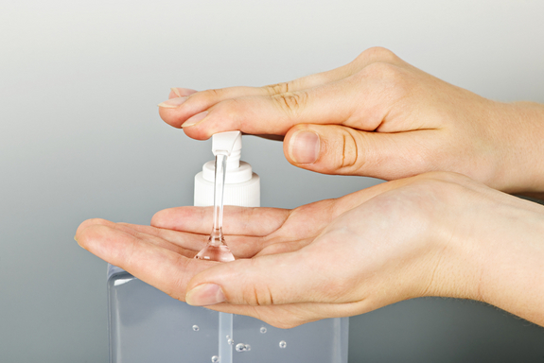
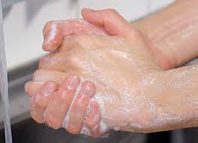
Hand disinfection vs. handwashing
Handwashing is not an alternative to hand disinfection because only disinfection is capable of reducing pathogens rapidly enough so that no more pathogens can be transmitted.

Slide 25
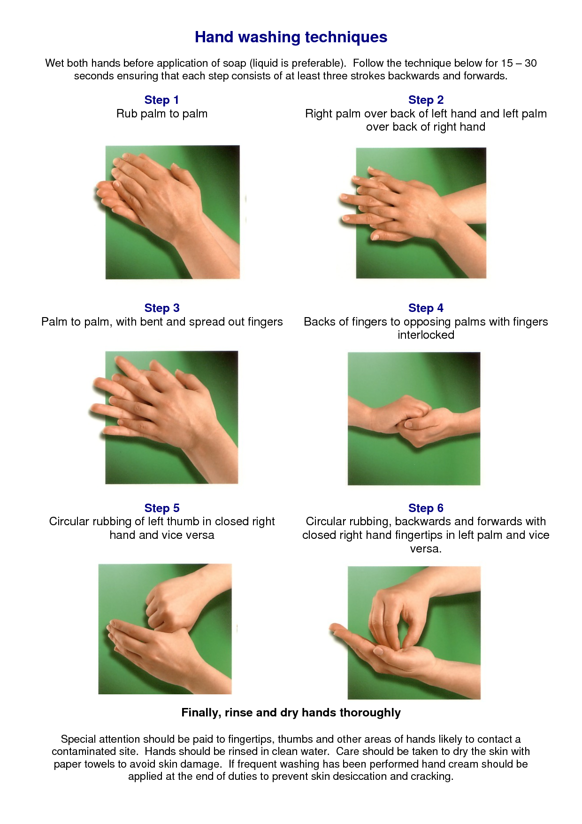
https://www.youtube.com/watch?v=rLmDerR1HqE
Notes:
I'll show you the video During the video disinfect your hand following instruction from video and after that I will check your hand up. Don´t touch anything.

Slide 26
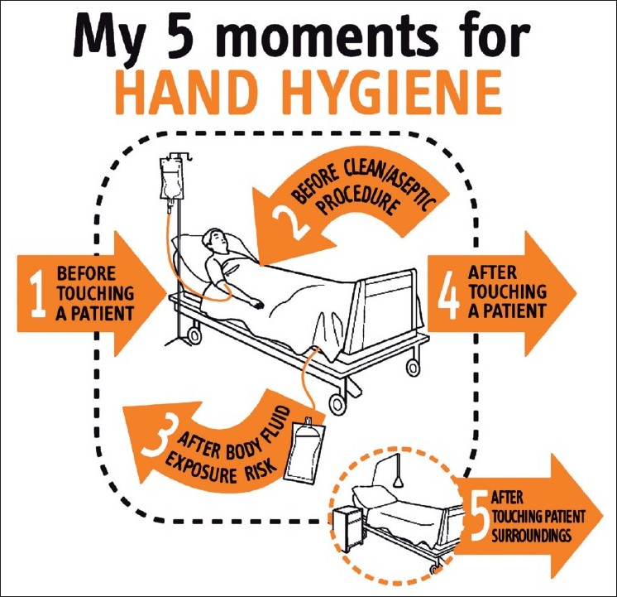

Slide 27
Assessment techniques
The techniques used may include
Inspection
Palpation
Percussion
Auscultation
Notes:
The assessment techniques for the physical examination are

Slide 28
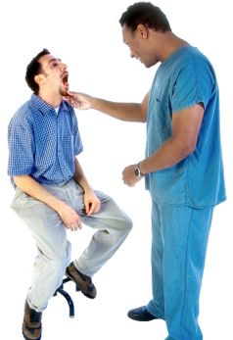
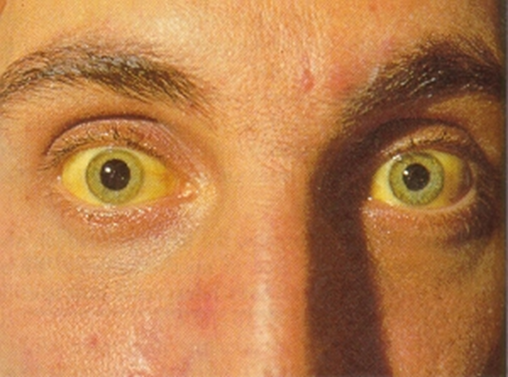
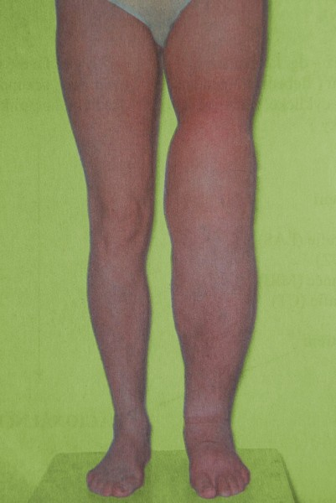
Inspection
Inspect each body system using vision
Assess for color, size, location, movement, texture, symmetry.
Notes:
obstruction of biliary tract, jaundice

Slide 29
Palpation
Assess for:
Temperature, texture, moisture
Organ size and location
Rigidity or Spasticity
Crepitation, Vibration
Position, Size
Tenderness or pain
Notes:
Crepitatiton is sound during joint movement

Slide 30
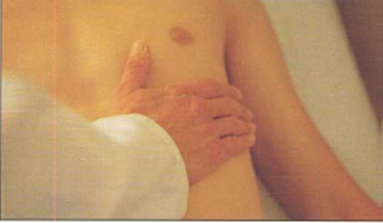
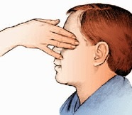
Types of Palpation
Light palpation - depress the skin about 1 to 2 cm with your finger pads, using the lightest touch possible.
Assess for texture, tenderness, temperature, moisture, elasticity, pulsations, and masses.

Slide 31
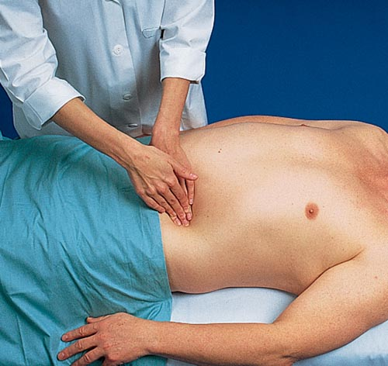
Types of Palpation
Deep palpation – depress the skin by for inches about 4 to 5 cm with firm, deep pressure
Use this technique to feel internal organs and masses for size, shape, tenderness, symmetry, and mobility.

Slide 32
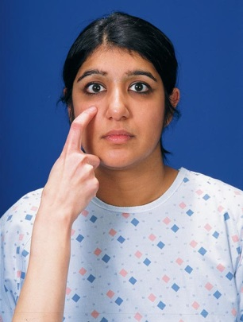
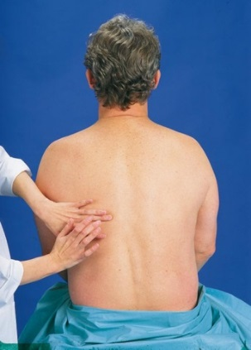
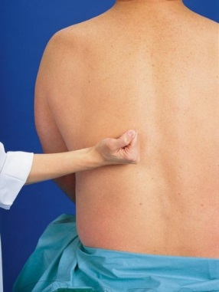
Percussion
Assess underlying structures for location, size, density of underlying the tissue.
direct - using one or two fingers, tap directly on the body part. Ask the patient to tell you which areas are painful, and watch his face for signs of discomfort.
indirect - this technique elicits sounds that give clues to the makeup of the underlying tissue.
blunt percussion - is used for assessing pain and tenderness in the gallbladder, liver, and kidney.

Slide 33
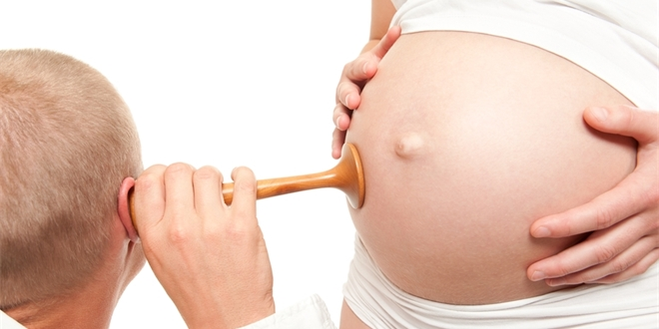
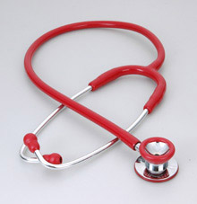
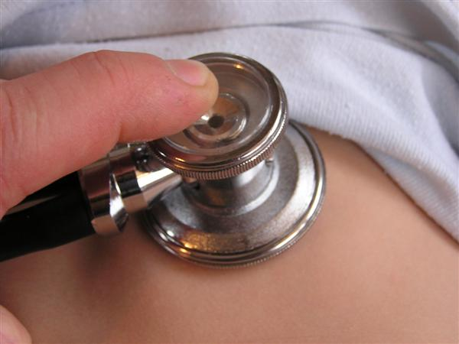
Auscultation
Auscultation involves listening for various lung, heart, and bowel sounds with a stethoscope.

Slide 34
Compression therapy – bandage of legs
Compression aims to counteract the force of gravity and promote the normal flow of venous blood up the leg.
Compression acts on the venous and lymphatic systems to improve venous and lymph return and reduce edema.
Notes:
Another intervention you can do during your practice is bandage of legs

Slide 35
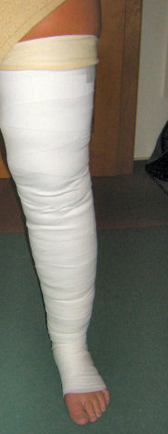
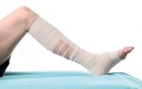
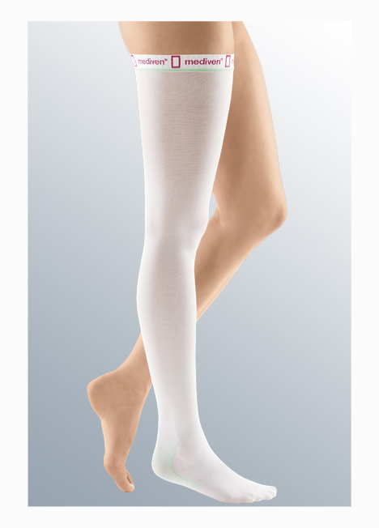
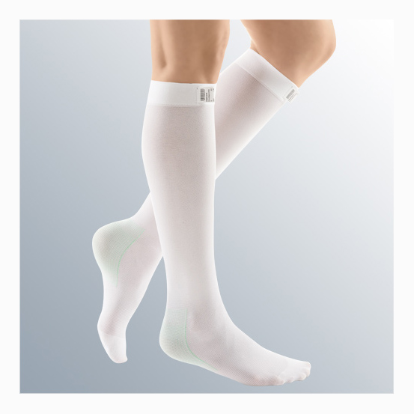
Compression therapy - bandage
The most commonly used compression therapy systems come in two forms:
Bandage components or layers wrapped around the leg
(either full leg or below knee)
or compression stockings

Slide 36
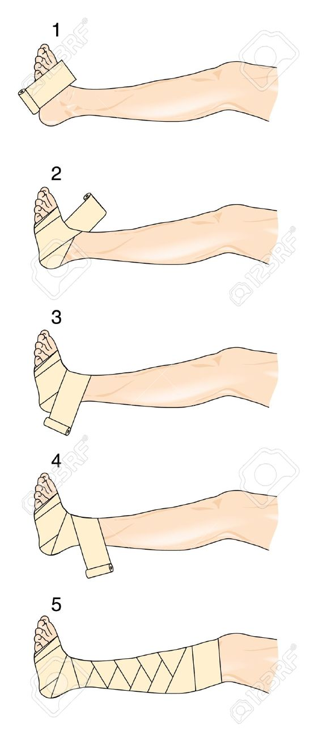
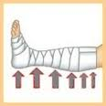
Making a Bandages
Figure of Eight Bandage
https://www.youtube.com/watch?v=oNHuK0X_I78
Notes:
How do you make a bandage

Slide 37
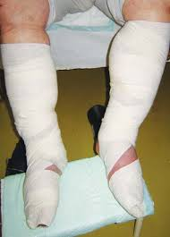
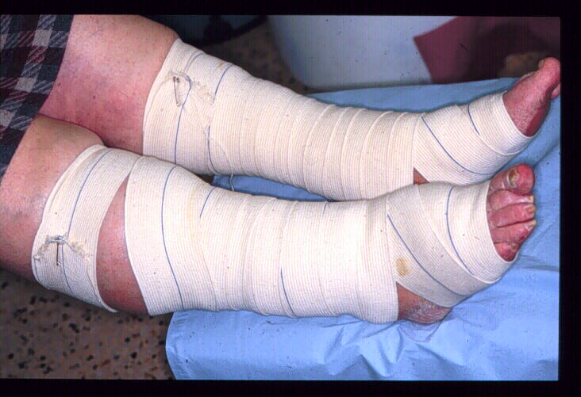
Incorrectly applied bandage

Slide 38
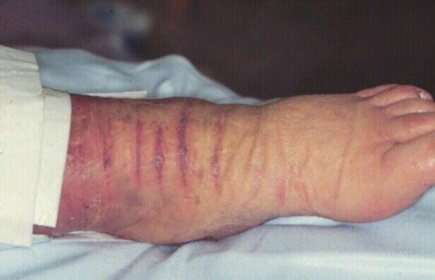
Necrosis caused by incorrectly applied bandage

Slide 39
Physical Examination
blood pressure,
pulse,
temperature,
respirations,
pulse oximetry,
ECG
Notes:
includes

Slide 40
Blood pressure
Is the force of blood against the walls of arteries.
Is recorded as two numbers – the systolic pressure and the diastolic pressure.
The systolic pressure is the maximum pressure in an artery at the moment when the heart is beating and pumping blood through the body.
The diastolic pressure is the lowest pressure in an artery in the moments between beats when the heart is resting.

Slide 41
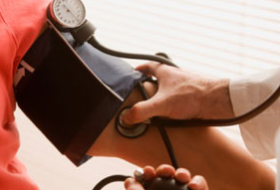
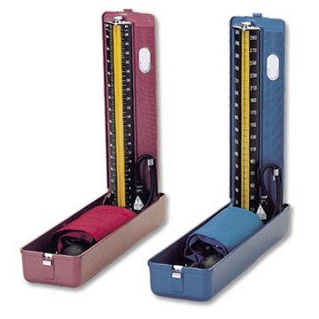
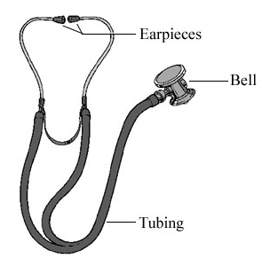
Blood pressure
Use an instrument called a sphygmomanometer and stethoscope

Slide 42
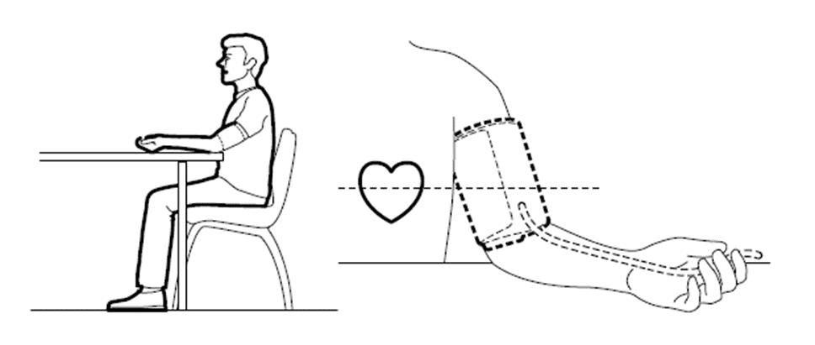
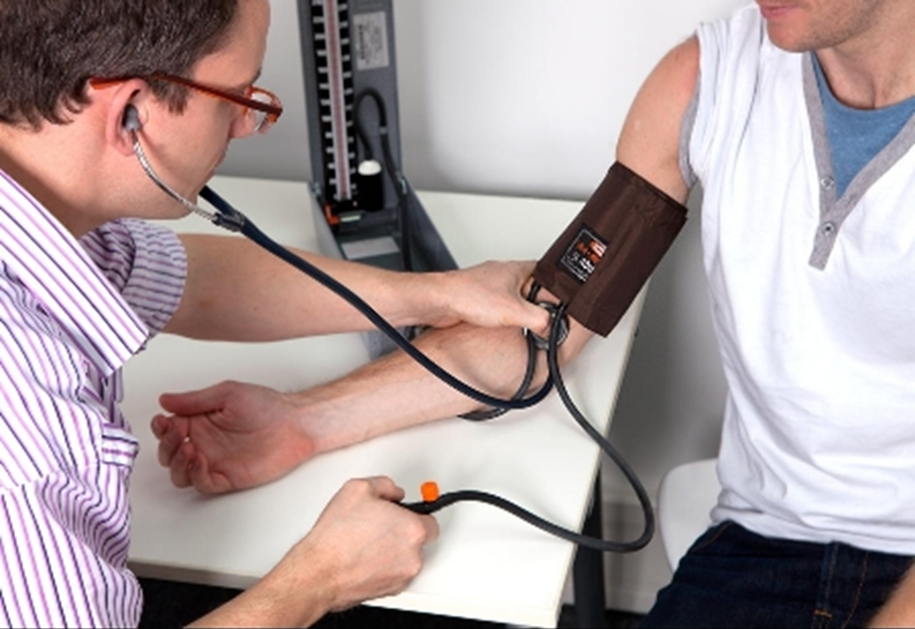
Measuring blood pressure
Wash hands and identify patient
(ask and check identity bracelet)
2. Explain procedure (změřím vám tlak)
3. Position patient comfortably, either seated or lying,
sit or lie down for at least 5-10 min before measuring.
Avoid taking a meal, smoking, exercising, bathing, drinking Alcohol, caffeine, or tea for at least 30 minutes before taking any measurement.
4. Position patient´s arm by supporting it on the bed or on the table with the palm turned upward, push sleeve up to shoulder
5. Place cuff 2-3 centimeters above bend in elbow, wrap it around the arm smoothly and secure it
6. Put earpiece in your ears, place diaphragm of the stethoscope over brachial artery and hold in place with one hand
Notes:
the first step is always the same

Slide 43
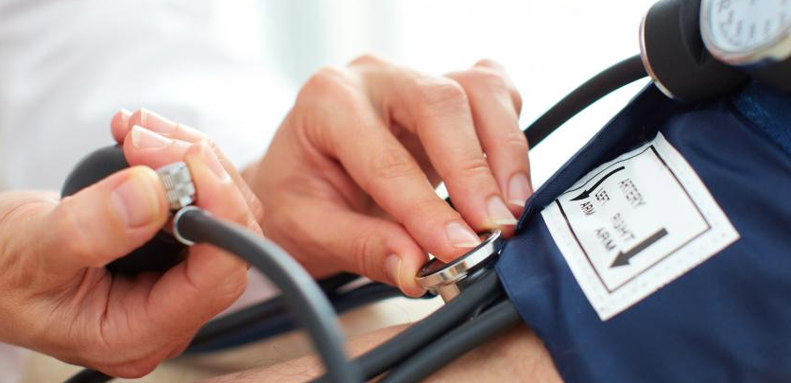
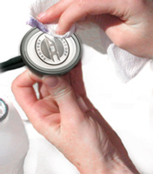
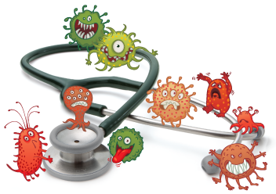
Measuring blood pressure
7. Close air valve and pump to inflate the cuff. Continue pumping the scale reads 180 (you can not listen sound)
8. Open slowly air valve and listen for first sound – its systolic pressure and read the scale.
9. Continue to release air, as soon as no sound take a second reading – its diastolic pressure
10. Deflate cuff completly
11. Record TK – 120/80 (sto dvacet na osmdesát)
120 over 80
12. Clean earpiece and diaphragm of the stethoscope

Slide 44
Vocabulary
I will take your blood pressure.
Změřím vám (krevní) tlak.
----------------------------------------------------------
Can I take your blood pressure?
Můžu vám změřit (krevní) tlak?
----------------------------------------------------------
Your blood pressure is normal - 120 over 80.
Váš (krevní) tlak je normální- 120 (stodvacet) na 80 (osmdesát).

Slide 45
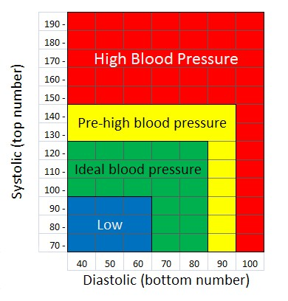
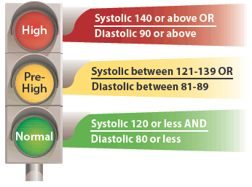
Categories for Blood Pressure - adults

Slide 46
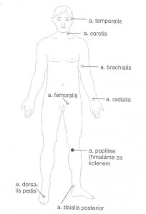
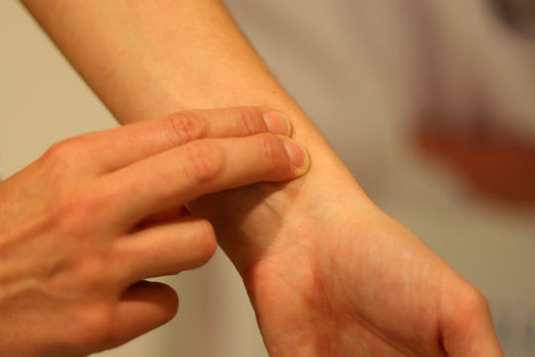
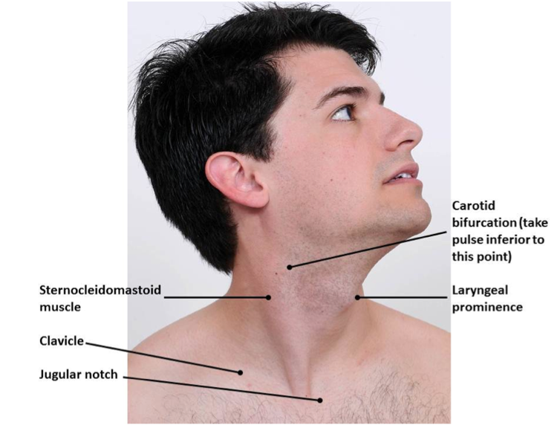
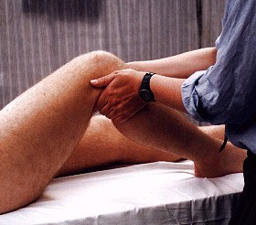
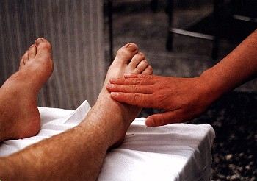
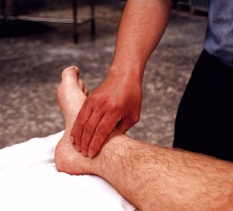
Assessing the Pulse
A. temporalis
A.radialis
A.carotis
A. poplitea
A. femoralis
A. dorsalis pedis
Posterior tibial pulse

Slide 47
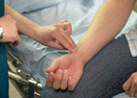
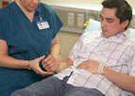
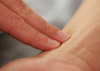
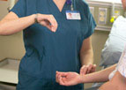
Assessing the Pulse
1. Wash hands and identify patient
2. Explain procedure (změřím vám puls)
3. The radial pulse is easy to find and is the most frequently checked peripheral pulse.
4. Assist patient to a seated or lying position to ensure relaxation and comfort.
4. To check the radial pulse with the patient supine, position the patient's arm along the side of the body or across the upper abdomen with the patient's wrist relaxed.
5. Apply light pressure with the pads of the fingers in the groove along the radial or thumb side of the patient's inner wrist.
Be careful not to apply too much pressure, as this can impair blood flow.
6. If the pulse is regular, count for 30 seconds, then multiply that number by 2.
If the pulse is irregular, count for 1 full minute
7. Record P – 89 ^{reg} (89´) or 89 ^{irreg}

Slide 48
Assessing the Pulse
Newborns 0 - 1 month old: 70 - 190 beats per minute
Infants 1 - 11 months old: 80 - 160 beats per minute
Children 1 - 2 years old: 80 - 130 beats per minute
Children 3 - 4 years old: 80 - 120 beats per minute
Children 5 - 6 years old: 75 - 115 beats per minute
Children 7 - 9 years old: 70 - 110 beats per minute
Children 10 years and older, and adults: 60 - 100 beats per minute
Well-trained athletes: 40 - 60 beats per minute

Slide 49
Vocabulary
I will take your pulse.
Změřím vám puls.
----------------------------------------------------------
Can I take your pulse?
Můžu vám změřit puls?
----------------------------------------------------------
Your pulse is 70 per minute.
Váš puls je 70 (sedmdesát) za minutu.

Slide 50
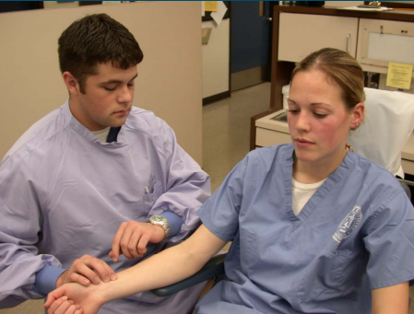
Assessing respirations
Count the number of breaths per minute, depth and rhythm of breathing and monitoring for signs of respiratory distress
1. With your fingers still in the vicinity of the radial artery start observing respirations. You do not want the patient to know that you are assessing respirations because the patient may change their breathing patterns or rate
2. Observe the rise and fall of the patient’s chest
3. After a complete cycle of inspiration and expiration has been observed, count respirations for 30 seconds and multiply by 2 if respiratory rate is regular. If irregular count for a full 60 seconds
4. Wash hands
5. Document respiratory rate, depth and rhythm on appropriate documentation form

Slide 51
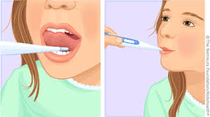
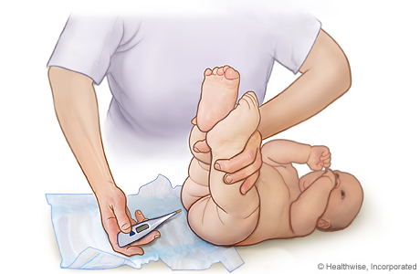

Assessing the Temperature
You can measure the temperature on three body location:
Mouth - place the probe under the tongue and close the mouth. Breathe through the nose, and use the lips to hold the thermometer tightly in place. Leave the thermometer in the mouth for 3 minutes or until the device beeps.
Rectum - this method is for infants and small children who are not able to hold a thermometer safely in their mouth. Place petroleum jelly on the bulb of a rectal thermometer. Place the small child face down on a flat surface or lap. Spread the buttocks and insert the bulb end about 1/2 to 1 inch into the anal canal. Be careful not to insert it too far. Struggling can push the thermometer in further. Remove after 3 minutes or when the device beeps.
Armpit - place the thermometer in the armpit, with the arm pressed against the body. Wait for 5 minutes before reading.

Slide 52




Assessing the Temperature
Non-contact forehead infrared thermometer - this thermometer is intended for scanning individuals or monitoring an individual for potential elevated temperatures. It is not a substitute for a clinical thermometer.
Simply press the trigger and read temperature on the large backlit LCD display in just half a second.
Notes:
Another option for assessing the temperature is non-contact measurement. If you have measured hight temperature, you have to use clinical termometr

Slide 53




Assessing the Temperature
Normal temperature range
Rectum – 36,6° - 38°C
Mouth – 35,5° - 37,5°C
Armpit – 35,8° - 37° C

Slide 54

Assessing the Temperature
1. Wash hands and identify patient
2. Explain procedure (změřím vám teplotu)
3. Assist patient to a seated or lying position to ensure relaxation and comfort.
4. Apply thermometer
5. Record TT – 36,5ºC

Slide 55
Vocabulary
I´ll take your tempereture.
Změřím vám teplotu.
----------------------------------------------------------
Can I take your temperature?
Můžu vám změřit teplotu?
----------------------------------------------------------
Your temperature is 36,5ºC.
Vaše teplota je 36,5ºC. (třicet šest celých pět)

Slide 56

Assessing ECG (EKG)
An electrocardiogram is the process of recording the electrical activity of the heart over a period of time using electrodes placed on a patient's body.
These electrodes detect the tiny electrical changes on the skin that arise from the heart muscle depolarizing during each heartbeat.

Slide 57

Assessing ECG (EKG)
Electrode name | Electrode placement
RA | On the right arm, avoiding thick muscle.
LA | In the same location where RA was placed, but on the left arm.
RL | On the right leg, lateral calf muscle.
LL | In the same location where RL was placed, but on the left leg.
V₁ | In the fourth intercostal space (between ribs 4 and 5) just to the right of the sternum (breastbone).
V₂ | In the fourth intercostal space (between ribs 4 and 5) just to the left of the sternum.
V₃ | Between leads V₂ and V₄.
V₄ | In the fifth intercostal space (between ribs 5 and 6) in the mid-clavicular line.
V₅ | Horizontally even with V₄, in the left anterior axillary line.
V₆ | Horizontally even with V₄ and V₅ in the midaxillary line.

Slide 58



Pulse oximetry
is a non-invasive method for monitoring a person's O2 saturation.
A finger pulse oximeter functions by shining light through your finger. The sensors detect how much oxygen is in your blood based on the way the light passes through your finger. Pulse oximetry is the technology calculating the results to display a number on the oximeter’s screen that tells you the percent of oxygen in your blood. A finger pulse oximeter also measures your pulse rate.
Record SPO₂ – 98 %

Slide 59
Pain management
An unpleasant sensory and emotional experience associated with actual or potential tissue damage, or described in terms of such damage.
Acute pain – pain that occurs immediately after illness or injury and resolves healing
Chronic pain – pain that persists beyond the time of normal healing and can last from a few months to many years (Headache, Low back pain, Cancer pain, Arthritis pain, Neurogenic pain, Psychogenic pain
Notes:
We recognize acute and chronic pain.

Slide 60

Pain management

Slide 61
Pain history
temporal features - onset, duration, course, pattern
intensity - average, least, worst and current pain
location - focal, multifocal, generalized, referred, superficial, deep
quality - aching, throbbing, stabbing, burning
exacerbating/alleviating factors - position, activity, weight bearing, cutaneous stimulation
Notes:
What can we find in the pain history out?

Slide 62

Pain measurements
Visual scales
Numerical scales
Verbal scales
Notes:
Pain is evaluated according to scales of pain. We can use visual, numerical or verbal scales.

Slide 63
Vocabulary
Do you have any pain?
Máte nějaké bolesti?
Where does it hurt?
Kde vás to bolí?
How much it hurt?
Jak moc vás to bolí?

Slide 64
Bedsores
Are also called decubitus ulcer, pressure ulcer or pressure sores.
= are injuries to skin and underlying tissue resulting from prolonged pressure on the skin.
Bedsores most often develop on skin that covers bony areas of the body, such as the heels, ankles, hips and tailbone.

Slide 65

Common sites pressure ulcers
Notes:
It depends on the position of the patient

Slide 66

Bedsores
Notes:
Bedsores are divided into for stages. The skin is red, swollen, warm and painful. What do you think? Which stage is the most painful? The stage 2 is the most painful, because the nerves still alive. In the stage 3 and 4 the nerves are damaged.

Slide 67
Bedsores - Prevention of pressure ulcers
Bedsores are easier to prevent than to treat, but that doesn't mean the process is easy or uncomplicated.
Preventive measures included
Repositioning on a bed
Skin care
Nutrition
Other strategies

Slide 68




Bedsores – Repositioning in a bed
Reposition patient frequently. Change patient´s body position every two hours.
Try a specialized mattress. Use special cushions, a foam mattress pad, an air-filled mattress or a water-filled mattress to help with positioning, relieving pressure and protecting vulnerable areas.
Adjust the elevation of patient´s bed. If patient´s hospital bed can be elevated at the head, raise it no more than 30 degrees. This helps prevent shearing.
Use cushions to protect bony areas. Protect bony areas with proper positioning and cushioning.

Slide 69




Bedsores - Skin care
Protecting and monitoring the condition of patient´s skin is important for preventing pressure sores
Clean the affected skin. Clean the skin with mild soap and warm water or a no-rinse cleanser. Gently pat dry.
Protect the skin. Use talcum powder to protect skin vulnerable to excess moisture. Apply lotion to dry skin. Change bedding and clothing frequently. Watch for buttons on the clothing and wrinkles in the bedding that irritate the skin.
Inspect the skin daily. Inspect the skin daily to identify vulnerable areas or early signs of pressure sores.
Manage incontinence to keep the skin dry.

Slide 70
Bedsores - Nutrition
A doctor, a dietitian or other members of the care team can recommend nutritional changes to help improve the health of patiens skin
Choose a healthy diet. Patients may need to increase the amount of calories, protein, vitamins and minerals in your diet. They may be advised to take dietary supplements, such as vitamin C and zinc.
Drink enough to keep the skin hydrated. Good hydration is important for maintaining healthy skin.

Slide 71
Bedsores - Other strategies
Other important strategies that can help decrease the risk of bedsores include the following:
Quit smoking.
Stay active. Limited mobility is a key factor in causing pressure sores.

Slide 72
Making of bed
Beds can be made either while occupied by the patient, or unoccupied.
Bedmaking provides a clean, comfortable sleeping and resting environment for the patient.
Notes:
Patient comfort depends on the bed frequency of the changes in his position. Hospital bed must be safe and comfortable for the patient.

Slide 73


Making of unoccupied bed
There are two types of unoccupied bed.
Close bed is made after the patient is this changed and its ready for new patient.
Open bed is when the top linen is folded back and patient can get into the bed and get covered up easily.

Slide 74

Making of bed
You will prepare: sheet, pad, disposable incontinent pad, quilt cover ad pillowcase
Patient´s comfort depends on the bed and frequency of changes in his position.
Hospital bed must be safe and comfortable for the patient.
Properly maintained bed makes patient feel better, it also promotes comfort and helps prevent bedsores.
The linens must remain taut and free of wrinkles even if the patient is restless and moving about in bed.
Because many patients stay in the bed,
daily change bed linens is necessary.

Slide 75
Vocebulary
Bed linen - ložní prádlo
Sheet - prostěradlo
Pad - podložka
Disposable incontinent pad - jednorázová podložka
Quilt cover - povlak na deku
Blanket - přikrývka (deka)
Pillowcase - povlak na polštář

Slide 76


Placing the bedpan
One of the necessary activities is placing the bedpan.
The best way to do so is with the patient lying face up, hands and feet placed on the bed with the legs bent, and instruct or help lift the buttocks from the bed.
If the patient is not able to cooperate, we will rotate him or her onto their side to be able to slip the bedpan in place, and then carefully move the patient back over it.

Slide 77
Body hygiene
Body hygiene should be performed every day; at times, some parts of body hygiene may need to be performed several times a day.
This procedures help the patient relax, eliminate body odors, help prevent skin breakdown, and can stimulate the circulation.
Being clean and having good body hygiene is also an issue of dignity and self-respect.
Body hygiene includes giving/assisting with a bath, providing perineal care, washing the hair, shaving, and caring for the nails.

Slide 78

Bathing the Patient
Depending on the patient’s situation and medical condition, daily bathing can be in the form of
a shower,
a tub bath,
a partial bed bath,
complete bed bath

Slide 79

Complete Bed Bath
Put on gloves, wear disposable protective apron
Position the bed so that the patient is flat. Not all patients can tolerate being completely flat, so assess each situation individually
Using a washcloth, soap and a no-rinse cleanser (perineal area)
Start at the face and head and move down
Change the water as needed.

