Slide 1
Antodots and treatment of intoxications
PharmDr. Milan Juhás

Slide 2
...before we begin
Toxicology information centre in Prague
  224 919 283, 224 914 570
Snake poisoning consult centre in General University Hospital in Prague
  224 962 244

Slide 3
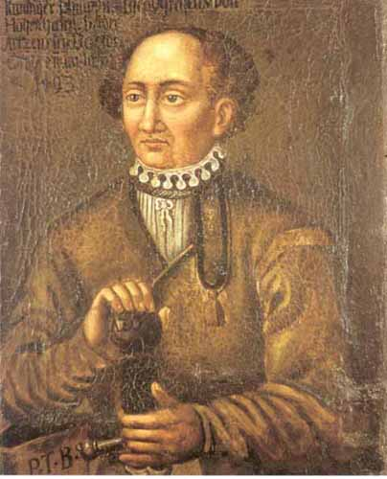
Notes:
Philippus Aureolus Theophrastus Bombastus von Hohenheim (1493 – 1541) - The difference between drug and poison is only a matter of dose.

Slide 4

Intoxication
Notes:
Intoxication – administration of a substance (drug), which alters basic physiological functions (breathing, blood circulation, cognition)

Slide 5
Intoxication treatment
Causal
Administration of antidote
Symptomatic
Stabilisation and support of vital functions
Notes:
Basic algorythm of treatment of intoxications

Slide 6
Necessary definitons
What exactly are „Antidots“ ?
  Drug or substance with opposite effect to poison or venom, which administration is expected with improvement of vital functions impaired by intoxication
Mechanism of action
Pharmakokinetic
Carbo Activatus
Pharmacodynamic
Flumazenil
Viper Antivenom
Notes:
Antidots – are drugs, which bind or in other way inactivate poison or are antagonists to its toxic effect !

Slide 7
Antidots available in Czech republic
Amanita Phalloides toxin | Silymarin, hepatoprotectives
Morphin and morphinomimetics (Narcotics) | Naloxone, Naltrexone
Atropin, anticholinergics | Physostigmine
Benzodiazepines | Flumazenil
Digitalis | Digitalis Antitoxin
Glycoles (polyoles) | Etanol
Warfarin and Coumarines | Vitamin K₁,
Cyanides | Amylum nitrosum, Hydroxycobalamine
Methemoglobinizing agents | Toluidine blue
Methanol | Etanol, Folic Acid
Lead | Succimer
Organophosphates | Atropin, obidoxime (AchE reactivators)
Paracetamol (Acetaminophen) | N-Acetylcysteine
Mercury | Unithiol
Viper venom | Viper Venom Antitoxin ®
Iron | Desferioxamin
Universal Antidot - Carbo activatus

Slide 8
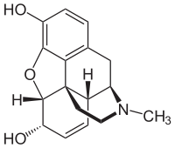
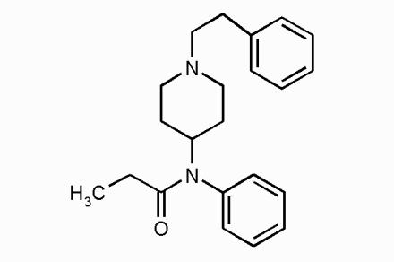
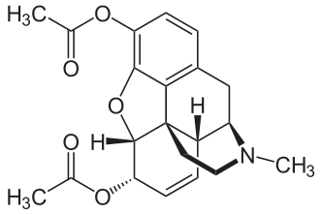
Opiates and narcotics
Opioid intoxication leads
sedation
Cognitive impairment
Depression of breathing centre of CNS
Notes:
Morphin, Heroine, Fentanyl

Slide 9
Opiates and narcotics
Symptoms
  Somnolence, miosis, nausea, vomitus
  Euphoria is strongest after Heroin
  Intestinal hypomotility and constipation (chronic use)
Selective antidots
  Naloxone
  Naltrexone
    Necessary to administer until is secured hepatal elimination of narcotic
Route of administration is crucial for proper pain management and minimazing risk of intoxication
(from the patient point of view) – i.v., per os, nasal
Notes:
Naloxone and Naltrexone are used in small doses to prevent adverse effects of opiates in chronic pain management (Suboxone®)

Slide 10
Management of withdrawal syndrome
Heroin addiction and overdose
  Opioid antagonist (NLX, NTX)
  Spasms and anxiety
    Diazepam
    Haloperidol
    Tiaprid

Slide 11
Atropin, Scopolamine, L-Hyocyamine
(Tropan alcaloids)
naturally occurence in Datura stramonium, Atropa belladona
Direct antagonists of Ach in parasympatikus
  Skin erubescence, mucose dryness (severe xerostomia), tachycardia, mydriasis, misorientation, urine retention, coma

Slide 12
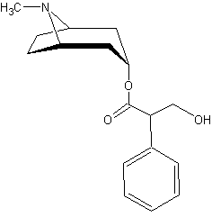
Atropin, Scopolamine, L-Hyocyamine (Tropan alcaloids)
Causal therapy
  Administration direct antagonist – physostigmin
Symptomatic therapy
  Beta-blockers (atenolol)
  Carbo activatus and stomach lavage

Slide 13
Anticholinergic agents
(1st generation antidepressants)
Tricyclic antidepressant agents
  Inhibition of serotonine and noradrenaline uptake
  Dosulepin, Amitriptylin, Imipramin
  Intoxication induces anticholinergic syndrome
    Xerostomia, mydriasis, tachycardia,
    sedation, expansion of QRS complex
Antidote – None
  High dose of carbo activatus
  Symptomatic therapy till improvement

Slide 14
Sedatives and hypnotics
Anticonvulsant and myorelaxant activity
Bezodiazepines
  Alprazolam
  Bromazepam
  Diazepam
Non-BZD hypno-sedatives
  Zolpidem
  Zopiclon
Symptoms
  Somnolence, ataxia and hypotension
  Escalation of pharmacodynamic effenct on GABA receptor – coma
Antidot for both BZD and non-BZD hypno-sedatives
  Flumazenil – antagonist on GABA receptor
Notes:
Flumazenil requires to be administered in cotinual i.v. Infusion, due to shorter elimination half-time.

Slide 15
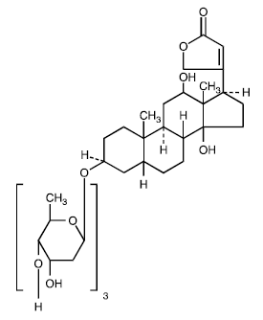
Digoxin and cardiac glycosides
D. Purpurea, D. Lanata,
Cardiotonicum, antiarrhytmic agent
Atrial fibrilation
Heart failure
Terapeutic drug monitoring
Notes:
Most common intoxication, range 0,5mmol/l – 1,15 mmol/l in plasma.

Slide 16
Management of digitalis toxicity
Digitalis Pharmacokinetic parameters
High level of plasma protein binding
Large distribution volume
Digitalis pharmacodynamic parameters
Na/K ATPase block
Arrhytmogenic potential
Strategy of treatment
Dialysis is uneffective
Antidote – digitalis antitoxin
Notes:
Digitalis antitoxin selectivelly binds to digoxin and allows its elimination through kidneys (very expensive).

Slide 17
Symptoms of digitalis toxicity
Hypokalemia – increased potassium kidney elimination
Nausea, vomiting
Color perception disorder – yellow sight
dizziness, arrhytmia
Strategy
  Discotinue digoxin administration
  In severe cases apply antitoxin

Slide 18
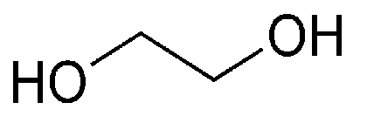
Management of glycol intoxication
Glycols
  Carbohydrates with more than one OH functional group
  Hepatal metabolism converts glycolsto oxalic acid and to calcium oxalate
  Risk of metabolic (chemical damage) acidosis and renal damage by precipitated calcium oxalate
Notes:
Calcium Oxalate insoluble in water (urine).

Slide 19
Management of glycol intoxication
Symptoms
  Renal
    Hematuria , albuminuria, acute tubular necrosis, anuria
  Non-renal
    Metabolic acidosis, hypocalcemia, spasms, dysrrhytimias
Ethyleneglycol metabolised by alcoholdehydrogenase
  Antidotum – ethanol
  Ethyleneglycol eliminated by kindeys in unchanged form
During threatment with ethanol, correction of metabolic acidosis and calcium supplementation is required

Slide 20
Lead poisoning
Toxicity of Lead
  Ligation to haemoglobin
  Inhibition of haem synthesis ( block of 5-ALA-synthase)
    Accumulation of koproporphyrines
Results to
  Sideroblast anaemia, neuropathy and constipation
Threatment
  Chelation by DMSA (dimercaptosuccunic acid) and elimination through kidneys, EDTA
  Organic forms of lead do not respond to chelation (penicilamine ?)
Notes:
Anaemia, neuropatia and constipation due to Iron accumulation in plasma

Slide 21
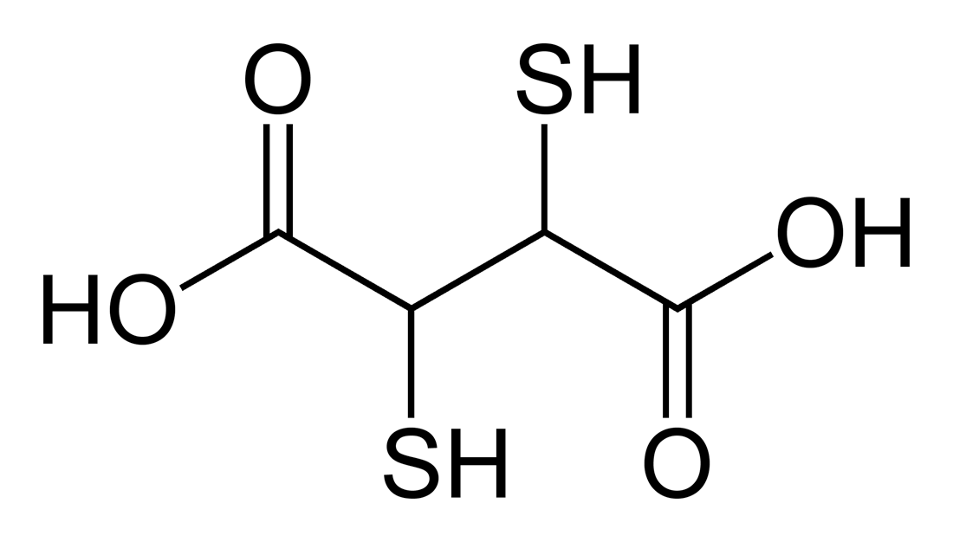

Slide 22
Mercury poisoning
form ion Hg²⁺ in mercury chloride and mercury nitrate
  Route on intoxication through lungs
  Central neural toxicity (tremor, sleep inversion, eretism)
Threatment with chelation
  Unithiol – dimercaptopropan sulphate
Notes:
Only 5 percent of ingested mercury reaches bloodstream, due to minimal GI absorbtion.

Slide 23
Organophosphates poisoning
Esters of phosphoric acid with carbohydric alcohols (methanol), which cause irreversibile inhibition of AchE
Irreversibile inhibition of AchE, which results to its toxicity
  Cumulation of acetylcholine
  Symptoms of parasympatomimetic stimulation
    Muscarine
      salivation, bradycardia, miosis, nausea, vomitus, lacrimation, diarrhoea
    Nicotinic
      Desorientation, spasms, coma
Notes:
Decrease of AchE activity under 30 percent si limit for presentation of toxicity, decrease of AchE activity under 20 percent is heavy poisoning.

Slide 24
Organophosphates poisoning
Strategy of treatment
AchE reactivators
Obidoxime
Organophosphate-AchE complex „Aging“ after more than 6 hrs since intoxication
Atropin manages only muscarinic symptoms
Oximes administered always after Atropin
Notes:
Organophosphate-AchE complex Aging – change in conformation, which makes whole complex stable and intact to any reactivation.

Slide 25
Carbamate insecticides
Carbamates
  Competitive inhibitors of AchE
  Poisoning is simillar to Organophosphates
  Atropin administered in individual dose according to improvement.
  Management of adverse phenomenon
    Symptomatic therapy
  Administration of Oximes is not necessary
Notes:
Similar symptoms, however not that severe.

Slide 26
Methemoglobinemia agents
Aromatic and alifatic organic amines (Aniline, etc.)
Nitroarenes (nitrobenzene, etc.)
  Industrial substances to prepare explosives, when ingested, causing oxidation of iron in Haemoglobin
    Fe²⁺ to Fe³⁺
15 – 30 % damaged haemoglobine
  Cyanosis, tachycardia, fatigue
30 – 50 %
  Weakness, dyspnoe, headache
50 – 70 %
  Cognition impairment, death

Slide 27
Antidotes and treatment
Chemical reduction of Fe³⁺ to Fe²⁺
  symptoms
    Dyspnoe, fuzziness, chest pain
Thiazine colours
  Toluidin blue 3 % solution i.v.
  Methylene blue 1% solution i.v.
    Donors of electrone necessary for NADPH- dependent mechanistm of methemoglobin-reductase enzyme
    Risk for patients with congenital GLUCOSE-5-PHOSPHATE DEHYDROGENASE deficiency
Indication of Thiazines administration is concentration of methemoglobin above 25 %
Notes:
Accumulation of non-reduced form of colour and worsening of methemoglobinaemia, due to acido-basic character of colours.

Slide 28
Inhalation trauma
First Aid !
Administration of oxygen
In case of bronchospasm
  Beta₂-mimetics (formoterol, salbutamol)
  Inhalation spasmolytic agents (ipratropium bromide)
Inhalation of corticosteroids is obsolent and has no effect

Slide 29
Warfarin
Anticoagulant widely used in many coagulopathies
  Necessary periodic monitoring of INR
  High risk of drug-drug interacions
  3 day latency
  Competitive inhibitor of vitamin K-mediated synthesis of coagulation factors ( II, VII, IX, X)
Antidote – vitamin K

Slide 30
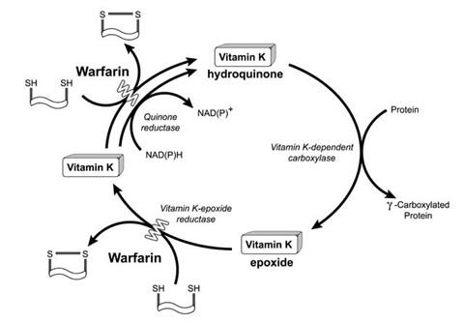

Slide 31
Iron intoxication
GI tract disorder
  Haemorhhagic gastritis, black vomitus and severe stomach pain
  Severe constipation and circulation colaps
Antidotum
  Chelation using deferoxamin
    i.v. , i.m.
    per os with gastric scope
  Symptomatic therapy to secure vital functions and prevent shock

Slide 32
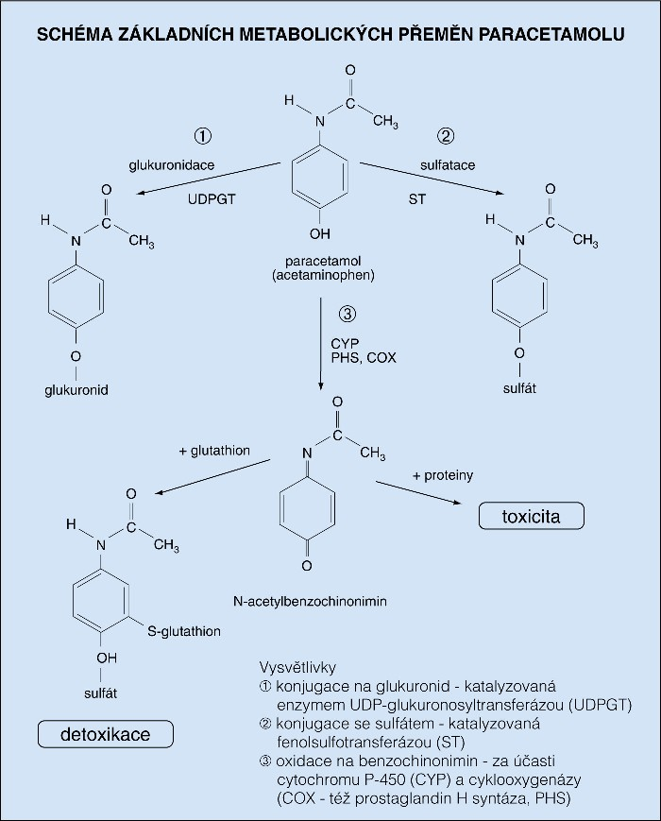
Paracetamol (Acetaminophen)

Slide 33
Toxicity of paracetamol
Toxic dose 140 – 150 mg/kg
  Nausea, vomitus, hepatotoxicity,
  After 24 hrs of no treatment lead to hepatorenal syndrome with hepatal and renal failure
High dose of carbo activatus, hepatoprotectives
  (N-acetylcysteine),
In case of vomitus (ondansetrone)
Therapy in cursu till normalisation of hepatic markers
Notes:
Prolongation of PTT, amonium encephalopathy, metabolic acidosis, death.

Slide 34
Methanol intoxication
Dangerous substitution for ethanol
Metabolized with same alcoholdehydrogenase to formic acid (toxic metabolite)
  Individual dose due to activity of Alcoholdehydrogenase and capacity of folic acid
  Cummulation of formic acid lead to damage of retina
Early symptoms
  Drunkness, gastritis
Late symptoms
  blindness (after 30 hrs), spasms, coma, death
Antidote – ethanol
  Formic acid creates with ethanol ester, which is harmlessly eliminated by kidneys
Notes:
Adjuvant antidotes – folic acid, fomepizol (inhibitor of alcoholdehydrogenase) used without ethanol !!!

Slide 35
Carbo activatus as universal antidote
Prepared by pyrolysis of plants
Characteristic with its high absorption surface (3700 m²/g)
Mechanism of effect
  Absorption
  Secondary elimination of toxins from bloodstream
Lack of effect with high-polar molecules
  Lithium, glycoles

Slide 36
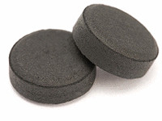

Slide 37
Indications
  Poisons with enterohepatal circulation
  Severe intoxications withou dialysis`s perspective
  Slow-release drug forms (repeatedly)
Contraindications
  Intoxication with irritative poisons (acid, lye)
  Cognitive impairment and airways blockage
  GI obstruction
Carbo activatus is without any severe adverse effect, in rare cases can cause constipation.

Slide 38
milan.juhas@fnusa.cz

