Slide 1

BASIC INDUSTRIAL TOXICOLOGY
PharmDr.Milan Juhás
St.Anne`s University Hospital Brno

Slide 2
Today`s goal ... (1)
Focus on industrial intoxications
  Lead poisoning (Pb)
  Carbon monooxide (CO)
  Insecticides (organophosphates)
  Hydrogen cyanide (HCN)
  Hydrogen sulphide (H₂S)

Slide 3
Today`s goal ... (2)
Focus on industrial intoxications
  Toxicokinetic properties
  Toxicodynamic effects
  Industrial occurance and health effects

Slide 4
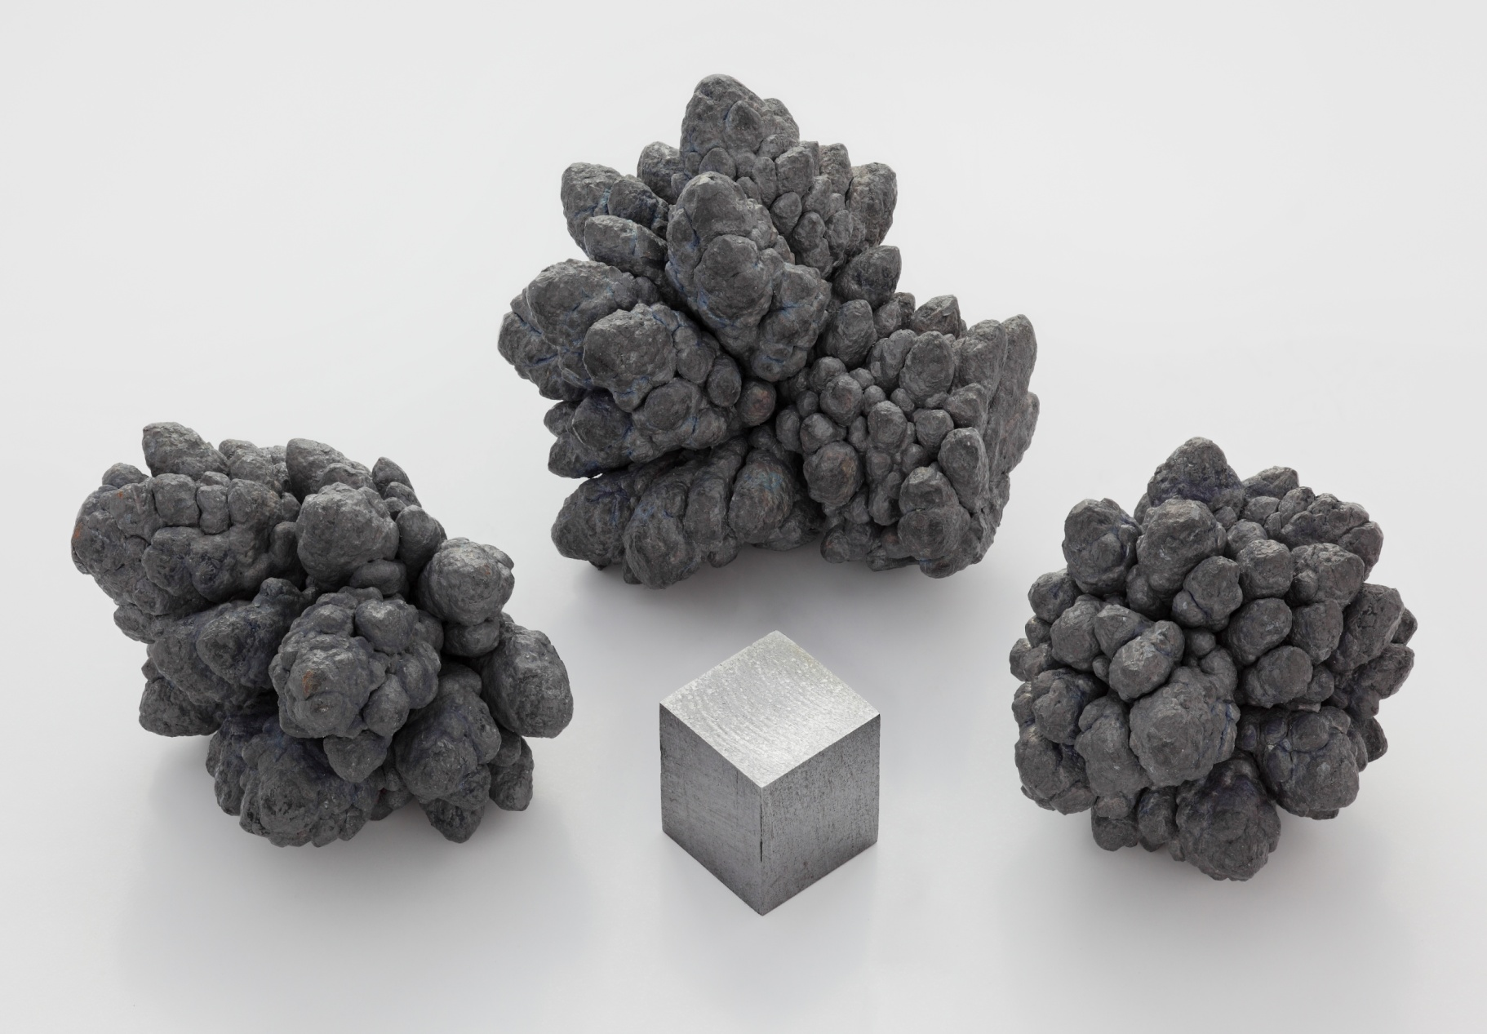
Lead (Pb)

Slide 5
Lead - properties
Heavy soft grey metal
High density and resistance against rust
Forms
  „pure“ metal
  Organic compund (petrol hydrocarbons) TML, TEL
  Inorganic compound (PbS)
Pipes, petrol, ammunition, foil

Slide 6
Lead - toxicokinetic parameters
Absorbtion
  Lungs (major absorption)
  minority via GIT
  Presence of other metals in diet increases GIT absoption !
Distribution
  RBC biomembrane
  Bone deposits
  Extreme long half-time
Notes:
Other metals (calcium, iron)

Slide 7
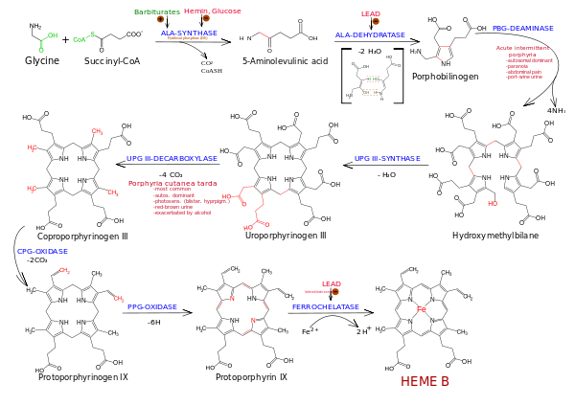
Lead - toxicodynamic parameters (1)
Schema author: Boswell, 2012
Notes:
Lead blocks conversion of D-ALA to protoporfyrinogen and incorporation of iron atom to central position in protoporphyrine IX, which results in lack of haem molecule formation.

Slide 8
Lead - health effects
Acute symptoms
  Fatigue, Abdominal cramps
  Constipation, Myalgia
  Encefalopathy, Renal failure (children)
Chronic intoxication
  Peripheral neuropathy,
  Anemia
Organic forms – psychosis, mania
Notes:
Lead manifests its toxic effects maily by binding to sulfhydryl groups of proteins, which causes „denaturation“ of several protein molecules and loss of its biologic activity.
TREATMENT – EDTA, PENICILLAMINE

Slide 9
Lead poisoning (Pb)
Carbon monooxide (CO)
Insecticides (organophosphates)
Hydrogen cyanide (HCN)
Hydrogen sulphide (H₂S)

Slide 10
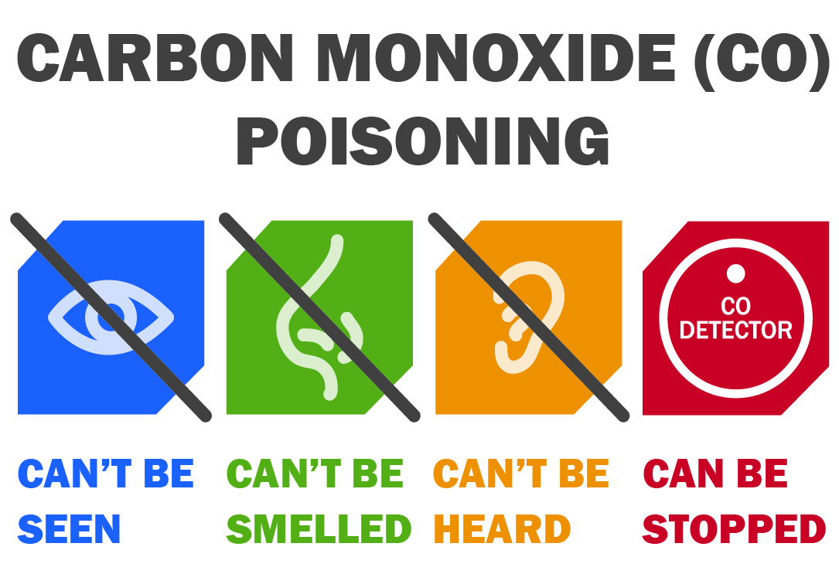
Carbon monooxice (CO) - properties
Incomplete combustion of carbonaceous compounds
Colourless, odourless gas

Slide 11
CO - toxicodynamics
CO causes tissue hypoxia
  Active competition with oxygen at HB binding sites
  Decrease of P_{O2}
  Carboxyhaemoglobin (COHb) synthesis
  HB vs. CO - high affinity ( 100 – 240 x stronger)
RESULT: Hb transport capacity for O₂ diminishes
Notes:
Po2 – partial gas pressure (parcialny tlak plynu)

Slide 12
CO – health effects
Toxicity in corelation with c[COHb]
CO level in acute intoxication
  Below 1 % - asymptomatic
  Up to 30 % - non specific effects: dizzyness, headache, neusea, vomitus, tachycardia
  Above 30 % - hypotension, spasms,
  cherry-red skin discoloration,
  Above 60 % - generalized weakness, confusion, cardiac and respiratory depression,
  Above 90 % - death within few minutes
Notes:
Chronic toxicity manifests headache, organic psychosyndrome,

Slide 13
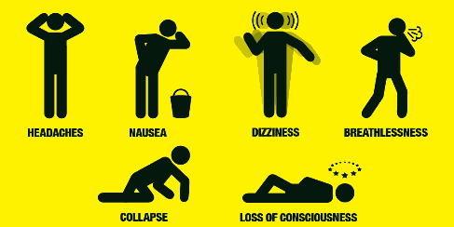
Carbon monooxide intoxication symptoms

Slide 14
CO intoxication treatment
Hyperbaric oxygen
  Increase P_{O2} in plasma
  Result: decrease of c[COHb] due to chemical competitive shift
Brain edema
  Corticosteroids, diuretic therapy
Notes:
CO halftime in healthy adults 4-5 hours in atmosphere at sea level

Slide 15
Lead poisoning (Pb)
Carbon monooxide (CO)
Insecticides(organophosphates)
Hydrogen cyanide (HCN)
Hydrogen sulphide (H₂S)

Slide 16
Organophosphates
Inhibition of AchE, PchE
Insecticides in agriculture (obsolete)
Chemical weapon – war gas
Route of poisoning
  Dermal absorption
  Inhalation
Notes:
Pche - pseudocholinesterase

Slide 17
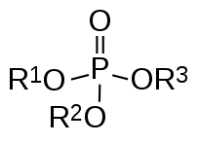
Organophosphates

Slide 18
Organophosphates
Accumulation of acetylcholine
  Synapsis
  RBC
  Increased c[acetylcholine] affects both central and peripheral nervous system
Treatment: atropine, AchE-reactivators
Problem: enzyme aging,
respiratory depressant medication
Notes:
Atropinw in high doses. Usually 2-4 mg in 10 minute interval until some improvement or atropin toxicity (tachycardia, xerostomia).
Obidoxime is in order in 250 mg i.v. infusion or slow i.m. injection repeatedly till respiratory functions improve.
Obidoxime is indicated only with maximum atropine dose.

Slide 19
Lead poisoning (Pb)
Carbon monooxide (CO)
Insecticides (organophosphates)
Hydrogen cyanide (HCN)
Hydrogen sulphide (H₂S)

Slide 20
Hydrogen cyanide (HCN)
Colourless gas with bitter smell
Use in industry
  Extraction of gold, silver
  Synthetic fibres and plastic matherials
  Metallurgy

Slide 21
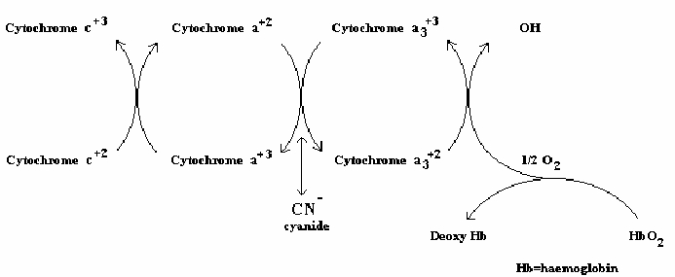
Hydrogen cyanide (HCN)
Toxicity
  Inhibition of cytochromeoxidase in mytochondrial oxydative metabolism

Slide 22
Hydrogen cyanide (HCN)
Route of intoxication
  Skin absorbtion
  inhalation
Acute toxicity symptoms
  Headache, tachycardia, hypotension, convulsion
  Death

Slide 23
Hydrogen cyanide (HCN)
Remove contaminated clothing
Wash exposed skin
Amylnitrite inhalation
25 % sodium thiosulphate sol. i.v.
Notes:
The nitrites oxidize some of the hemoglobin's iron from the ferrous state to the ferric state, converting the hemoglobin into methemoglobin.Cyanide binds avidly to methemoglobin, forming cyanmethemoglobin, thus releasing cyanide from cytochrome oxidase.^{[14]} Treatment with nitrites is not innocuous as methemoglobin cannot carry oxygen, and methemoglobinemia needs to be treated in turn with methylene blue.
The evidence for sodium thiosulfate's use is based on animal studies and case reports: the small quantities of cyanide present in dietary sources and in cigarette smoke are normally metabolized to relatively harmless thiocyanate by the mitochondrial enzyme rhodanese(thiosulfate cyanide sulfurtransferase), which uses thiosulfate as a substrate. However, this reaction occurs too slowly in the body for thiosulfate to be adequate by itself in acute cyanide poisoning. Thiosulfate must therefore be used in combination with nitrites.^{[14]}

Slide 24
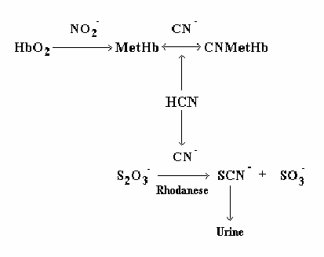
Hydrogen cyanide (HCN)
Notes:
The nitrites oxidize some of the hemoglobin's iron from the ferrous state to the ferric state, converting the hemoglobin into methemoglobin.Cyanide binds avidly to methemoglobin, forming cyanmethemoglobin, thus releasing cyanide from cytochrome oxidase.^{[14]} Treatment with nitrites is not innocuous as methemoglobin cannot carry oxygen, and methemoglobinemia needs to be treated in turn with methylene blue.
The evidence for sodium thiosulfate's use is based on animal studies and case reports: the small quantities of cyanide present in dietary sources and in cigarette smoke are normally metabolized to relatively harmless thiocyanate by the mitochondrial enzyme rhodanese(thiosulfate cyanide sulfurtransferase), which uses thiosulfate as a substrate. However, this reaction occurs too slowly in the body for thiosulfate to be adequate by itself in acute cyanide poisoning. Thiosulfate must therefore be used in combination with nitrites.^{[14]}

Slide 25
Lead poisoning (Pb)
Carbon monooxide (CO)
Insecticides (organophosphates)
Hydrogen cyanide (HCN)
Hydrogen sulphide (H₂S)

Slide 26
Hydrogen sulphide (H₂S)
Colourless gas with characteristic smell
Toxicity similar to HCN
Inhibition of oxidative mitochondrial metabolism (cytochromeoxidase, HbO₂)
Sulphmethaemoglobin formation
Petrol products (fuel gas), ruber factories
Notes:
Smell of rotten eggs.

Slide 27
Hydrogen sulphide (H₂S)
Acute poisoning
  Lacrimation, photophobia, mucose irritation (low concentration)
  Pneumonitis, respiratory centre paralysis (high concentration)
Chronic exposure
  Keratitis, skin vesicles

Slide 28
Hydrogen sulphide (H₂S) - therapy
Immediate removal of hydrogen sulphide source
Oxygen
Sodium amylnitrite
  conversion of sulphmethaemoglobin
  Symptomatic therapy

Slide 29
milan.juhas@fnusa.cz

