Slide 1
Occupational cancer diseases

Slide 2
External environment and the occurrence of malignancies
80 – 90 % of tumors are caused by external factors:
smoking – 30 %
nutritional factors and diet – 35 %
alcohol – 5 %
infections, especially viral – 5-10 %
low physical activity – 5 %
solar radiation, pollution

Slide 3
Occupational cancer diseases
Occupational cancer is caused wholly or partly by exposure to a cancer causing agent (carcinogen) at work, or by a particular set of circumstances at work.
It is estimated that 5% of tumors are caused by exposure to carcinogens in the workplace.
Men are affected more often.

Slide 4
Cancers in the EU
New cases of cancer: > 2 million/year
Cancer mortality: > 1 million/year
In the EU, 23 % of the workforce exposed to carcinogens on a daily basis
Occupational cancer: 5-8 %, probably higher among male workers
It is estimated that occupational cancers are a leading cause of work-related death in Europe (and also worldwide)

Slide 5
What causes occupational cancer?
Occupational cancer is caused by exposure to carcinogens in the workplace.
Carcinogens are agents that cause the development or increase the incidence of cancer.
There are three different types of occupational carcinogens:
-Biological carcinogens
-Physical carcinogens
-Chemical carcinogens

Slide 6
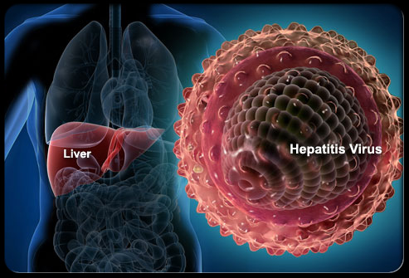
Biological carcinogens
some micro-organisms such as viruses have been known to cause cancer:
by damaging cells directly
by decreasing the body's ability to control abnormal cells
for example Hepatitis B, C,
HIV viruses and so on
(hepatocellular carcinoma
in response to HBV, HCV)

Slide 7
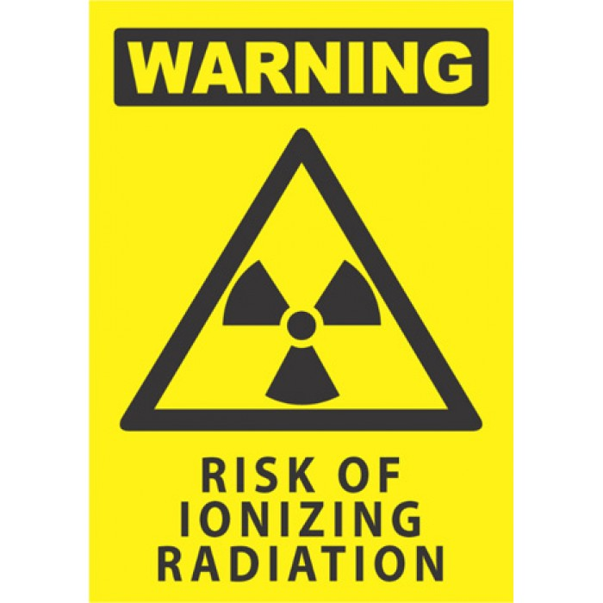
Physical carcinogens
agents such as ionising and
ultraviolet (UV) radiation have
the potential to cause cancer
ionising radiation: X-rays, alpha, beta and gamma, neutron radiation (skin cancer, leukemia…)
UV radiation can be divided into a number of bands such as UV-B, UV-C etc, some of which are known to cause skin cancer (historically - sailors)

Slide 8
Chemical carcinogens
a number of chemicals are known to be carcinogenic
these chemicals may occur naturally, such as asbestos, be manufactured like vinyl chloride, or be by-products of industrial processes, for example, polycyclic aromatic hydrocarbons

Slide 9
Most widespread carcinogens at work:
Radioactive substances (radon)
Asbestos
Coke oven gases and polycyclic aromatic hydrocarbons
Aromatic amines and nitro compounds
Benzene
Vinyl chloride monomer
Silica dust
Wood dust
Others: solar radiation, passive smoking, diesel engine exhausts, formaldehyde, chromium, arsenic etc.

Slide 10
Common Exposures, EU

Slide 11
IARC
International Agency for Research on Cancer, Lyon France
www.iarc.fr
official institute to declare a certain substance or factor as proven human carcinogen
4 groups of factors + TARGET ORGANS

Slide 12
IARC

Slide 13
Carcinogens by IARC/WHO
1. Sufficient evidence of carcinogenicity to humans (118) – (benzen, VCM, aromatic amines, crude mineral oils, alcohol, ionising radiation…)
2. Limited evidence of carcinogenicity
2A) Probably carcinogenic to humans (79) -
(acrylamide, cisplatin…)
2B) Possibly carcinogenic to humans (290) -
(lead,…)
3. Not classifiable as to its carcinogenicity to humans (501) – (cholesterol, caffeine, toluene,…)
4. Probably not carcinogenic to humans – only one chemical! (caprolactam - production of polyamide fibers - nylon)

Slide 14
Most affected organs
Lung
Urinary bladder
Nasal cavity
Liver (angiosarcoma)
Mesothelioma
Leukemia
Non-melanocytic skin cancer

Slide 15
Types of occupational cancers
Cancers associated with occupational exposure include:
bladder cancer (arsenic; aromatic amines; coal tars and pitched, diesel engine exhaust; work as a hairdresser or barber; metalworking fluids and mineral oils; work as a painter; work in the rubber industry)
bone cancer (ionising radiation)
brain and other central nervous system cancers (ionising radiation)
breast cancer (ionising radiation; ethylene oxide; shift (night) work)
colon and rectal cancer (asbestos, ionising radiation)
kidney cancer (arsenic, cadmium; coke production; trichloroethylene)
laryngeal cancer (asbestos; work in the rubber industry: strong inorganic acid mists including sulphuric acids)
leukaemia (benzene, ethylene oxide, formaldehyde, ionising radiation, non-arsenical insecticides)
liver and biliary cancer (ionising radiation; trichloroethylene, vinyl chloride)

Slide 16
Types of occupational cancers
lung cancer (arsenic; asbestos; beryllium; cadmium; chromium; coal tar and pitches, cobalt; coke production, diesel engine exhaust, dioxins; inorganic lead; iron and steel foundry work, mineral oils; nickel; work as a painter; natural radon in workplaces; ionising radiation, rubber production; silica; work as a welder…)
melanoma of the eye (welding)
mesothelioma (asbestos)
nasal and sinus cancer (chromium, formaldehyde, leather dust, nickel, textile industry, wood dust)
non-hodgkin’s disease (work as a hairdresser or barber, non-arsenical insecticides, work as a painter, tetrachloroethylene, trichloroethylene)
non-melanoma skin cancer (coal tars and pitches, mineral oils, solar radiation)
oesophageal cancer (soots; tetrachloroethylene)
pharyngeal cancer (asbestos)
stomach cancer (asbestos)

Slide 17
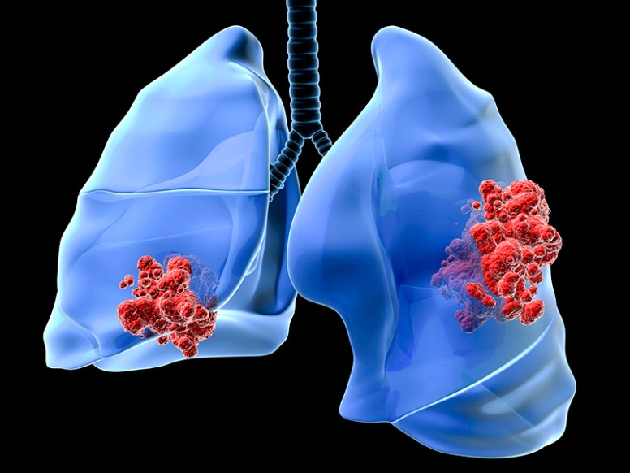
Lung cancer from radioactive substances
is the most common occupational cancer in the Czech Republic
miners of uranium mines
etiology:
radon and its
radioactive decay
products
(alpha radiation)

Slide 18
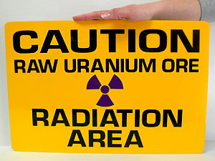
Radon 222
is created by the radioactive decay of radium and uranium
emissions from uranium ore
inert gas, great diffusion capability
natural decay (T 3,8 day) → radioactive decay products of radon (T s-min) → binding the particles to dust →
radioactive aerosol → inhalation and deposition in the airways to the surface of the epithelial lining, decay and emission of alpha radiation with high biological activity →
radiated energy is absorbed in the basal
cells of the bronchial epithelium →
bronchogenous carcinoma

Slide 19
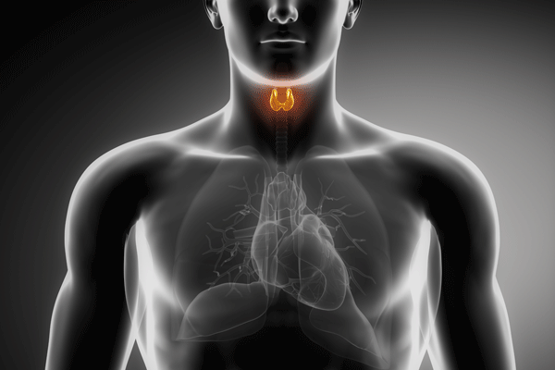
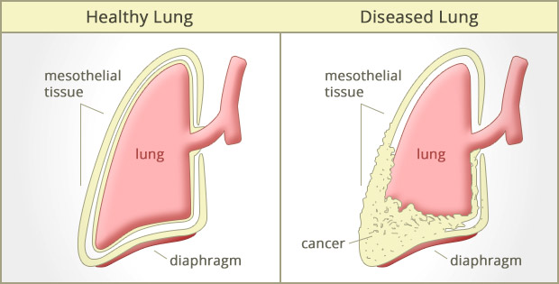
Tumors arising from exposure to asbestos
lung or larynx cancer caused by asbestos in connection with asbestosis or pleural plaques
malignant mesothelioma (pleural – most common, peritoneal)
ovarian cancer caused by asbestos

Slide 20
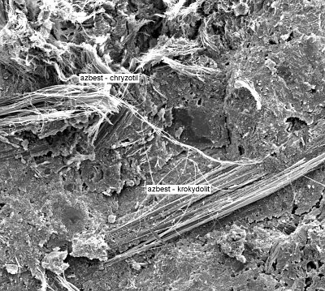
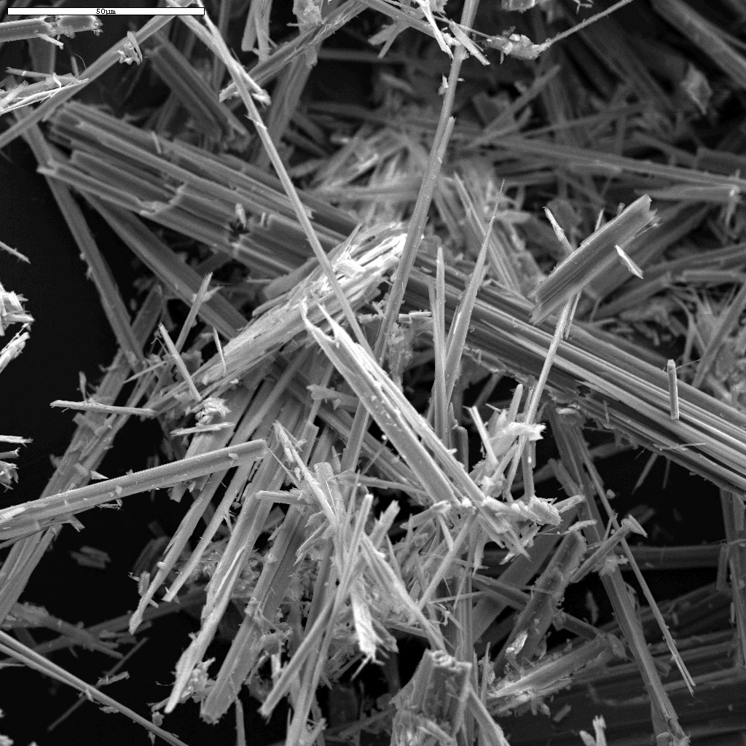
Asbestos
silicate, fibrous minerals
in nature in two forms:
serpentine - chrysotile
amphibole – amosite,
crocidolite, actinolite, tremolite
asbestos fibers are extremely durable and resistant to fire and most chemical reactions
strength and flexibility → used for many years in various industrial branches (roofing shingles, pipeline, textile protective equipment…)

Slide 21
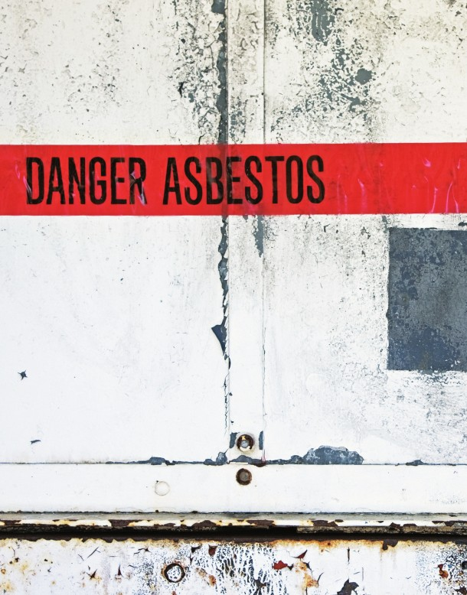
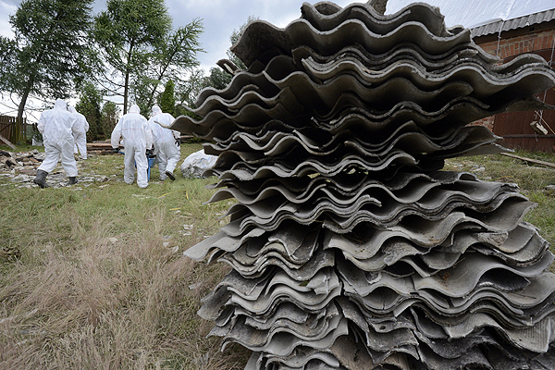
Asbestos
biological effects of asbestos: fibrogenic and carcinogenic (amphibole)
exposure to this mineral can be linked to a number of lung and respiratory diseases →
asbestos is now strictly regulated!

Slide 22
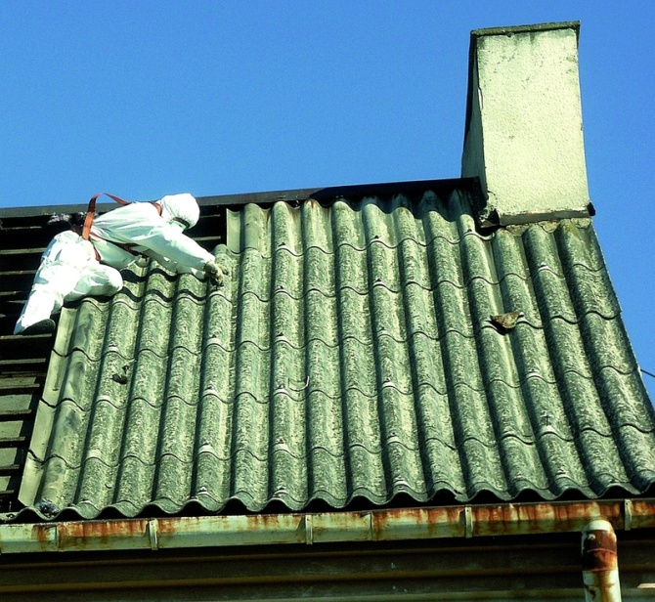
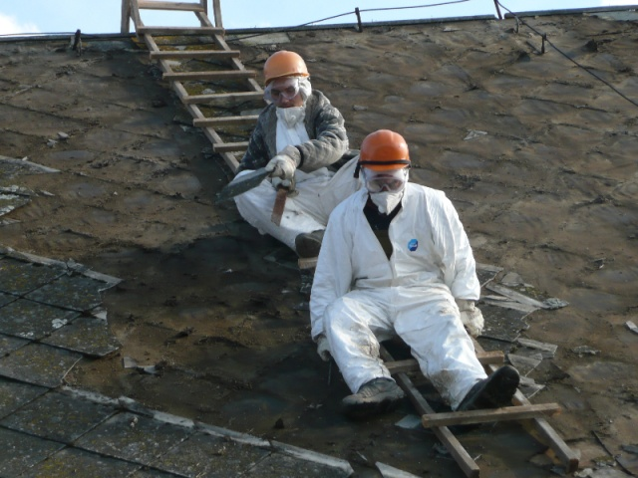
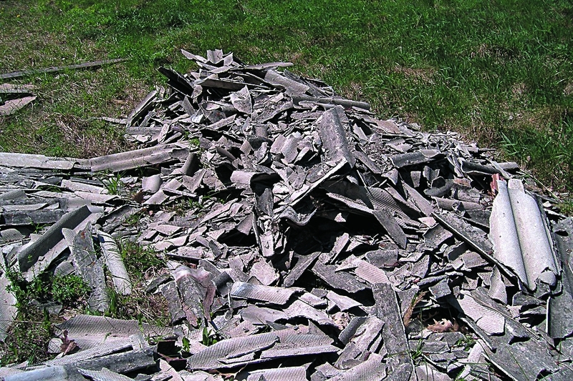
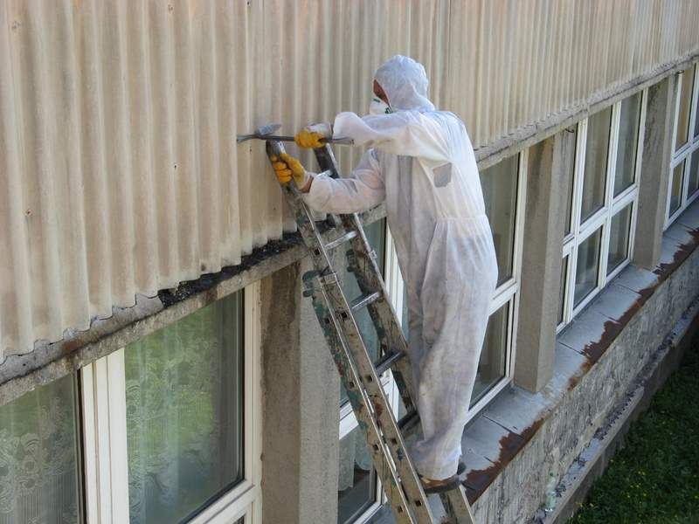
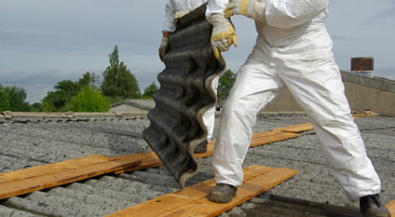

Slide 23
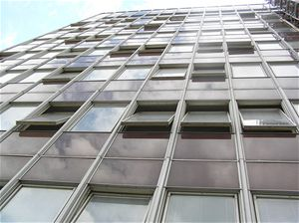
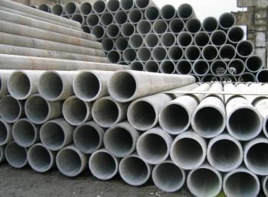
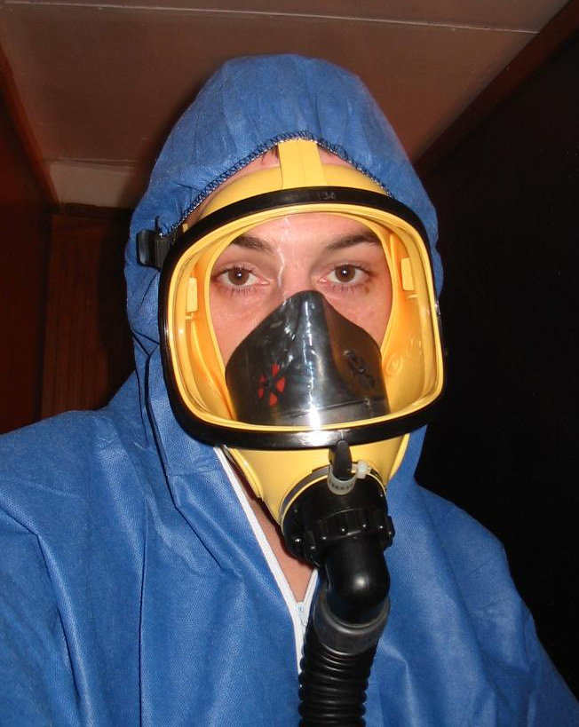
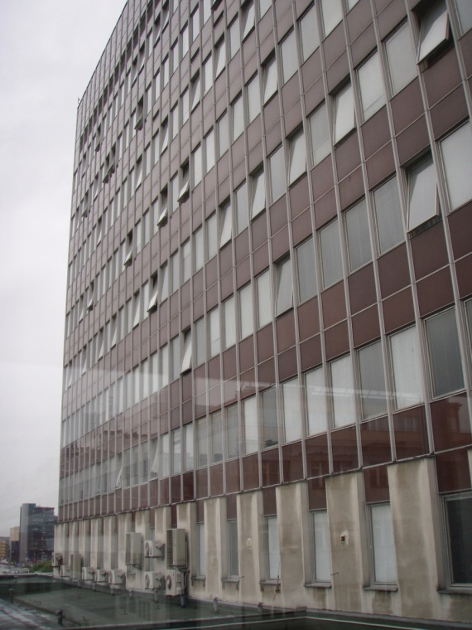
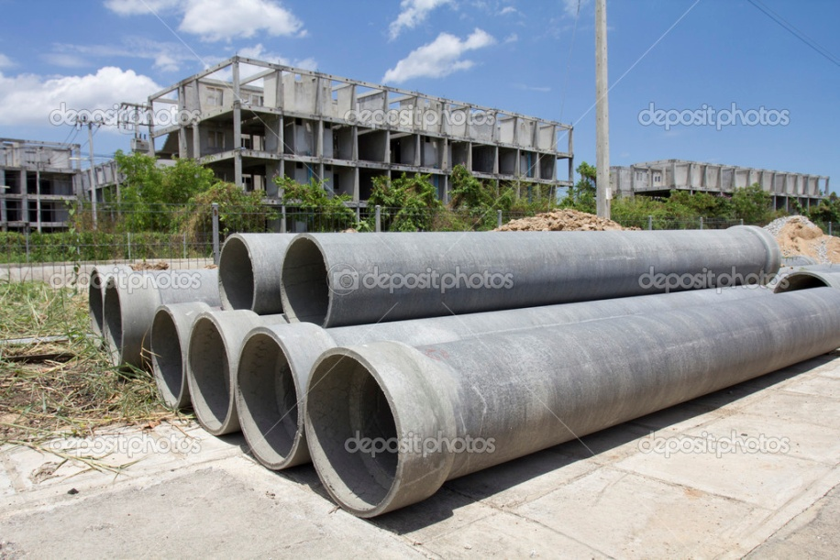

Slide 24
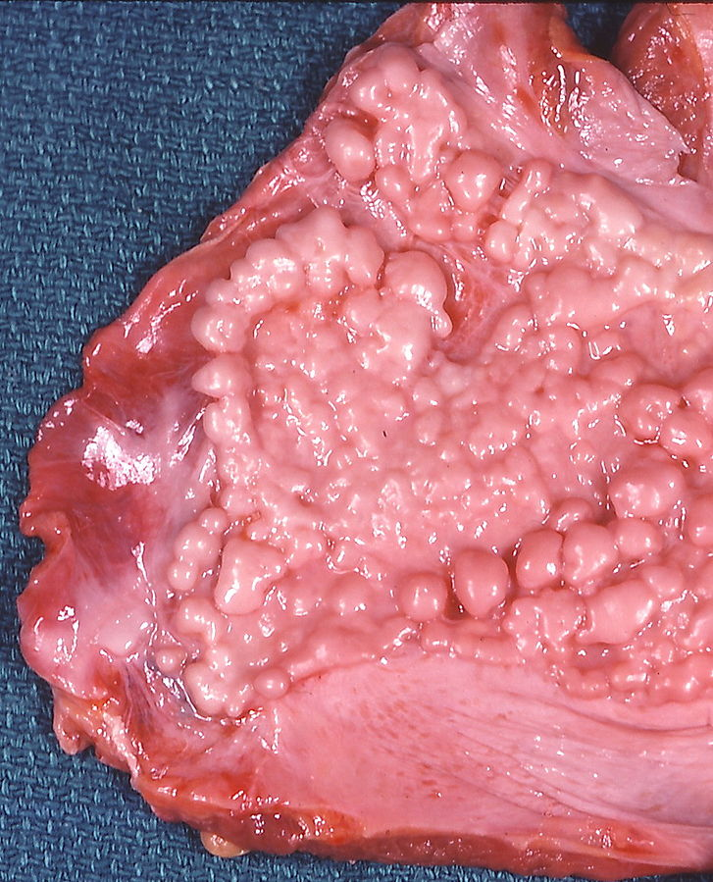
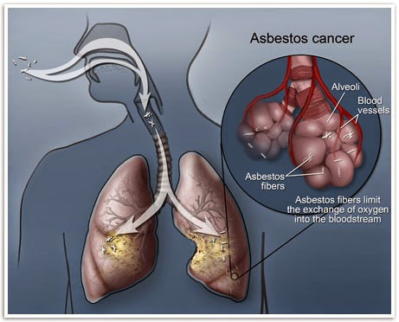
Lung cancer caused by asbestos
increase in the incidence 15-30 years after the beginning of exposure
the effect of asbestos and smoking are synergistic
indistinguishable from lung cancer
from other causes
Fibrous pleura plaque
(asbestosis)

Slide 25
Pleural Mesothelioma
is a rare but aggressive form of asbestos cancer for which the only known cause is exposure to asbestos
anamnesis: exposure to asbestos in the past
long latency period (30-45 years)→ it remains silent in the body for decades, finally appearing via symptoms like cough, shortness of breath, difficulty breathing, chest pain and fatigue
prognosis: 6-12 month

Slide 26
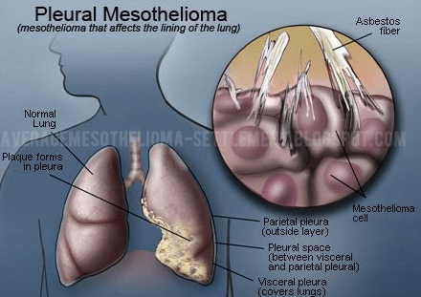
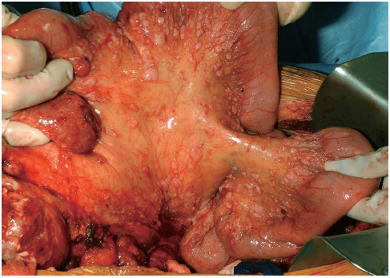
peritoneal mesothelioma

Slide 27
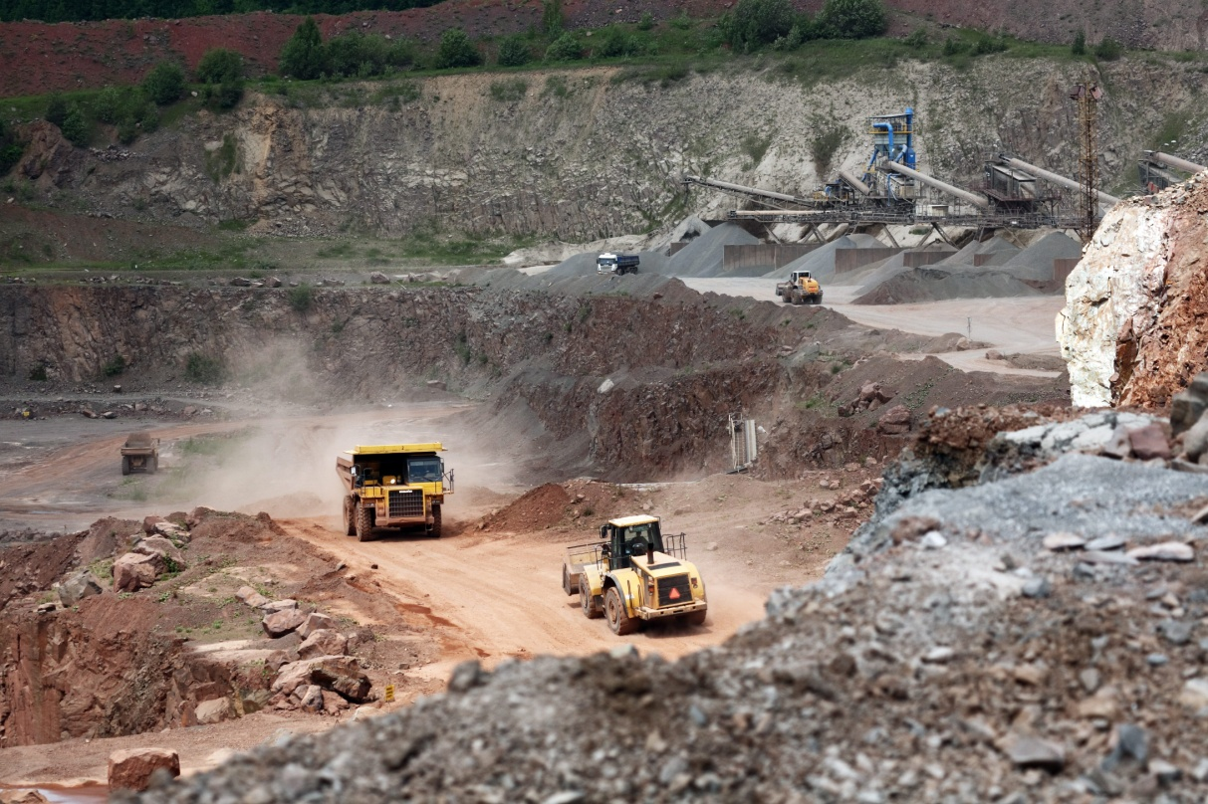
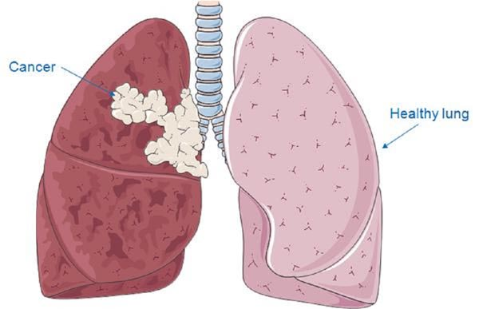
Lung cancer in connection with pneumoconiosis caused by silica dust
workers in high risk jobs such as foundry work, stonecutting, rock drilling, quarry work and tunneling

Slide 28
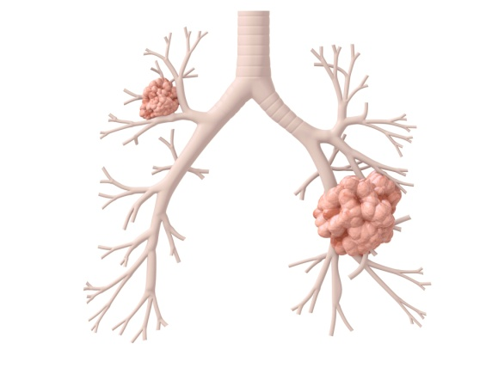
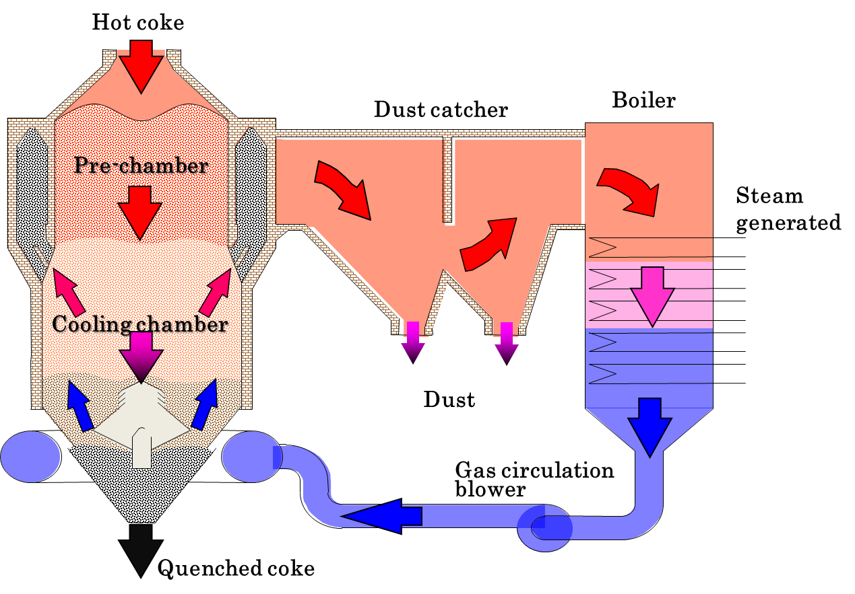
Cancer of the respiratory tract and lungs caused by coke oven gases
production of coke, coal gasification, coal tar, crude mineral oil, soot
polycyclic aromatic hydrocarbons – benzopyrene

Slide 29
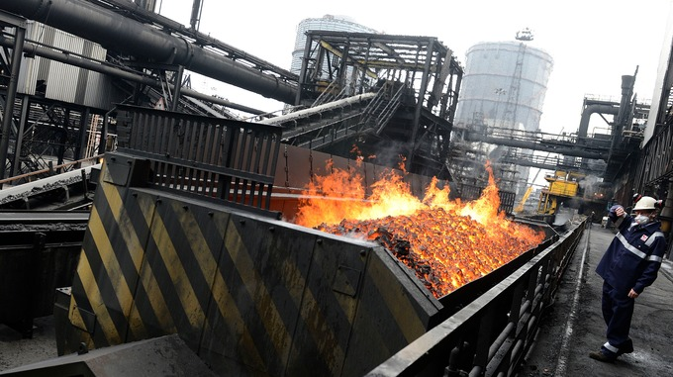
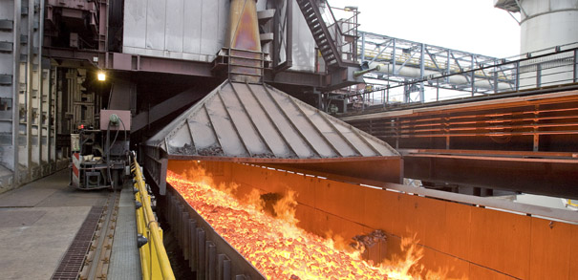

Slide 30
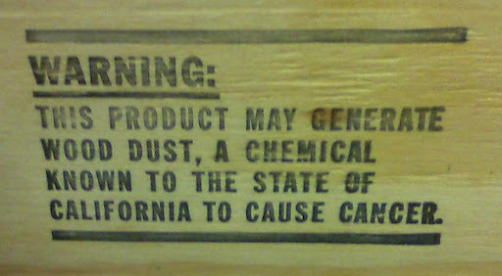
Cancer of nasal mucosa or paranasal sinuses from wood dust
especially adenocarcinomas
exposure to hardwood dust (oak, beech, exotic wood)
furniture and cabinet making, sawmill works and carpentry
long latency

Slide 31
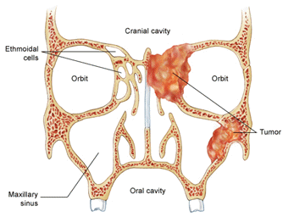
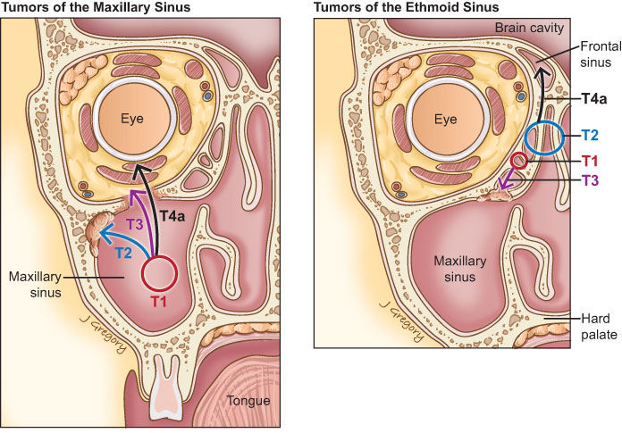
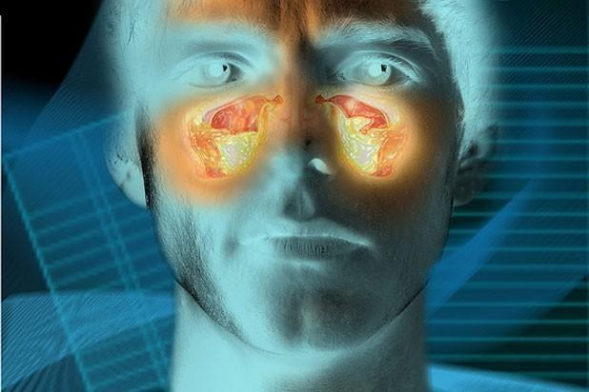

Slide 32
Diagnosis considerations
Occupation accounts for all or part of the tumor process in 5 per cent of cancers
Long latency - induction times for cancer
As a general rule, cancers that are of occupational origin are not distinguishable from non-occupational cancers whether in clinical features, natural history, pathological findings or other special investigations
Occupational cancer may present earlier than the non-occupational varieties
Movement of workers between jobs, work areas or industries
Rare tumors may be an indicator
Multiple exposures

Slide 33
Taking measures
First of all, the material which is defined as carcinogen should be forbidden in industry.
Therefore, a substitute for this material should be researched.
If there is a need of working by carcinogens, taking measures of decreasing exposure as minimum is mandatory.

Slide 34
MEASURES THAT REDUCE EXPOSURE
producing and carrying of carcinogens inside a closed system
measuring exposures in working atmosphere and worker’s biological system
well working ventilation system
personal protective equipment
prohibiting of smoking cigarettes and eating on workplace

Slide 35
Sources
https://www.iosh.co.uk/Books-and-resources/Our-OH-toolkit/Occupational-cancer.aspx
http://www.iarc.fr/
http://www.ttl.fi/en/pages/default.aspx
http://www.ttl.fi/en/chemical_safety/carex/countries/pages/default.aspx
http://www.cancer.gov/about-cancer/causes-prevention/risk/substances/radon/radon-fact-sheet
http://www.mesothelioma.com/asbestos-cancer/what-is-asbestos.htm
https://www.osha.gov/OshDoc/data_General_Facts/crystalline-factsheet.pdf
http://www.cancer.ca/en/cancer-information/cancer-type/nasal-paranasal/risks/?region=on

