Slide 1
INTRODUCTION TO THE STUDY OF PHARMACOLOGY
Notes for Students
This study material is exclusively for students of general medicine and stomatology in Pharmacology I course. It contains only basic notes of discussed topics, which should be completed with more details and actual information during practical courses to make a complete material for test or exam studies. Which means that without your own notes from the lesson this presentation IS NOT SUFFICIENT for proper preparation for neither tests in practicals nor the final exam.

Slide 2
Literature
Rang, H.P. a kol. Rang and Dale‘s pharmacology 8th ed.(2016)
http://web.b.ebscohost.com/ehost/ebookviewer/ebook/bmxlYmtfXzExNjA0OTNfX0FO0?sid=82e7fdcf-dd4c-43d3-b3a3-7b4b24c21b8e@sessionmgr103&vid=0&format=EB&lpid=lp_1&rid=0

Slide 3


Slide 4
Literature
Practicals in Pharmacology, 2006
Hadasova, Novakova, Pistovcakova,
Vinklerova, Sulcova, Starobova
Pdf available at: IS.muni.cz

Slide 5
Pharmacology, definition, aims
„pharmacon“ + „logos“ / „logia“
Scientific discipline dealing with
INTERACTIONS BETWEEN SUBSTANCES.. introduced into the organism from the environment
..AND THE LIVING ORGANISM
on all levels of complexity:
molecular
cellular
organ
organism as a whole

Slide 6
Pharmaceutics
the general area of study concerned with the formulation, manufacture, stability, and effectiveness of pharmaceutical dosage forms

Slide 7
DRUG
„substance or mixture of substances, suppopsed to be administered to the humans or animals for prevention, treatment or diagnosis of diseases or its symptomes or for physiological function adjustment“
Drugs are administered for
Prevention,
Diagnosis,
Treatment of disseases

Slide 8
Pharmacon/um – drug
classical WHO definition:
„Any substance (other than normal body components or substances necessary for normal body functions (food, water, oxygen), that, after administration into the organism evokes a change of a body function“
More precise definition according to Ph.Eur.:
Substances or their mixtures designed to the administration in humans or animals with a purpose of treatment, mitigation, prevention or diagnose of a disease or its symptoms and also to modulation of physiological substances.
  European Pharmacopoea (Ph. Eur. 6th Ed.)
  Pharmacopoea Bohemica 2009 (Ph. B. 2009)

Slide 9
A synthesis of several biomedical sciences….
Biochemistry
Physiology
Pharmacology
Chemistry
Medicine
…but unique in its own right

Slide 10
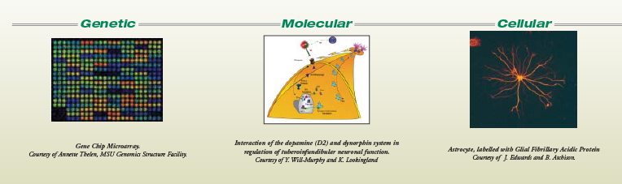
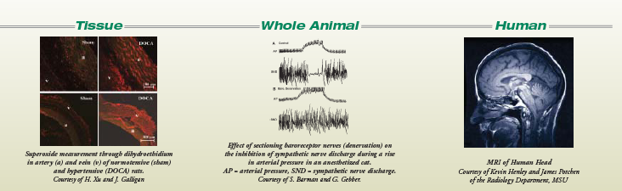
Pharmacologists study science at every level

Slide 11
What Pharmacology is NOT...
Pharmacy
This is a separate profession responsible for the
preparation and dispensation of medication.
Pharmaceutical Science

Slide 12
Basic Pharmacology
General principles
Systems Pharmacology

Slide 13
General principles
Principles which predestinate the interactions of the drug and body
General Pharmacokinetics
General Pharmacodynamics
Two important and interrelated areas:

Slide 14
Pharmacokinetics (PK)
Deals with the fate of the drug in the body – processes of
Absorption,
Distribution
Metabolism
Excretion …“ADME“
„What the body makes with the drug“
Pharmacodynamics (PD)
deals with the mechanism of action (e.g. receptor sites, molecular level of action..)
„How does it work“

Slide 15
Systems Pharmacology
Is focused on individual organ systems and its pharmacotherapy
e.g.
Autonomic drugs
Psychoactive drugs
Drugs used in cardiovascular diseases….

Slide 16
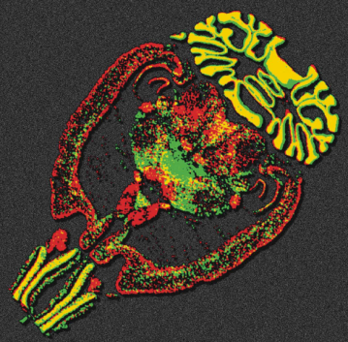

Systems Pharmacology
Neuropharmacology: study of the effect of drugs on
components of the nervous system (brain, spinal cord, nerves)
Example: treatment of Alzheimer‘s disease
Cardiovascular Pharmacology: study of the effects of drugs on heart, vasculature, kidney, nervous and endocrine systems that participate in cardiovascular function.
Example: treatment of high blood pressure (hypertension)

Slide 17
Branches of Pharmacology
Clinical pharmacology
deals with different drugs and their varied clinical usage
interdisciplinary branch, which integrates basic and
experimental Pharmacology with the clinical and
complementary branches
AIM: to study and evaluate the effect of the drug using
objective methods (EBM)
Sub-branches of clinical pharmacology:
Clinical Pharmacokinetics, clin. Pharmacodynamics,
Rational prescribing, Clinical toxicology

Slide 18
Toxicology
the study of the toxic effects of chemicals on living organisms
study of symptoms, mechanisms, treatments and detection of poisoning
experimental (in vitro, in vivo)
clinical - poisoning prophylaxis, diagnosis, treatment
forensic toxicology…

Slide 19
Pharmacogenetics
    deals with the influence of genetic variation on Pharmacokinetics and Pharmacodynamics
    study of the drug response in patients by correlating gene expression or single-nucleotide polymorphisms with a drug's efficacy or toxicity
consequences can be either quantitative or qualitative

Slide 20
Pharmacogenetics
1959 Friedrich Vogel used first time term „pharmacogenetics“
1997 First time used term “Pharmacogenomics“
Pharmacogenetics considers one or at most a few genes of interest, while pharmacogenomics considers the entire genome.

Slide 21
Biochemical and molecular pharmacology
detail study of the mechanism of action at molecular level
Chronopharmacology
Study of the action of the drugs with respect to the biorhythm
(antiasthmatics, glukocorticoids, statins, etc. )

Slide 22
Pharmacovigilance
Pharmacological science relating to the detection, assessment, understanding and prevention of adverse effects
collecting, monitoring, researching and evaluating information from healthcare providers and patients on the adverse effects of medication
Drug safety monitoring
AIM: to minimize the risk of adverse effects

Slide 23
Pharmacoepidemiology
- study of the effect of drugs on populations; questions dealing with the influence of genetics are particularly important
risks and benefits of the therapy using epidemiological methods
Approach of the health specialists (GP, pharmacist)
patient (compliance)
society (drug abuse, marketing, financial resources…)

Slide 24
Pharmacoeconomy
- rationalize the use of sources in health care
- Compares the costs of therapeutic approaches by the pharmacoeconomical analyses
The goal is not „to decrease total money spent in health care“ , but to use the sources effectively

Slide 25
Biological experiment
Experimental pharmacology
in vitro – isolated structures or organs,
cell cultures, microorganisms
- regulatory factors we have to satisfy:
☺ ethical (replacement, refinement, reduction)
☺ small amounts of drugs
☺ use of human cells
☹ elimination of systhemic reaction of the whole body

Slide 26
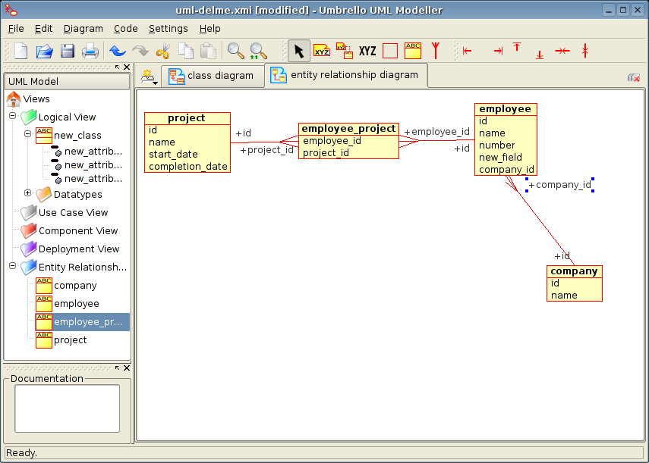
Biological experiment
in silico – use of IT, especially computer modelling (f-kinetics), databases

Slide 27
Biological experiment
in vivo – whole animal
- systhemic effects
- we record toxicity, possible adverse and alergic effects
- impact on memory and other cognitive faculties, learning abilities, depression

Slide 28
Experimental animal
Experimental animal (is born, breed and maintained for experimental purposes)
Defined genetic features:
- randombred – natural breeding - heterozygots
- inbred – breeding of brosthers and sisters, approx. 20 generations homozygots
diabetic mice, hypercholesterolemic mice, hypertonic mice…

Slide 29
Experimental animal
Defined microbial settlement:
- SPF – have 4-5 saprofyte patogens
- Gnotobiotic animals – are born by hysterectomy, pathogens free
- Conventional breeding – not defined settlement (there may be: brucela, leptospira, mycobakteria, salmonela, toxoplasma…)

Slide 30
Experimental animal
Mammals
RODENTS: mouse, hamster, rat, guinea-pig
NON-RODENTS (e.g. Lagomorpha): rabbit

Slide 31
Experimental animal
Mammals
carnivores: dog, cat, ferret
Mammals
monkeys: macaque (Macacus sp.), green monkey (Erythrocebus sp.)
Birds
common quail, hen, duck
Amphibians
Xenopus sp.
Fish
guppy (Poecilia reticulata), carp, trout
Crustaceans
Cladocera, Cyclops strenuus

Slide 32
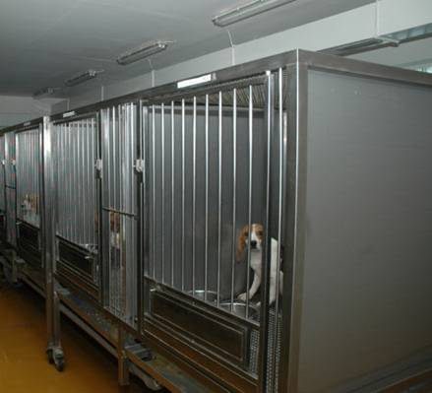
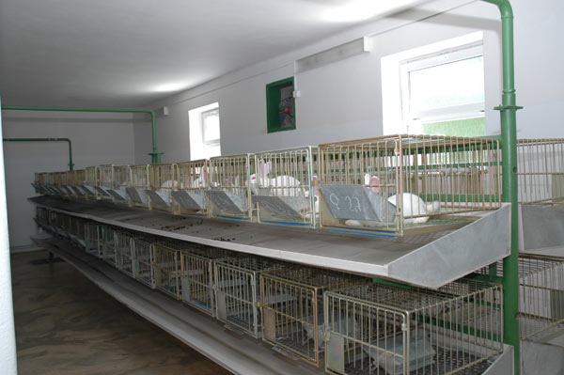
Project – experiment - protocol
Certificates
for quarters, stabling and handling conditions, qualified staff

Slide 33
Experimental design
Suitable animal
Homogeneity of the group
- gender, weight, age, feeding
Control experiment
- the same treatment and number of animals
Repetition of the experiment
  - limitation of influence of the individual variability

Slide 34
Protocol of the experiment in pharmacology
Name of the experiment, aims
Methods
  Data about the animals
  Description of the method
Results
Discussion (evaluation), statistics
Conclusion
Date, number, support, statement of interests

Slide 35
Laws
EU
1986 Council of Europe – rules of protection for vertebrates used for experimental purposes in Europe
Principle 3R: replacement
reduction
refinement

Slide 36
Laws
Czech Republic
Law no. 149/2004 „na ochranu zvířat proti týrání“ – about animal protection against cruelty
Notice no. 207/2004 „o ochraně, chovu a využití pokusných zvířat“ - about protection, breeding and use of laboratory animals
Authorities encharged of animal protection:
Ministry of agriculture, Comission for animal protection, veterinary authorities, ethical comitties

Slide 37
Drug names
Chemical name
according to the IUPAC nomenclature rules
e.g.: N-acetyl-para aminophenol
Generic name (non-proprietary)
INN (International Non-proprietary Name)
not registered, supposed to be used internationally
has to be printed on the packing of the drug (under the registered trade name)
for the universal terminological identification of the medicines
formed from the chemical name (shortness) accordingly with the rules (WHO)
each drug has its own CAS No (Chemical Abstracts Sevice Number)
e.g. paracetamol

Slide 38
Drug names
Trade name (proprietary)
registered, patent-protected ®
has to be acompanied with the INN
e.g. Panadol, Coldrex, Paralen
Officinal name
latin name in Pharmacopoeia (e.g. Paracetamolum)
usually very similar to INN
has to be prescribed on Rx formulary in case of individually prescribed medicines
established name for a drug substance is usually found in the originating country's Pharmacopeia
Paracetamolum
…

Slide 39
Some drug-family names
-olol betareceptor antagonists
-caine local anaestethics
-tidine histamine receptor antagonists
-dipine calcium channel blockers of dihydropyridine type
-statin inhibitors of HMG CoA transferase

Slide 40
„GENERICS“
Drug which is produced and distributed after ending of patent protection - mostly manufactured by other company which has not developed the original drug (the same active substance!)
Mostly cheaper than original preparation
Assumed to be identical in dose, strength, route of administration, safety, efficacy, and intended use
Bioequivalent trials are needed before registration
Registration procedures are much easier than in orig. preparation
Drug patents give 10 years of protection, but they are applied for before clinical trials begin, so the effective life of a drug patent tends to be between 7 and 12 years

Slide 41
„GENERIC PRESCRIPTION“
prescription of the generic name (INN) on Rx formulary
+ dose, number of doses
Pharmacist will chose apropriate ready-mady preparation after consultation with the patient
„ GENERIC SUBSTITUTION“
  substitution of the prescribed preparation with another one (generic)

Slide 42
DOSE
A specified quantity of a therapeutic agent, prescribed to be taken at one time or at stated intervals.
If administered in the body, desintegrates, solutes, and distribute across the barriers in the body compartments. Than it is measured like „concentration“

Slide 43
DOSE
DOSIS SINGULA - single dose
DOSIS PRO DIE - daily dose
- for 24 h !!
DOSIS CHRONICA
- (adjusted) dose in the chronic treatment (long-term)
on Rx !

Slide 44
DOSE
DOSIS CURATIVA
- total dose of the drug needed for whole period of treatment

Slide 45
DOSE (from effect point of view)
Sub-threshold - cause no observed biological effect
Threshold - minimally effective dose; dose, after which can be observed any effect
Therapeutic dose - produces mostly beneficial effects;
►MAXIMAL
- does not produce harmfull effects
►►DOSIS MAXIMA SINGULA
►►DOSIS MAXIMA PRO DIE
TOXIC – mostly harmfull effects (RISK>BENEFIT)
LETHAL – cause death

Slide 46
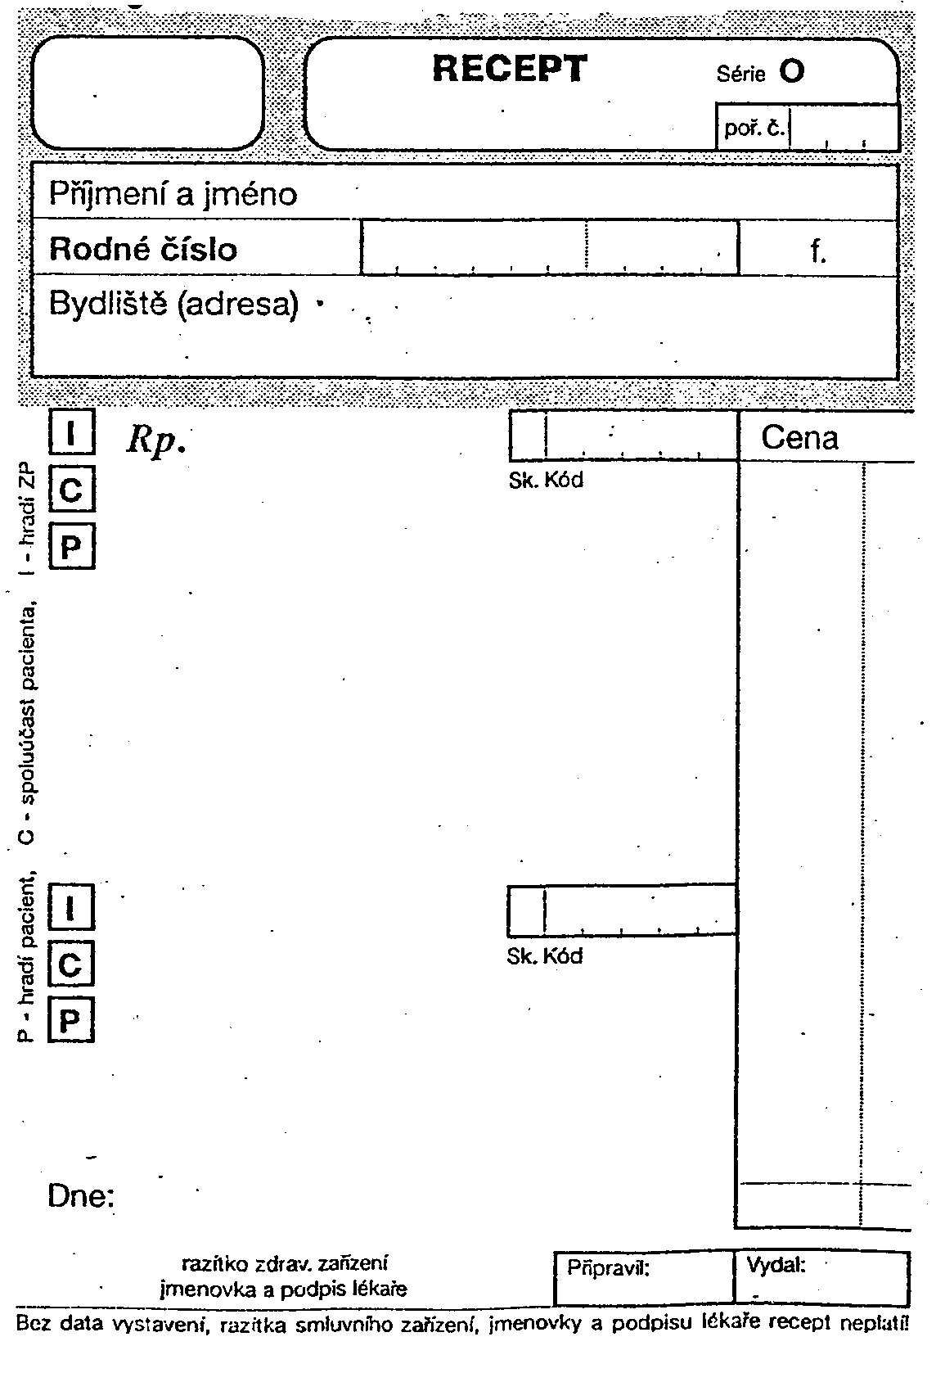
Latin terminology in drug prescription

Slide 47

Pharmacopoeia
pharmacon = drug
poieo = prepare
Substances in pharmacopoeia- called officinal drugs

Slide 48
Definition
basic reference work for pharmaceutical drug specifications
published by the authority of a government or a medical or pharmaceutical society
book containing directions for the identification of samples and the preparation of compound medicines
assures quality, efficacy, safety, standards

Slide 49
Pharmacopoeias may be:
National e.g. Brazilian, British, Chinese, Indian, Japanese, Mexican, Spanish, United States
Regional e.g. European (Ph.Eur.)
    The 7th Edition of the European Pharmacopoeia
International The International Pharmacopoeia

Slide 50
National and regional pharmacopoeias
Cover medicines used in the relevant country or region
Are legally binding "official" in the relevant country or region
Are prepared by a national or regional authority

Slide 51
International Pharmacopoeia
A few dates…
The history of the International Pharmacopoeia dates back 1874…
→ 1948 First World Health Assembly established
Expert Committee on Unification of Pharmacopoeia
→ 1950 WHA approved publication of Pharmacopoeia Internationalis

Slide 52
International Pharmacopoeia
→implementation: “ready for use” by Member States
"The Ph.Int [… ] is intended to serve as source material for
reference or adaptation by any WHO Member State wishing to establish pharmaceutical requirements. The pharmacopoeia, or any part of it, shall have legal status, whenever a national or regional authority expressly introduces it into appropriate legislation."
[World Health Assembly resolution WHA3.10, WHO Handbook of Resolutions and Decisions, Vol. 1, 1977, p. 127]

Slide 53
Scope since 1975
→ Model Lists of Essential Medicines
→ Medicines recommended and specifications needed by WHO Programmes, e.g. to treat Malaria, TB, HIV/AIDS and
→ Medicines for children!

Slide 54
International Pharmacopoeia
A collection of monographs and requirements for:
→ Drug substances
→ Excipients
→ Finished dosage forms
→ General methods and requirements:
dosage forms, e.g. tablets, liquid preparation for oral use
dissolution testing
→ Supplementary information, e.g. General guidelines for Chemical Reference Substances
→ Infrared reference spectra

Slide 55
Specifications of substances
Description, Chemistry, Solubility, Storage, Labelling
Definition, with information on polymorphism if relevant
Identification
Assay
Specific tests (sulphated ash, optical rotation, loss on drying…)
Related substances

Slide 56
Specifications of substances
Precise description of analytical methods
Impurities (chemical names, structures, origin)
Any relevant information on
Performance testing (e.g. dissolution)
Stability
Validation of analytical methods

Slide 57
International Pharmacopoeia
current: 4th Edition + 1st Supplement
→ Consolidated in : 2 Volumes
Vol. 1: pharmaceutical substances (A-O)
Vol. 2: pharmaceutical substances (P-X)
+ dosage forms + radiopharmaceuticals
+ methods of analysis + reagents
1st Supplement - new requirements and revisions

Slide 58
PHARMACOPOEIA BOHEMICA
3 volumes + CD, 2017
Translation of 7th ed. of Eur. Pharmacopoieia
Issued by The Czech Ph. Comm. Of Ministry of Health

Slide 59
Vol. 1 General methods and requirements
Vol. 2 Monographs A-N
  Medicines, excipients
Vol. 3
Monographs N-Z
  Medicines, excipients
  National part
General methods and requirements
Tables (I-XII)
  Medicines, excipients

Slide 60
PHARMACOPOEIA
WHAT we can not find there !
  pharmacological properties of drugs, their pharmacodynamics,
  pharmacokinetics
  indications, contra-indications
  toxic effects

Slide 61
Drug dosology in paediatrics
Doses divided into 3 age groups
0-1 1-6 6-15
Calculation according to the body surface
body surface[m²]
Dose for children = -------------------------- x adult dose
1,73
7 * age (yrs) + 45
Body surface [m²] = --------------------------------------
100

Slide 62
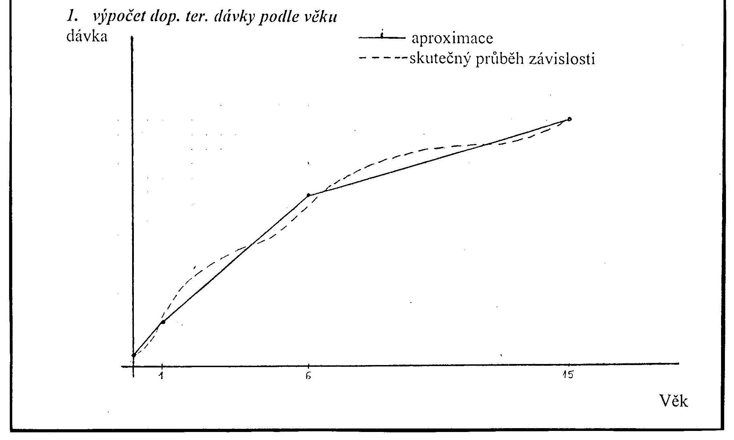

Slide 63
Doses for children
Interpolation
d₂ - d₁
d = d₁ + -----------. n_{d}
n
d…..recommended dose for the given age
d₁.…recommended dose for lower limit of the age interval
d₂ … recommended dose for upper limit of the age interval
n…..number of year intervals within the range of age
n_{d}….number of year intervals from the beginning of range of age to the age of the given child

Slide 64
Calculate the DTS of a substance X for 10 years old child,
if the dose interval from 6 to 15 years of age is 0,7-1,5 g.
d2 - d1
d = d1 + -----------. nd
n
d1 = 0,7
d2 = 1,5
n = 9
nd = 4
1,5 – 0,7
d = 0,7 + -----------. 4 = 0,7 + 0,088*4 = 1,05 g
9

