Slide 1
PHARMACOPOIEA

Slide 3
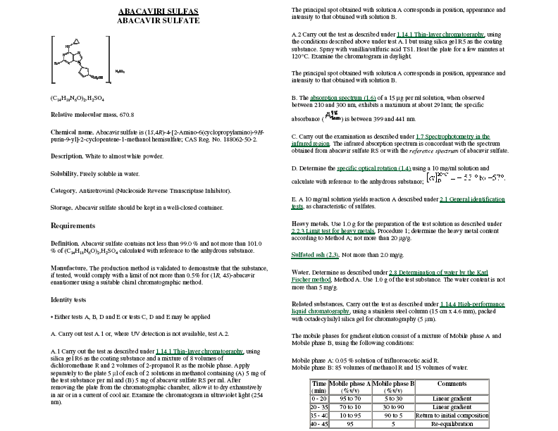

Slide 4
