Slide 1
PHENOBARBITAL

Slide 2
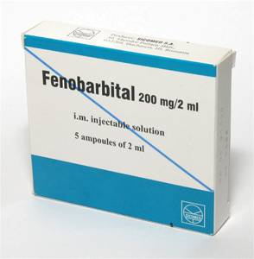
CLINICAL APPLICATION OF UNDERSTANDING MECHANISMS OF ACTION (EXAMPLE)
ELIMINTION OF HYPNOTIC DRUG PHENOBARBITAL (AND OTHER ACID SUBSTANCES)
FROM ORGANISM (E.G. OVERDOSING)

Slide 3
Diffusion of a drug across biological membrane – the substance must be non-ionised.
Level of ionisation affect: dissociation constant of the drug
pH of environment
DISSOCIATION CONSTANT
Constant for each drug
It is not changed owing to factors of environment
Indicated with symbol pK

Slide 4
Barbiturate hypnotic drug phenobarbital has pK value = 7,5
Hypnotic drug phenobarbital has pK = 7,5 this means that at pH = 7,5 we find 50 % of the
substance in the form of ions – ionised (I) and 50 % in the form of molecules – non-ionised (NI).

Slide 5
Phenobarbital is a very weak acid.
The effect of different pH in organism on phenobarbital dissociation.
BLOOD (pH = 7,4)
48,7
51,3

Slide 6
The effect of different pH in organism on phenobarbital dissociation.
Eliminated to acidic URINE (pH = 5,0)
0,7
99,3
Acidic substances are in acid solution mainly in non-ionised form.

Slide 7
The effect of different pH in organism on phenobarbital dissociation.
When eliminated to alcaline URINE – shift of urine pH by alcalising substances (pH = 8,5)
Acidic substances are in alkaline solution mainly in ionised form.
Ionised part of the drug does not cross biological membranes by diffusion, because it is
not soluble in lipids.

Slide 8
pH 7,5
pH 7,4 (blood plasma)
Phenobarbital is eliminated via urine
pH 5,0 (acidic urine)
Usual pH of urine = 5,0
Phenobarbital is immediately converted to almost non-ionised form in urine (99,3 % non-ionised)

Slide 9
Normally phenobarbital crosses biological membranes of kidneys back to the blood stream
and to the brain
- its sedative effects continues.
Therapy: acidic substances arte in alkaline environment
present mainly in ionised form – they cross the membranes only to very limited extent.

Slide 10
Use of alkalising substances suppresses reverse resorption in kidneys
Non-ionised part in urine = 9,1 %, ionised part = more than 90 %
- significantly decreased reverse diffusion of phenobarbital.
pH 7,4 (blood plasma)
pH 8,5 (alkalised urine)
pH 5,0 (acidic urine)
E.g. NaHCO₃

