Slide 1
RULES OF DRUG PRESCRIPTION
Notes for Students
This study material is exclusively for students of general medicine and stomatology in Pharmacology I course. It contains only basic notes of discussed topics, which should be completed with more details and actual information during practical courses to make a complete material for test or exam studies. Which means that without your own notes from the lesson this presentation IS NOT SUFFICIENT for proper preparation for neither tests in practicals nor the final exam.

Slide 2
Individually prepared preparations (IPP):
  prepared in the pharmacies on the base of individual medical prescriptions
Ready-made drug preparations (RMP):
  final preparations made by pharm. companies,
  ready to be issued by the pharmacy to patients without any further modifications

Slide 3
Drug preparations
Covered by insuarance company (fully)
Covered by patient + ins. comp. (in part)
Covered by patient (fully)
Expedition is
bound upon prescription
unbound upon Rx (OTC)
Both in pharmacies and in other places (supermarkets, petrol stations, etc.)
only in pharmacies
„earmarked drugs“ (since 1998): act 378/ 2007, 106/2008 Sb.,
„about good practice of the sellers of earmarked drugs and about the specialized education of sellers of earmarked drugs“

Slide 4
RULES FOR DRUG PRESCRIPTION
refers to the valid Pharmaceuticals Act 378/ 2007
and from the related acts and regulations 54/2008 and 106/2008.

Slide 5
PRESCRIPTION
official document compiled in accordance with fixed rules.
written in Latin language
must have all parts filled up, must be legible
corrections should be signed by the physician
following the abbreviation corr. (correxit-corrected)
written in a non-erasible manner
max. 2 kinds of medicines/one form of Rx

Slide 6
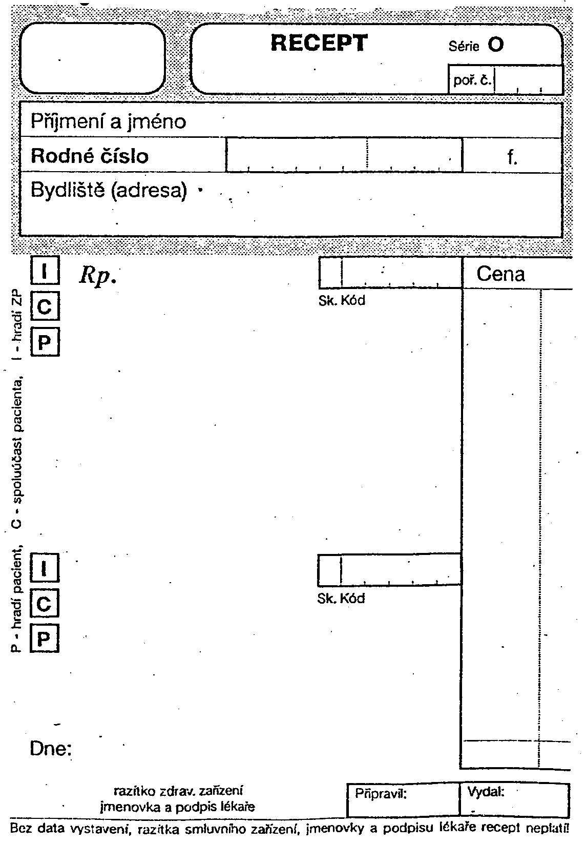

Slide 7
Inscriptio
Personalia aegroti
Invocatio
Ordinatio
Compositio (Praescriptio)
Subscriptio
Signatura
Stamp, name of the doctor
date
signature

Slide 8
Inscriptio
  the heading of the prescription
Personalia aegroti
  patient s personal data (name, surname, birth number and domicile)
Invocatio
  induced by the abbreviation Rp. (recipe take).
Ordinatio
  the actual prescription of the healing preparation
= compositio + subscriptio + signatura

Slide 9
COMPOSITIO
  RMP
  the trade name in the nominative,
  specification of pharmaceutical dosage form,
  dose and package
  IPP
  list of pharmacopoeial (officinal) names of substances in the genitive of singular
  + dosages and package

Slide 10
SUBSCRIPTIO
Instruction for the pharmacist
  RMP – how many packages should be issued
4th case sg. or pl.
Expeditionem originalem numero unam – Exp.orig.No.I
Expeditiones originales numero duas – Exp.orig.No.II (duas)
  IPP – how the preparation should be made of the prescribed components
Misce fiat (sg) Misce fiant (pl) – mix to obtain …
Different dosage forms:
- misce fiat pulvis - M.f.pulv. , unguentum - M.f.ung.
solutio - M.f.sol., oculoguttae - M.f.oculogutt

Slide 11
SIGNATURA
D.S.
Detur (et) Signetur
Exact use instruction for patient – dose, interval, where to apply
instructions how the preparation should be used by the patients.
D.S. 3 times a day 1 tbl.

Slide 12
date
the stamp of the health facility
the identification of the physician
and the physician s personal signature

Slide 13
Acidi borici 2,0
Vaselini albi ad 100,0
M. f. ung.
D.S. twice a day on the focus

Slide 14
Paralen 125 tbl.
20 x 125 MG
Exp. orig. No. III (tres)
D.S. 1 tablet in pain,
maximum 4 per day

Slide 15
Validity of prescription
• Common Rx – 14 days
• ATB – 5 days
• ATB topically – 14 days
• Narcotics, Psychotropics
– 14 days
• Rx for repeated issue – 6 moths, max 1 Year
• Rx issued by emergency next day after the Rx issue (= max. 48 h)
• Date – Rx not valid if missing
• Validity may be prologned by physician

Slide 16
Symbols in Rx formulary
! – when max. dose was exceeded
® - physician specify „not to be substituted with generic medicine“
„PERICULUM IN MORA“ – emergency situation,when normal form is not available

Slide 17
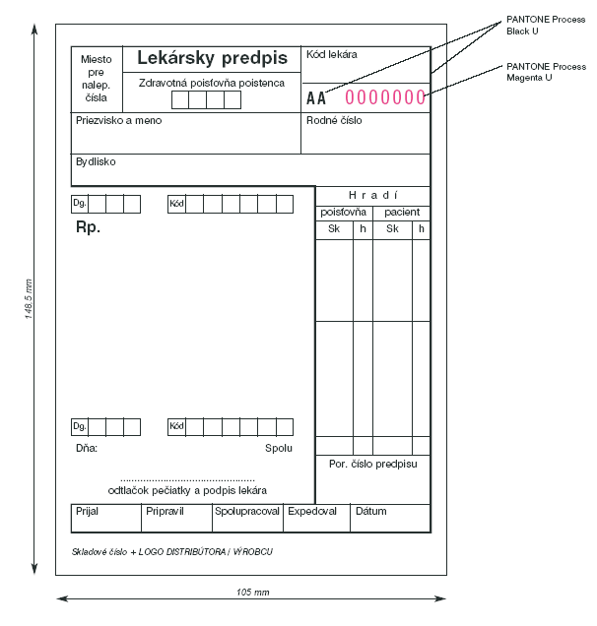
Slovakia

Slide 18
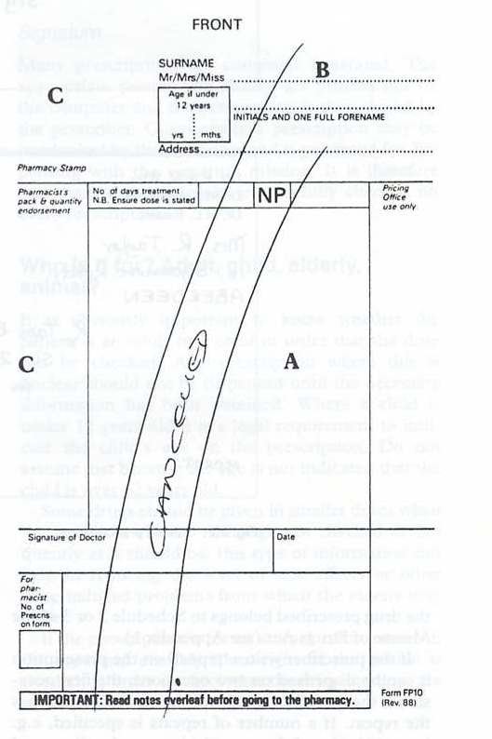
UK

Slide 19
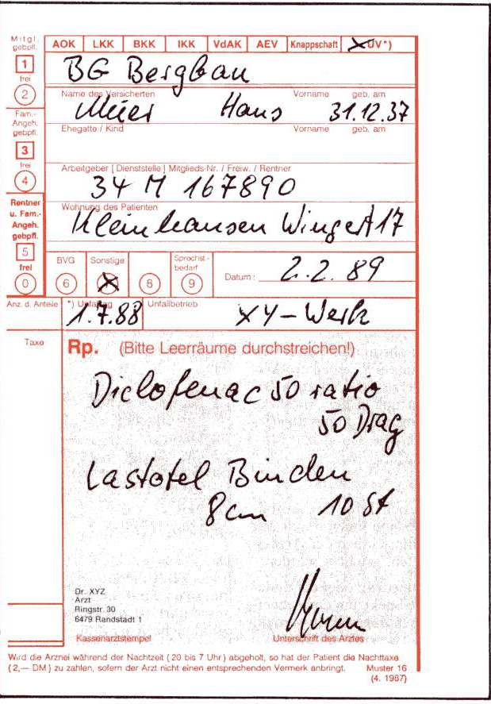
Germany

Slide 20
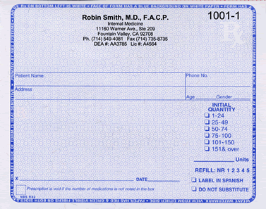
USA

Slide 21
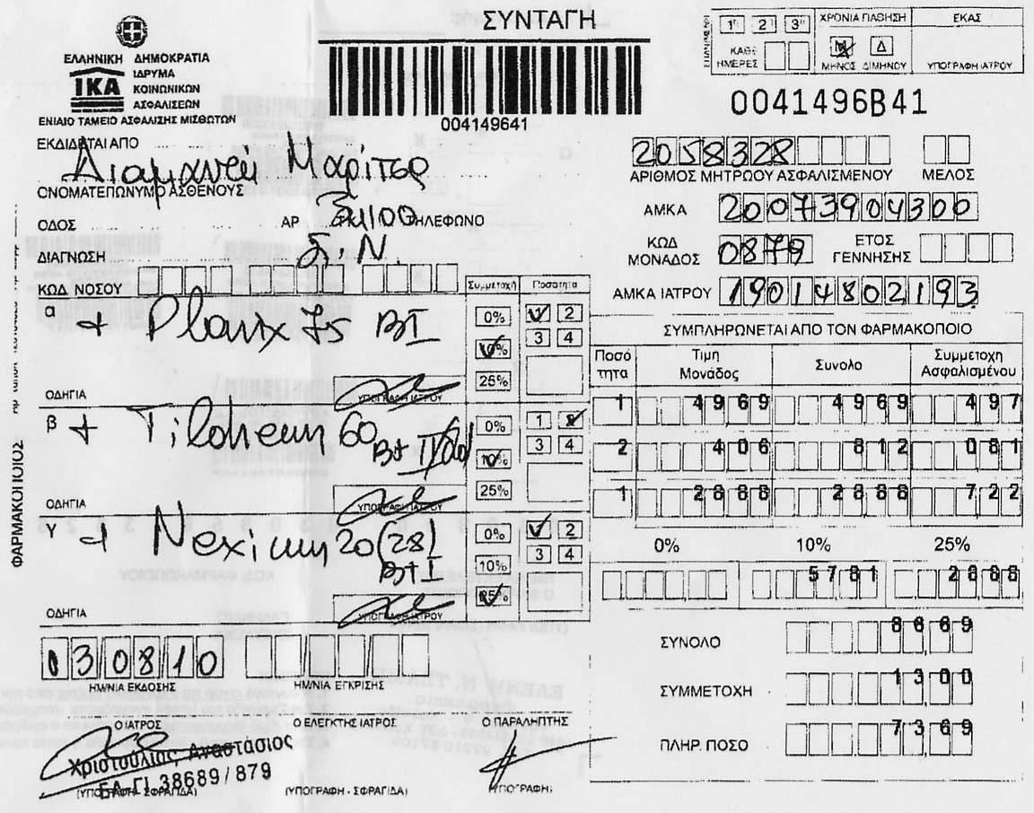
Greece

Slide 22
Electronic Prescription
Physician
Central server for data storage (SÚKL)
Pharmacy
Patient + his password/PIN

Slide 23
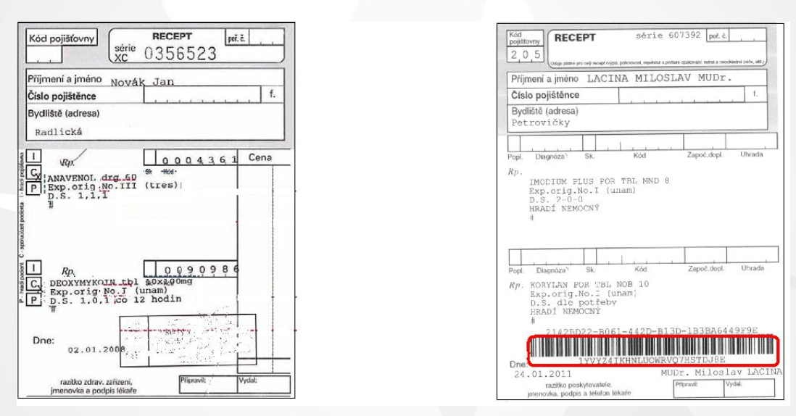
Common and E-prescription

Slide 24
Narcotics and psychotropic drugs
blue band on the form
very strict accounting
three copies
only one preparation
14 days of validity

Slide 25
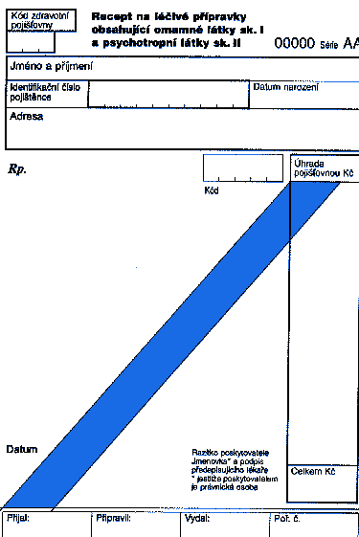

Slide 26
Drug information databases
EMA http://www.ema.europa.eu/ema/
Dynamed http://web.ebscohost.com/dynamed/search/basic?sid=d3f0d39b-dd7c-4bab-9f4f-3478d4639a2e%40sessionmgr4008&vid=0&hid=4107
Medicines.org.uk
Drugs.com https://www.drugs.com/
Micromedex http://www.thomsonhc.com/hcs/librarian

Slide 27
Drug information databases
National databases
SÚKL www.sukl.cz
AISLP www.aislp.cz
Pharmindex Remedia
Pharmindex Brevíř

