Slide 1
DRUG DOSAGE FORMS
Notes for Students
This study material is exclusively for students of general medicine and stomatology in Pharmacology I course. It contains only basic notes of discussed topics, which should be completed with more details and actual information during practical courses to make a complete material for test or exam studies. Which means that without your own notes from the lesson this presentation IS NOT SUFFICIENT for proper preparation for neither tests in practicals nor the final exam.

Slide 2
final drug form ready for administration to pacient
modifies the general effect of the drug
Classification: based on consistence
        solid
        semi-solid
        liquid
        gaseous
based on routes of administration (internal/external-others)
based on shape specificity (specific/nonspecific)

Slide 3
    suitable form of active substance (AS) for the administration
    administration of a specified dose of AS
    protection of AS against environmental influences (light, humidity)
    protection of AS in human body (↓ pH in stomach)
    adjustment of organoleptic properties (smell, taste)
    influence of the PK properties:
      release adjustment
      targeted distribution of AS

Slide 4
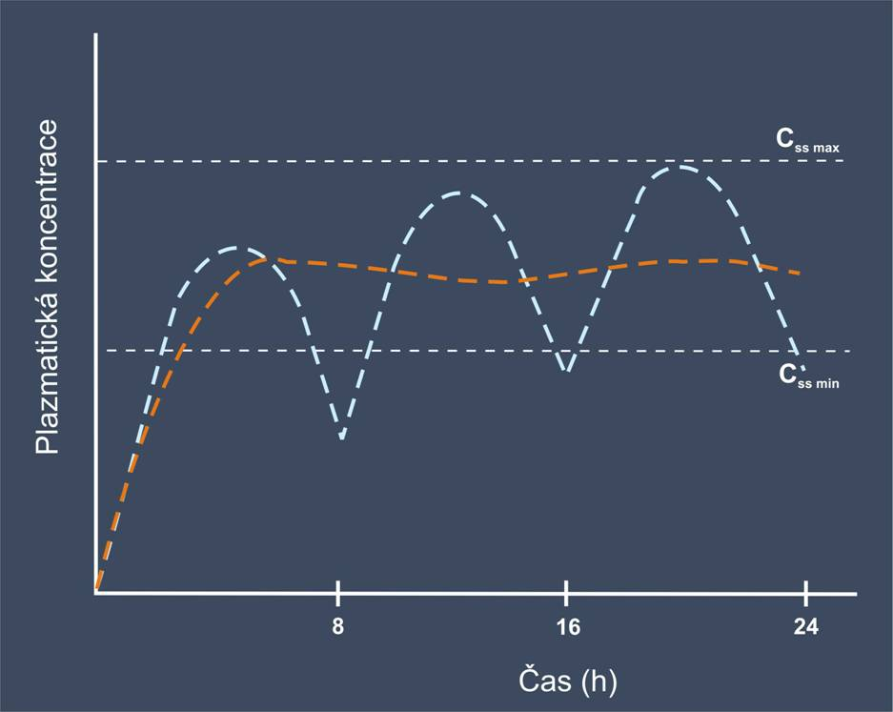
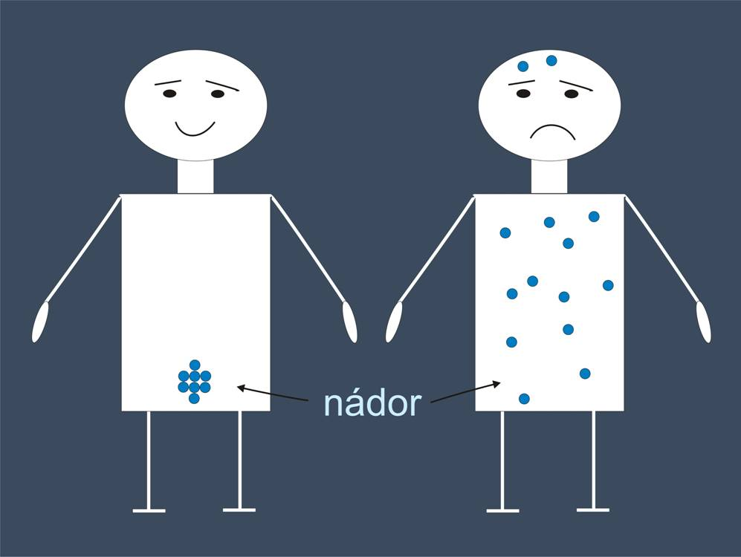
DDF Classification
For systemic effect
1. generation: DDF without release control (conventional)
2. generation : controlled release DDF (CR)
3. generation : targeted distribution DDF (drug delivery system)

Slide 5
LIQUID DOSAGE FORMS

Slide 6
liquida cutanea (pulveres adspersorii liquidi)
liquida peroralia
oromucosalia
otoguttae
rhinoguttae
oculoguttae
injectiones
infusiones
(aquae aromaticae a tincturae)

Slide 7
Liquida cutanea
for topical application
local or systemic action
solutions, emulsions, suspensions
antimicrobial agents, stabilizers, emulsifier
Solvens (vehiculum):
hydrophillic: Aqua purificata, Aqua conservans, Glycerolum 85%, Ethanolum 60%, 85%, 96%
lipophillic: Helianthi oleum raffinatum, Olivae oleum raffinatum, Arachidis oleum raffinatum

Slide 8
Liquida cutanea
Solutions for compresses and spreading
rem. cardinale in appropriate conc.
quantity depends on: size of treated area, frequency of application, period of treatment
Pulveres adspersorii liquidi–liquid powders
suspensions
calming, cooling, antipruritic action
composition:
  solid base(pulveres): 30-40%, usually talc and ZnO
  liquid base: Glycerol 85%,, Ethanolum 60%
  viscosity enhancers: Bentoniti magma, Aerosil

Slide 9
Liquida peroralia
for internal use
local or systemic effect
true and colloid solutions
antimicrobial agents, stabilizers, emulsifiers, taste and smell modifiers
Classification:
1. peroral drops
2. peroral solutions,emulsions, suspensions
3. syrups
„tinctures and aromatic waters“

Slide 10
Liquida peroralia
prescribed as undivided preparations
divided into doses by patient before use
easy administration (pediatrics)
measure cups, spoons, drops
1 aqueous drop 0.05 g 1 dessert spoon 10.0 g
1 tea spoon 5.0 g 1 table spoon 15.0 g
Peroral drops
exact volume of drug
for highly efficient drugs
usually DTS in 1 g of aqueous or 0,3g spirituous solution(20 drops)
total amount: 10-25g

Slide 11
Syrups
concentrated aqueous solutions of sugars or polyols
usually as adjustment of taste properities
Officinal: Althaeae sirupus, Plantaginis sirupus, Sirupus simplex
Plantaginis sirupus
Plantaginis folium 5,0
Aqua purificata 45,0
Saccharosum 64,0
Methylparabenum 0,15
Ethanolum 96% 1,0

Slide 12
Aquae aromaticae
saturated aqueous solutions of essential oils
typical smell
spasmolytic, carminative effect
carminative = against meteorism and flatulence
Officinal: Aqua carminativa
Aqua carminativa rubra

Slide 13
Tincturae
spirituous extracts
administered in drops (10-20)
amounts 10-20 g
Officinal: Tinctura amara, Valerianae tct.
  Capsici tinctura normata
  Salviae tinktura
  Myrhae tct., Gallarum tct., Ratanhiae tct.

Slide 14
Oromucosalia
for administration to the oral cavity and/or oropharynx
local or systemic action
  Gargarismata
  Aquae gingivales
  Solutiones gingivales
  Guttae oromucosales, praeparata pro aerodispersione oromucosali et preparata pro aerodispersione sublinguali

Slide 15
Otoguttae
solutions, emulsions, suspensions
suitable for administration into ear
up to 20 g
adjusted into bottles + dropper!
antimicrobials, wax softeners
Officinal: Aluminii acetotartratis otoguttae

Slide 16
Rhinoguttae
local or systemic effect
isotonic
usually 10-20 g
ATBs, antihistamines, antiseptics, decongestants
hormones, kalcitonin, insulin?

Slide 17
Occuloguttae
local effect with a risk of systemic reaction
isotonic, sterile (isoacid)
up to 10 g
S.s.v.
mydriatics for diagnosis and treatment
antiglaucomatics
antiseptics, antibiotics
antihistamines, decongestants

Slide 18
Iniectiones
sterility
pyrogen-free (test for bacterial
endotoxins – pyrogens)
solutions for infusion or injection (limpidity) → absence of foreign particles → test for sub-visible particles
parenteral preparations may require the use of excipients e.g.
  to make the preparation isotonic with blood
  to adjust the pH
  to increase solubility
  to provide adequate antimicrobial properties

Slide 19
Infusiones
similar requirements as in iniections
without antimicrobial agents
volumes 100-400 ml (1000 ml)
IPP:
- Ad lagoenam pro infusione.
- Suo nomin. Cum formula.
- some can be prescribed like officinal drugs
Officinal: Glucosi infusio (5%, 10%, 20%, 40%), Natrii chloridi infusio isotonica

