Slide 1
Dept. of Pharmacology, Faculty of Medicine, Masaryk University
PARASYMPATHETIC
NERVOUS SYSTEM
Notes for Pharmacology I Practicals
This study material is exclusively for teachers of general medicine and dentistry in Pharmacology I course. It contains only basic notes of discussed topics, which should be completed with more details and actual information during practical courses to make a complete material for teaching ☺.

Slide 2
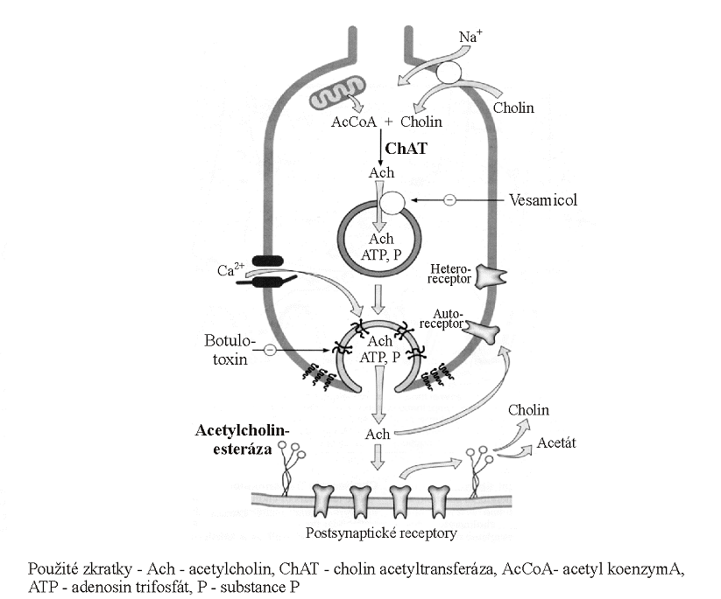
hemicholine
ACHE inhibitors
https://www.youtube.com/watch?v=dkpohXE06pg

Slide 3
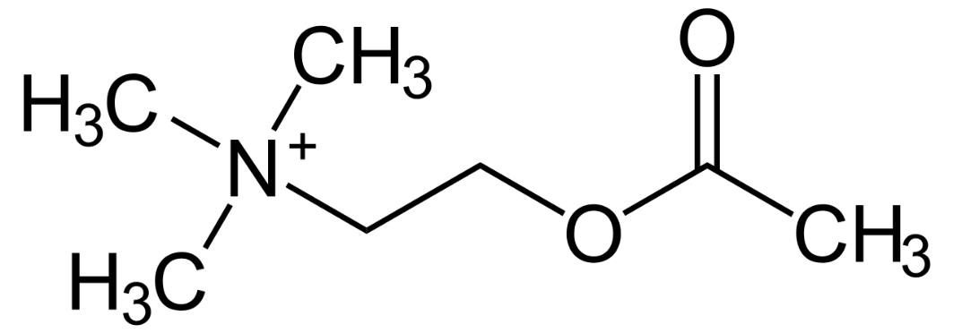
Cholinergic drugs elicit their effect:
via the parasympathetic synapses of effector organs
via synapses of the autonomic nerve ganglia
3) via synapses of neuromuscular junctions
4) via synapses in CNS
- they can influence synapses, where acetylcholin (ACh) acts as their neurotransmitter

Slide 4
acetylcholine esterase (ACHE) inhibitors
acetylcholine analog.
cholinotropics
cholinomimetics
cholinolytics
direct
indirect
indirect
direct
N_{N}
M
N_{N}
M
ganglioplegics
parasympatolytics
parasympathomimetics
gangliomimetics
muscle relaxants
N_{M}

Slide 5
Cholinergic nervous system
- pharmacological interventions
acetylcholine analog.
⊝Θ
cholinotropics
Θ
cholinomimetics
ACHE inhibitors
cholinolytics
direct
indirect
indirect
direct
N_{N}
M
N_{N}
M
ganglioplegics
parasympatholytics
parasympathomimetics
gangliomimetics
muscle relaxants
N_{M}

Slide 6
Terminology:
Cholinomimetics - ↑ activity at cholinergic synapses
  direct – ACh and its analogues
  they imitate ACh effects on M and N receptors
  indirect - ACHE inhibitors
  always non-selective https://www.youtube.com/watch?v=k7YX9kuWrxA
        short-term effect - edrophonium
        intermediate and long-term effect - carbamates („stigmins“)
        very long effect - organophosphates
Parasympathomimetics - they imitate ACh effect on M rc.
  direct (mostly non-selective effect)
  stimulatory agents selective to M receptors for ACh

Slide 7
Terminology:
Cholinolytics
- direct:
- agents blocking acetylcholine receptors
  Parasympatholytics - M receptor blockers
  - without any effect on nicotinic receptors
  Ganglioplegics - N_{N}-receptor blockers
  Peripheral muscle relaxants (non-depolarizing) –
  - N_{M}-receptor blockers
- indirect: e.g. presynaptic inhibition of ACh release

Slide 8
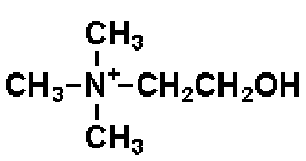
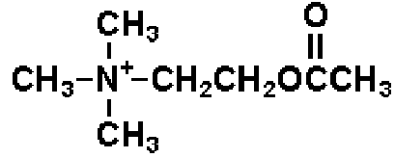
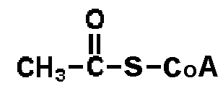
Acetylcholine synthesis
choline in lecithin form is a dietary supplement
lecithin acts as a precursor to ACh
+
acetyl CoA
choline
choline acetyltransferase (CHAT)
acetylcholine (ACh)

Slide 9
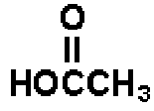
Acetylcholine degradation
hydrolysis
acetylcholinesterase
(ACHE)
acetylcholine
+
choline
acetate

Slide 10
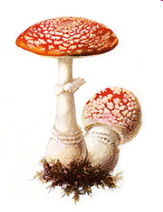
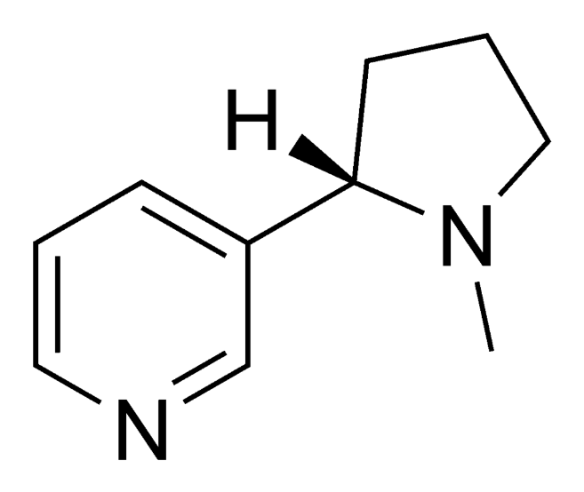
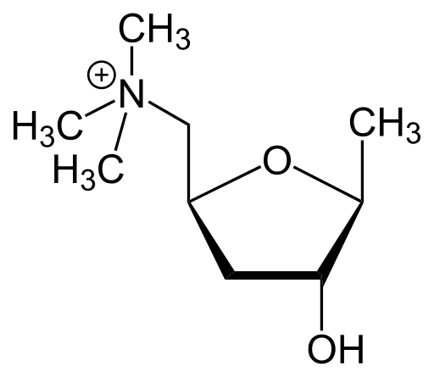

Cholinotropic agents
- according to their chemical structure we distinguish:
  agents with quaternary ammonium cation - quaternary amines with low GIT absorption (they do not cross BBB), e.g. muscarine
  tertiary amines, e.g. natural alkaloids (nicotine, physostigmine)
muscarine
nicotine
acetylcholine

Slide 11
Cholinomimetics - cholinergic agonists
- pharmacological effects
CVS - negative chronotropic effect
- heart depression
- generalized vasodilation
GIT - increased motility of smooth muscles
respiratory tract - bronchoconstriction
↑ bronchial secretion
eye - miosis, ↓ intraocular pressure
↑ lacrimation
↑ sweating, ↑ salivation
CNS - tremor, increased locomotion

Slide 12
Cholinomimetika
Choline analogues (M and N receptor agonists)
acetylcholine
- effects: ↓ BP, bradycardia, heart arrest
  vasodilation: NO release (indirect effect)
  nausea, coughing, dyspnoe, ↑GIT motility
  miosis, sweating, salivation, lacrimation, mucosal glands secretion
Léčivo | Sensitivita k ACHE | M Rc | N Rc
acetylcholine | + + + | + + + | + + +
(metacholine) | + + | + + + | +
karbachol | 0 | + + | + + +
betanechol | 0 | + + + | 0
cevimeline | 0 | + + + | 0

Slide 13
Cholinomimetics
Choline analogues (M / N receptor agonists)
Léčivo | Sensitivita k ACHE | M Rc | N Rc
acetylcholine | + + + | + + + | + + +
metacholine * | + + | + + + | +
carbachol | 0 | + + | + + +
bethanechol ♦ | 0 | + + + | 0
* metacholine - cholinergic agonist - not used in Czech rep.
♦ bethanechol, cevimeline - parasympathomimetics

Slide 14
Acetylcholine and its analogues
acetylcholine
rapid biodegradation by ACHE → not used in clinics
5-20 s effect after i.v. administration
limited absorption after oral / s.c. administration
does not penetrate BBB
- other choline esters:
carbachol
poor absorption from GIT
agonist of M and N Rc
not hydrolyzed by cholinesterase → long duration of action
I: ophthalmology - miosis
cevimeline
selective M agonist - parasympathomimetic
I: xerostomia (dry mouth), Sjögren’s syndrome

Slide 15
Acetylcholine and its analogues
↑ postganglionic neuronal activity
↑ adrenaline and noradrenaline (NA) release from adrenal glands
↑ neuromuscular signal transduction
↑ activity of parasympathetic effectors
↑ sympathetic stimulation of sweat glands
- pharmacological effects:
  ↓ BP, bradycardia, danger of heart arrest
  nauzea, cough, dyspnoe
  vascular dilation: NO release
  salivation, lacrimation, ↑ mucosal gland secretion
  excessive sweating

Slide 16
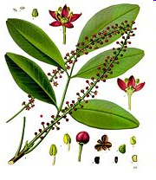
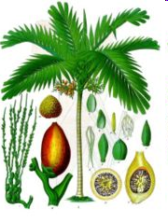
Cholinomimetics - natural alkaloids
pilocarpine (Pilocarpus)
non-selective M receptor agonist
good absorption from GIT
BBB crossing (→CNS excitation)
stimulates gland secretion
stimulates m. sphincter pupilae (eyedrops)
I: miotic agent used in ophthalmology 2-4%, Sjögren's syndrome
muscarine (Inocybe, Clitocybe, Amanita muscaria/phalloides)
M receptor agonist, quaternary amine
arecoline (Areca catechu)
CNS stimulant, tertiary amine
M and N receptor agonist

Slide 17
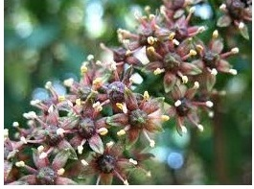
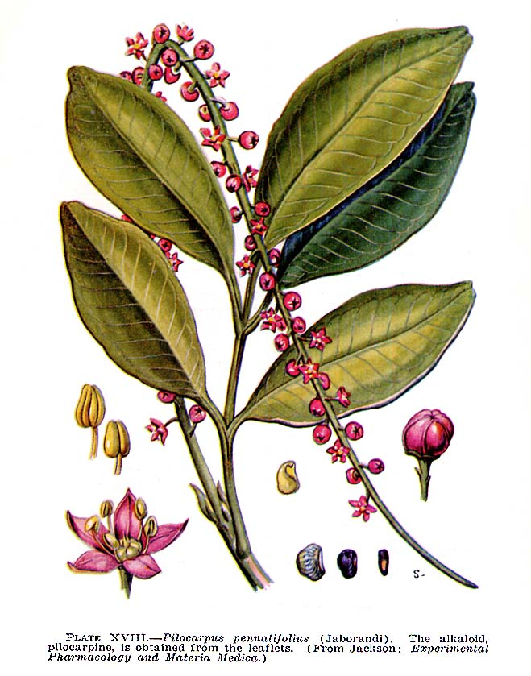
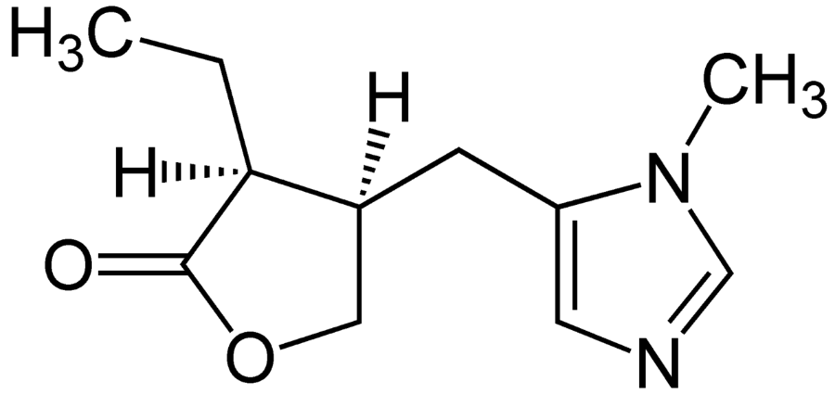
Cholinomimetics - natural alkaloids
pilocarpine
non-selective M receptor agonist
I: glaucoma, xerostomia, Sjögrenův sy
2% or 4% eyedrops
HVLP combined with timolol
KI: asthma bronchiale, COPD
sinus bradycardia, heart failure

Slide 18
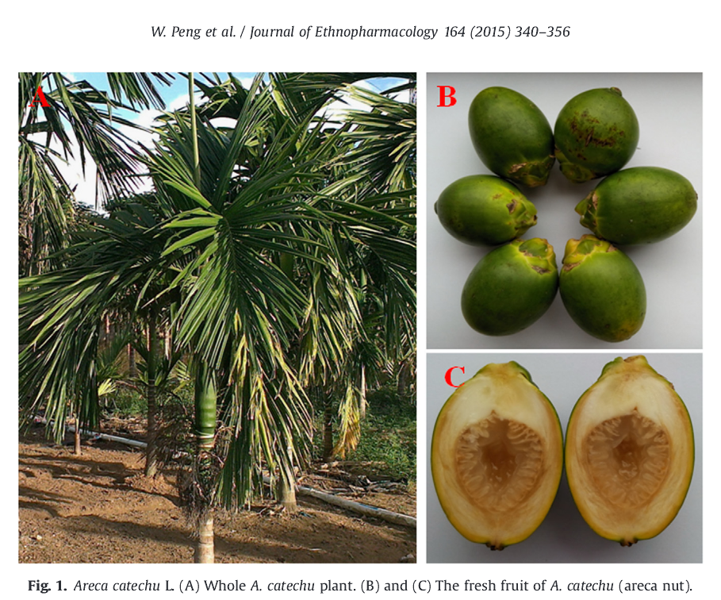
Cholinomimetics - natural alkaloids
arecoline from Areca catechu L.

Slide 19
Antiglaucoma agents - miotics
pilocarpine
carbachol
physostigmine
atropine
scopolamine

Slide 20
Indirect cholinomimetics
ACHE inhibitors
short-term
(REVERSIBLE
long-term
(IRREVERSIBLE)
competitive
enzyme inhibition
complex
inhibitor + enzyme
COVALENT INHIBITION
medicinal use
toxicology

Slide 21
Indirect cholinomimetic agents
ACHE inhibitors
increase ACh concentration at its synapses and postganglionic receptors
different duration and reversibility of their effect
reversible/short or intermediate effect - therapy
B) irreversible inactivation/long acting - toxicology

Slide 22
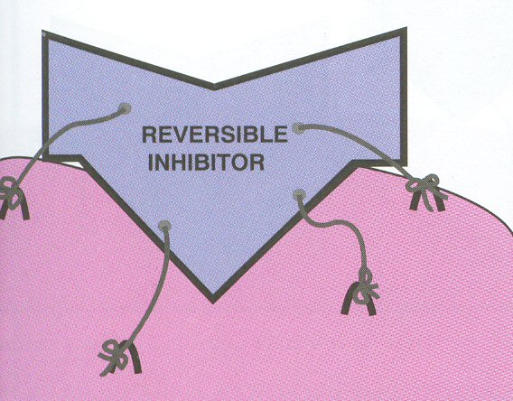
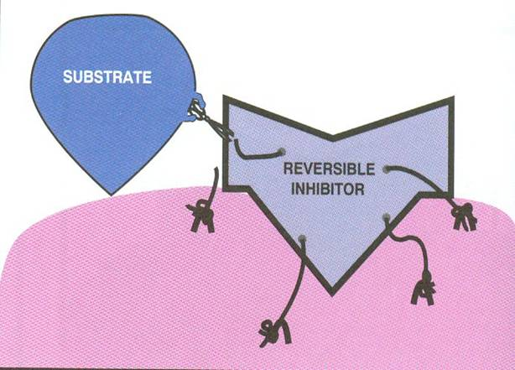
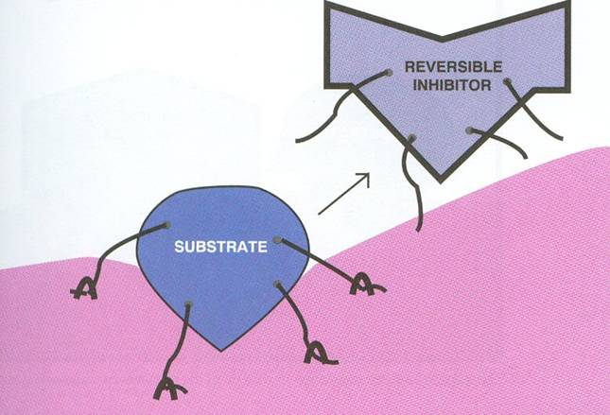
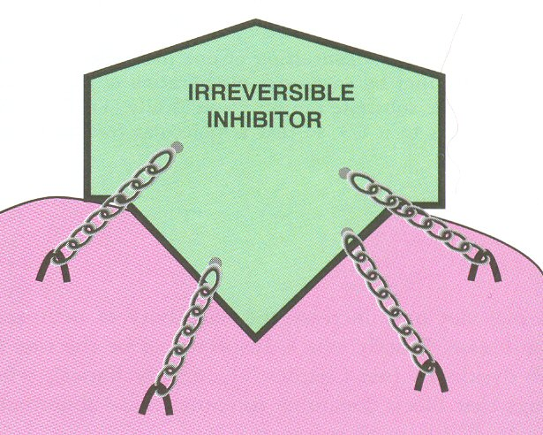
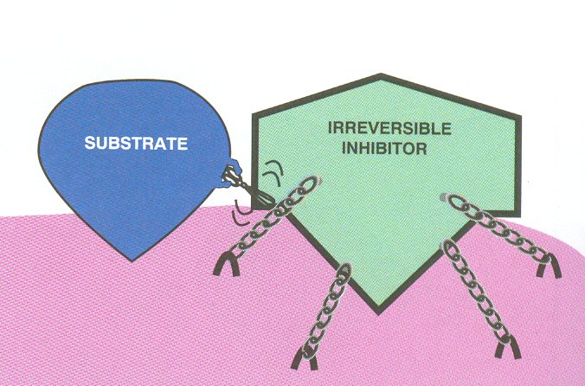
Indirect cholinomimetics
Acetylcholinesterase binding

Slide 23
Indirect cholinomimetic agents
Reversible ACHE inhibitors
General indications:
      glaucoma
      GIT atony
      urinary retention
      antidotes of non-depolarizing muscle relaxants
      myasthenia gravis (use quaternary amines)
      Alzheimer‘s disease (use tertiary amines)
      intoxication with organophosphates
      poisoning associated with the central anticholinergic syndrome (atropine)

Slide 24
Indirect cholinomimetic agents
Reversible ACHE inhibitors
Side effects:
  miosis
  increased glandular secretion
  nausea, diarrhea
  heart depressants (negative chronotropic effect)
  CNS – stimulation followed by depression
  neuromuscular junction - fasciculation and twitching (overdose - depolarization blockade)
  overdosing = cholinergic crisis – depolarization blockade - muscle paralysis

Slide 25
Indirect cholinomimetics
Reversible ACHE inhibitors
neostigmine, (edrophonium)
short-term effect
I: diagnosis of myasthenia gravis
„decurarization“, antidotes of competitive muscle relaxants
pyridostigmine, ambenonium
longer effect than neostigmine, slower onset of action
weaker muscarinic effect - less GIT side effects
I: myasthenia gravis
distigmine
long-acting reversible ACHE inhibitor
I: myasthenia gravis, atonic the urinary bladder, uterine atony, postoperative GIT atony, paralytic ileus

Slide 26
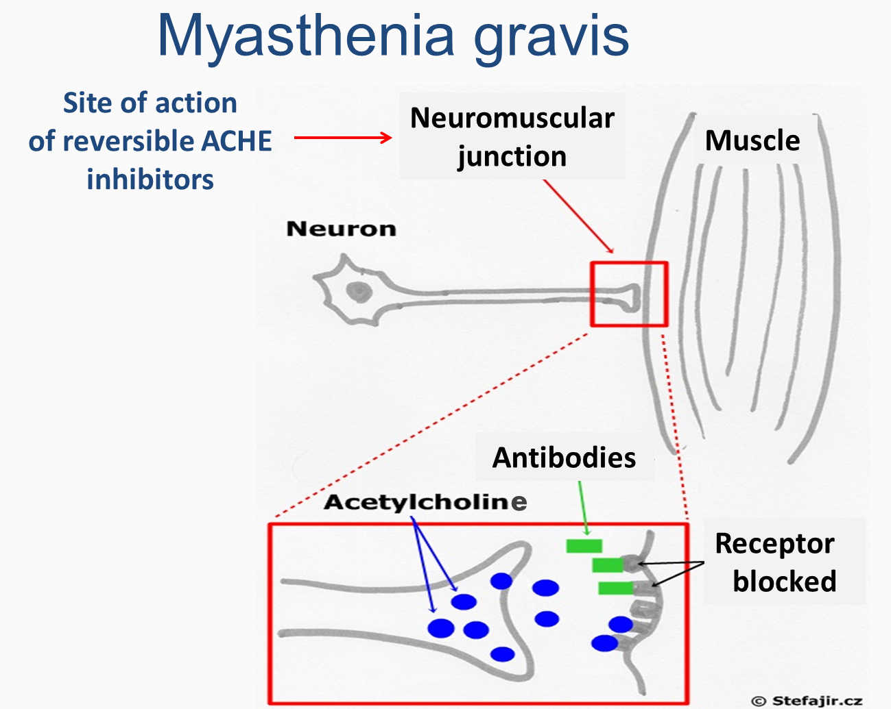

Slide 27
Indirect cholinomimetics Reversible ACHE inhibitors
  neuromuscular junction - longer and stronger effect of ACh NT
  → stronger muscle contraction, fasciculations video
fasciculations - adverse effects of ACHEI
physostigmine - https://www.youtube.com/watch?v=YYMZFvJEO6I
  at high doses – tremor, muscle paralysis
  Ondra:
edrophonium in dog (diagnosis of myasthenia gravis)
https://www.youtube.com/watch?v=k7YX9kuWrxA
Google Tensilon test (human)

Slide 28
Indirect cholinomimetics
Reversible ACHE inhibitors
- CNS effects of drugs, that can cross the blood-brain barrier
physostigmine
I: antidote in acute intoxications with central anticholinergic syndrome
galantamine, rivastigmine, donepezil
I: dementias of the Alzheimer´s type
galantamine has a positive allosteric effect
on ACh binding on N receptors

Slide 29
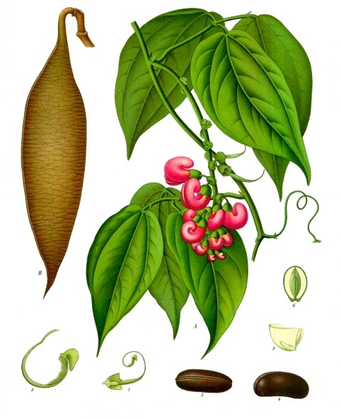
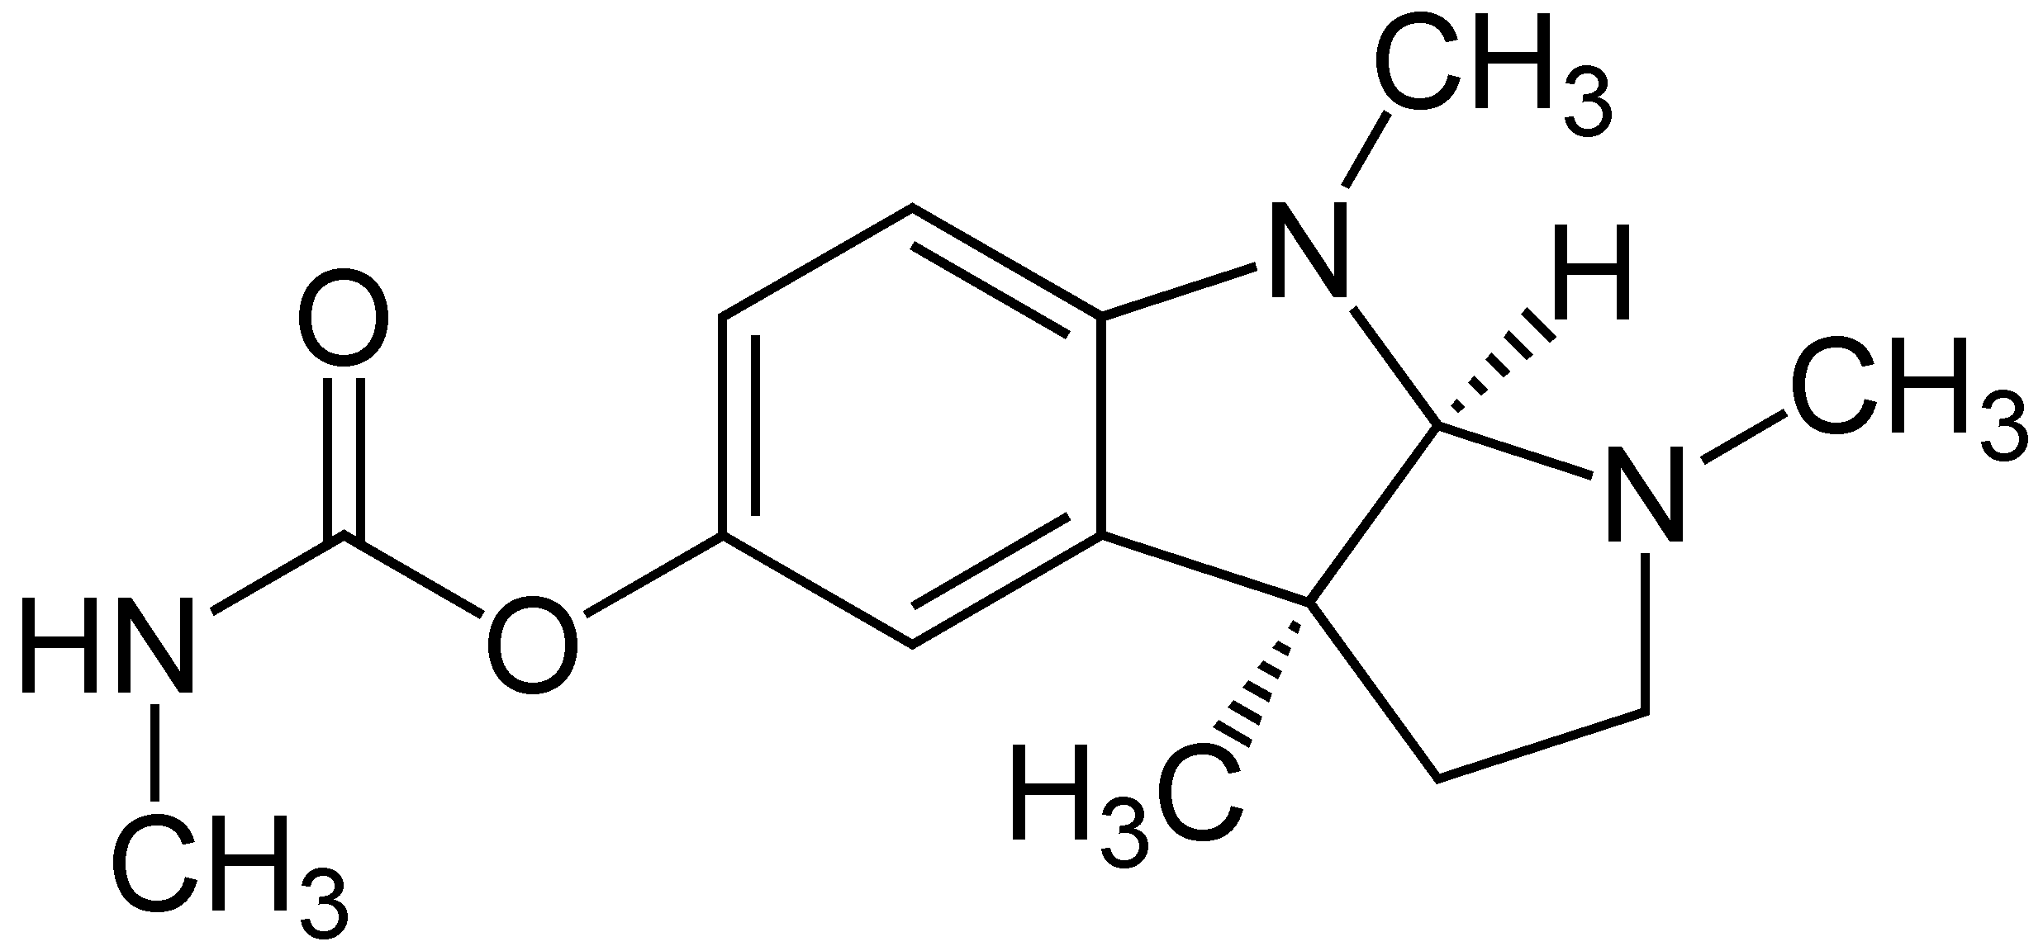
Indirect cholinomimetics
Reversible ACHE inhibitors
physostigmine - alkaloid from Physostigma venenosum
- CNS effect, specific therapeutic programe
antidote in case of overdose
with parasympatholytics
antidote for central
anticholinergic poisoning
miotic - antiglaucoma agent
https://www.youtube.com/watch?v=YYMZFvJEO6I
Notes:
).

Slide 30
Indirect cholinomimetics
Irreversible ACHE inhibitors
effects: nausea, vomitus, sweating, CVS collapse, breath depression, fasciculation and twitching →muscle paralysis, CNS convulsions
insecticides (malathion, parathion
chemical weapons such as nerve gas sarin or VX, soman, tabun
antidotes: obidoxime, trimedoxime, pralidoxime

Slide 31
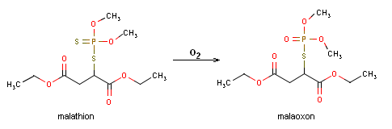
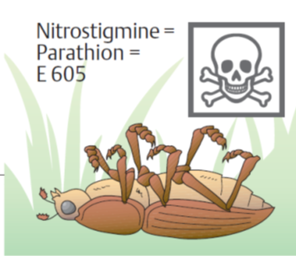
Indirect cholinomimetics
Irreversible ACHE inhibitors
Organophosphates
insecticides: malathion (→ malaoxon) parathion (→ paraoxon)
chemical weapons (neurotoxic poisons):
                VX- agent, sarin, tabun, soman
    Intoxication symptoms: miosis, dyspnoe, bronchospasm, vomiting, sweating, salivation, lacrimation, diarrhea, neuromuscular paralysis
    CNS: convulsions → coma, late neurological toxicity (demyelinization, polyneuritis, vision impairment)

Slide 32
Indirect cholinomimetics
Irreversible ACHE inhibitors
Therapy of organophosphate itoxication:
1. reduce further neurotoxine absorption
2. mechanical ventilation
3. atropine i.v. in high doses 2 mg every 5 min until a slight overdose (in mass-casualty settings s.c.)
4. ACHE reactivators : obidoxime, (pralidoxime)
      5. therapy of muscle convulsions i.v. benzodiazepines
      6. high doses of reversible ACHE inhibitors
      7. bioscavengers

Slide 33
Parasympatholytics
tertiary amines
quaternary amines
blockade of M >N receptors
(blockade of M receptors
atropine
scopolamine
tropicamide, cyklopentolate
oxybutynine, tolterodine
solifenacin, darifenacin
procyclidine, biperiden
(pirenzepine, telenzepine) (homatropine)
butylscopolamine
phenpiverine, propiverine
otilonium, glycopyrrolate
ipratropium, tiotropium
aclidinium, umeclidinium
trospium
(oxyphenonium),(poldin)

Slide 34
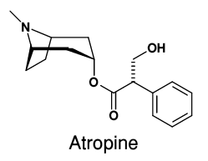
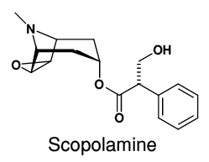
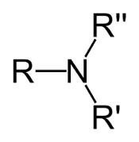
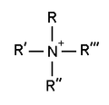
Antimuscarinic
semisynthetic and synthetic derivatives
Tertiary amines
  homatropine, tropicamide, oxybutynine, cyclopentolate, darifenacin, tolterodine, biperiden
  CNS effects (antihistamines, neuroleptics, antidepressants)
  used in ophthalmology
Quaternary amines
  ipratropium, tiotropium, butylscopolamine, trospium, otilonium
  more peripheral effects and less CNS effects
base
tropic acid

Slide 35
Parasympatholytics
direct antimuscarinic agents
- effects of reversible M receptors antagonists:
  glandular secretion
  CVS
  eye
  GIT
  bronchi
  CNS

Slide 36
Parasympatholytics
direct antimuscarinic agents
- clinical use:
spasmolytics
bronchodilators
antiarrhythmics
mydriatics
premedication prior to GA
antiemetics
antiparkinsonics
antidotes for pilocarpine
antidotes for ACHEI poisoning (physostigmine)

Slide 37
Parasympatholytics
direct antimuscarinic agents
-side effects:
dry mouth (xerostomia)
dry eyes (xerophthalmia)
loss of accommodation (cycloplegia)
heart palpitations
constipation
urinary retention
CNS: seizures, severe dyskinesias, hallucinations, agitated delirium, respiratory depression, coma

Slide 38
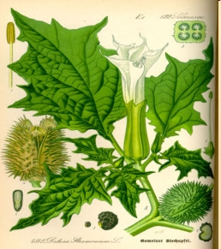
PL with tertiary N
atropine, tropicamide, cyclopentolate, homatropine
mydriasis (stimulation of m. sphincter pupilae)
cycloplegia (paralysis of the ciliary muscle of the eye)
I: for diagnostic and therapeutic mydriasis
scopolamine (hyoscine) TTS, supp.
I: therapy of kinetosis, CNS depression
oxybutinine
orally, TTS
pharmacokinetics: high 1st pass effect
I: antispasmodic agent used for overactive urine bladder

Slide 39
alkaloids from Solanaceae family
(Solanum nigrum)
(Datura stramonium)

Slide 40
PL with tertiary N
Selective parasympatholytics:
darinefacin, solifenacin
M₃ selective antagonists
symptomatic therapy of overactive urinary bladder
(pirenzepine)
gastric M1 Rc selective antagonist
former indication: gastroduodenal ulcers

Slide 41
PL with quaternary N
- do not cross BBB (blood-brain barrier)
spasmolytics for functional bowel disorders: otilonium
N-butylscopolamine
phenpiverine (oxyphenonium),(poldin)
urinary antispasmodics for overactive urinary bladder: trospium
bronchodilator agents: ipratropium (SAMA) tiotropium, aclidinium
                glycopyrrolate, umeclidinium
(LAMA)
* long acting muscarinic antagonists (LAMA)
short acting muscarinic antagonists (SAMA)

Slide 42
Anticholinergic effects of other drugs
Antidepressants (amitriptyline)
Antipsychotics (chlorpromazine)
Antiemetics (thiethylperazine)
Antiparkinson agents (procyclidine, biperiden)
Antihistaminics (cyproheptadine, orphenadrine)
Central muscle relaxant
orphenadrine inj.
anticholinergic, muscle relaxant
with antihistamine effects
I: vertebrogenic pain syndrome,
neurosurgery (CNS effects)

Slide 43
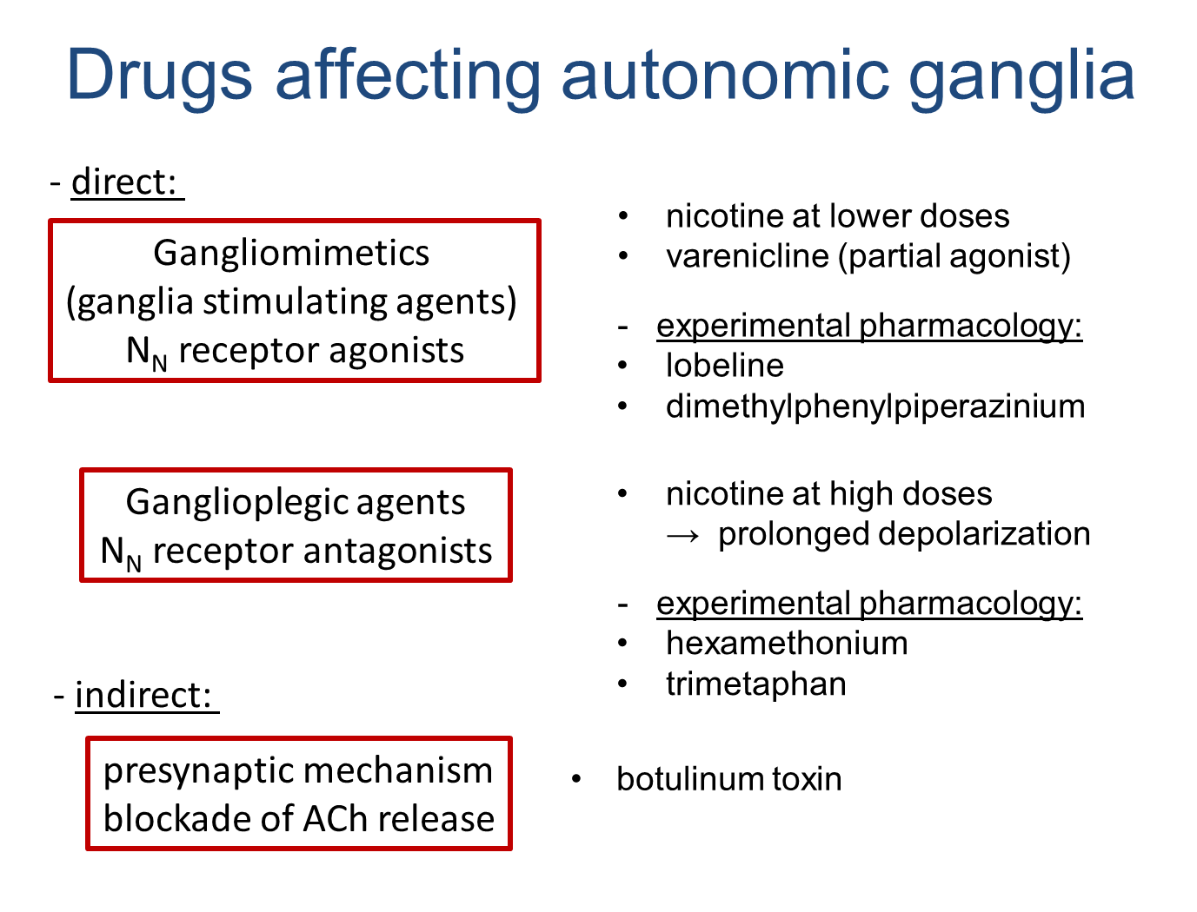

Slide 44
Skeletal muscle relaxants
1. Centraly acting
2. Peripheral effect on neuromuscular junctions
nondepolarizing depolarizing
- N_{M} antagonists - N_{M} agonists
- antag. by ACHEI - decamethonium
- tubocurarine - suxamethonium
- mivacurium
- atracurium, cisatracurium
- rocuronium, pipecuronium
- (pancuronium, vecuronium)
indirect muscle relaxants: dantrolene, botulinum toxin

