Slide 1
Antihistaminines

Slide 2
Histamine
- autacoid (local hormone)
- endogenous amine (hydrophilic)
- in tissues is formed from histidine
Location: in granules in mast cells, basophiles (histaminocytes) → bound to heparan sulphate and acidic protein
  in almost all tissues, highest levels in lungs, GIT, skin
Main roles in the body:
  neurotransmitter – CNS
  mediator of allergic/inflammatory reactions – mast cells, basophilles
  regulation of gastric acid release (↑) - stomach

Slide 3
Histamine
is released from mast cells granules by exocytosis (activation of phospholipase C a ↑ Ca²⁺)
Stimuli:
  imunological: antigen + IgE
  physical, chemical or mechanical cell damage
  drugs

Slide 4
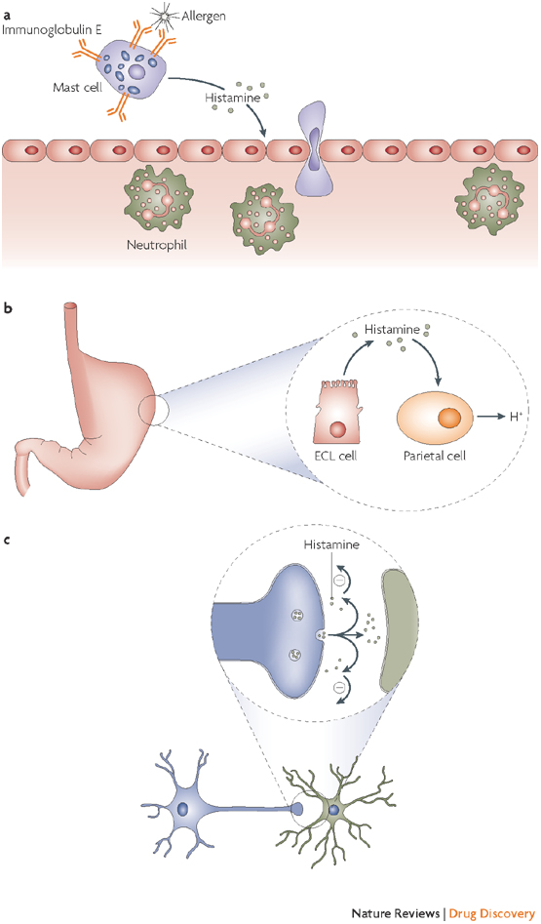
doi:10.1038/nrd2465

Slide 5
Histamine metabolism
L-histidine
histidinde karboxylase
imidazole-N-
methyltransferase
Histamine
diamine oxidase
metylhistamine
MAO
imidazole acetaldehyde
metylhimidazole acetaldehyde
aldehyde dehydrogenase
methylimidazole acid
imidazeacetic acid

Slide 6
Histamine receptors
4 subtypes (H₁ – H₄)
G protein-coupled receptors
their stimulation results in increase in cellular concentration of Ca²⁺ ions

Slide 7
H₁ receptors
postsynaptic, G_{q}-protein ↑ phospholipase C →
↑ IP3 and DAG → ↑ Ca²⁺
Location:
  endothel, smooth muscles (vessels, bronchi, uterus, GIT), peripheral neuron ending, CNS (!!!)
Effects:
  smooth muscle contraction (bronchi, uterus, ileum)
  vasodilatation of minor vessels (↓BP, reddening of skin)
  increase in vessel permeability (swelling)
  irritation of peripheral neuron endings (itching, even pain)
  excitation of CNS

Slide 8
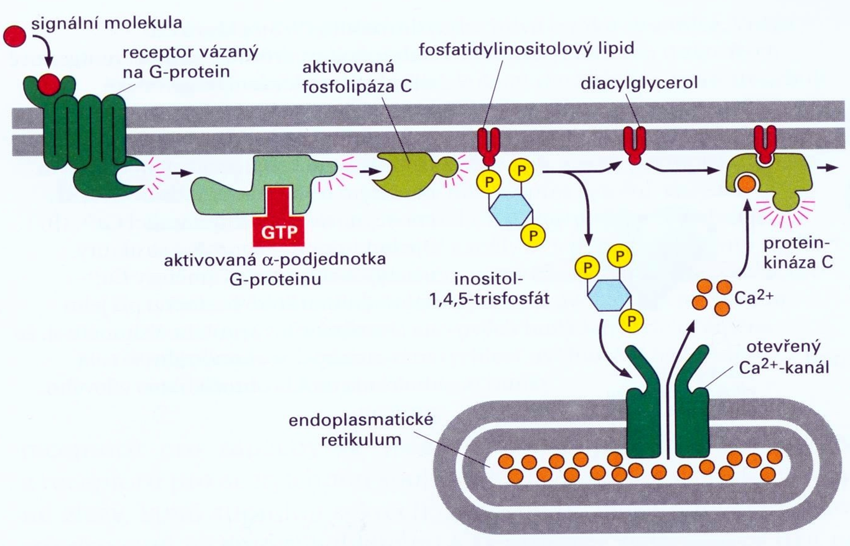
Alberts et al., The molecular Biology of the Cell, 2002

Slide 9
H₂ receptors
postsynaptic, G_{s}-protein ↑ activity of adenylate cyclase → ↑cAMP
Location:
  stomach mucosa, heart, vessels, immune system
Effect:
  in stomach: gastric acid, pepsine, intrinsic factor secretion
  slower and longer vasodilatation
  + inotropic, + chronotropic effect

Slide 10
H₃ receptors
presynaptic, G_{i} protein → inhibition of N-type Ca²⁺ channels → ↓ cellular Ca²⁺
  feedback inhibition of histamine release
heteroreceptors, ↓ release of other neurotransmitters
Location:
  mainly in CNS (but in PNS tissues as well)
Effects:
sedation
  negative chronotropic effect
  bronchoconstriction

Slide 11
H₄ receptors
possibly isoform of H₃
Location:
eosinophiles, basophiles, bone marrow, thymus, intestine, spleen
Effects:
  influencing activity of immune system
  important for chemotaxis

Slide 12
How to antagonize effects
of histamine?
Treat the symptom
  vasoconstrictiors, sedatives, antacides, tocolytics etc.
Treat the cause
  inhibition of synthesis (glucocorticoids)
  inhibition of release (cromoglycate, nedokromil, β₂-SM, glucocorticoids)
  receptor antagonism:
    - non-specifically, indirectly (epinephrine)
    - specifically, directly (H1, H2, H3 - antihistaminines)

Slide 13
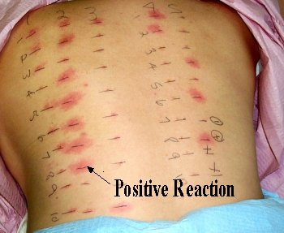
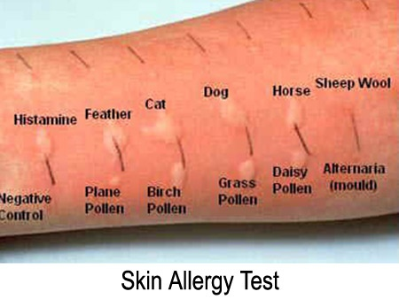
Histamine in clinical practise
limited use (ineffective when given orally)
diagnostics in allergology
histamine analogue → betahistine

Slide 14
Lewis reaction
typical response to intradermal histamine administration:
  skin reddening (vasodilatation of arterioles)
  wheal (capillary permeability)
  flare (redness in the surrounding area due to arteriolar dilatation mediated by axon reflex)
used in allergy testing – positive control
it is used to evaluate the potential antiallergic effect of H1 antihistamines

Slide 15
Allergy
has a high incidence, 10-30% (and growing)
genetic factors
various theories about its origin
Mechanism of alergic reaction:
early contact with allergen
allergen binds to IgE antibody
degranulation of cells containing histamine
activation of phospholipase C
  → mobilization of intracellular Ca²⁺
  → mediators are released: HIS, PG, LT, PAF, cytokines

Slide 16
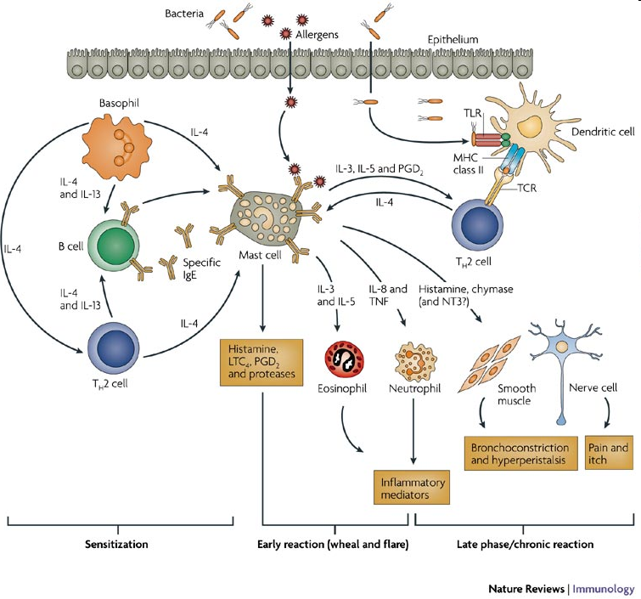
Stephan C. Bischoff. Nature Reviews Immunology 7, 93-104, February 2007

Slide 17
Allergy treatment
always as an addition to taking enviromental control measures and avoiding allergen
H₁- antihistamines
glucocorticoids
mast cells stabilizers
immunotherapy
epinephrine (anaphylactic shock)

Slide 18
H₁ antihistamines
MoA: antagonization of H₁ receptor
they antagonize the allergy symptomes caused by histamine
high selectivity to H₁ rp. → low affinity to H₂ rp.
3 generations
AE:
  antimuskaric, antiserotonergic a antiadrenergic effects of older drugs of this group (sedation, fluctuating blood presure,...)
  block of Na⁺ channels → locally anaesthetic and antipruritic effect

Slide 19
H₁ antihistamines pharmacokinetics
Dosage forms:
  oral, topical, parenteral (i.m., infusion)
easy and quickly absorbed from GIT
distributed evenly in the body
metabolized in liver (some in form of prodrug)
excreted in urine, stool
drugs of I. generation cross the blood-brain barrier → central effects (sedation)
cross the placenta and are distributed into milk!

Slide 20
H₁ antihistamines - I. generation
relatively old drugs
in general lower selectivity to H₁ receptors
they cross the blood-brain barrier
effect lasts approx. 4 - 6 h
rather common adverse effects
dimetinden (Fenistil®)
promethazine
bisulepin (Dithiaden®)
moxastine – for motion sickness (Kinedryl®)
cyproheptadine – treatment of serotonin syndrome
ketotifen

Slide 21
H₁ antihistamines
AE of I. generation
sedative, even hypnotic eff.– driving, heavy mashinery operation (!)
paradoxical reaction (children, elderly) = excitation (sleeplessness, nervousness, tachycardia, tremor, ...)
  indigestion (nausea, vomiting, diarrhea x constipation)
skin symptoms → phototoxicity
anticholinergic effects
increas in appetite (antiserotoninergic effect)
ortostatic hypotension (weak block of α-adrenergic rp.)

Slide 22
H₁ antihistamines
II. and III. generation
low distribution to CNS – minimal sedative effect
better properties – higher selectivity towards rp., less AE
- effect lasts for 12 – 24 hours, given 1 - 2 times a day
II. generation
cetirizine
loratadine
fexofenadine
azelastine
levocabastine
III. generation
levocetirizine
desloratadine
bilastine
rupatadine

Slide 23
Novel H₁ antihistamines
III. generation
bilastine
  high selectivity towards H₁-receptors, antiinflammatory properties
  not metabolized by liver or intestinal wall, low potential for drug-drug interaction
rupatadine
  long-term effect
  dual effect (H₁ antagonist + blocks PAF receptors)

Slide 24
H₁ antihistamines
AE of II. generation
arrythmogenic→ QT interval prolongation (some drugs even withdrawn)
possible sedation when overdosed (cetirizine)
Interactions:
  are metabolised by CYP3A4 → be cautious of inhibitors of this isoform (macrolide ATB, azole antifungals, verapamil, grapefruit juice...)

Slide 25
H₁ antihistamines
Indications I
treatment of symptoms of allergic diseases
  - allergic rhinitis
  - urticaria, drug and food allergy
add-on treatment of anafylactic reactions
pruritus of various ethiology (e.g. itching in allergic and non-allergic dermatitis + insect bites)
tinitus, Meniére‘s disease

Slide 26
H₁ antihistamines
Indications II
migraine
nausea a vomiting
  movement sickness (moxastine, embramine)
  vertigo
prophylactic premedication before some drugs (e.g. monoclonal antibodies)
sleeplessness, when hypnotics are not tolerated
anxiety (hydroxyzine → mild anxiolytic effect)

Slide 27
H₁ antihistamines
Contraindications
- alcohol dependency
- hypersensitiveness to that substance
- serious hypotension
- simultaneous administration of sedative drugs
(I.generation)
- activities which require full attention
(I.generation)
- patients with history of arrythmias
(II. generation)

Slide 28
H₃ antihistamines
betahistine
  MoA: H₃ antagonist, H₁ agonist
  analogue of histamine
  improves microcirculation of the inner ear by vasodilatating capillaries
  indications: tinitus, vertigo, Menière‘s disease

