Slide 1
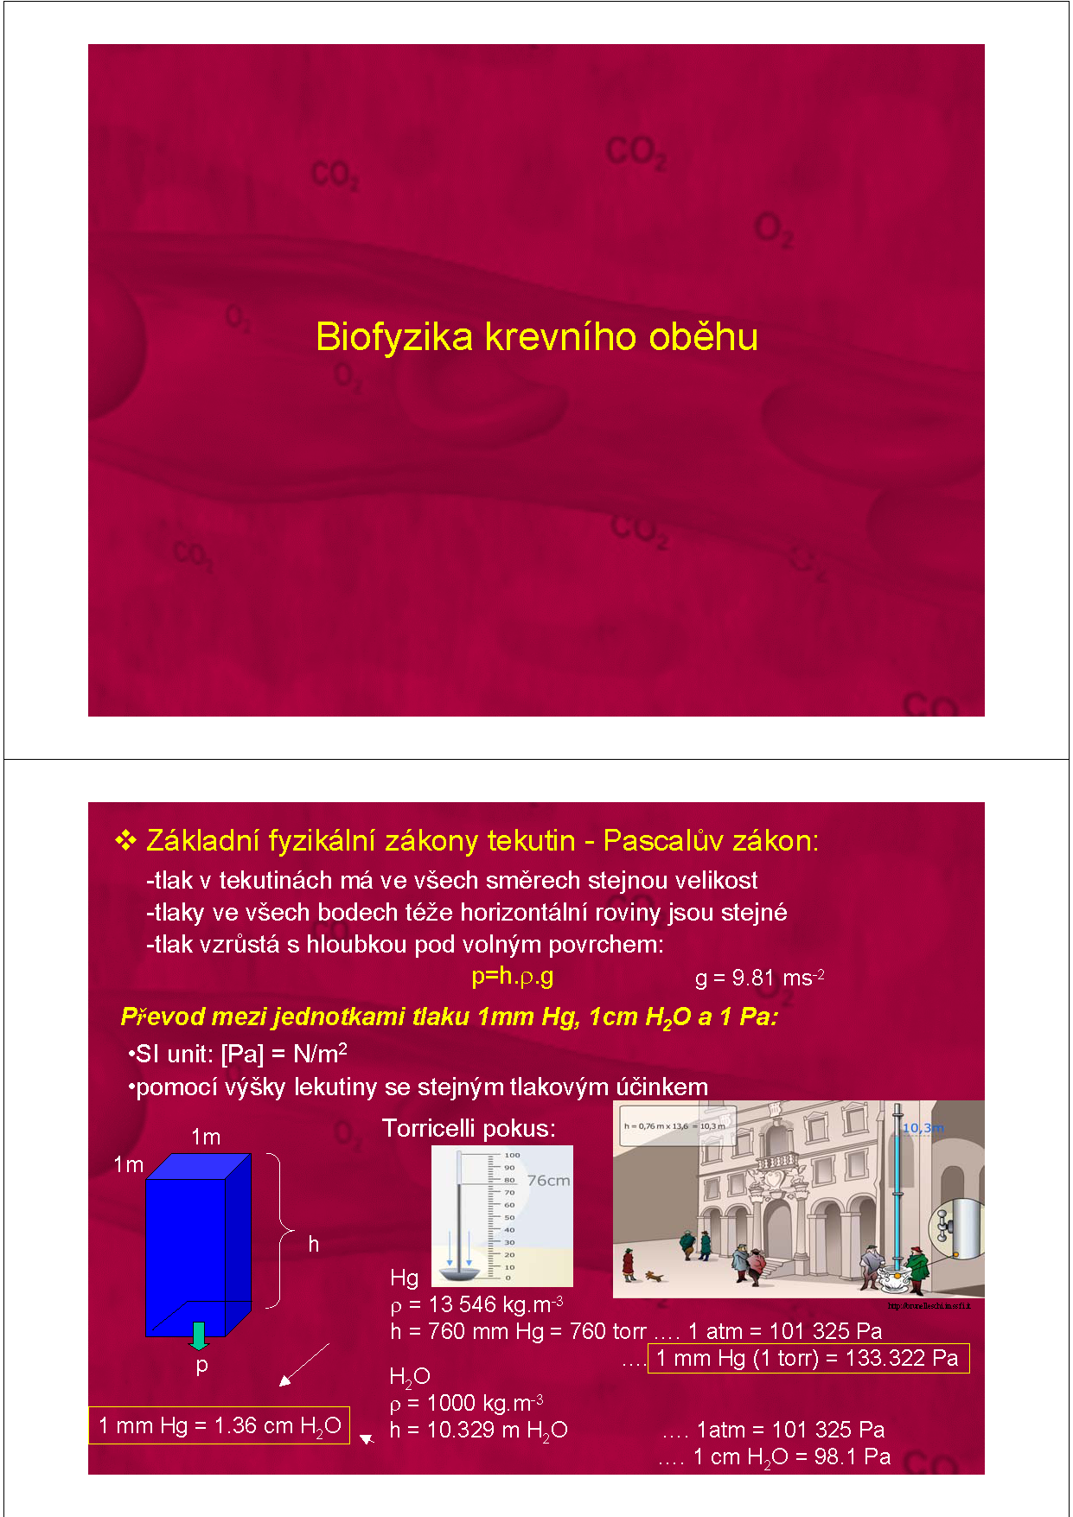
Rheology of blood circulation

Slide 2
1. Basic physical laws of liquids

Slide 3
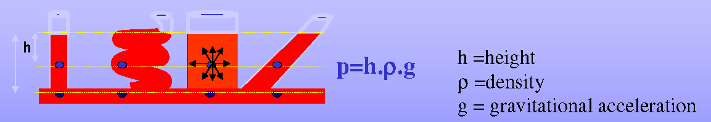
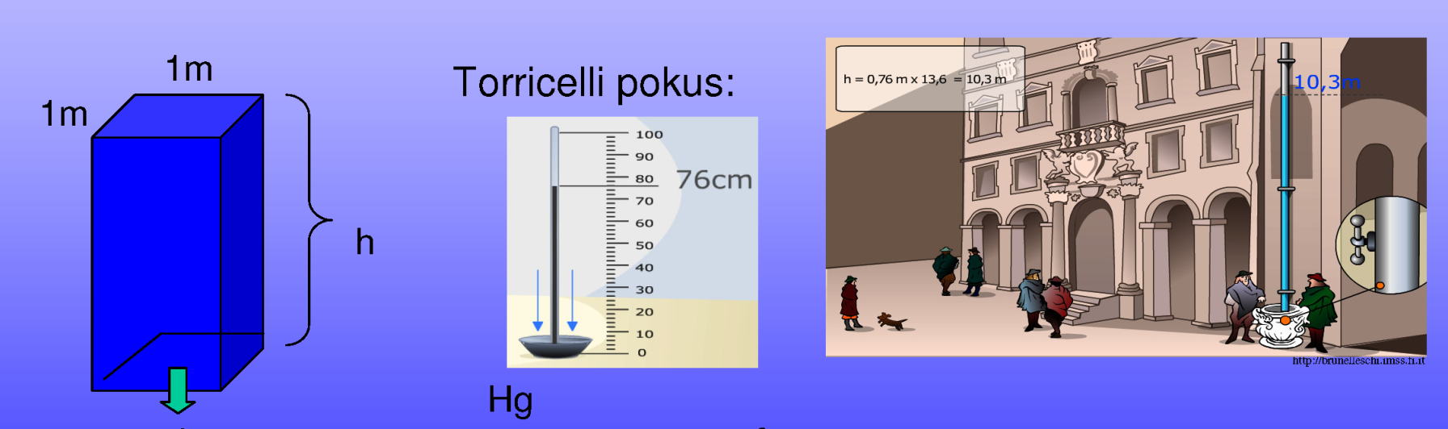
Law of Pascal
Liquid column causes a pressure (hydrostatic pressure) that is directly proportional to the height of the liquid column (h), density of the liquid (ρ) and gravitational acceleration (g).
10.3 m
H₂O
Pa
mm Hg
mm H₂O
133,322 Pa = 1 mm Hg
760 mmHg= 1 atm = 10.3 m H₂O
Notes:
Law of Pascal
Liquid column causes a pressure (hydrostatic pressure) that is directly proportional to the height of the liquid column (h), density of the liquid (ρ) and gravitational acceleration (g). At any given depth (h) in the liquid the pressure is the same no matter what shape the container (vessel) is and is transmitted equally in all directions. A pressure developed by 760 mmHg is the same as the pressure developed by earth atmosphere. This is equivalent to pressure generated by 10.3 m of water column.

Slide 4
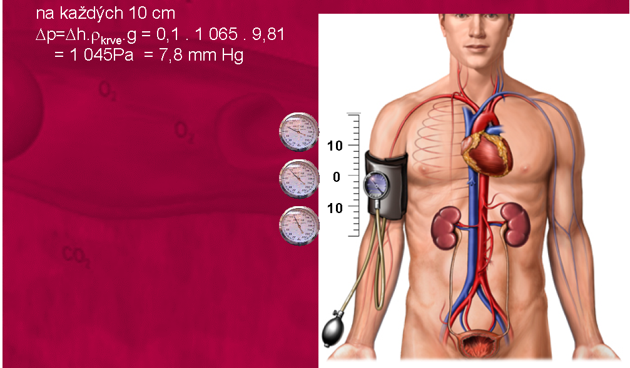
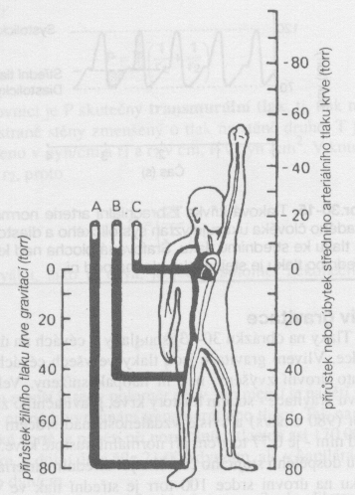
Effect of gravity on arterial and venous pressure
Per each 10 cm
7.8 mm Hg
Increment or decrement in mean arterial pressure (mm Hg]
Increment in venous pressure
due to gravity (mm Hg]
Notes:
Consequence of Pascal's law for blood pressure
As illustrated in the right figure, the blood column causes a decrease of blood pressure if measured over the heart and increase of blood pressure if measured below the heart. Therefore, to obtain a proper value of blood pressure, it is important for the cuff to be placed at the level of heart. Besides, because of the same effect, the blood pressure at the level of brain may be sometimes too low, which may lead to insufficient perfusion of brain tissue (especially under hypotension) and collapse. On the contrary, the high blood pressure at the level of feet (see the pressure increment due to the blood column in the left figure) may lead to edema.

Slide 5
Law of Laplace
Relation between distending pressure (P [N/m²]) and tension in the wall of hollow object (T [N/m]) :
P
(
)
R₁ and R₂ are the biggest and the smallest radii of curvature
T=
1
1
+
R₁
R₂
For vessel:
For sphere:
R₂ = ∞ ⇒
T= P• R
R₁ = R₂ ⇒
T= P• R/2
T
P
P
T
R
h
R
Considering thickness of vessel
wall (h [m]): T=P•R/h [N/m²]
Notes:
Law of Laplace
Law of Laplace defines the relation between distending pressure (P [N/m²]) and tension in the wall of hollow object (T [N/m]). In vessels, P represents a pressure difference across the vessel wall (transmural pressure). The resulting tangential mural tension T [N/m] is a function of the inner radius R [m] of the vessel. Note that the higher is R of the vessel the higher is T.

Slide 6
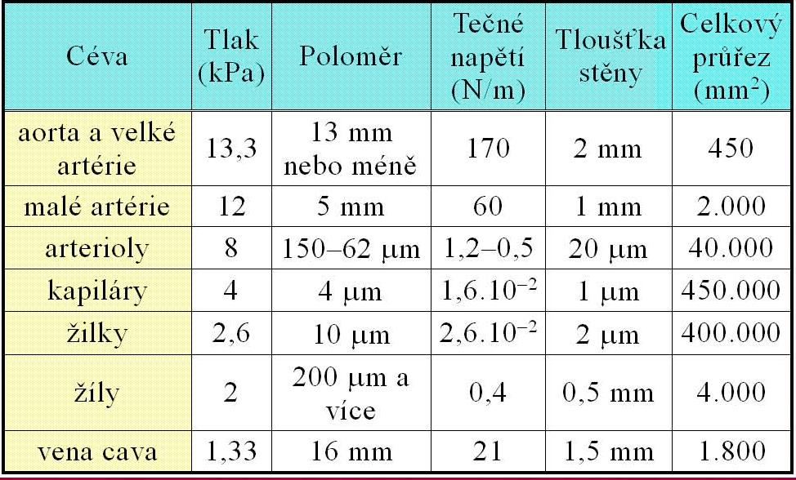
Characteristics of vessels
P
R
P• R
h
P• R/h
P
[kPa]
tension
(N/m)
wall thickness
tension
(N/m²)
vessel
radius
2
aorta
85000
arteries
60000
arterioles
40000
capillaries
16000
venules
13000
veins
800
vena cava
14000
Notes:
Consequences of Laplace law for tension in vessel wall
Consequences of the Laplace law for vessels can be well demonstrated when comparing the wall tension in aorta and capillary. Despite that the wall thickness of aorta (~ 2 mm) is incomparably larger than the wall thickness of capillary (~ 1 μm) the wall tension in aorta is substantially higher. The reason is the large radius of aorta. Aorta is therefore the most stressed vessel in the human body, and a high tension in its wall can sometimes lead to aortic aneurism or even to aortic rupture.

Slide 7

















Continuity equation
The volume of fluid flowing through a tube (vessel) per unit of time (Q [l/s]) is constant.
Q = S₁ •v₁ = S₂ • v₂ = constant
S₁
v₁
v₂
S₂
v – velocity
S – area
Average blood velocity in vessels
Q
v =
S
vessel
diameter
number
total area
velocity
aorta
1
arterioles
20-50 μm
capilaries
4-9 μm
venules
vena cava
2
Notes:
Continuity equation
The continuity equation states that the volume of fluid flowing through a tube (vessel) per unit of time (Q [l/s]) is constant. This implicates that each change of cross-sectional area of vessel must be accompanied by a change of blood flow velocity.
Cross-sectional area and velocity of blood flow in different segments of circulation system
Because the same volume of blood must flow through each segment of the circulation system during a minute, the velocity of blood flow in a given segment can be computed as a ratio of cardiac output to total cross-sectional area of the segment. Thus, under resting conditions, the average velocity of blood flow is about 20 cm/sec in aorta but only 0.4 mm/s in capillaries..

Slide 8
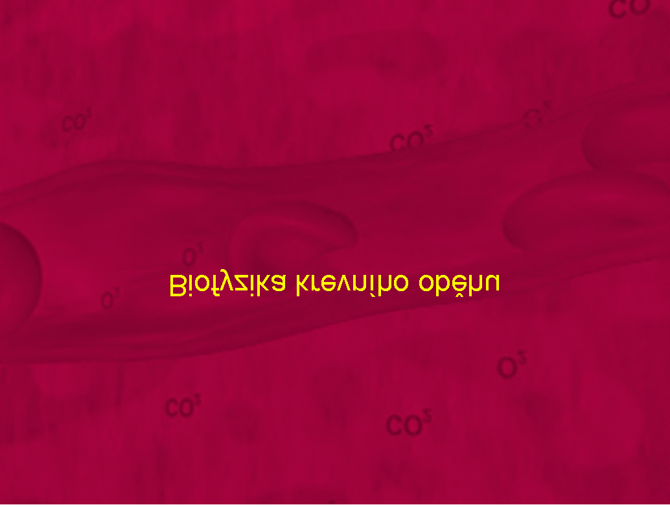
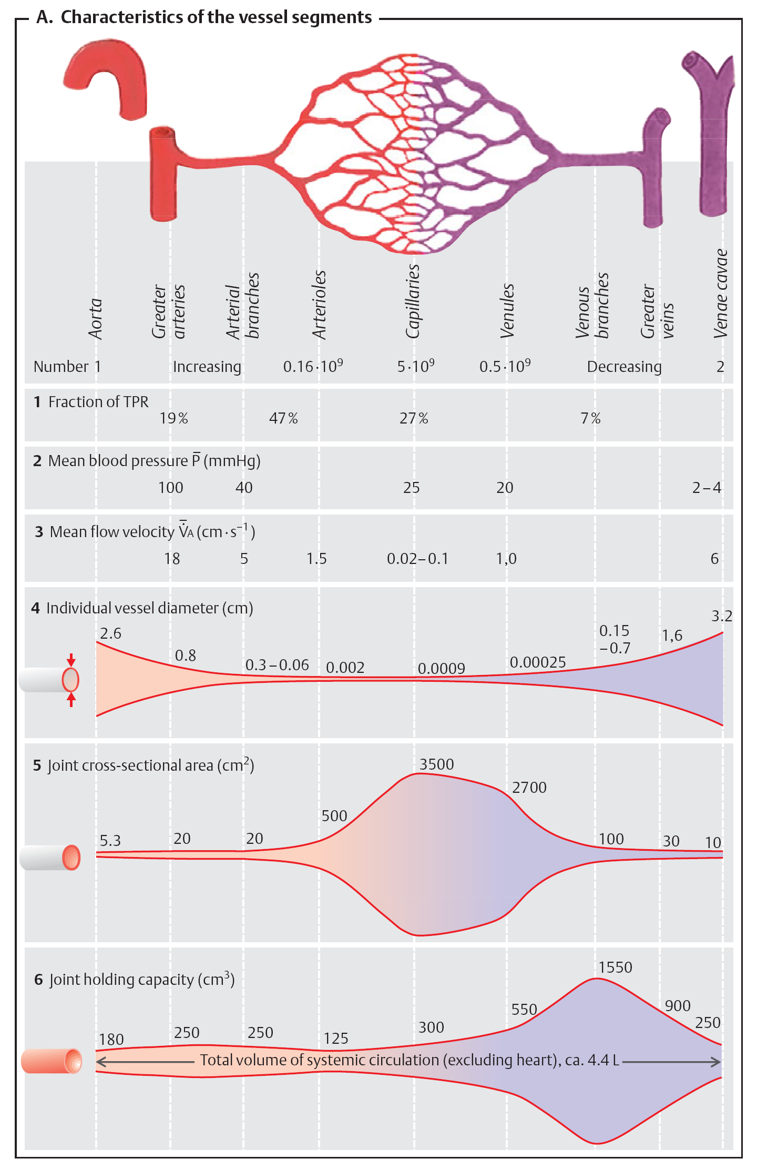
Relation between total cross-sectional area of vessels and mean blood flow velocity
aorta
arteries
arterioles
capilares
venules
veins
v. cava
Notes:
Graphical representation of the relation between total cross-sectional area of vessels and mean blood flow velocity
Note the large cross-sectional area of the system of capillaries resulting from enormous number of capillaries (5*10⁹) arranged in parallel. The consequent slow blood flow velocity in capillaries is important for efficient exchange of solutes through the capillary wall.

Slide 9
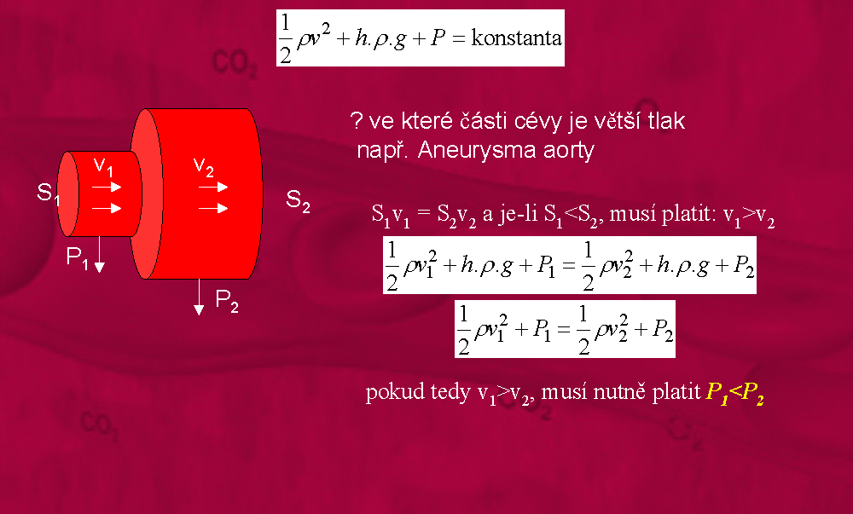
Bernoulli’s principle
P_{2,} v₂
Law of energy conversation for fluid :
h₂
P_{1,} v₁
costant
h₁
h₁
Implication for aortic aneurysm
T₂
T₂= P₂⋅ R₂
For v₂ < v₁ ⇒ P₂ > P₁
Notes:
Bernoulli’s principle
Bernoulli’s principle states that, in a steady flow, the sum of all forms of energy in a fluid along a streamline is the same at all points of that streamline. This requires that the sum of kinetic energy (1/2ρv²), potential energy (hρg) and pressure energy (P) remains constant. Thus, an increase in the speed of the fluid – implying an increase in its kinetic energy – occurs with a simultaneous decrease in pressure energy (including the static pressure). This has serious implications for pathologically distended parts of vascular system such as aortic aneurysm.
Implications for aortic aneurysm
Considering that S₁<S₂ (see the figure on the left side) it must hold that v₁> v₂ (according to the continuity equation). As follows from the Bernoulli’s principle applied on both the normal and pathologically distended parts of aorta, if v₂<v₁ than P₂> P₁. Consequently, according to the Laplace's law, the tension in the wall of aneurysm (T₂) rises because of the increase of both the radius R₂ and pressure P₂. This leads to further distension of aneurism and its rupture if not treated.

Slide 10
Poiseuille – Hagen equation
P_{A}
2r
P_{B}
l
π · ΔP · r⁴
Q=
8 · l · η
The flow of liquid in the cylindrical tube (Q) is directly proportional to the pressure difference between two ends of the tube (ΔP=P_{A}-P_{B}), to the fourth power of the tube radius (r) and inversely proportional to tube length (l) and to the viscosity of liquid (η).
Limitation:
• For stationary flow in Newtonian fluids where viscosity is constant and independent on flow velocity.
Notes:
Poiseuille – Hagen equation states that flow of liquid in the cylindrical „rigid“ tube (Q) is directly proportional to the pressure difference between two ends of the tube (ΔP=P_{A}-P_{B}), to the fourth power of the tube radius (r) and inversely proportional to tube length (l) and to the viscosity of liquid (η).
Note: Rigid tube means that the tube radius is constant (not dependent on ΔP).

Slide 11
π · ΔP · r⁴
ΔP
Q=
⇔
Q=
8 · l · η
R_{v}
Vascular resistance (R_{v}): a consequence of the friction between fluid and vessel wall.
ΔP
8 · l · η
R_{v} =
=
Q
π · r⁴
Parallel arrangement of vessels
Series arrangement of vessels
R₁
R₂
R₁
R₂
R₃
R₃
1
1
1
R_{c}= R₁ + R₂ + ….
= + + ….
R_{c}
R₁
R₂
pro R₁=R₂=R₃=R_{n}
pro R₁=R₂=R₃=R_{n}
R_{c}=R/n
R_{c}=R⋅n
Notes:
Dependence of vessel resistance on vessel radius
Slight change in vessel radius (r) cause tremendous changes in vessel resistance due to its nonlinear dependence on r powered by 4 (see the equation for R_{v}).
Resistance to blood flow in series and parallel vascular circuits
When blood vessels are arranged in series, flow through each blood vessel is the same and the total resistance to blood flow (R_{total}) is equal to the sum of the resistances of each vessel. In the human body, blood pumped by the heart flows from the high pressure part of the systemic circulation (i.e., aorta) to the low pressure part (i.e., vena cava) through many miles of blood vessels arranged in series and in parallel. The systems of arteries, arterioles, capillaries, venules, and veins are collectively arranged in series. Therefore, the total vascular (peripheral) resistance is equal to the sum of resistances of these vascular systems.
Blood vessels branch extensively to form parallel circuits that supply blood to the many organs and tissues of the body. This parallel arrangement permits
each tissue to regulate its own blood flow, to a great extent, independently of flow to other tissues. For a system of blood vessels arranged in parallel the total resistance to blood flow is always lower than the resistance of individual vessels.

Slide 12
Relation between vessel radius and peripheral resistance
aorta
arteries
arterioles
capilares
venules
veins
v. cava
peripheral resistance
highly variable
Notes:
Graphical representation of the relation between radius of vessels, their number and peripheral resistance
Peripheral resistance is resistance of vessels to blood flow caused by the friction between the vessel wall and flowing blood. As the vessels constrict, the resistance increases and as they dilate, the resistance decreases (mathematical expression for one vessel is in the previous slide). In the human body, the highest resistance (nearly 50%) is generated by the system of small arteries and arterioles due to their small radius and limited branching. However, the vasomotor activity of these vessels allows them to change their radius and thus to regulate their resistance greatly. This is important for efficient regulation of blood flow into bodily tissues according to their metabolic demands.

Slide 13

Total peripheral resistance (TPR) of vascular system
Q
Q_{rest} ≈ 90 ml/s
P_{v}
ΔP
P_{a}
venous system
TPR =
arterial system
Q
P_{v,mean} ≈ 3 mm Hg
TPR
P_{a,mean} ≈ 93 mm Hg
ΔP
P_{a}-P_{v}
P_{a}
93
mmHg s
TPR =
=
≈
=
≈
1
Q
Q
Q
90
ml
For constant Q: ↑TPR ⇒ ↑ P_{a} ⇒ hypertension,…cardiac disease.
Notes:
Total peripheral resistance
The amount of blood flowing through the entire circulatory system is equal to the amount of blood pumping by the heart - that is, it is equal to the cardiac output. The resting cardiac output is approximately 90 ml/sec. The pressure difference from the systemic arteries to the systemic veins is about 90 mmHg. Therefore, the resistance of the entire systemic circulation, called the total peripheral resistance (TPR), is about 1 mmHg⋅s/ml.
In conditions in which all the blood vessels throughout the body become strongly constricted, the TPR occasionally rises four times. Conversely, when the vessels become greatly dilated, the resistance can fall to 20% of resting TPR.
Note that each condition that causes an increase of TPR (under constant Q) leads to an increase of P_{a} and hence to hypertension. A long time increase of TPR may lead to heart hypertrophy (adaptation of the heart to higher pressure) and to heart disease such as cardiomyopathy or heart failure.

Slide 14
2. Rheological features of blood and vessels

Slide 15
Blood viscosity
R_{v} = 8·l·η/(π·r⁴)
Effect of hematocrit
Effect of diameter in small vessels
Fahraes-Lindqvist effect
8
↑R_{V}
6
Blood
Viscosity in relative units
4
2
Water
cap.
Phys. range
arterioles
0
20
40
60
Hematocrit
Other factors causing increase of viscosity:
• decrease of blood flow velocity
elevation of plasma proteins
Notes:
Effect of blood viscosity on vascular resistance and blood flow
An important factor in Poiseuille’s equation is viscosity of the blood. The viscosity describes the tendency of a fluid to resist flow. The viscosity of normal blood is about three times as great as the viscosity of water and increases progressively with a rise of haematocrit (percentage of red blood cells in a given blood volume). Thus, the higher is hematocrit, the greater is blood viscosity and finally vascular resistance. This results in lower flow of blood in vessels or higher load of the heart if the cardiac output is held constant.
The viscosity of blood changes with the diameter of the vessel it travels through. In particular, there is a decrease in viscosity as the vessel's diameter decreases from 300 to 10 micrometers (the Fahræus–Lindqvist effect). This is because erythrocytes move over to the centre of the vessel, leaving only plasma near the wall of the vessel. The consequent decrease of the friction forces between the blood and vessel wall contributes to a reduction of blood viscosity.

Slide 16
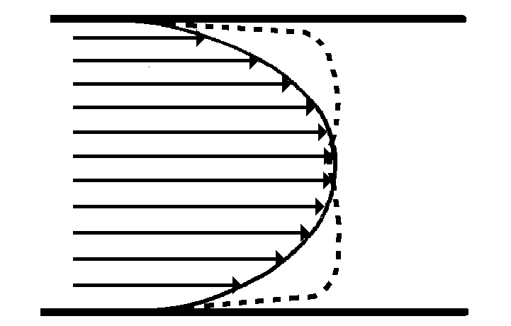
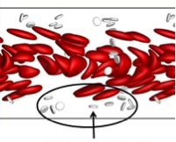
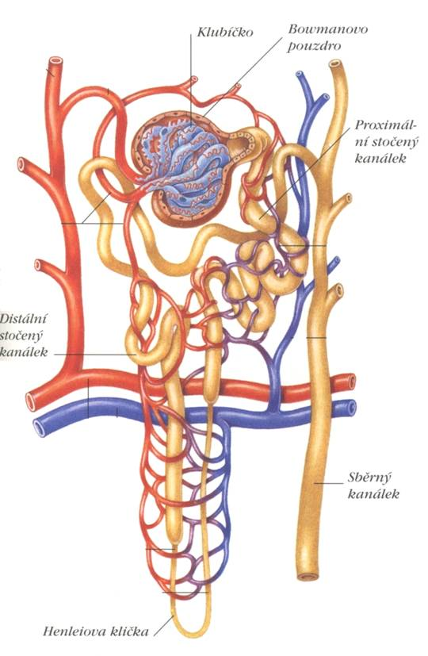
Velocity profile of the blood flow in vessels
aorta
small
arteries
plasma-skimming
In small arteries the velocity profile of the flowing blood has a parabolic shape. In the bigger arteries it has a piston shape.
The layer close to vessel wall is poor of erythrocytes.
Notes:
Parabolic velocity profile during laminar flow
When the fluids are made to flow, a parabolic interface develops between them. The portion of fluid adjacent to the vessel wall has hardly moved, the portion slightly away from the wall has moved a small distance, and the portion in the center of the vessel has moved a long distance. This effect is called the “parabolic profile for velocity of blood flow.”
The cause of the parabolic profile is the following: The fluid molecules touching the wall barely move because of adherence to the vessel wall. The next layer of molecules slips over these, the third layer over the second, the fourth layer over the third, and so forth. Therefore, the fluid in the middle of the vessel can move rapidly because many layers of slipping molecules exist between the middle of the vessel and the vessel wall; thus, each layer toward the center flows progressively more rapidly than the outer layers.
Piston velocity profile during laminar flow
All layers in the flowing fluid have the same velocity.

Slide 17
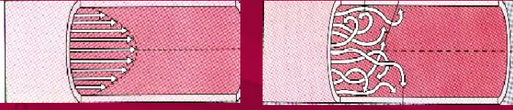
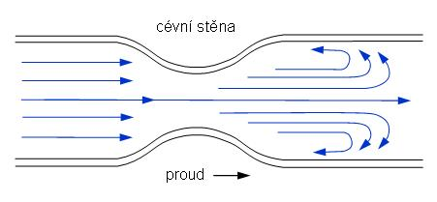
Laminar and turbulent flow
Velocity profile in laminar and turbulent flow
The character of the flow is determined by Reynolds number
v⋅ρ ⋅r
R_{e}=
η
laminar flow
Re<2000
turbulent flow
Re>3000
Sudden change of vessel diameter
↑v
↑R_{e}
⇒
↑R_{V}
↑r
↓r
↑↑v
Pathological states causing turbulent flow: aneurisma, stenosis, arteriosclerosis, decreased blood viscosity, .
Notes:
Laminar flow of blood in vessels
When blood flows at a steady rate through a long, smooth blood vessel, it flows in streamlines, with each layer of blood remaining the same distance from the vessel wall. Also, the central most portion of the blood stays in the center of the vessel. This type of flow is called laminar flow or streamline flow, and it is the opposite of turbulent flow, which is blood flowing in all directions in the vessel and continually mixing within the vessel.
Turbulent flow of blood in vessels
When the rate of blood flow becomes too great, when it passes by an obstruction in a vessel, when it makes a sharp turn, or when it passes over a rough surface, the flow may then become turbulent, or disorderly, rather than streamline. Turbulent flow means that the blood flows crosswise in the vessel as well as along the vessel, usually forming whorls in the blood called eddy currents. These are similar to the whirlpools that one frequently sees in a rapidly flowing river at a point of obstruction. When eddy currents are present, the blood flows with much greater resistance than when the flow is streamline because eddies add tremendously to the overall friction of flow in the vessel. The tendency to turbulent flow increases in direct proportion to the velocity of blood flow, the diameter of the blood vessel, and the density of the blood, and is inversely proportional to the viscosity of the blood, in accordance with the following equation:
R_{e}=(v⋅ρ ⋅r)/η
where R_{e} is Reynolds’ number and is the measure of the tendency for turbulence to occur, v is the mean velocity of blood flow, r is the vessel radius, ρ is density, and η is the viscosity. The viscosity of blood is normally about 1/30 poise, and the density is only slightly greater than 1. When Reynolds’ number rises above 200 to 400, turbulent flow will occur at some branches of vessels but will die out along the smooth portions of the vessels. However, when Reynolds’ number rises above approximately 2000, turbulence will usually occur even in a straight, smooth vessel. Reynolds’ number for flow in the vascular system even normally rises to 200 to 400 in large arteries; as a result there is almost always some turbulence of flow at the branches of these vessels. In the proximal portions of the aorta and pulmonary artery, Reynolds’ number can rise to several thousand during the rapid phase of ejection by the ventricles; this causes considerable turbulence in the proximal aorta and pulmonary artery where many conditions are appropriate for turbulence: (1) high velocity of blood flow, (2) pulsatile nature of the flow, (3) sudden change in vessel diameter, and (4) large vessel diameter. However, in small vessels, Reynolds’ number is almost never high enough to cause turbulence.

Slide 18
Elasticity of vessels
flow
rigid tube
real vessel
critical pressure
pressure
aorta
compliance
v. cava
P
P
10
1
KPa
C↓
ΔV
KPa
C↑
C =
ΔP
ΔV
V
ΔV
V
Notes:
Effect of pressure on vascular resistance and tissue blood flow
One might expect that an increase in arterial pressure will cause a proportionate increase in blood flow through the various tissues of the body. However, the effect of pressure on blood flow is greater. The reason for this is that an increase in arterial pressure not only increases the force that pushes blood through the vessels but also distends the vessels at the same time, which decreases vascular resistance. Thus, greater pressure increases the flow in both of these ways. Therefore, for most tissues, blood flow at 100 mm Hg arterial pressure is usually four to six times as great as blood flow at 50 mm Hg instead of two times as would be true if there were no effect of increasing pressure to increase vascular diameter (rigid vessel).
Vascular distensibility
A valuable characteristic of the vascular system is that all blood vessels are distensible. Vascular distensibility plays an important roles in circulatory function. For example, the distensible nature of the arteries allows them to accommodate the pulsatile output of the heart and to average out the pressure pulsations. This provides smooth, continuous flow of blood through the very small blood vessels of the tissues. The most distensible by far of all the vessels are the veins. Even slight increases in venous pressure cause the veins to store 0.5 to 1.0 liter of extra blood. Therefore, the veins provide a reservoir function for storing large quantities of extra blood that can be called into use whenever required elsewhere in the circulation. Conversely, the walls of the arteries are far stronger than those of the veins. Consequently, the arteries, on average, are about eight times less distensible than the veins. That is, a given increase in pressure causes about eight times as much increase in blood in a vein as in an artery of comparable size.
Vascular compliance
In hemodynamic studies, it usually is much more important to know the total quantity of blood that can be stored in a given portion of the circulation for each millimeter of mercury pressure rise than to know the distensibilities of the individual vessels. This value is called the compliance.
Compliance and distensibility are quite different. A slightly distensible vessel that has a slight volume may have far less compliance than a much less distensible vessel that has a large volume because compliance is equal to distensibility times volume.
The compliance of a systemic vein is about 24 times that of its corresponding artery because it is about 8 times as distensible and it has a volume about 3 times as great (8 × 3 = 24).

Slide 19
Pulse wave velocity (PWV)
h
2r
PWV
ρ
E_{inc} – modulus of stiffness
Moens-Korteweg (1878)
E_{inc} ⋅ h
PWV =
2 ⋅ r ⋅ ρ
In aorta PWV = 4 - 6 m/s
Notes:
Pulse wave velocity
When the heart ejects blood into the aorta during systole, at first only the proximal portion of the aorta becomes distended because the inertia of the blood prevents sudden blood movement all the way to the periphery. However, the rising pressure in the proximal aorta rapidly overcomes this inertia, and the wave front of distention spreads farther and farther along the aorta. This is called transmission of the pulse pressure in the arteries. The velocity of pulse pressure transmission (or pulse wave velocity, PWV) in the normal aorta is 3 to 5 m/sec; in the large arterial branches, 7 to 10 m/sec; and in the small arteries, 15 to 35 m/sec. In general, the smaller the compliance (and higher stiffness) of a given vascular segment, the higher the velocity, which explains the slow PWV in the aorta and the much faster PWV in the much less compliant small distal arteries. In the aorta, the PWV is 20 or more times the velocity of blood flow because the pulse pressure is simply a moving wave of pressure that involves little forward total movement of blood volume. The relation between PWV, vascular stiffness, vessel radius, and thickness of vessel wall shows the equations derived by Moens-Kortweg in 1878. It is worth noting that PWV can be simply measured and can be used as a predictor of increased vascular stiffness and of related tendency to hypertension.

Slide 20
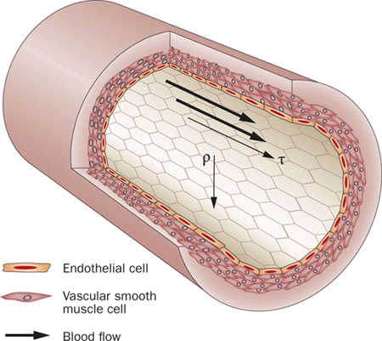
Share stress in vessel wall
τ = 4ηQ/πr³
T
τ
Share stress in vessel wall may lead to a tear in endothelial layer and to arterial dissection.
Notes:
Shear stress is defined as the frictional force generated by blood flow in the endothelium, that is, the force that the blood flow exerts on the vessel wall in direction of the flow. The magnitude of shear stress depends on velocity of blood flow, viscosity of the blood, and vessel radius. Increased values of share stress may lead to a tear in endothelial layer and to arterial dissection.

Slide 21
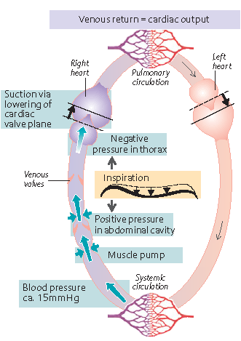
Mechanisms of venous return
2
4
5
3
1
Notes:
Venous return
Blood from the capillaries is collected in the veins and returned to the heart. The driving forces for this venous return are: (1) vis a tergo, i.e., the postcapillary blood pressure (ca. 15 mmHg); (2) the suction that arises due to lowering of the cardiac valve plane in systole; (3) the pressure exerted on the veins during skeletal muscle contraction (muscle pump); (4) the increased abdominal pressure together with the lowered intrathoracic pressure during inspiration, which leads to thoracic venous dilatation and suction. The valves of veins (5) prevent the blood from flowing in the wrong direction.

Slide 22
3. Blood circulation and pressure

Slide 23
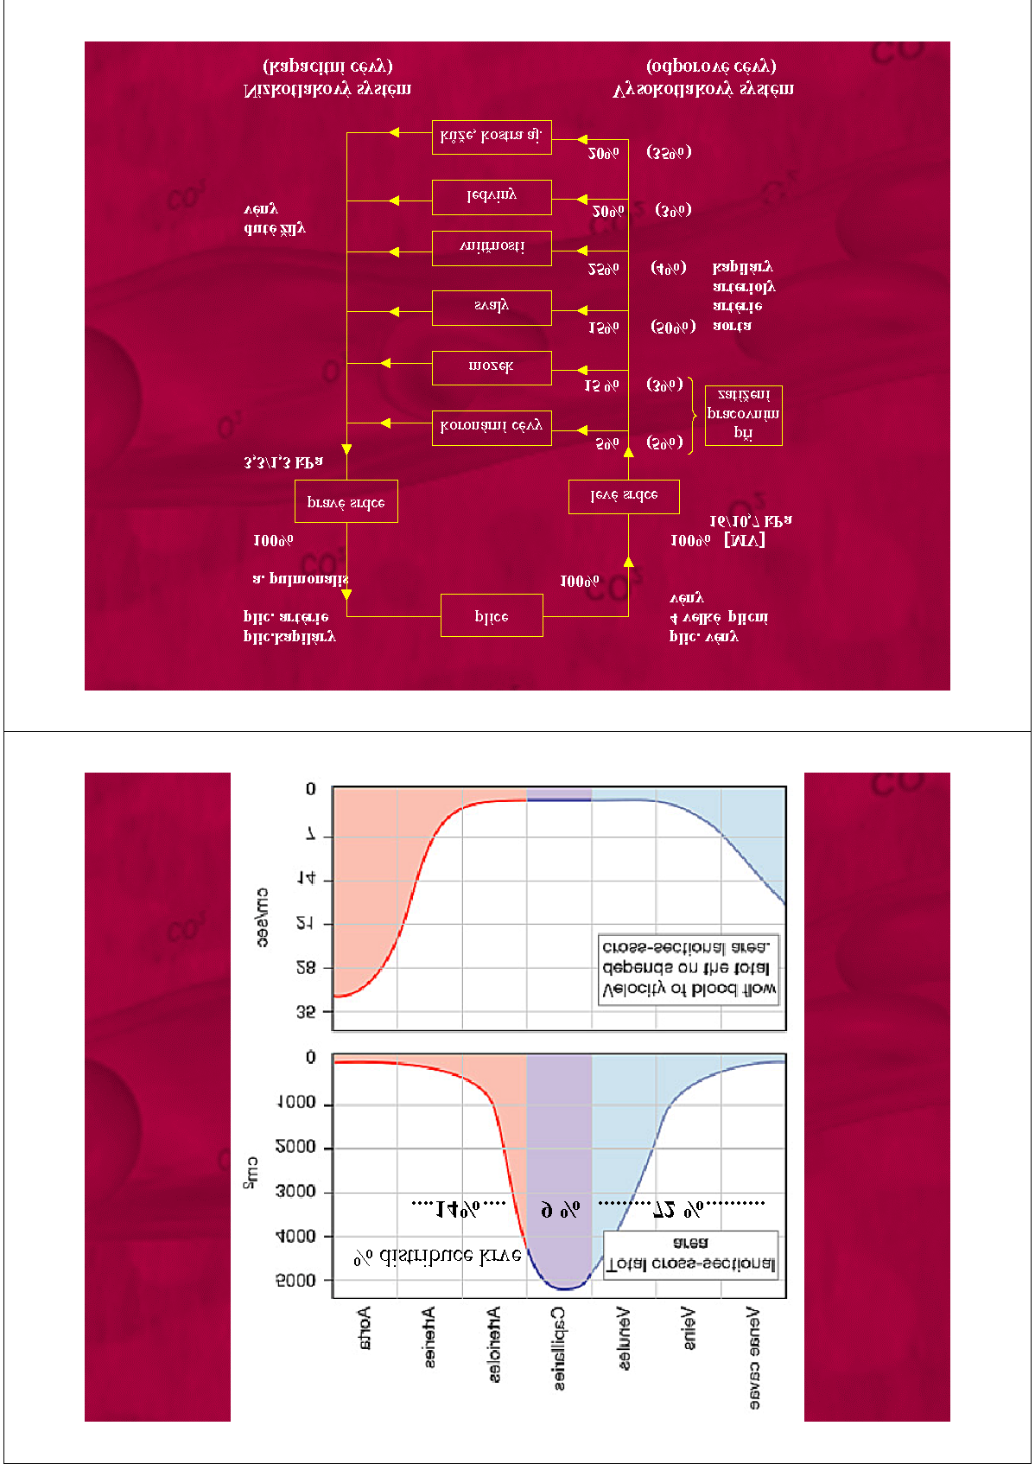
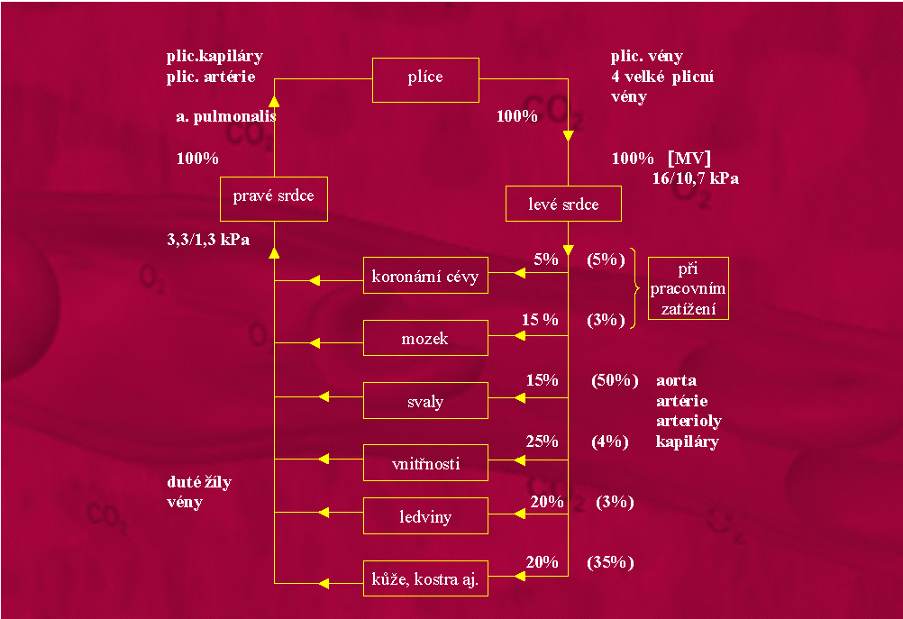
Blood circulation
lungs
pulmonary circulation
Cardiac output in rest
5 - 6 l/min
right heart
left heart
systemic circulation
After load up to 20 l/min
∼3 mm Hg
coronary vessels
120/80
mm Hg
brain
muscles
liver, gastro- intestinal tract
kidneys
Low-pressure system
(reservoir function)
High-pressure system
(supply function)
skin and other organs
rest
load
Notes:
Function of blood circulation
The function of the circulation is to service the needs of the body tissues—to transport nutrients to the body tissues, to transport waste products away, to conduct hormones from one part of the body to another, and, in general, to maintain an appropriate environment in all the tissue fluids of the body for optimal survival and function of the cells.
The rate of blood flow through most tissues is controlled in response to tissue need for nutrients. The heart and circulation in turn are controlled to provide the necessary cardiac output and arterial pressure to ensure the required blood flow into the individual tissues (note the differences in blood distribution between individual organ systems in rest and under load).
Physical characteristics of the circulation
The circulation is divided into the systemic circulation and the pulmonary circulation. Because the systemic circulation supplies blood flow to all the tissues of the body except the lungs, it is also called the greater circulation or peripheral circulation.
Functional parts of the circulation
Before discussing the details of circulatory function, it is important to understand the role of each part of the circulation. The function of the arteries is to transport blood under high pressure to the tissues. For this reason, the arteries have strong vascular walls, and blood flows at a high velocity in the arteries.
The arterioles are the last small branches of the arterial system; they act as control conduits through which blood is released into the capillaries. The arteriol has a strong muscular wall that can close the arteriole completely or can, by relaxing, dilate it several fold, thus having the capability of vastly altering blood flow in each tissue bed in response to the need of the tissue.
The function of the capillaries is to exchange fluid, nutrients, electrolytes, hormones, and other substances between the blood and the interstitial fluid. To serve this role, the capillary walls are very thin and have numerous minute capillary pores permeable to water and other small molecular substances.
The venules collect blood from the capillaries, and they gradually coalesce into progressively larger veins. The veins function as conduits for transport of blood from the venules back to the heart; equally important, they serve as a major reservoir of extra blood.
Because the pressure in the venous system is very low, the venous walls are thin. Even so, they are muscular enough to contract or expand and thereby act as a controllable reservoir for the extra blood, either a small or a large amount, depending on the needs of the circulation.
Basic theory of circulatory function
Although the details of circulatory function are complex, there are three basic principles that underlie all functions of the system.
The rate of blood flow to each tissue of the body is almost always precisely controlled in relation to the tissue need. When tissues are active, they need greatly increased supply of nutrients and therefore much more blood flow than when at rest—occasionally as much as 20 to 30 times the resting level. Yet the heart normally cannot increase its cardiac output more than four to seven times greater than resting levels. Therefore, it is not possible simply to increase blood flow everywhere in the body when a particular tissue demands increased flow. Instead, the microvessels of each tissue continuously monitor tissue needs, such as the availability of oxygen and other nutrients and the accumulation of carbon dioxide and other tissue waste products, and these in turn act directly on the local blood vessels, dilating or constricting them, to control local blood flow precisely to that level required for the tissue activity. Also, nervous control of the circulation from the central nervous system provides additional help in controlling tissue blood flow.
2. The cardiac output is controlled mainly by the sum of all the local tissue flows. When blood flows through a tissue, it immediately returns by way of the veins to the heart. The heart responds automatically to this increased inflow of blood by pumping it immediately into the arteries from whence it had originally come. Thus, the heart acts as an automaton, responding to the demands of the tissues. The heart, however, often needs help in the form of special nerve signals to make it pump the required amounts of blood flow.
3. The arterial pressure is controlled independently of either local blood flow control or cardiac output control. The circulatory system is provided with an extensive system for controlling the arterial blood pressure. For instance, if at any time the pressure falls significantly below the normal level of about 100 mm Hg, within seconds a barrage of nervous reflexes elicits a series of circulatory changes to raise the pressure back toward normal. The nervous signals especially (a) increase the force of heart pumping, (b) cause contraction of the large venous reservoirs to provide more blood to the heart, and (c) cause generalized constriction of most of the arterioles throughout the body so that more blood accumulates in the large arteries to increase the arterial pressure. Then, over more prolonged periods, hours and days, the kidneys play an additional major role in pressure control both by secreting pressure-controlling hormones and by regulating the blood volume.

Slide 24
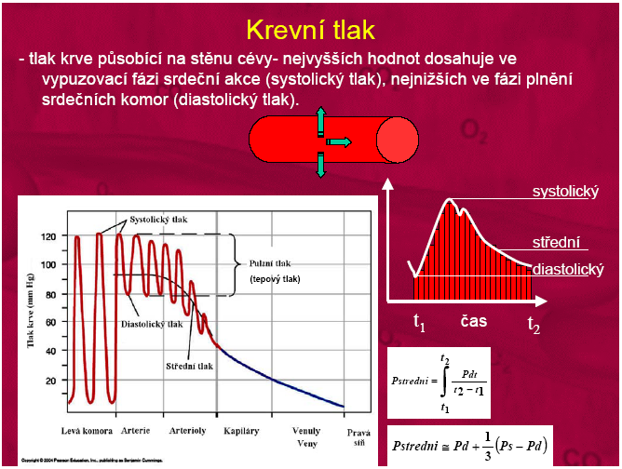
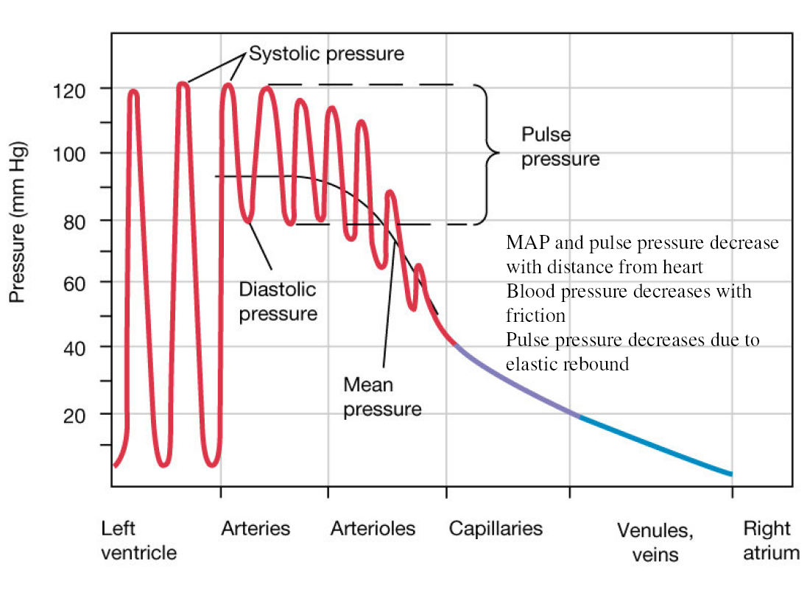
Blood pressure
Blood pressure (BP) is the pressure exerted by circulating blood upon the walls of blood vessels.
systolic
mean
diastolic
P_{mean}
P_{mean}
Notes:
Pressures in the various parts of the circulation system
Because the heart pumps blood continually into the aorta, the mean pressure in the aorta is high, averaging about 100 mmHg. Also, because heart pumping is pulsatile, the arterial pressure alternates between a systolic pressure level of 120 mm Hg and a diastolic pressure level of 80 mm Hg. As the blood flows through the systemic circulation, its mean pressure falls progressively to about 0 mmHg by the time it reaches the termination of the venae cavae where they empty into the right atrium of the heart.
Note that the mean pressure fall is the fastest at the system of arterioles. This is a consequence of the highest resistance of this system to the blood flow.

Slide 25
Dependence of blood pressure on cardiac output and vascular parameters
ΔP
ΔV
Q=
Q
C=
R
HEART
SV, HR
ΔP
C_{a}
P_{v}
venous system
aorta
P_{a}
V_{a}
R
P_{a,mean} - P_{v,mean} = Q · R
ΔV ≅ SV
P_{a,mean} = SV · HR · R + P_{v,mean}
PP ≅
SV
C
P_{a,mean} ≅ SV · HR · R
PP
P_{a,mean}
Notes:
The effect of changes of cardiac output and of vascular parameters on mean arterial pressure (P_{a,mean}) and pulse pressure (PP) can be approximately estimated from the two following relations:
P_{a,mean} ≅ SV · HR · R
PP ≅ SV/C
where SV, HR, R, and C stand for stroke volume, heart rate, total peripheral resistance and compliance of aorta, respectively.
Note that these two relations are derived from the equations of blood flow (Q=ΔP/R) and vascular compliance (C=ΔV/ΔP).

Slide 26
resting state
activity
+SV↑
HR↑
+R↓
P_{a,mean} ≅ SV · HR · R
PP ≅
SV
C
Notes:
Changes of mean arterial pressure and of pulse pressure during exercise
Consistently with the relations for P_{a,mean} and PP a separate increase of HR induced by the physical activity would cause only the rise of P_{a,mean}. A simultaneous increase of SV will cause a further rise of P_{a,mean} and an increase of PP. Due to a subsequent reduction of R (consequence of the vascular vasodilatation in active muscles) the P_{a,mean} falls down but PP remains increased.
This example shows a separate effect of changes that accompany physical activity but may be applied to other situations. In reality, the changes may occur simultaneously.

Slide 27
Model of blood pressure changes in aorta
F_{i} [ml/s]
Δ t
t [s]
  (P_{a} – P_{v})
  R
t = t+Δt
F_{o} =
HEART
SV, TF
F_{i}
C_{a}
P_{v}
venous system
aorta
P_{a}
V_{a}
R
F_{o}
P_{a} = P_{a} +ΔP_{a}
ΔV_{a} = (F_{i} - F_{o})⋅Δt
  ΔV_{a}
    C_{a}
ΔP_{a} =
Notes:
Model of blood pressure changes in aorta
Simulation of aortic function is based on a simple “Windkessel” model. Blood pressure change in the aorta (ΔP_{a}) is directly proportional to blood volume change in the aorta (ΔV_{a}) according to equation:
ΔP_{a}=ΔV_{a}/C_{a}.
where C_{a} is compliance of aorta (in l/Pa).
Blood volume change in the aorta during short time interval of cardiac cycle (Δt) is given by equation:
ΔV_{a} = (F_{i} − F_{o})×Δt
where F_{i} (in l/s) corresponds to blood inflow from the left ventricle and F_{o} blood outflow to other parts of arterial system.
In our model, the inflow is characterised by a triangular pulse and corresponds to blood flow through the aortic valve. During clinical examination, speed (in m/s) is measured by Doppler method and flow is calculated as a product of blood speed and area of aortic valve. Area surrounded by triangular pulse corresponds then to stroke volume (SV). By multiplying SV by heart rate (HR) the cardiac output (CO) is calculated. Outflow is defined as:
F_{o} = (P_{a}− P_{v})/R,
where P_{a}− P_{v} is pressure difference between the aorta and v. cava and R is peripheral vascular resistance (its physiological value is ∼1.0 mmHg∙s/ml).
Time course of blood pressure can be than simulated by repeated calculations of F_{o} and F_{i} at discrete time moments (t₀, t₀+Δt, t₀+2Δt,…..) and by introduction of their values into the formula for ΔV_{a} and ΔP_{a} calculation. Actual values of BP as well as values of systolic (SBP) and diastolic (DBP) blood pressure are thus given by four variables: SV, HR, C, and R.

