Slide 1
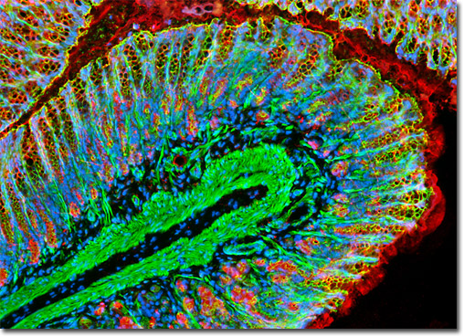
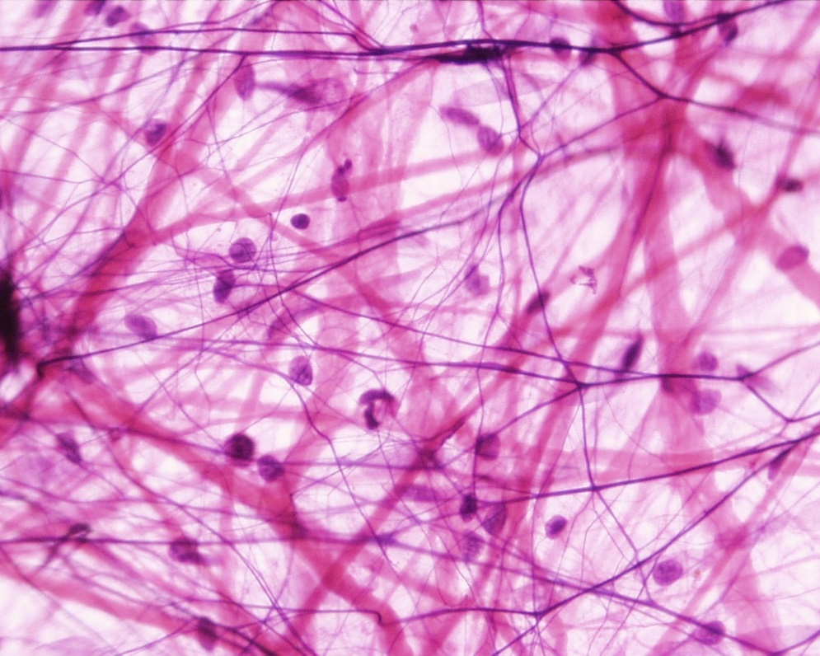
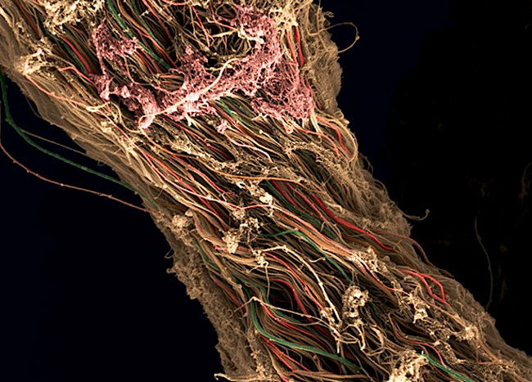
CONNECTIVE TISSUE
Petr Vaňhara, PhD
Department of Histology and Embryology,
Faculty of Medicine MU
pvanhara@med.muni.cz

Slide 2
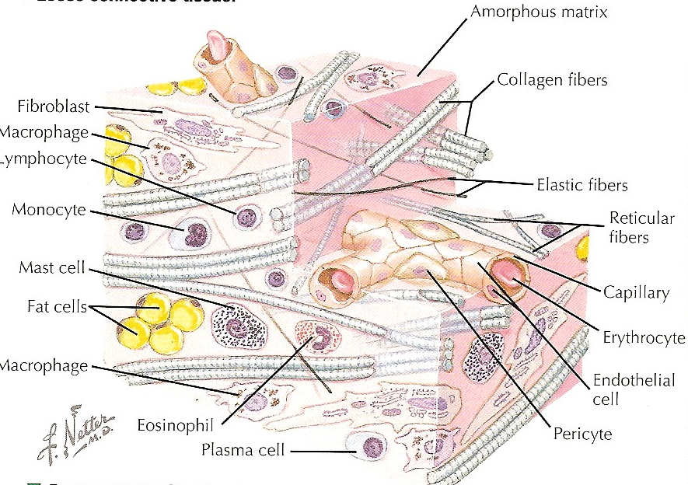
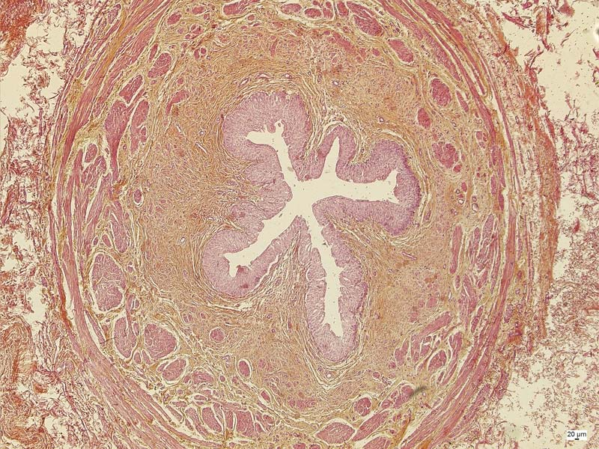
CONNECTIVE TISSUE
Mechanical and biological properties
→ surrounds other tissues, allows compartmentalization, provides support, defines physico-chemical environment, brings immunological support, provides storage of energy, ...

Slide 3
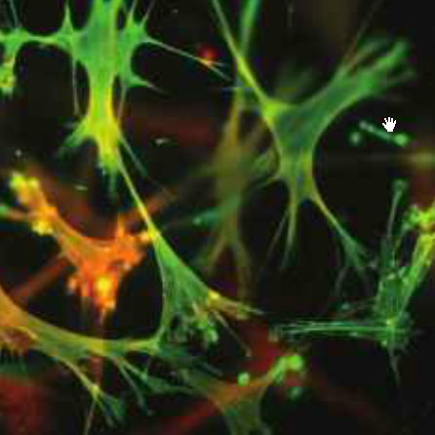
GENERAL COMPOSITION OF CONNECTIVE TISSUE
Cells and extracellular matrix (ECM)
Cells
Connective tissue – permanent and transient cell populations (e.g. fibroblasts/myofibroblasts, immune cells, adipocytes, adult stem cells)
Cartilage – chondroblasts/chondrocytes
Bone – osteoblasts/osteocytes/osteoclasts
Matrix – fibrous and amorphous
Fibrous component
collagen
reticular
elastic
Amorphous component (amorphous ground substance)
Complex matrix consisting of
glycosaminoglycans
glycoproteins
proteoglycans
composition dependent on tissue type (connective × ligament × cartilage × bone)

Slide 4
CLASSSIFICATION OF CONNECTIVE TISSUE
Embryonic CT
Mesenchyme
Jelly-like CT (Wharton jelly, dental pulp, stroma of iris)
Adult CT
Areolar (loose, interstitial) CT
Dense collagen irregular CT
Dense collagen regular CT
Fat (adipose tissue)
Cartilage
Bone
Blood and hematopoietic tissue
Lymphatic tissue
CT
Specialized CT
Trophic CT (body liquids)

Slide 5
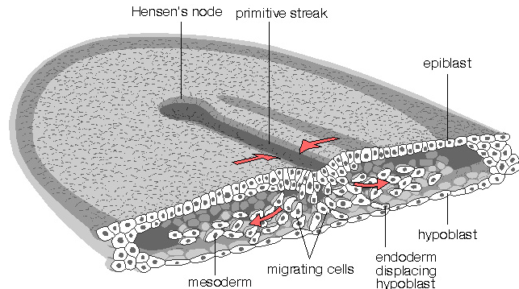
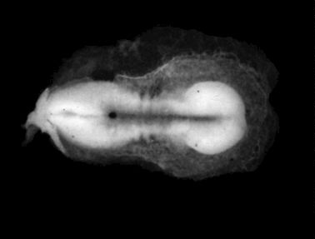
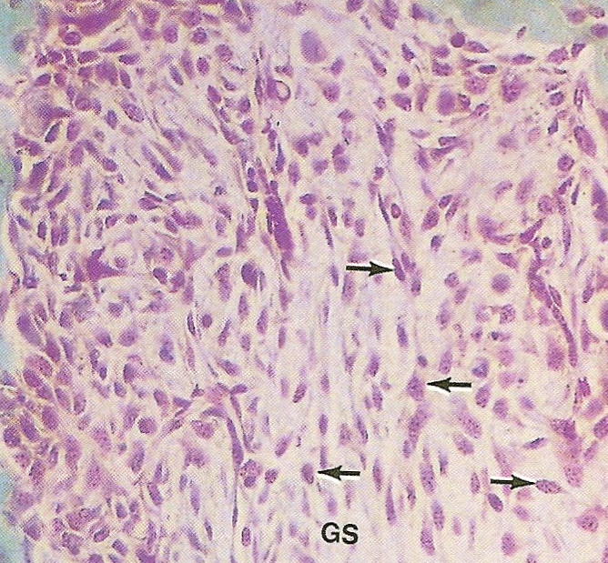
EMBRYONIC ORIGIN OF CONNECTIVE TISSUE
Mesenchyme = loose tissue between germ layers
Complex network of star- or spindle-shaped cells
Jelly-like amorphous ground substance
DAY 12 of embryonic development
http://www.mun.ca/biology/desmid/brian/BIOL3530/DB_Ch02/DBNModel.html

Slide 6
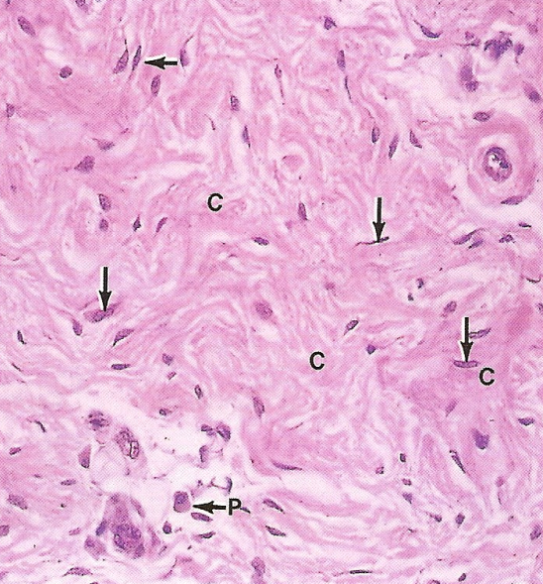
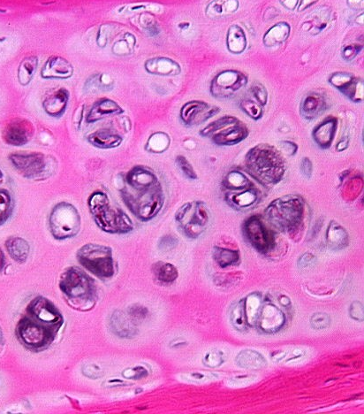
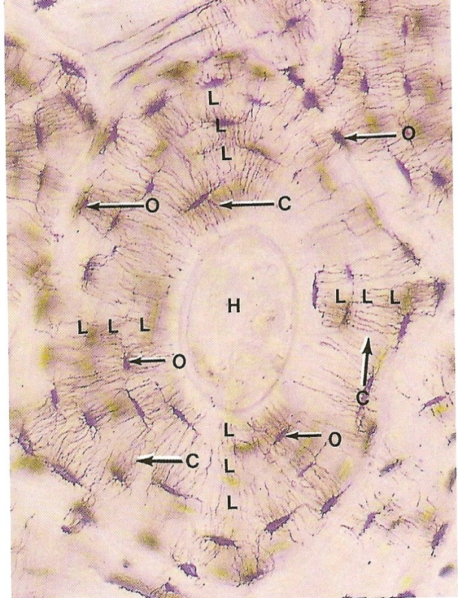
DERIVATIVES OF CONNECTIVE TISSUE
Mesenchyme
Connective
Cartilage
Bone

Slide 7
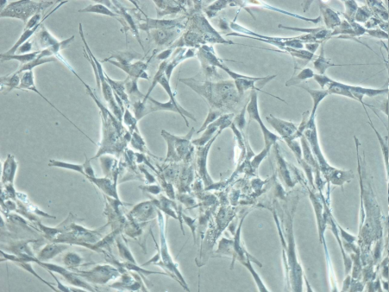
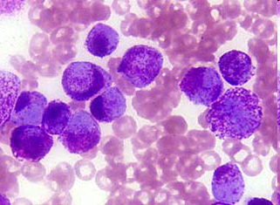
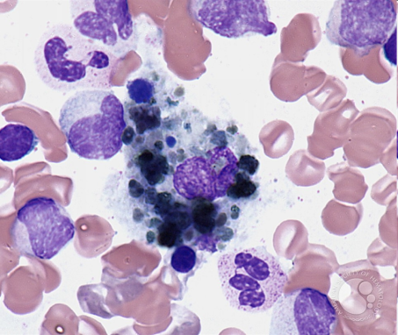
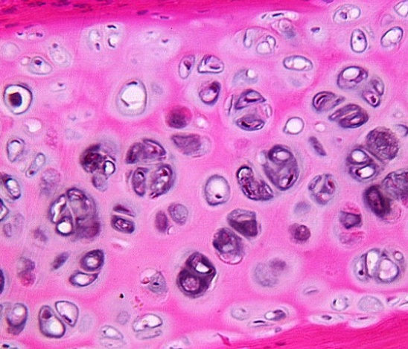
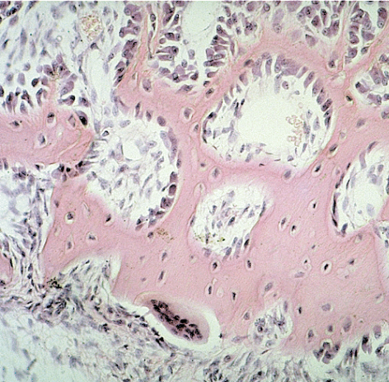
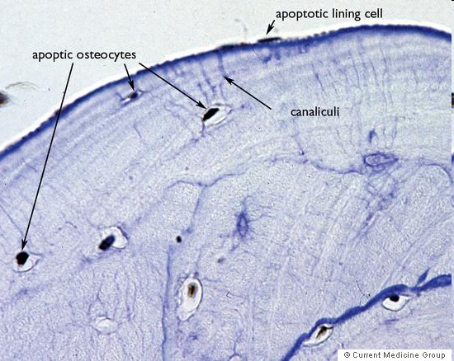
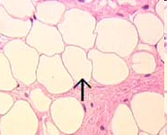
LOOSE COLLAGEN CONNECTIVE TISSUE
Cells
Fibroblasts/fibrocytes/myofibroblasts
Heparinocytes
Macrophages of CT = histiocytes
Plasma cells
Lymphocytes
Adipocytes
Adult stem cells
Extracellular matrix
- Fibrous compound
- Amorphous ground substance

Slide 8
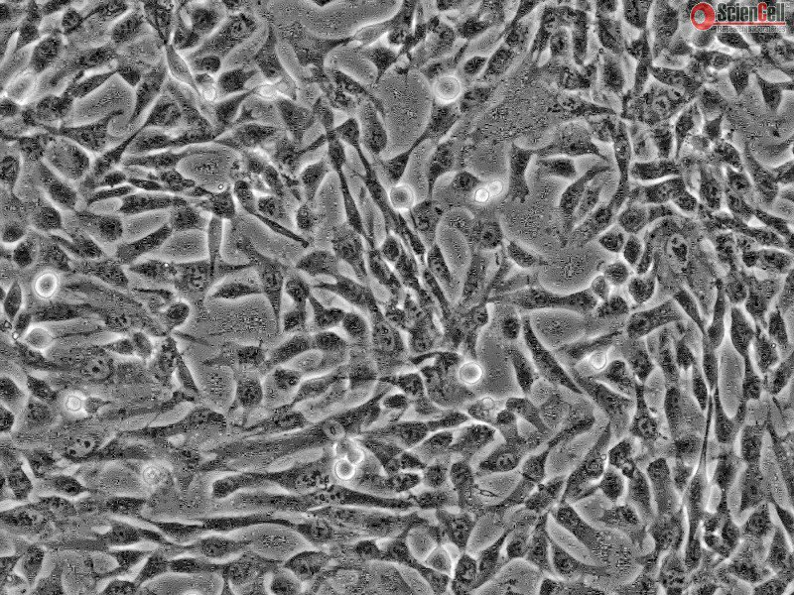
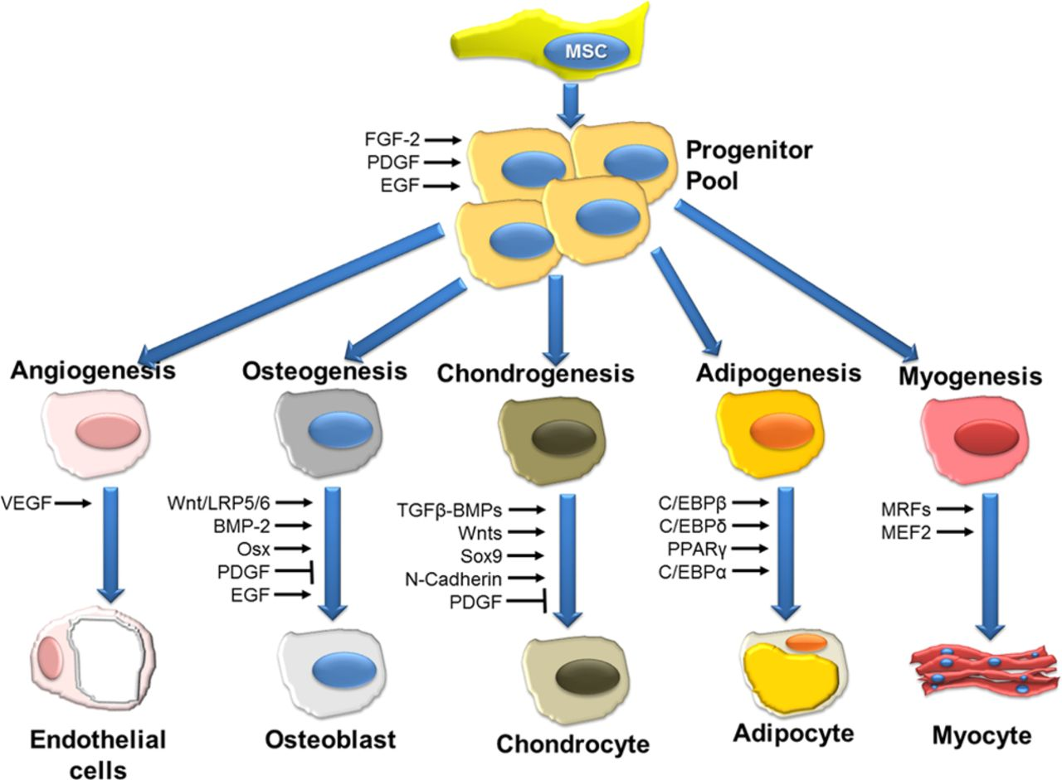
CELLS OF LOOSE COLLAGEN CONNECTIVE TISSUE
Mesenchymal (adult) stem cells

Slide 9
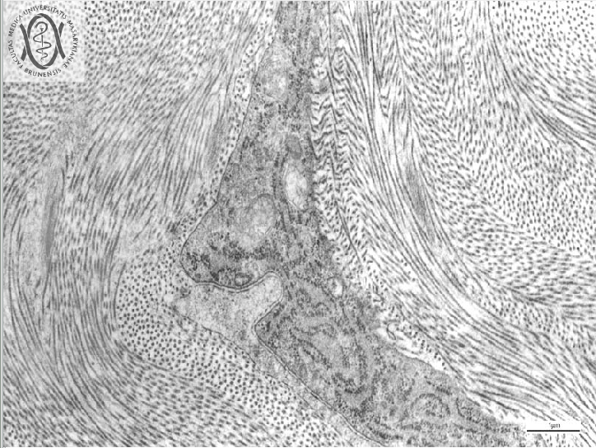
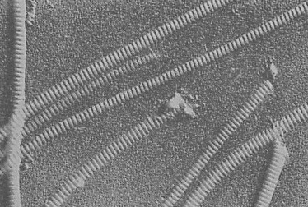
EXTRACELLULAR MATRIX – FIBROUS COMPONENT
Collagen fibers
family of fibrous proteins encoded by >35 genes (2013)
polymer – subunit = tropocollagen; triple helix
different structural and mechanical properties (strength, elasticity, pliability…)
most abundant protein in human body ( 30% dry weight)

Slide 10
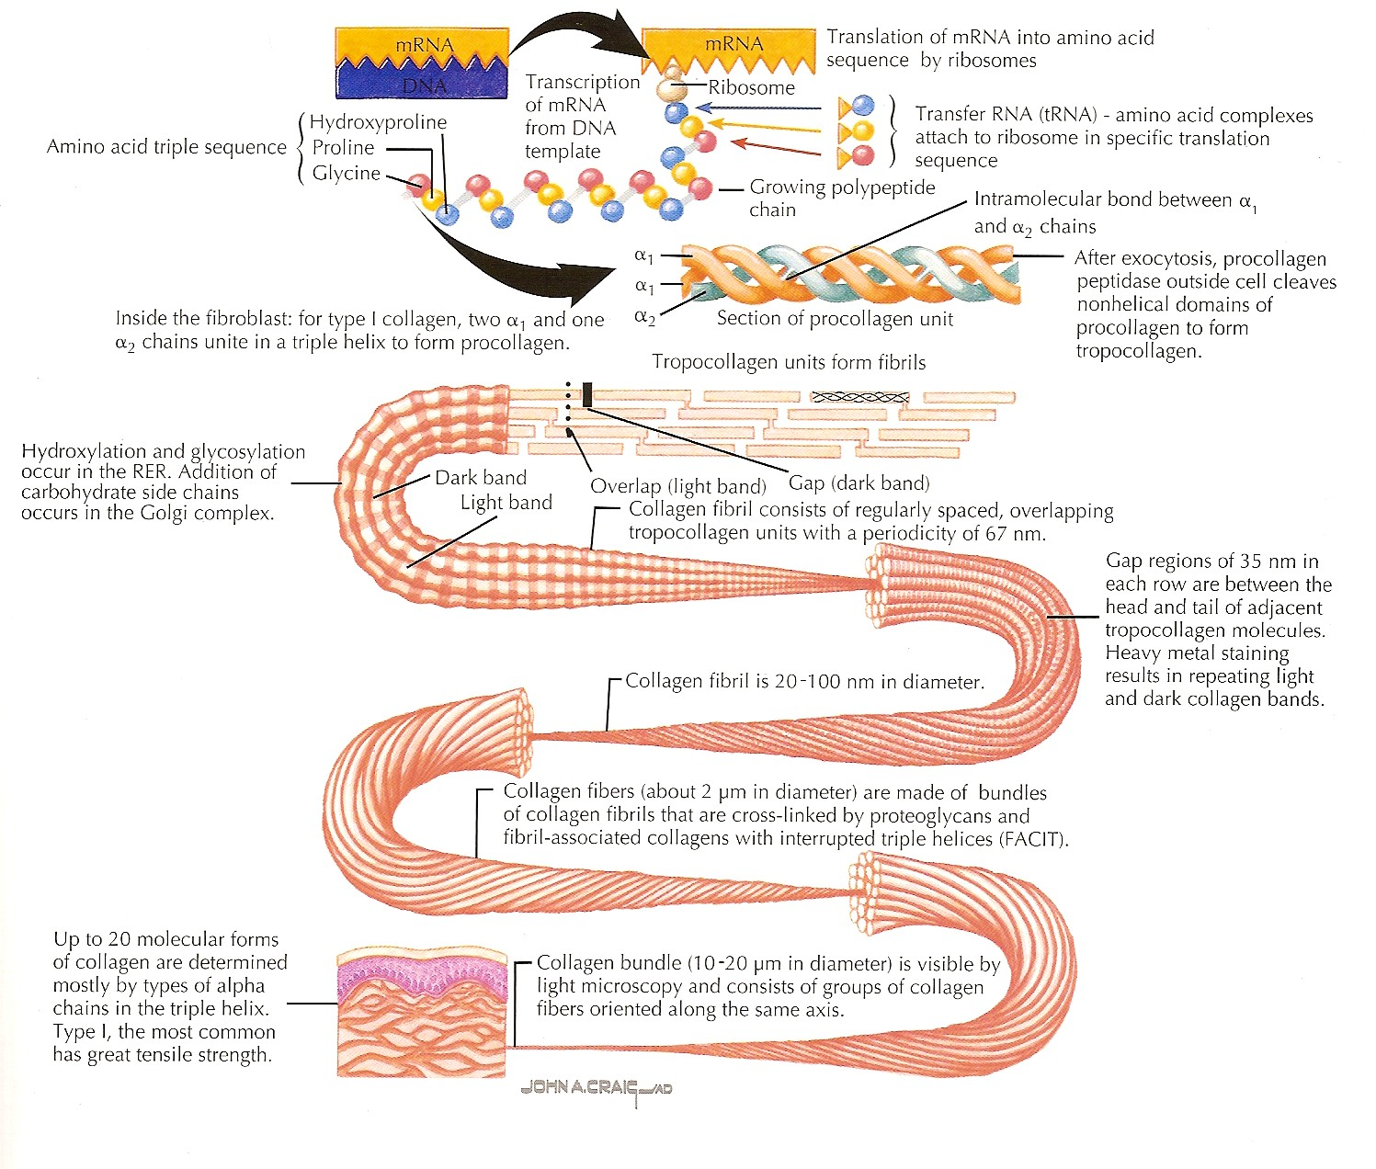
COLLAGEN
further study: https://www.ncbi.nlm.nih.gov/books/NBK507709/

Slide 11
COLLAGEN
Type | Localization | Structure | Main function
I | Bone, tendons, meniscus, dentin, dermis, capsules of organs, loose CT 90% of type I | Fibrils (75nm) – fibers (1-20μm) | Resilience in pull
II | Hyaline and elastic cartilage | Fibrils (20nm) | Resilience in pressure
III | Skin, veins, smooth muscles, uterus, liver, spleen, kidney, lung | Like I, high content of proteoglycans and glycoprotiens, reticular network | Shape formation
IV | Basal lamina of epithelium and endtohelium, basal membranes | No fibrils or fibers | Mechanical support
V | Lamina of muscle cells and adipocytes, fetal membranes | Like IV
VI | Interstitial tissue, chondrocytes – adhesion |  | Connecting dermis and epidermis
VII | Basal membrane of epithelium
VIII | Some endothelia (Cornea)
IX, X | Growth plate, hypertrophic and mineralized cartilage |  | Growth of bones, mineralization

Slide 12
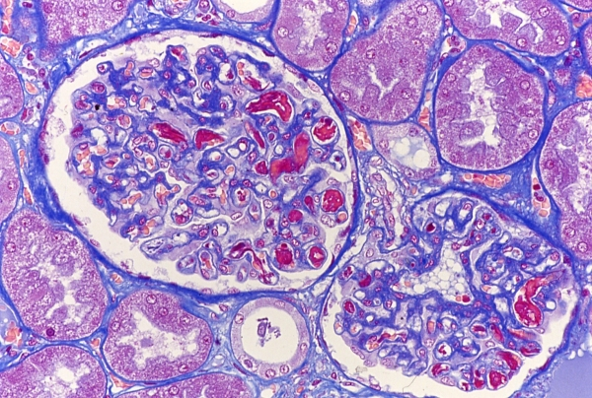
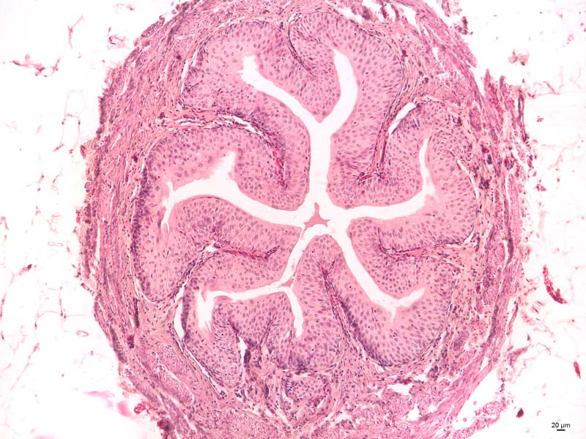
COLLAGEN IN LIGHT MICROSCOPE
AZAN
HE
HES

Slide 13
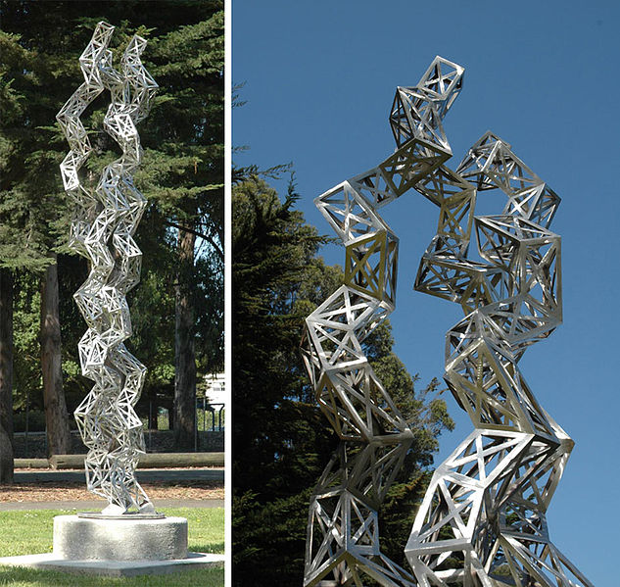
COLLAGEN IN ART
Julian Voss-Andreae
"Unraveling Collagen"
2005
Orange Memorial Park Sculpture Garden, City of
South San Francisco, CA

Slide 14
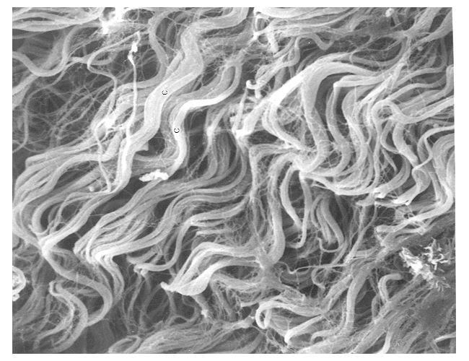
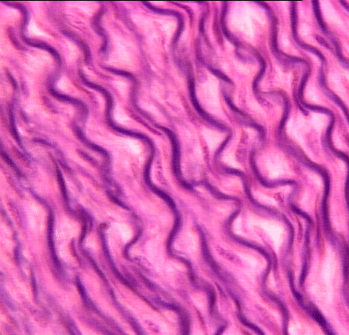
ELASTIC FIBERS
less abundant than collagen
polymer – tropoelastin
minimal tensile resistance, loss of elasticity if overstretched
reduction of hysteresis = allow return back to original state after mechanic change

Slide 15
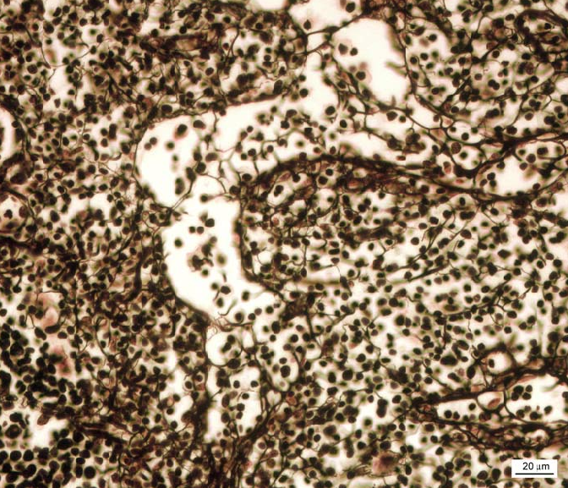
RETICULAR FIBERS
collagen 3D meshwork
bone marrow, spleen, lymphatic nodules
microenvironment for e.g. hematopoietic stem cells and progenitors

Slide 16
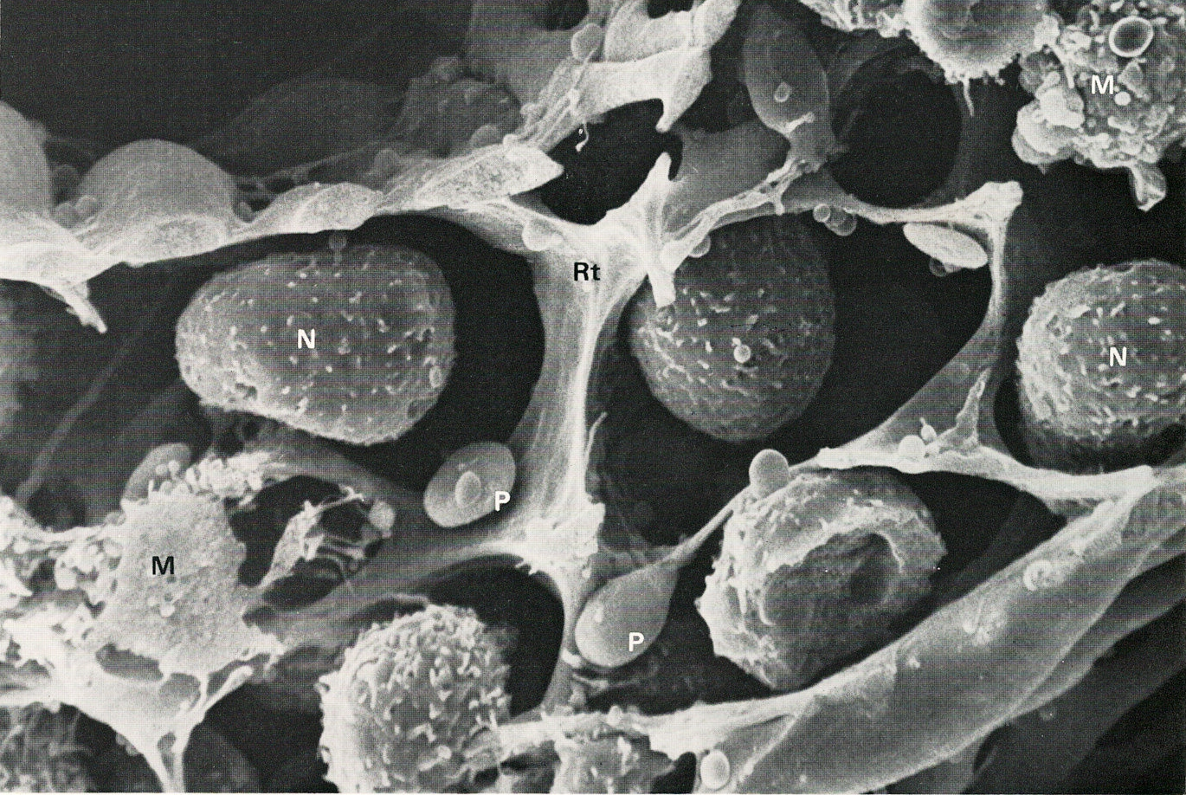
RETICULAR CONNECTIVE TISSUE

Slide 17
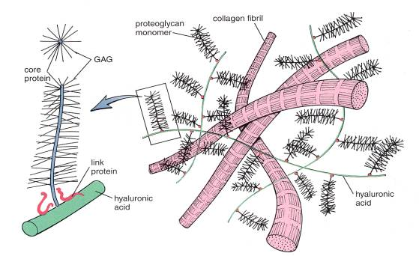
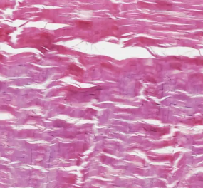
EXTRACELLULAR MATRIX – GROUND SUBSTANCE
Amorphous extracellular matrix
Colorless, transparent, homogenous substance consisting of glycosaminglycans, proteoglycans and structural glycoproteins

Slide 18
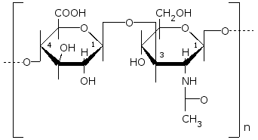
linear polysaccharides composed of two disaccharide subunits
– uronic acid and hexosamine
GLYCOSAMINOGLYCANS
polysaccharides rich in hexosamines = acid mukopolysaccharides
glucuronic or iduronic acid
glucosamin or galactosamin

Slide 19
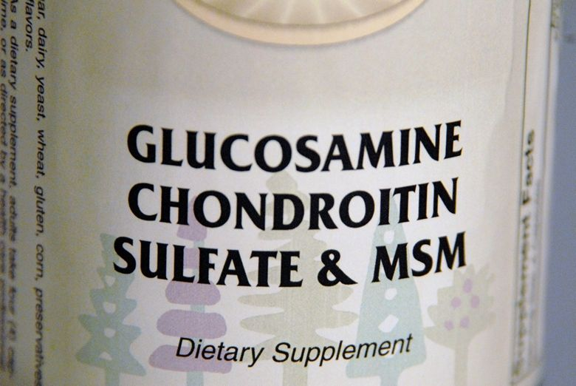
GLYCOSAMINOGLYCANS
They bind to protein structures (except for hyaluronic acid)
Glycosaminoglycan | Localization
Hyaluronic acid | Umbilical cord, synovial fluid, fluid of corpus vitreum, cartilage
Chondroitinsulphate | Cartilage, bone, cornea, skin, notochord, aorta
Dermatansulphate | Skin, ligaments, adventitia of aorta
Heparansulphate | Aorta, lungs, liver, basal membranes
Keratansulphate | Iris, cartilage, nucleus pulposus, anulus fibrosus

Slide 20
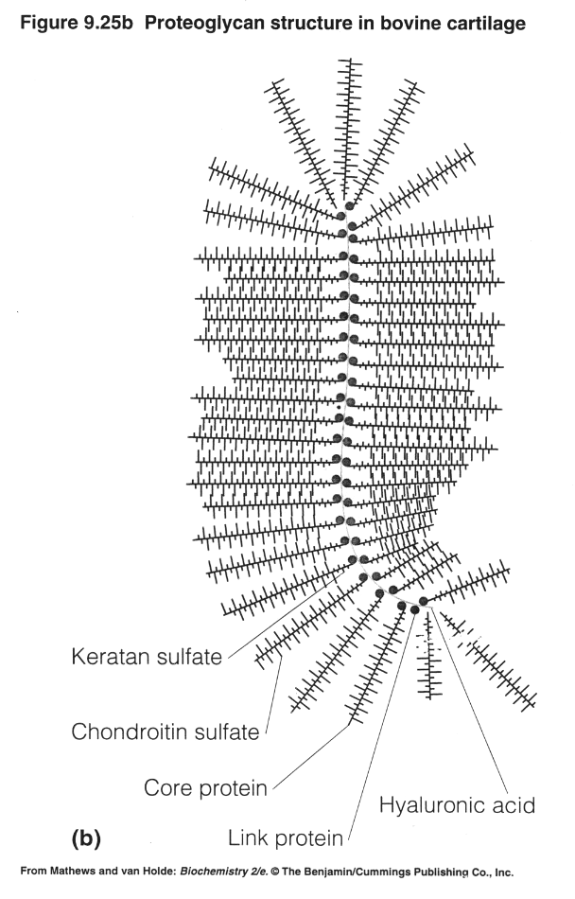
PROTEOGLYCANS
protein + dominant linear saccharide component
proteoglycan aggregates
water-binding, volume dependent of hydratation
aggrecan (cartilage)
syndecan
fibroglycan

Slide 21
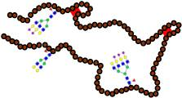
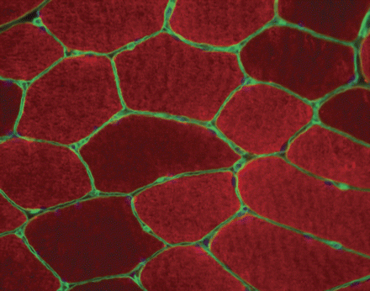
STRUCTURAL GLYCOPROTEINS
dominant protein + branched saccharide component
interaction between cells and ECM
fibronectin – connects collagen fibers and glykosaminoglycans, cell adhesion and migration
laminin – basal lamina – epithelial integrity
chondronectin – cartilage – adhesion of chondrocytes to collagen
(J. Nutr. 136:2123-2126, 2006)

Slide 22
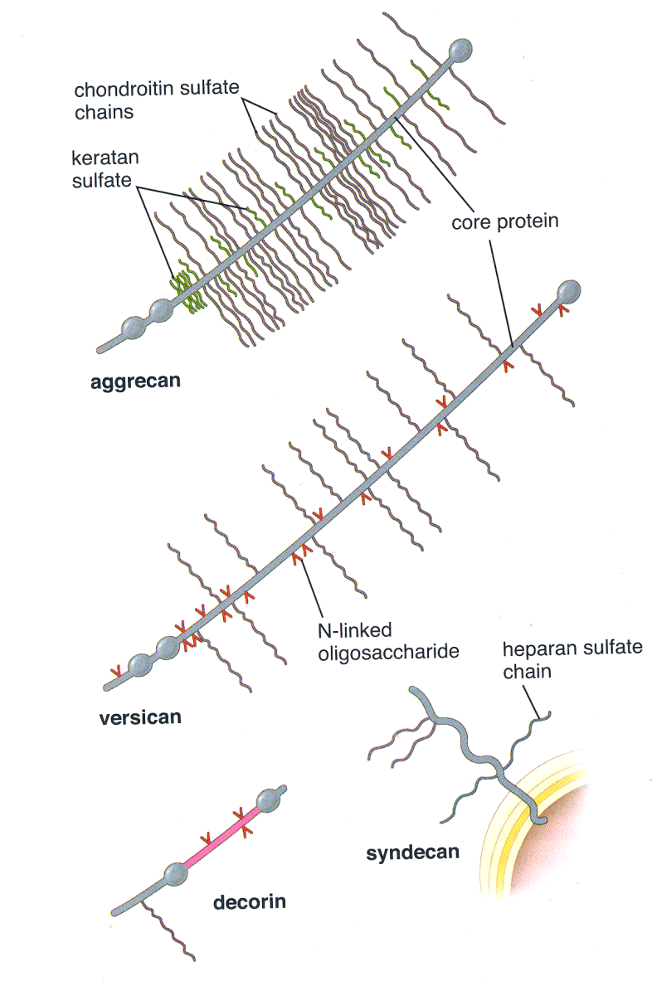
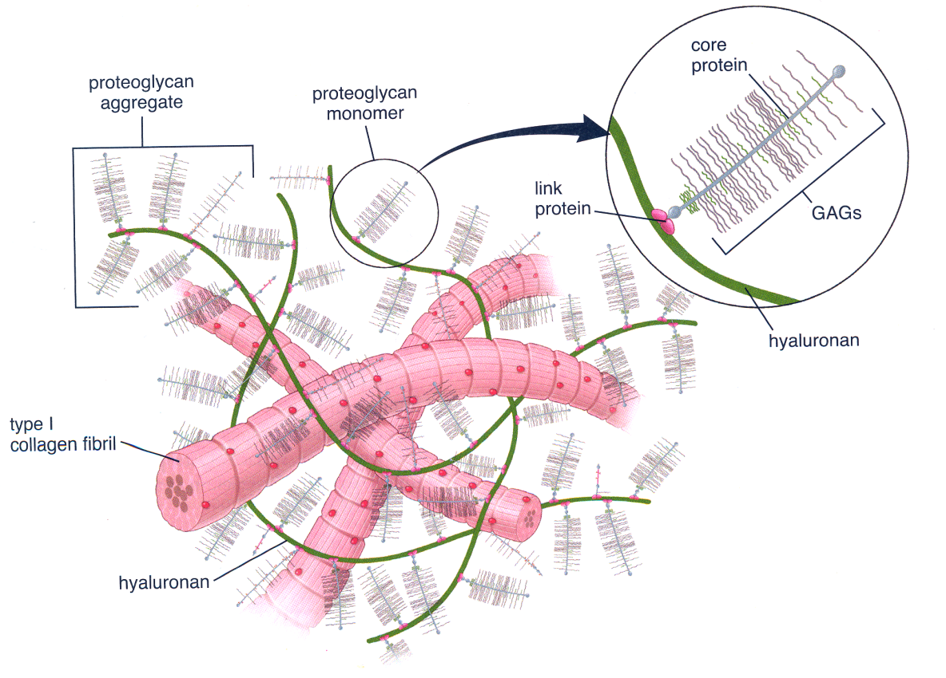
COMPOSITION OF ECM

Slide 23
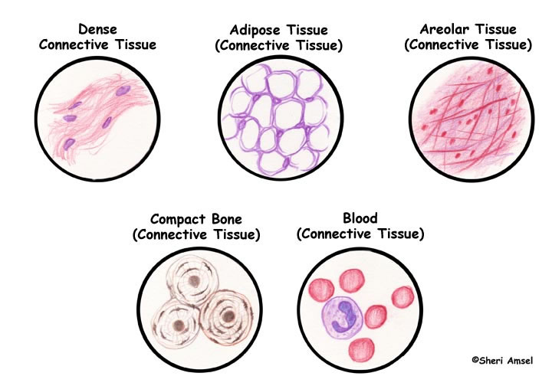
CLASSIFICATION OF SPECIALIZED CONNECTIVE TISSUE
http://www.exploringnature.org/db/detail.php?dbID=21&detID=691

Slide 24
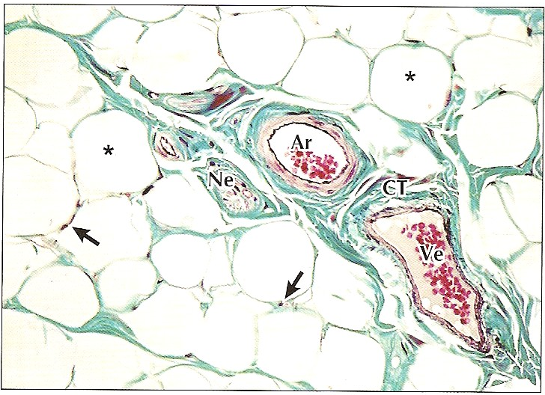
ADIPOSE TISSUE
Adipocytes, fibroblasts, reticular, collagen and elastic fibers, capillaries
White and brown adipose tissue

Slide 25
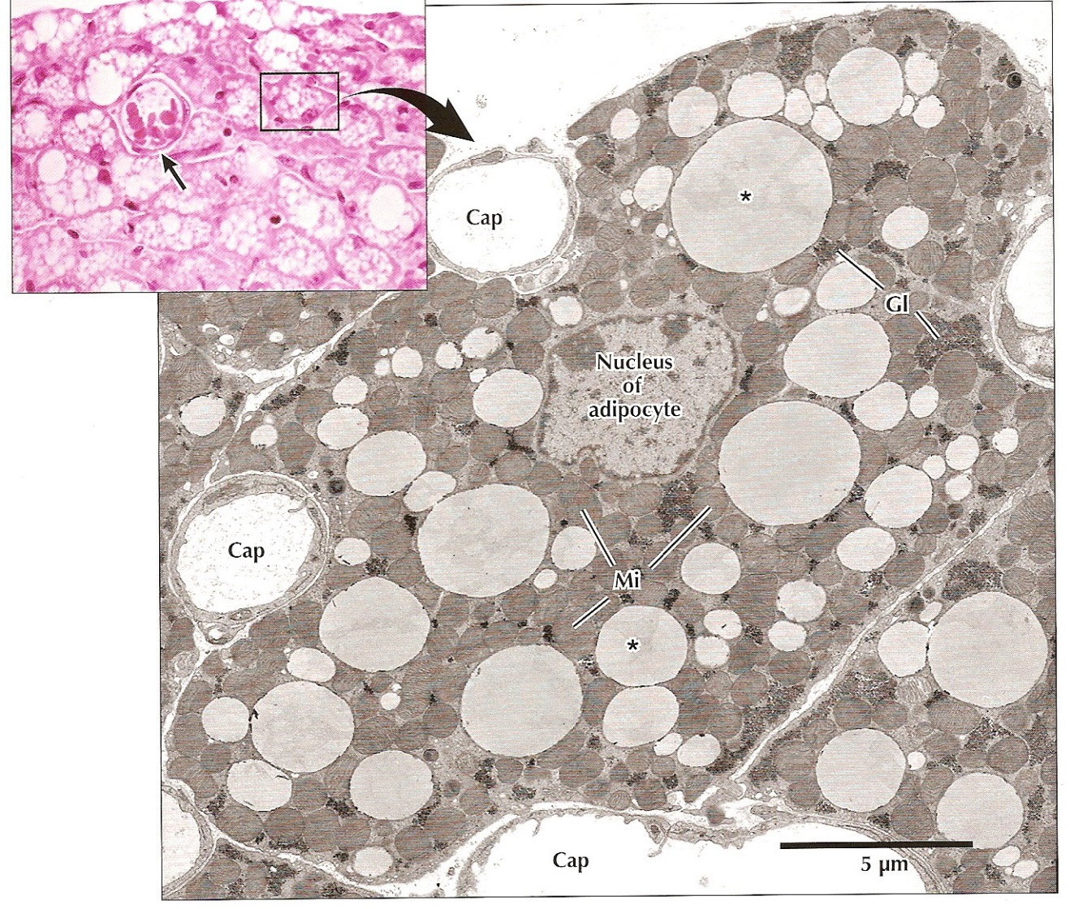
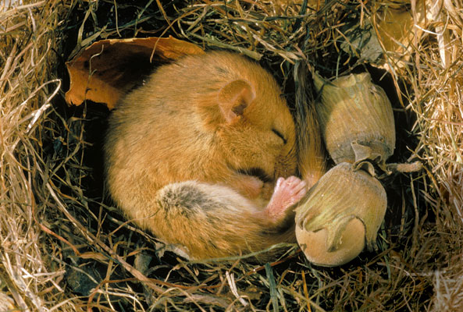
BROWN ADIPOSE TISSUE
fetus and children up to 1st year of life
fast source of energy
typical localization – between shoulder blades, axilla, mediastinum, around kidneys, pancreas, small intestine
small cells with numerous fat droplets

Slide 26
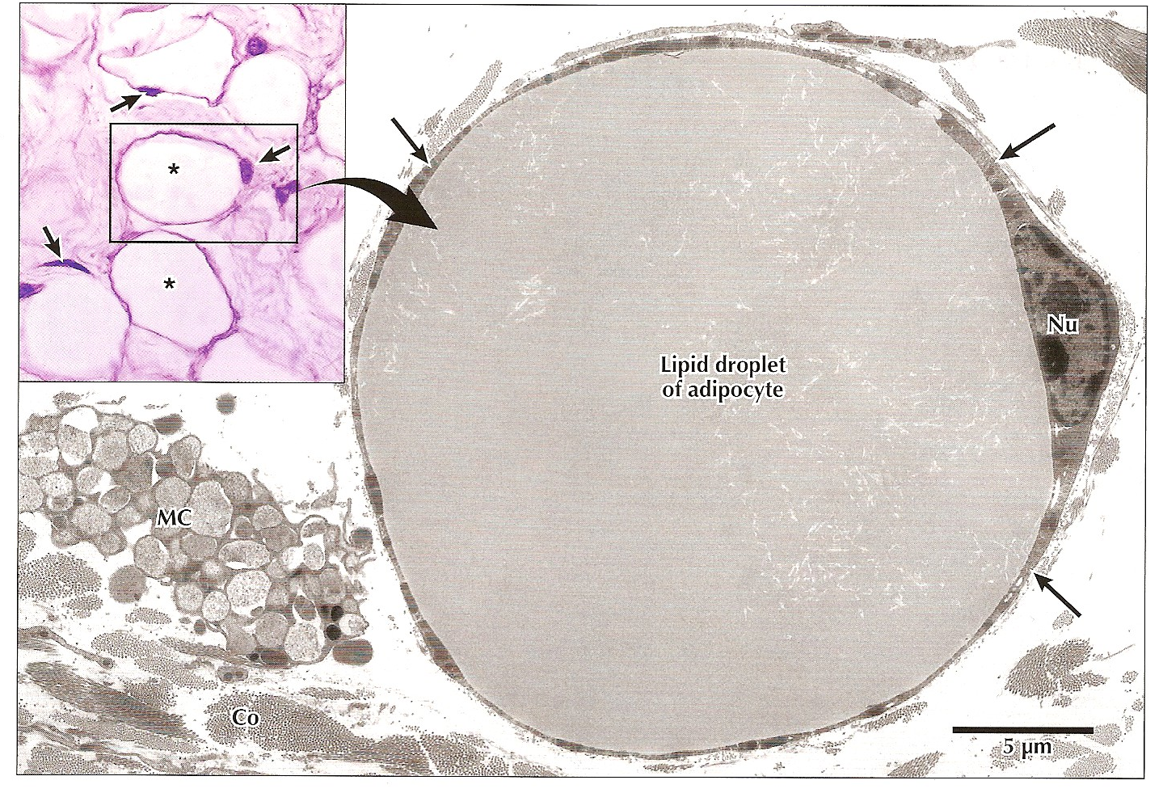
WHITE ADIPOSE TISSUE
adipocytes are actively formed until 2nd year of life
no innervations, but rich vascularisation
adipocytes with only one lipid droplet
leptin (adipokinins)

Slide 27
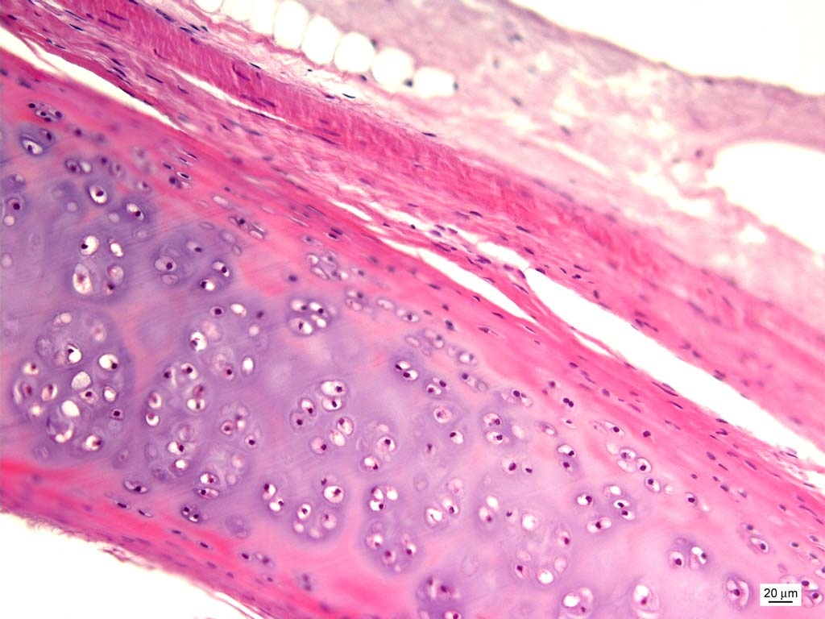
CARTILAGE

Slide 28
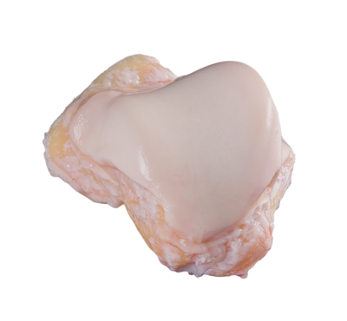
CARTILAGE
General features:
specialized connective tissue with continuous ECM
flexible, mechanically resistant
avascular, non-innervated
support of soft tissues - trachea, larynx
skeletal support - costal cartilages
diarthrosis - joints
bone growth
cells
fibrils
amorphous ground substance

Slide 29

CARTILAGE – COMPOSITION AND STRUCTURE
Perichondrium – connective tissue around cartilage (except joints)
Extracellular matrix – water, proteoglycans and collagen fibrils
Cells of cartilage - chondroblasts, chondrocytes
Nutrition
Growth
Solid consistence
Pressure elasticity
Growth
ECM production

Slide 30
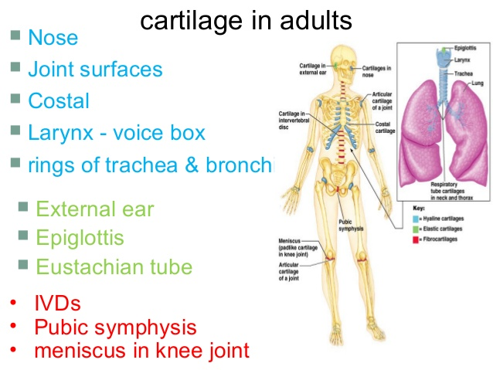
DISTRIBUTION
Hyaline
Elastic
Fibrous

Slide 31
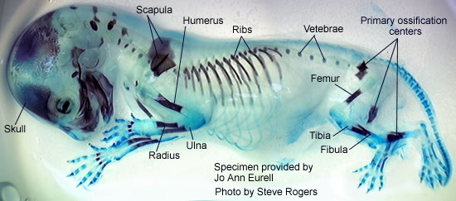
DISTRIBUTION
Hyaline
Alcian Blue&Alizarin Red
most abundant
temporary embryonal/fetal skeleton
epiphyseal growth plate
articulation (joints) respiratory passages
http://chickscope.beckman.uiuc.edu/explore/embryology/day14/dev2.html

Slide 32
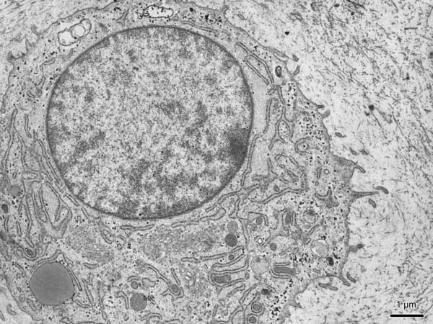


CELLS OF CARTILAGE
Chondroblasts and chondrocytes
mesenchymal origin
typical ultrastructure of proteosynthetically active cells
production of extracellular matrix
interstitial proliferation
isogenetic groups, lacunae

Slide 33

DIFFERENTIATION OF CHONDROBLASTS
C/EBP
PPARγ
Runx2
Osx
Sox9
Runx2
Collagen 2A
aggrecan

Slide 34


DIFFERENTIATION OF CHONDROBLASTS

Slide 35

ULTRASTRUCTURE OF CHONDROBLASTS
oval → round cells
rich in organelles, especially rER and GA
glycogen granules (anaerobic metabolism)
occasionally lipid droplets

Slide 36

ULTRASTRUCTURE OF CHONDROBLASTS

Slide 37

ULTRASTRUCTURE OF CHONDROBLASTS

Slide 38

HOW IT WORKS?
Extracelullar matrix
glycosaminoglycans
proteoglycans
fibers
water
biomechanical properties

Slide 39


GLYCOSAMINOGLYCANS IN CARTILAGE
linear unbranched polysaccharides containing a repeating disaccharide unit:
1. N-acetylgalactosamine (GalNAc) or N-acetylglucosamine (GlcNAc)
2. uronic acid (glucuronate (GlcA)) or iduronate.
hyaluronic acid

Slide 40


GLYCOSAMINOGLYCANS IN CARTILAGE
Glycosaminoglycan | Localization
Hyaluronic acid | Umbilical cord, synovial fluid, fluid of corpus vitreum, cartilage
Chondroitinsulphate | Cartilage, bone, cornea, skin, notochord, aorta
Dermatansulphate | Skin, ligaments, adventitia of aorta
Heparansulphate | Aorta, lungs, liver, basal membranes
Keratansulphate | Iris, cartilage, nucleus pulposus, anulus fibrosus
Chondroitinsulphate
Keratansulphate

Slide 41

PROTEOGLYCANS AND FIBERS
proteoglycans
protein + dominant linear saccharide component
proteoglycan aggregates
water-binding – 80%, volume dependent of hydratation
  aggrecan (cartilage)
  syndekan
  fibroglykan
collagen fibrils
col II + col IX/XI
thin fibrils (15-20 nm → no striation) that do not form fibers like col I
interconnected with perichondrium
elastic fibers

Slide 42

TISSUE ARCHITECTURE OF CARTILAGE ECM
pericellular
territorial
interterritorial
transduction of biochemical and biomechanical signals

Slide 43

TISSUE ARCHITECTURE OF CARTILAGE ECM
pressure elasticity
proteoglycans – polyanionic (COO⁻, SO₄^{II-})
expansion prevented by collagen fibrils
repulsion forces
biphasic model of cartilage conditioned by ECM composition
proteoglycans, collagen, cells, and lipids constitute the solid phase of the mixture
interstitial fluid that is free to move through the matrix fluid phase)
under impact loads, fluid flows through the framework, until the cartilage start to behave as a single-phase, incompressible, elastic solid - the fluid does not flow
after load release, fluid returns
nutritive aspect

Slide 44

TISSUE ARCHITECTURE OF CARTILAGE ECM
synovial cartilage
tangential (superficial) zone
transitional zone
radial (deep) zone
tide mark
mineralized cartilage zone
subchondral bone

Slide 45

NUTRITION AND GROWTH
Apositional growth
Exchange of metabolites
Interstitial proliferation

Slide 46

PERICHONDRIUM
stratum fibrosum
biomechanics
stratum chondrogenicum
growth

Slide 47




SYNOVIUM
membrana fibrosa
dense collagen c.t.
membrana synovialis
intima, subintima
folds extending to the joint cavity
numerous blood and lymphatic vessels, nerves
discontinuous cell layers (synovialocytes)
basal membrane and intercellular junctions absent - not an epithelium: mesenchymal (c.t.) origin
synovial fluid rich in hyaluronans
bursae synoviales, vaginae tendineum
http://www2.indstate.edu/thcme/mmmoga/histology/slide35.html
https://www.dartmouth.edu/~anatomy/Histo/lab_2/bone/DMS090/53.gif

Slide 48

ELASTIC CARTILAGE
acidophilic elastic fibers dispersed in matrix
no isogenetic groups
auricula, meatus, larynx, epiglottis

Slide 49

ELASTIC FIBERS
less abundant than collagen
polymer – tropoelastin
minimal tensile resistance, loss of elasticity if overstretched
reduction of hysteresis = allow return back to original state after mechanic change

Slide 50

ELASTIC CARTILAGE

Slide 51



FIBROCARTILAGE
fibrous compound dominant – collagen I and II – mechanical durability
minimum of amorphous matrix-fibers visible
intervertebral discs, symphysis pubis, articular discs, meniscus

Slide 52


CLINICAL CORRELATION
Cartilage – no innervation, no vascularization – no spontaneous regeneration
No migration of chondrocytes to site of damage
Initiation of other degenerative events leading to cartilage erosion (arthritis)
Therapy:
joint mobility
restoration of biochemical and biophysical parameters of cartilage
prevention of further damage
removal of damaged tissue, autologous transplantation, MSCs on biocompatible scaffolds

Slide 53

BONE

Slide 54


HISTOLOGICAL CLASSIFICATION OF BONE TISSUE
Primary (woven, fibrous)
Temporary, growth and regeneration of bones, collagen fibrils woven
Replaced by secondary bone
Remains only in some parts of body - sutures of skull, tuberositas ossium, tooth cement
Secondary (lamellar)
Lamellae – collagen fibers in concentric layers (3-7μm) around a canal with capillaries = Haversian system (osteon)

Slide 55

PRIMARY (WOVEN) BONE
Temporary, growth and regeneration of bones, collagen fibrils woven
Replaced by secondary bone
Remains only in some parts of body - sutures of skull, tuberositas ossium, tooth cement

Slide 56




SECONDARY (LAMELLAR) BONE
Lamellae – collagen fibers in concentric layers (3-7μm) around a canal with capillaries = Haversian system (osteon)
Spongy (trabecular)
  Trabeculae, similar to compact
  Epiphyses of long bones, short bones, middle layer of flat bones of the skull (diploe)
Compact
  Outer and inner coat lamellae typical Haversian systems
  Volkmann’s canals
  Interstitial canals

Slide 57

BONE SURFACES
Outer surface
Synovial joint – hyaline cartilage
Periosteum (periost) – membrane – dense CT, inner layer (osteoblasts) and outer layer (fibrous CT)
Inactive bone - fibrous CT in periost dominant
Collagen fibers – parallel to the bone surface
Sharpey’s fibers fix periost to the bone

Slide 58

BONE SURFACES
National Museum of Natural History NY, USA

Slide 59


BONE SURFACES
Inactive
Active

Slide 60



BONE SURFACES
Inner surface – lining of cavities
medullar cavity
endosteum (endost) – single cell lining – bone remodeling
red bone marrow – hematopoiesis
yellow and gray bone marrow – adipocytes or CT
rich vascularization
hematopoietic niche

Slide 61

ENDOSTEAL SURFACE OF COMPACT BONE

Slide 62

BONE MATRIX
60% mineral compound, 24% organic compound 12% H₂0, 4% fat
crystals – calcium phosphate, hydroxyapatite

Slide 63


BONE MATRIX

Slide 64

CELLS OF BONE – OSTEOBLASTS
lining bone surface
produce ECM – collagen (I) and noncollagenous proteoglycans, glycoproteins
basophilic cytoplasm, rER, well developer Golgi Apparatus
euchromatin nucleus
osteocytes embedded in matrix
canalliculi ossium

Slide 65





CELLS OF BONE – OSTEOCYTES

Slide 66


CELLS OF BONE – OSTEOCLASTS
multinuclear, formed by fusion of mononuclear macrophages
bone matrix resorption

Slide 67

CELLS OF BONE – OSTEOCLASTS

Slide 68


CELLS OF BONE – OSTEOCLASTS
complex architecture
enzymes degrading organic matrix
HCl

Slide 69



BONE OSSIFICATION
Intramembraneous
Endochondral

Slide 70

INTRAMEMBRANEOUS OSSIFICATION

Slide 71



ENDOCHONDRAL OSSIFICATION
1
2
3
4
5

Slide 72

ENDOCHONDRAL OSSIFICATION

Slide 73

ENDOCHONDRAL OSSIFICATION

Slide 74

GROWTH PLATE
GROWTH

Slide 75

GROWTH PLATE
GROWTH

Slide 76



BONE REMODELLING
http://ns.umich.edu/Releases/2005/Feb05/img/bone.jpg

Slide 77


CLINICAL CORRELATIONS – FRACTURE HEALING
Reactive phase
- fracture and inflammatory phase
- granulation tissue formation
Reparative phase
- cartilage callus formation
- lamellar bone deposition
Remodeling phase
- remodeling to original bone shape

Slide 78




CLINICAL CORRELATIONS – DISBALANCE OF BONE HOMEOSTASIS
OSTEOPOROSIS
REVMATOID ARTHRITIS
OSTEOPETROSIS
PAGET DISEASE

Slide 79


JOINTS
Synarthrosis
joint by intercalated tissue (catilage, bone or c.t.)
  Synostoses – joint by bone tissue – os coxae, os sacrum
  Synchondrosis – joint by hyaline cartialge – development of synostosis
  Symphysis – joint by fibrocartilage– os pubis, intervertebral discs
  Syndesmosis – dense collage regular c.t. – sutures of skull, gomphosis
Diarthrosis
synovial joint
  hyaline cartilage without perichondrium
  cartialge calcification in site of attachment to the bone
  joint capsule
    Stratum fibrosum
    Stratum synoviale
    meniscus – fibrocartialge, avascular, without inervation
    tendons – dense collagen regular c.t., elastic fibers
    bursae – like joint capsule

Slide 80








FURTHER STUDY
http://www.med.muni.cz/histology

Slide 81

Thank you for attention

