Slide 1
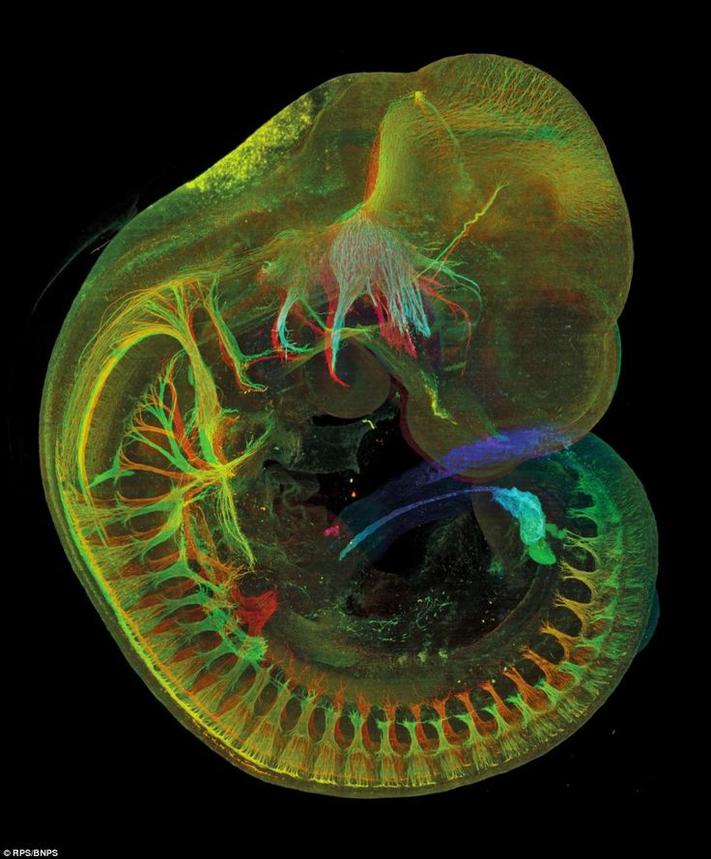
Crash course H&E I 21-25.9.2020
Revision of embryonic and fetal development
Petr Vaňhara,
Dept. of Histology and Embryology LF MU
Mouse embryo, approximately 10.5 days post-fertilisation
(equivalent to day 28 in humans).
Photo by Jim Swoger BNPS.co.uk (01202) 558833

Slide 2
Crash course H&E I 21-25.9.2020
Gametogenesis
From fertilization to early embryo
Embryogenesis to 8th week
CONTENT
Fetal development
Fetal position in uterus, hallmarks of newborn
Introduction to teratology and prenatal diagnostics

Slide 3
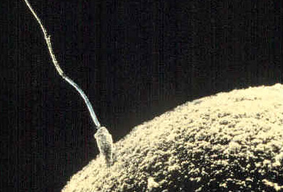
GAMETOGENESIS
Sperm (spermatozoon)
Oocyte

Slide 4
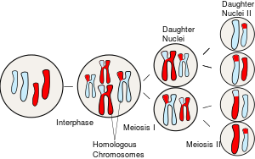
GAMETOGENESIS
meiosis
diploid primordial germ cells → haploid gametes
primordial germ cells
extraembryonic origin
spermatogonia → spermatogenesis and spermiogenesis → spermatozoon
oogonia → oogenesis → oocyte (→ ovum)
gonad
unique microenvironment for development of gametes
endocrine axis hypothalamus-pituitary gl.
important endocrine functions
2n 2c
2n 4c
1n 2c
1n 1c

Slide 5
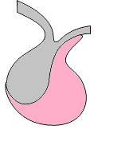
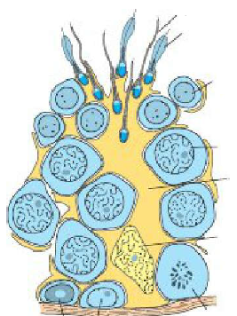
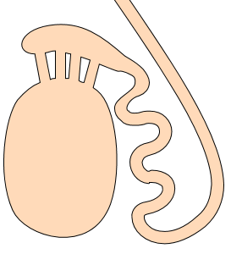
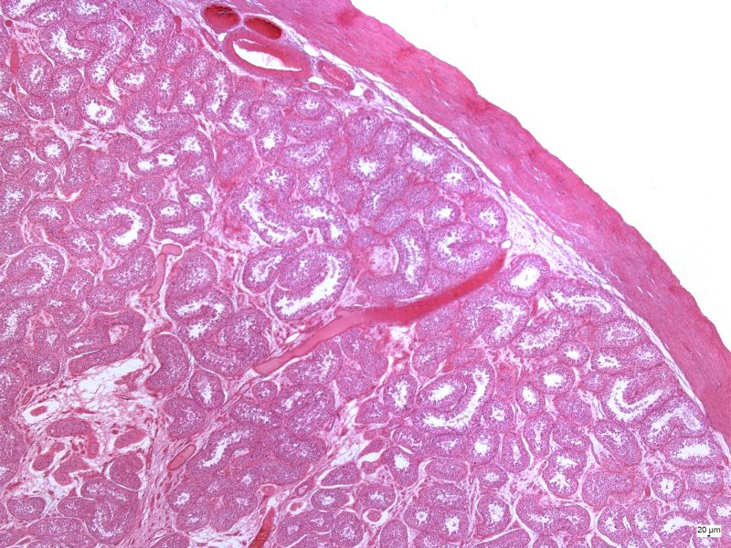
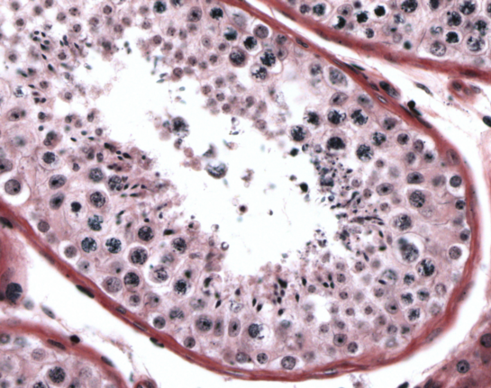
SPERMATOGENESIS AND SPERMIOGENESIS
CNS
Hypothalamus
Spermatozoa
Spermatids
Pituitary
Secondary spermatocyte
Primary spermatocyte
Cytoplasm of Sertoli cells
Gonadotropins
Nucleus of Sertoli cell
Spermatogonia
Testes
Germinal epithelium

Slide 6
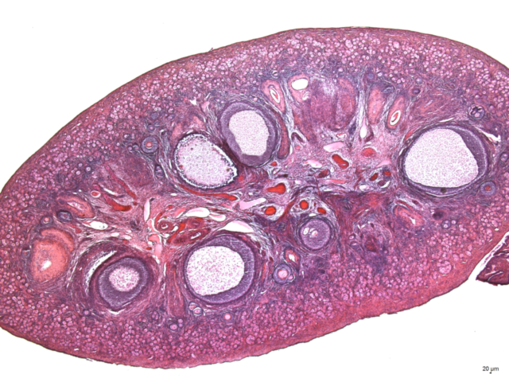
OOGENESIS
CNS
Hypothalamus
Pituitary
Gonadotropins
Ovarium
Oogonia are present only during prenatal development in utero
After birth, only primary oocytes in primordial follicles are present
Cell cycle of primary oocyte is arrested in dictyotene stage of prophase M I until onset of puberty
In each ovarian cycle (starting in puberty), a cohort of follicles enters maturation, however, usually only a single follicle reaches ovulation. Atresia of the remaining follicles in cohort.
Primary oocyte → Secondary oocyte → Ovum (matures after fertilization)
Primordial follicle → Primary follicle (unilaminar and multilaminar) → Secondary follicle → Graafian follicle (ovulation)
Luteogenesis (formation of corpus luteum)

Slide 7
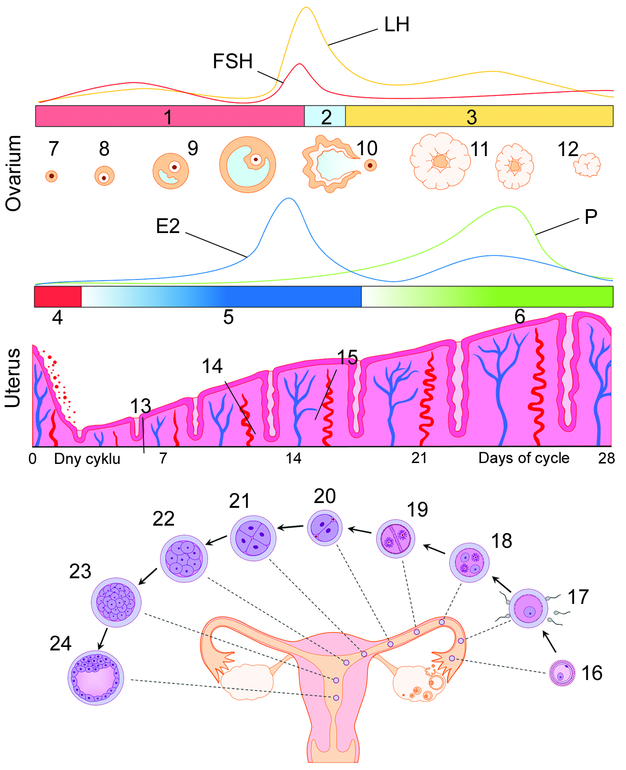
OVARIAN AND MENSTRUAL CYCLE
CNS (hypothalamus)
Gonadoliberins
Pituitary
FSH
LH
Ovarian cycle
Follicular cells: Estrogen
Corpus luteum: Progesterone
Menstrual cycle
Synchronization of oogenesis (in ovarium) and readiness of endometrium (uterine lining) to putative implantation.
https://munispace.muni.cz/library/catalog/book/1440

Slide 8
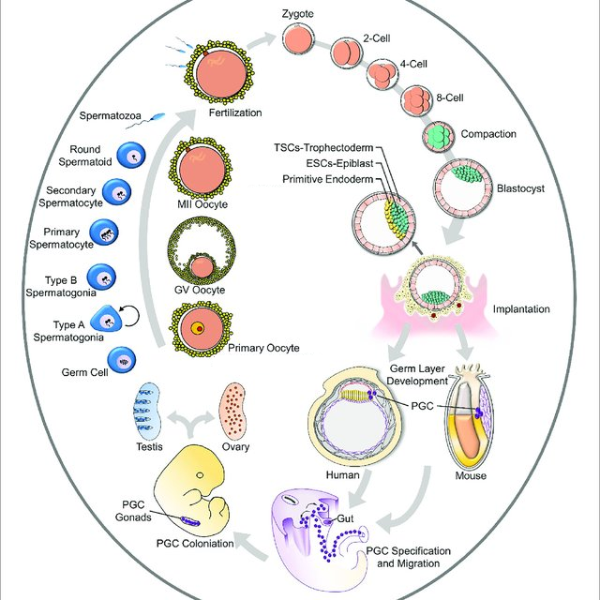
GAMETOGENESIS

Slide 9
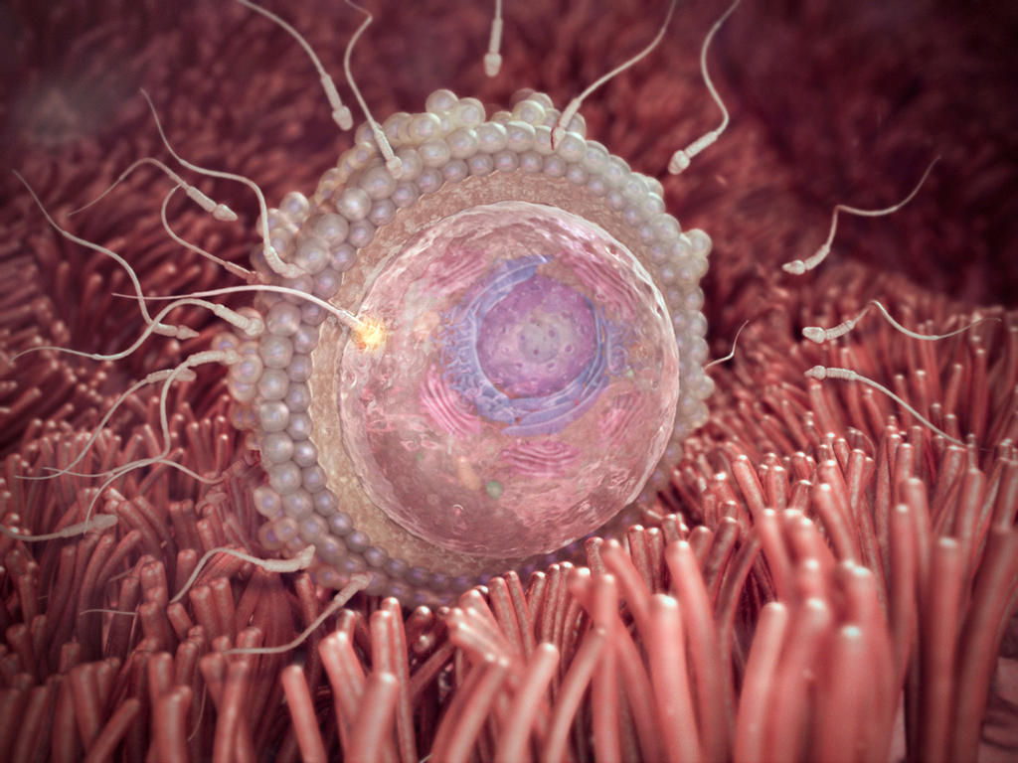
FERTILIZATION
300-500×10⁶ sperms
Capacitation
Contact with corona radiata
Oocyte in metaphase MII
Ovulation
Acrosomal reaction (acrozin)
Penetration of zona pellucida
Ampulla of oviduct (most often)
Contact of sperm and oocyte
3-Dart-LLC-MEDICAL
Cortical (zonal) reaction
(× polyspermy)
Fusion of oocyte and sperm
Re-entry of oocyte to cell cycle
Generation of 2nd polar body
Replication of DNA of pronuclei
Fusion of pronuclei
Beginning of cleavage

Slide 10
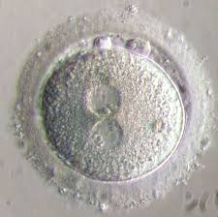
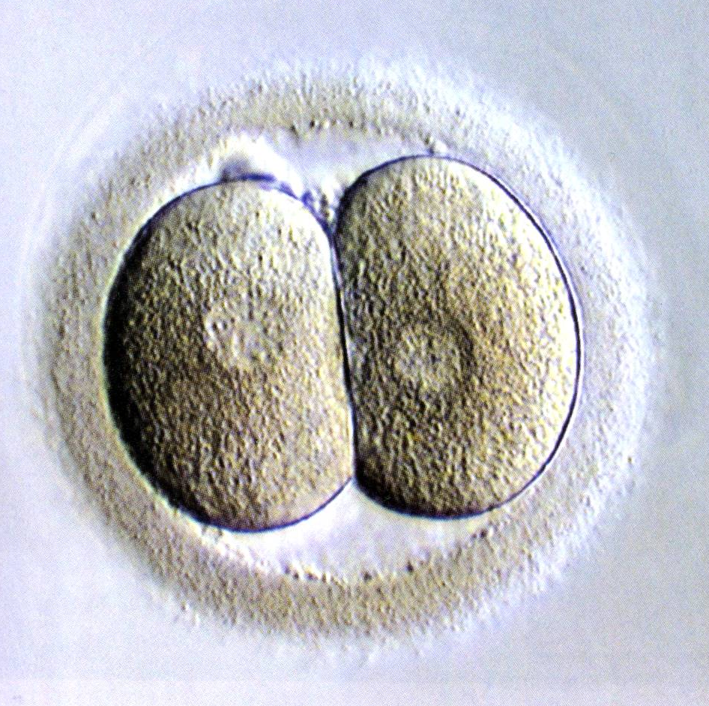
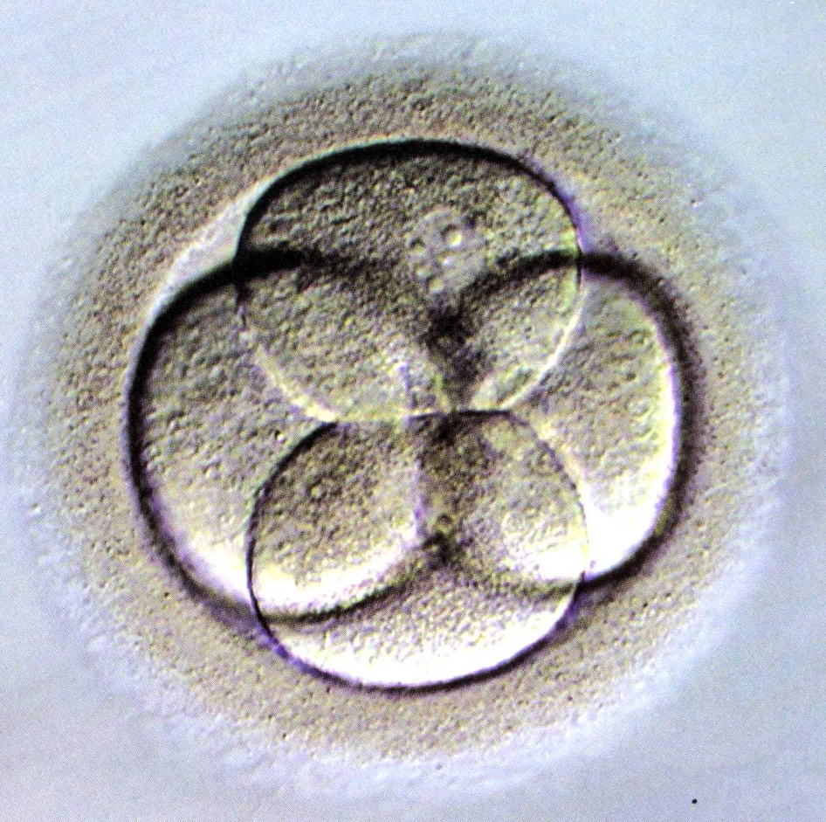
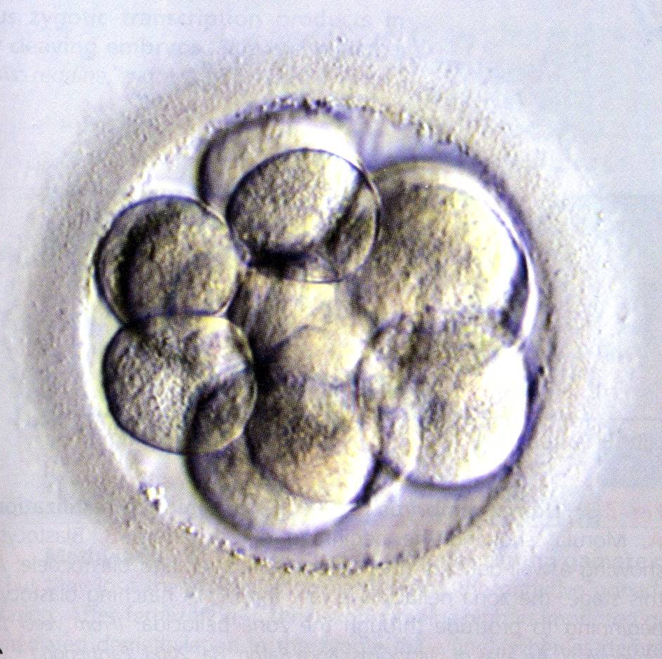
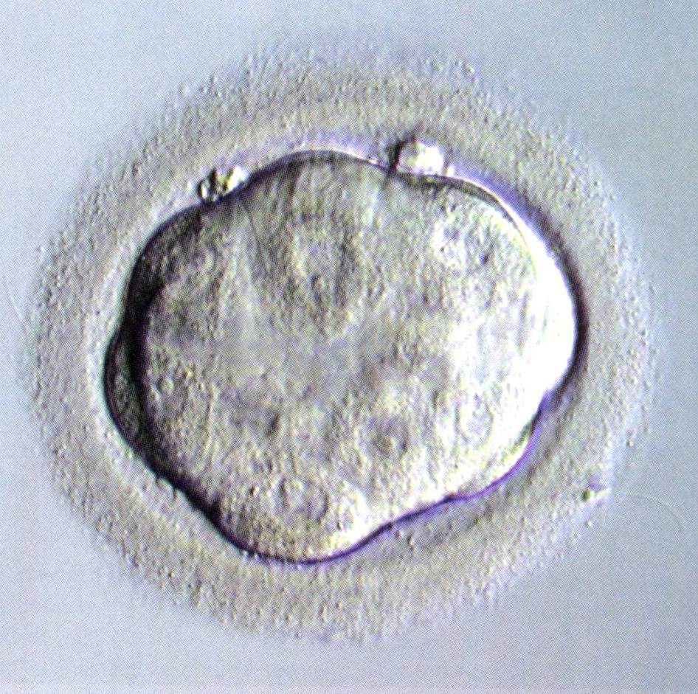
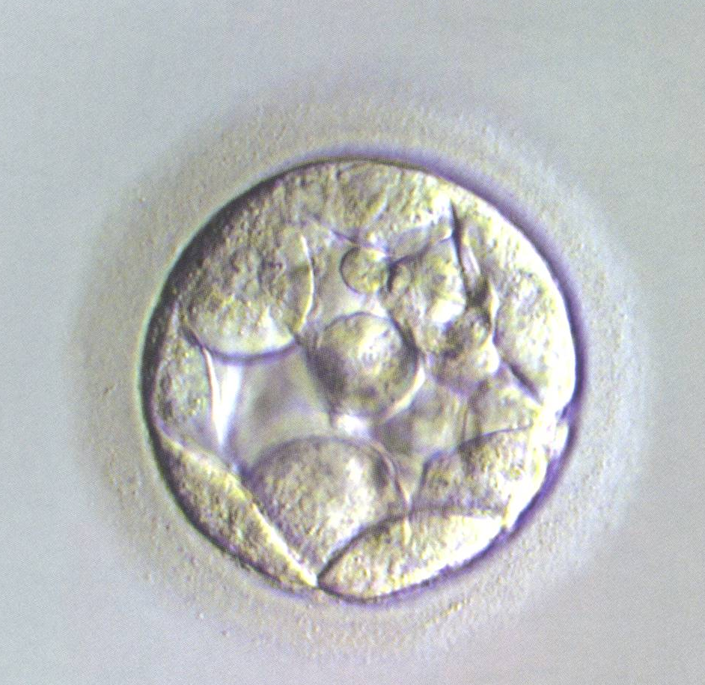
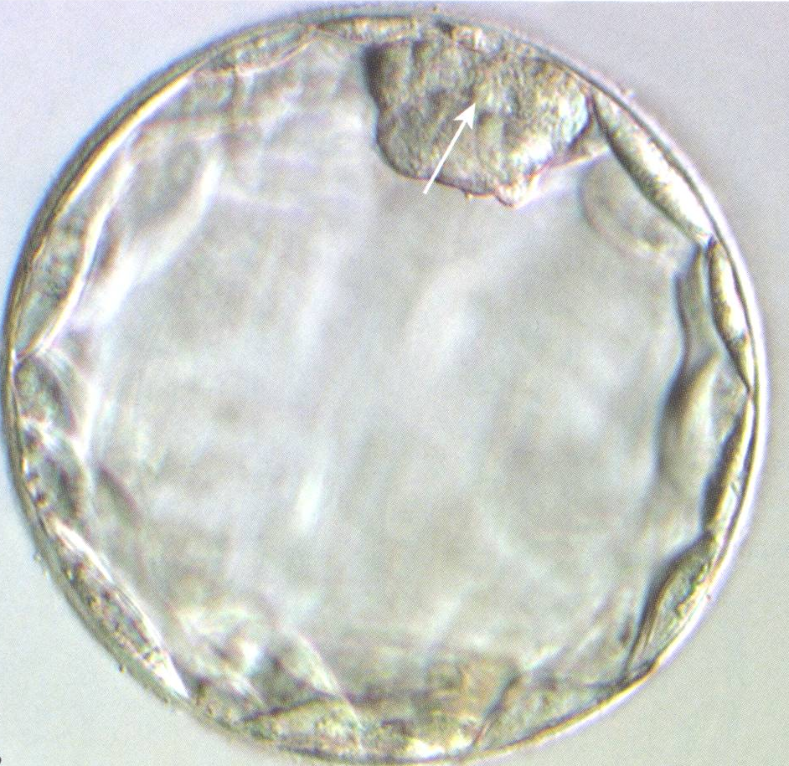
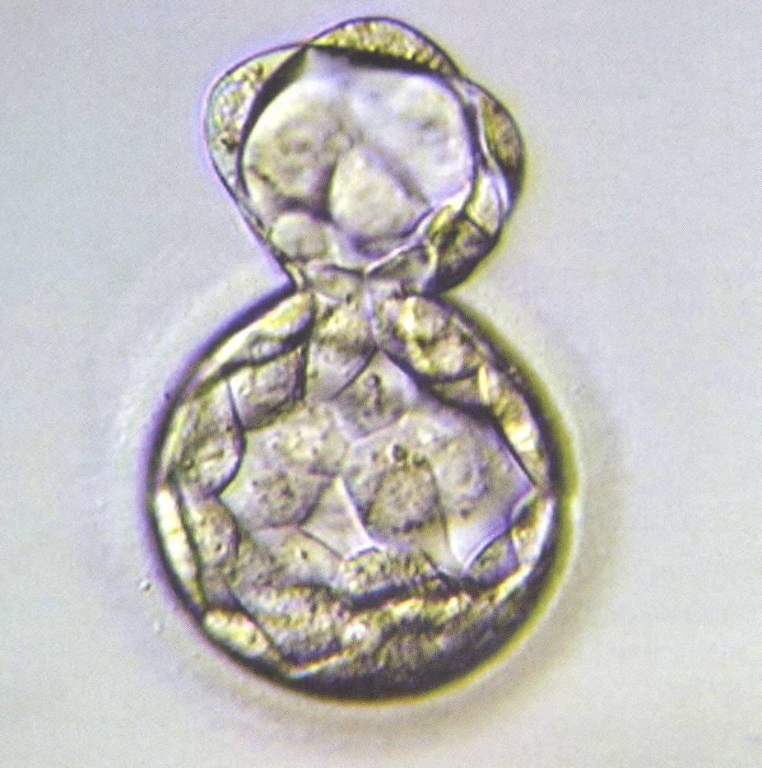
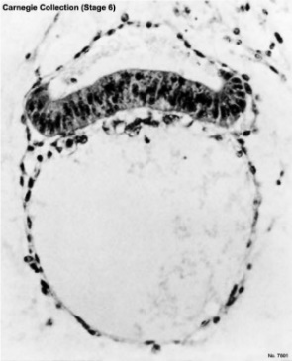
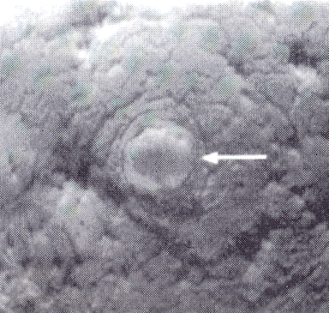
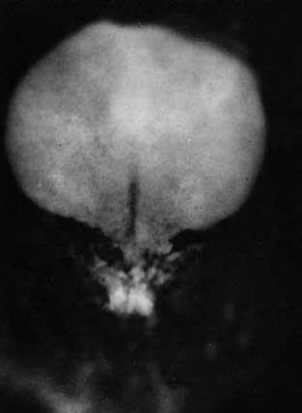
FIRST EVENTS IN HUMAN LIFE
Fertilization
Cleavage
START!
1
2
3
Blastogenesis
4
1st week
5
Embryogenesis
6
7
8
Implantation
9
2nd week
Adhesion of blastocyst
Differentiation of trofoblast
10
Differentiation of embryoblast
Bilaminar germ disc
Amniotic cavity
Primary yolk sac
Extraembryonic mesoderm
11
End of implantation
12
13
14
3rd week
15
16
Trilaminar germ disc
Differentiation of epiblast
Primitive node and primitive streak
Differentiation of mesoderm
Differentiation of ectoderm and neuroectoderm
Somitogenesis
17
18
19
20
21

Slide 11
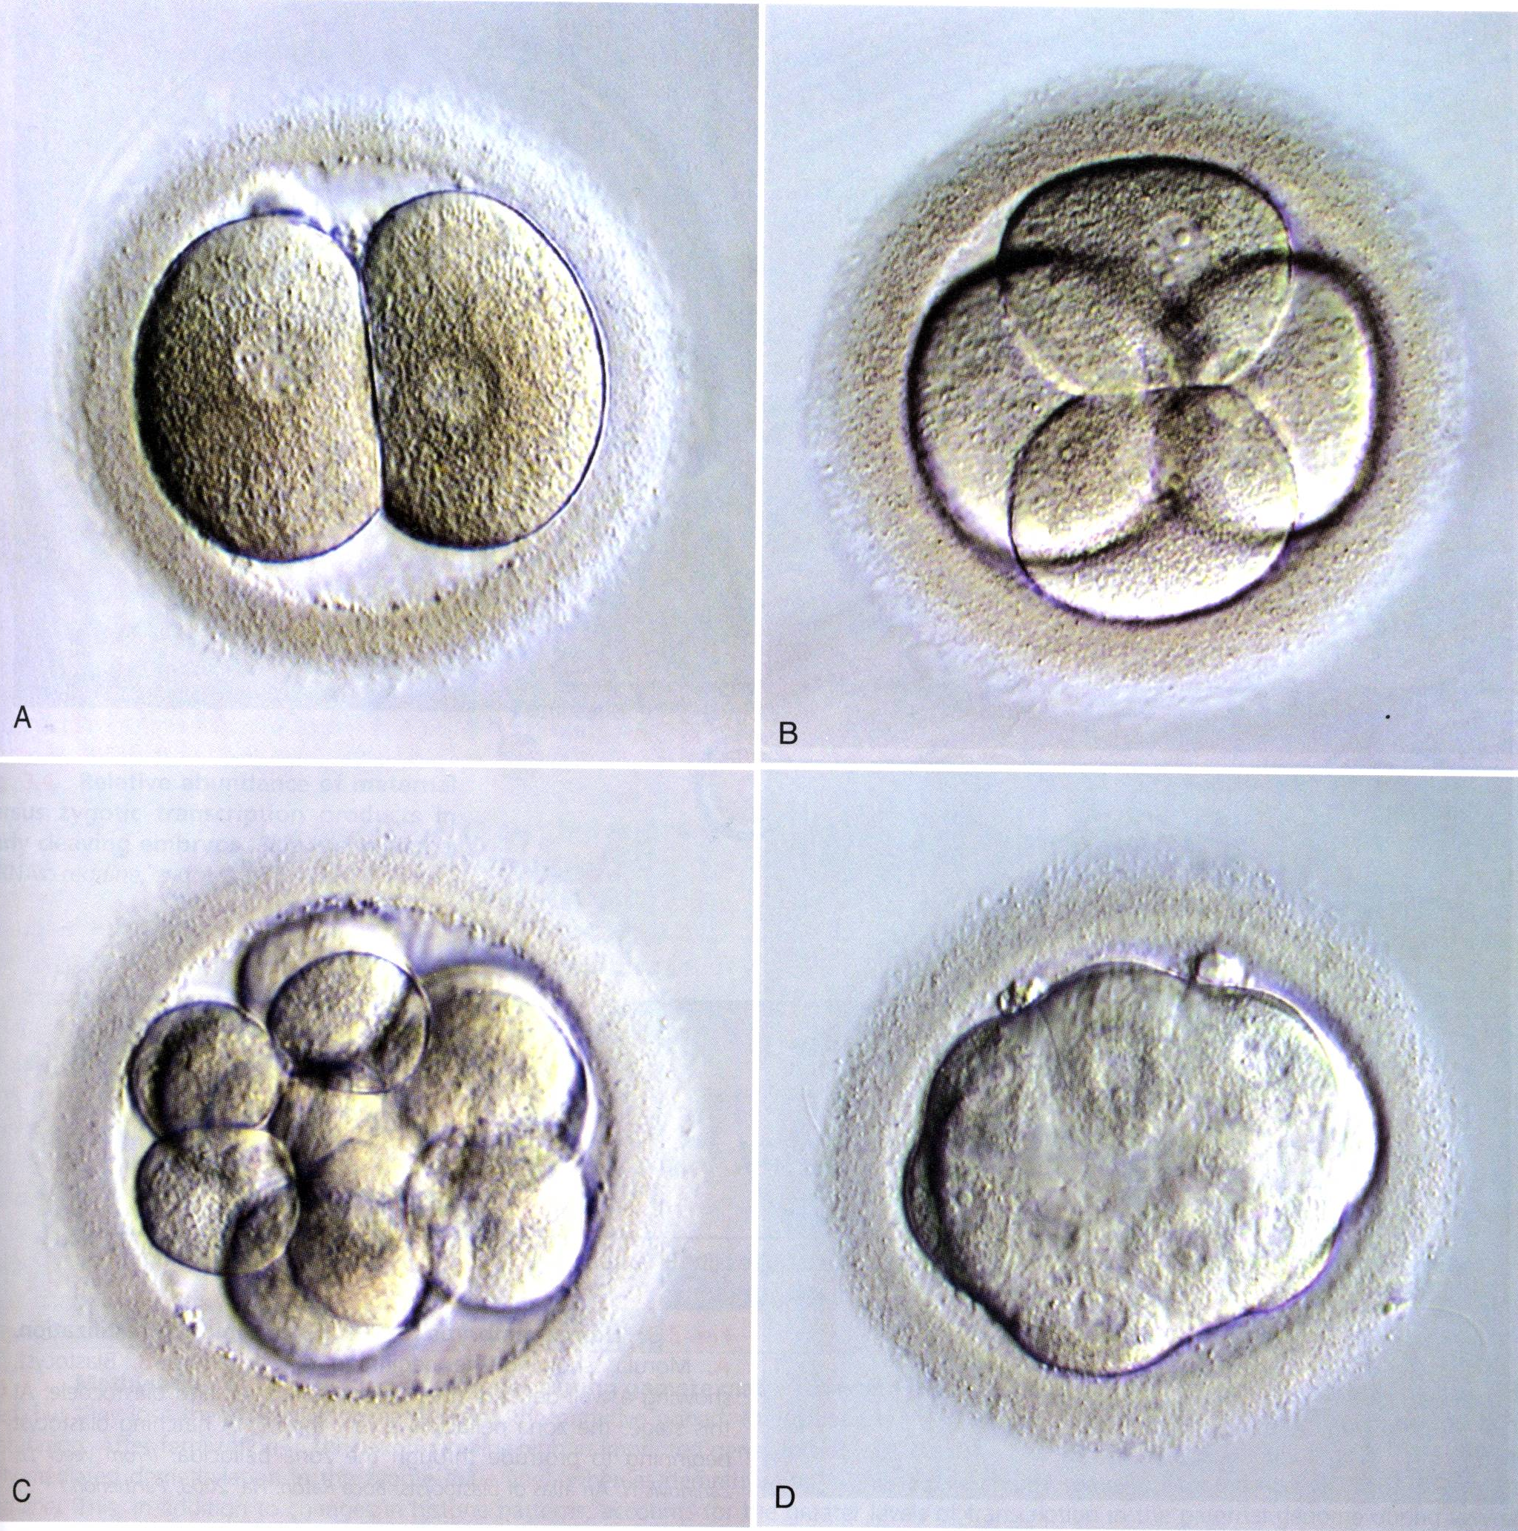
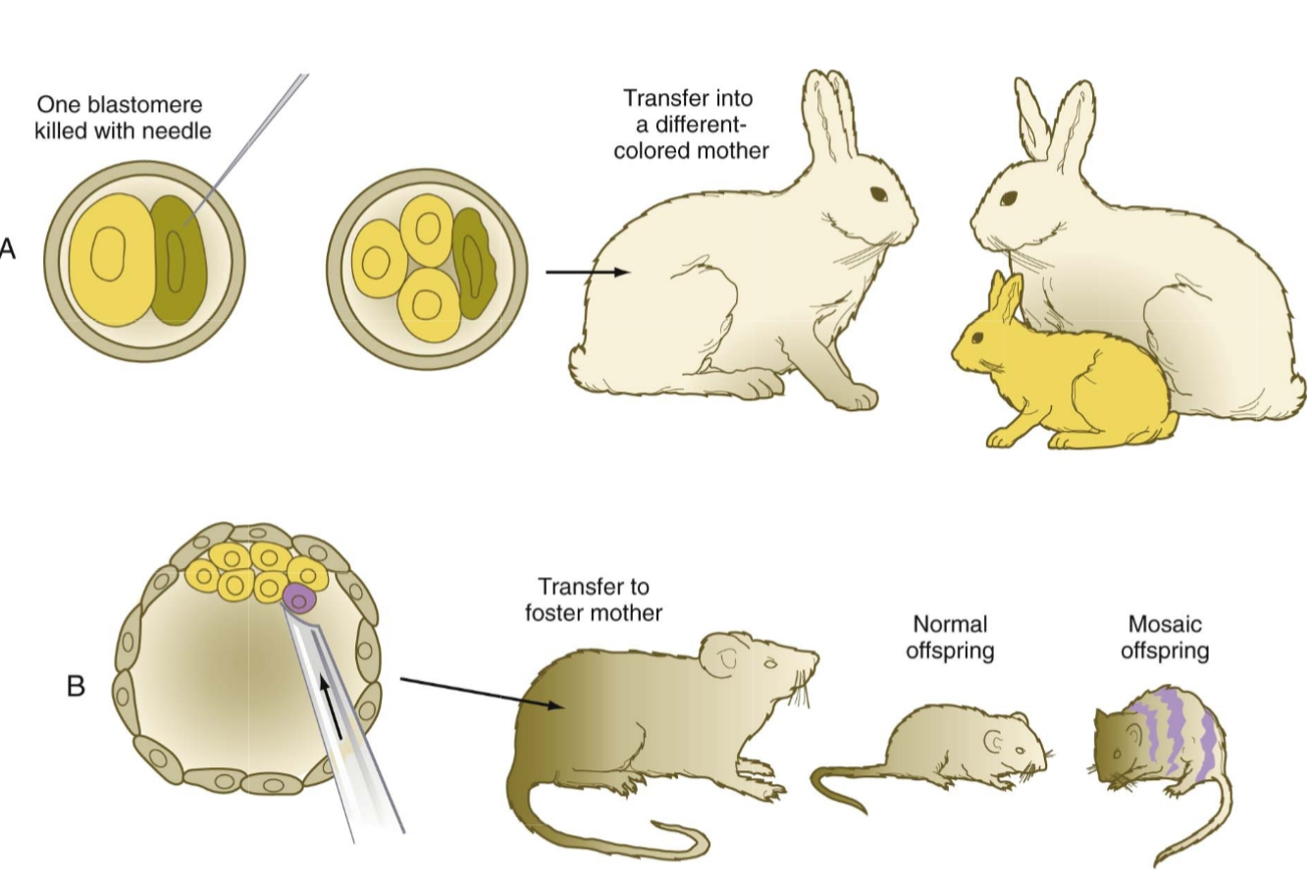
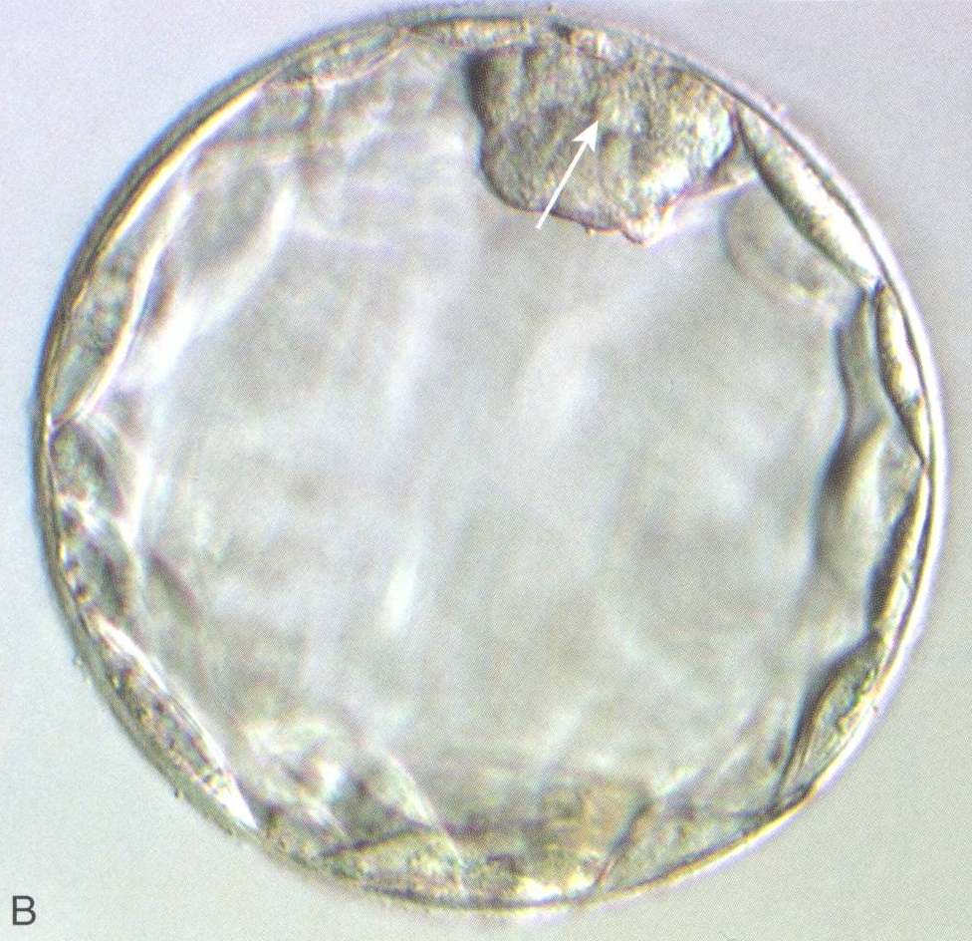
FIRST EVENTS IN HUMAN LIFE
SOLO FOR BLASTOMERES
1st week
WHAT IS DEVELOPMENTAL POTENTIAL OF BLASTOMERES?
Really?
Conclusion: all blastomeres are equal.

Slide 12
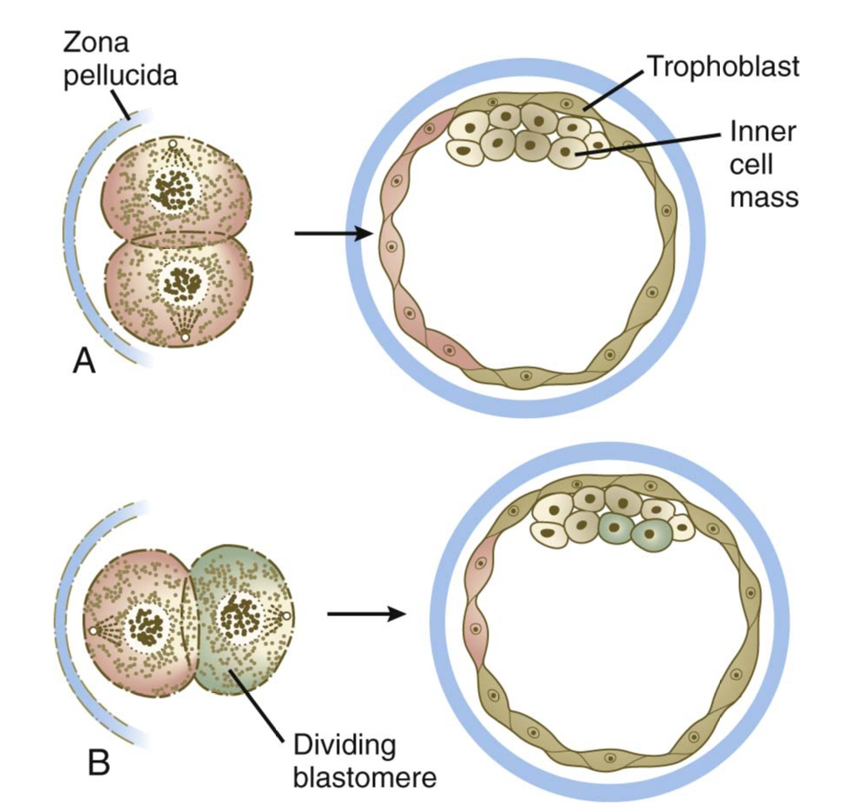
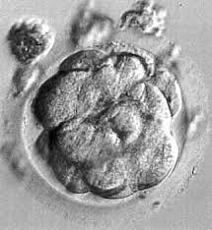
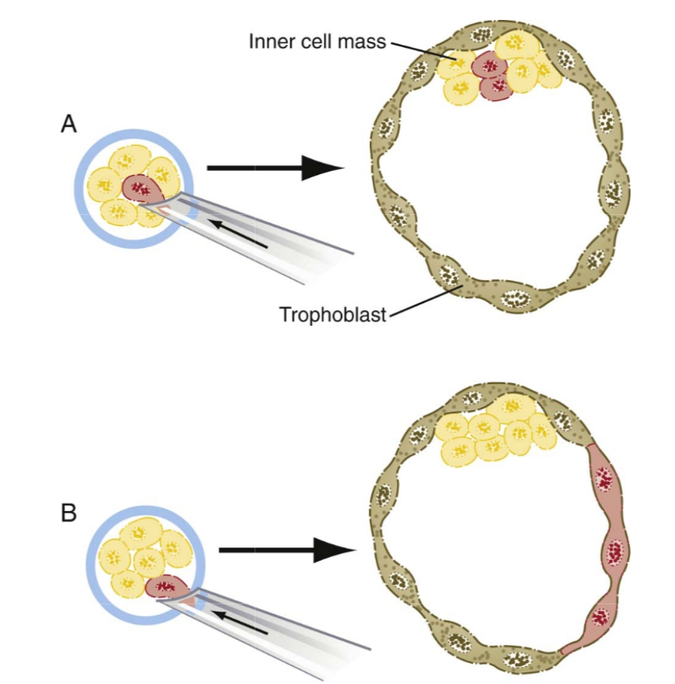
FIRST EVENTS IN HUMAN LIFE
DETERMINATION OF BLASTOMERES
1st week
Mechanism of diferentiation
„cell polarity“
„inside-outside“
16-cell embryo is still totipotent – later (32-cell), it loses the full developmental potential → cell are determined.

Slide 13
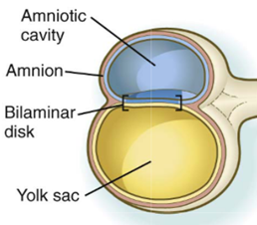
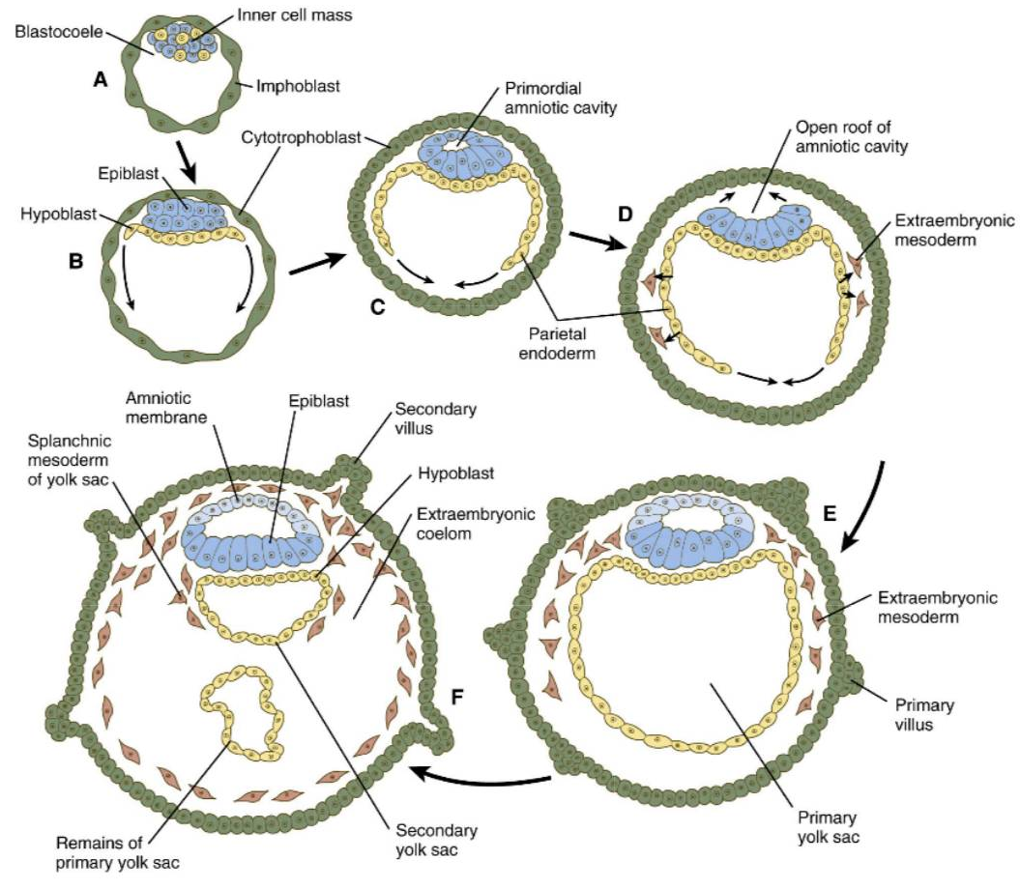
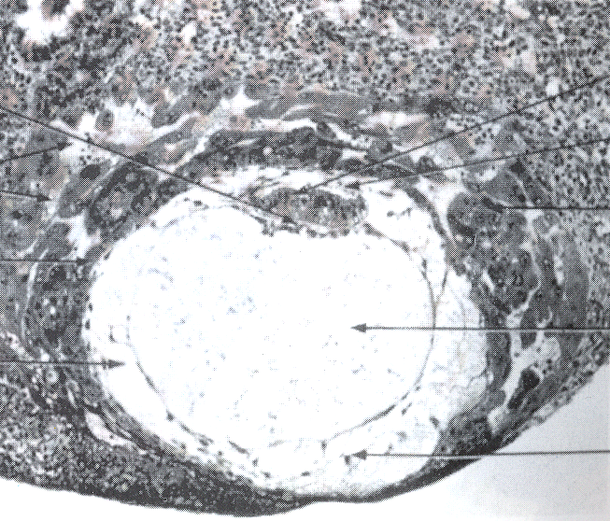
FIRST EVENTS IN HUMAN LIFE
DEVELOPMENT OF GERM DISC
1st-2nd week
BILAMINAR GERM DISC
Day 5
Day 7 ^{1/2}
Day 6
Day 8
Day 9
amnion
epiblast
hypoblast
lacunae
end of 2nd week
cytotrophoblast
syncytiotrophoblast
extraembryonic coelom
primary yolk sac
extraembryonic mesoderm

Slide 14
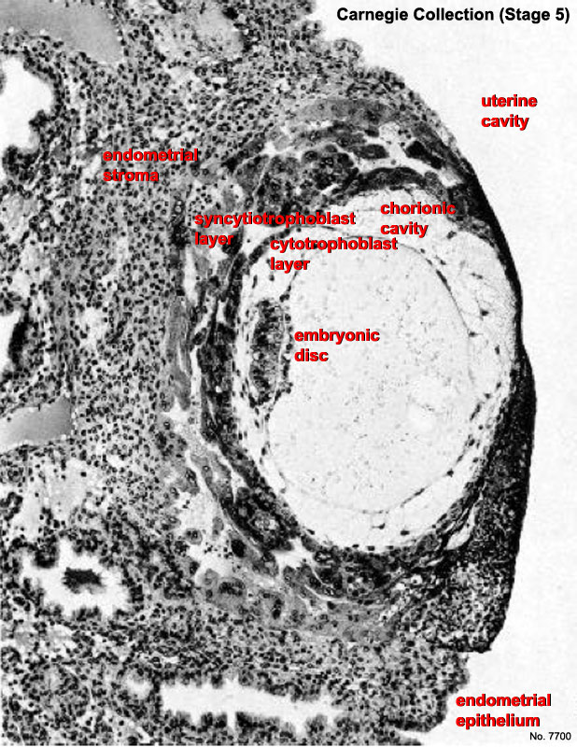
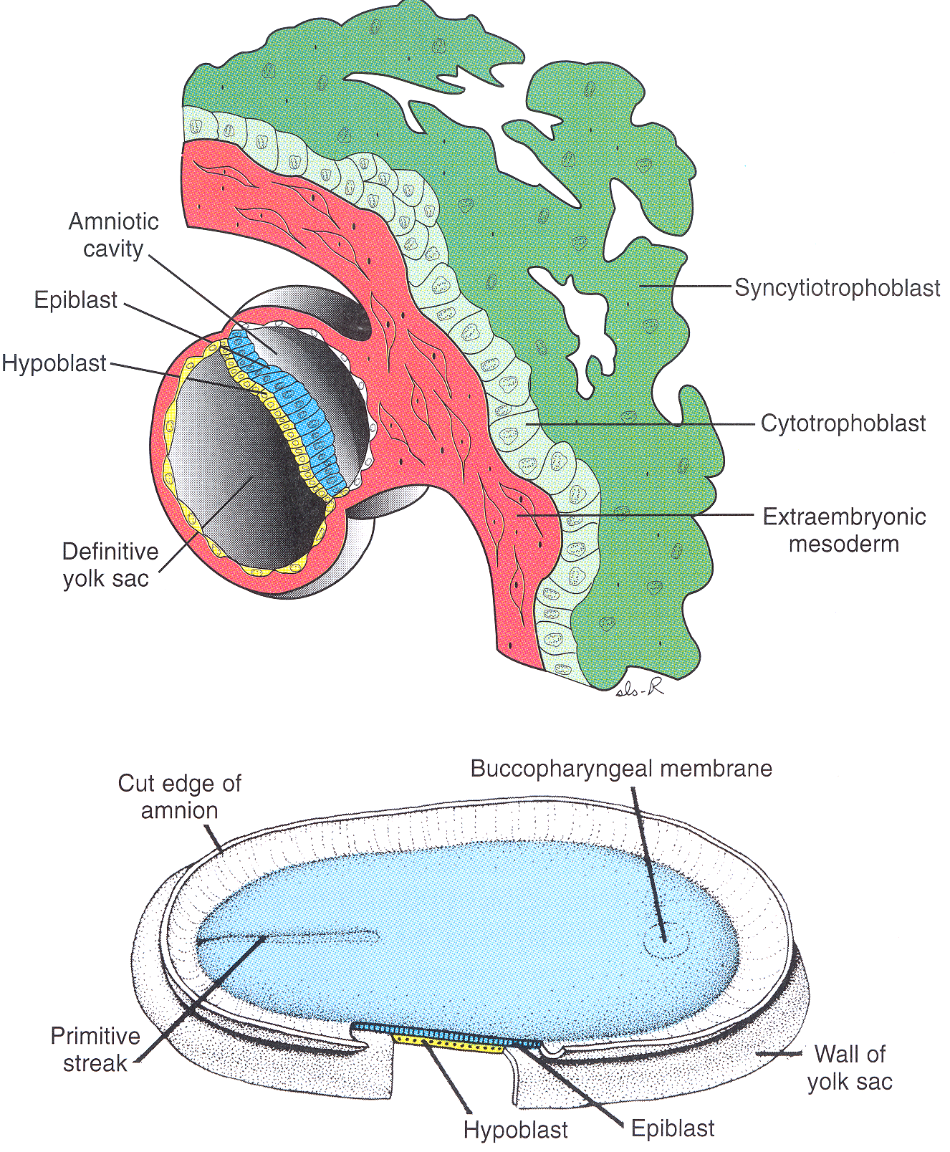
ORGANIZER EXISTS IN MAMMALLS
BILAMINAR GERM DISC
2nd week
Primitive node

Slide 15
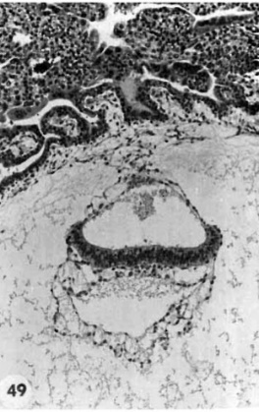
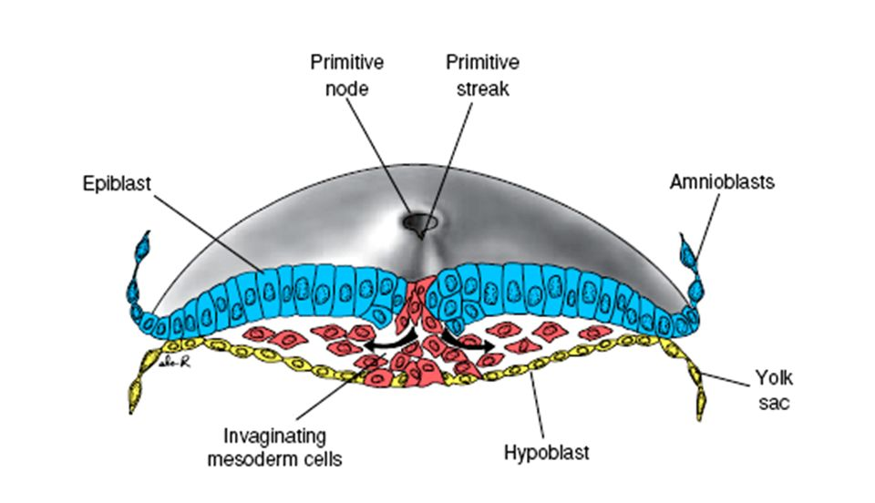
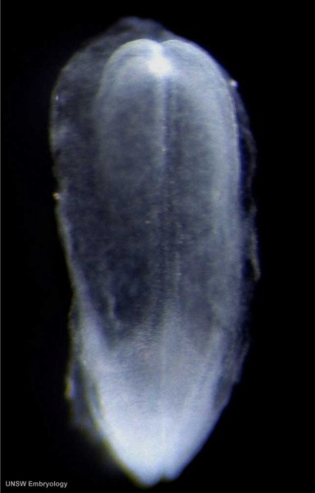
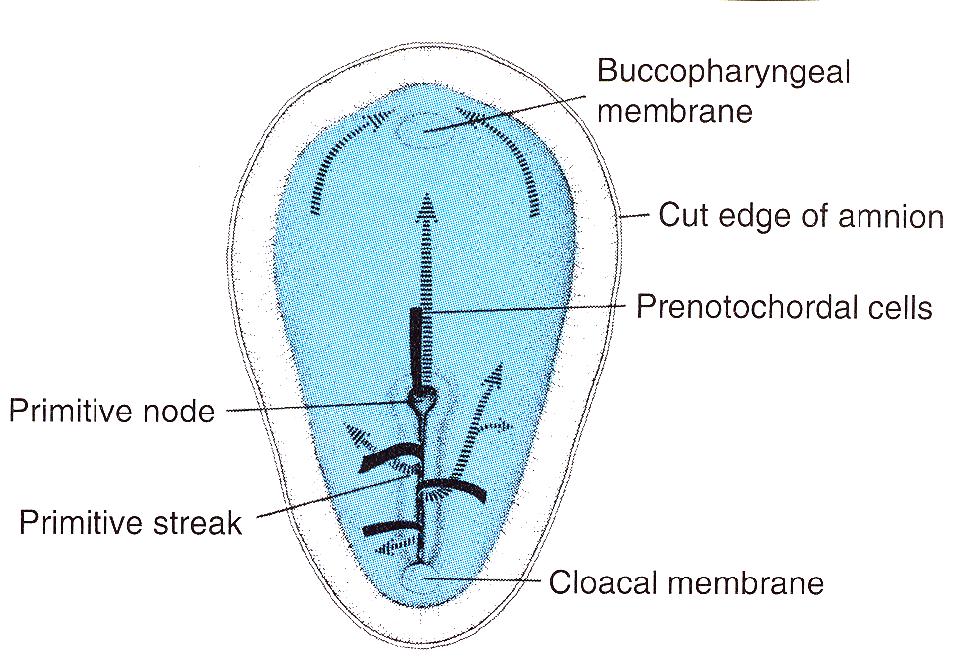
TRILAMINAR GERM DISC
PRIMITIVE STREAK AND PRIMITIVE NODE
2nd week ends
NEW STRUCTURES
3rd week begins
16
17
22
23
24
28
15
18
20
21
25
26
27
14
19
3. týden
Neural plate
Primitive node
Primitive streak
Day 16
Day 18

Slide 16
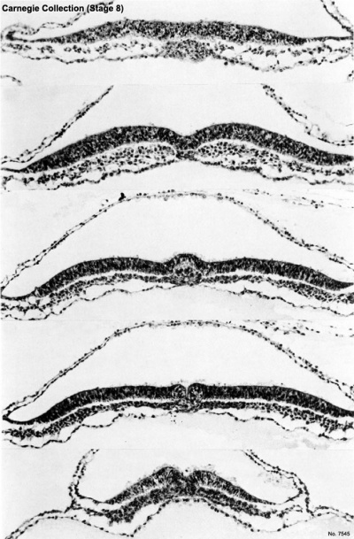
TRILAMINAR GERM DISC
PRIMITIVE STREAK AND PRIMITIVE NODE
3rd week
Prechordal plate
Neural plate
Notochordal process

Slide 17
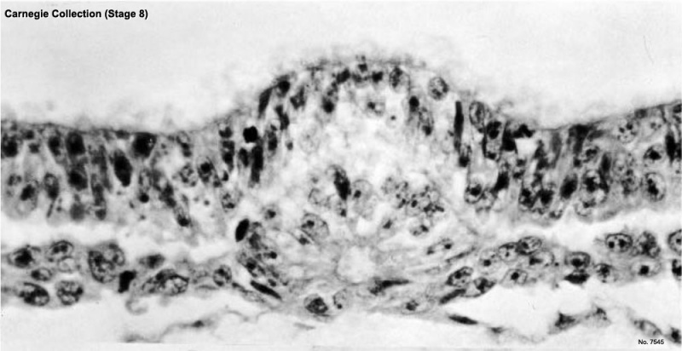
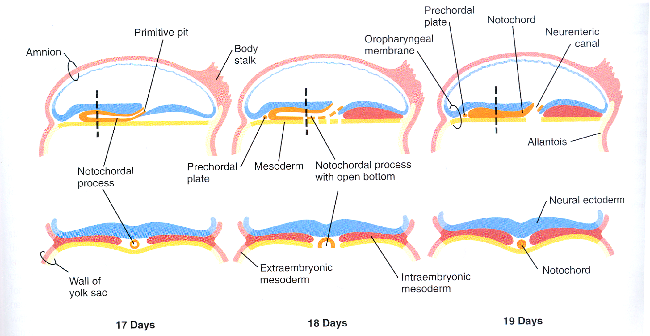
TRILAMINAR GERM DISC
PRIMITIVE STREAK AND PRIMITIVE NODE
3rd week
Day 17
Day 18
Day 19

Slide 18
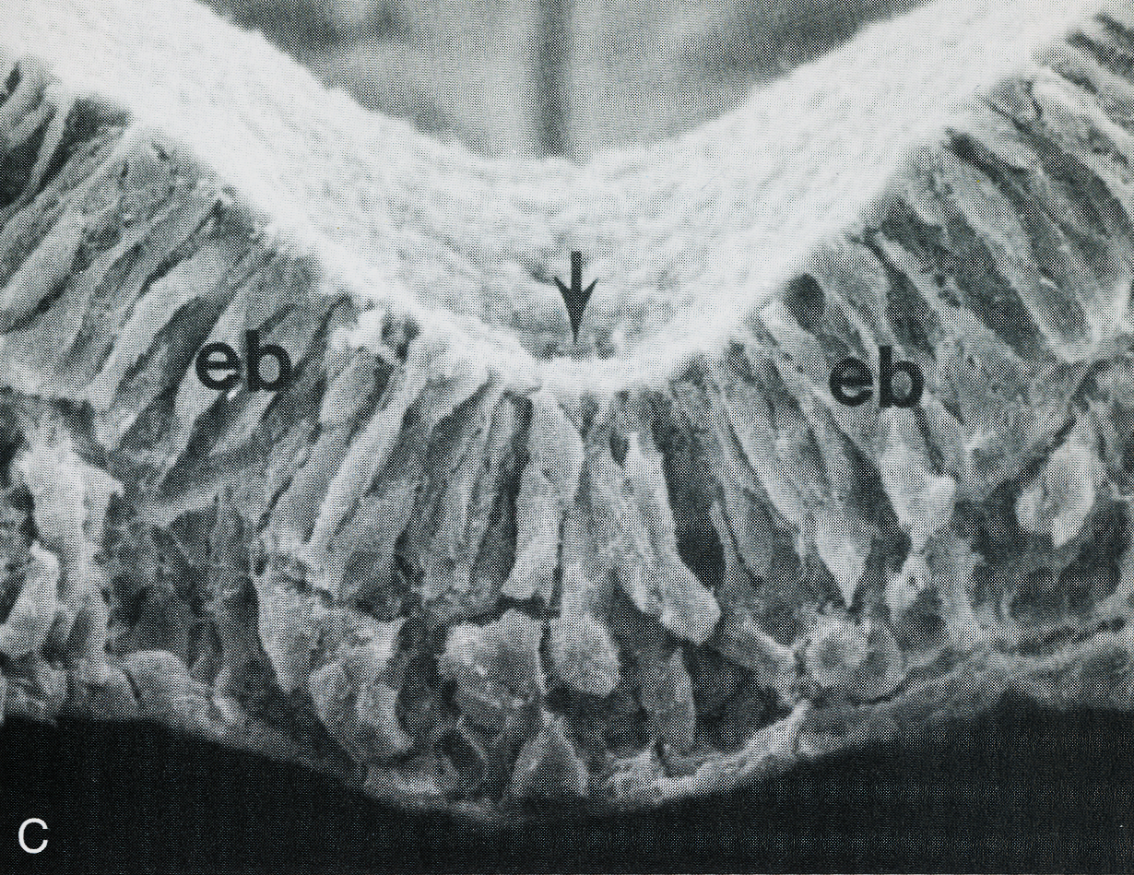
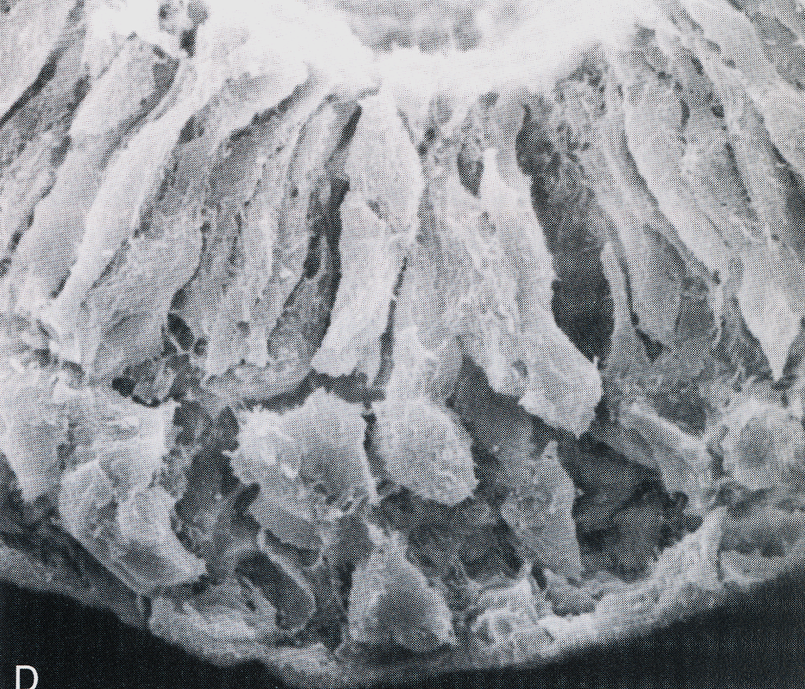
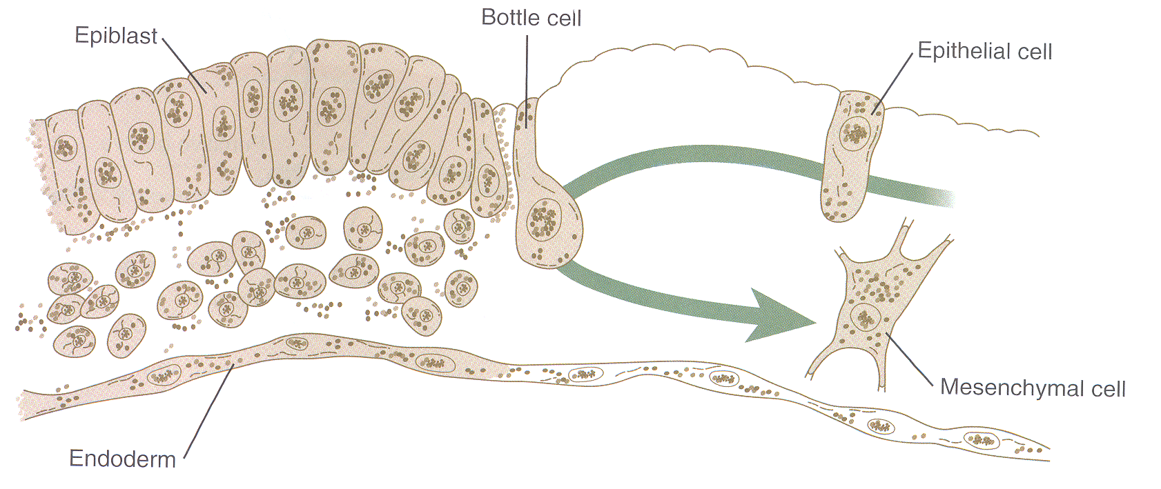
TRILAMINAR GERM DISC
PRIMITIVE STREAK AND PRIMITIVE NODE
3rd week

Slide 19
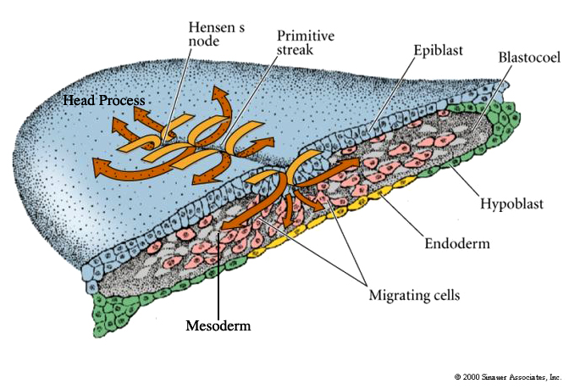
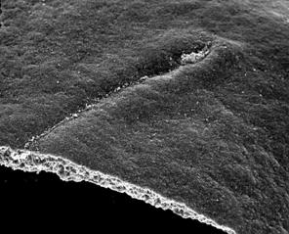
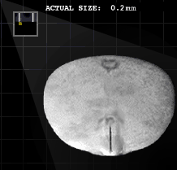
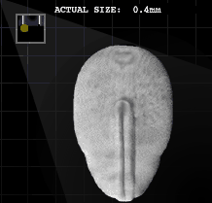
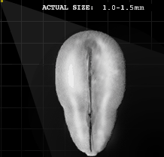
TRILAMINAR GERM DISC
PRIMITIVE STREAK AND PRIMITIVE NODE
3rd week
A new cell population appears - MESODERM

Slide 20
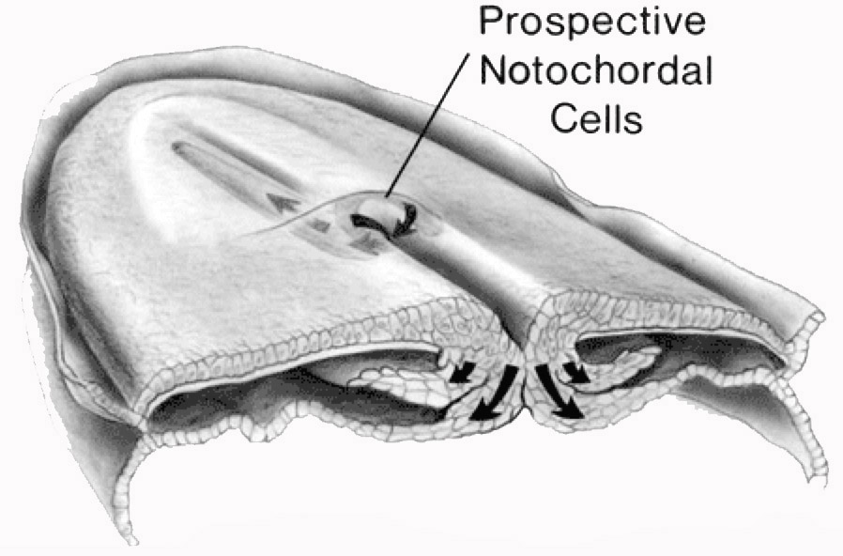
DERIVATIVES OF MESODERM
NOTOCHORD
End of 2nd week
End of 3rd week

Slide 21
NEURULATION
NEUROECTODERM
3rd week
Notochord induces differentiation of ectoderm – cellular basis of nerve system is established –
NEUROECTODERM

Slide 22
NEURULATION
NEURAL TUBE
3rd week
Neural plate
Neural folds
Neural tube
Neural crest

Slide 23
NEURULATION
NEURAL TUBE
3rd week
Edtoderm and mesoderm produce BMP4, that induces development of epidermis
Notochord produces inhibitors of BMP4 - noggin, chordin and follistatin (cranially) a wnt3a and FGF (caudally) - ectoderm differentiates into neuroectoderm.

Slide 24
NEURULATION
NEURAL TUBE AND NEURAL CREST
3rd – 4th week

Slide 25
NEURULATION
NEURAL TUBE AND NEURAL CREST

Slide 26
NEURULATION
NEURAL TUBE AND NEURAL CREST

Slide 27
NEURAL TUBE

Slide 28
Embryology.med.unsw.edu.auc

Slide 29
NOTOCHORD IN ADULT BODY
INTERVERTEBRAL DISC

Slide 30
GASTRULATION
MESODERM
3rd week
Chordomezodermový výběžek

Slide 31
DERIVATIVES OF MESODERM
SOMITES
3rd – 4th week

Slide 32
DERIVATIVES OF MESODERM
SOMITES

Slide 33
DERIVATIVES OF MESODERM
SOMITES
Paraxial: sclerotomes, myotomes, dermatomes
Intermediate: nephrotomes
Lateral plate: somatopleura, splanchnopleura

Slide 34
OTHER DERIVATIVES OF MESODERM
3rd – 4th week
heart, cardiovascular system
urogenital system
muscle and skeletal system
hematopoietic and lymphatic systems
connective tissue, dermis
mesothelium

Slide 35
DEVELOPMENTAL DISORDERS DURING GASTRULATION
Primitive streak is a temporary embryonic structure. Persistent primitive streak causes sacrococcgyeal teratoma.
Failure of primitive streak leads to absence of mesoderm in affected region - sirenomelia
limbs
urogenital system
GIT

Slide 36
DEVELOPMENTAL DISORDERS DURING GASTRULATION
If two primitive streaks form, conjoined twins may develop

Slide 37
NEW BODY PLAN
FOLDING OF EMBRYO
4th week

Slide 38
NEW BODY PLAN
FOLDING OF EMBRYO
extraembryonic coelom
umbilical vein
extraembryonic coelom
umbilical artery

Slide 39
NEW BODY PLAN
FOLDING OF EMBRYO
Extraembryonic coelom
Chorion and chorionic villi
Cytotrophoblast
Neural tube
Connective stalk and allantois
Skin umbilicus
Extraembryonic somatopleura
Extraembryonic splanchnopleura

Slide 40
NEW BODY PLAN
FOLDING OF EMBRYO
bilaminar → trilaminar germ disc
cephalocaudal and lateral flexion of embryo
http://www.embryology.ch/anglais/iperiodembry/carnegie03.html#st710
Day 19
0.4 mm
Carnegie stage 7
Day 25
1.5-2.5 mm
Carnegie stage 9
Day 28
2-3.5 mm
Carnegie stage 10
Dorsal
Ventral
1 Yolk sac
2 Primitive streak
3 Primitive node
4 Germ disc
1 Amnion
2a Neural ridge 2b Neural tube
2c Caudal neuroporus 2d Rostral neuroporus
1 Primitive streak 2 Neural folds 3 Amnion
3 Neural folds
4 Somites
5 Yolk sac

Slide 41
EMBRYONIC DEVELOPMENT
week 4-6
4W
5W
6W
6W
Derivatives of endodermal pharyngeal pouches (parathyroid, thymus)
Adrenal gland
Heart and lungs descended to thorax
Innervation of limbs, differentiation of myoblasts
Face development – maxillary and mandibulary processes, palatine, choans
Telencephalon stratifies – archicortex, paleocortex and neocortex. Choroid plexus
Rotation of stomach
Pancreatic diverticula fuse
Mesoderm segmentation
Primitive gut
Esophagotracheal diverticulum
Heart (starts beating day 22-23)
Limb buds
Primary brain vesicles, closing of neuropores
Differentiation of neural crest
Origin of thyroid and anterior pituitary
Ectodermal placodes, optic vesicle
Liver diverticulum
Septum transversum
Segmentation of mesoderm continues
Posterior pituitary
Heart septation begins
Lung buds branch - pseudoglandular stage of lung development
Cochlea grows
Lens vesicle, nasal placodes
Fourth brain ventricle forms
Pharyngeal arches, ridges and pouches
Limb buds grow
Hematopoiesis in liver
Retinal pigment

Slide 42
EMBRYONIC DEVELOPMENT
week 8
7-8W
8-9W
Secretion from endocrine pancreas
Growth of liver, growth and luminization of bile ducts
Ossification of limbs begin
Development of brain nuclei
Joints of upper and later lower limbs allow rotation
Fingers grow
Stratification of cerebellar cortex
Perforation of anal membrane
Herniation of intestinal loops
Testes produce testosterone
Nose, meatus, eyelids, developer, external ears start to grow
Backbone - 33-34 cartilaginous vertebrae
Embryonic tail diminished

Slide 43
LENGTH OF PREGNANCY
280 days (= 40 weeks = 10 lunar months) from the first day of the last menstruation
266 days (= 38 weeks) from ovulation (gestation age)
Calculation of term: First day of the last menstruation + 1 year– 3 months + 7 days
Conception age
Fertilization
0 3 8 weeks
38 weeks
DELIVERY
40 weeks
Beginning of the last menstruation
Menstrual age
preembryo
embryo
fetus

Slide 44
FETAL DEVELOPMENT
month 4-5
60-70mm, 150 g
130mm, 450 g
3M
4M
Fetus swallows amniotic fluid – necessary for GIT development
Rapid growth of head (non-proportional to rest of body)
Eyelids fuse
Ossification centers visible by ultrasound examination
Development of external genitalia
Kidneys produce urine, other organs start to work
Skeletal muscles innervated
Physiological umbilical hernia, in 12th weeks reposition of intestinal loops
Rapid growth of fetus
Ossification of skeleton
Face growths, mandible visible
Apparent external genitalia

Slide 45
FETAL DEVELOPMENT
month 5-9
160-200mm, 500-600 g
300mm, 800-900 g
400mm, 2000g
5M
6-7M
8-9M
Limbs growth
Mother feels fetal movements
Vernix caseosa, lanugo
Short hairs and eyelashes
Fetus reacts to sound and later to light
Lungs start to produce surfactant
Limit of viability
Eyelids open
Wrinkled skin with visible capillaries
Subcutaneous fat
Hairs grow
Maturing of organ systems
Subcutaneous fat accumulates in limbs
Smooth, red skin
Hallmarks of full term fetus

Slide 46
FULLTERM NEWBORN
LENGTH OF PREGNANCY × FETAL MATURITY
Full term – related to length of pregnancy (menstrual age)
preterm (<37 weeks)
full term (38 – 40 weeks)
after term (>42 weeks) (meconium in amniotic fluid)
Fetal maturity – development of fetus: mature X immature
HALLMARKS OF FETAL MATURITY
Major:
length (50 – 51 cm),
weight (around 3500 g, physiological range 2500 - 4000g),
head sizes
boys - testes in scrotum, girls - labia majora over labia minora
Minor:
eutrophic fetus, subcutaneous fat
skin is not blue (no cyanosis), lanugo remains on shoulders and back,
eyelashes, hairs several cm long, nails over fingertips
cranial bones hard, anterior and posterior fontanelle are palpable, and separated
newborn cries and moves (Apgar score)

Slide 47
FULLTERM NEWBORN
HEAD SIZE
Diameter bitemporalis – 8,00 cm
(join of the most distant points on sutura coronaria)
Diameter biparietalis – 9,5 cm
(join of midpoints of tubera parietalia)
Diameter bitemporalis
Diameter biparietalis

Slide 48
FULLTERM NEWBORN
HEAD SIZE
Oblique sizes:
Diameter frontooccipitalis – 12.0 cm (join of forehead midpoint and most distant point of occiput)
Circumferentia frontooccipitalis – 34.0 cm
Diameter suboccipitobregmatica – 9.5 cm (join of protuberantia occipitalis externa and midpoint of large fontanelle)
Circumferentia suboccipitobregmatica – 32.0 cm
Diameter mentooccipitalis – 13.5 cm (join of chin midpoint and most distant point of occiput)
circumferentia mentoocipitalis – 35 - 36 cm
Diameter biacromialis – 12.0 cm, circumferentia biacromialis – 35 cm
(join of acromion – acromion)
Diameter frontooccipitalis
Diameter suboccipitobregmatica
Diameter mentoooccipitalis

Slide 49
RULE OF HASSE
RELATIONSHIP BETWEEN AGE AND LENGTH OF FETUS
RULE OF HASSE
forensic medicne
3. – 5. lunar month: length in cm = square of month
6. – 10. lunar month: length in cm = months multiplied by 5
Lunar month | Length of fetus[cm]
3 | 9
4 | 16
5 | 25
6 | 30
7 | 35
8 | 40
9 | 45
10 | 50

Slide 50
FETUS IN UTERUS
1. LIE (SITUS) = relationship of the long axis of the fetus to that of the mother
longitudinal: (99 %)
transverse: (1 %) perpendicular axes
oblique: unstable → longitudinal or transverse position
2. POSITION (POSITIO) = fetal backbone relative to uterus ridge
first= left (back to the left)
second= right (back to the right)
first/second common/less common
3. FETAL HABITUS (HABITUS) = relationship of one fetal part to another
regular = head and limbs in flexion
irregular = everything else
4. PRESENTATION (PRAESENTATIO) = that part of the fetus lying over the pelvic inlet; the presenting body part of the fetus.
occiput (most common)
vertex, forehead, face (1%)
breech
trunk, shoulder

Slide 51
FETUS IN UTERUS
1. LIE (SITUS) = relationship of the long axis of the fetus to that of the mother
longitudinal: (99 %)
transverse: (1 %) perpendicular axes
oblique: unstable → longitudinal or transverse position
longitudinal - occiput
longitudinal - breech
transverse
oblique

Slide 52
FETUS IN UTERUS
2. POSITION (POSITIO) = fetal backbone relative to uterus ridge
first= left (back to the left)
second= right (back to the right)
first/second common/less common
tranverse
Note: Normally uterus is in anteversion and anteflexion (rarely retroversion, retroflexion)
In late pregnancy, uterus is in dextroversion and dextrotorsion (rarely sinistroversion, sinistrotorsion)

Slide 53
POSITION OF FETUS
2. COMMON
1. LESS COMMON
dextroversion
dextrotorsion
sinistroversion
sinistrotorsion
2. LESS COMMON
1. COMMON
sinistroversion
sinistrotorsion
dextroversion
dextrotorsion

Slide 54
POSITION OF FETUS

Slide 55
FETUS IN UTERUS
3. FETAL HABITUS (HABITUS) = relationship of one fetal part to another
regular = head and limbs in flexion
irregular = everything else
HABITUS
irregular (any other)
regular

Slide 56
HABITUS AND PRESENTATION
4. PRESENTATION (PRAESENTATIO) = that part of the fetus lying over the pelvic inlet; the presenting body part of the fetus.
occiput (most common)
vertex, forehead, face (1%)
breech
trunk, shoulder
PRESENTATION
occiput
vertex
forehead
face

Slide 57
PHYSIOLOGICAL IMPOSITION OF FETUS IN UTERUS
LIE LONGITUDINAL - HEAD FIRST
POSITION FIRST COMMON
HABITUS REGULAR
PRESENTATION - OCCIPUT

Slide 58
INTRODUCTION TO TERATOLOGY
Congenital disorders – due to abnormal developmental events
Genetic (inherited) or nongenetic (external) causes
Teratogens
Life style (alcohol, smoking, drugs)
Infections (rubeola, HIV, toxoplasmosis)
Lack or abundance of key substances (folic acid × retinoids)
Chronic diseases (medical treatment)
Physical (temperature, radiation)

Slide 59
INTRODUCTION TO TERATOLOGY
Critical developmental periods

Slide 60
INTRODUCTION TO PRENATAL DIAGNOSTICS
Interdisciplinary care – biochemistry, genetics, gynecology and obstetrics, neonatology – parts of fetal medicine
Revealing high risk pregnancies, access to preventive and therapeutic care
Preventing delivery of fetuses with severe congenital malformations
Support of delivery of genetically high-risk babies
Planning and providing clinical care
Genetic counselling
Biochemical and ultrasound screening
Karyotyping and DNA diagnostics
Clinical diagnostics
Indication:
congenital disorders in family
positive screening in 1st or 2nd trimester
abnormal finding by ultrasound
maternal age (over 35 years)
ČR 1994-2008

Slide 61
GENETIC COUNSELING
Anamnesis (case history)
Preconception counselling
Explaining of examination results, causes, clinical symptoms, therapeutic options
Minimization of risk of repeated disease
Providing diagnosis and information for free choice
Providing precise diagnosis and risk estimation
Providing care during pregnancy and later
NONDIRECTIVE
ALL EXAMINATIONS AND PROCEDURES ARE VOLUNTARY

Slide 62
BIOCHEMICAL SCREENING
Non invasive
Revealing high risk pregnancies – chromosomal aberrations and clefts
Screening is not a diagnostics → further examinations (amniocentesis, karyotype, US)
Tests between weeks 14-16 („TRIPLE test“)
low sensitivity and specificity (50-60%), high false positivity (70%)
AFP, E3, hCG
chromosomal aberrations, abnormal closing of neural tube, defects of body walls
Combined screening in week 11-13
chromosomal aberrations – Down: 47,XY,+21, Edwards: 47,XY,+18, Patau 47,XY,+18
US –nuchal translucence, NT
PAPP-A, hCG (multiplies of median, MoM)
age included in algorithm
output: screening positive vs. negative (limit 1:100)

Slide 63
INVASIVE DIAGNOSTICS
Amniocentesis
16th-20th week
US controlled amniotic fluid aspiration
Cell culture, karyotype
Risk of miscarriage 0.5-1%
Chorion villus biopsy
10th-13th week
Karyotype, molecular genetic examination
Risk 0.5-1%
Cordocentesis
22nd week
Sampling of venous umbilical blood
Now diagnostics and therapy of blood diseases (anemia, infections), or diagnostics in multiple pregnancies
Risk 1%
Fetoscopy
Transabdominally (earlier transcervically)
Visualization and fetal biopsy
Risk 3-10%, done rarely

Slide 64
ULTRASOUND DIAGNOSTICS
6-8th week
confirmation of pregnancy, heart action
number of fetuses
13-14th week
nuchal translucence (risk > 3 mm)
nasal bone (present × absent), minor markers (omphalocele, tricuspidal regurgitation, abnormality in ductus venosus flow, enlargement of urinary bladder-megavesica)
fetal size
20-22nd week
detailed screening
fetal biometry (biparietal diameter, head circumference, length of femur)
head and CNS (shape, cavity in septum pellucidum, ventricles, cerebellum, cisterna magna), face (lip, jaws, nose, orbits, profile), heart (action, size, axis, 4-chamber projection, outflow tracts, ...), thorax (pathological structures), abdominal cavity (stomach, intestine, kidneys, urinary bladder, umbilicus and umbilical vessels), backbone, limbs, palms, feet
placenta, volume of amniotic fluid
30th week
fetal size
volume of amniotic fluid
placenta (exclusion of placenta praevia)

Slide 65
ADVANCEMENTS IN MOLECULAR GENETICS
Analysis of cell-free fetal DNA in maternal blood
Since 12th week
Massive paralell sequencing (Next-Gen Sequencing)
Common aneuploidies (trisomy 21,13,18)
Monogeneous disorders

Slide 66
Thank you for attention
Questions and comments
pvanhara@med.muni.cz
http://www.med.muni.cz/histology

