Slide 1
General Traumatology
1st Dpt. Of Surgery
University Hospital of St. Anne, Masaryk university, Brno

Slide 2
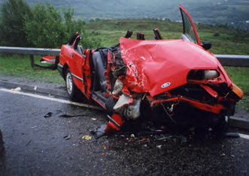
Polytrauma

Slide 3
“ What people die of ? “
Cardiovascular disease (IHD, strokes) 52%
Tumors 26%
Trauma (external causes) 7%
  Traffic, work, sports, home, industria, criminal
Trauma under 40y on 1st place !

Slide 4
Terms and Definitions
Monotrauma - single systeme injury
Polytrauma - significant injury in at least two body regions (one of which or their combination is immediately life-threatening)
Body regions:
Head, neck, and cervical spine
Face
Chest and thoracic spine
Abdomen and lumbar spine
Limbs and bony pelvis
External (skin)

Slide 5
Injured systemes
Limbs 90%
Skull and brain 72%
Chest 53%
Abdomen 29%
Pelvis 24%
Spine 10%
Heart and vessels 10%

Slide 6
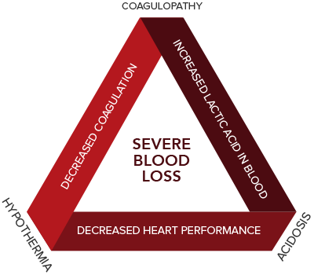
“Lethal triad”
Hypothermia
Acidosis
Coagulopathy

Slide 7
Approach to polytraumatised patient
Pre-hospital care (pre-medical, technical, medical)
Transport to the trauma center
Damage control
Definitive treatment

Slide 8
3 “R” rule
Right patient
Right hospital
Right time

Slide 9
Field triage (ATLS)
Vital signs and level of consciousness
  GCS < 13
  Systolic blood pressure < 90
  Respiratory rate < 10 or > 29 (or need for ventilatory support)
Anatomy of injury
  All penetrating injuries
  Pelvic fractures
  Two or more proximal long-bone fractures
  Crushed, degloved, mangled, or pulseless extremity
  Amputation proximal to wrist or ankle
  Open or depressed skull fracture
  Paralysis
Mechanism of injury
  Falls > 6 meters (second floor)
  High risk auto crash (ejection, intrusion, death of another passenger, telemetry)
  Motorcycle crash > 30 km/h
  Auto vs. pedestrian/bicyclist > 30 km/h
Consider special conditions
  Age < 6y or > 55y
  Cardiopulmonar comorbidity
  Pregnancy
  etc

Slide 10
Scoring systemes
Glasgow coma scale
Abbreviated injury scale (AIS)
Injury severity score (ISS)
AO classification
Tscherne, Gustillo-Anderson

Slide 11
Pre-hospital medical care
“ABCDE”
Resuscitation
Secondary treatment
Transport to place of definitive treatment (trauma center)
Cervical spine immobilization
Immobilization of unstable fractures
Analgesia
Monitoring

Slide 12
Procedures in trauma patients
ABC
Urgent procedures
  Tension pneumothorax, hearth tamponade, urgent laparotomy for major bleeding, stabilisation of long bone/hip fractures
Acute (3-6 hours)
Delayed (1-2 days)
Planned (weeks)

Slide 13
Damage control
Resustitation / surgery / orthopedics
Analgosedation, OTI + ventilation, volume therapy (TU, FFP, crystaloids/coloids)
Surgery - life saving procedures in unstable patient, time-limited (max 90´)
  Control of bleeding, contamination
  return to operating room after stabilisation on ICU
Stabilization of long bone fractures (pelvic fractures) - external fixator

Slide 14
Death following polytrauma
Trimmodal distribution curve
Immediate death (on sceen) - 50-60%
  Lethal injuries
Early death - 30%
  Within hours after admision (max. 24 hours)
  Potentially reversible (disruption of airways, blood loss)
Late death - 10-20%
  days to weeks after injury
  ARDS, sepsis, MOF, PE
  Potentially reversible

Slide 15
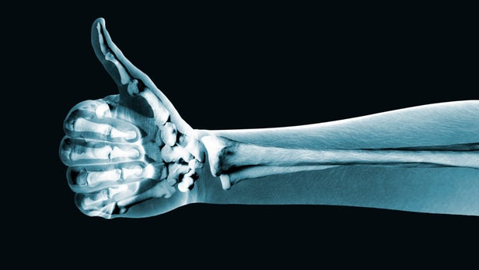
Fractures and bone healing

Slide 16
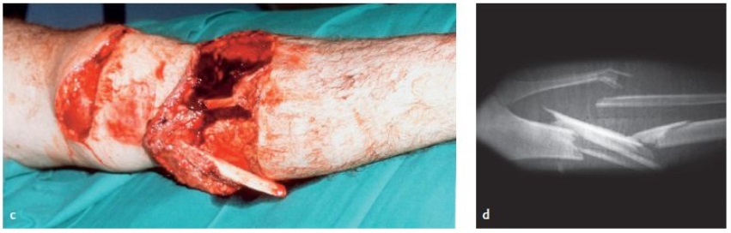
Fracture
Partial or complete break in the continuity of the bone.
Damage to the soft tissues with the breakage of the bone.

Slide 17
Fractures
(classification basics)
Traumatic x Pathologic x Stress
Complete x Incomplete
Closed x Open
Extra-articular x Intra-articular

Slide 18
Classification of fractures
X-ray descriptive / anatomical
AO classification
Specific classification systemes
  e.g. proximal femur fractures (Pipkin, Garden, Pauwels)
  Salter-Harris (pediatric fractures involving growth plate)
  Tscherne (open fractures)
  etc.

Slide 19
Mechanism of fractures
Energy
  High energy
  Low energy
Forces
  Direct forces
  Indirect forces

Slide 20
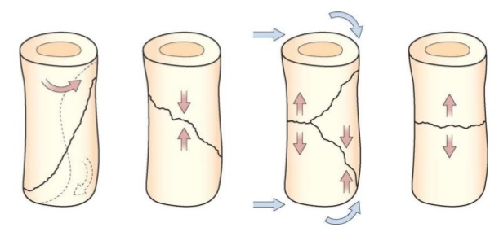
Some fracture patterns suggest causal mechanism...

Slide 21
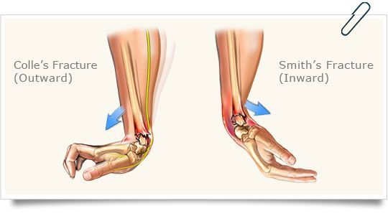

Slide 22
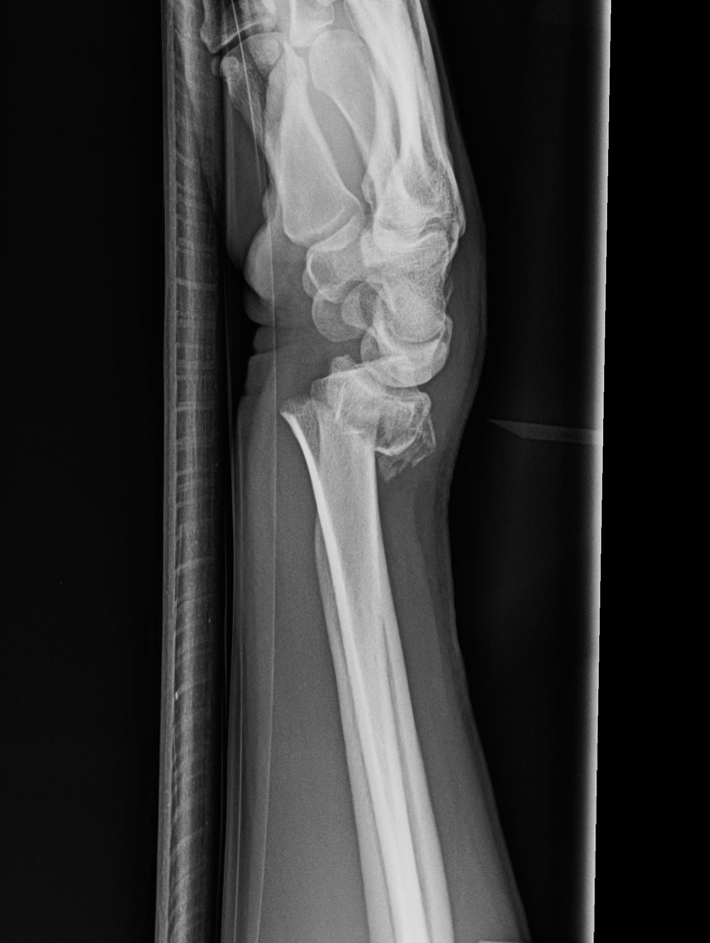
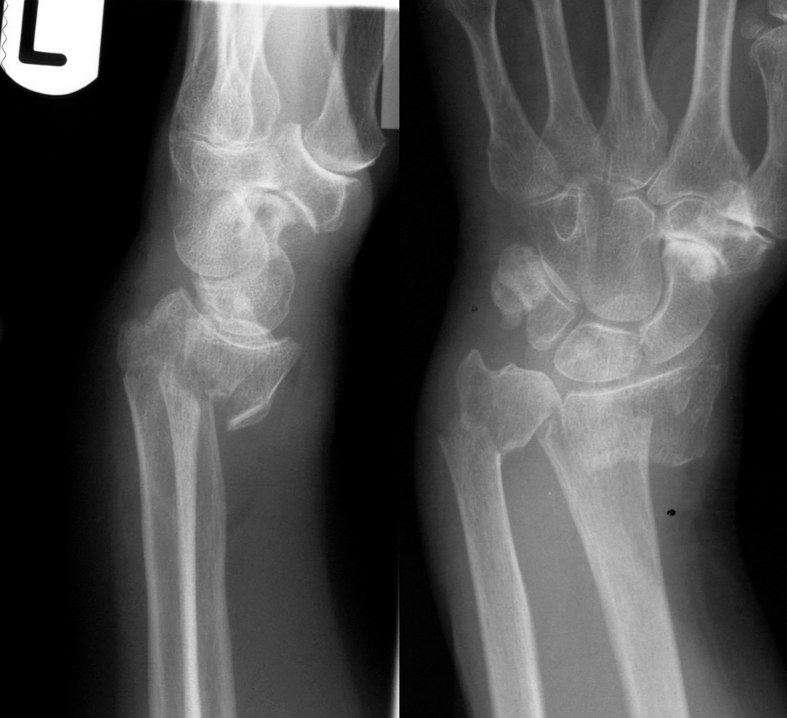

Slide 23
X-ray descriptive classification
Location
  bone and were (diaphysis, proximal femur...)
Orientation / fracture pattern
  Transverse, oblique, spiral, segmental, comminuted (complex), avulsion, impaction/compression
Displacement of main fragments
  with contraction/distraction, axial angulation, rotation (twist), lateral displacement (translation)

Slide 24
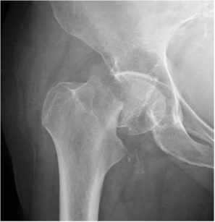
How to describe this fracture ?

Slide 25
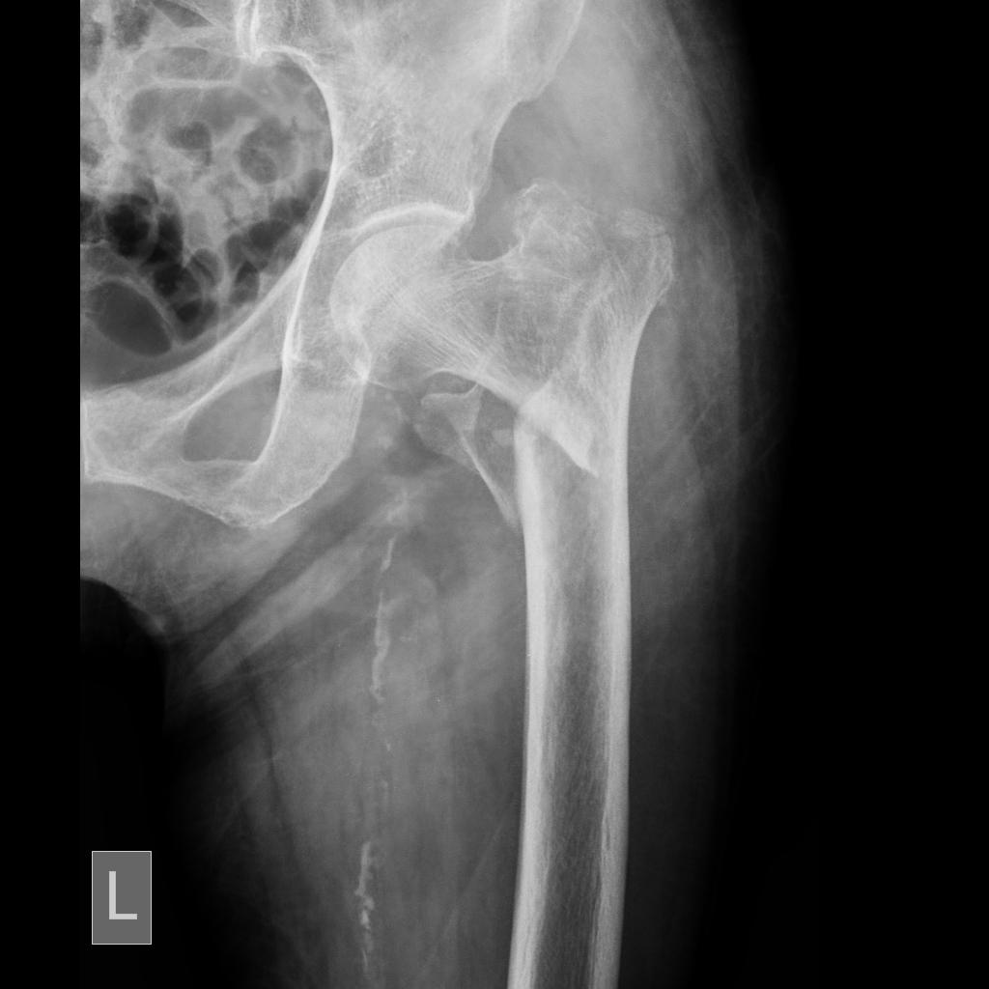

Slide 26
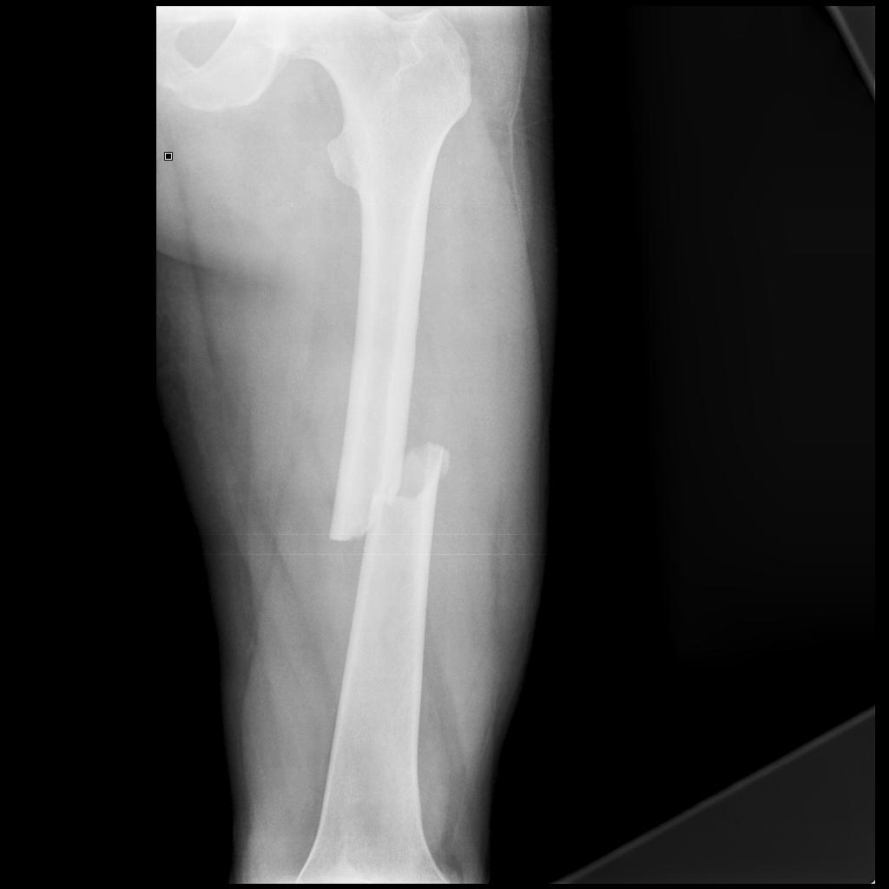

Slide 27
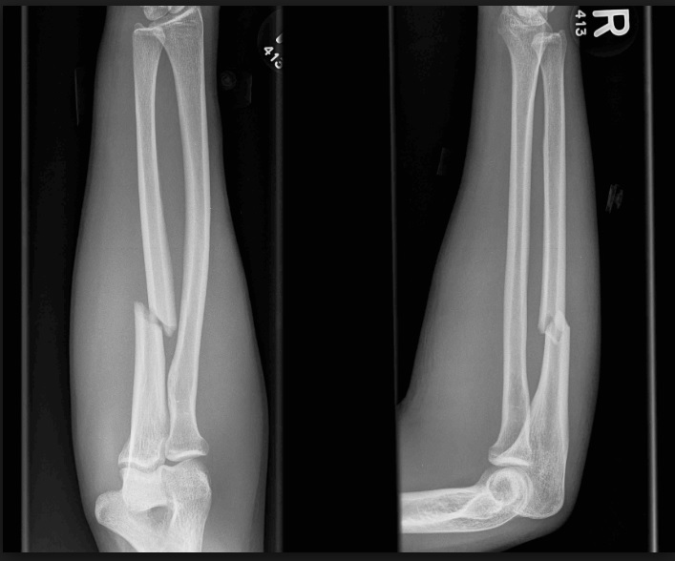

Slide 28
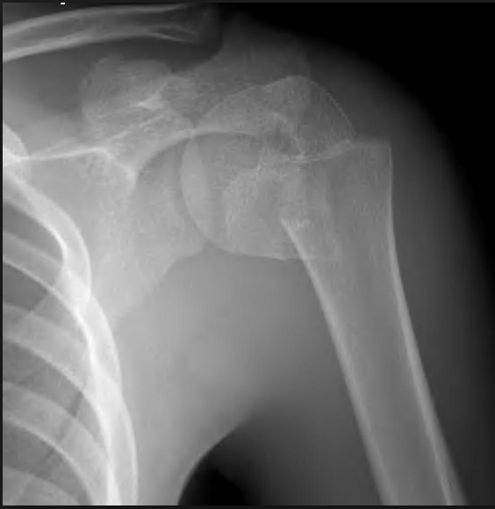

Slide 29
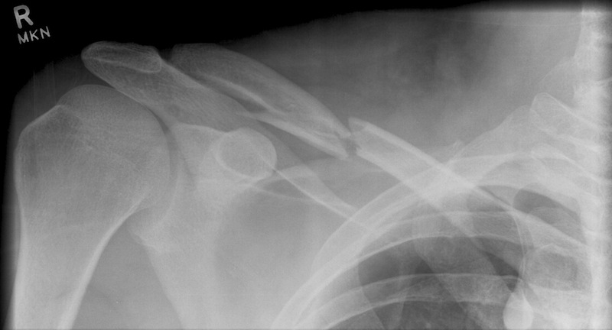

Slide 30
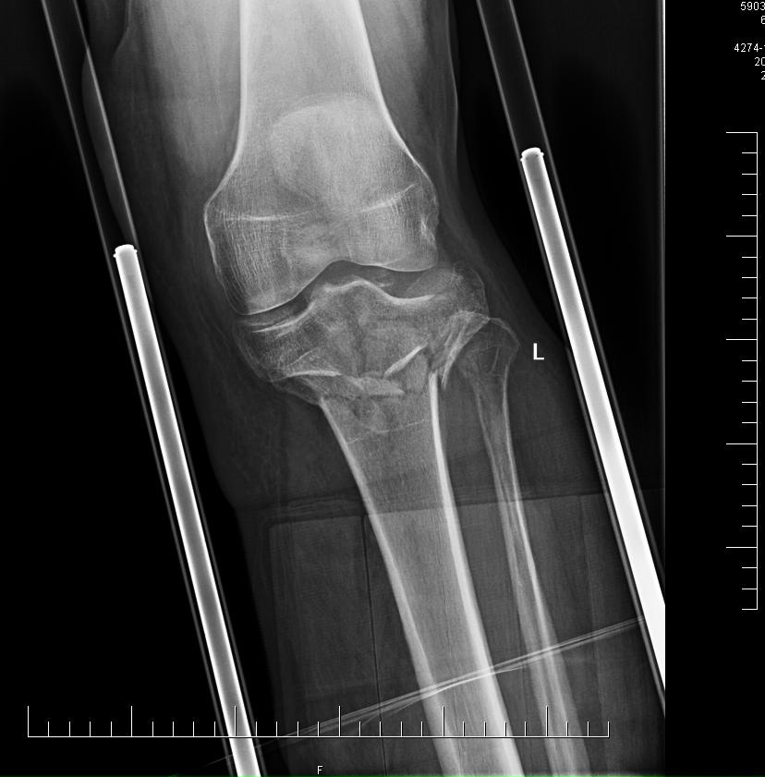

Slide 31
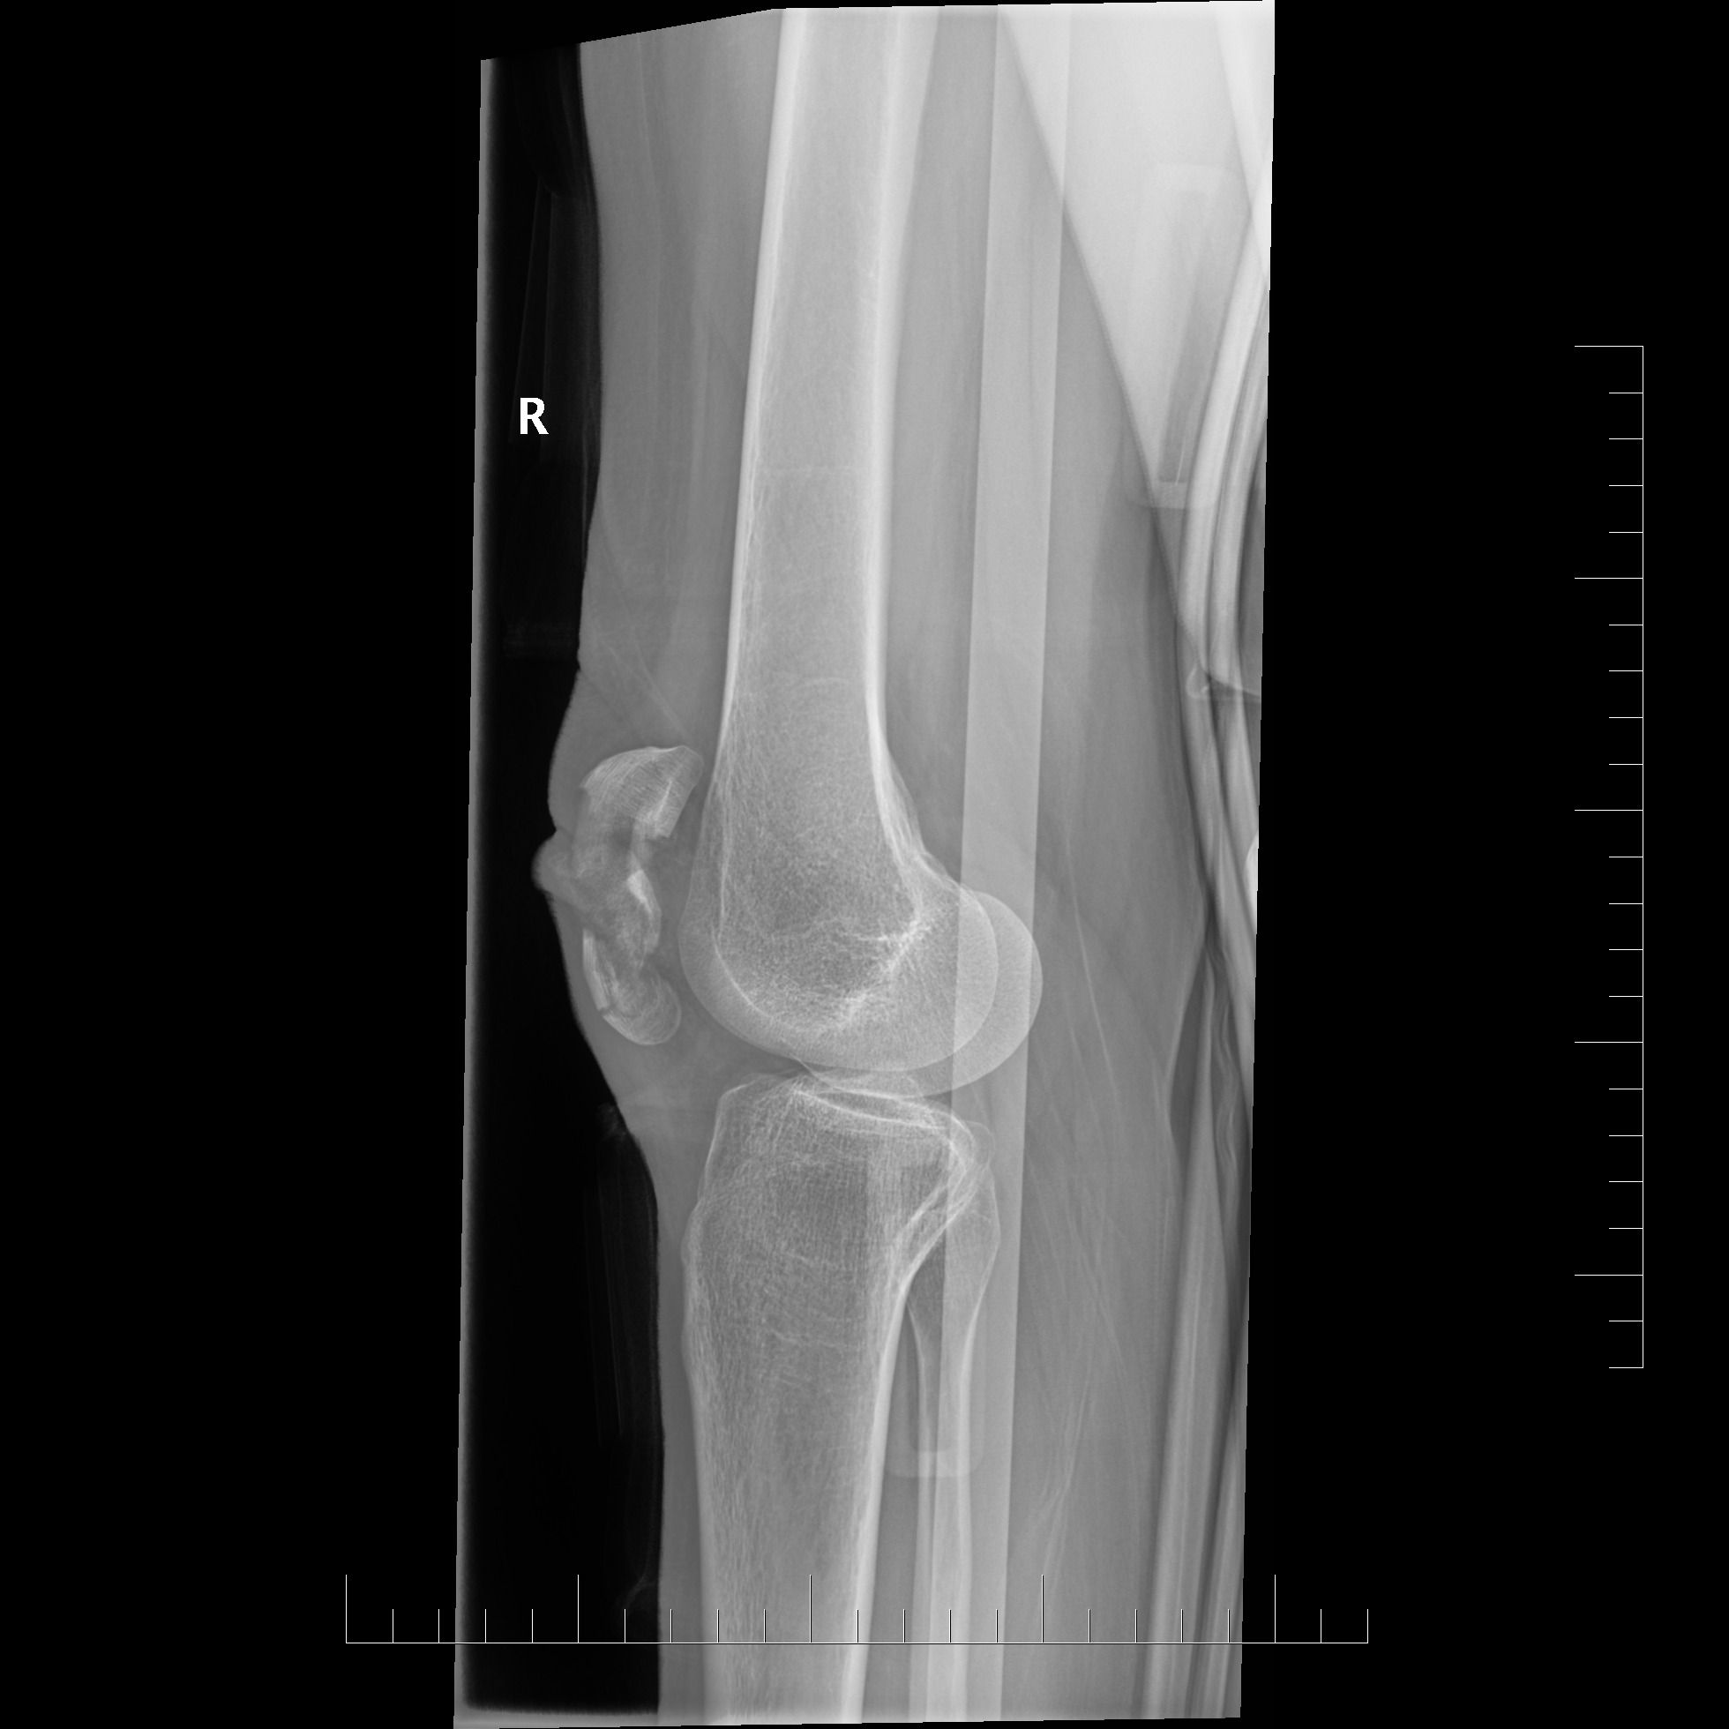
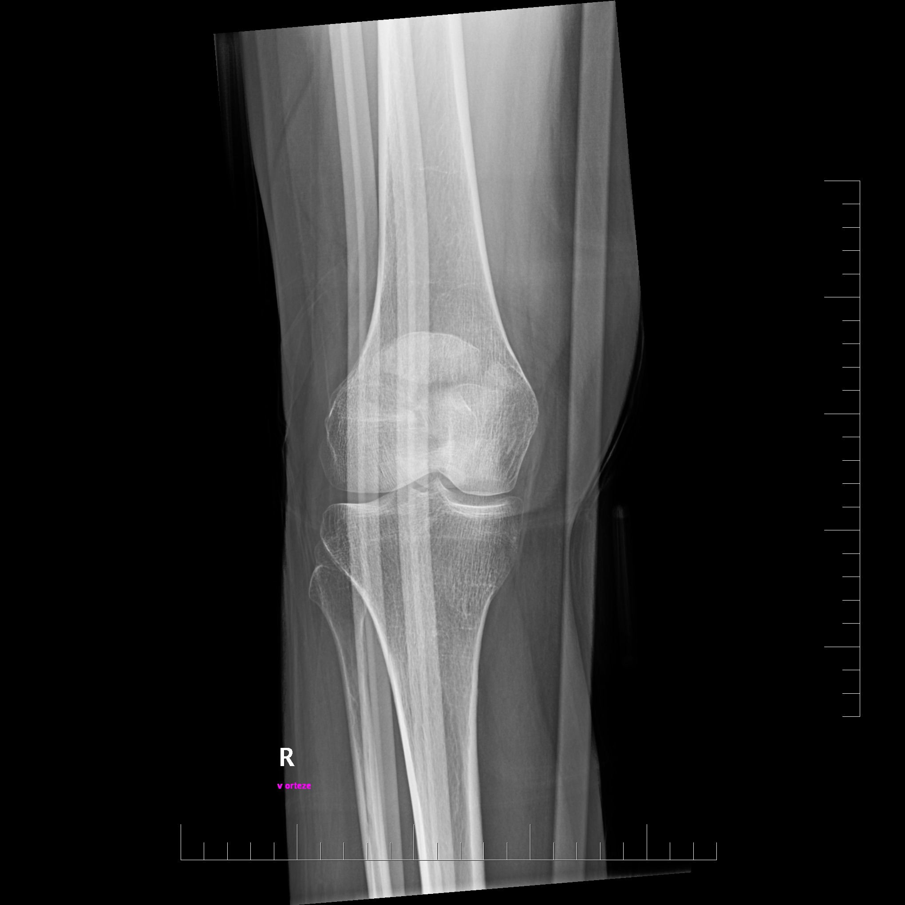

Slide 32
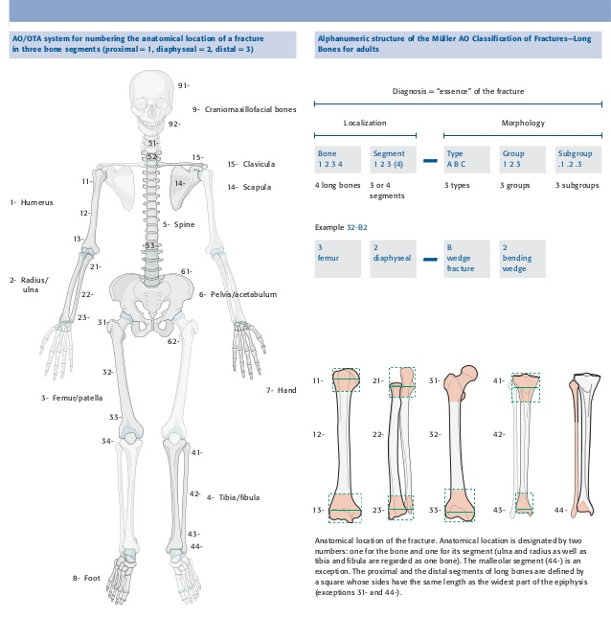
AO classification

Slide 33
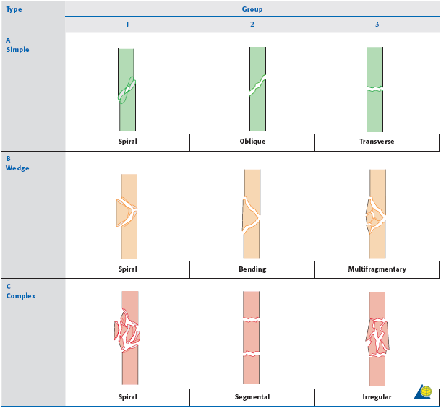
Diaphyseal fractures

Slide 34
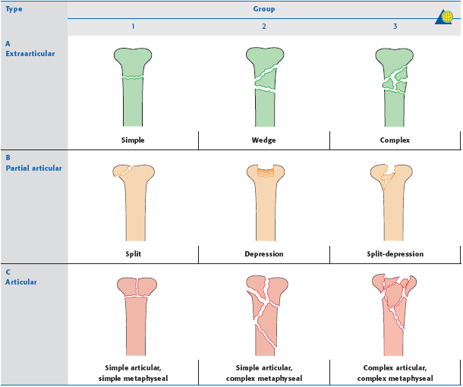
Proximal / Distal epiphysis

Slide 35
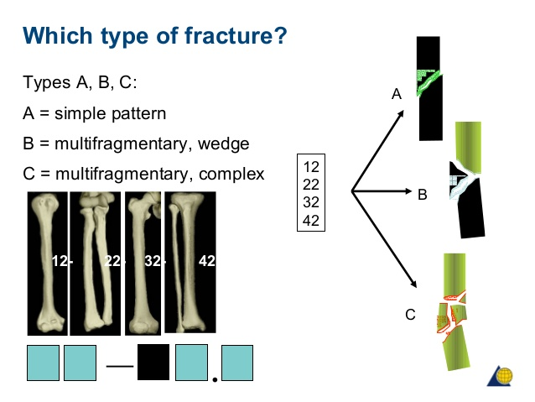

Slide 36
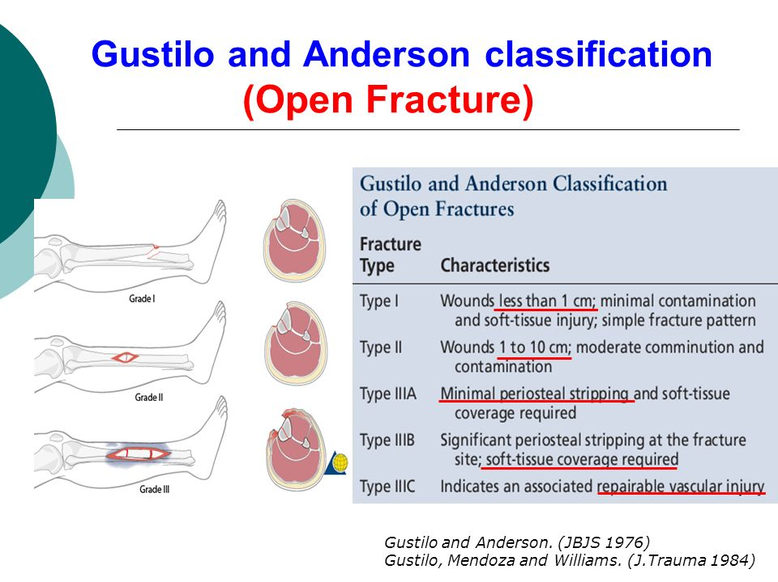

Slide 37
Structure of bones
Mineral component
  Hydroxyapatite (Ca5(PO4)3(OH))
  strength, stiffness, and rigidity characteristic of bone
Organic component
  primarily type I collagen
  tensile strength and resiliency
Cortical / cancellous bone
Periosteum
  vascular supply - leading role for fracture healing !

Slide 38
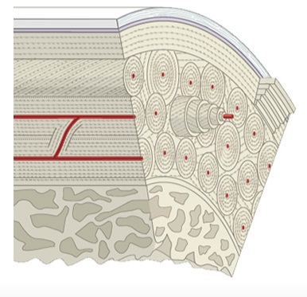
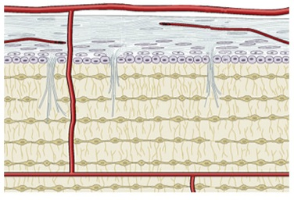
Microanatomy of the bone

Slide 39
Bone healing
Primary (direct) bone healing
  anatomic reposition and stable fixation
  by direct osteonal remodeling,
  no or minimal callus formation
  need more time to heal strong
Secondary (indirect) bone healing
  Physiological respond of a bone to fracture
  Sequence of bone healing
    Hematoma callus
      day 1-5
    Gelatinous callus day
      day 5-10
    Granulation callus
      day 10-15
    Endochondral ossification
      day 15-21
    Remodeling
      day 21-

Slide 40
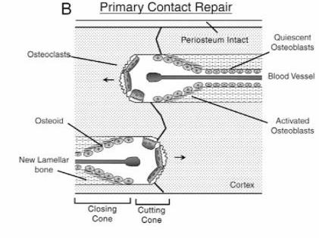
Primary bone healing – contact/direct

Slide 41
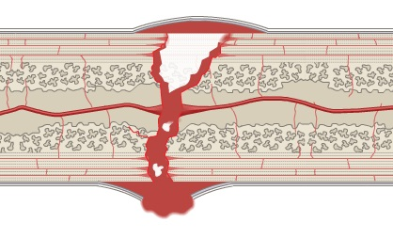
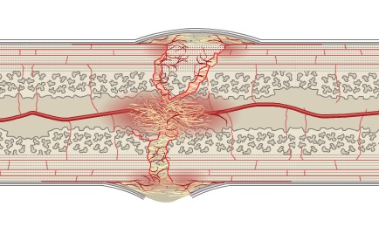
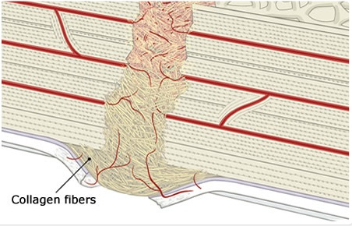
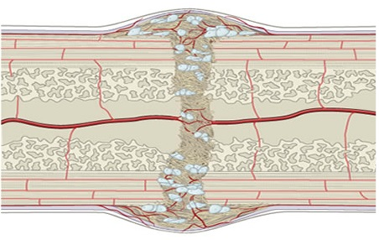
Secondary bone healing – gap/indirect

Slide 42
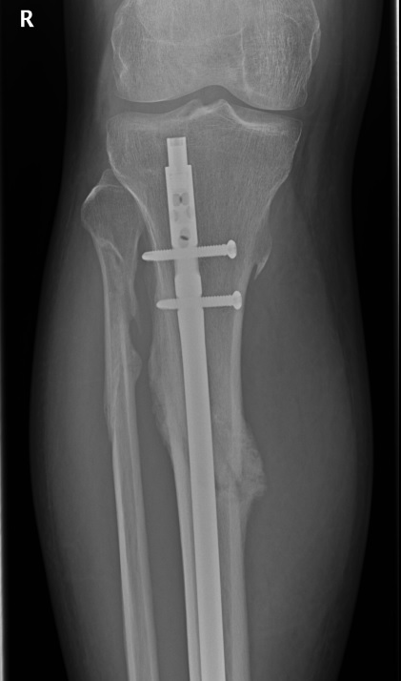
Indirect bone healing

Slide 43
Diagnostic approach
Anamnesis
Physical exam
  definite x possible signs of fracture
X-ray
  at least 2 projections in perpendicular plane
  special projections (Judet, Drasnar...)
Ultrasound
  including FAST
CT
  Intraarticular fractures
  Cranial, spine, pelvic fractures
  Doubts on X-ray…
MRI
  rarely in acute stage

Slide 44
Fracture management
(in general)
Reposition
  Closed x Open
Retention
  Plaster
  Internal fixation
  External fixation
Rehabilitation

Slide 45
Fracture management
Conservative treatment
  undisplaced or minimally displaced stable fractures, incomplete fractures
  stable fractures after proper reposition and fixation
  (most) pediatric fractures
  contraindication of anesthesia and surgery
Osteosynthesis
  displaced fractures
  unstable fractures
  (most) intra-articular fractures
  open fractures

Slide 46
Principles of osteosynthesis
Absolute stability
  Primary bone healing process
  Anatomic reposition, interfragmentary compression, minimal motion
      Lag screw
      Tension band
      Compression plate
Relative stability
  Secondary bone healing process
  Allows small degrees of motion between the fragments
      Intramedullary nails
      Bridge plateing
      External fixateur

Slide 47
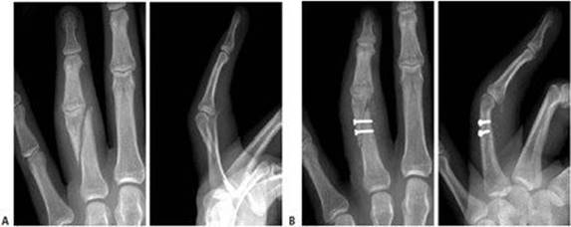
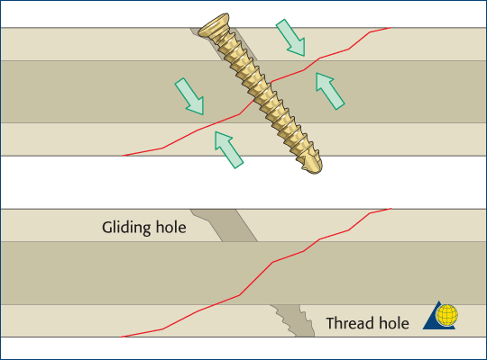
Lag screw

Slide 48
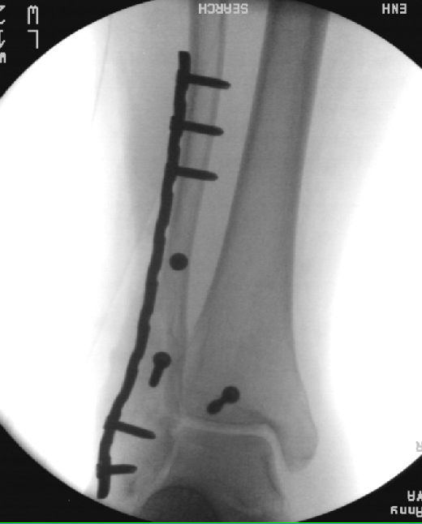
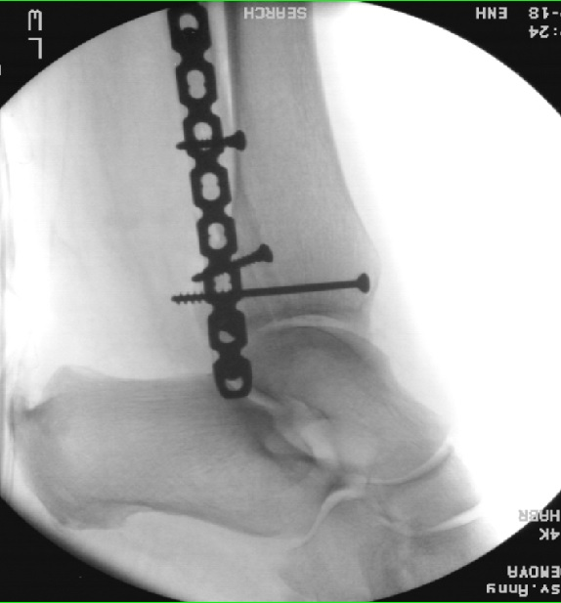
Absolute stability

Slide 49
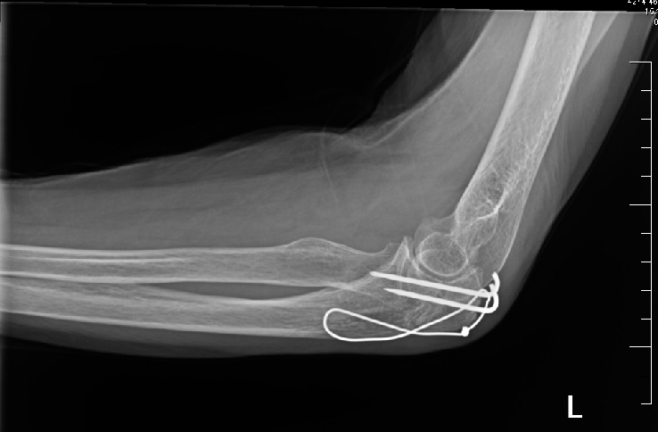

Slide 50
Relative stability

Slide 51
Complications of bone healing
Prolonged healing, pseudoarthrosis (“non-union”)
Aseptic necrosis
Infection (osteomyelitis)
Secondary dislocation

Slide 52
Open fractures
Direct communication with external environment (damaged skin integrity)
Trauma to the bone, soft tissues, risk of infection
Tscherne classification
  Ist - sharp bone fragment tear the skin from inside-out, a small wound /less the 5cm/, small soft tissue injury, low risk of infection
  IInd - traumatic injury from outside-in, contusion of soft tissure, risk of bacterial infection
  IIIrd - high energy trauma, soft tissue defects, risk of injury to large vessels and nerves, primary bacterial contamination
  IVth - devastating injury, subtotal amputation, vessel and nerves injury, ischemia, bacterial contamination

Slide 53
Management (basics)
Pre-hospital care
  reposition (if possible without force), sterile coverage, immobilization (vacuum splint)
ATB (broad spectrum) and TAT prophylaxis
Revision on aseptic operating room
  only 25% of open fractures are contaminated before admission
  debridement and lavage
  primary skin closer / temporary closer
Stabilisation and fixation (Tscherne I,II - OS, external fixator)
Rehabilitation
(Reconstructive surgery)

Slide 54
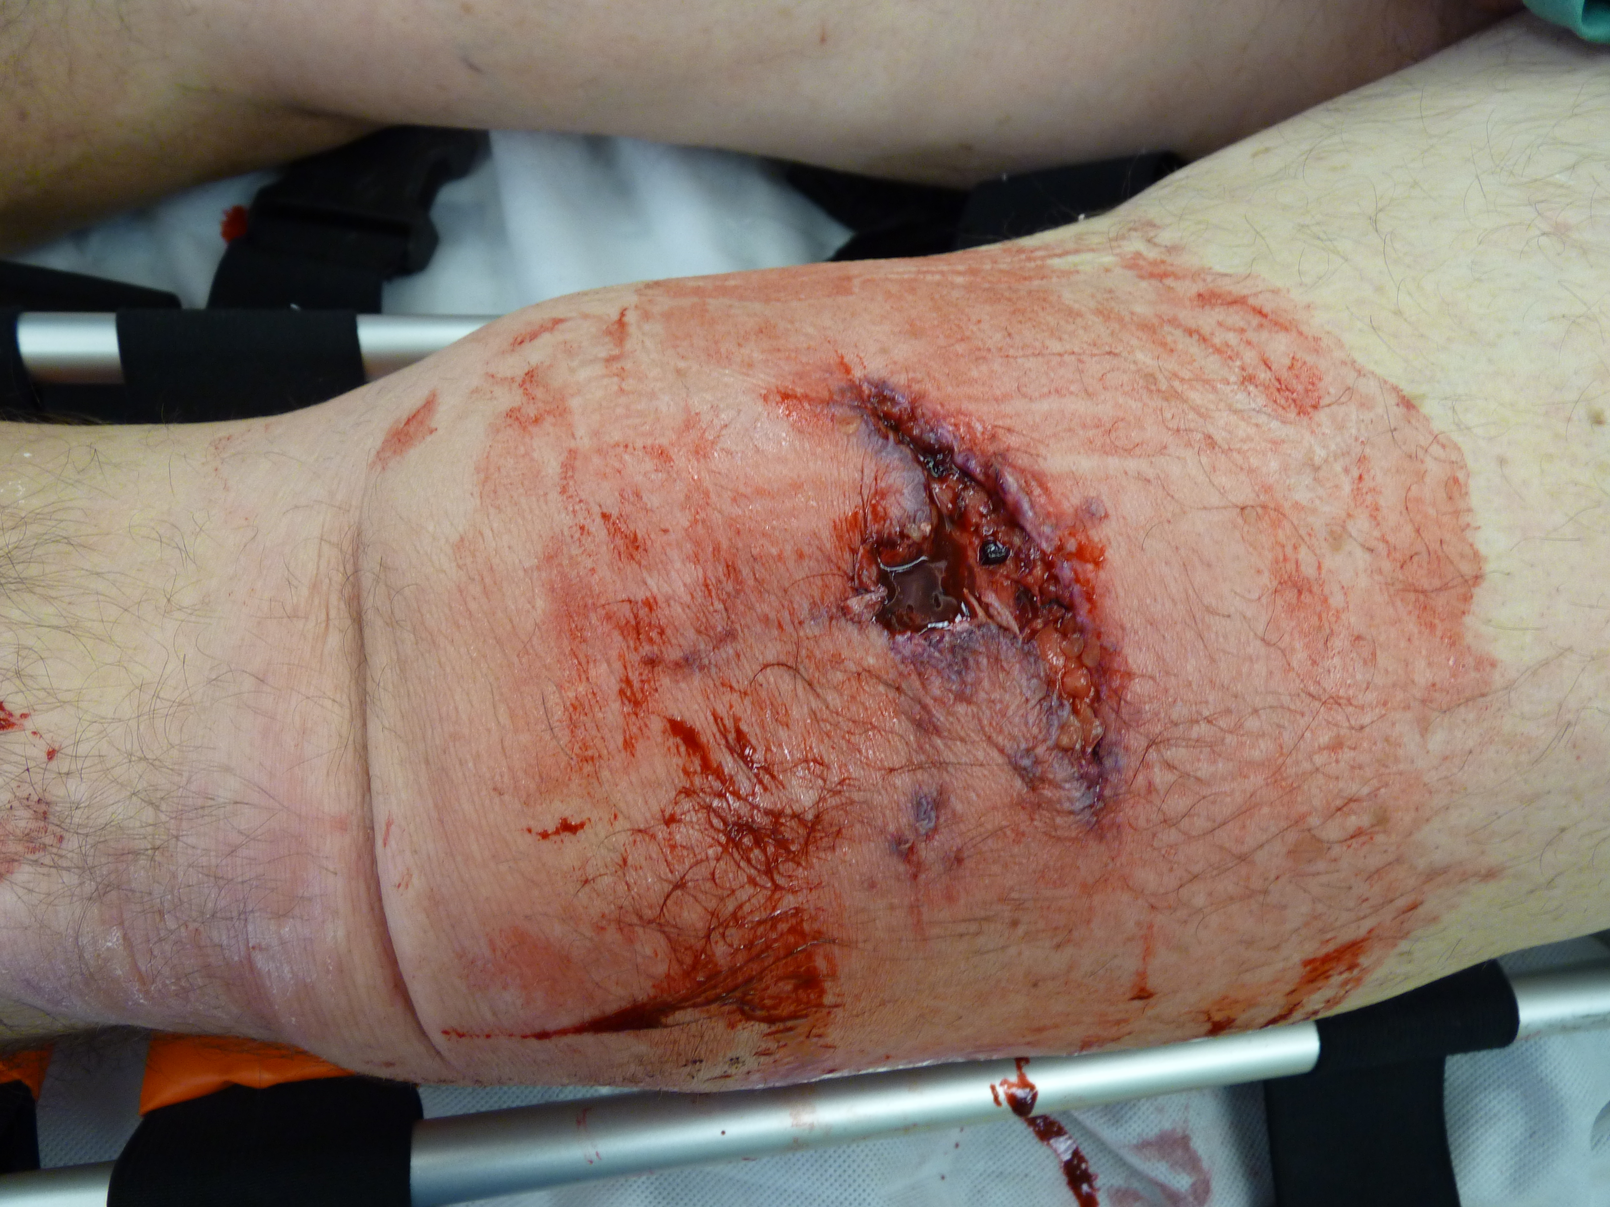

Slide 55
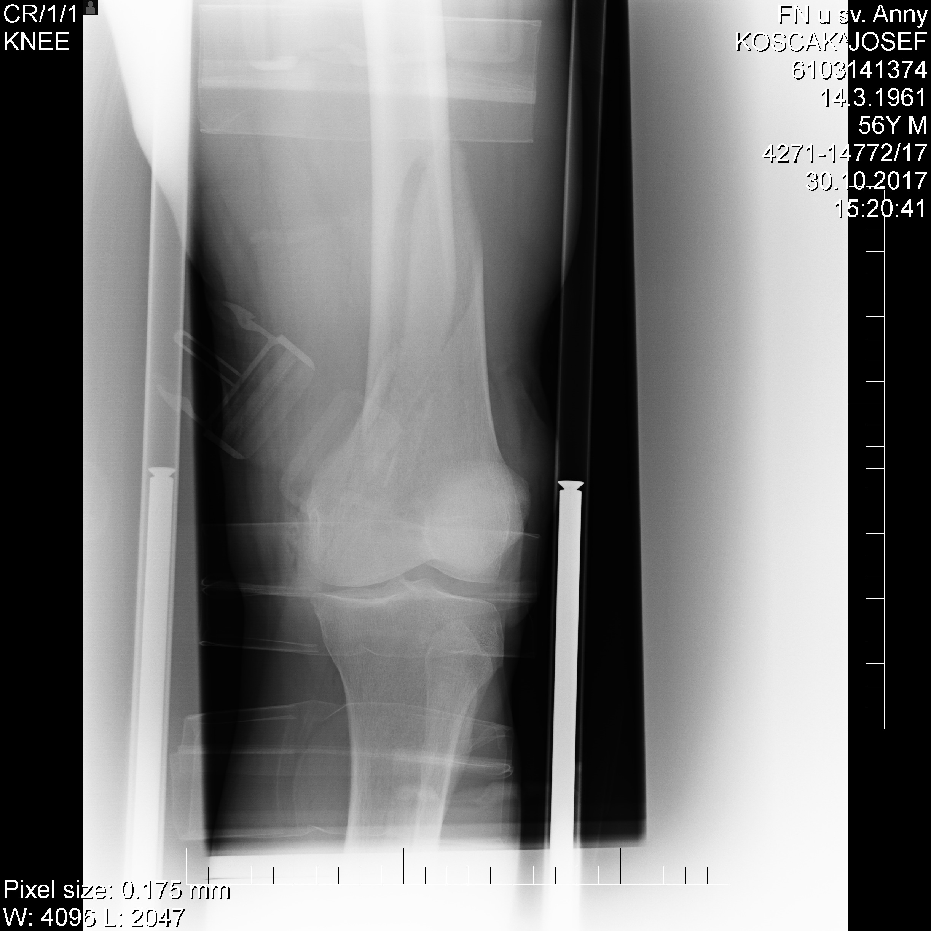
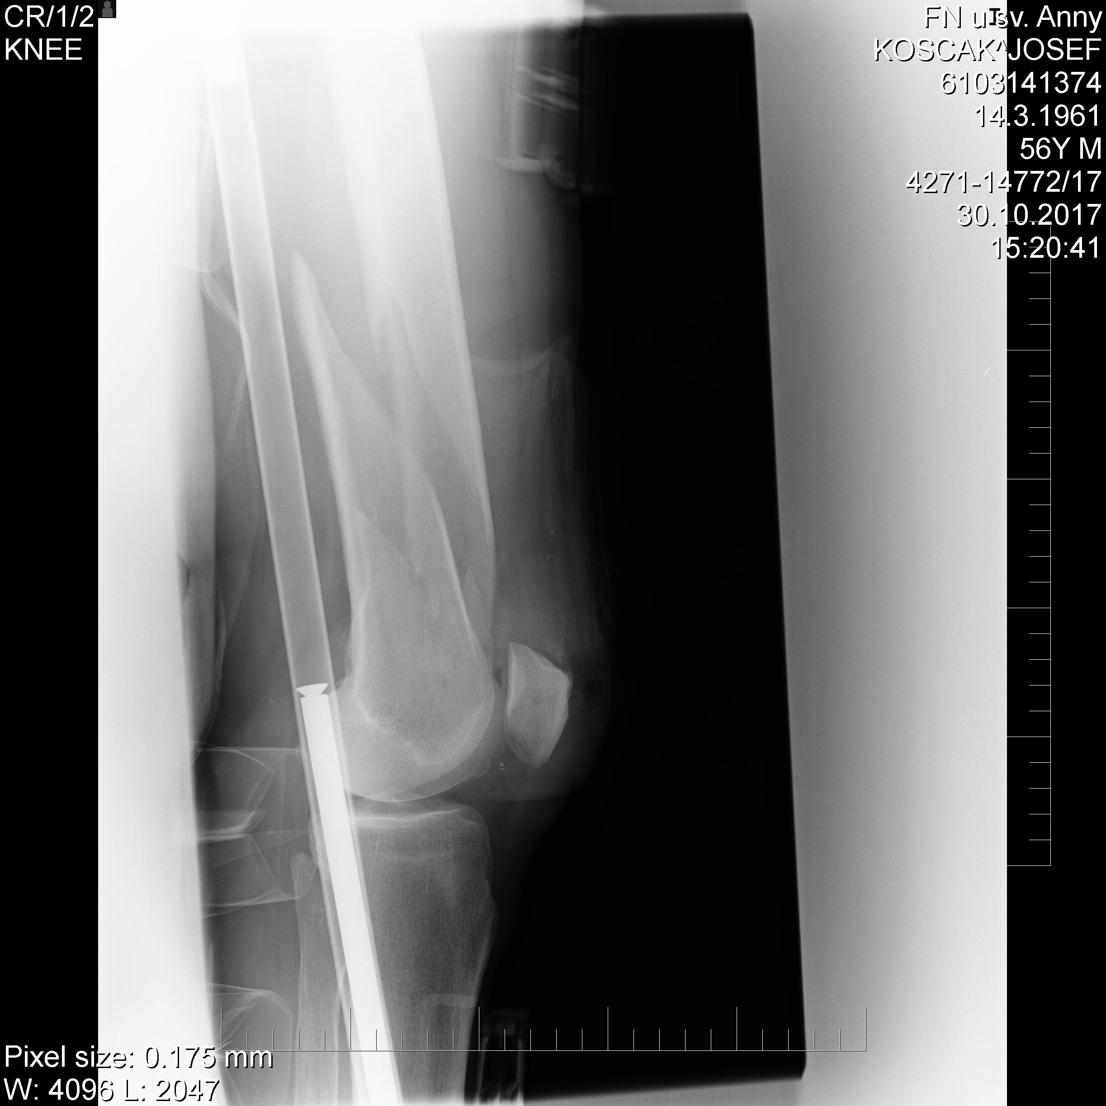

Slide 56
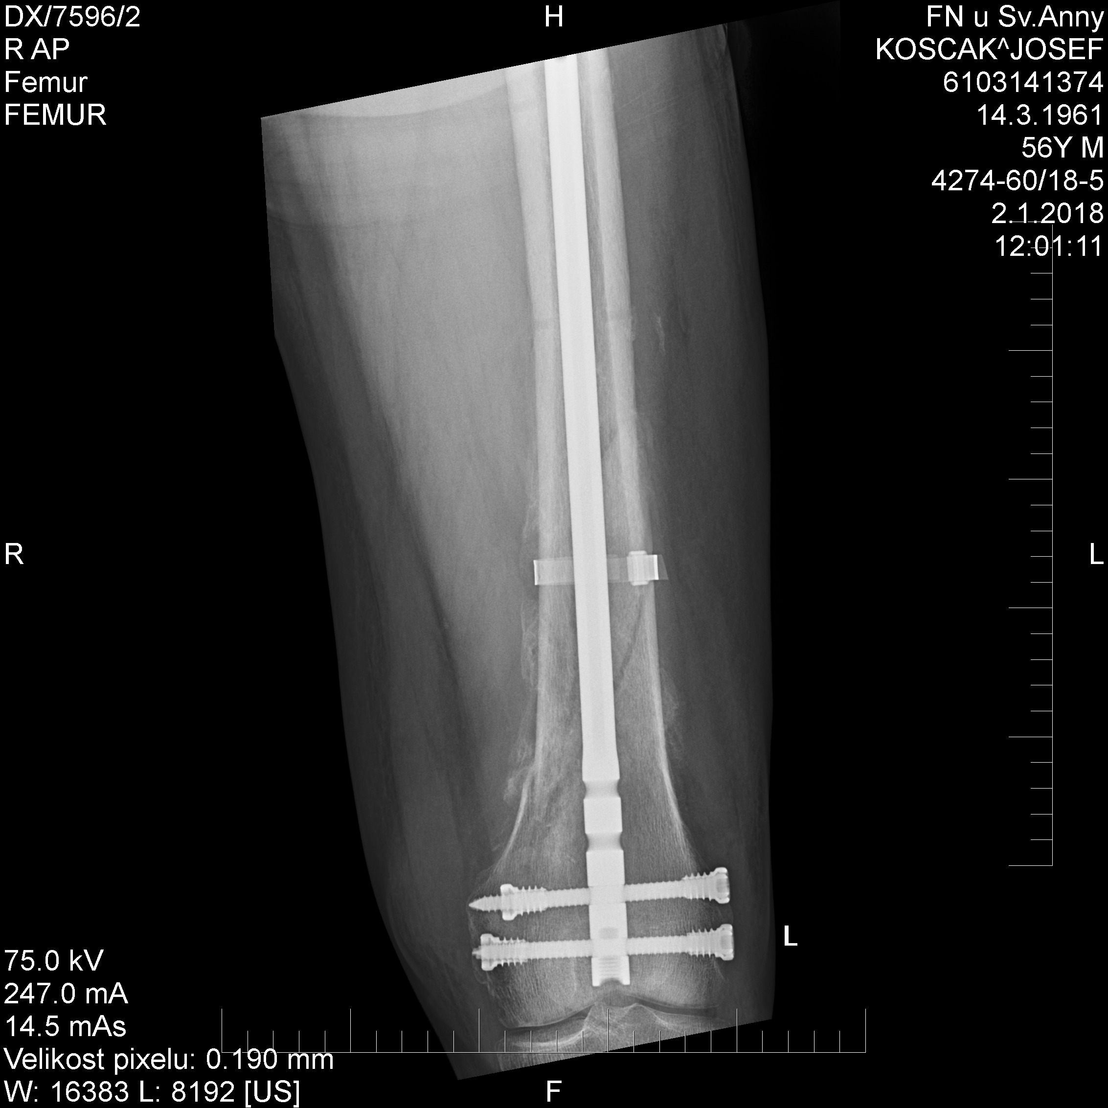
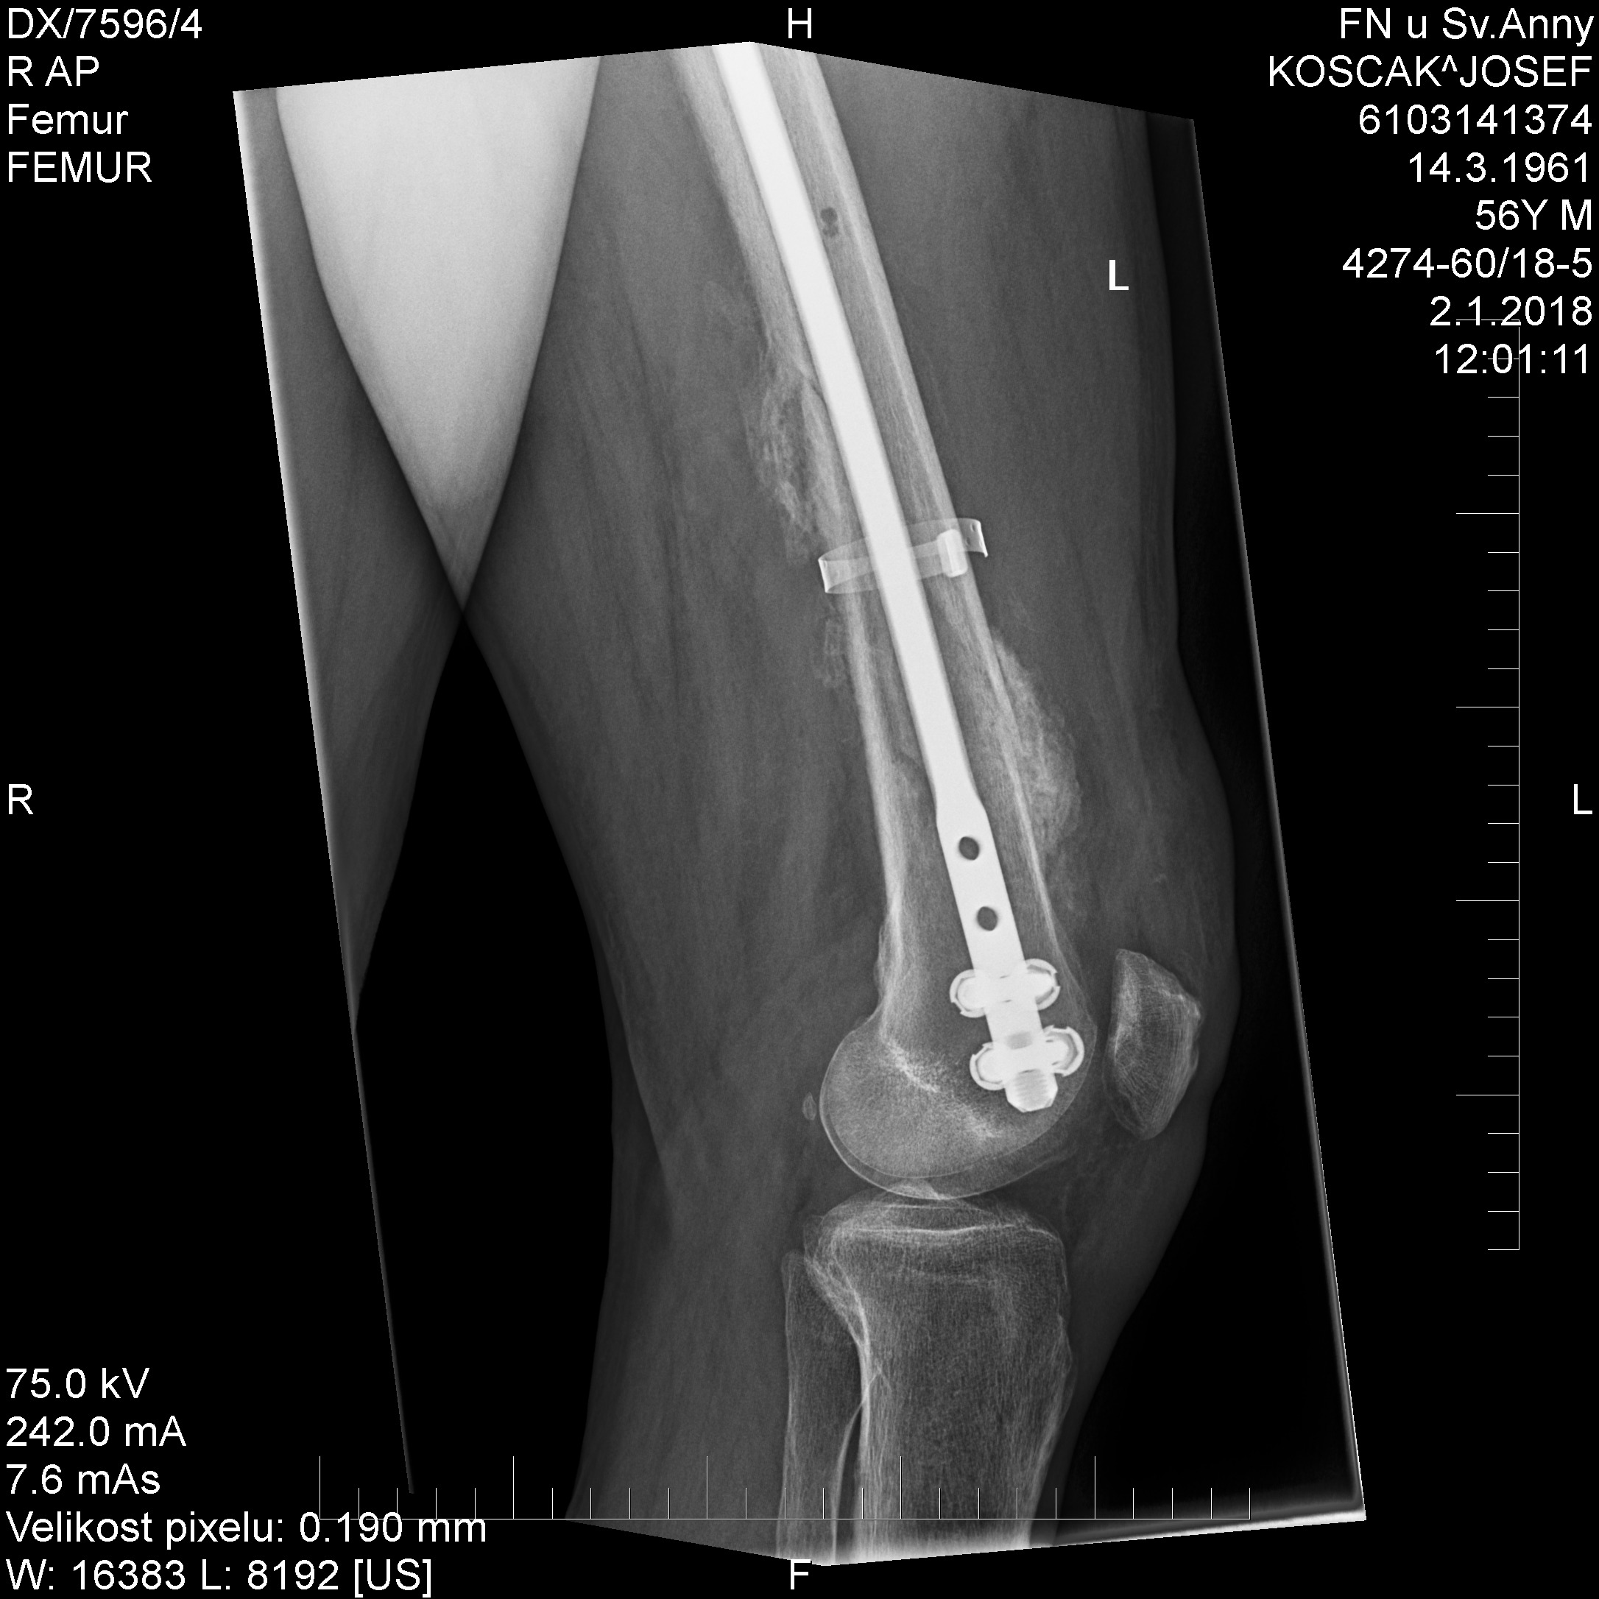

Slide 57
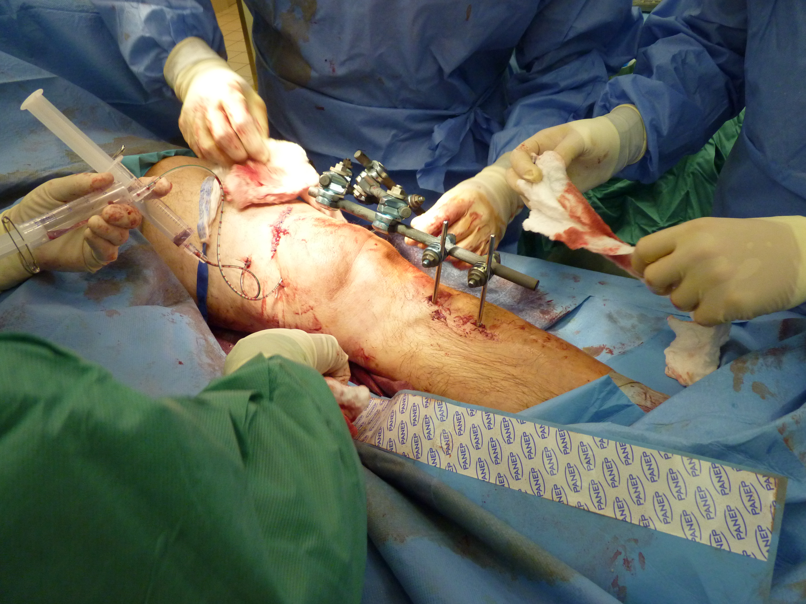

Slide 58
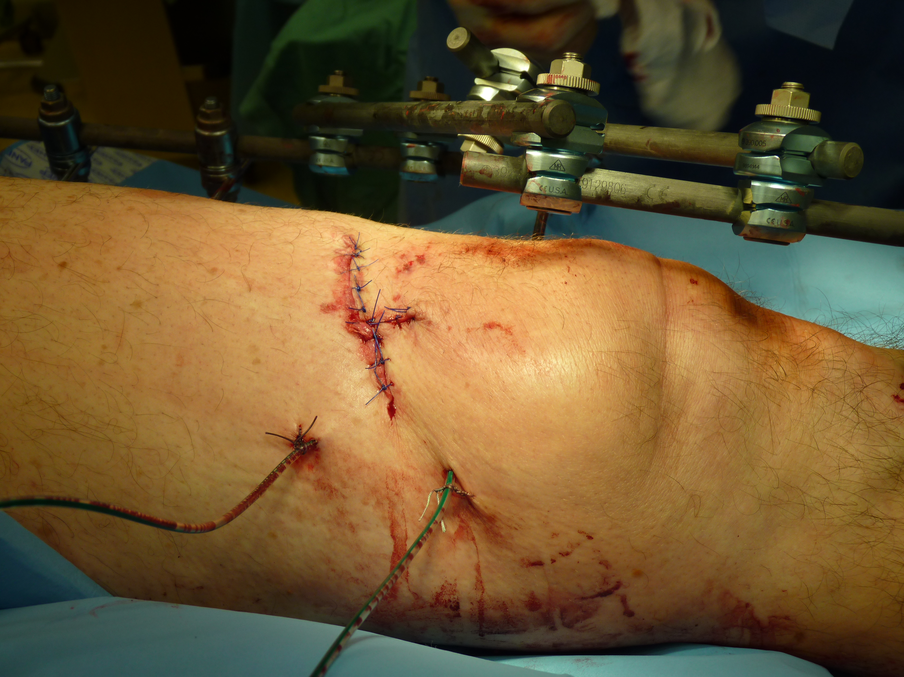

Slide 59
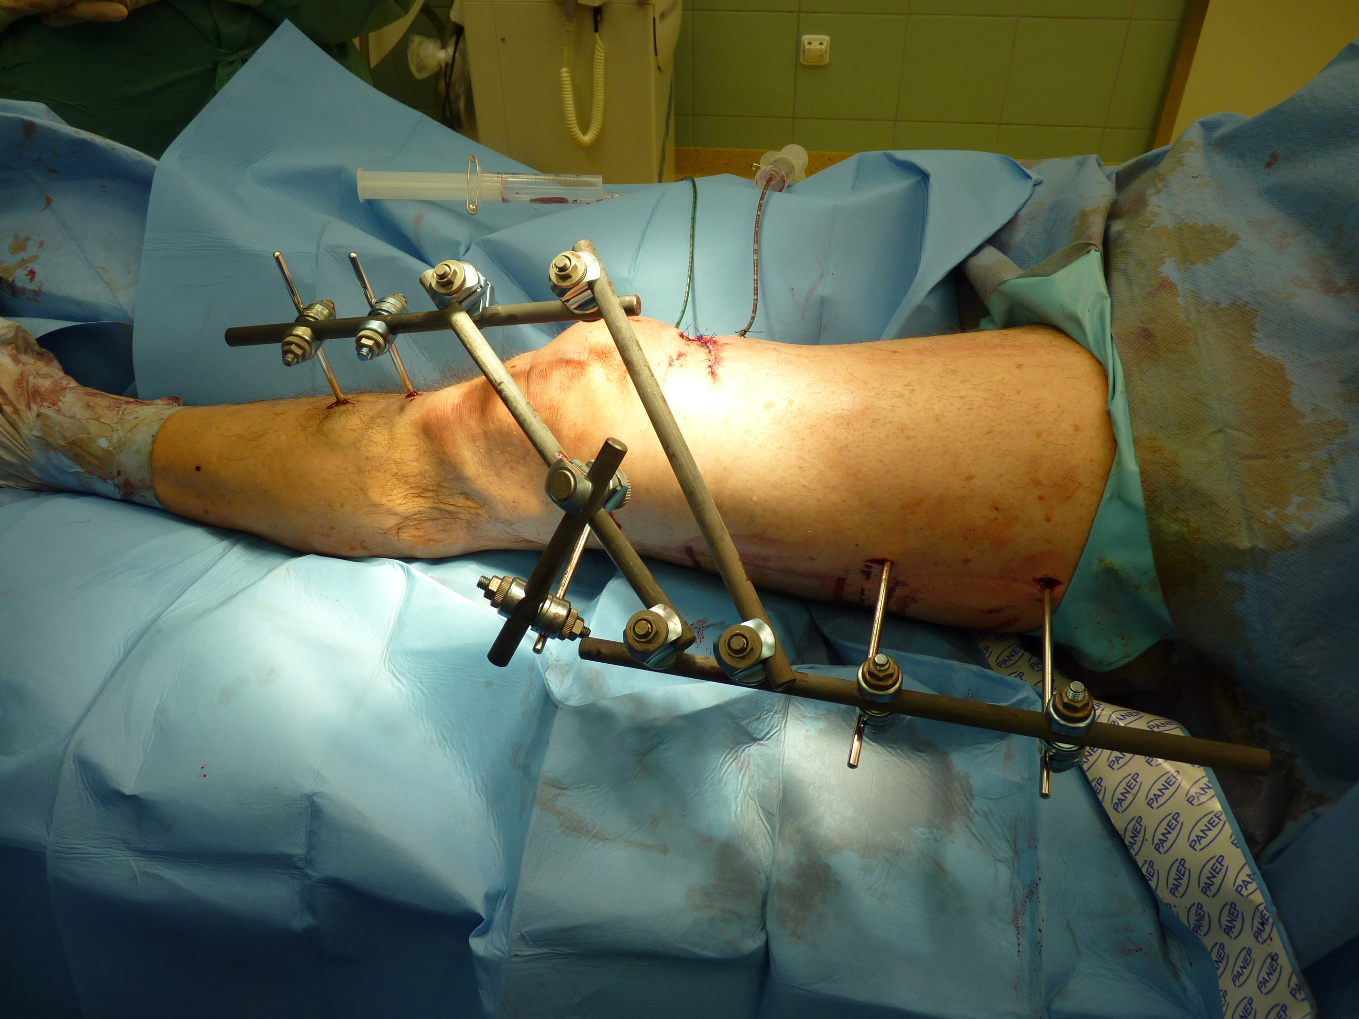

Slide 60
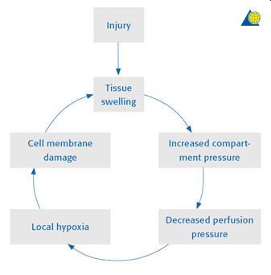
Compartment syndrome

Slide 61
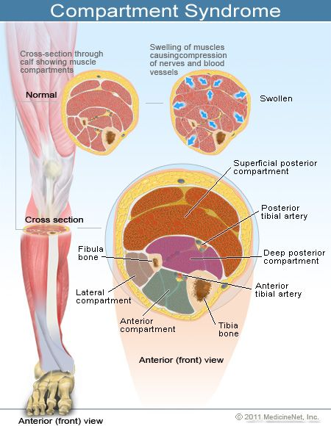
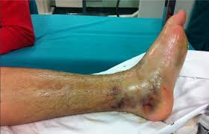

Slide 62
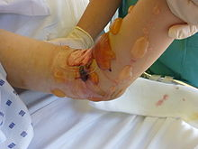
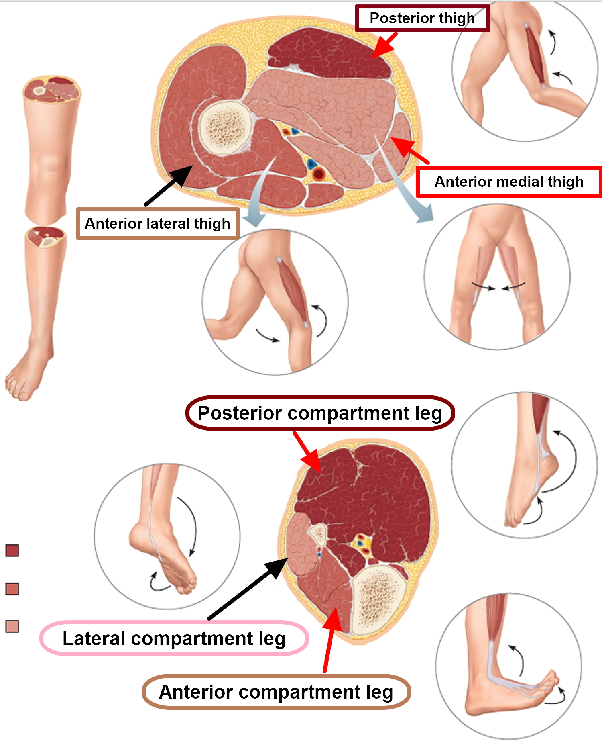
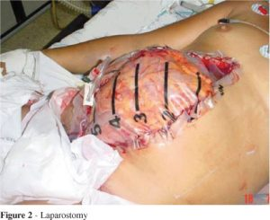
Where can you expect compartment syndrome?
Shank
Thigh
Gluteal region
Forearm
Arm
Foot
Hand
Abdominal cavity!!!

Slide 63
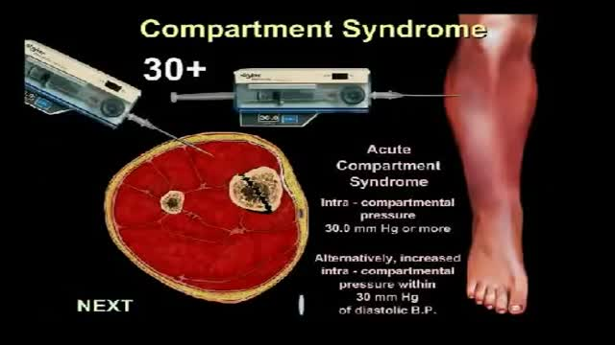

Diagnostic
Increased pain greater than expected, altrought adequate analgesia
swelling, tenderdnessblisters
Neurological disability - altered sensation, parestesia
Pulsation peripheraly intact!!!
Measurement: more than 30-35mmHg
Compartment syndrome is a clinical dg. and is not solely determined by pressure measurement!!!!

Slide 64

Treatment - fasciotomy!!! If you are concidering fasciotomy, perform it!!!
Dermatomyofasciotomy
Releasing ALL compartments
Identifying source of swelling /bleeding, necrosis/
Debridement
Covering:
- dynamic suture
- synthetic covering
- NPWT
- ….

Slide 65



Slide 66

Thank you for attention!

