Slide 1
Colour
color, oris, m. (Lat.) = chroma, chromatis, n. (Gr.)

Slide 2
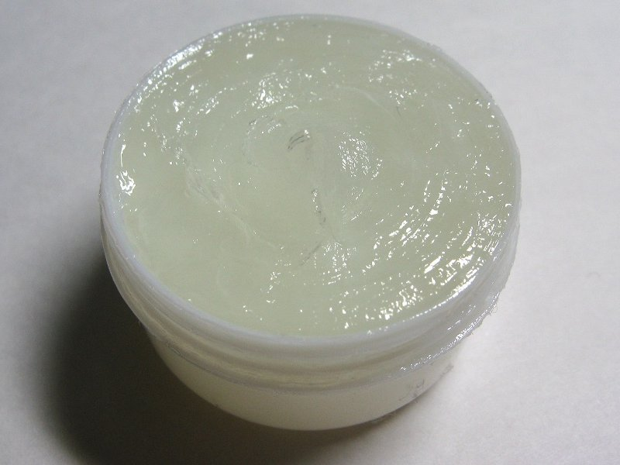
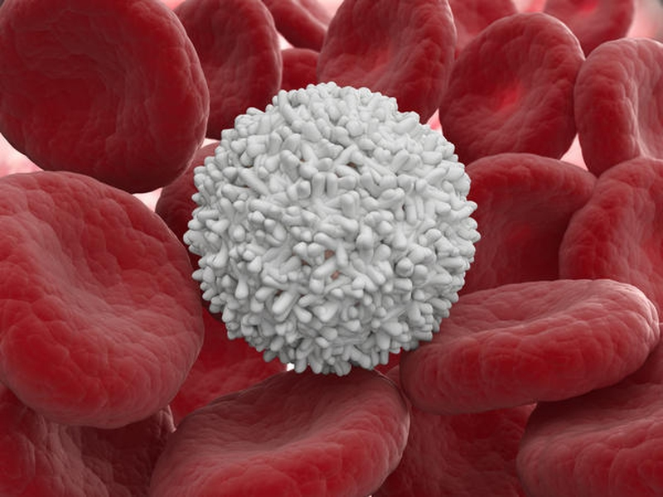
Albus, a, um (L.) = Leuko - (G.)
WHITE
Vaselinum album
White vaseline
Albinismus
Albinism
Leucocytus
Leucocytes, white blood cells

Slide 3
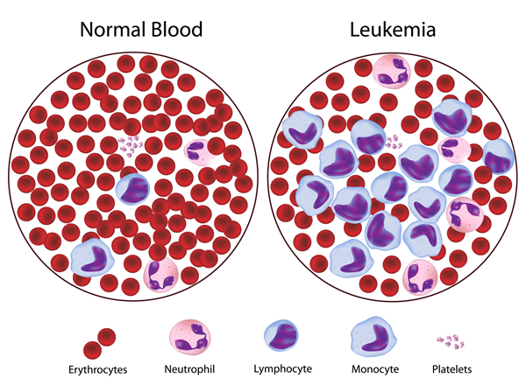
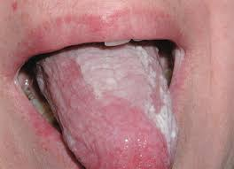
Albus, a, um (L.) = Leuko - (G.)
WHITE
Leucorrhoea
White vaginal discharge from hormonal imbalance
Leukaemia
Cancer of bone marrow that results in abnormal white blood cells
Leucoplakia
White lesion of oral mucosa

Slide 4
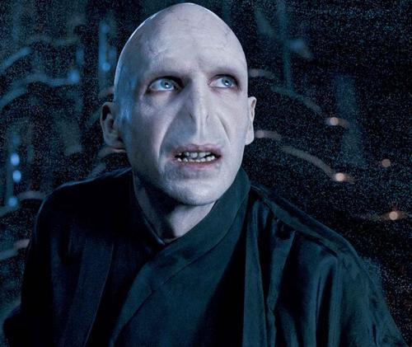
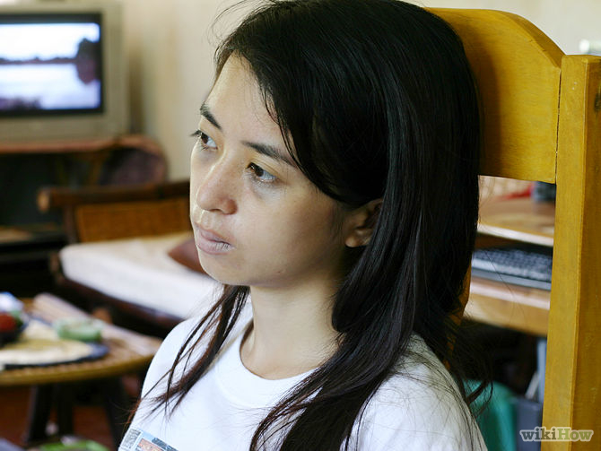
Pale
pallidus, a, um (L.)
Facies pallida
Pale face/pallor
Febris pallida
Pallor with fever

Slide 5
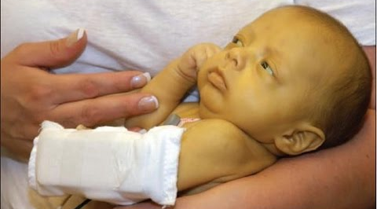
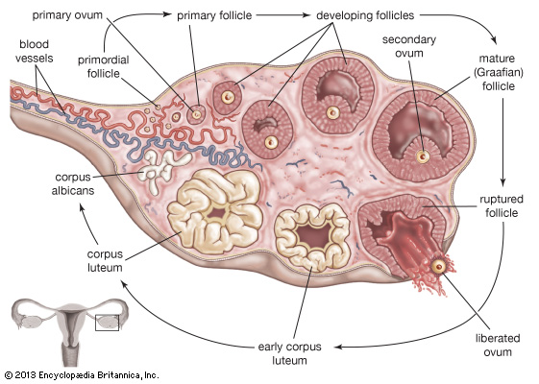
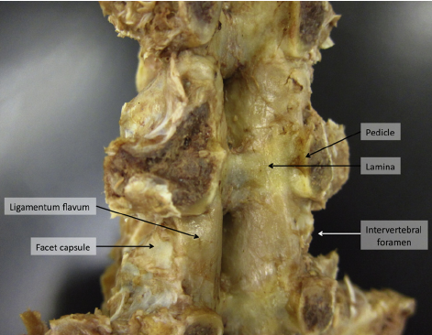
Yellow
flavus/luteus, a, um (L.) = xantho-/cirrho- (G.)
Febris flava
Yellow fever
Corpus luteum
Yellow endocrine body formed at the site of a ruptured ovarian follicle
Ligamenta flava
Ligaments of the spine

Slide 6
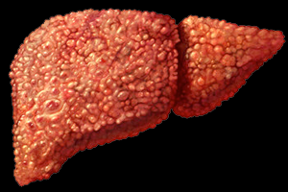
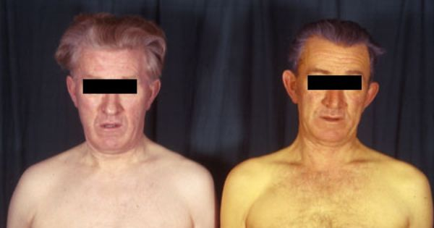
Yellow
flavus/luteus, a, um (L.) = xantho-/cirrho- (G.)
Xanthoderma
Yellowish discolouration of the skin
Cirrhosis
Scarring of the liver

Slide 7
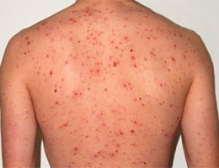
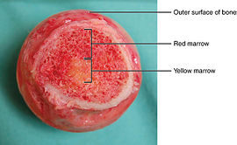
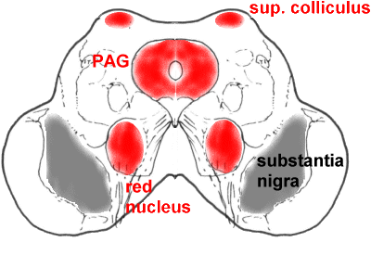
Red
ruber, a, um (L.) = erythro- (G.)
Medulla ossium rubra
Red bone marrow
Nucleus ruber
Red nucleus
Rubeola
The ordinary measles

Slide 8
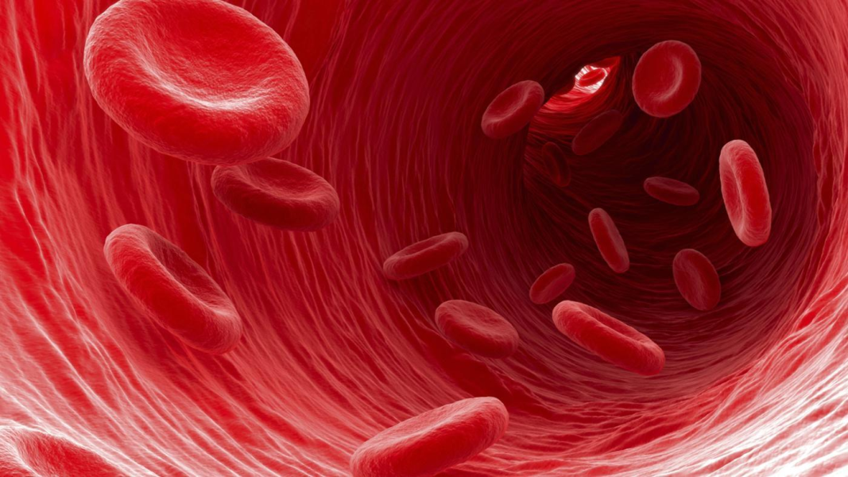
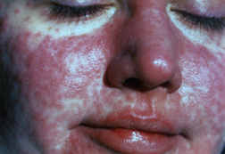
Red
ruber, a, um (L.) = erythro- (G.)
Erythrocytus
Red blood cells
Erythroderma
Redding of the skin due to inflammatory skin disease

Slide 9
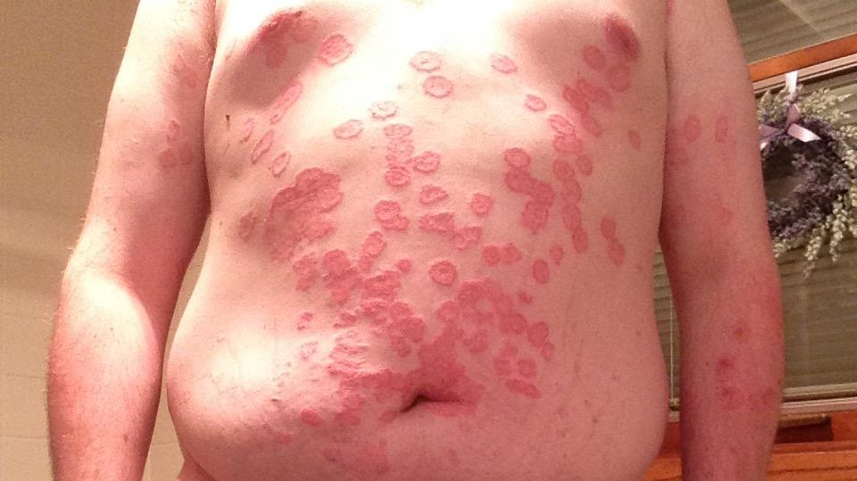
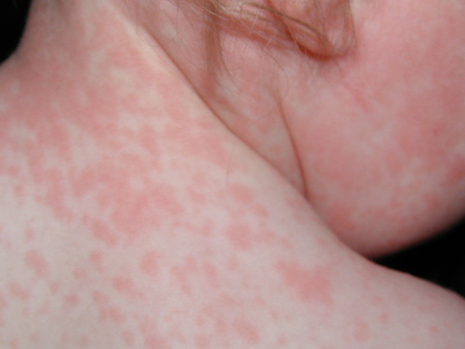
pink
roseus, a, um (L.)
Pithyriasis rosea
A benign rash
Roseola
A viral illness with a rash following a fever

Slide 10
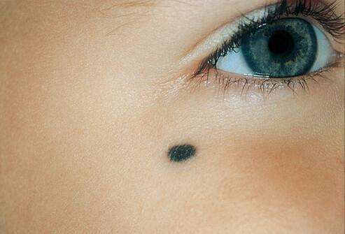
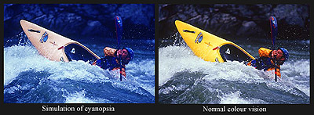
Blue/blue-black
caeruleus, a, um (L.) = cyano- (G.)
Naevus caeruleus
A blue nevus, an unusual harmless mole
Cyanopsia
Blue vision

Slide 11
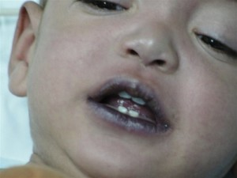
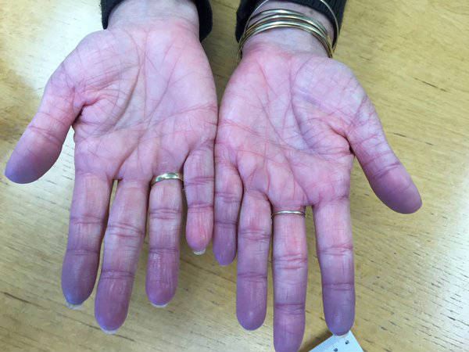
Blue/blue-black
caeruleus, a, um (L.) = cyano- (G.)
Cyanosis
Bluish discolouration
Cyanoticus
Cyanotic

Slide 12
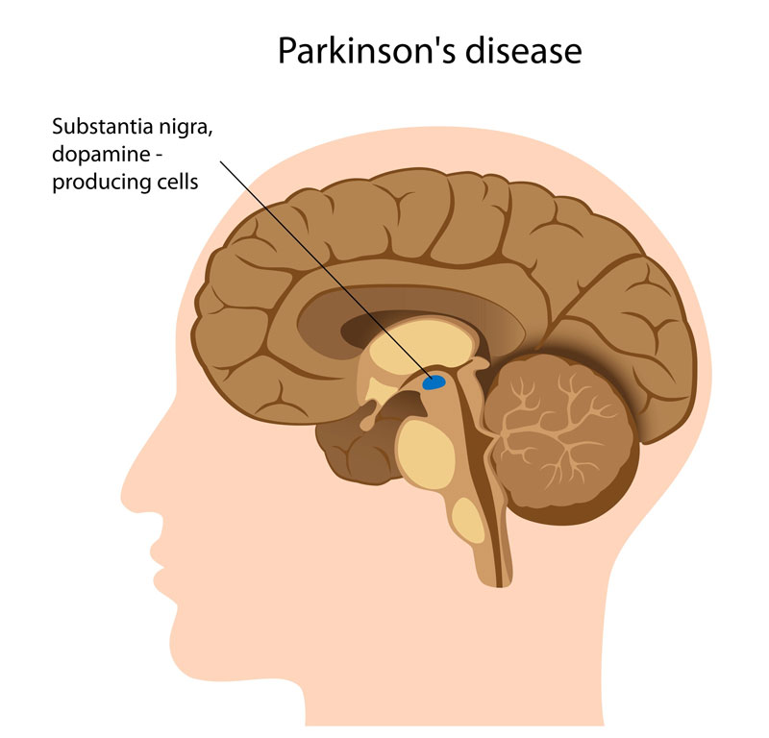
Black-1
niger, a, um (L.)
= melano-/anthraco- (G.)
Lingua villosa nigra
= Black hairy tongue
a condition of the tongue where the filiform papillae elongate with black or brown discoloration
Substantia nigra
a large nucleus in midbrain

Slide 13
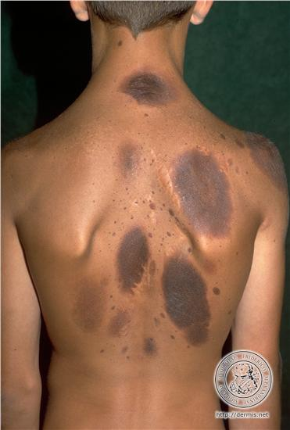
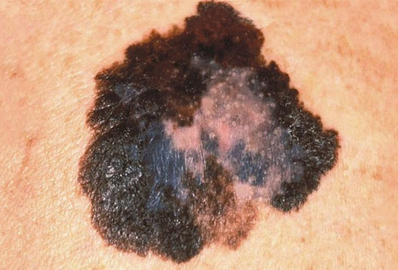
Black-2
niger, a, um (L.) =
melano-/anthraco- (G.)
Melanoma
a type of cancer that appers as a dark spot or tumor on the skin
Melanosis
a form of hyperpigmentation associated with increased melanin

Slide 14
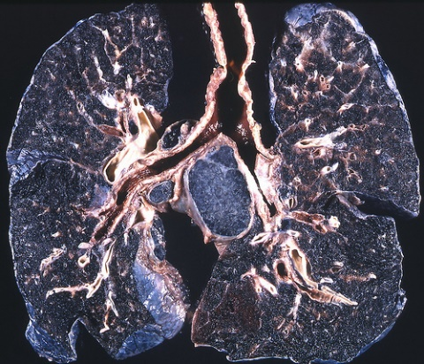
Black-3
niger, a, um (L.) =
melano-/anthraco- (G.)
Anthracosis
pneumoconiosis from accumulation of carbon from inhaled smoke or coal dust in the lungs

Slide 15
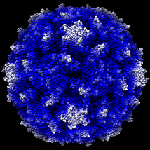
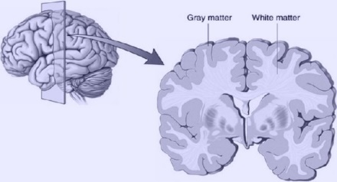
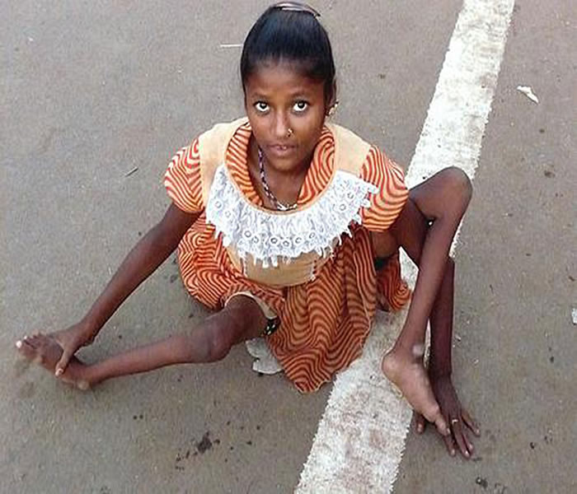
Grey
griseus, a, um (L.)
= polio- (G.)
Poliomyelitis
=Polio, Infantile paralysis
Poliovirus
Substantia grisea
= Gray matter

Slide 16
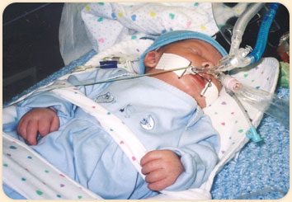
lividus, a, um (L.)
Livid, discoloured, bluish
Asphyxia livida
= Blue asphyxia
an abnormal condition in which a newborn’s skin is cyanotic, the pulse is weak and slow, and the reflexes are slow or absent

Slide 17
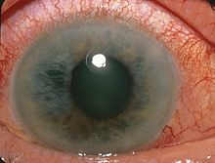
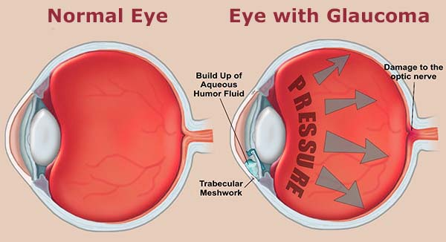
Green-Blue
glauco- (G. ~ chloro-)
Glaucoma
an eye disease that causes gradual loss of sight

Slide 18
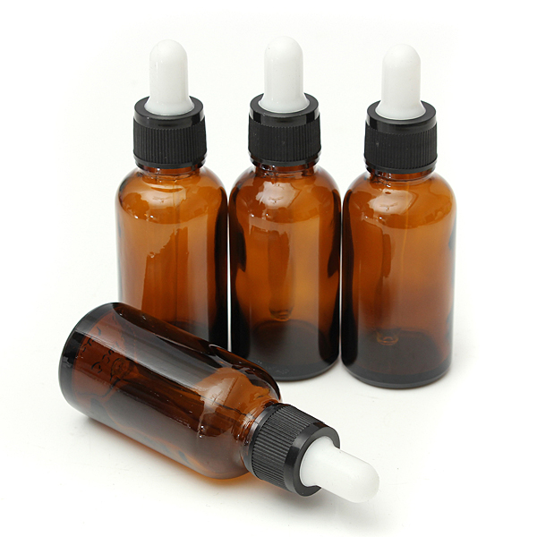
Dark Brown
fuscus, a, um
Lagoena fusca
= Dark brown bottle

Slide 19
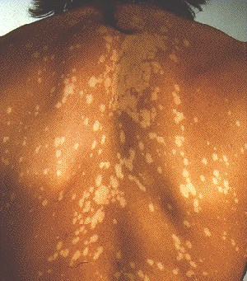
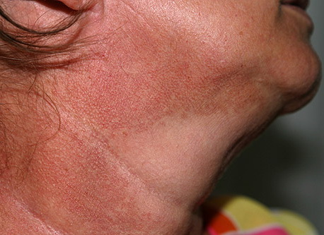
versicolor, oris (L.)
= poikilo- (G.)
Vari-coloured
Poikiloderma
a skin condition that consists of areas of hypopigmentation, hyperpigmentation, telangiectasias and atrophy
Pithyriasis versicolor
=Tinea versicolor
a common yeast infection of the skin, in which flaky discoloured patches appear on the chest and back

Slide 20
questions
What is the Latin word for blue/ blue-black?
What is the yellow endocrine body in the ovary called?
What does "griseus" mean?
Where is substantia nigra located?

