Slide 1

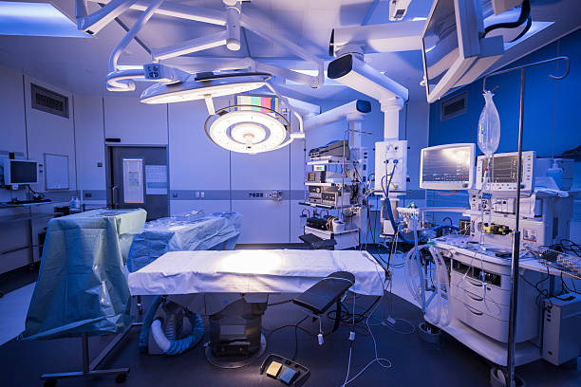
DEATH
By Carolina and Somuto
Study group: 33

Slide 2
WHAT TERMS DO YOU KNOW EXPRESS DEATH?

Slide 3
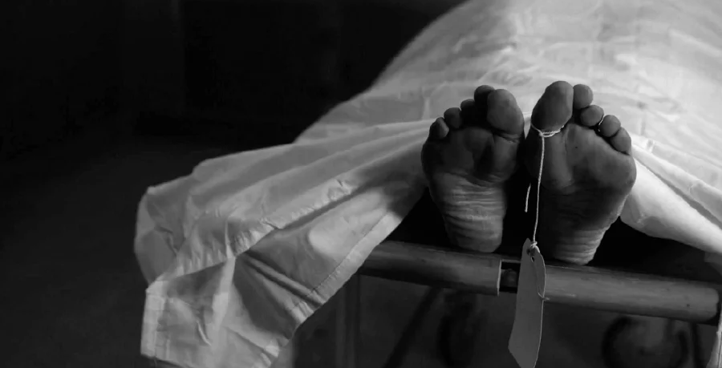
Different terms expressing death
Mors, Mortis , F
Used in Pathological Anatomy
Exitus, Exitus, F
Used in Clinical Anatomy

Slide 4
Different terms expressing death
Moribundus, a, um = the one who is going to die, dying man
Mortuus, a, um = dead

Slide 5
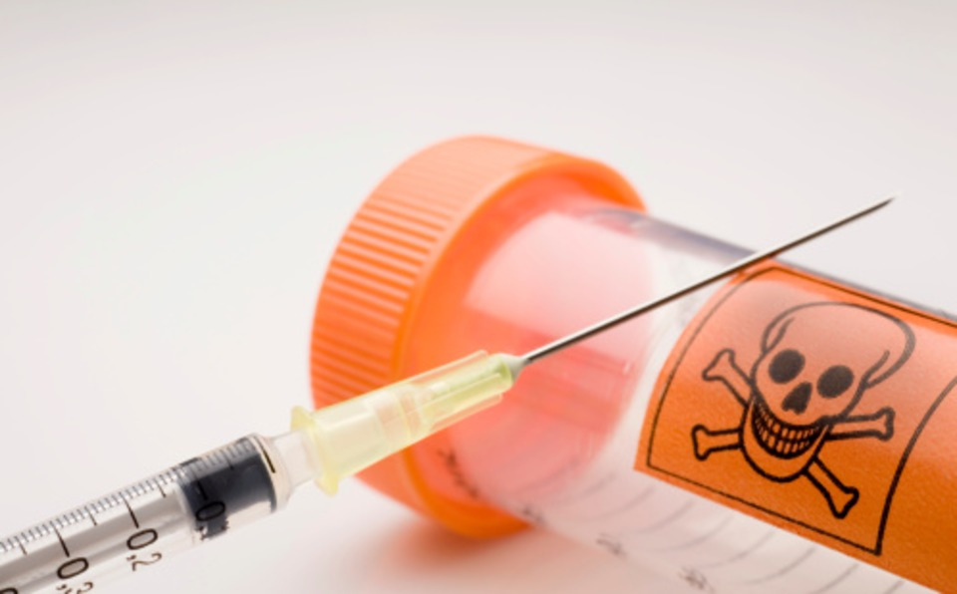
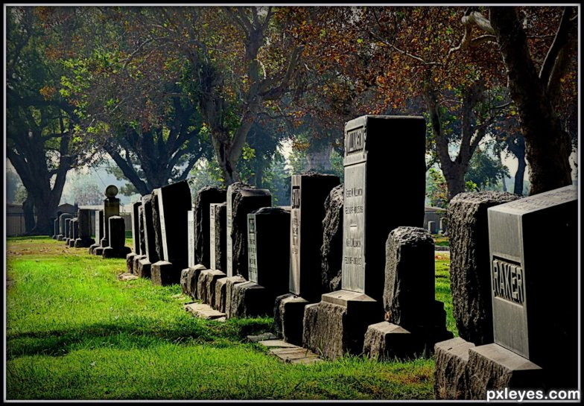
Different terms expressing death
Finis, Finis, m
The End
Letalis, e / Mortalis, e (Latin)
Lethal

Slide 6
Expressing Death Using Stems
-cide - (Latin) = kill
-thanat- (Greek) = dead or death
Necro- (Greek) = Dead

Slide 7
Explain meanings of the following compounds
Electrothanasia
Death by electrocution.
Necrophila
An erotic attraction to corpses.
Euthanasia
A quiet, painless death
Aneuthanasia
A painful death
Death of most or all of the cells in an organ or tissue.
Necrosis
Thanatophobia
Fear of death

Slide 8
Match the following terms to the definitions:
Mors biologica
death of a new-born up to 10 days after birth.
Mors clinica
death on the operation table
Mors neonatalis
a permanent cellular damage resulting from lack of oxygen, which is irreversible.
Mors praenatalis
a cessation of blood circulation and breathing, which is reversible by resuscitation methods.
Mors in tabula
death of fetus before it starts breathing independently.

Slide 9
Mors subita
weak signs of life
Mors lentissima
sudden death
Vita minima
in the moment of death.
Postmortem spasm
very slow death
rare form of muscular stiffening that occurs at the moment of death and persists into the period of rigor mortis.
In articulo mortis

Slide 10
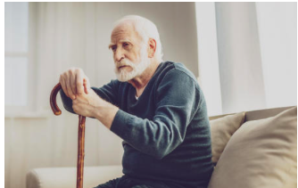
Mental confusion or disorientation
Signs of impending death
Excessive fatigue and sleep
Loss of appetite
Coolness in the tips of the fingers and toes
Increased physical weakness
Social withdrawal
Mottled veins
Changes in urination habits
Swelling in feet and ankles
Laboured breathing (Cheyne-Stokes, Death rattle)

Slide 11
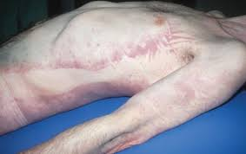
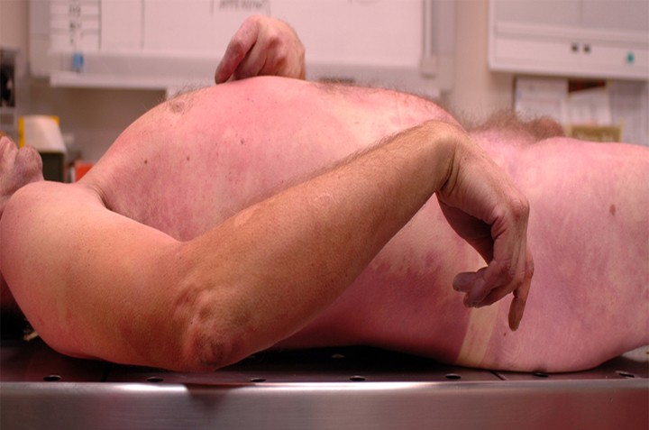
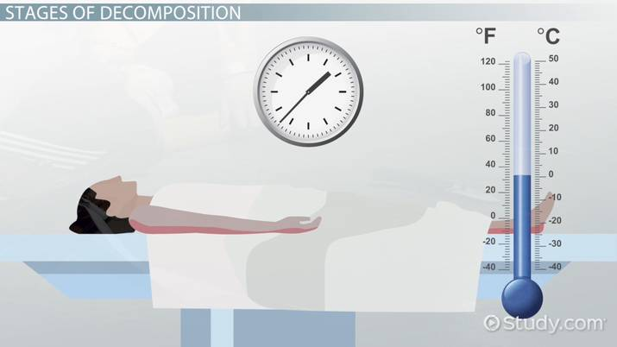
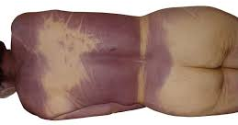
Stages of Death
Algor Mortis
The cooling of body temperature, till it reaches the room's temperature. The 2nd stage of death.
Pallor Mortis
Rigor Mortis
Paleness that occurs 15–120 minutes after death. The 1st stage of death.
Stiffening of muscles fibres after death. The 3rd stage of death.
Livor Mortis
The bluish-purple discoloration (lividity) under the skin of the lower body parts due to gravitation of blood after death. The 4th stage of death.

Slide 12
Verification of Death
Part of our duties as doctors within the hospital is to verify the death of a patient.
The procedure is as follows:
Confirm the identity of the patient – check the wrist band
General inspection – skin colour / any obvious signs of life
Look for signs of respiratory effort
Check if the patient responds to verbal stimuli
Check if the patient respond to pain? – press on fingernail / trapezius squeeze / supraorbital pressure
Assess pupils using pen torch – after death they become fixed and dilated
Feel for a central pulse – carotid artery
Auscultation: Listen for heart sounds for at least 2 minute then Listen for respiratory sounds for at least 3 minutes.
Inform family
Complete a death certificate

Slide 13
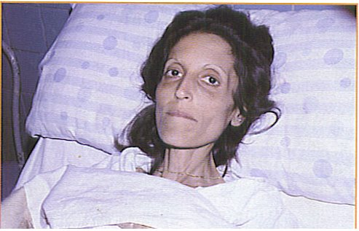
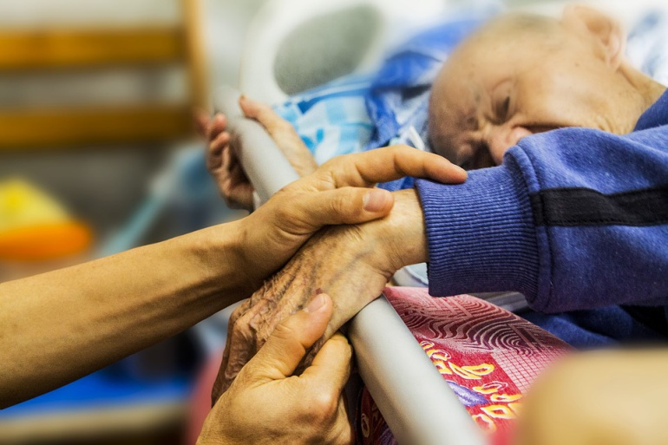
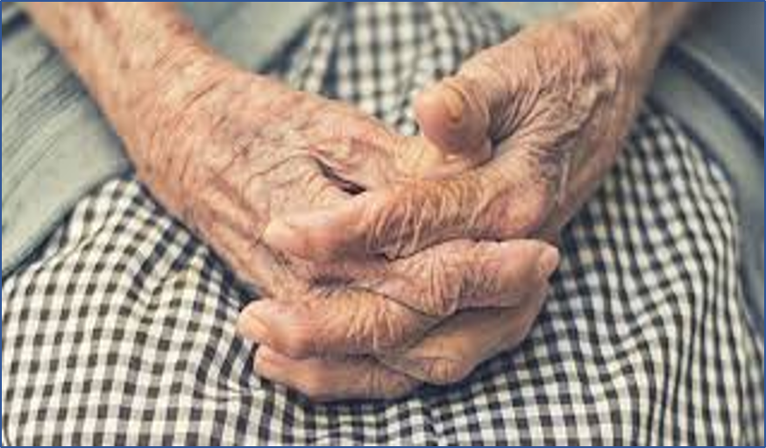

Phrases Related to Death
At the last moment of life.
Facies Hippocratica
The pallid or shrunken face of someone about to die.​
In extremis vitae momentis
Exitus Letalis
At the moment of death
Natural Death
In extremis / In Ultimis

Slide 14
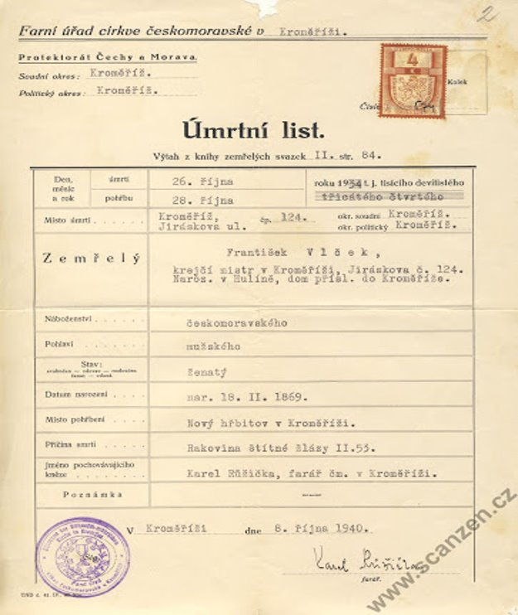
Death certificate
Czech Republic
Officially known as úmrtní list

Slide 15
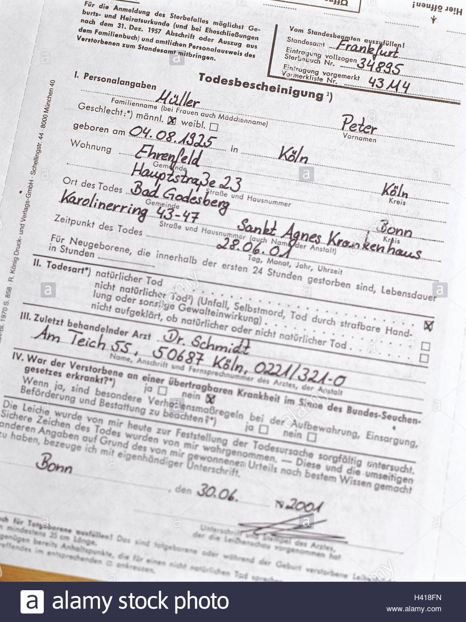
Death certificate
Germany
Officially known as Totenschein

Slide 16
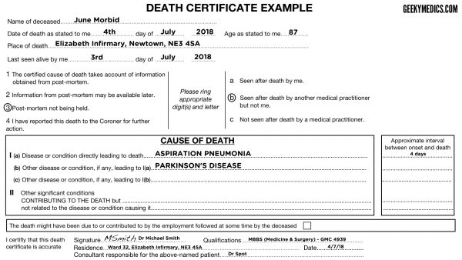
Death certificate
THE UK
Officially known as Medical Certificate of Cause of Death (MCCD)

