Slide 1
Expressing positions in medical terminology
By Denzel Gordon, Hiromasa Hideshima, Tonje Hem
March 2017

Slide 2

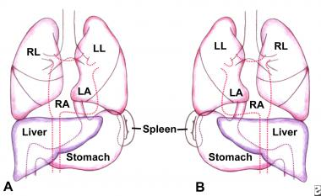
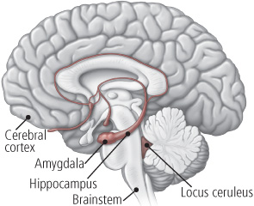
General terms
Locus, i, m. (more specific – locus caeruleus)/ Situs, us, m (more abstract – situs inversus)
topo- (Greek prefix)
e.g. topophobia = fear of a certain place or situation, e.g stage fright
Situs inversus totalis
Locus caeruleus

Slide 3
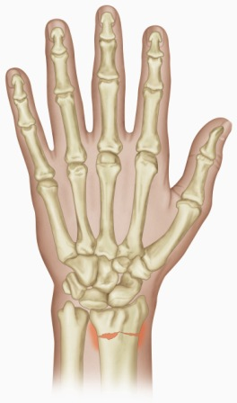
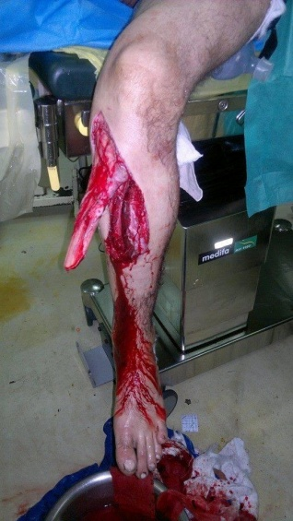
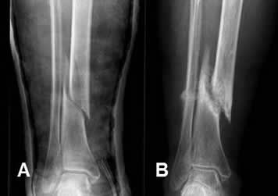
In situ = in the (afore-mentioned) place
Loco typico = in the typical place (where it is usual to get an injury)
Fractura tibiae in situ
Fractura radii loco typico

Slide 4
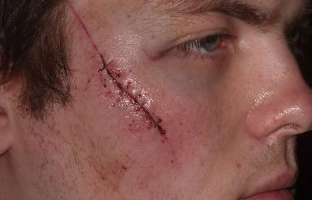
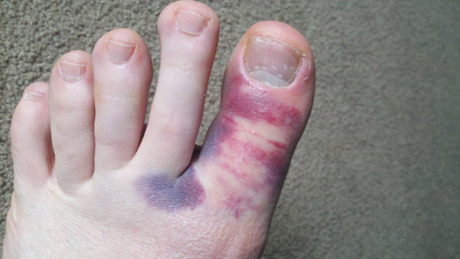
Loco cicatricis = in the place of the scar (cicatrix, icis, f = scar)
Eodem loco = in the same place
Curatio loco cicatricis
Fractura hallucis et contusio eodem loco

Slide 5
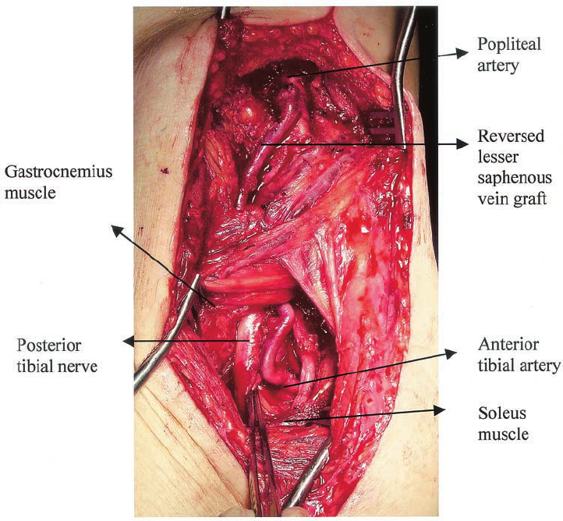
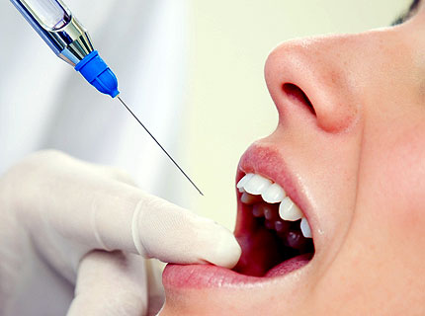
Localis, e = local
Positio, onis, f = position, location
Anaesthesia localis
Positio arteriae popliteae

Slide 6
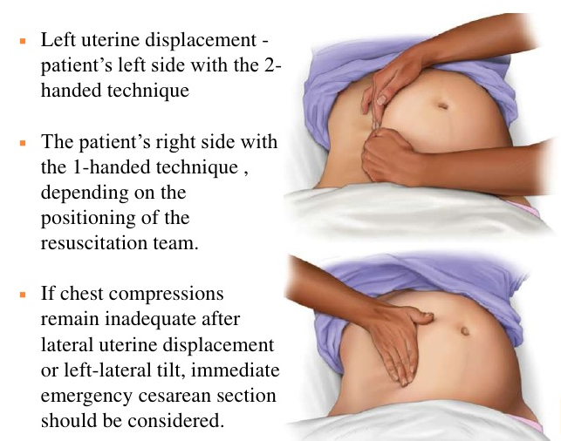
Lateral position
“Later“ - prefix
Relates to the side – ‘lateropositio’ a shift to one side or displacement to one side. Lateropositio uteri.

Slide 7

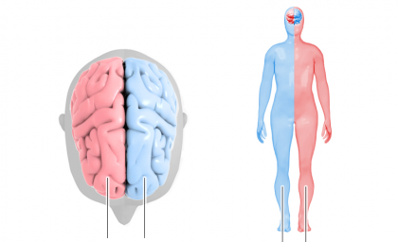
Lateris dextri (l.dx), Lateris sinistri (l.sin)
On the right side – the right one, On the left side – the left one respectively
R L L R

Slide 8
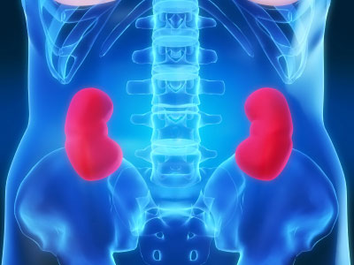
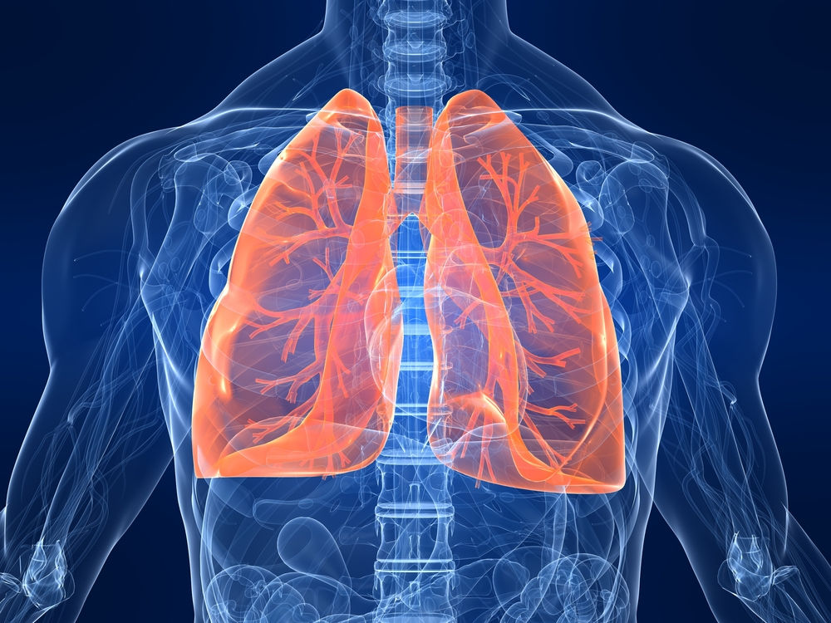
Lateris utriusque (l.utr)
On both sides

Slide 9
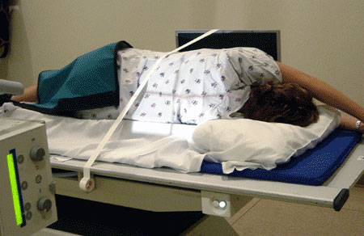
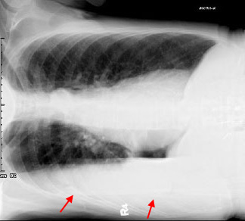
Bi-lateralis, e
Bilateral: E.g. Decubitus bilaterales = bilateral bedsores/pressure ulcers

Slide 10
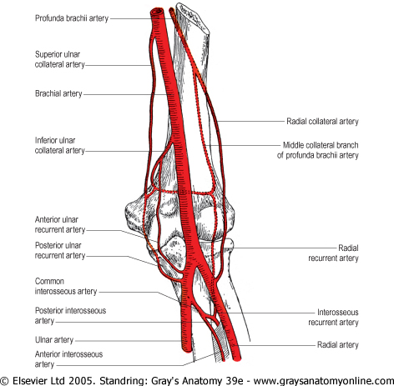
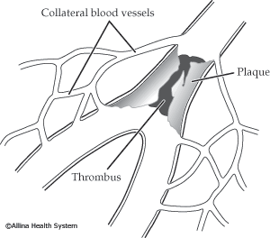
Collateralis, e
Located on the same side, eg. arteria collateralis

Slide 11
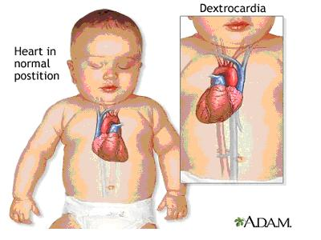
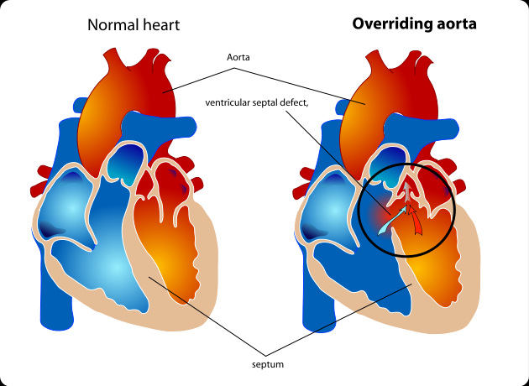
Sinistro-/dextropositio
Reversal of an organ to the left /right – sinistro/dextroposition of the heart. Can be described as an congenital anomaly in which an anatomically correct heart is displaced to the right in the thoracic cavity
Notes:
overriding aorta is a congenital heart defect where the aorta is positioned directly over a ventricular septal defect (VSD), instead of over the left ventricle. The result is that the aorta receives some blood from the right ventricle, causing mixing of oxygenated and deoxygenated blood, and thereby reducing the amount of oxygen delivered to the tissues.
It is one of the four findings in the classic tetralogy of Fallot. The other three findings are right ventricular outflow tract (RVOT) obstruction (most often subpulmonary stenosis), right ventricular hypertrophy (RVH), and ventricular septal defect (VSD).
overriding aorta is a congenital heart defect where the aorta is positioned directly over a ventricular septal defect (VSD), instead of over the left ventricle. The result is that the aorta receives some blood from the right ventricle, causing mixing of oxygenated and deoxygenated blood, and thereby reducing the amount of oxygen delivered to the tissues.
It is one of the four findings in the classic tetralogy of Fallot. The other three findings are right ventricular outflow tract (RVOT) obstruction (most often subpulmonary stenosis), right ventricular hypertrophy (RVH), and ventricular septal defect (VSD).

Slide 12
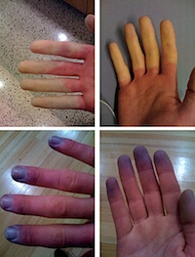
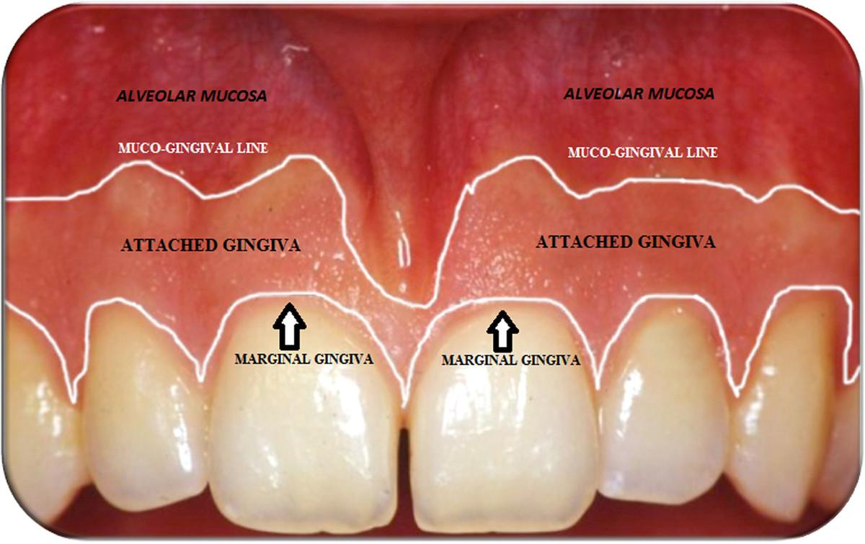
Marginalis, e Acralis,e (G.)
Marginal, eg. Gingivitis marginalis. The crest of the free gingiva surrounding the tooth like a collar. It is about 1 mm wide and forms the soft tissue portion of the gingival sulcus.
Referring or belonging to extremities of peripheral areas, eg. Cyanosis acralis

Slide 13
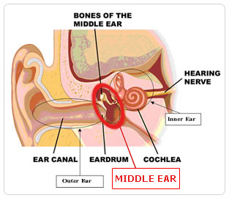
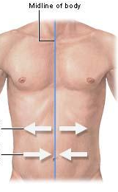
Medial position
Medius, a, um
Medianus, a, um
linea mediana
= exactly in the middle
auris media

Slide 14
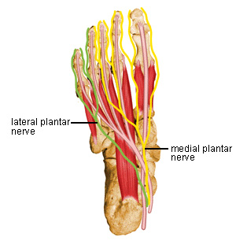
Medialis, e
relating to structures located close to the midline of the body
Lateralis, e
refers to structures to the sides (left/right)
nervus plantaris lateralis
nervus plantaris medialis

Slide 15
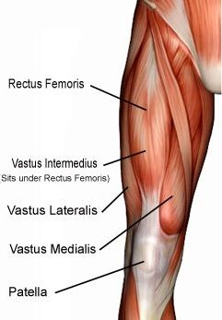
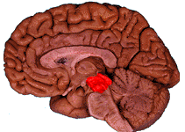
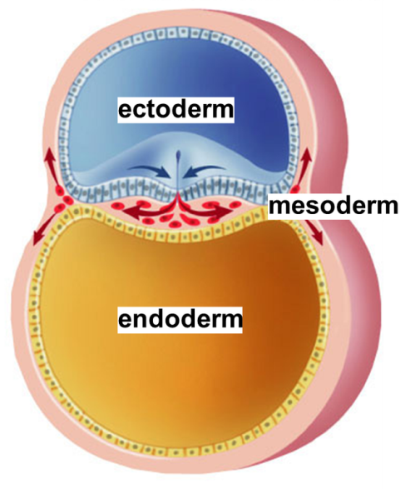
Intermedius, a, um
Located between two things
Meso- (prefix)
middle, intermediate, halfway
mesencephalon
musculus vastus intermedius
mesoderm

Slide 16
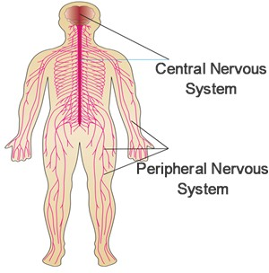
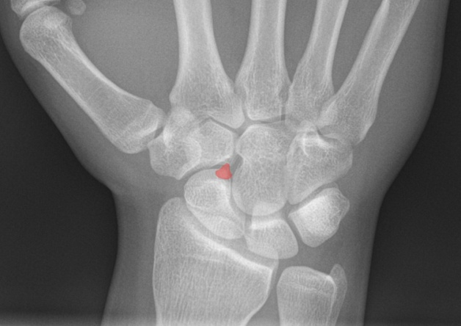
Centralis, e
central
systema nervosum centrale
os centrale

Slide 17
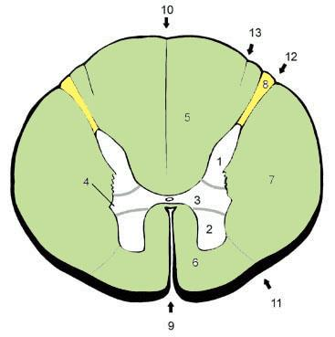
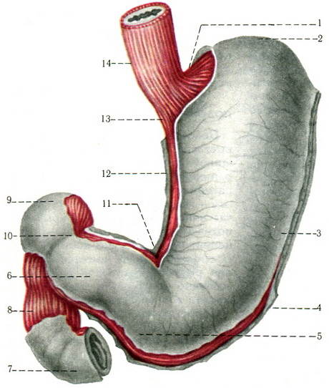
Anterior position/before
Anterior, anterius = the position meaning above something (anterius is for neutral gender)
Antero = prefix meaning before, eg. If you want to give two adjectives (direction) describing position.
Paries anterior gastris
Funiculus anterolateralis

Slide 18
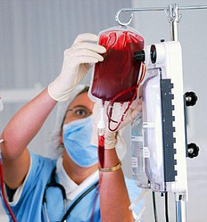
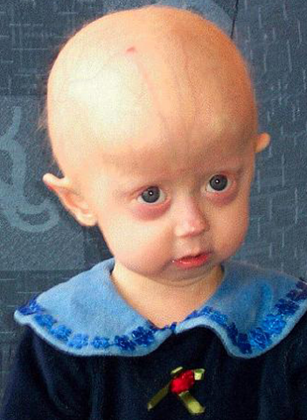
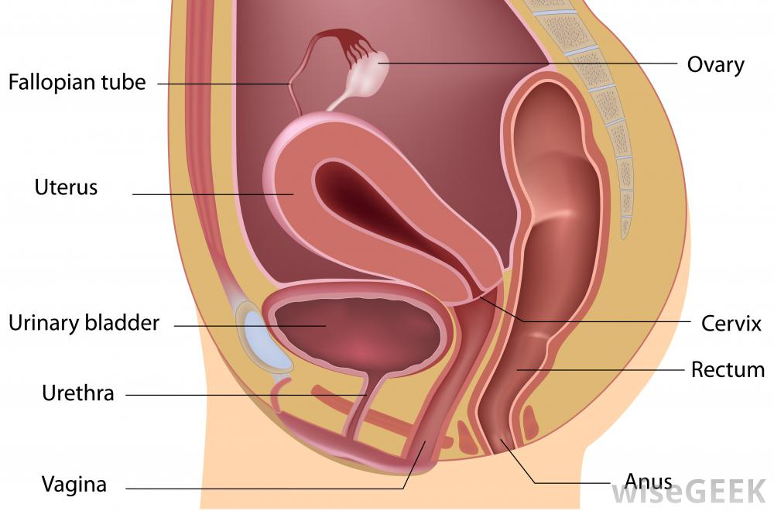
Prefixes
Ante- = before (position)
Prae- = before (time)
Pro- = before (in front of, ie protraction of mandible)
Antepositio uteri
Transfusio praeoperativa
Progeria adultorum

Slide 19
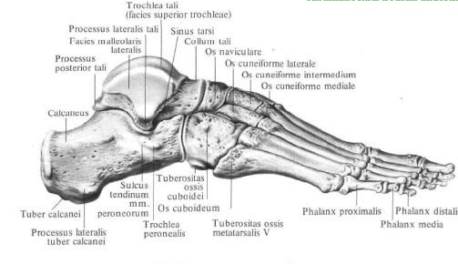
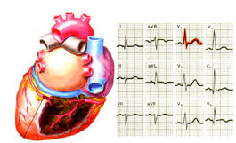
Posterior position/after sth
Posterior, ius (comp. form) – meaning behind or towards rear or dorsal surface of the body.
(prefix) postero – prefix to mean behind or dorsal end
Processus posterior tali
Infarctus posterolateralis

Slide 20
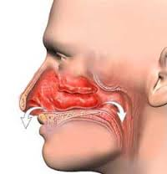
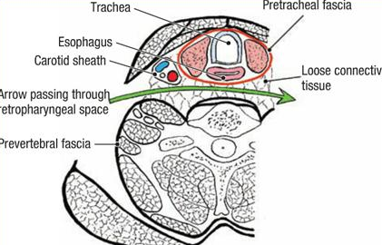
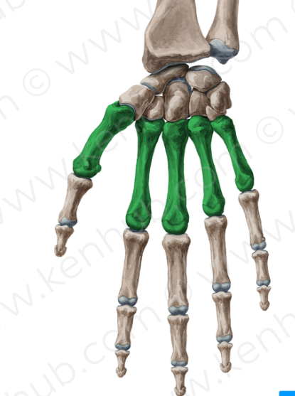
Prefixes
Post – (L.) - after, behind or later
Retro – (L.) – back, backwards
Meta – (L.) – along with, among, beyond
Regio postnasalis
Spatium retropharyngeum
Ossa metacarpalia

Slide 21
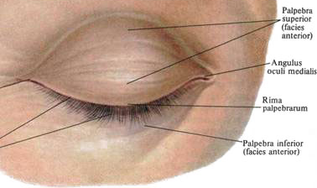
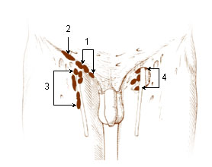
Superior position
Superior, ius (comp. adj. / adverb)
higher, upper / above
Supero- (prefix)
above, over, beyond
nodi lymphatici inguinales superficiales superomediales
Palpebra superior

Slide 22
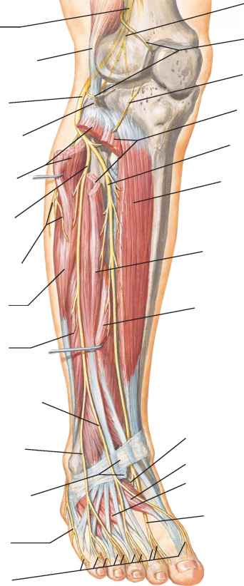
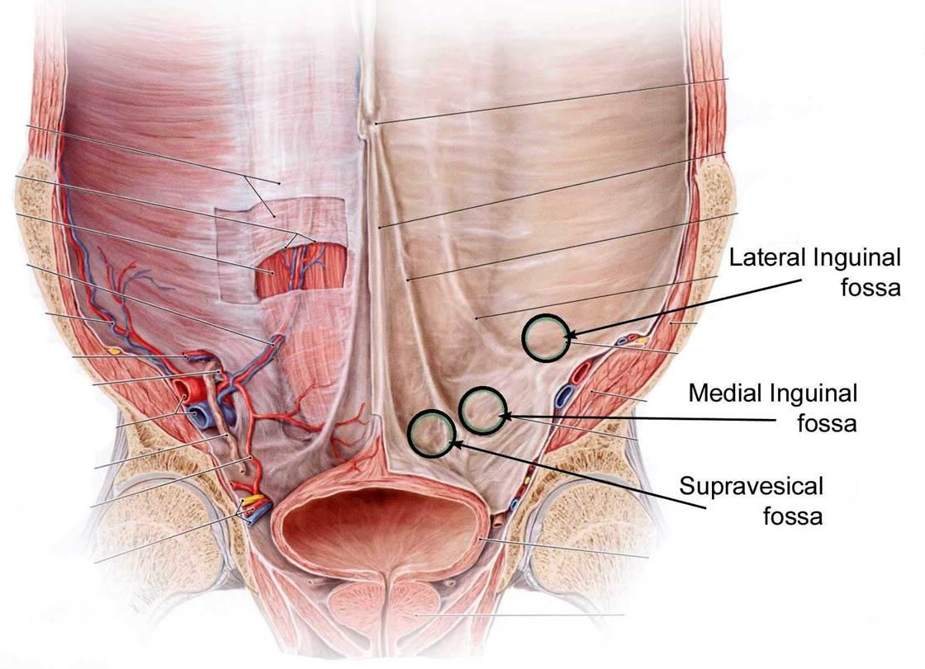
Supra- / Super- (prefix)
over/ on the surface of
nervus peroneus superficialis
fossa supravesicalis

Slide 23
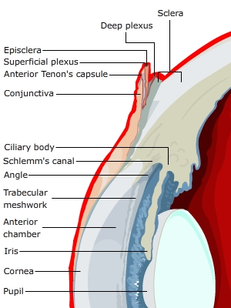
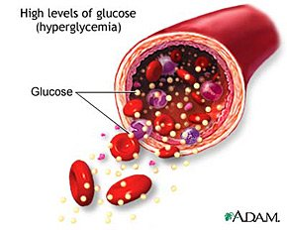
Epi- (prefix)
on the surface of
Hyper- (prefix)
over, above, excessive
Lamina episcleralis
hyperglycemia

Slide 24
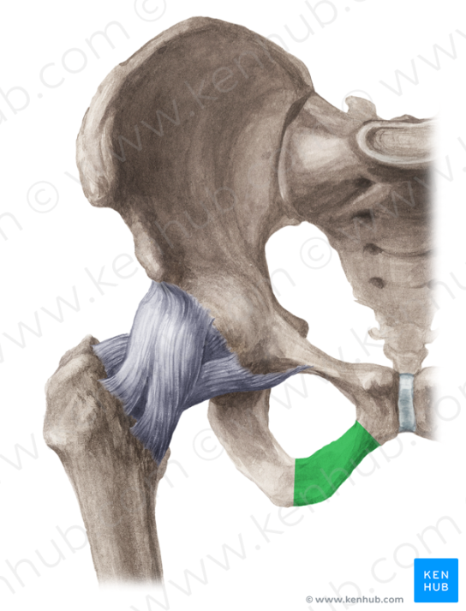
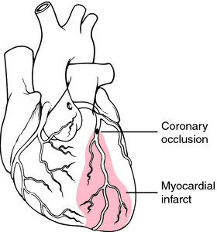
Inferior position
Inferior, ius = beneath/inferior to (comparative, inferius is for neutrals)
Infero- = position when using several adjectives (prefix)
Ramus ossis pubis inferior
Infarctus inferoposterior

Slide 25
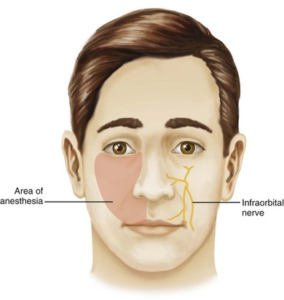
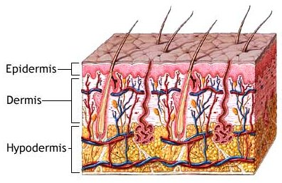
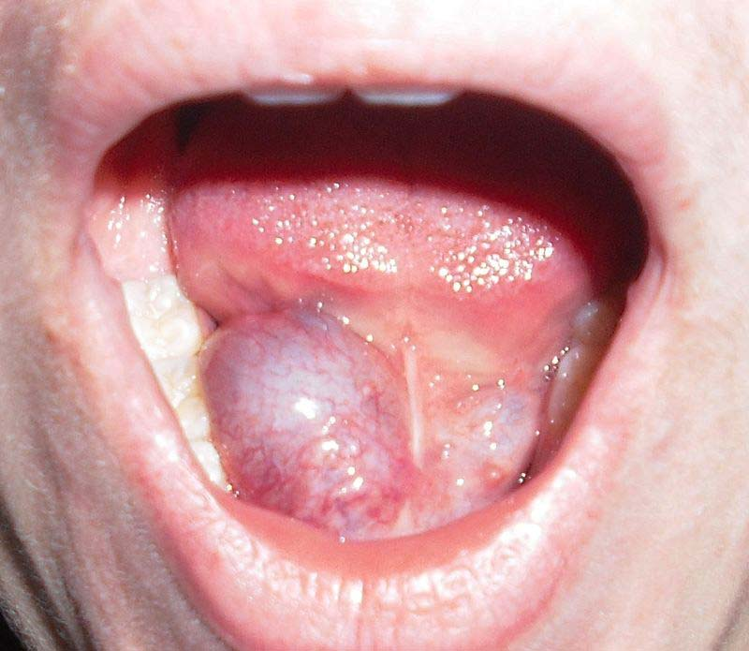
Prefixes
Infra- = when describing location
Sub- = below describing location
Hypo- = rarely used to describe location
Nervus infraorbitalis
Glandula sublingualis
Hypodermis

Slide 26



Internal position
Internus, a, um - internal, deep, inward
(prefix) Intra (L.) - between, within
(prefix) endo (G.) – inside, within
Auris interna
Haemorrhagia intracranialis
Endocarditis

Slide 27

External position
Externus, a, um
external
meatus acusticus externus

Slide 28



Extra- (prefix)
outer
Ecto- / Exo- (prefix)
outside
ectoparasitus
Circulatio extracorporalis
exotropia

Slide 29
Translate from Latin to English
Nervi supraclaviculares mediales
Septum intermedium
Venae superficiales membri superioris
Venae episclerales
Ductus sublingualis major

Slide 30
Answers
Nervi supraclaviculares mediales
Medial supraclavicular nerves
Septum intermedium
Intermedial septum
Venae superficiales membri superioris
Superficial veins of upper limb
Venae episclerales
Episcleral veins (small veins in the sclera in the corneal margin)
Ductus sublingualis major
Major sublingual duct

Slide 31
Revision Questions
(by Akimasa Iijima and Ole Victor Hessoe)
Loco
Anaesthesia localis
lateris utriusque
manus bilateralis
aure media
Anterolateralis, e
Translate “in typical location” = typico
Translate “local anesthesia” = _
Original form and translation of “l. utr.” = _
Translate “pain of bilateral hand” = dolor _
Translate “in the middle ear” = in _
Create adjective using prefix of “anterior” and “lateral”
___ _
Notes:
Answers
Loco
Anaesthesia localis
lateris utriusque
manus bilateralis
aure media
Anterolateralis

Slide 32
Revision Questions
7. Which of following prefixes does not represent posterior/after?
a. post-
b. caudo-
c. retro-
d. meta-
8. Which gland contains “suprarenal cortex”?
9. When Rx saying “nitroglycerin sublingual”, how is drug administered to patient?
10. What is opposite prefix of “ecto”?
Notes:
7. b
8. Adrenal gland
9. Drug is placed under tongue
10. Endo

