Slide 1
Facial expressions
General term - Facies, faciei, f. – Face; expression, countenance (typical for certain disease or state)

Slide 2
Categories of facial expressions
Terms referring to healthy or pathological state
Terms referring to a certain disease/dysfunction of a certain organ (most important)
Eponyms (i.e. terms derived from the names of real persons)

Slide 3
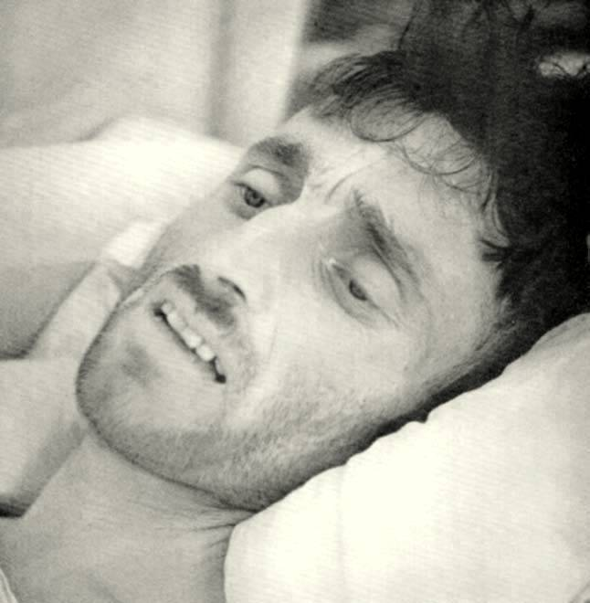
Terms referring to healthy or pathological state
F. composita – The normal, natural face of a healthy person
F. dolorosa – facial expression of a person suffering from pain’
  From dolor, oris, m.

Slide 4
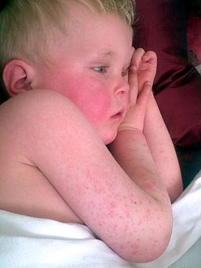
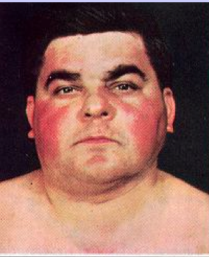
F. febrilis – feverous face expression, i.e. restless, discomposed characterized by shiny eyes and redness in face
  From febris, is, f.
f. plethorica - hyperemic face with florid, red complexion due to excessive circulation of blood

Slide 5

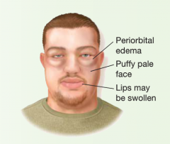
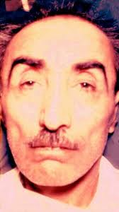

Terms referring to a certain disease/dysfunction of a certain organ
f. alcoholica / aethylica - bloated, persistently red face as a consequence of excessive drinking
f. pneumonica - one-sided blush on the same cheek as the lung affected by pneumonia
  From pneumonia, ae, f.
f. nephritica - oedematous, pale face due to the inflammation of kidneys with swelling appearing most around eyes
  From nephros, i, m. > nephritis, itidis, f.
f. cardiaca - oedematous, pale, and yellowish face with cyanotic hue; half open mouth, cyanotic lips; typically accompanies heart failure
  From cor, cordis, n.

Slide 6
f. anaemica - very pale face with greenish tint in patients with iron deficiency
  From anaemia, ae, f.
f. mitralis - blush on cheeks, cyanotic tip of the nose and ears; the patient looks younger his/her age; typical of patients with mitral stenosis
f. gastrica - facial expression typical of acute stomach problems; deep nasolabial fold
  From gaster, (e)ris, f.
f. tuberculosa / hectica - exhausted, pale face with blush on cheeks, “burning” eyes, dry lips, excited countenance, half open mouth
  From tuberculosis, is, f.

Slide 7
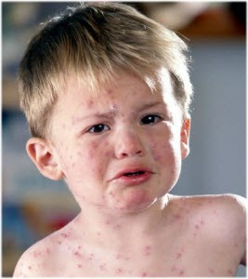
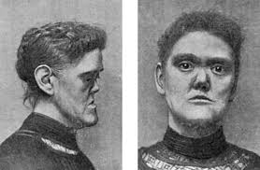
f. morbillosa - “unhappy” facial expression with rash and reddened eyes sensitive to light; typical of children suffering from measles
  From morbilli, orum, m. (= measles)
f. syphilitica - melancholic facial expression with saddle nose deformation; typical of the patients having the late congenital syphilis (syphilis congenital tarda)

Slide 8
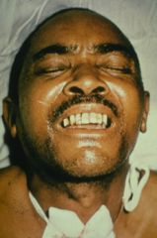
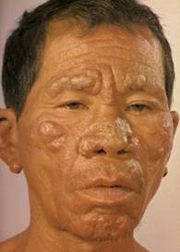
f. tetanica / risus sardonicus - facial expression typical of tetanus patients; mouth widened as in laughter, but the skin on forehead as if expressing grief; tonic spasm of mimic and chewing muscles
f. leontina - the lion-like facial appearance occurring in patients with certain forms of leprosy

Slide 9
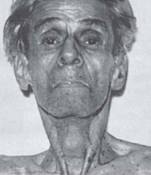
Eponyms
facies Hippocratica → facies abdominalis - sunken eyes, pinched nose, deadly livid and cyanotic skin sometimes covered with large drops of cold sweat, specific for the collapse due to severe disease of abdominal organs accompanied by peritonitis (rupture of gall bladder, perforated ulcer in stomach or duodenum)
  Characteristic for people in late stage diseases/right before they pass away
  Note the sunken appearance

Slide 10
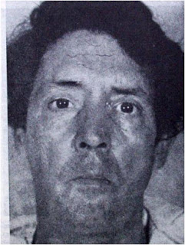
facies Parkinsonica / oleosa - amimic face with characteristic stare; the patient seems to lean forward to the observer; oily skin of face, sometimes drooling occurs; typical of patients with advanced Parkinson's disease (morbus Parkinson)

Slide 11


Slide 12
Answer the following:
Name 2 eponyms
Which facial expressions are derived from the words below:
morbilli, orum, m.
gaster, (e)ris, f.
Which facial expressions do these pictures describe?

Slide 13
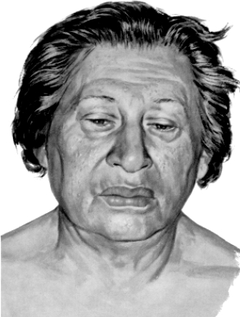
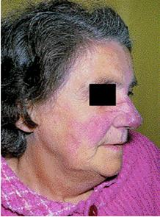
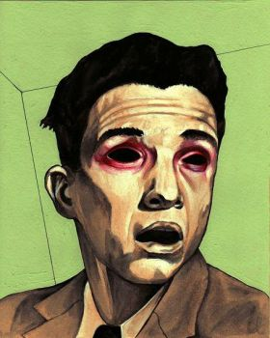
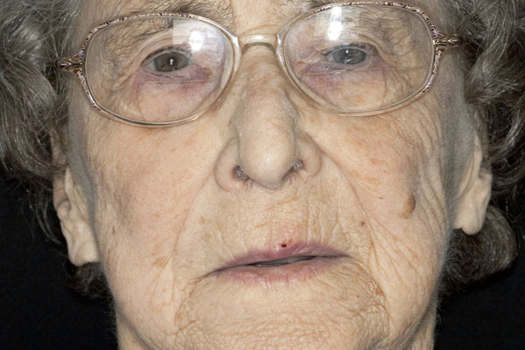
Label these faces according to the Names given
F. anaemica
F. mitralis
F. gastrica
F. tuberculosa

Slide 14
Dorthe Aslaksen and Jesika Agarwala
Group 31
Thank you for your attention!

