Slide 1
PAIN

Slide 2
PAIN
pain is a protective modality
International Association for the Study of Pain (IASP):
„Pain is an unpleasant sensory and emotional experience
associated with actual or potential tissue damage,
or described in terms of such damage“.
pain threshold: the minimum intensity of a stimulus
that is perceived as painful, the intensity at which
a stimulus begins to evoke pain varies

Slide 3
Nociceptors/nocisensors
nocere – to injure or to hurt in Latin
are activated by noxious mechanical, thermal or chemical
stimuli
detect signals from damaged tissue or the threat of damage
free nerve endings found in the skin, muscles, joints, bones
and viscera

Slide 4
Nociceptors
nociceptors of Aδ fibres (5-30 meters/sec)
Aδ mechanical nociceptors
Aδ thermal nociceptors
nociceptors of C fibres (0.5-2.0 meters/sec)
C polymodal nociceptors – react to thermal, mechanical
and chemical stimuli
silent nociceptors (MIA = mechanically insensitive afferents)
- responsive after inflammation and tissue injury

Slide 5
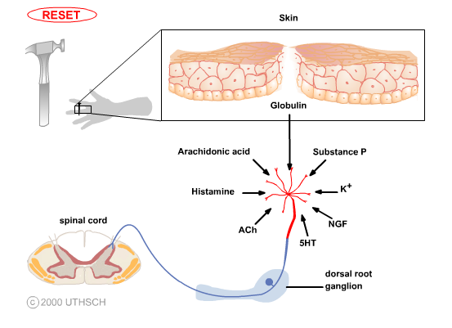
Factors that activate nociceptors

Slide 6
Peripheral sensitization
Central sensitization = activity- or use-dependent
neuronal plasticity in the spinal cord
hyperalgesia - exaggerated or prolonged response
to noxious inputs
allodynia - pain induced by normally innocuous
inputs

Slide 7
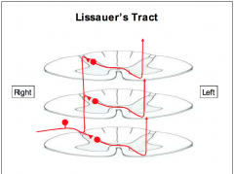
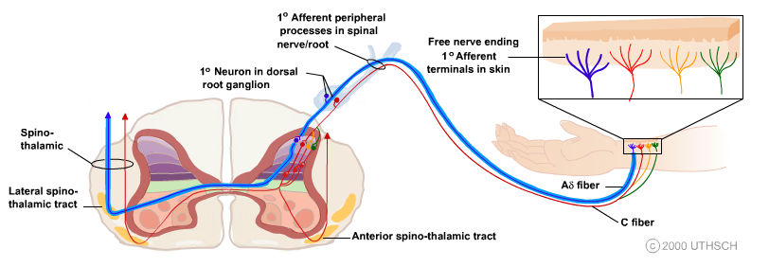
Nociceptive afferents
Aδ fibres – thin myelinated fibres
sharp, localized pain
C non-myelinated fibres
dull, non-localized pain
Spinoreticular tract

Slide 8
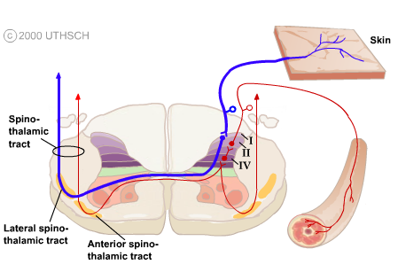
The noxious information from visceral organs is mostly carried
to the CNS in different pathways than that from the skin.

Slide 9
Pain pathways from the trunk and limbs
PALEOSPINOTHALAMIC
PATHWAY
tr. spino-reticulo-thalamicus
diffuse, non-localized pain
autonomic and reflexive
responses to pain stimuli
emotional and affective
reactions to pain
intralaminar nuclei of the
thalamus, hypothalamus
postcentral gyrus,
insula and cingulate gyrus
NEOSPINOTHALAMIC
PATHWAY
tr. spino-thalamicus lat.
sharp, well localized pain
somatotopic representation
ventral posterolateral
(VPL) and posterior
nucleus of the thalamus
postcentral gyrus

Slide 10
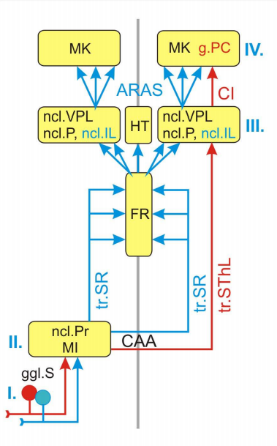
Cortex
Paleospino-
thalamic
pathway
Neospino-
thalamic
pathway
Thalamus
Spinal cord

Slide 11
Pain pathways from the
TRACTUS TRIGEMINO-RETICULO-
THALAMICUS
diffuse, non-localized pain
TRACTUS TRIGEMINO-
THALAMICUS ANTERIOR
sharp, well localized pain

Slide 12
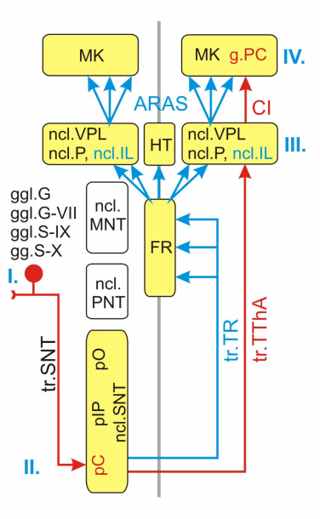
Cortex
Thalamus
Medulla

Slide 13
The phylogenetically old, paleospinothalamic and trigemino-
reticulothalamic, pathways through the RF are concerned with
the arousal and affective (emotional) aspects of somatic sensory
stimuli.
In contrast, the direct, neospinothalamic and anterior
trigeminothalamic, pathways are analytic, encoding
information about modality, intensity, and location.

Slide 14
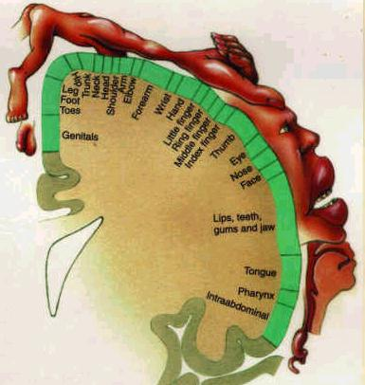
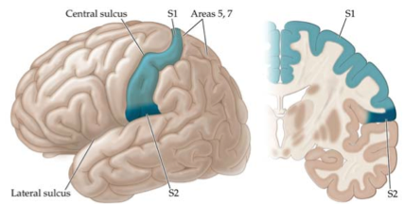
Primary somatosensory (somesthetic)
cortex (SI)

Slide 15
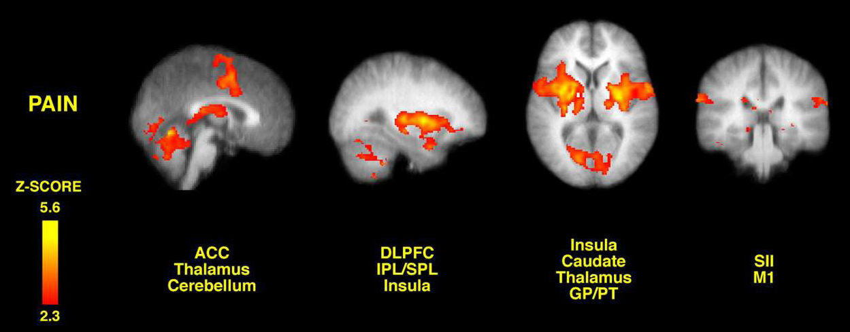

Slide 16
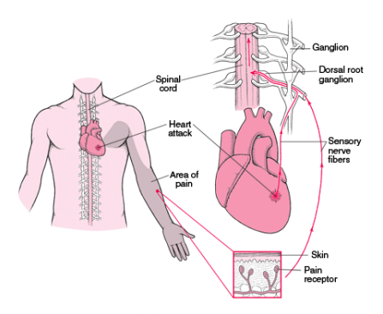
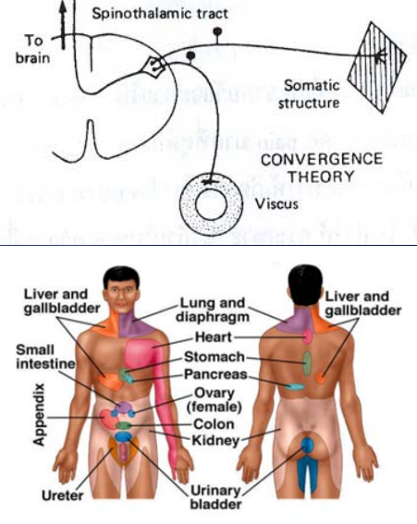
Referred pain
Common dermatome hypothesis
Convergence theory
Facilitation or irritable focus
Learned phenomenon

Slide 17
Dental Pain
Aβ + Aδ fibres – tingling, vibration, touch, sharp pain
C fibres – dull ache
pulp + dentin – enormous number of free nerve endings
periodontal ligament – Ruffini mechanoreceptors and
proprioreceptors
inflammed pulp or periapex – peripheral and central
sensitization – hyperalgesia, allodynia and spontaneous pain
referred orofacial pain – both source and referral site
wide area of pain – difficulty to locate the pathology

Slide 18
MODULATING SYSTEMS
OF NOCICEPTIVE PATHWAYS
level of modulation of nociceptive pathways
spinal cord (“gate control theory”)
RF of brain stem
periaquaeductal gray matter (PAG)

Slide 19
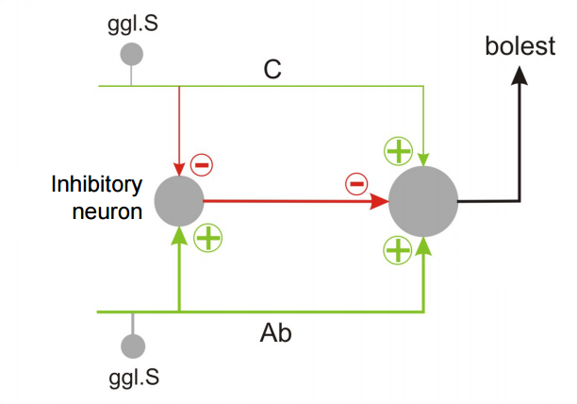
“Gate control theory”

Slide 21
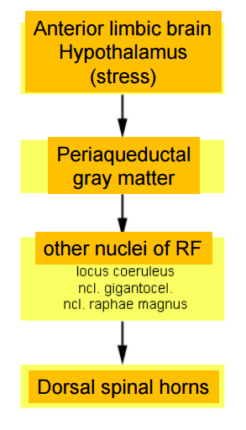
Stress-induced analgesia
(both opiate and non-opiate forms)

Slide 22
SOMATOMOTOR PATHWAYS

Slide 23
Necessary components of
proper motor control
Volition
Coordination of signals to many muscle groups
Proprioception
Postural adjustments
Sensory feedback
Compensation for the physical characteristics
of the body and muscles
Unconscious processing
Adaptability

Slide 24
Levels of movement regulation
spinal cord
brain stem
cortex
cerebellum
basal ganglia

Slide 25
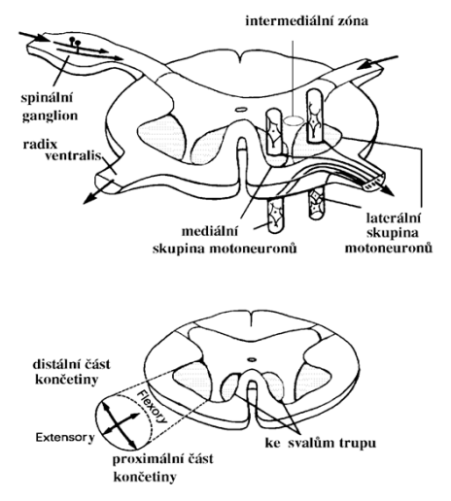
Lower motor neurons – spinal cord
α motoneurons
γ motoneurons
Somatotopic organization
medial column – axial muscles
lateral column – limb muscles
anteriorly – extensors
posteriorly - flexors

Slide 26
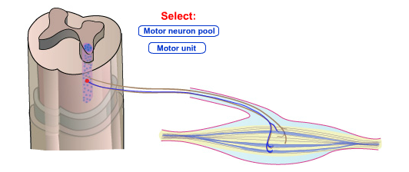
Motor neurons have highly branched, elaborate
dendritic trees, enabling them to integrate the inputs
from large numbers of other neurons and to calculate
proper outputs.
The combination of an individual motor neuron and all
of the muscle fibers that it innervates is called
a motor unit.

Slide 27
size of motor unit
small motor unit – 1 motoneuron innervates several
muscle fibers (extraocular muscles, muscles of hand)
large motor unit – 1 motoneuron innervates
500 – 1000 muscle fibers (back muscles)

Slide 28
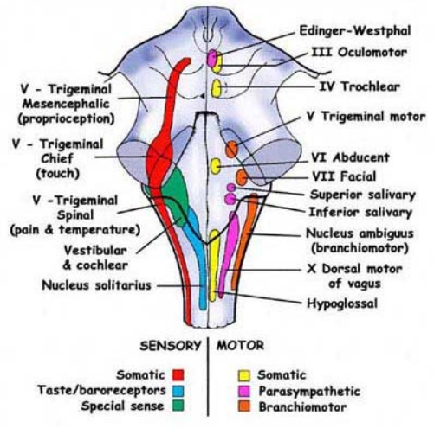
Lower motor neurons – brain stem
Somatomotor nuclei
CN III, IV, VI, XII
Branchiomotor nuclei
CN V, VII, IX, X, XI

Slide 29
Supraspinal system of movement control
Medial system
bilateral
terminates on the interneurons or
the medial column of lower motor neurons
controls maintenance of balance and postural movements
Lateral system
mostly cross the midline and descend contralaterally
terminates on the interneurons or
the lateral column of lower motor neurons
controls fine manipulative movements of the hand and
fingers
The “third” motor system
aminergic pathways of the brain stem

Slide 30
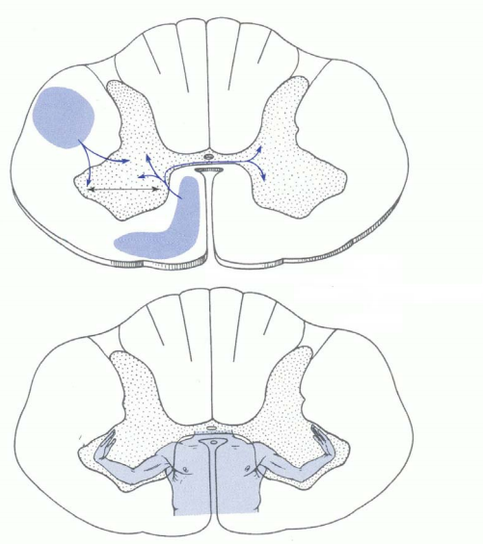

Slide 31
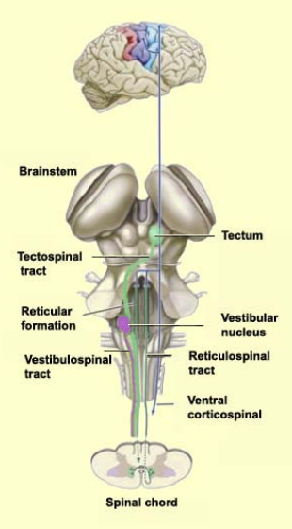
Medial system
Subcortical pathways
Medial (MLF) and lateral vestibulospinal
tracts - control of balance and
postural movements, head movements
Tectospinal tract (sup. colliculus, MLF)
– coordination of movements of
the head and eyes during watching
Medial (pontine) and lateral
(medullary) reticulospinal tracts
- control of postural movements
Cortical pathways
Anterior corticospinal tract
- medial column of lower motor neurons

Slide 32
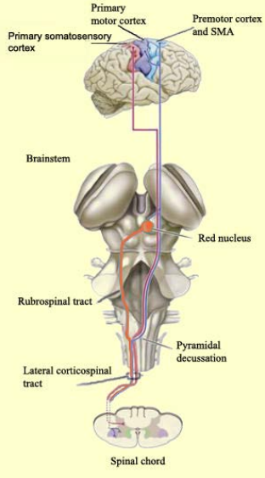
Lateral system
Subcortical pathways
Rubrospinal tract
- contralaterally descends to the
lateral column
Cortical pathways
Lateral corticospinal tract

Slide 33
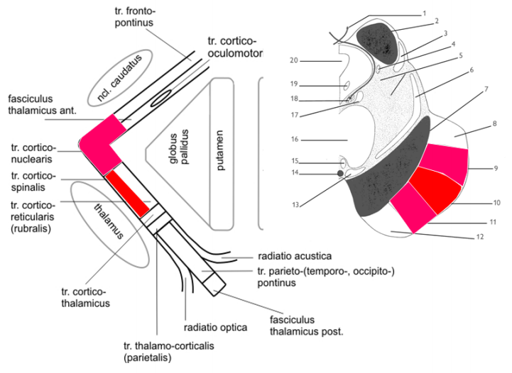
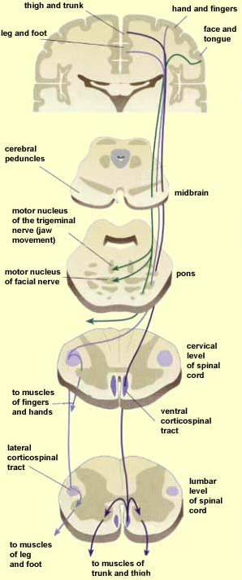
Corticospinal and corticonuclear tracts

Slide 34
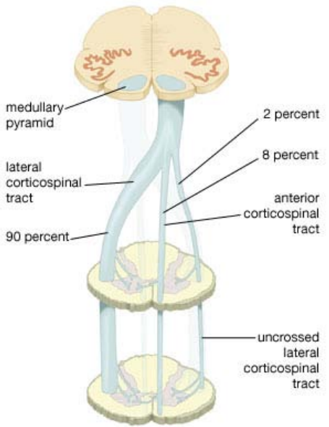

Slide 35
DIRECT MOTOR PATHWAYS (PYRAMIDAL):
corticospinal tract
corticonuclear tract
INDIRECT MOTOR PATHWAYS (EXTRAPYRAMIDAL):
corticorubrospinal tract
cerebellorubrospinal tract
corticoreticulospinal tracts
cerebelloreticulospinal tracts
corticotectospinal tract
cerbellovestibulospinal tracts

Slide 36
The third system
the oldest one
nuclei of RF – raphespinal and coeruleospinal tracts
control of involuntary emotional movements

Slide 37
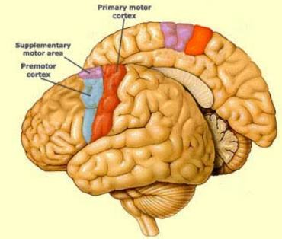
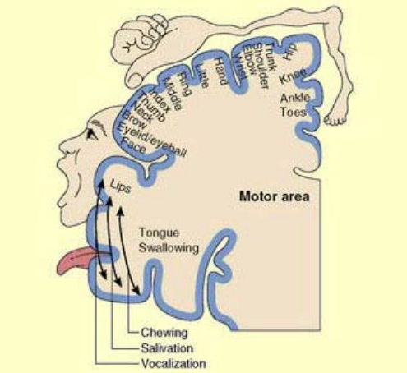
Motor cortex

Slide 38
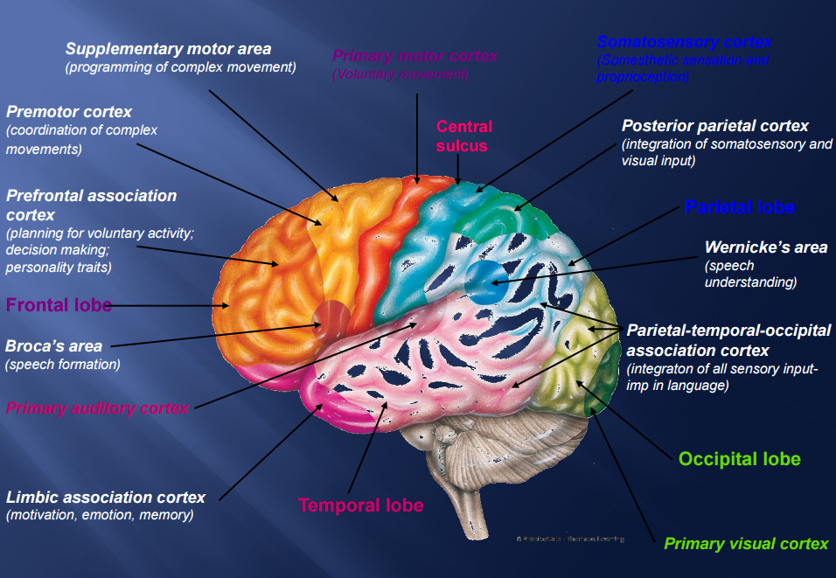

Slide 39
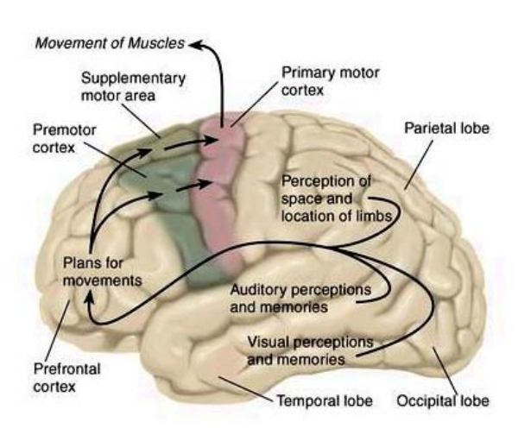
Planning of movements

Slide 40
Illustrations were copied from:
Neuroscience Online, the Open-Access Neuroscience
Electronic Textbook
Department of Neurobiology and Anatomy
University of Texas Medical School at Houston

