Slide 1
Urinary syndromes
MUDr. Ivan Řiháček, Ph.D.

Slide 2
Introduction
Kidney anatomy
Differential diagnosis of kidney disease
Kidney examination
Urine examination
Urinary syndromes
Diagram of urinary syndromes

Slide 3
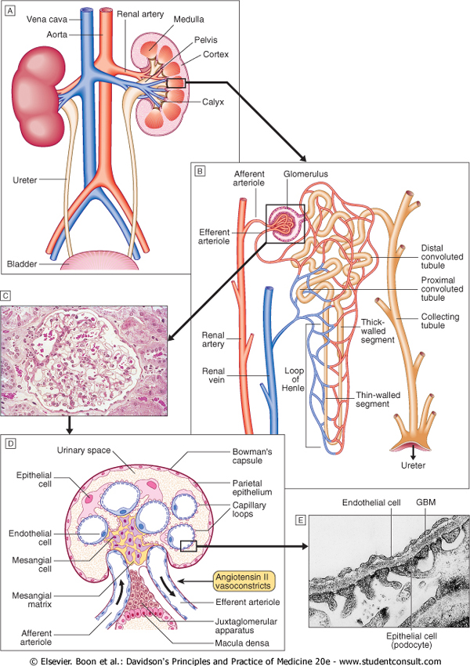
Anatomy
Notes:
The nephron consists of glomerulus (with afferent and efferent arteriole, Bowmans capsule), proximal tubule, loop of Henle, distal tubule and collecting tubule.

Slide 4
Functions of the kidneys
Excretion of ammonium, urea and creatinine (products from protein metabolism)
Excretion of uric acid (products from nuclei acids)
Regulate the body fluid volume and concentration of minerales
  Sodium, Potasium, Chloride, Calcium, Phosphorus, Magnesium
  Under control of many hormonal and haemodynamics signals (RAAS, ADH, volumoreceptors…)
Regulate the acid-base balance (HCO₃⁻ , H⁺ )
The kidneys are main source of some hormone (volume and metabolic effect)
  Renin, erytropoetin, calcitriol – vit D3

Slide 5
Signs of renal disease
Early signs:
Albuminuria: ≥ 30 mg/24h A2
or albumin/creatinine ratio ≥ 3,0 mg/mmol
Mild decrease of eGFR: CKD G2 and G3a
Advanced signs:
Proteinuria: ≥ 300 mg/24h A3
Oliguria and elevated plasma creatinine
Hypalbuminemia ˂ 35 g/l
Edema
Oliguria ˂ 500ml/24h urine Anuria: 0-100ml/24h urine

Slide 6
Investigation of renal and urinary tract disease
Personal history
Physical examination
Laboratory work up (creatinine, eGFR, potasium, albumin, imunology)
Noninvasive imaging techniques (ultrasound, IVU, pyelography, CT, MRI, radionuclide)
Invasive techniques (cystoscopy, pelvi-ureteroscopy, angiography, renal biopsy)
Urinanalysis

Slide 7

Physical examination
Palpation:
Bimanual palpation
(Israeli's touch)
Healthy kidney is not palpable

Slide 8
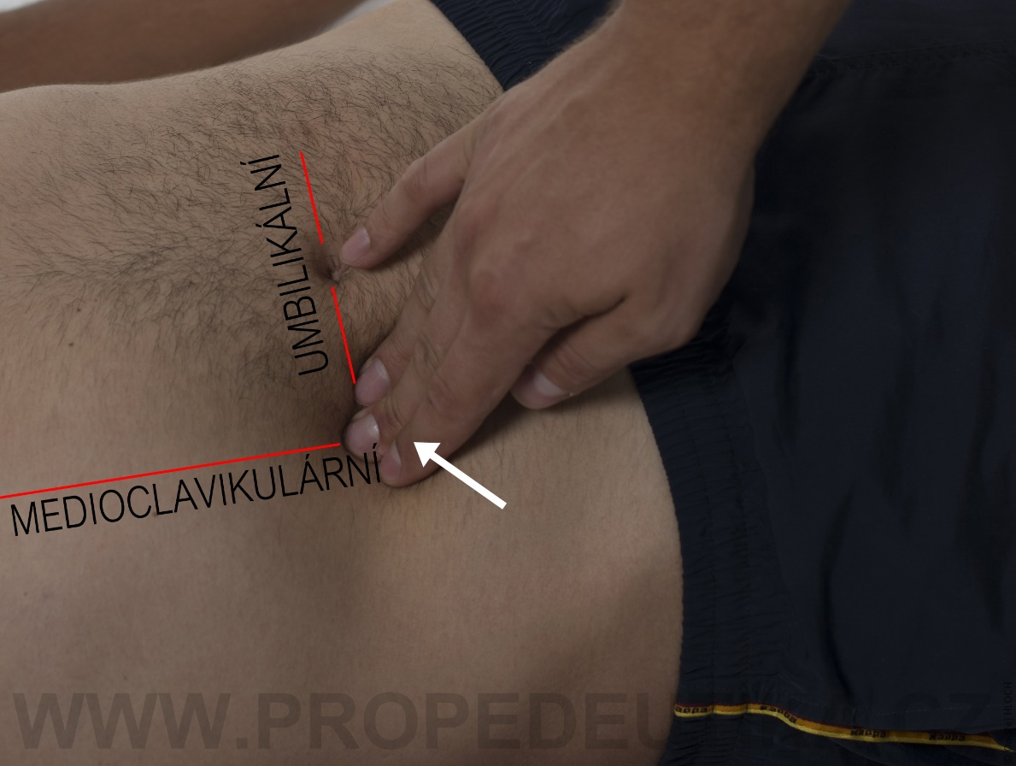
Physical examination
Palpation:
Ureteral points
Pain during renal colic

Slide 9

Physical examination
Percussion:
Tapottement
Pain in inflammation

Slide 10
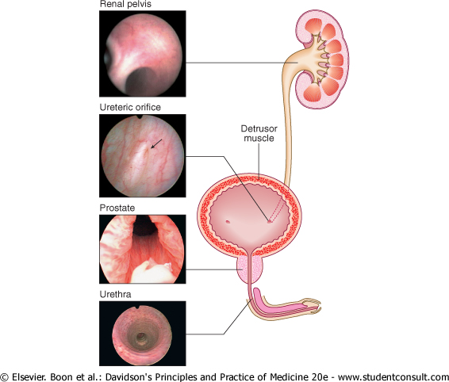
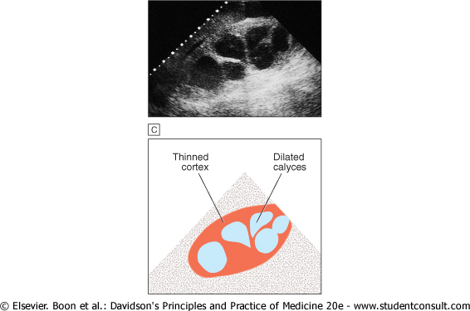
Some imaging techniques
Endoscopic view of urinary tract
Ultrasonography

Slide 11
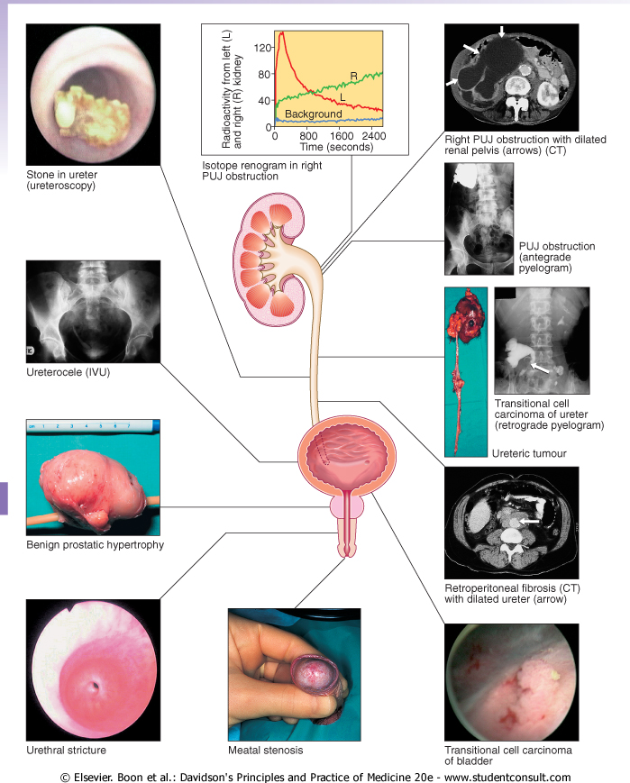
Some imaging techniques

Slide 12
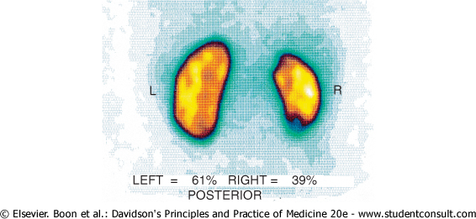
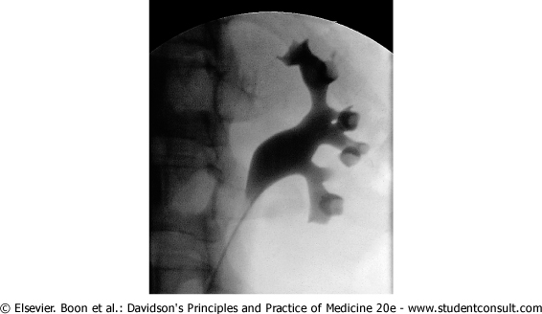
Some imaging techniques
Dimercaptosuccinic acid labeled by ^{99m}Tc DMSA renogram
Retrograde pyelography

Slide 13
Renal biopsy
Obtaining a tissue sample - examination microscopically, histological conclusion = subsequent
treatment
It is performed with a needle under sonographic control
There must be normal blood pressure and blood coagulation testing, monitoring 24h in the hospital
Indication:
  Suspected of rapidly-progressing glomerulonephritis (GN)
  Proteinuria and hematuria of unclear origin
  Nephrotic syndrome of unclear cause
  Acute renal failure of unclear cause
  Suspected kidney disease in systemic diseases
  Rapid worsening of renal failure in treated glomerulopathy
  Suspected kidney transplant rejection

Slide 14
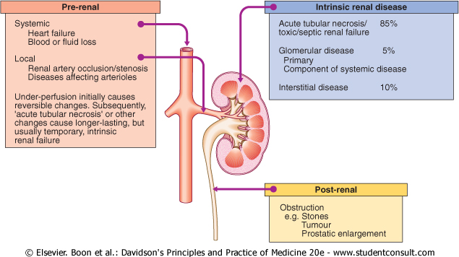
Differential diagnosis of acute kidney injury (AKI)
Pre-renal
Decrease of intravacular volume (hypotension) (fluid)
Renal artery stenosis
Heart failure (diuretics)
Renal
Renal parenchymal disease (nefrological care)
Post-renal
Obstruction (urological care)

Slide 15
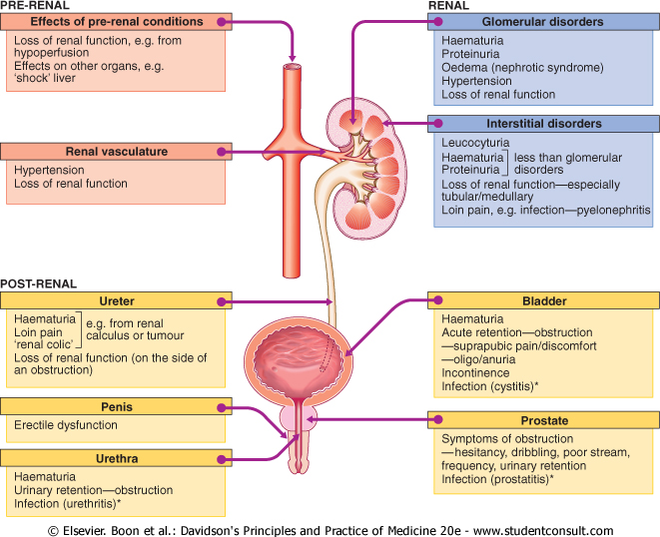
Differential diagnosis of chronic kidney disease (CKD)
Pre-renal
Hypertension aterosclerotic disease (large artery)
Renal
Glomerular disorders (core, GN, diabetic nephropathy, hypertension – small arteries)
Interstitial disorders (medulla, tubuli, renal pelvis)
Post-renal
Obstruction (urological care, renal calculi, tumours, prostate enlargement, infection)

Slide 16
Urine examination
Preparation:
Disinfection around the urethra
Medium urine flow
Catheterized urine (females)
Morning urine (more concentrated)
Collected urine for 3, 10, 24 hours
Urine chemically: (paper, instrument)
PH
Glycaemia
Proteins
Hemoglobine
Bilirubine
Urobilinogene
Ketones

Slide 17
Urine examination
Urinary sediment:
Addis (10 hours night urine)
  Erytrocyte 1-2 mil/24h
  Leukocyte 1-4 mil/24h
  Casts 100 000/24h
Hamburger (3 hours urine)
  Erytrocyte 2000/min
  Leukocyte 4000/min
  Casts 60-70/min
Microscopic examination
Hematuria (blood in urine)
Leukocyturia (white blood cells, inflammation)
Cylinders (castings of precipitate from canals)
Crystals (depends on PH urine, stones)

Slide 18
Microbiological examination of urine
Sampling of morning urine
Careful disinfection of the external orifice of the urethra
Medium current flow/catheterized urine
At room temperature as soon as possible send for culture examination
Culture media, bacterial type/antibiotic sensitivity, up to 24 hours, ˃ 10⁵ bacteria
The most common pathogens: E coli, enterobacter, klebsiela

Slide 19
Syndromes
Leukocyturia
Proteinuria
Hematuria

Slide 20
Leukocyturia
Presence of white blood cells in urine
  Urinary tract infections (UTI)
  women
  the elderly
  diabetes
  pregnancy
  stones
  Pus in urine (pyuria, turbid urine = bacterial inflammation)
Sterile urine leukocyturia (culture negative)
  Gonorrhea
  Trichomonas, TBC, fungi, mycoplasmas, chlamydia
  Tubulointerstitial nephropathy
  Prostate or bladder cancer
  Injury of urethra
  Urinary stones, vesicoureteral reflux

Slide 21
Proteinuria
Urine protein quantitatively:
Albuminuria (30-300mg/24h)
Proteinuria (over 300mg/24h)
Small up to 1.5 g/24h
Medium 1,5 to 3.5 g/24h
Big above 3.5 g/24h
Selective: mainly albumin
Non-selective: globulins, fibrinogen
Urine protein according to origin:
Renal
  Glomerular (diseases of the ball)
  Tubular (canal diseases)
Prerenal (increased serum protein concentrations – paraprotein, Bence-Jones)
Postrenal (tumors, urinary tract inflammation, heart failure)

Slide 22
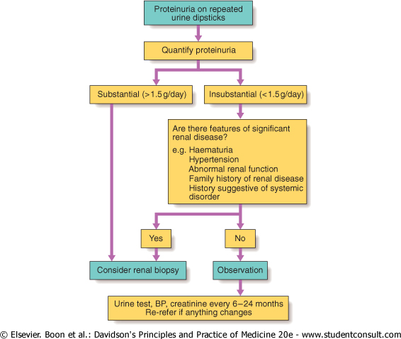
Differential dg of proteinuria

Slide 23
Hematuria
Microscopic:
(It does not change the color of the urine)
Phase contrast (GN x urinary tract)
Glomerulonephritis (+ protein, cylinders)
Urinary stones, tumors
Infections (+ leukocytes + bacteria)
Interstitial nephritis
Infectious diseases other than kidneys
After extreme physical stress
Macroscopic:
(Changes color, 1 ml or more of blood/liter of urine)
False (porphyry, beetroot, rifampicin !!)
  Urinary stones
  Tumors
  Trauma
  TBC (+ leukocyturia without bacteria)
  Kidney cysts
  Cystitis, infection
  Clotting disorder (blood diseases)
Notes:
Going through glomerulus

Slide 24
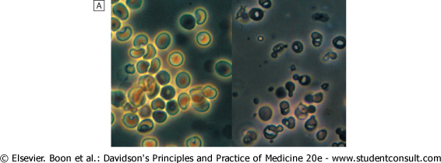
Hematuria
Phase contrast erytrocytes
Left: normal erytrocytes from
urine tract
Right: damaged erythrocytes
after passing through the
glomerulus - GN

Slide 25
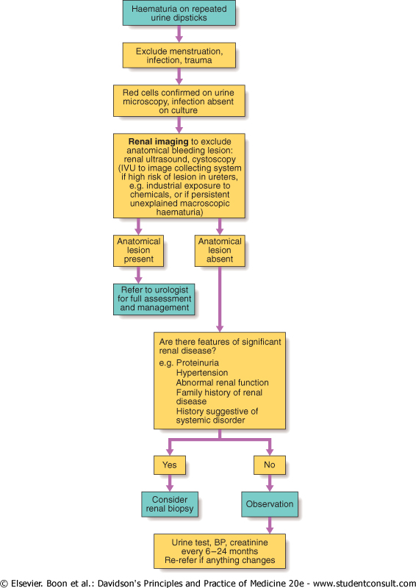
Differential dg of hematuria

Slide 26
Urinary syndromes
1. Small isolated proteinuria
2. Small isolated hematuria
3. Big isolated selective proteinuria
4. Big non-selective proteinuria
5. Proportional proteinuria and hematuria
6. Macroscopic hematuria

Slide 27
1. Small isolated proteinuria
Amount of protein up to 2g/24h.
It can be intermittent (stress, orthostatic) or permanent.
It is typical for:
Diabetic nephropathy, early stage
Congestive heart failure,
Benign nephrosclerosis,
Remission glomerulonephritis,
Hypertensive renal disease.

Slide 28
2. Small isolated hematuria
Microscopic hematuria and proteinuria ≤ 300mg/24 hr.
It is typical for:
IgA - nephropathy
Vasculitis
Alport's syndrome
Thin basal membrane nephropathy

Slide 29
3. Big isolated selective proteinuria
Proteinuria ˃ 5g/24h
Erythrocytes are not present or only in negligible
quantities.
It is clearly diagnostic for minimal glomerular changes
in Nephrotic syndrome.

Slide 30
4. Big non-selective proteinuria
Proteinuria ˃ 5g/24h and mild hematuria
It is typical for:
membranous and membranoproliferative glomerulonephritis (GN)
diabetic nephropathy
amyloidosis
focal segmental glomerulosclerosis as part of Nephrotic syndrome.

Slide 31
5. Proportional proteinuria and hematuria
Membranoproliferative and mesangioproliferative GN
3 types according to proteinuria and erythrocyturia:
Smal proteinuria ≤ 2g/24 hours with microscopic hematuria
Medium proteinuria 2-5 g/24 h, micro- to macroscopic hematuria
Big proteinuria ˃ 5g / 24 hours with macroscopic hematuria

Slide 32
6. Macroscopic hematuria
Macroscopic hematuria with mild proteinuria <1.5g/24h
In some acute intestinal or respiratory diseases
In IgA-nephropathy
In thin basal membrane nephropathy

Slide 33
Clinical syndromes
Combination of extrarenal symptoms, urinary findings, severity of the renal disorder and rate its progression.

Slide 34
Clinical syndromes
Syndrome | Diagnostic symptoms | Clinical symptoms
Asymptomatic urine abnormality | Small proteinuria, hematuria, sterile pyuria
Acute nefritic syndrome (GN) | Proteinuria, hematuria, leukocyturia, cylinders, damaged erytrocytes | Edema, hypertension, oliguria, azotemia,
Acute kidney injury (AKI) | Increase of plasma urea, creatinine, oligo/anuria | Edema, hypertension, proteinuria, hematuria, pyuria
Chronic kidney disease (CKD) | Azotemia more than 3 months, anemia, ↑ phosphates | Hypertension, proteinuria, edema hematuria, polyuria, nycturia
Nefrotic syndrome | Proteinuria ˃ 3,5g/d, dyslipidemia, hypalbuminemia | Edema
Urinary tract obstruction | Hydronephrosis, urinary retention, oliguria, anuria, azotemia | Dysuria, hematuria, pyuria
Urinary tract infection (UTI) | Bacteriuria ˃ 10⁵ , pyuria, ↑ CRP, polakisuria | Febrilie, smal proteinuria, hematuria, azotemia
Renal tubular syndromes | Electrolyt disorders, metabolic acidosis, polyuria | Tubular proteinuria, hematuria
Uremic syndrome | Azotemia ˃ 3M, dyspeptic disorders, multiorgan disorders, Kussmauls breathing, prutitus | Edema, hypertension, anemia
Renal stones | Renal colic, hydronephrosis | Hematuria, pyuria

Slide 35
Clinical conclusions
The standard is the examination of urine and urinary sediment
  Elementary with paper stick, if positive quantitatively
  Morning urine sample
When finding erythrocytes and proteins we think of glomerulopathy
  Phase contrast microscopy and quantitative examination
When leukocytes and bacteria are found - UTI
  Bacteriuria itself is often a contamination

