Slide 1
Autonomic nervous system

Slide 2
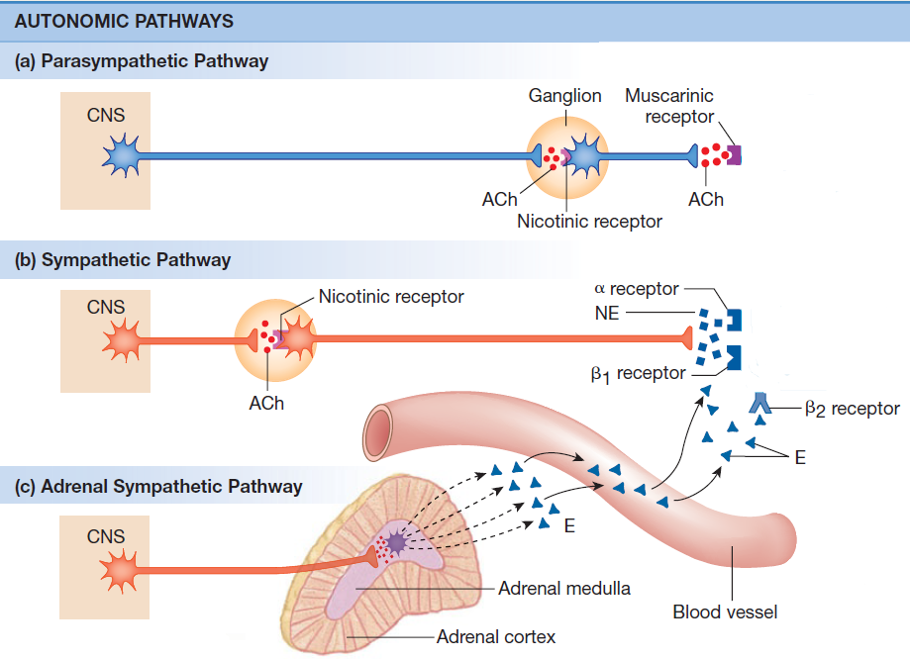
Autonomic nervous system

Slide 3
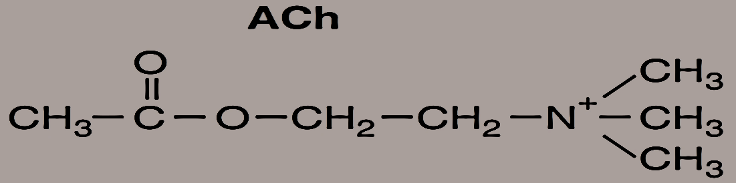
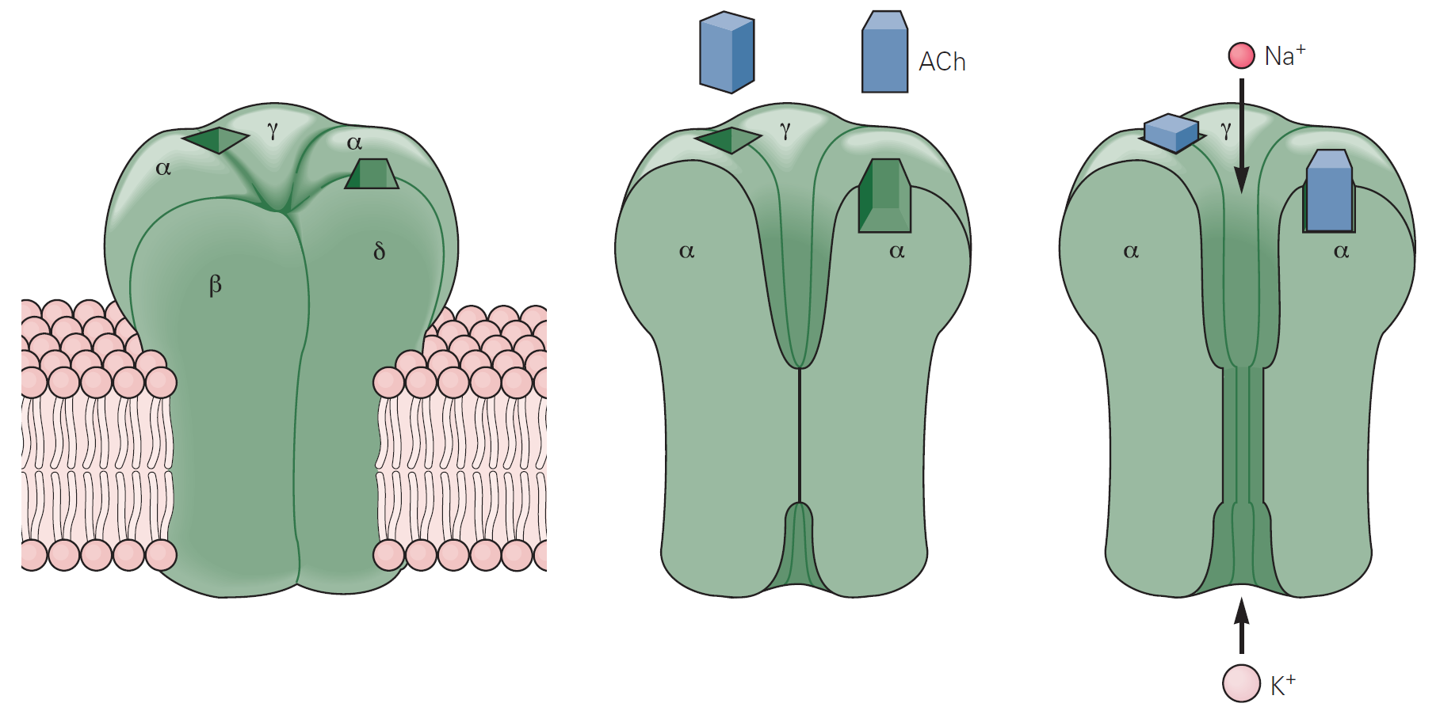
Autonomic nervous system
Preganglionic fibers
SNS, PNS
Nikotinic receptor
  N_{N} type and N_{M} type
  Excitatory receptors

Slide 4
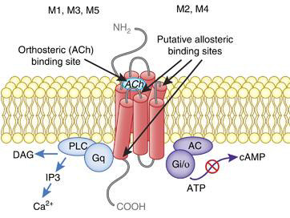
Autonomic nervous system
Postganglionic fibers
PNS
Muscarinic receptor
  G-protein coupled
  Excitatory receptors (M₁, M₃, M₅)
  Inhibitory receptors (M₂, M₄)

Slide 5
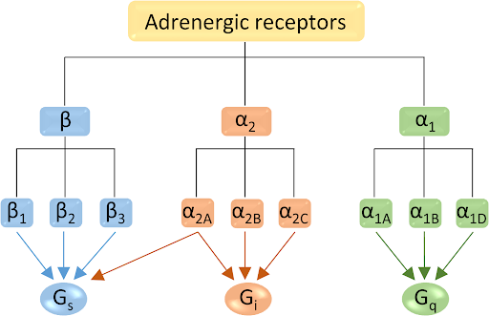
Autonomic nervous system
Postganglionic fibers
SNS
Adrenergic receptor
  G-protein coupled

Slide 6
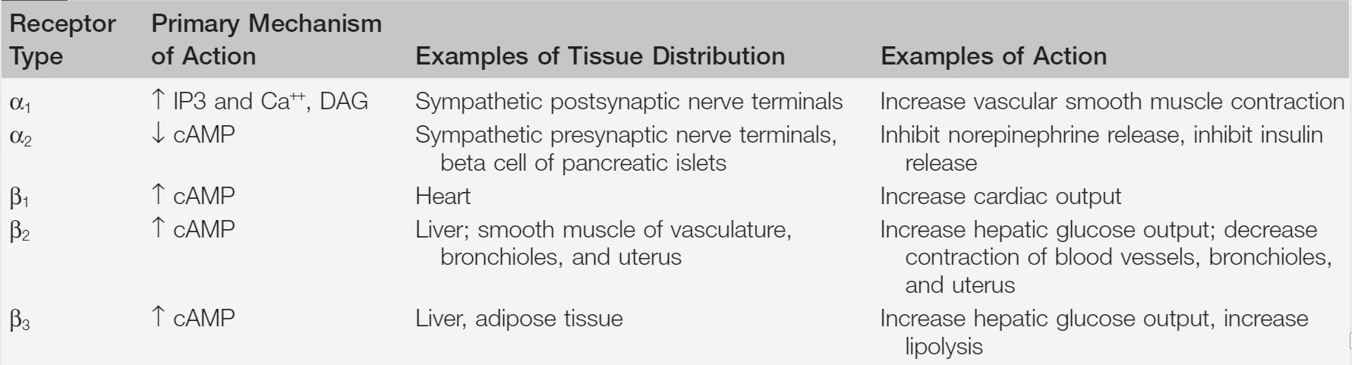
Autonomic nervous system
Adrenergic receptor
G-protein coupled
Type α –Excitatory receptors
Type β – Inhibitory receptors

Slide 7
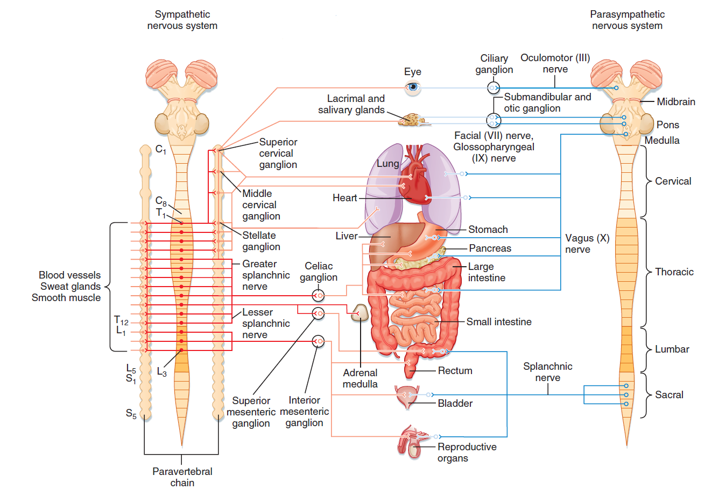
Autonomic nervous system
FIGHT OR FLIGHT
REST OR DIGEST

Slide 8
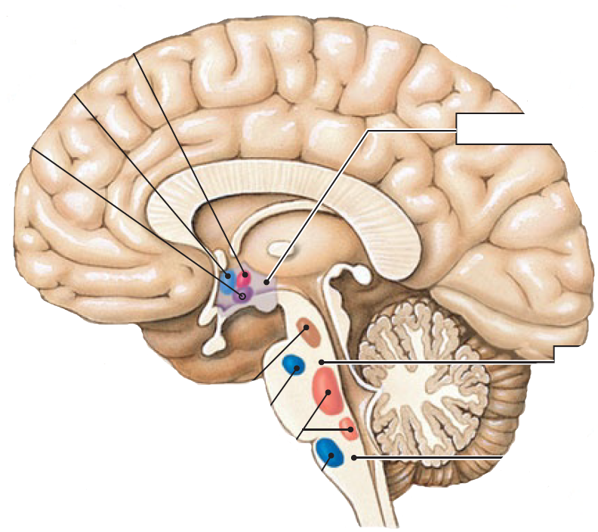
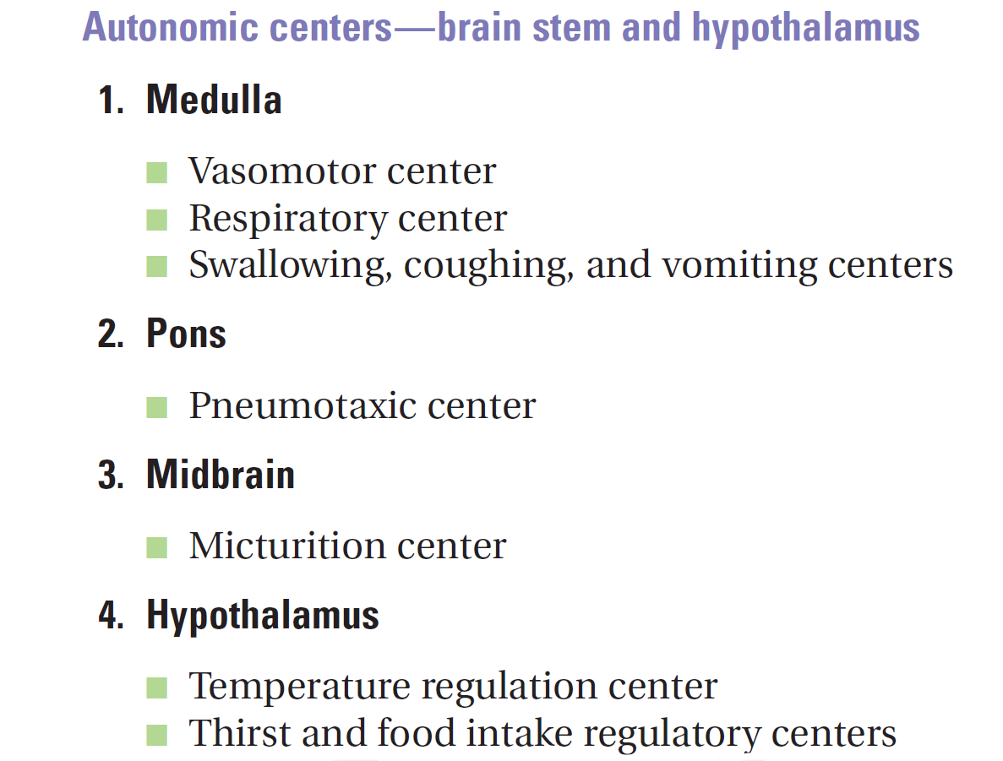

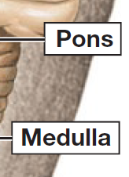
Brain control of ANS
Temperature control
Water balance
Eating
behavior
Urinary bladder
control
Secondary
respiratory center
Respiratory center
Blood pressure
control

Slide 9
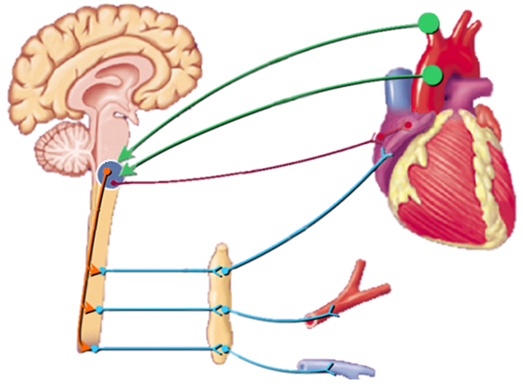
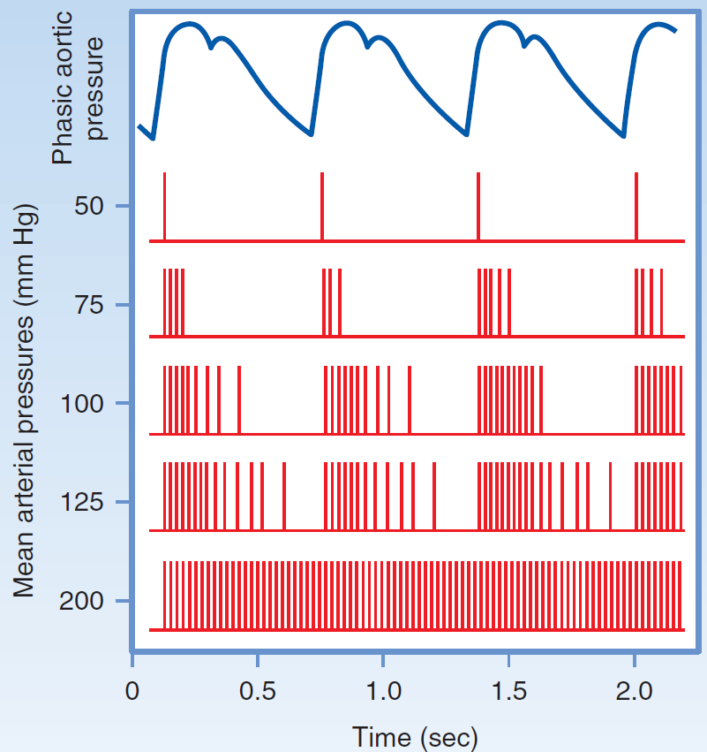
Baroreflex I
HR
Aferent pathway
Parasympathetic pathway
Sympathetic pathway
R
Inotropic
Chronotropic
Dromotropic
Batmotropic
effect
BP=HR x SV x R

Slide 10
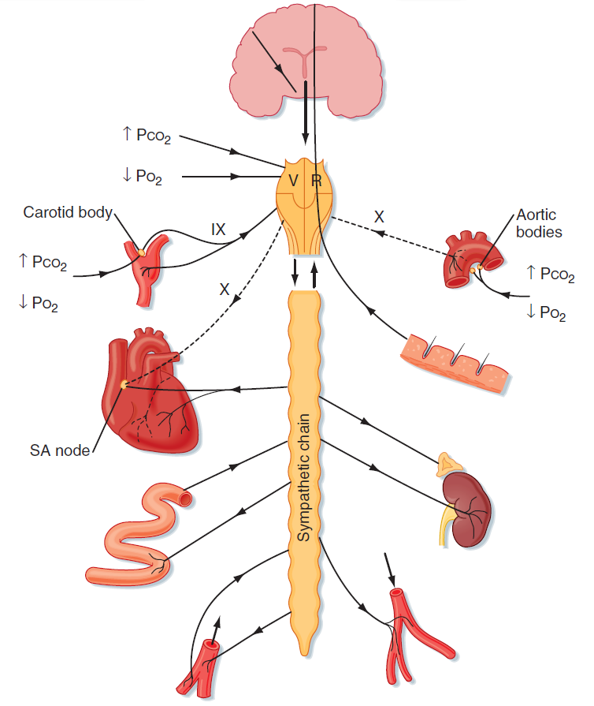
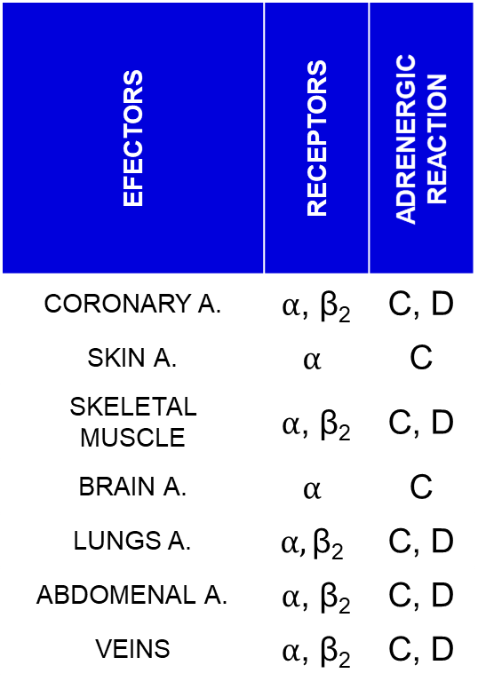
ANS and blood vessels
EFECTORS | RECEPTORS | ADRENERGIC REACTION
CORONARY A. | $α$, β₂ | C, D
SKIN A. | $$α$$ | C
SKELETAL MUSCLE | $α$, β₂ | C, D
BRAIN A. | $$α$$ | C
LUNGS A. | $$α,\text{β}\text{2}$$ | C, D
ABDOMENAL A. | $α$, β₂ | C, D
VEINS | $α$, β₂ | C, D

Slide 11
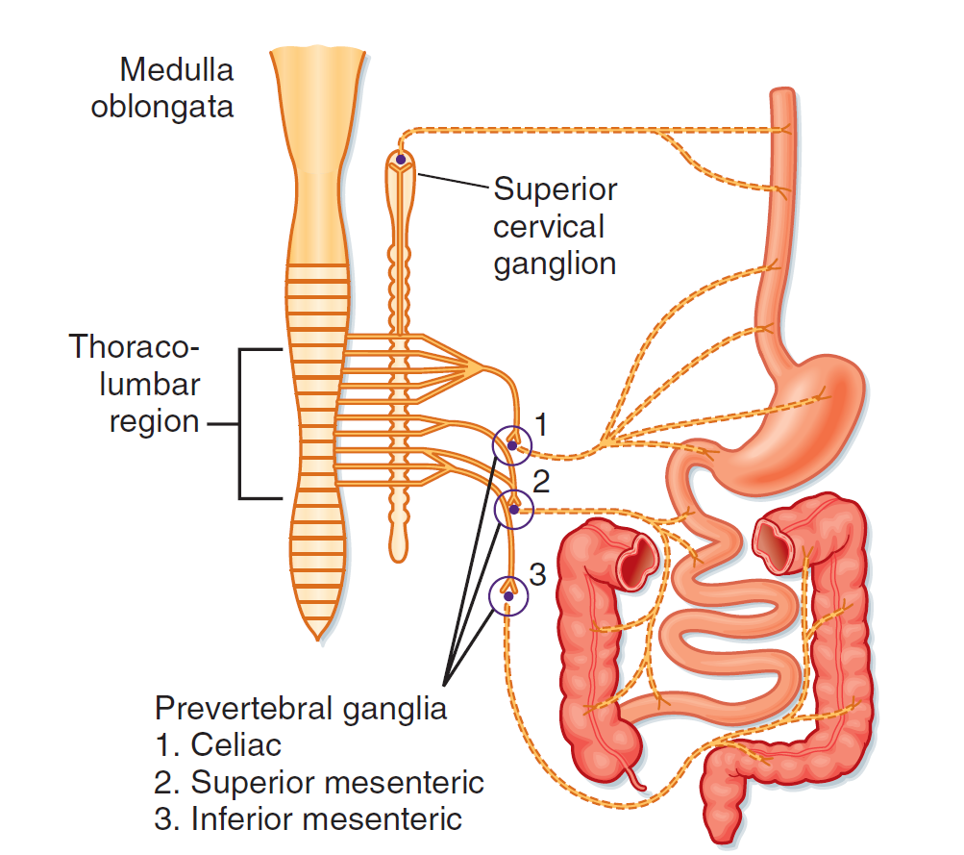
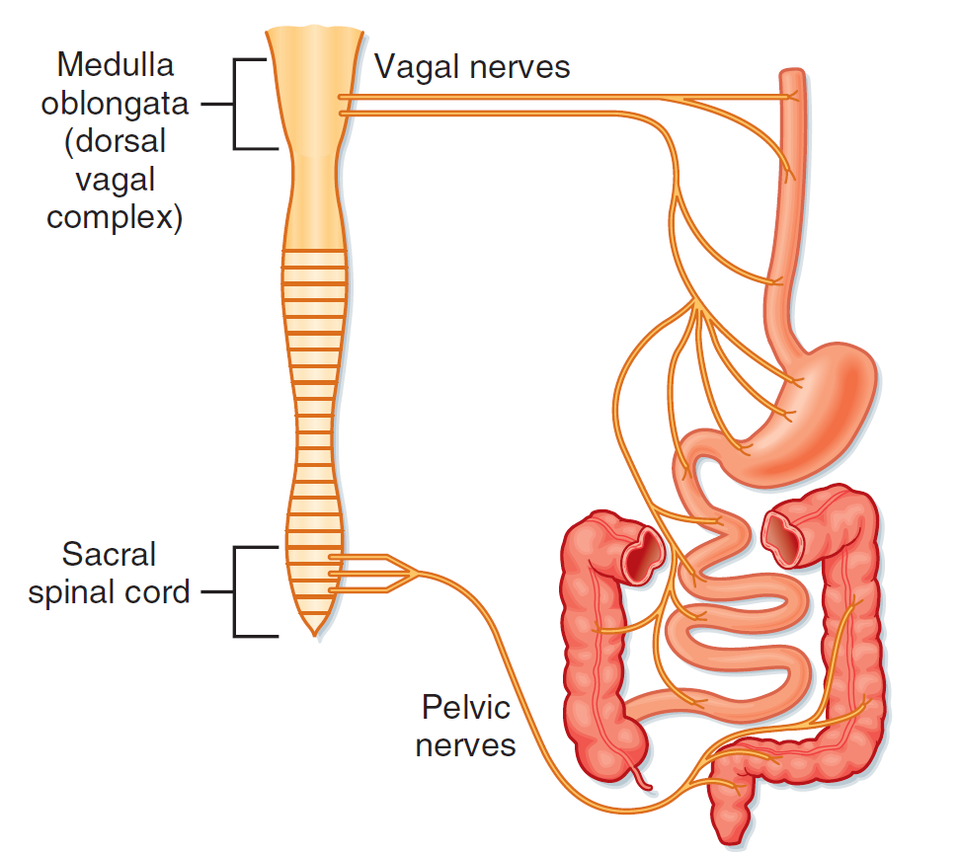
GIT and ANS
SNS
PNS

Slide 12
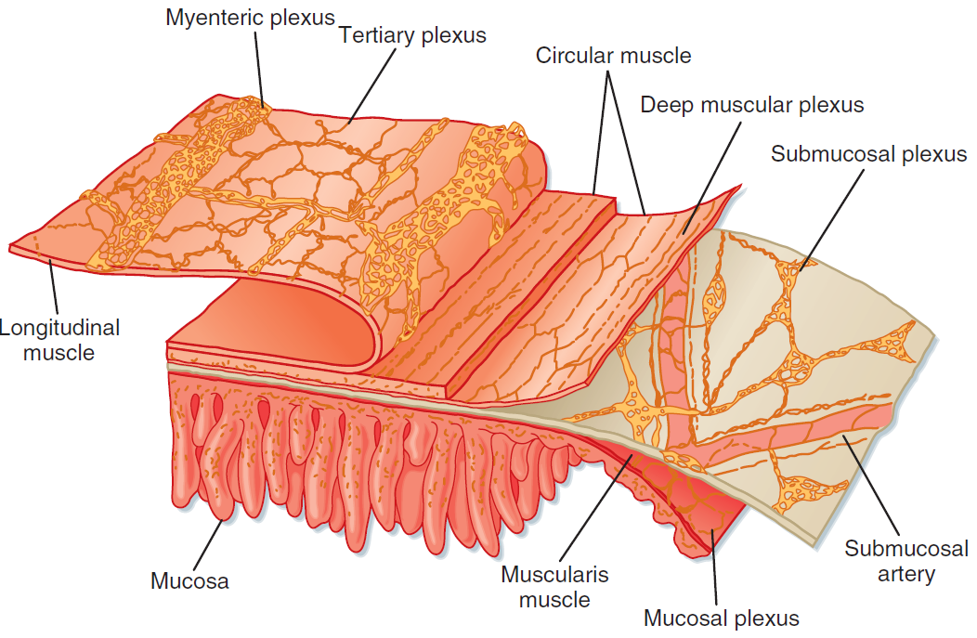
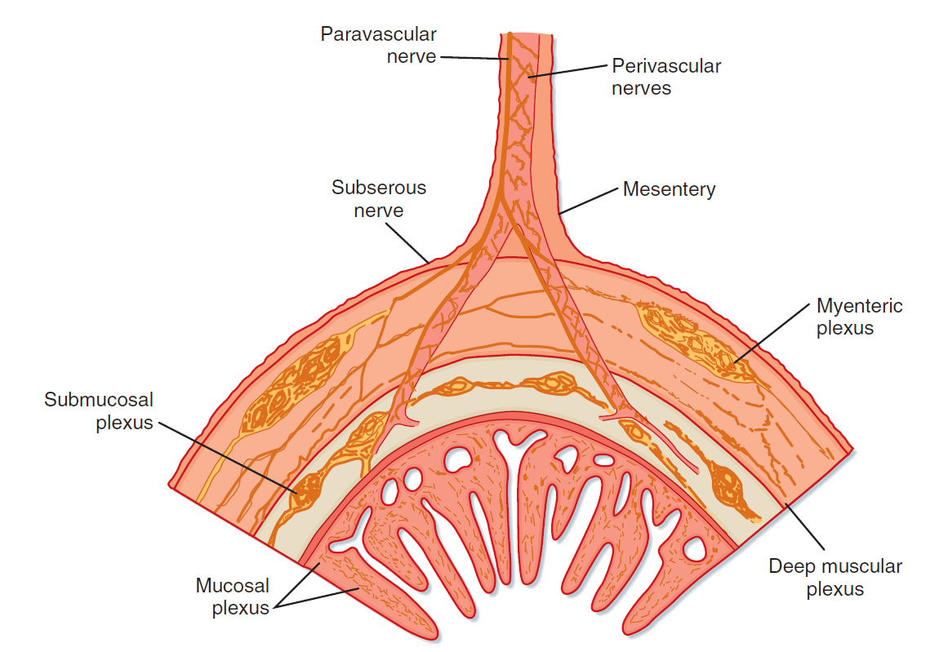
GIT - Enteric Nervous System

Slide 13
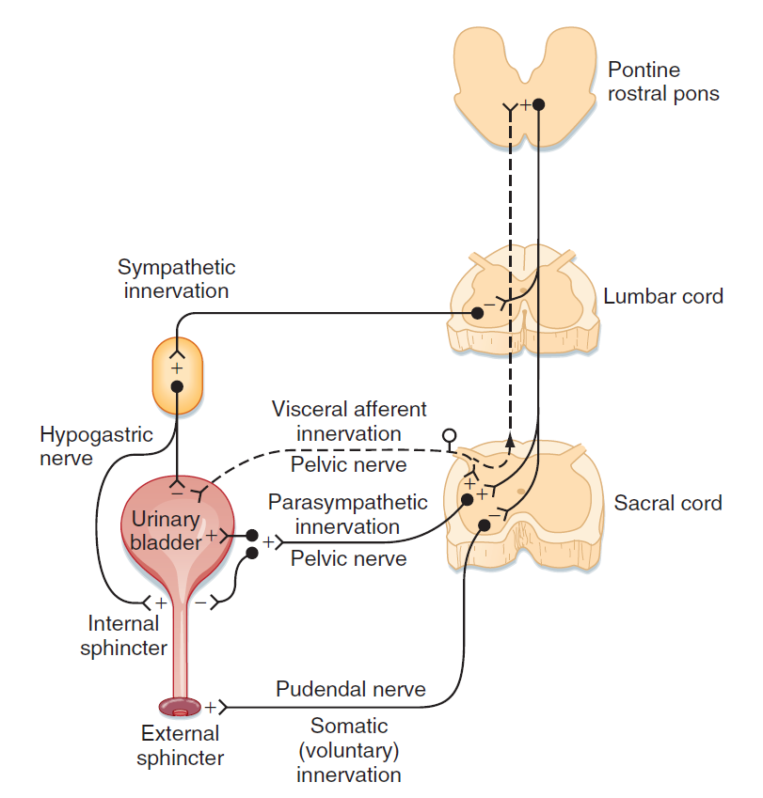
ANS and urinary bladder
SNS
DETRUSOR | RELAXATION
SPHINCTER | CONTRACTION
PSN
DETRUSOR | CONTRACTION
SPHINCTER | RELAXATION

Slide 14
Thank you for your attention

