Slide 1
Respiratory system.

Slide 2
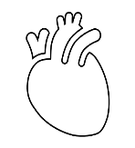
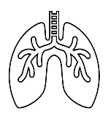
A22: Hypoxia and ischemia
Hypoxia is a general name for a lack of oxygen in the body or individual tissues
Ischemia, meaning insufficient blood flow to a tissue, can also result in hypoxia
The most common types of hypoxia:
Hypoxic
Transport (anemic)
Ischemic (stagnation)
Histotoxic
O₂
O₂
O₂
ERY
ERY
O₂
ERY: ♀ 3.4 – 4.4 * 10¹²/l
♂ 4.5 – 5.5 * 10¹²/l
pO₂: 21kPa

Slide 3
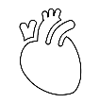
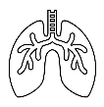
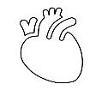
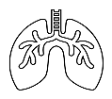
A22: Hypoxia and ischemia
Hypoxic:
physiological: stay at higher altitudes
↓ pO₂; N Ery
pathological: hypoventilation during lung or neuromuscular diseases
↓ ventilation; N pO₂; N Ery
Transport (anemic):
reduced transport capacity of blood for oxygen (anemia, blood loss)
N pO₂; ↓ Ery/Hb
Ischemic (stagnation):
restricted blood flow to tissue (heart failure, obstruction of an artery)
N pO₂; N Ery
Histotoxic
cells are unable to utilize oxygen (cyanide poisoning)
N pO₂; N Ery

Slide 4
A25: Lung ventilation, volumes, measurement
Ventilation, or breathing, is the movement of air through the conducting passages between the atmosphere and the lungs
Principle: determination the air flow velocity from the measured pressure differences between the inner and outer spirometer membranes, the volumes being calculated (PowerLab spirometry)

Slide 5
A25: Lung ventilation, volumes, measurement
V [l]
IRV (2,5 l)
Vt (0,5 l)
ERV (1,5 l)
RV (1,5 l)
Tidal volume (TV) – the volume of air that enters the lungs during each inspiration (or the volume that is exhaled during every expiration).
Inspiratory reserve volume (IRV) – the maximal amount of additional air that can be drawn into the lungs by determined effort after a normal inspiration at rest.
Expiratory reserve volume (ERV) – the additional amount of air that can be exhaled from the lungs by determined effort after a normal expiration.
Residual volume (RV) – the volume of air still remaining in the lungs after the most forcible expiration possible.

Slide 6
A25: Lung ventilation, volumes, measurement
V [l]
IRV (2,5 l)
Vt (0,5 l)
ERV (1,5 l)
RV (1,5 l)
Lung capacity:
VC = VT + IRV + ERV
TLC = VC + RV
FRC = ERV + RV
IC = IRV + VT
EC = ERV + VT
Dynamic lung volumes:
VE
MMV

Slide 7
A25: Lung ventilation, volumes, measurement
Dynamic lung volumes
V [l]
FVC – the maximum volume of air that can be exhaled after maximum inhale
FEV₁ – the volume of air exhaled with the greatest effort in 1 second after maximum inhale
FEV₁/FVC (%) – Tiffeneau index – around 0,8 (80 %)
FEV₁
FVC
RV
1 s
Time [s]

Slide 8
A25: Lung ventilation, volumes, measurement
V [l]
V [l]
FVC > FVC
FEV₁
FEV₁
1 s
Time [s]
1 s
Time [s]
Obstruction lung disease
(FVC=N; FEV₁=↓)
tracheal stenosis
astma bronchiale
CHOPN
tumor
Restrictive lung disease
(FVC=↓; FEV₁=N)
Pulmonarzy etiology
pulmonary fibrosis
lung resection
pulmonary edema
pneumonia
Extrapulmonary etiology
ascites
kyphoscoliosis
burns
high diaphragm condition

Slide 9
A25: Lung ventilation, volumes, measurement
Helium dilution method – residual volume
V₁
c₁
c=$\frac{n}{V}$
V₂=RV+V₁
c₂
V₁$×c1=(RV+V1)×$c₂
$$RV=\frac{V1×c1}{c2}−V1$$

Slide 10
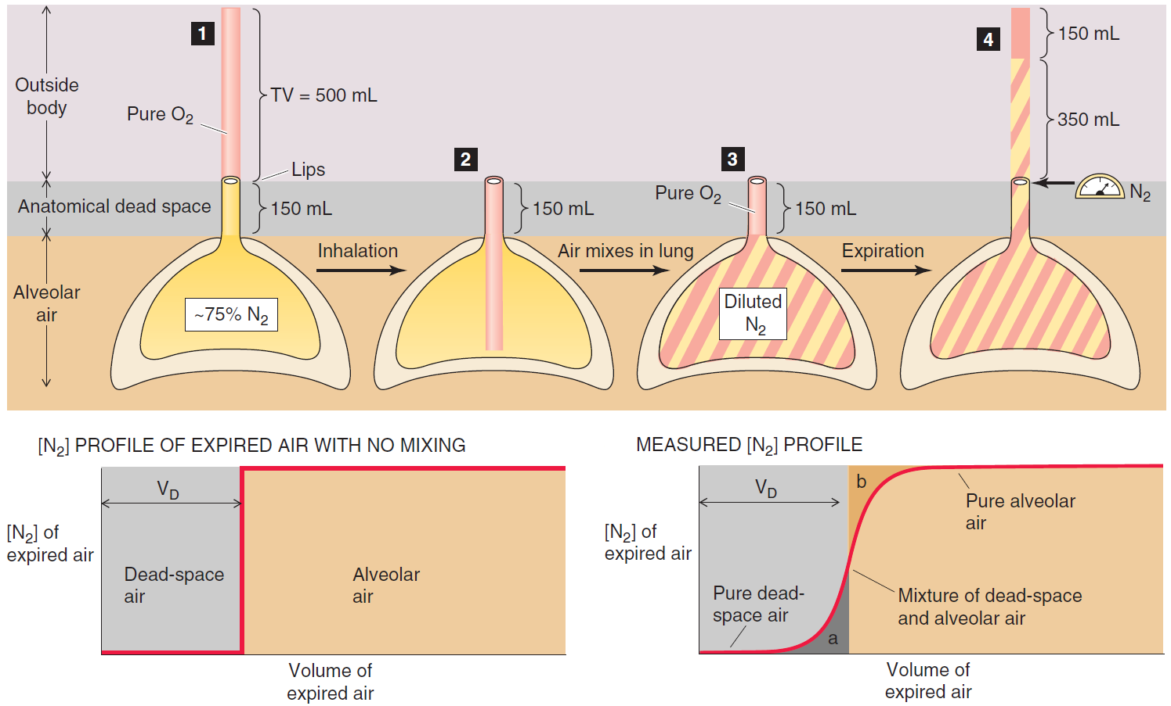
A26: Dead space, measurement

Slide 11
A46: Compliance of lungs. Respiratory work. Pneumothorax
According to etiology:
traumatic pneumothorax (due to an injury) occurs if the chest wall is perforated or during an injury of the esophagus, bronchi, and during rib fractures.
spontaneous pneumothorax
primary idiopathic pneumothorax (without any known cause) may occur in tall healthy young men with an incidence of pneumothoraxes in the family,
secondary pneumothorax arises as a consequence of lung diseases (such as COPD or cystic fibrosis),
iatrogenic pneumothorax (due to medical procedures) occurs during invasive medical examinations such as transparietal aspiration biopsy, subclavian vein catheterization, or mechanical ventilation with positive pressure.
artificially induced (deliberate) pneumothorax is used during thoracoscopy, an endoscopic examination the thoracic cavity.
According to the communication of the pleural space with its surroundings
open pneumothorax (when the hole in the pleural space remains open, the air in the pleural cavity moves back and forth with each breath of the patient)
closed pneumothorax (when a small opening through which air enters the pleural cavity closes)
valvular pneumothorax (the tissue of the lungs or the chest wall covers the hole in such a way that a valve emerges, this valve allows air to flow inside during inspiration, but it prevents the air from leaving the pleural cavity during exhalation).

Slide 12
A47: Composition of atmospheric and alveolar air. Gas exchange in lungs and tissues.
O₂ 20.95 % F_{O2} ≅ 0,21
N₂ 78.09 % F_{N2} ≅ 0,78
CO₂ 0.03 % F_{CO2} ≅ 0,0004
COMPOSITION OF DRY ATMOSPHERIC AIR
BAROMETRIC PRESSURE IN SEA LEVEL
1 atmosphere = 760 mm Hg
PARTIAL PRESSURE OF DRY AIR IN SEA LEVEL
P_{O2} = 760 x 0,21 = ~160 mm Hg
P_{N2} = 760 x 0,78 = ~593 mm Hg
P_{CO2} = 760 x 0,0004 = ~ 0,3 mm Hg
1 kPa = 7,5 mm Hg (torr)

Slide 13
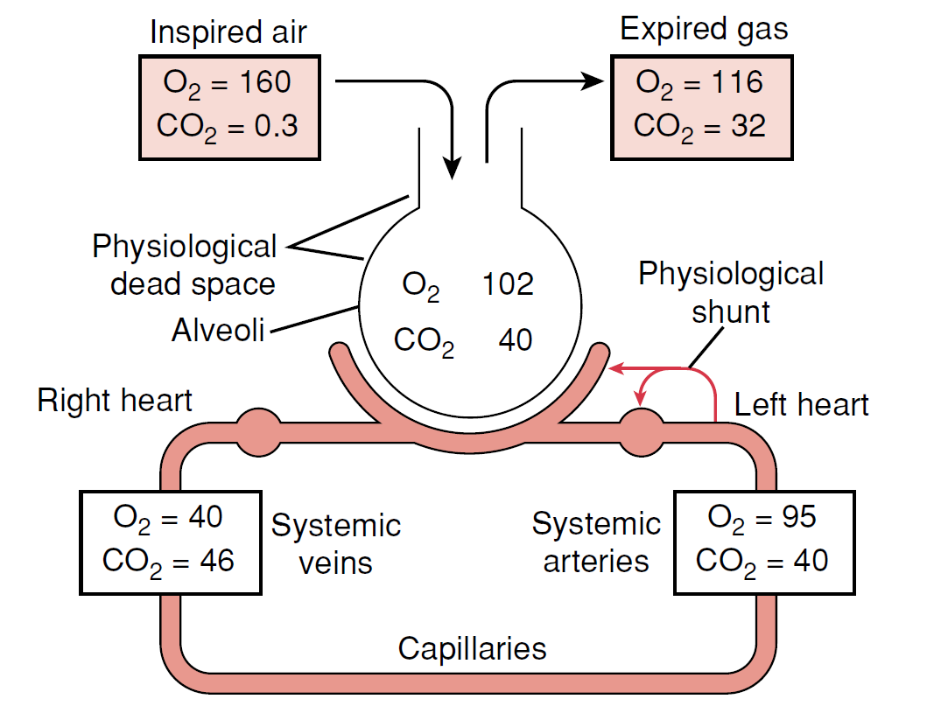
A47: Composition of atmospheric and alveolar air. Gas exchange in lungs and tissues.

Slide 14
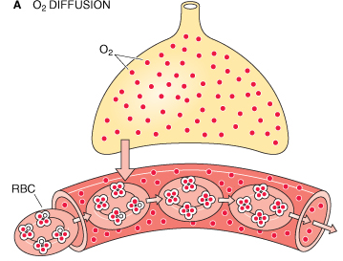
A48: Transport of O2. Oxygen - haemoglobin dissociation curve. Transport of CO2
O₂ is transported in two forms :
physically dissolved(1%)
in chemical bond with Hb (99%)
Fetal hemoglobin(2α, 2γ)
Methemoglobin (Fe³⁺)
Carboxyhemoglobin (CO)
Carbaminohemoglobin (CO₂)
Oxyhemoglobin (O₂)
Deoxyhemoglobin (without any gases)

Slide 15
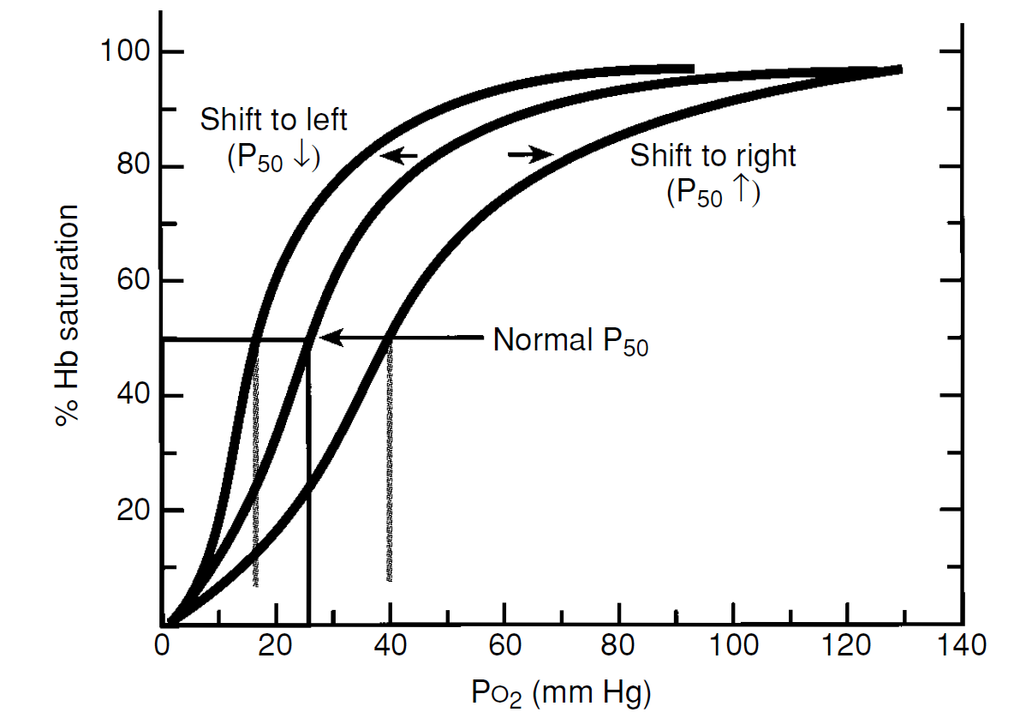
A48: Transport of O2. Oxygen - haemoglobin dissociation curve. Transport of CO2
Dissociation curve of Hb is influenced by:
pH of blood
pCO₂ of blood
Temperature
Concentration of 2,3 - BPG

Slide 16
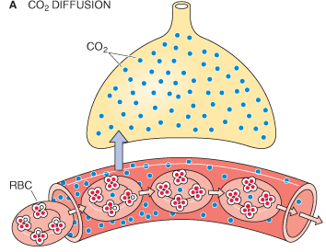
A48: Transport of O2. Oxygen - haemoglobin dissociation curve. Transport of CO2
CO₂ is transported in next forms :
physically dissolved(5 %)
in the form of bicarbonate anions (85%)
in chemical bond with Hb (10%)
CO₂
H⁺ + Hb
KAH
CO₂ + H₂O H₂CO₃
HCO₃⁻
CO₂
Cl⁻
Hb
H⁺ + HCO₃ ⁻
H₂CO₃
KAH
CO₂ + H₂O
Cl⁻

Slide 17
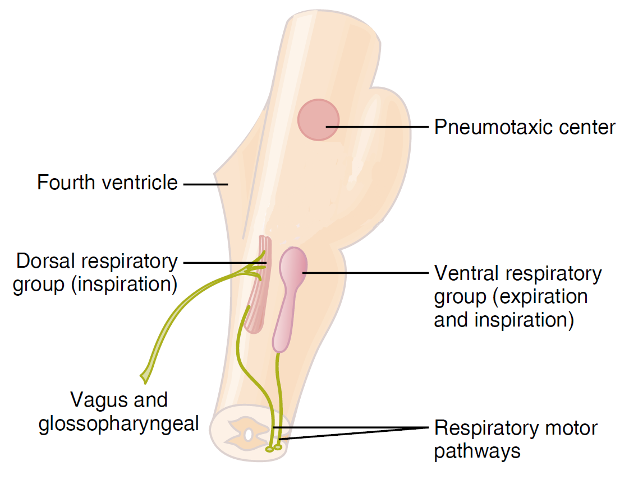
A49: Regulation of ventilation

Slide 18
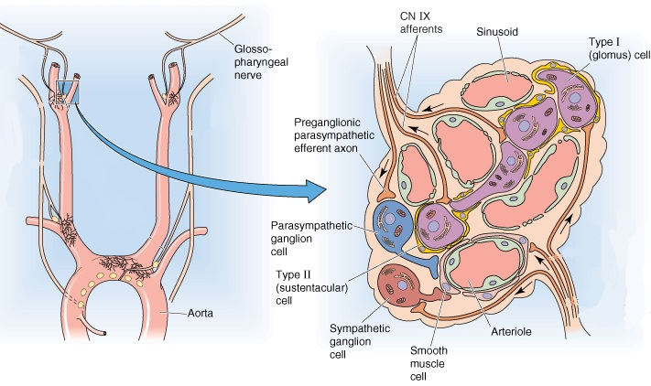
A49: Regulation of ventilation

Slide 19
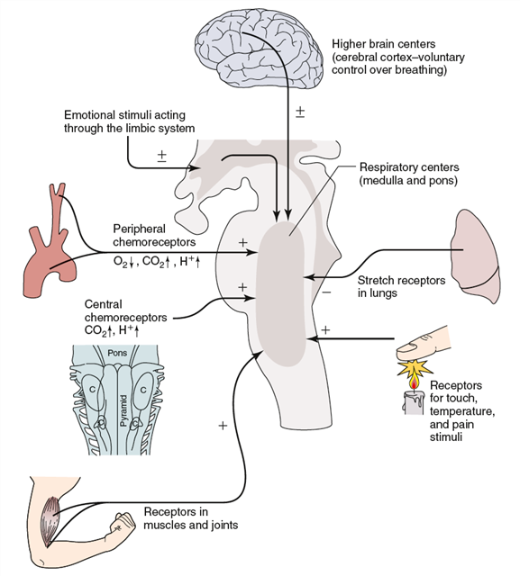
A49: Regulation of ventilation

