Slide 1
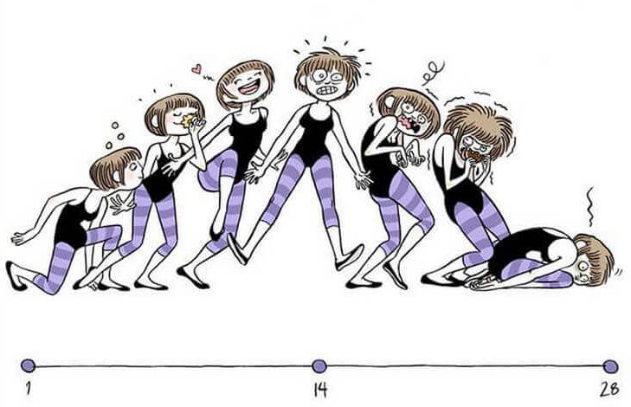
Physiology of reproduction.

Slide 2
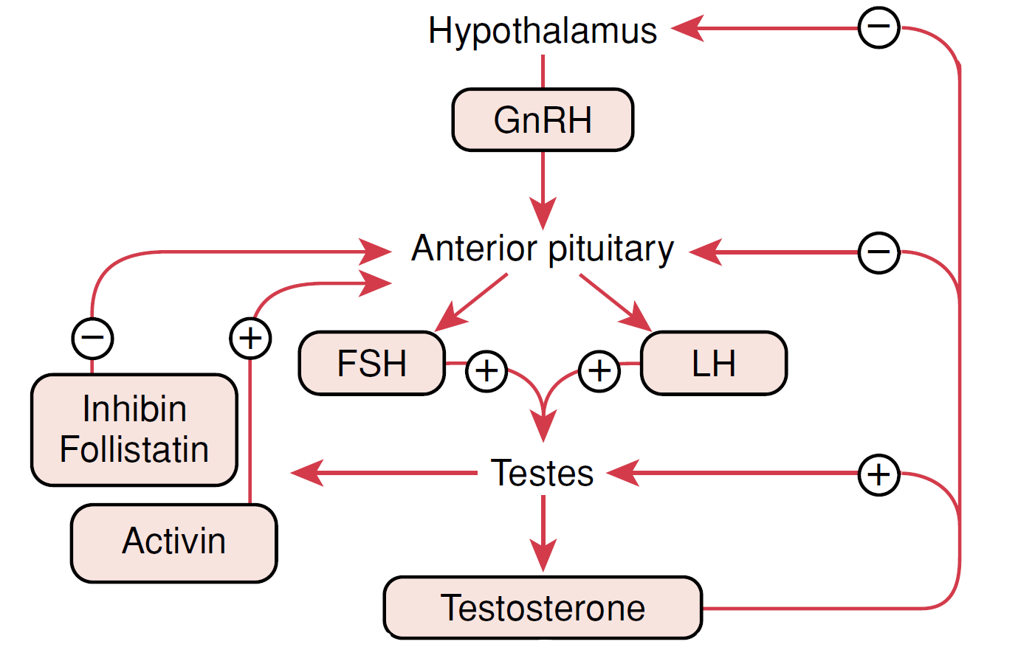
Hypothalamus – hypophysis – gonads

Slide 3
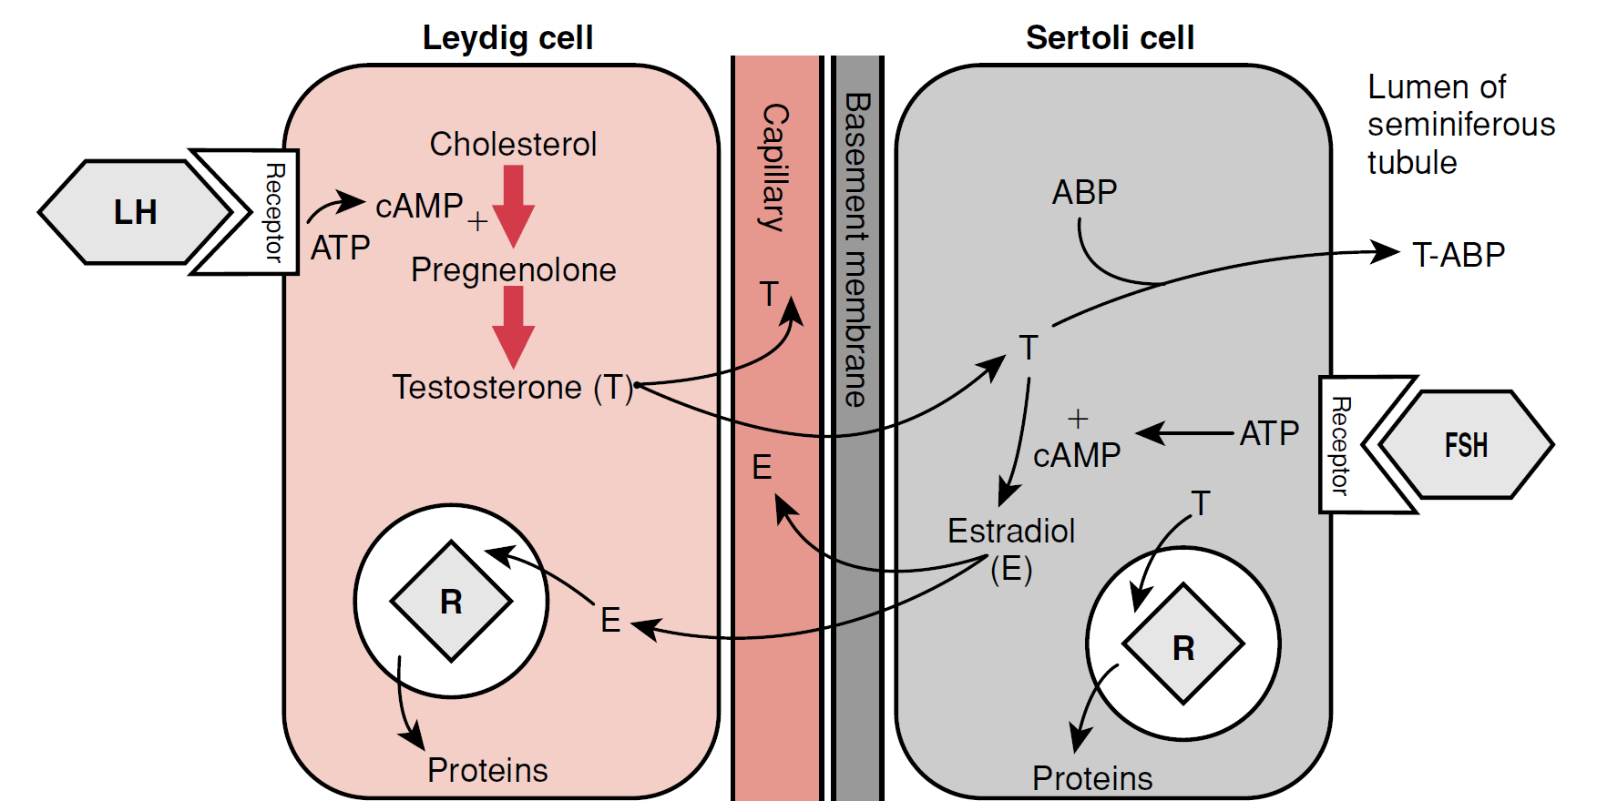
Hypothalamus – hypophysis – gonads

Slide 4
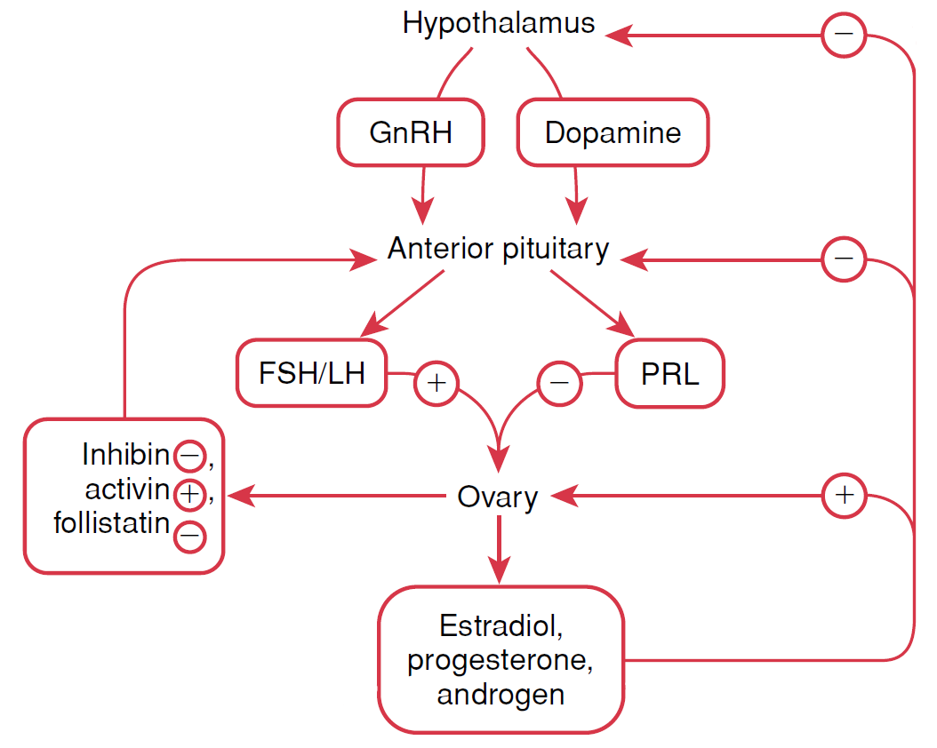
Hypothalamus – hypophysis – gonads

Slide 5
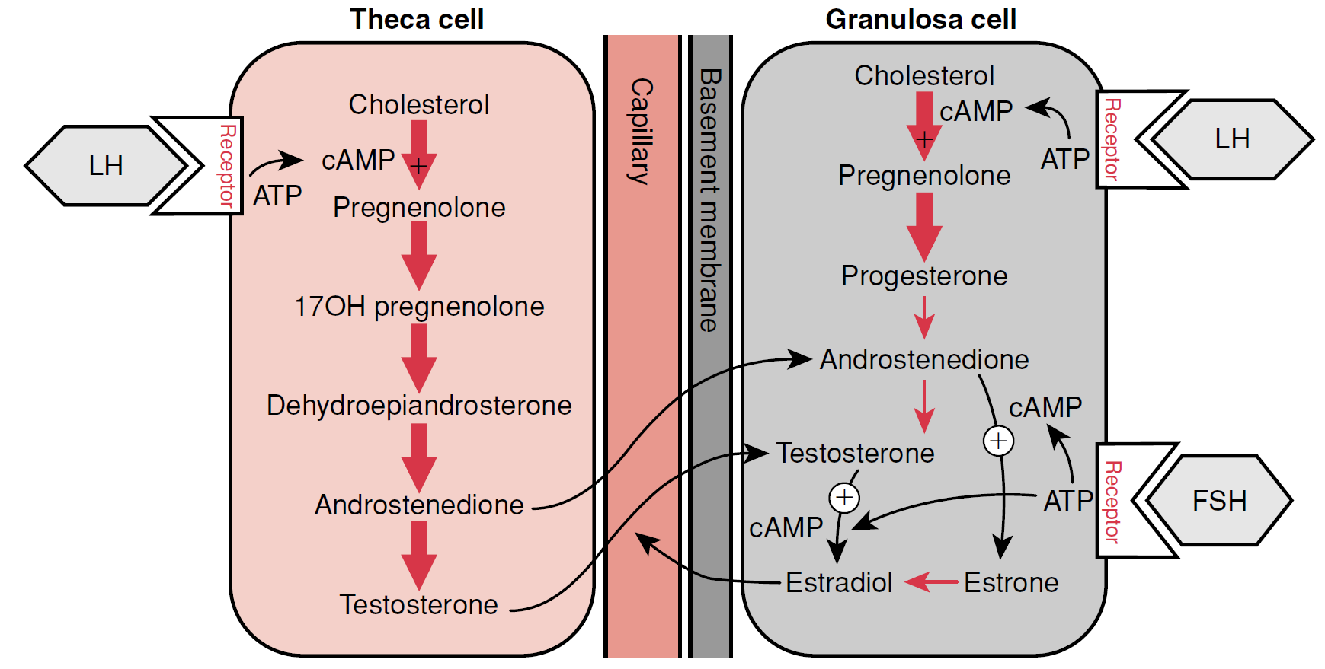
Hypothalamus – hypophysis – gonads

Slide 6
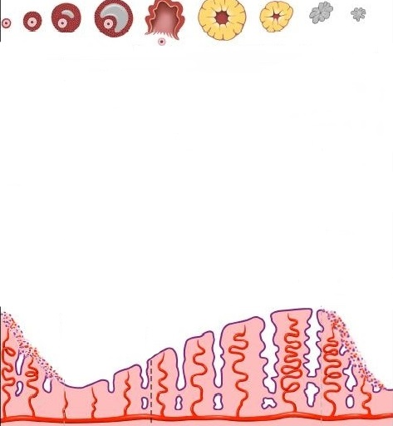
Menstrual cycle
follicle selection
ovulation
corpus luteum
37◦
36◦
LH
FSH
E
P
1
14
28
follicular phase
luteal phase
1
menstruation

Slide 7
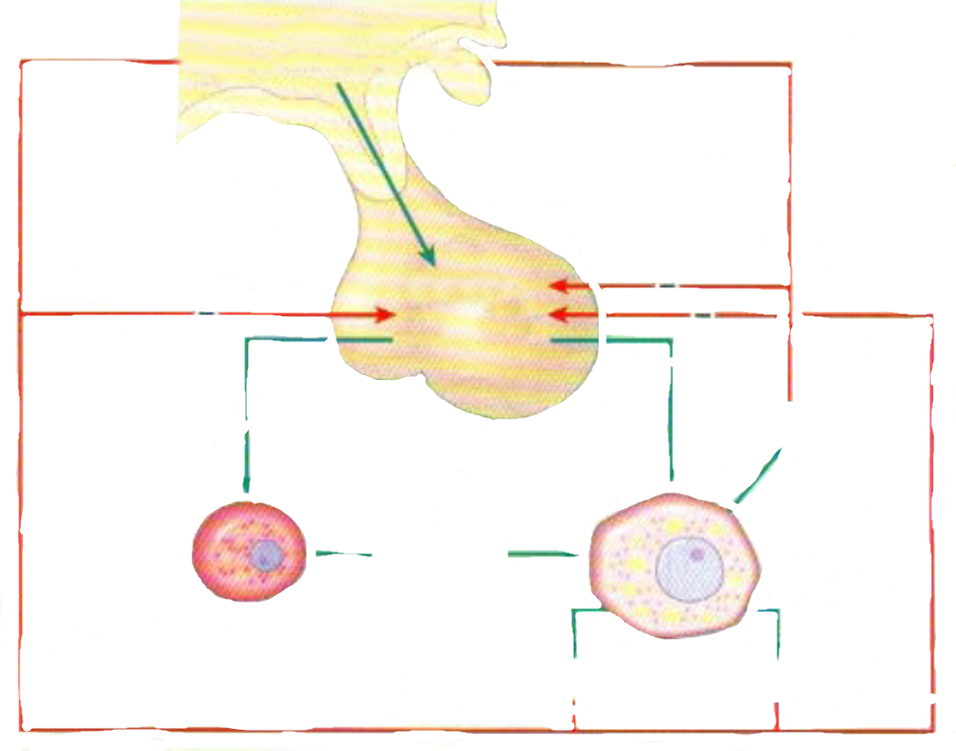
Negative feedback
HYPOTHALAMUS
GnRH
HYPOFYSIS
LH
FSH
LH
FSH
INHIBIN
ANDROGENS
PROGESTINS
ESTROGENS

Slide 8
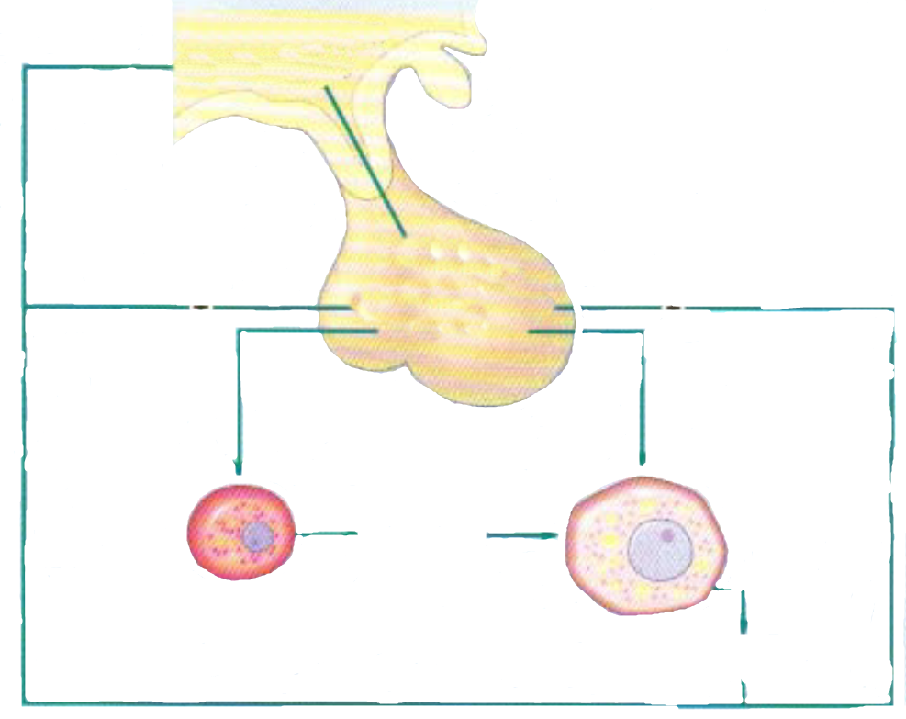
Positive feedback
HYPOTHALAMUS
GnRH
HYPOFYSIS
LH
FSH
LH
FSH
ANDROGENS
ESTROGENS

Slide 9
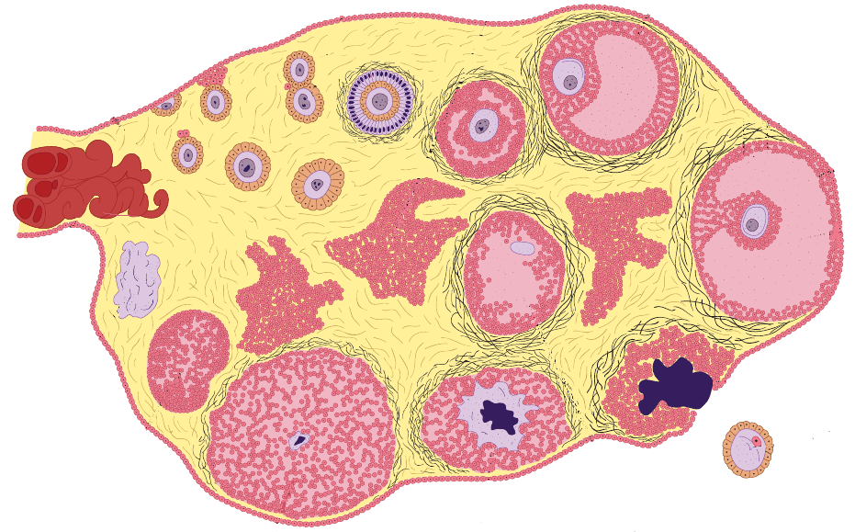
Ovarian cycle
primordial follicles
primary follicle
dominant follicle
corpus albicans
corpus haemorraghicum
ovum
corpus luteum

Slide 10
Menstrual cycle
follicle selection
ovulation
corpus luteum
37◦
36◦
LH
FSH
E
P
1
14
28
menstruation
proliferative phase
secretory phase
1
menstruation

Slide 11
Functions of the PLACENTA
TRANSPOR function
Respiratory gases
transport and metabolism of sacharides
transport and metabolism of aminoacods
transport and metabolism of fat
transport of H2O, minerals and vitamines
ENDOCRIN function
Estrogens
Progesteron
HCG
HPL
Growth factors (epidermal and insulin-like growth factors)
PROTECTIV function
Cytochrom P450
Pinocytosis (IgG)
Barier against bacterias, virus etc.

Slide 12
HCG
HCG (Human Chorionic Gonadotropin)
Glycoprotein
secreted by the syncytial trophoblast cells
prevents involution of the corpus luteum
prevent menstruation and cause the endometrium to continue to grow
can ﬁrst be measured in the blood 8 to 9 days after implantation
effect on the fetal testes
↓ - ectopic pregnancy, dead fetus
↑ - multiple pregnancy and diagnosis of trisomy 21 - Down syndrome
4
8
12
16
20
24
28
32
36
40
1
2
3

Slide 13
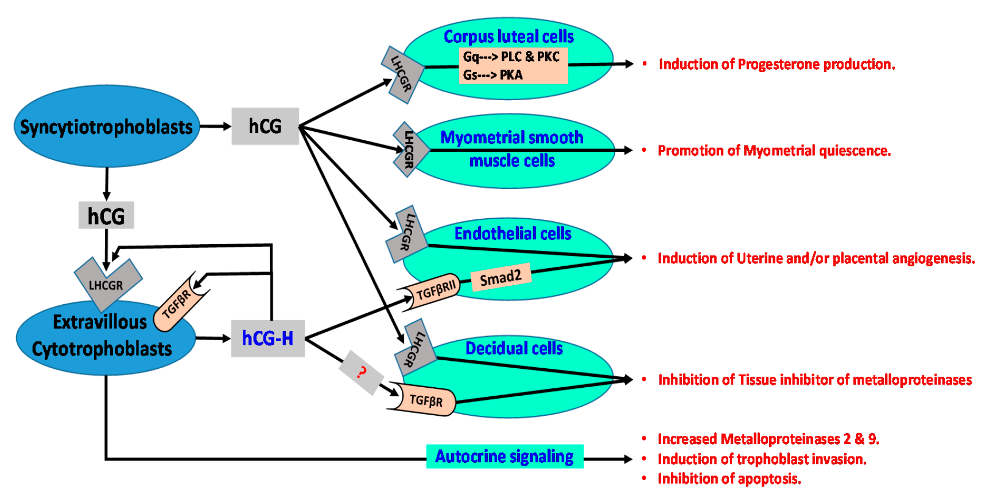
HCG

Slide 14
RX
RX (Relaxin)
relaxes the pubic symphysis and other pelvic joints and softens
dilates the uterine cervix
mediate hemodynamic changes (pregnancy)
RX
4
8
12
16
20
24
28
32
36
40
1
2
3

Slide 15
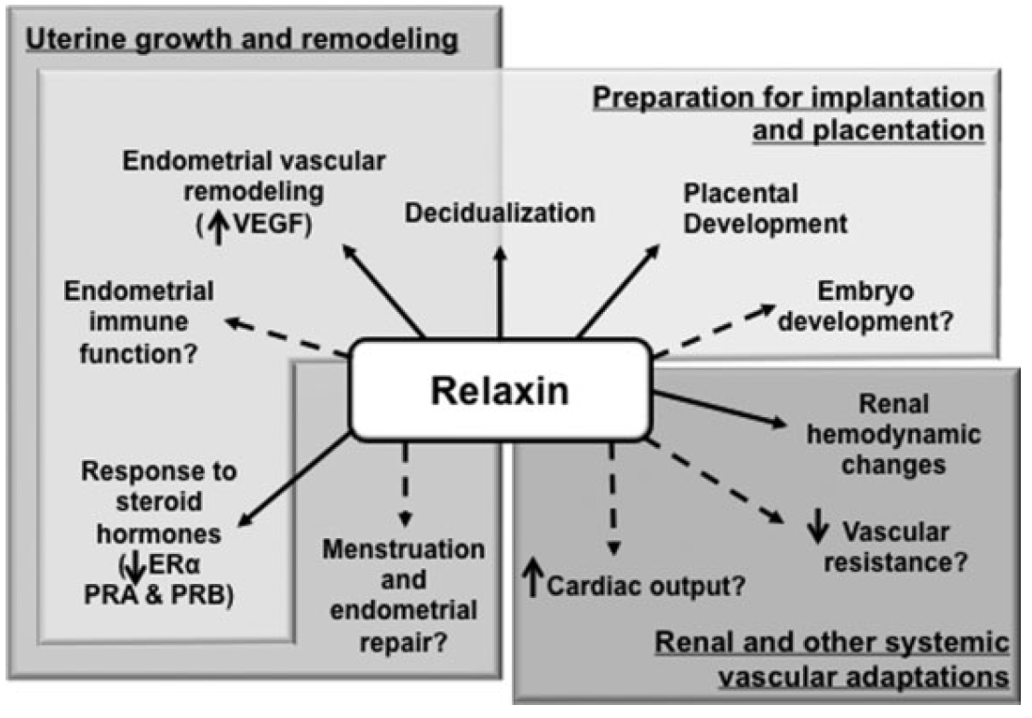
RX

Slide 16
HCS/HPL
HCS (Human Chorionic Somatomammotropin)
placental growth hormone - Human placental lactogen (hPL)
has weak actions similar of growth hormone
causes retention of nitrogen, potassium, calcium
causes decreased insulin sensitivity and decreased utilization of glucose in the mother
secretion of this hormone increases progressively in direct proportion to the weight of the placenta
HCS/HPL
4
8
12
16
20
24
28
32
36
40
1
2
3

Slide 17
PROL
PROL (Prolactin)
luteotropic hormone or luteotropin
stimulates the mammary glands to produce milk (lactation)
provides the body with sexual gratification after sexual acts
plays an important role in maternal behavior
inhibits maturation of ovum
PROL
4
8
12
16
20
24
28
32
36
40
1
2
3

Slide 18
OX
OX (Oxytocin)
secreted by the neurohypophysis (nucleus paraventricularis)
causes uterine contraction
mediates the let-down reflex
OX
4
8
12
16
20
24
28
32
36
40
1
2
3

Slide 19
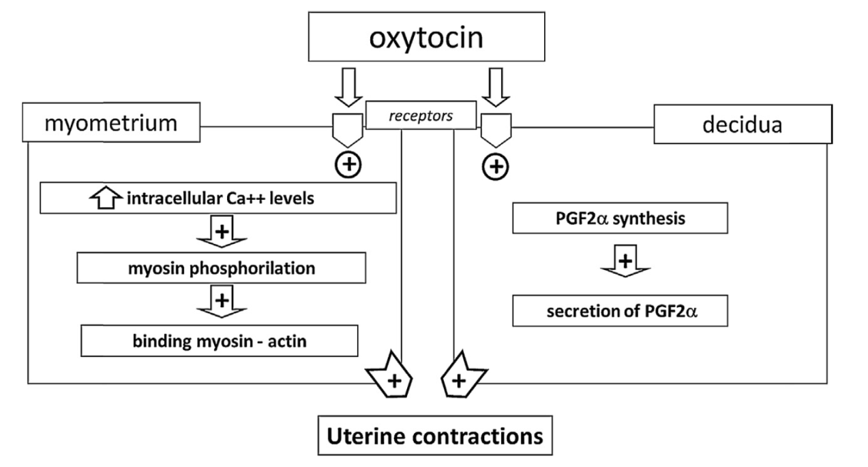
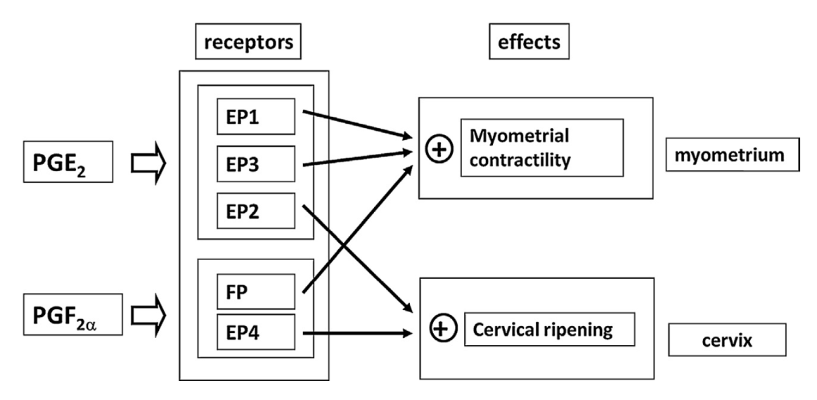
OX

Slide 20
Progesteron
P (Progesteron)
causes decidual cells to develop in the uterine endometrium
decreases the contractility of the pregnant uterus
contributes to the development of the conceptus even before implantation
prepares the mother’s breasts for lactation
P
4
8
12
16
20
24
28
32
36
40
1
2
3

Slide 21
Estroen
E (Estrogen)
enlargement of the mother’s uterus
enlargement of the mother’s breasts and growth of the breast ductal structure
and enlargement of the mother’s female external genitalia
relax the pelvic ligaments of the mother
dampen the formation of the pituitary gonadotropins - not mature further follicles, miss menstrual cycles
E
4
8
12
16
20
24
28
32
36
40
1
2
3

Slide 22
E
HCG
P
PROL
RX
HPL
OX
4
8
12
16
20
24
28
32
36
40
1
2
3

Slide 23
Fetoplacental unit
FETUS
HPA axis
CORTISOL
GROWTH OF FETUS
PLACENTAL
ENDOCRINE AXIS
UTERINE
GROWTH
EXTENSION
OF UTERUS
(+)
P
E
(-)
ACTIVATION
STIMULATION
Gap junctions
oxytocin
PGs
PARTURITION

Slide 24
Fetoplacental unit
FETUS
FETOPLACENTAL
UNIT
MATERNAL
COMPARTMENT
cortisol
cortisol
cortisol
cholesterol
hypotalamus
hypotalamus
CRH
estrogens
adenohypophysis
neurohypophysis
ACTH
ardenal glands
placental OT
PGs
oxytocin
cortisol
(preparation of fetal organs)
placental CRH
uterus
(vazodilation of the placenta)
PARTURITION

Slide 25
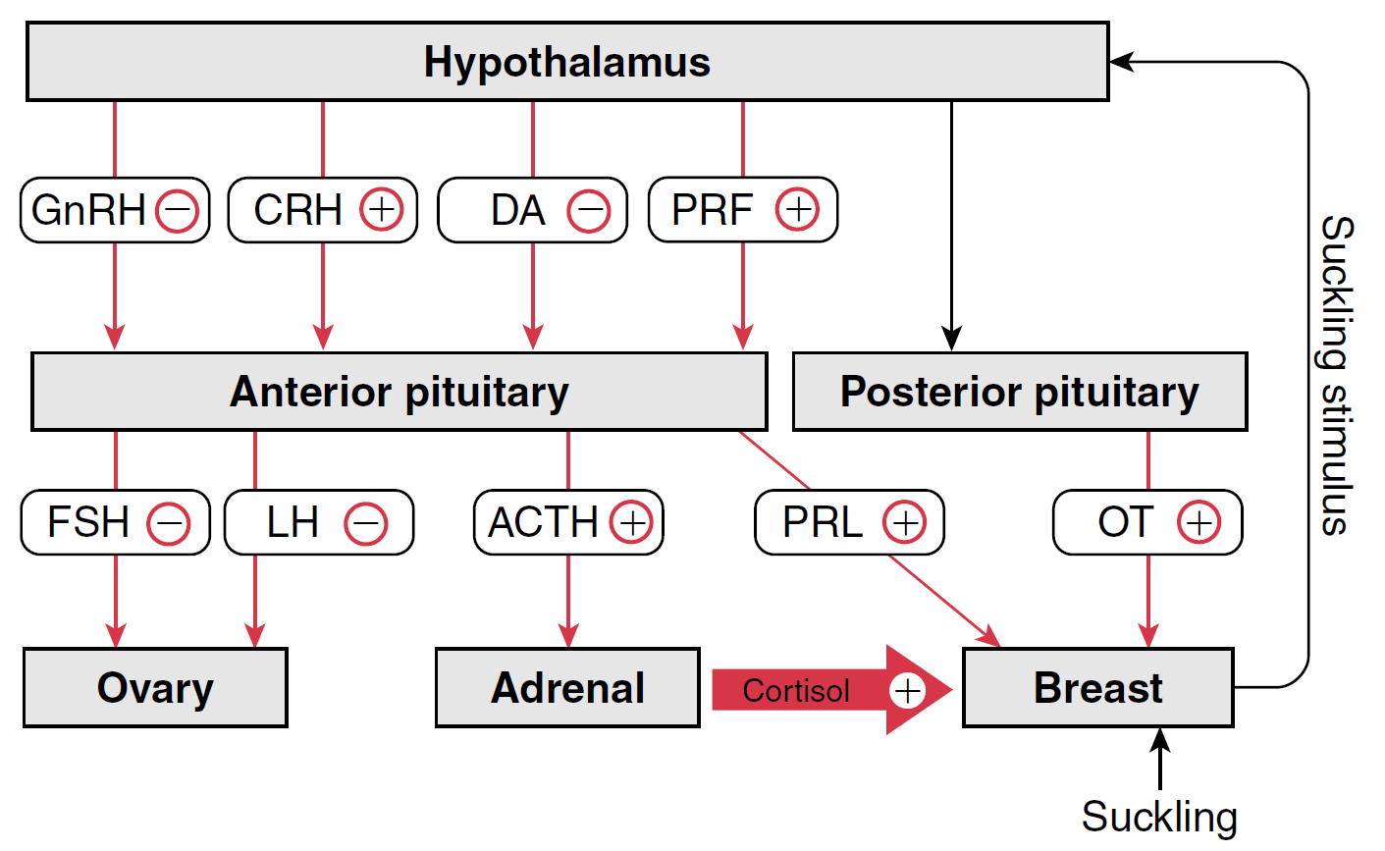
Lactation

Slide 26
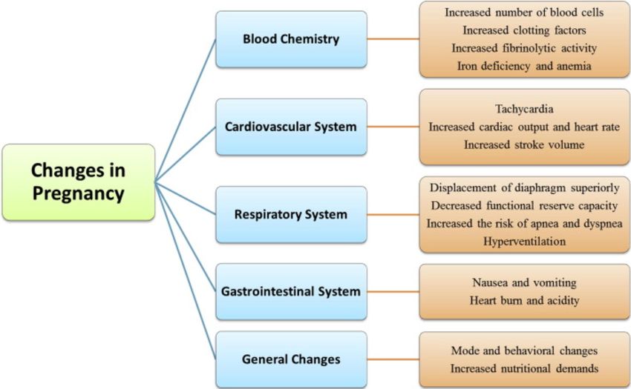
Physiological changes during pregnancy

Slide 27
THANK YOU FOR YOUR ATENTION

