Slide 1
Rheumatoid diseases
Exercise therapy

Slide 2
Systemic autoimmune diseases
Rheumatoid arthritis
Juvenile arthritis
Systemic lupus erythematodes
Sclerodermia
Sjogren syndrom
- Polymyalgia rheumatica
Spondylartritis
Ancylosing spondylitis
Psoriatic arthritis

Slide 3
Crystal arthritis
Gout
Chondrocalcinosis (calciumpyrophosphates)
Artritis in connection with infection
Lyme´s boreliosis
Septic arthritis

Slide 4
Rheumatoid arthritis
Chronic autoimmune disease
Chronic polyarthritis
Bone errosions
Destruction of joints
Disability- low physical activity
Extraarticular symptoms
Comorbidities, higher mortality
1% of population
Female 4 times more affected
Onset in 4. and 5. decade

Slide 5
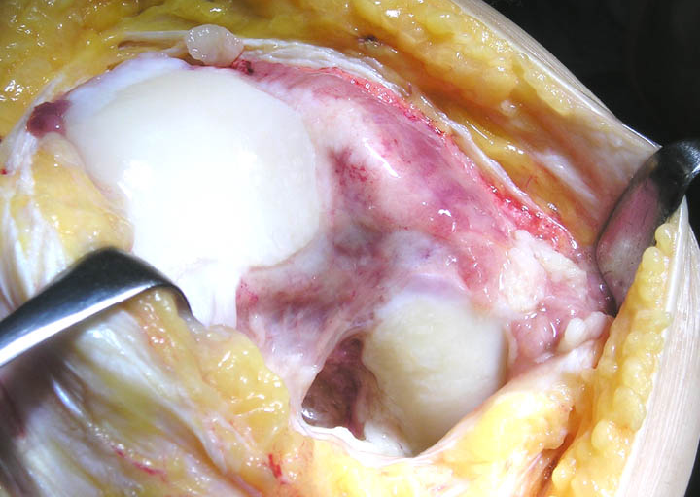
Basic feature: hypervascularisation tissue – pannus formation
in a joint
leading to damage of hyaline cartilage, decalcination
and bone errosions

Slide 6
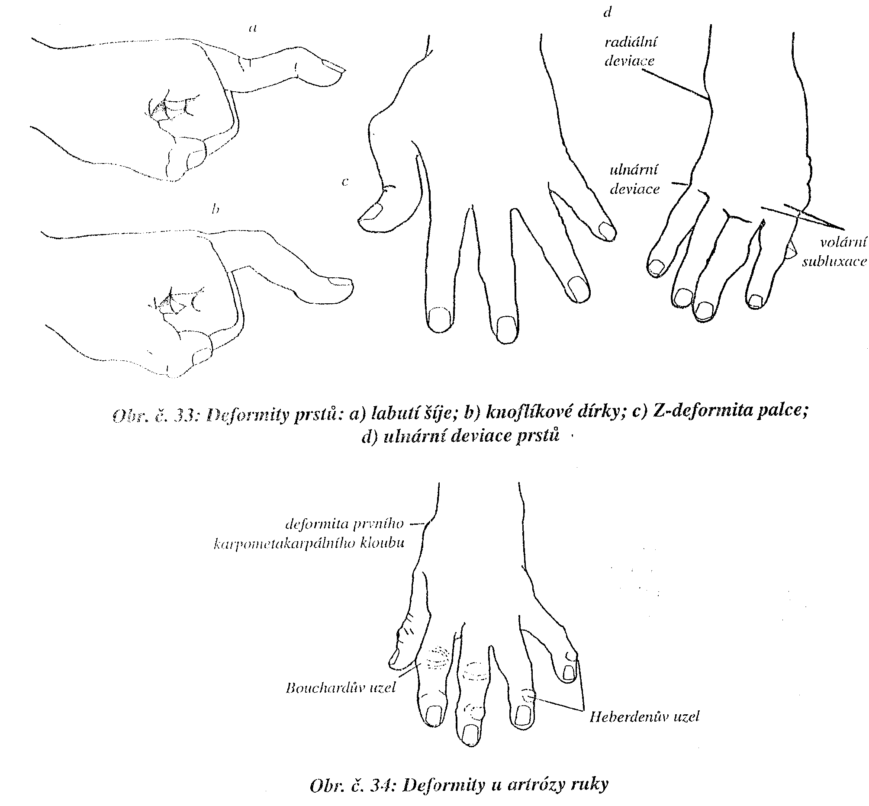
Hand
Oedema
Rheumatoid nodes
Synovitis, synovial hyperplasia
Ulnar deviations of fingers
Z deformity of the thumb
Swan neck deformity
Button hole deformity
Volar subluxation of the wrist joint

Slide 7
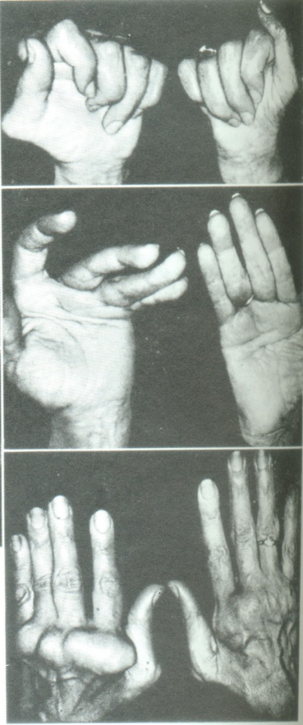
Deformities in the hand
Swan neck deformity
Z deformity of the thumb
Ulnar deviation of fingers
Synovitis of MCPh, DIP joints
Digiti telescopici
Button hole deformity

Slide 8
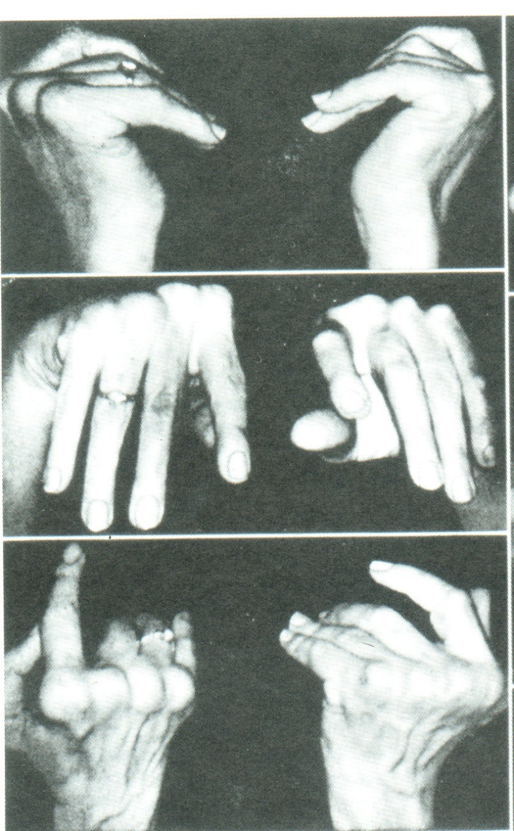
Hand in RA
Radial deviation of the wrist joint
Volar subluxation of the wrist
Dorsal prominence of the head of ulna

Slide 9
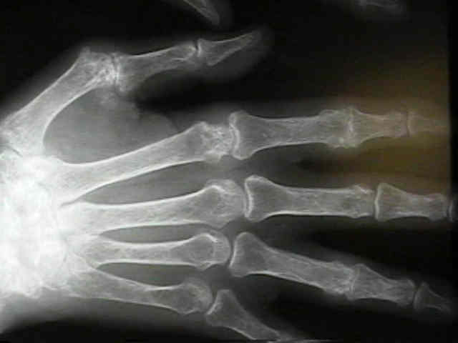
X ray

Slide 10
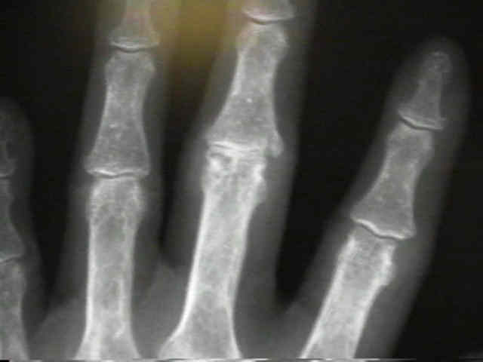
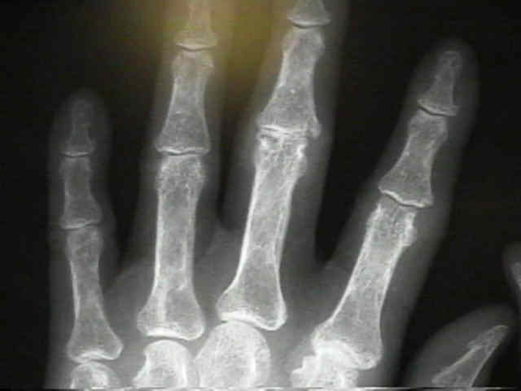
X ray

Slide 11
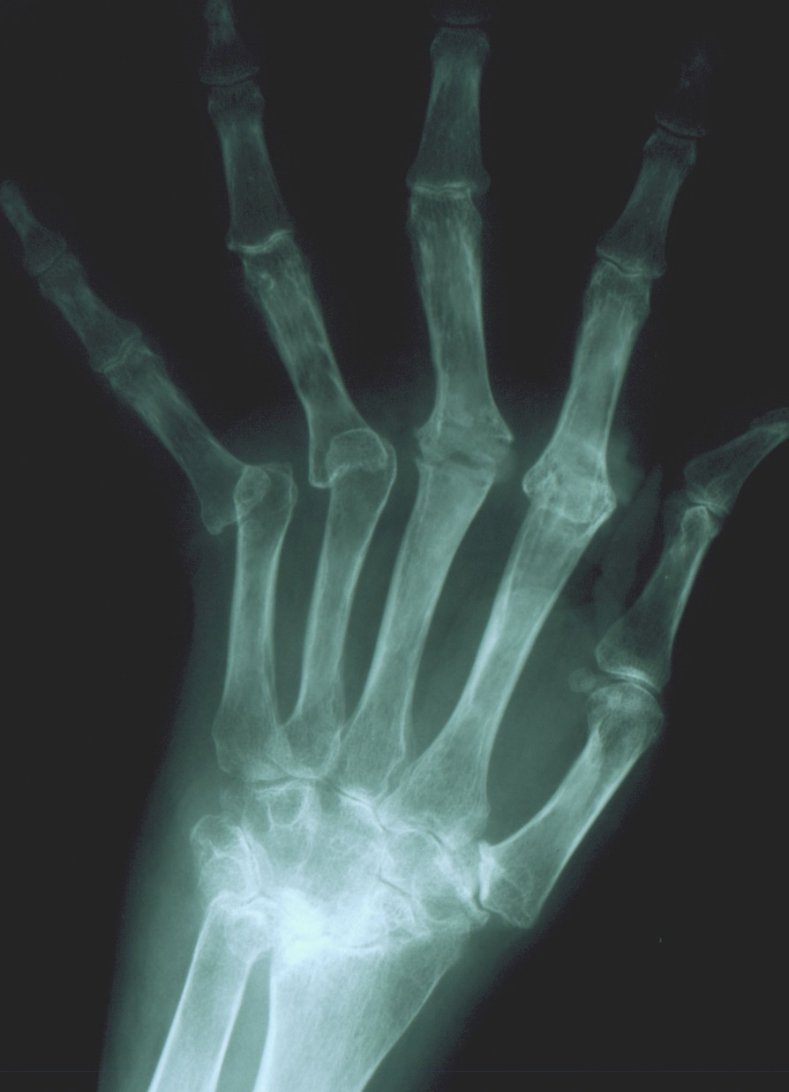
X ray

Slide 12
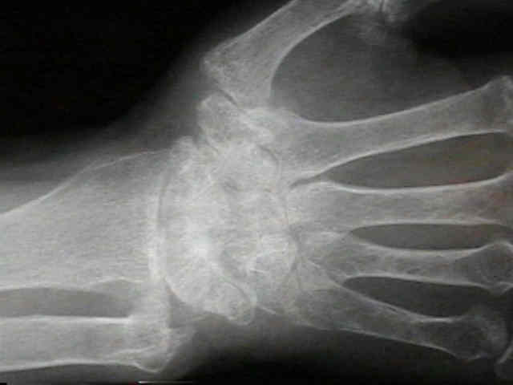
X ray

Slide 13
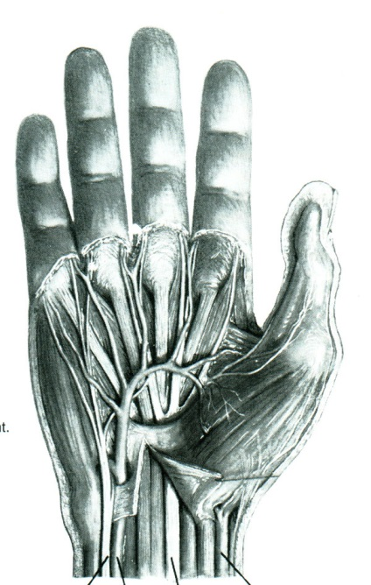
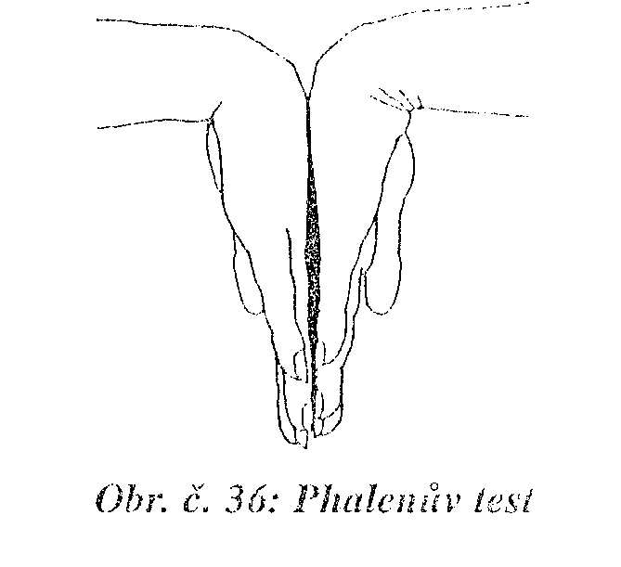
Carpal tunnel syndrom
Compresion neuropaty of median nerve
Pain
Hypotrophy of thenar muscles
Limited muscle power
Limited pinch and grasp
Parestesia, tingling and itching
Tenderness
Tinnel sign
Phalen test

Slide 14
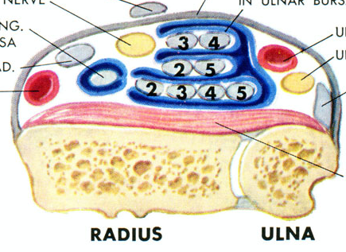
Guyon canal syndrom
Compression of ulnar nerve
near os pisiforme
Symptoms:
- Parestesia in ulnar side
- Hypotrophy of hypothenar muscles
Tenderness in region of os pisiforme
Therapy: local corticoid, NSA
surgery

Slide 15
Therapy of rheumatoid arthritis
Complex
pharmacological: NSAID, glukocorticoids, DMARDs
Physical therapy : to maintain ROM
social program – job, pension
surgery : to maintain biological joint
replacement

Slide 16
Management
The aim: to achieve long lasting remision or
at least low level of activity of the disease
NSAID- Cox 1 a Cox 2
DMARD- disease modifying antirheumatic drugs
syntetic: metotrexat, leflunomid, sulfasalazin, hydroxychlorochin
biological: infliximab, etanercept, adalimumab, golimumab
abatacept, tocilizumab
Glukocorticoids: hydrocortizon, prednison, dexametason, betametazon,
methylprednisolon, triamcinolon

Slide 17
Surgery
Synovectomy
Suture of tendons
Artrodesis- fusion
Atlantoaxial fusion
Osteotomy
Joint replacement

Slide 18
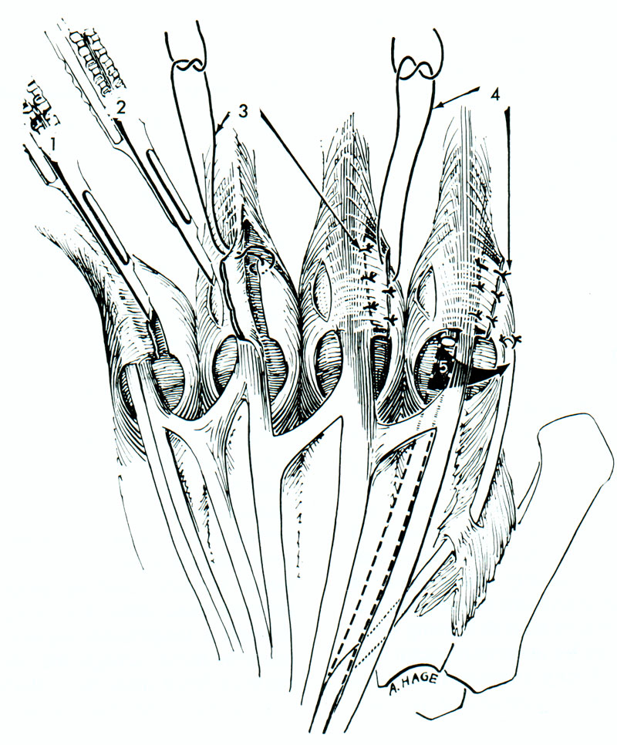
Synovectomy of MP joints
and capsular plasty

Slide 19
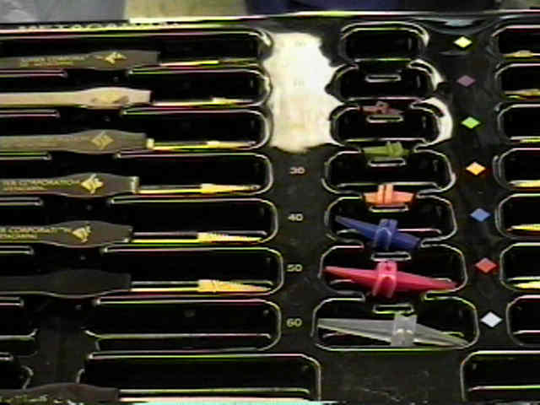
Silastik - replacement

Slide 20
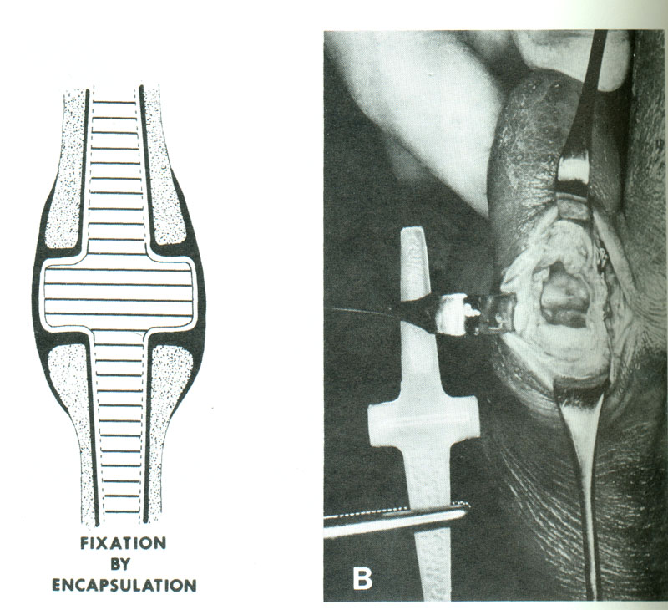

Slide 21
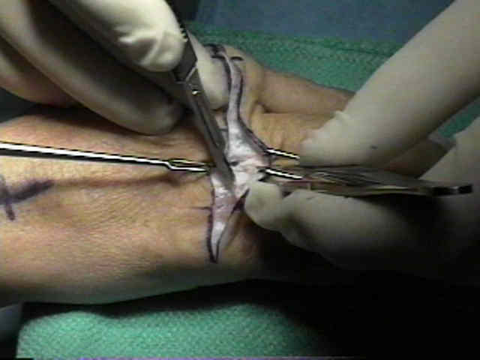
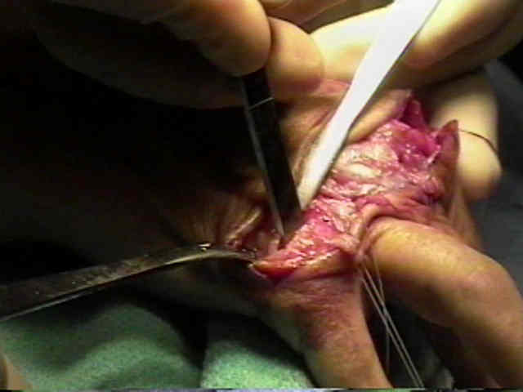
Silastik - replacement

Slide 22
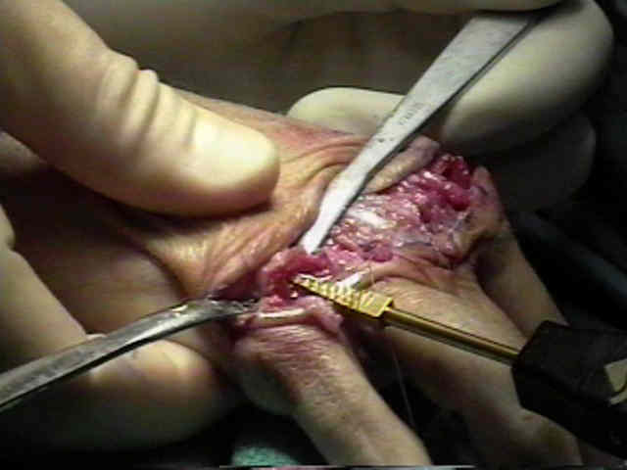
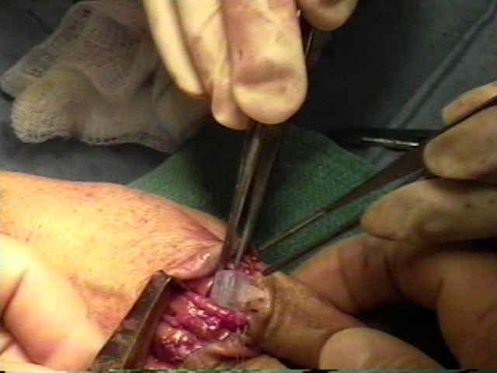
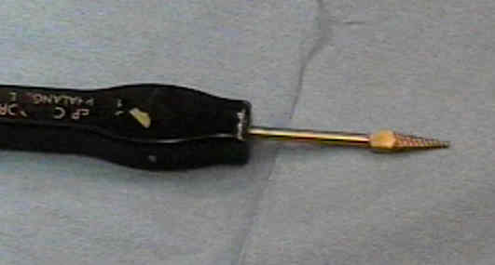
Silastik – replacement

Slide 23
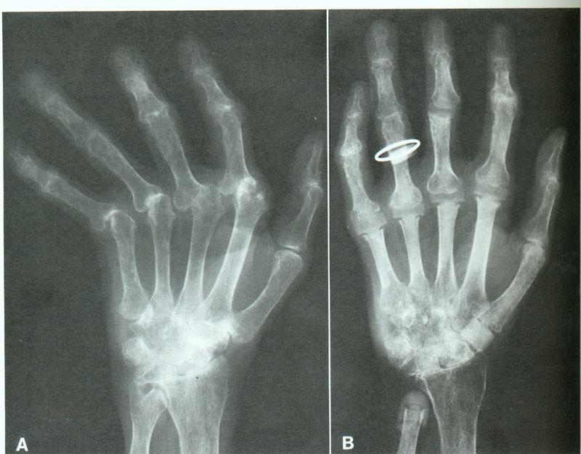
Silastic joints
Preop postop.

Slide 24
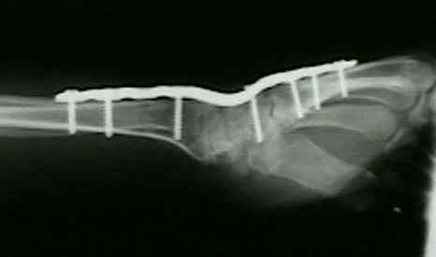
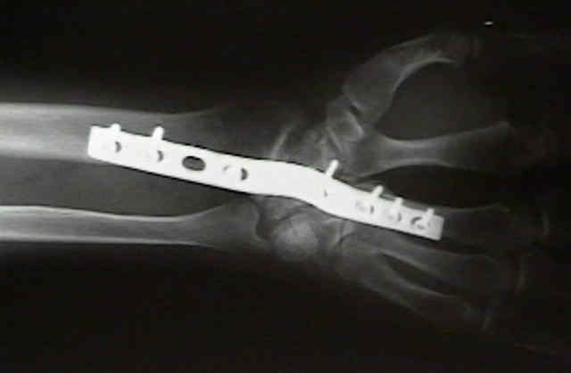
Wrist fusion
10-15 st. dorsiflexion
5-10 st. ulnar deviation

Slide 25
Rheumatoid arthritis
Synovialitis:
Elbow
Shoulder
IV joints C1-C2- axial instability
Hips
Knee joints
Ankle joints
Small joints of the foot
Tenosynovialitis of tendons
Th.- synovectomy

Slide 26
Psoriatic arthritis
In 20% of psoriatic patients
Seronegative arthritis associated with psoriasis
Peripheral joints (artritis DIP, telescoping fingers, oligoarthritis
hips, knee, shoulder )
Axial skeleton- spondylarthritis ( sacroileitis, spondylitis,
severe destructions)
Entesitis ( Achillis tendon, plantar aponeurosis, pelvis)
Dactylitis ( Wurstfinger)

Slide 27
Management of psoriatic arthritis
NSAID
Glukocorticoids
DMARDs – syntetic (metotrexat, sulfasalazin, leflunomid,
cyklosporin)
biologic- infliximab, etanercept, adalimumab aj.
Surgery- replacement, synovectomy, fusion

Slide 28
Ankylosing spondylitis
Bechtěrev disease
Chronic affection involving SI joints, vertebral column,
less peripheral joints
Sacroileitis, entesitis
Back pain
Other locations: uveitis, skin, lung, eye
HLA B27 antigen positive increases the risk of disease 50 times more
0,5 % of population
Female: male 3:1
Symptoms: back pain, gluteal region, entesitis of ligaments and tendons
rhisomelic form (hips, shoulders)
peripheral arthritis- knee, dactylitis

Slide 29
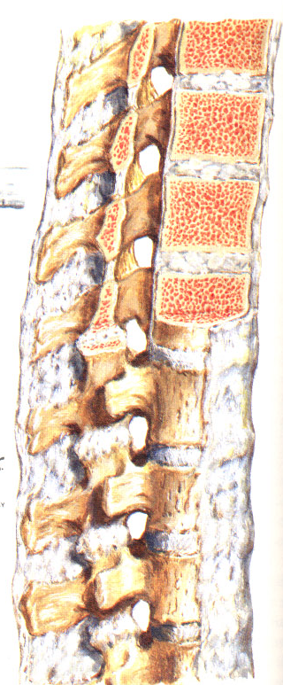
Ancylosing spondylitis
Onset in SI joints
Progress into lumbar, thoracic, cervical spine
Onset- 20-40 years
Back pain, heel pain, effusion in knee joints.
Progressive limitation of movements in the spine
Increased thoracic kyphosis, diaphragma breathing
Ancylosis of intervertebral joints
Ancylosis of costovertebral joints
Ossification of disc, ligaments
Obr. 21

Slide 30
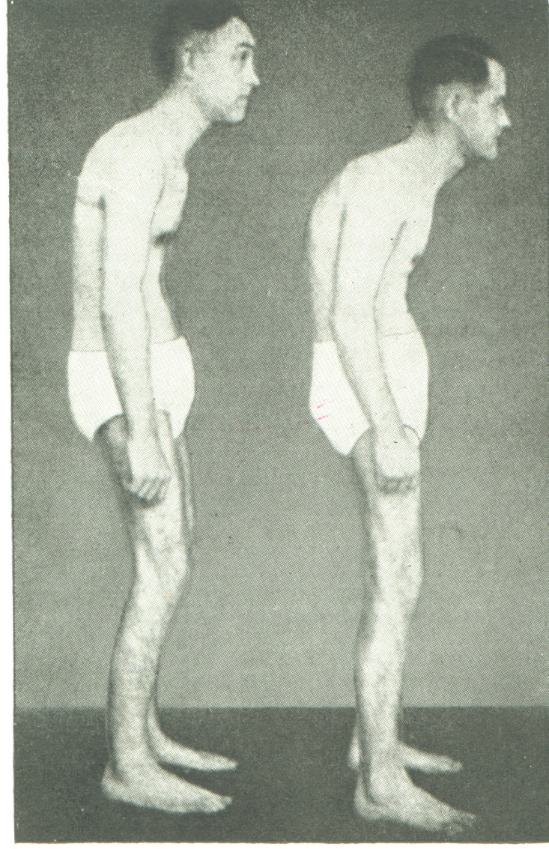
Clinical examination
Restricted movements in the spine
Schober, Thomayer, bending
Exspirium- inspirium rib cage circumference
less than 4 cm
Limited rotation in cervical spine
Hyperkyphosis
Fleche- distance Th spine- wall
Entesitis
Daktylitis

Slide 31
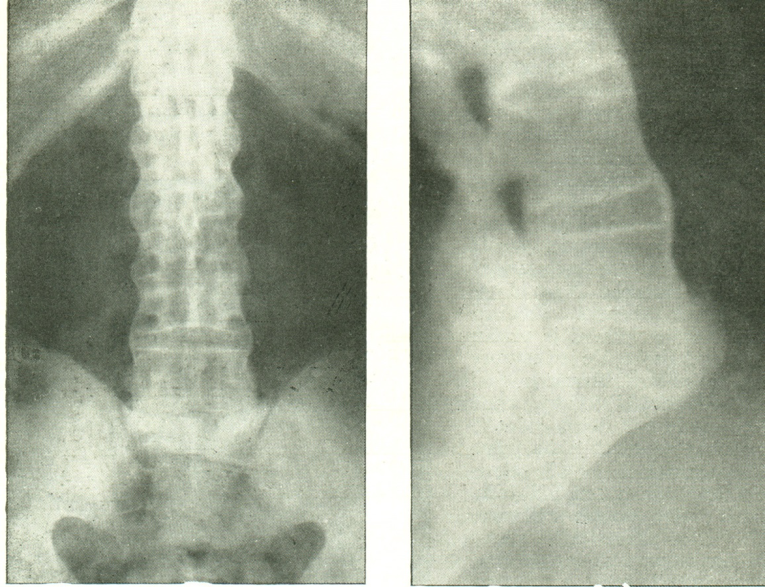
X ray
Sacroilitis
Rectangular shape of vetebras
Syndesmophytes
Fusion of apophyseal joints
Bamboo rod
Bamboo rod

Slide 32
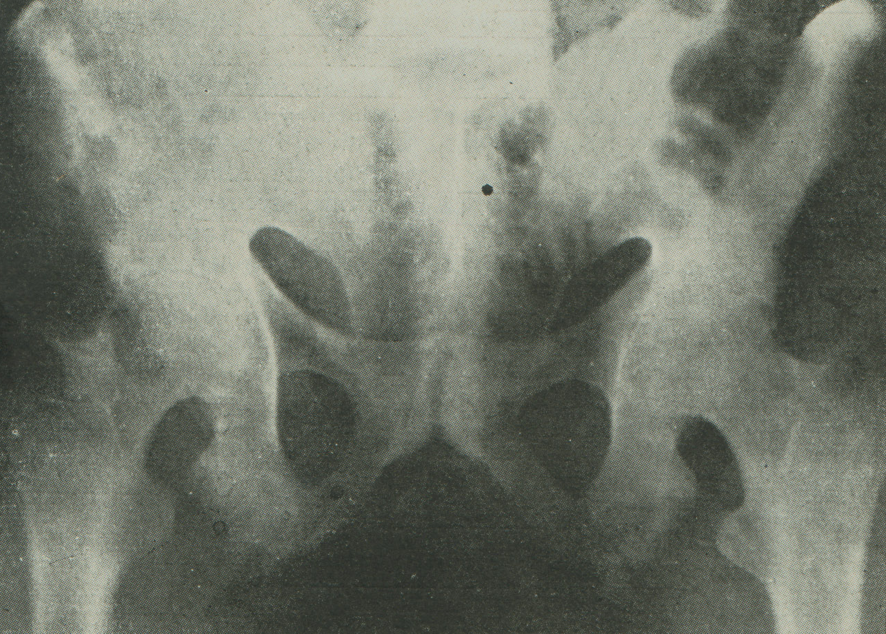
Rhisomelic form
Obr. 2

Slide 33
Management
NSAID
Glucocorticoids
DMARDs syntetic
biologic
Physical therapy
Surgery: replacement
surgery in spine

