Slide 1
Exercise therapy after amputation
Z. Rozkydal
I. Müller

Slide 2
Physiotherapy after amputation
Management for amputees:
Prescription
Prosthetic fabrication
Rehabilitation
Pain management
Social care
Occupation
Psychology
Only 70 % of amputees use effectively the prosthesis

Slide 3
Indication for amputation
Vascular problem- severe ischemia
Severe diabetic macroangiopathy
Severe trauma – no chance for reconstruction
Severe infection with sepsis in urgent cases
Malignant tumors
Neuropathies leading to deep trophic ulcers
Congenital abnormalities – useless parts of the limb

Slide 4
The amputee has to meet certain criteria:
physical, psychological and social
Prosthesis is controlled by the strength of muscles
of the residual limb
Ambulation with the prosthesis is more demanding:
Oxygen expediture is 400 times greater than
in bipedal locomotion
Low physical condition is contraindication for prosthesis:
ischemic heart disease
severe asthma
decompensated hypertension etc.

Slide 5
Functional prosthesis
Basic requirements is the shape and the length of the residual limb
Certain minimal length of the residual limb is required
The longer residual length the greater the strength
The thigh: optimal length for the residual limb is
approximately 1/3 of the length of the femur
Distal part of the residual limb has to be conical in shape
Myoplastic amputation ensures maximum muscle coverage
of the residual limb
The residual limb developes usually for one year-
- atrophy of muscles

Slide 6
Physiotherapy
Bandaging with elastic wraps into conical shape
Management of postoperative oedema
Limb positioning- to prevent flexion contracture
Brushing- to restore skin sensitivity
Temperature tolerance- alternating streams of warm and cold water
Passive movements
Active movements
Movement imaging- exercise with the opposite extremity and
doing the same in mind with affected limb
Verticalisation- cruthes, platform walkers, paraler bars
Balance training
Gait training: according to the age, concomitant disease, overall fitness.

Slide 7
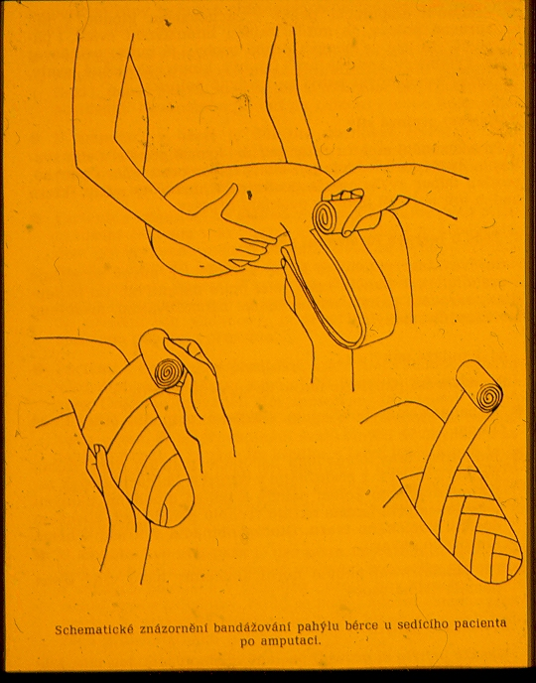
Bandaging

Slide 8
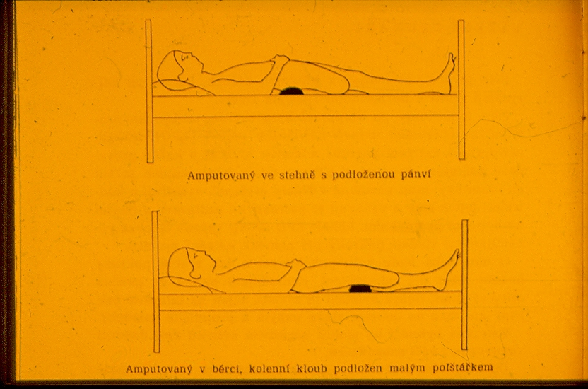
Positioning after above knee amputation

Slide 9
Positioning after bellow knee amputation

Slide 10
Prescription of the prosthesis
Surgeon
Orthopaedic surgeon
Rehabilitation physician
Neurologist
Initial prosthetic fitting
Final prosthetic fitting – after 6-12 months
Standard prosthesis is changed after 2 years
Repairs and modifications- covered by insurance company

Slide 11
Prescription of the prosthesis
5 categories of amputees
according to patient´s potential functional abilities
The prosthesis has to meet patient´s needs
Different technical fabrication
Selection of individual components
Patient´s history
Patient´s current condition
Patient´s positive motivation for the use of prosthesis

Slide 12
Functional indication of the prosthesis
according to activity of the patient
Degree of activity 0 : non ambulatory, cosmetic accesory
Degree of activity 1 : household ambulation
Degree of activity 2 : limited community ambulation
Degree of activity 3: unlimited community ambulation
ability to work in light duty positions
Degree of activity 4: unlimited community ambulation
fully working individuals with special needs
Fabrication of the prosthesis is made according to the activity
of the patient.
Special sport prostheses are not paid by insurance companies!

Slide 13
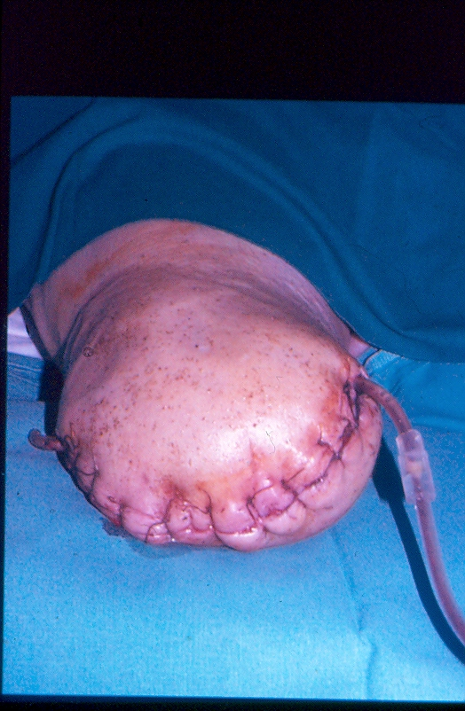
Complications of the amputation
Wound healing problem
Infection
Necrosis
Dermatitis
Alergic reaction of the skin
Skin erosions
Pressure sores
Neuroma – prevention: perpendicular transection of the nerve
Phantom pain - unpleasant feeling of amputated part of the limb

Slide 14
Summary
Rehabilitation, psychology and adequate prosthetic fitting is prerequisity for acceptable life comfort of the amputee

